Slide 1
Sample Exercise 10.4 Using the Ideal-Gas Equation
Calcium carbonate, CaCO₃(s), the principal compound in limestone, decomposes upon heating to CaO(s) and CO₂(g). A sample of CaCO₃ is decomposed, and the carbon dioxide is collected in a 250-mL flask. After decomposition is complete, the gas has a pressure of 1.3 atm at a temperature of 31 °C. How many moles of CO₂ gas were generated?
Solution
Analyze We are given the volume (250 mL), pressure (1.3 atm), and temperature (31 °C) of a sample of CO₂ gas and asked to calculate the number of moles of CO₂ in the sample.
Plan Because we are given V, P, and T, we can solve the ideal-gas equation for the unknown quantity, n.
Solve In analyzing and solving gas law problems, it is helpful to tabulate the information given in the problems and then to convert the values to units that are consistent with those for R(0.08206 L-atm/mol-K). In this case, the given values are
V = 250 mL = 0.250 L
P = 1.3 atm
T = 31 °C = (31 + 273) K = 304 K
Remember: Absolute temperature must always be used when the ideal-gas equation is solved.
We now rearrange the ideal-gas equation (Equation 10.5) to solve for n

Slide 2
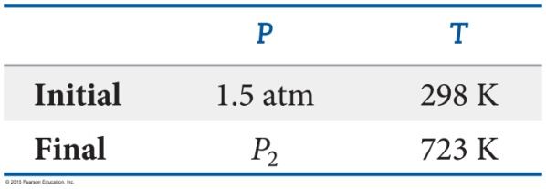
Sample Exercise 10.5 Calculating the Effect of Temperature Changes on Pressure
The gas pressure in an aerosol can is 1.5 atm at 25 °C. Assuming that the gas obeys the ideal-gas equation, what is the pressure when the can is heated to 450 °C?
Solution
Analyze We are given the initial pressure (1.5 atm) and temperature (25 °C) of the gas and asked for the pressure at a higher temperature (450 °C).
Plan The volume and number of moles of gas do not change, so we must use a relationship connecting pressure and temperature. Converting temperature to the Kelvin scale and tabulating the given information, we have
Solve To determine how P and T are related, we start with the ideal-gas equation and isolate the quantities that do not change (n, V, and R) on one side and the variables (P and T) on the other side.

Slide 3
Sample Exercise 10.5 Calculating the Effect of Temperature Changes on Pressure
Continued
Because the quotient P/T is a constant, we can write
(where the subscripts 1 and 2 represent the initial and final states, respectively). Rearranging to solve for P₂ and substituting the given data give
Check This answer is intuitively reasonable—increasing the temperature of a gas increases its pressure.
Comment It is evident from this example why aerosol cans carry a warning not to incinerate.

Slide 4
Sample Exercise 10.6 Using the Combined Gas Law
An inflated balloon has a volume of 6.0 L at sea level (1.0 atm) and is allowed to ascend until the pressure is 0.45 atm. During ascent, the temperature of the gas falls from 22 °C to –21 °C. Calculate the volume of the balloon at its final altitude.
Solution
Analyze We need to determine a new volume for a gas sample when both pressure and temperature change.
Plan Let’s again proceed by converting temperatures to kelvins and tabulating our information.
Because n is constant, we can use Equation 10.8.
Solve Rearranging Equation 10.8 to solve for V₂ gives

Slide 5
Sample Exercise 10.7 Calculating Gas Density
What is the density of carbon tetrachloride vapor at 714 torr and 125 °C?
Solution
Analyze We are asked to calculate the density of a gas given its name, its pressure, and its temperature. From the name, we can write the chemical formula of the substance and determine its molar mass.
Plan We can use Equation 10.10 to calculate the density. Before we can do that, however, we must convert the given quantities to the appropriate units, degrees Celsius to kelvins and pressure to atmospheres. We must also calculate the molar mass of CCl₄.
Solve The absolute temperature is 125 + 273 = 398 K. The pressure is (714 torr) (1 atm/760 torr) = 0.939 atm. The molar mass of CCl₄ is 12.01 + (4) (35.45) = 153.8 g/mol. Therefore,
Check If we divide molar mass (g/mol) by density (g/L), we end up with L/mol. The numerical value is roughly 154/4.4 = 35, which is in the right ballpark for the molar volume of a gas heated to 125 °C at near atmospheric pressure. We may thus conclude our answer is reasonable.

Slide 6
Sample Exercise 10.8 Calculating the Molar Mass of a Gas
A large evacuated flask initially has a mass of 134.567 g. When the flask is filled with a gas of unknown molar mass to a pressure of 735 torr at 31 °C, its mass is 137.456 g. When the flask is evacuated again and then filled with water at 31 °C, its mass is 1067.9 g. (The density of water at this temperature is 0.997 g/mL.) Assuming the ideal-gas equation applies, calculate the molar mass of the gas.
Solution
Analyze We are given the temperature (31 °C) and pressure (735 torr) for a gas, together with information to determine its volume and mass, and we are asked to calculate its molar mass.
Plan The data obtained when the flask is filled with water can be used to calculate the volume of the container. The mass of the empty flask and of the flask when filled with gas can be used to calculate the mass of the gas. From these quantities we calculate the gas density and then apply Equation 10.11 to calculate the molar mass of the gas.
Solve The gas volume equals the volume of water the flask can hold, calculated from the mass and density of the water. The mass of the water is the difference between the masses of the full and evacuated flask:
1067.9 g – 134.567 g = 933.3 g
Rearranging the equation for density (d = m/V), we have
The gas mass is the difference between the mass of the flask filled with gas and the mass of the evacuated flask:
137.456 g – 134.567 g = 2.889 g

Slide 7
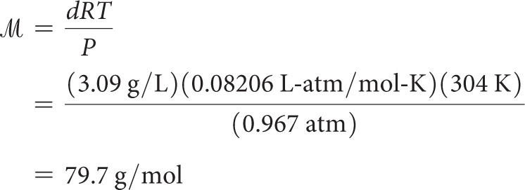
Sample Exercise 10.8 Calculating the Molar Mass of a Gas
Continued
Knowing the mass of the gas (2.889 g) and its volume (0.936 L), we can calculate the density of the gas:
d = 2.889 g/0.936 L = 3.09 g/L
After converting pressure to atmospheres and temperature to kelvins, we can use Equation 10.11 to calculate the molar mass:

Slide 8
Sample Exercise 10.10 Applying Dalton’s Law of Partial Pressures
A mixture of 6.00 g of O₂(g) and 9.00 g of CH₄(g) is placed in a 15.0-L vessel at 0 °C. What is the partial pressure of each gas, and what is the total pressure in the vessel?
Solution
Analyze We need to calculate the pressure for two gases in the same volume and at the same temperature.
Plan Because each gas behaves independently, we can use the ideal-gas equation to calculate the pressure each would exert if the other were not present. Per Dalton’s law, the total pressure is the sum of these two partial pressures.
Solve We first convert the mass of each gas to moles:
We use the ideal-gas equation to calculate the partial pressure of each gas:

Slide 9
Sample Exercise 10.10 Applying Dalton’s Law of Partial Pressures
Continued
According to Dalton’s law of partial pressures (Equation 10.12), the total pressure in the vessel is the sum of the partial pressures:
P_{t} = P_{O2} + P_{CH4} = 0.281 atm + 0.841 atm = 1.122 atm

Slide 10
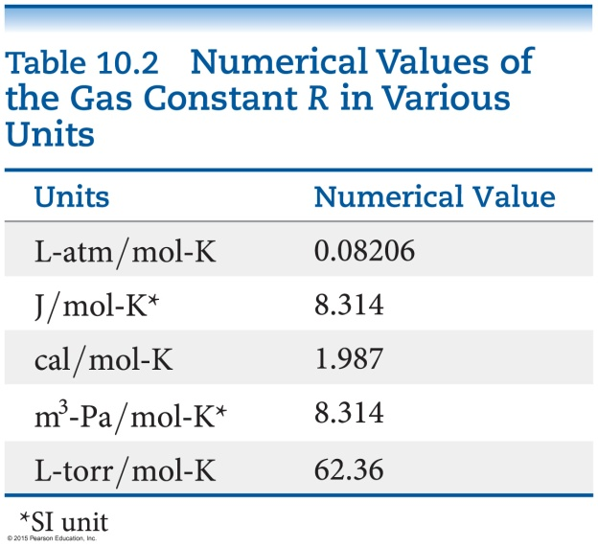
Sample Exercise 10.13 Calculating a Root-Mean-Square Speed
Calculate the rms speed of the molecules in a sample of N₂ gas at 25 °C.
Solution
Analyze We are given the identity of a gas and the temperature, the two quantities we need to calculate the rms speed.
Plan We calculate the rms speed using Equation 10.20.
Solve We must convert each quantity in our equation to SI units. We will also use R in units of J/mol-K (Table 10.2) to make the units cancel correctly.
Comment This corresponds to a speed of 1150 mi/hr. Because the average molecular weight of air molecules is slightly greater than that of N₂, the rms speed of air molecules is a little smaller than that for N₂.

Slide 11
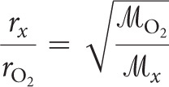
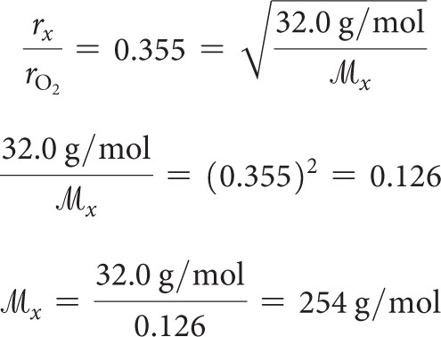
Sample Exercise 10.14 Applying Graham’s Law
An unknown gas composed of homonuclear diatomic molecules effuses at a rate that is 0.355 times the rate at which O₂ gas effuses at the same temperature. Calculate the molar mass of the unknown and identify it.
Solution
Analyze We are given the rate of effusion of an unknown gas relative to that of O₂ and asked to find the molar mass and identity of the unknown. Thus, we need to connect relative rates of effusion to relative molar masses.
Plan We use Equation 10.22 to determine the molar mass of the unknown gas. If we let r_{x} and represent the rate of effusion and molar mass of the gas, we can write
Solve From the information given,
r_{x} = 0.355 × r_{O2}
Thus,

