Slide 1
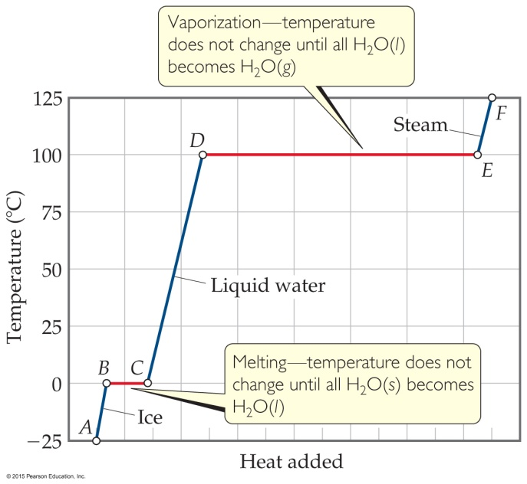
Sample Exercise 11.3 Calculating ΔH for Temperature and Phase Changes
Calculate the enthalpy change upon converting 1.00 mol of ice at –25 °C to steam at 125 °C under a constant pressure of 1 atm. The specific heats of ice, liquid water, and steam are 2.03, 4.18, and 1.84 J/g-K, respectively. For H₂O, ΔH_{fus} = 6.01 kJ/mol and ΔH_{vap} = 40.67 kJ/mol.
Solution
Analyze Our goal is to calculate the total heat required to convert 1 mol of ice at –25 °C to steam at 125 °C.
Plan We can calculate the enthalpy change for each segment and then sum them to get the total enthalpy change (Hess’s law, Section 5.6).
Solve For segment AB in Figure 11.22, we are adding enough heat to ice to increase its temperature by 25 °C. A temperature change of 25 °C is the same as a temperature change of 25 K, so we can use the specific heat of ice to calculate the enthalpy change during this process:
For segment BC in Figure 11.22, in which we convert ice to water at 0 °C, we can use the molar enthalpy of fusion directly:
AB: ΔH = (1.00 mol)(18.0 g/mol)(2.03 J/g-K) (25 K) = 914 J = 0.91 kJ
BC: ΔH = (1.00 mol)(6.01 kJ/mol) = 6.01 kJ

Slide 2
Sample Exercise 11.3 Calculating ΔH for Temperature and Phase Changes
Continued
The enthalpy changes for segments CD, DE, and EF can be calculated in similar
fashion:
The total enthalpy change is the sum of the changes of the individual steps:
Check The components of the total enthalpy change are reasonable relative to the horizontal lengths (heat added) of the segments in Figure 11.22. Notice that the largest component is the heat of vaporization.
CD: ΔH = (1.00 mol)(18.0 g/mol)(4.18 J/g-K)(100 K) = 7520 J = 7.52 kJ
DE: ΔH = (1.00 mol)(40.67 kJ/mol) = 40.7 kJ
EF: ΔH = (1.00 mol)(18.0 g/mol)(1.84 J/g-K)(25 K) = 830 J = 0.83 kJ
ΔH = 0.91 kJ + 6.01 kJ + 7.52 kJ + 40.7 kJ + 0.83 kJ = 56.0 kJ

Slide 3
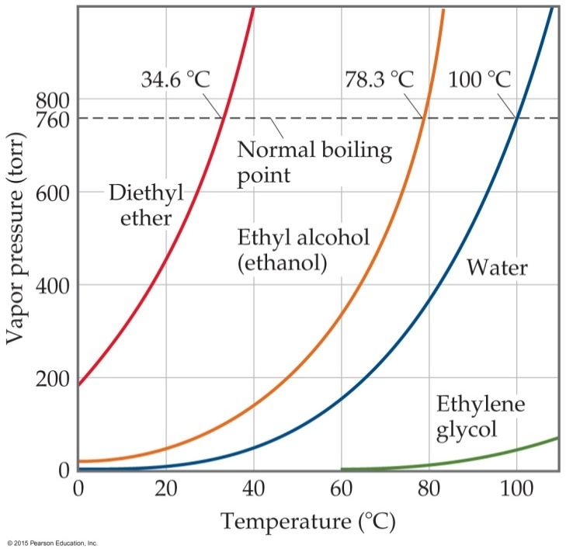
Sample Exercise 11.4 Relating Boiling Point to Vapor Pressure
Use Figure 11.25 to estimate the boiling point of diethyl ether under an external pressure of 0.80 atm.
Solution
Analyze We are asked to read a graph of vapor pressure versus temperature to determine the boiling point of a substance at a particular pressure. The boiling point is the temperature at which the vapor pressure is equal to the external pressure.
Plan We need to convert 0.80 atm to torr because that is the pressure scale on the graph. We estimate the location of that pressure on the graph, move horizontally to the vapor–pressure curve, and then drop vertically from the curve to estimate the temperature.
Solve The pressure equals (0.80 atm)(760 torr/atm) = 610 torr. From Figure 11.25 we see that the boiling point at this pressure is about 27 °C, which is close to room temperature.
Comment We can make a flask of diethyl ether boil at room temperature by using a vacuum pump to lower the pressure above the liquid to about 0.8 atm.

