Slide 1
Sample Exercise 6.2 Calculating Frequency from Wavelength
The yellow light given off by a sodium vapor lamp used for public lighting has a wavelength of 589 nm. What is the frequency of this radiation?
Solution
Analyze We are given the wavelength, λ, of the radiation and asked to calculate its frequency, ν.
Plan The relationship between the wavelength and the frequency is given by Equation 6.1. We can solve for ν and use the values of λ and c to obtain a numerical answer. (The speed of light, c, is 3.00 × 10⁸ m ⁄ s to three significant figures.)
Solve Solving Equation 6.1 for frequency gives (ν = c ⁄ λ). When we insert the values for c and λ, we note that the units of length in these two quantities are different. We can convert the Wavelength from nanometers to meters, so the units cancel:
Check The high frequency is reasonable because of the short wavelength. The units are proper because frequency has units of “per second,” or s^{–1}.

Slide 2
Sample Exercise 6.3 Energy of a Photon
Calculate the energy of one photon of yellow light that has a wavelength of 589 nm.
Solution
Analyze Our task is to calculate the energy, E, of a photon, given λ = 589 nm.
Plan We can use Equation 6.1 to convert the wavelength to frequency:
ν = c ⁄ λ
We can then use Equation 6.3 to calculate energy:
E = hν
Solve The frequency, ν, is calculated from the given wavelength, as shown in Sample Exercise 6.2:
ν = c ⁄ λ = 5.09 × 10¹⁴ s^{–1}
The value of Planck constant, h, is given both in the text and in the table of physical constants on the inside back cover of the text, and so we can easily calculate E:
E = (6.626 × 10^{–34} J-s)(5.09 × 10¹⁴ s^{–1}) = 3.37 × 10^{–19} J
Comment If one photon of radiant energy supplies 3.37 × 10^{–19} J, we calculate that one mole of these photons will supply:
(6.02 × 10²³ photons ⁄ mol)(3.37 × 10^{–19} J ⁄ photon) = 2.03 × 10⁵ J ⁄ mol

Slide 3
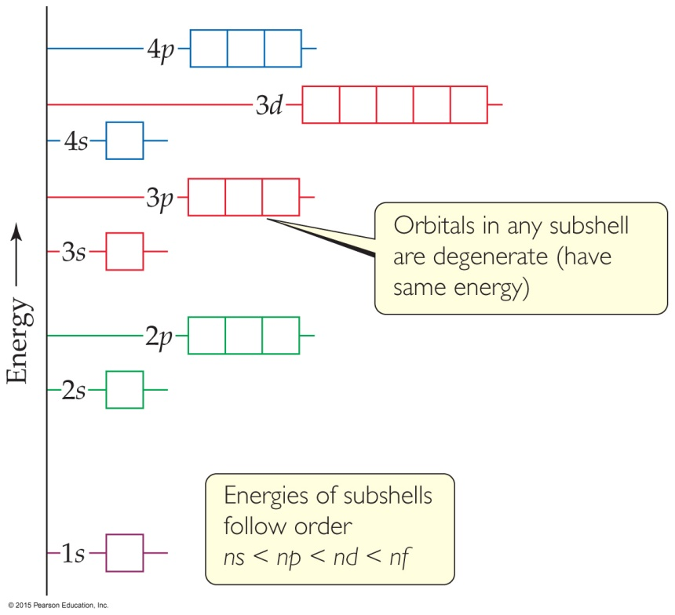
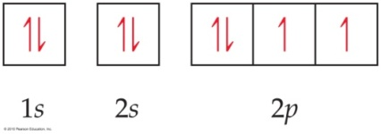
Sample Exercise 6.7 Orbital Diagrams and Electron Configurations
Draw the orbital diagram for the electron configuration of oxygen, atomic number 8. How many unpaired electrons does an oxygen atom possess?
Solution
Analyze and Plan Because oxygen has an atomic number of 8, each oxygen atom has eight electrons. Figure 6.25 shows the ordering of orbitals. The electrons (represented as half arrows) are placed in the orbitals (represented as boxes) beginning with the lowest-energy orbital, the 1s. Each orbital can hold a maximum of two electrons (the Pauli exclusion principle). Because the 2p orbitals are degenerate, we place one electron in each of these orbitals (spin-up) before pairing any electrons (Hund’s rule).
Solve Two electrons each go into the 1s and 2s orbitals with their spins paired. This leaves four electrons for the three degenerate 2p orbitals. Following Hund’s rule, we put one electron into each 2p orbital until all three orbitals have one electron each. The fourth electron is then paired up with one of the three electrons already in a 2p orbital, so that the orbital diagram is
The corresponding electron configuration is written 1s²2s²2p⁴. The atom has two unpaired electrons.

Slide 4
Sample Exercise 6.8 Electron Configurations for a Group
What is the characteristic valence electron configuration of the group 7A elements, the halogens?
Solution
Analyze and Plan We first locate the halogens in the periodic table, write the electron configurations for the first two elements, and then determine the general similarity between the configurations.
Solve The first member of the halogen group is fluorine (F, element 9). Moving backward from F, we find that the noble-gas core is [He]. Moving from He to the element of next higher atomic number brings us to Li, element 3. Because Li is in the second period of the s block, we add electrons to the 2s subshell. Moving across this block gives 2s². Continuing to move to the right, we enter the p block. Counting the squares to F gives 2p⁵. Thus, the condensed electron configuration for fluorine is
F: [He]2s²2p⁵
The electron configuration for chlorine, the second halogen, is
Cl: [Ne]3s²3p⁵
From these two examples, we see that the characteristic valence electron configuration of a halogen is ns²np⁵, where n ranges from 2 in the case of fluorine to 6 in the case of astatine.

