Slide 1
Sample Exercise 9.1 Using the VSEPR Model
Use the VSEPR model to predict the molecular geometry of (a) O₃, (b) SnCl₃–.
Solution
Analyze We are given the molecular formulas of a molecule and a polyatomic ion, both conforming to the general formula AB_{n} and both having a central atom from the p block of the periodic table. (Notice that for O₃, the A and B atoms are all oxygen atoms.)
Plan To predict the molecular geometries, we draw their Lewis structures and count electron domains around the central atom to get the electron-domain geometry. We then obtain the molecular geometry from the arrangement of the domains that are due to bonds.
Solve
(a) We can draw two resonance structures for O₃:

Slide 2
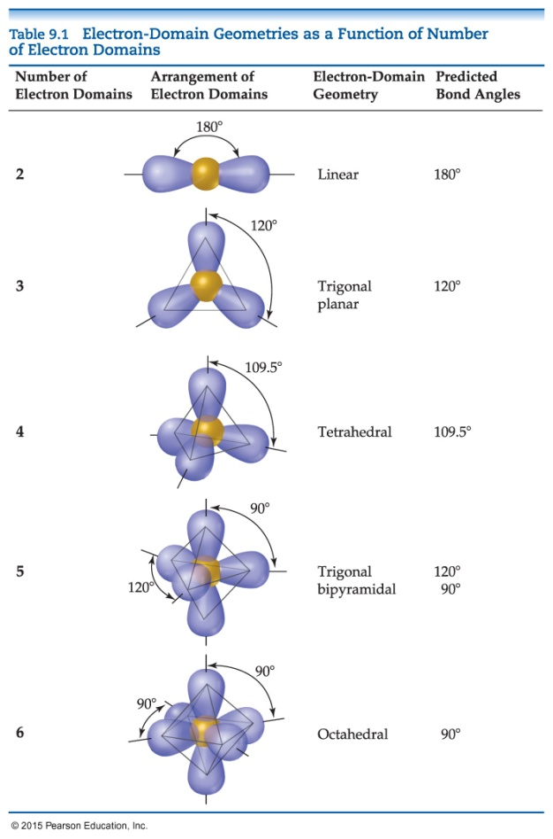
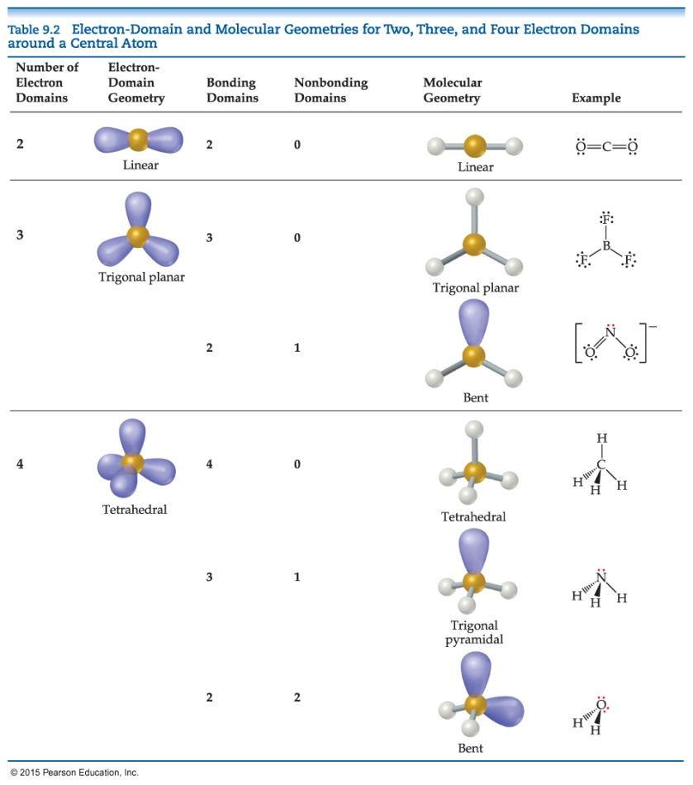
Sample Exercise 9.1 Using the VSEPR Model
Continued
Because of resonance, the bonds between the central O atom and the outer O atoms are of equal length. In both resonance structures the central O atom is bonded to the two outer O atoms and has one nonbonding pair. Thus, there are three electron domains about the central O atoms. (Remember that a double bond counts as a single electron domain.) The arrangement of three electron domains is trigonal planar (Table 9.1). Two of the domains are from bonds, and one is due to a nonbonding pair. So, the molecular geometry is bent with an ideal bond angle of 120° (Table 9.2).

Slide 3
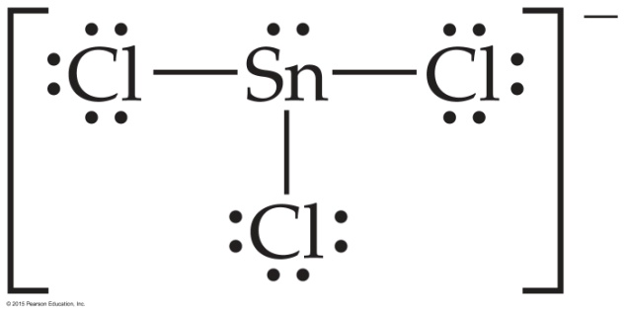
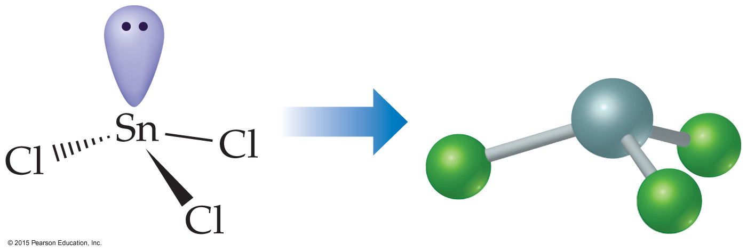
Sample Exercise 9.1 Using the VSEPR Model
Continued
Comment As this example illustrates, when a molecule exhibits resonance, any one of the resonance structures can be used to predict the molecular geometry.
(b) The Lewis structure for SnCl₃– is

Slide 4
Sample Exercise 9.1 Using the VSEPR Model
Continued
The central Sn atom is bonded to the three Cl atoms and has one nonbonding pair; thus, we have four electron domains, meaning a tetrahedral electron-domain geometry (Table 9.1) with one vertex occupied by a nonbonding pair of electrons. A tetrahedral electrondomain geometry with three bonding and one nonbonding domains leads to a trigonal-pyramidal molecular geometry (Table 9.2).

Slide 5
Sample Exercise 9.2 Molecular Geometries of Molecules with Expanded Valence Shells
Use the VSEPR model to predict the molecular geometry of (a) SF₄, (b) IF₅.
Solution
Analyze The molecules are of the AB_{n} type with a central p-block atom.
Plan We first draw Lewis structures and then use the VSEPR model to determine the electron-domain geometry and molecular geometry.
Solve
(a) The Lewis structure for SF₄ is

Slide 6
Sample Exercise 9.2 Molecular Geometries of Molecules with Expanded Valence Shells
Continued
The sulfur has five electron domains around it: four from the S—F bonds and one from the nonbonding pair. Each domain points toward a vertex of a trigonal bipyramid. The domain from the nonbonding pair will point toward an equatorial position. The four bonds point toward the remaining four positions, resulting in a molecular geometry that is described as seesaw-shaped:

Slide 7
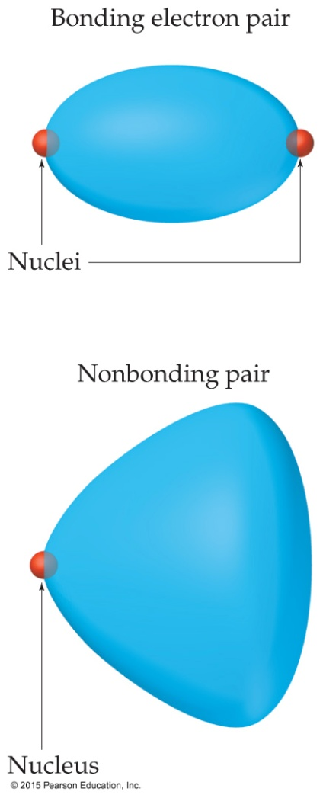
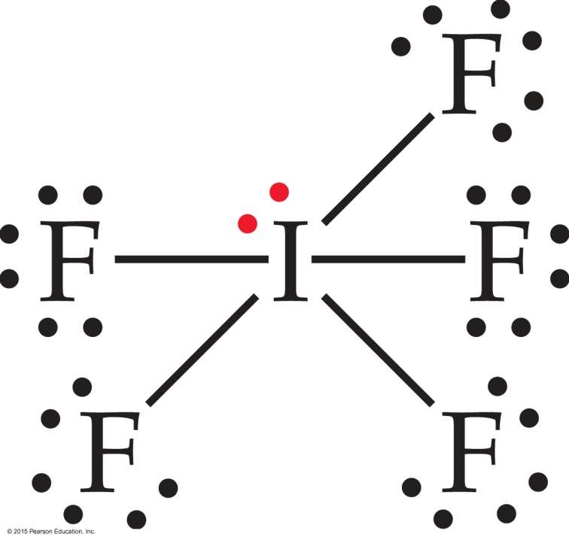
Sample Exercise 9.2 Molecular Geometries of Molecules with Expanded Valence Shells
Continued
Comment The experimentally observed structure is shown on the right. We can infer that the nonbonding electron domain occupies an equatorial position, as predicted. The axial and equatorial S—F bonds are slightly bent away from the nonbonding domain, suggesting that the bonding domains are “pushed” by the nonbonding domain, which exerts a greater repulsion (Figure 9.7).
(b) The Lewis structure of IF₅ is

Slide 8
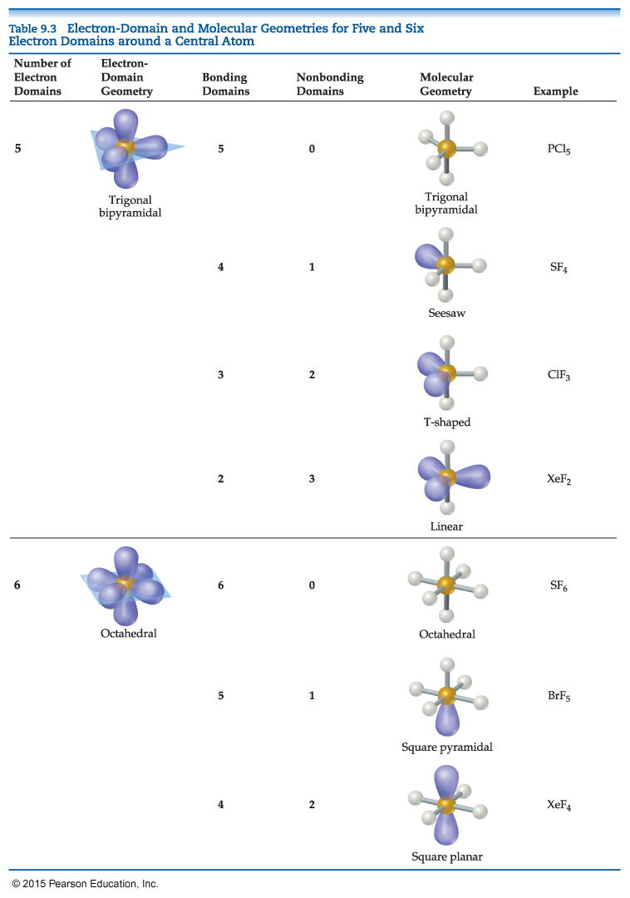
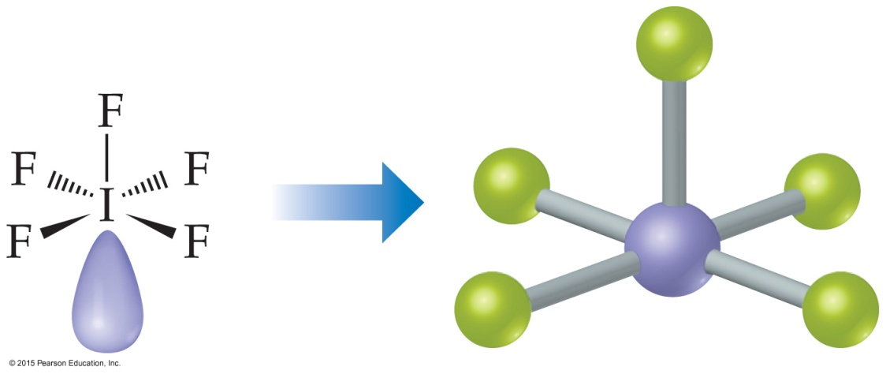
Sample Exercise 9.2 Molecular Geometries of Molecules with Expanded Valence Shells
Continued
The iodine has six electron domains around it, one of which is nonbonding. The electron-domain geometry is therefore octahedral, with one position occupied by the nonbonding pair, and the molecular geometry is square pyramidal (Table 9.3):

Slide 9
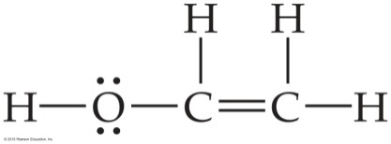
Sample Exercise 9.3 Predicting Bond Angles
Eyedrops for dry eyes usually contain a water-soluble polymer called poly(vinyl alcohol), which is based on the unstable organic molecule vinyl alcohol:
Predict the approximate values for the H—O—C and O—C—C bond angles in vinyl alcohol.
Solution
Analyze We are given a Lewis structure and asked to determine two bond angles.
Plan To predict a bond angle, we determine the number of electron domains surrounding the middle atom in the bond. The ideal angle corresponds to the electron-domain geometry around the atom. The angle will be compressed somewhat by nonbonding electrons or multiple bonds.
Solve In H—O—C, the O atom has four electron domains (two bonding, two nonbonding). The electron-domain geometry around O is therefore tetrahedral, which gives an ideal angle of 109.5°. The H—O—C angle is compressed somewhat by the nonbonding pairs, so we expect this angle to be slightly less than 109.5°.
To predict the O—C—C bond angle, we examine the middle atom in the angle. In the molecule, there are three atoms bonded to this C atom and no nonbonding pairs, and so it has three electron domains about it. The predicted electron-domain geometry is trigonal planar, resulting in an ideal bond angle of 120°. Because of the larger size of the C C domain, the bond angle should be slightly greater than 120°.

Slide 10
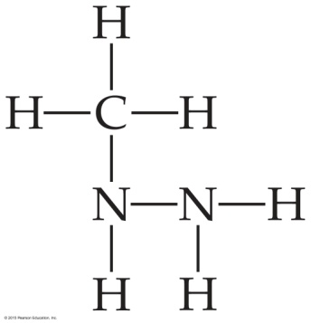
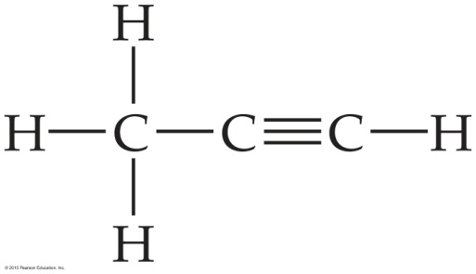
Sample Exercise 9.3 Predicting Bond Angles
Continued
Practice Exercise 1
The atoms of the compound methylhydrazine, CH₆N₂, which is used as a rocket propellant, are connected as follows (note that lone pairs are not shown):
What do you predict for the ideal values of the C—N—N and H—N—H angles, respectively?
(a) 109.5° and 109.5° (b) 109.5° and 120° (c) 120° and 109.5° (d) 120° and 120° (e) None of the above
Practice Exercise 2
Predict the H—C—H and C—C—C bond angles in propyne:

Slide 11
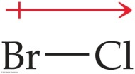
Sample Exercise 9.4 Polarity of Molecules
Predict whether these molecules are polar or nonpolar: (a) BrCl, (b) SO₂, (c) SF₆.
Solution
Analyze We are given three molecular formulas and asked to predict whether the molecules are polar.
Plan A molecule containing only two atoms is polar if the atoms differ in electronegativity. The polarity of a molecule containing three or more atoms depends on both the molecular geometry and the individual bond polarities. Thus, we must draw a Lewis structure for each molecule containing three or more atoms and determine its molecular geometry. We then use electronegativity values to determine the direction of the bond dipoles. Finally, we see whether the bond dipoles cancel to give a nonpolar molecule or reinforce each other to give a polar one.
Solve
(a) Chlorine is more electronegative than bromine. All diatomic molecules with polar bonds are polar molecules. Consequently, BrCl is polar, with chlorine carrying the partial negative charge:
The measured dipole moment of BrCl is μ = 0.57 D.

Slide 12
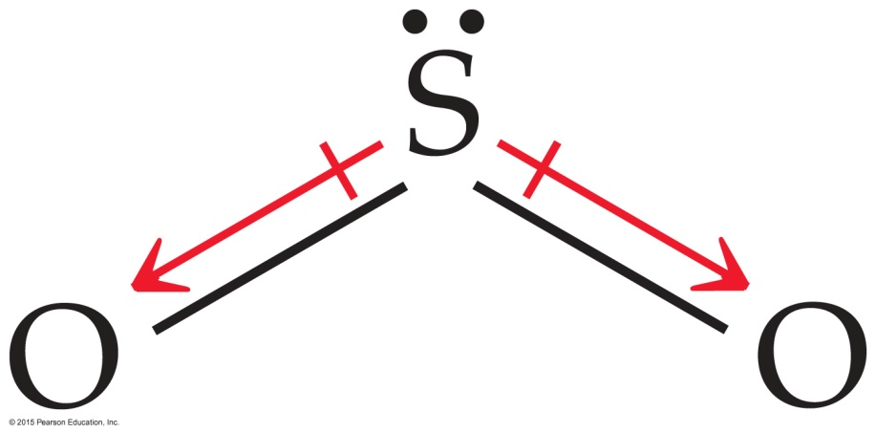
Sample Exercise 9.4 Polarity of Molecules
Continued
(b) Because oxygen is more electronegative than sulfur, SO₂ has polar bonds. Three resonance forms can be written:
For each of these, the VSEPR model predicts a bent molecular geometry. Because the molecule is bent, the bond dipoles do not cancel, and the molecule is polar:

Slide 13
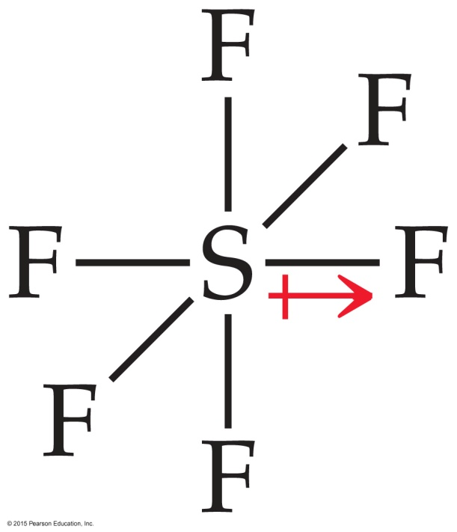
Sample Exercise 9.4 Polarity of Molecules
Continued
(c) Fluorine is more electronegative than sulfur, so the bond dipoles point toward fluorine. For clarity, only one S—F dipole is shown. The six S—F bonds are arranged octahedrally around the central sulfur:
Because the octahedral molecular geometry is symmetrical, the bond dipoles cancel, and the molecule is nonpolar, meaning that μ = 0.

Slide 14
Sample Exercise 9.5 Describing the Hybridization of a Central Atom
Describe the orbital hybridization around the central atom in NH₂–.
Solution
Analyze We are given the chemical formula for a polyatomic anion and asked to describe the type of hybrid orbitals surrounding the central atom.
Plan To determine the central atom hybrid orbitals, we must know the electron-domain geometry around the atom. Thus, we draw the Lewis structure to determine the number of electron domains around the central atom. The hybridization conforms to the number and geometry of electron domains around the central atom as predicted by the VSEPR model.
Solve The Lewis structure is

Slide 15
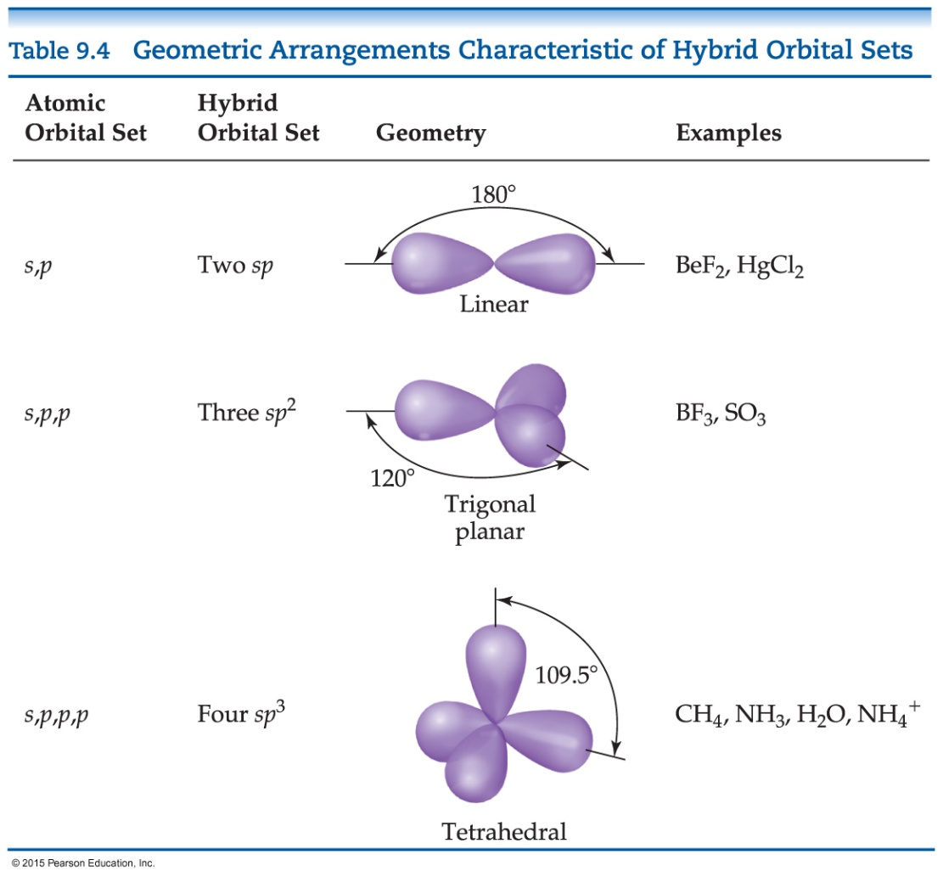
Sample Exercise 9.5 Describing the Hybridization of a Central Atom
Continued
Because there are four electron domains around N, the electron-domain geometry is tetrahedral. The hybridization that gives a tetrahedral electron-domain geometry is sp³ (Table 9.4). Two of the sp³ hybrid orbitals contain nonbonding pairs of electrons, and the other two are used to make bonds with the hydrogen atoms.

Slide 16
Sample Exercise 9.5 Describing the Hybridization of a Central Atom
Continued
Practice Exercise 1
For which of the following molecules or ions does the following description apply? “The bonding can be explained using a set of sp² hybrid orbitals on the central atom, with one of the hybrid orbitals holding a nonbonding pair of electrons.”
(a) CO₂ (b) H₂S (c) O₃ (d) CO₃^{2–} (e) More than one of the above
Practice Exercise 2
Predict the electron-domain geometry and hybridization of the central atom in SO₃^{2–}.

Slide 17
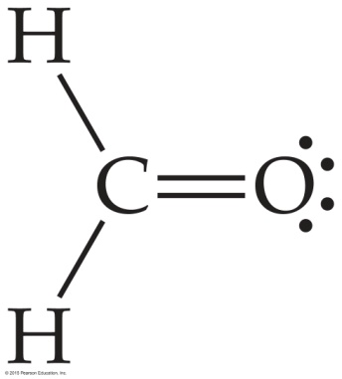
Sample Exercise 9.6 Describing σ and Π Bonds in a Molecule
Formaldehyde has the Lewis structure
Describe how the bonds in formaldehyde are formed in terms of overlaps of hybrid and unhybridized orbitals.
Solution
Analyze We are asked to describe the bonding in formaldehyde in terms of hybrid orbitals.
Plan Single bonds are $σ$ bonds, and double bonds consist of one σ bond and one π bond. The ways in which these bonds form can be deduced from the molecular geometry, which we predict using the VSEPR model.

Slide 18
Sample Exercise 9.6 Describing σ and Π Bonds in a Molecule
Continued
Solve The C atom has three electron domains around it, which suggests a trigonal-planar geometry with bond angles of about 120°. This geometry implies sp² hybrid orbitals on C (Table 9.4). These hybrids are used to make the two C—H and one C—O σ bonds to C. There remains an unhybridized 2p orbital (a p_{π} orbital) on carbon, perpendicular to the plane of the three sp² hybrids.

Slide 19
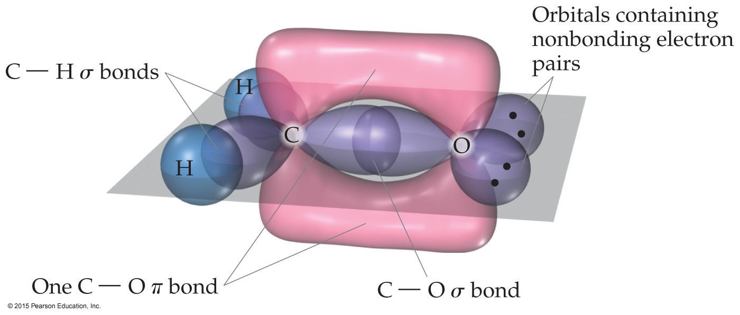
Sample Exercise 9.6 Describing σ and Π Bonds in a Molecule
Continued
The O atom also has three electron domains around it, and so we assume it has sp² hybridization as well. One of these hybrid orbitals participates in the C—O σ bond, while the other two hold the two nonbonding electron pairs of the O atom. Like the C atom, therefore, the O atom has a p_{π} orbital that is perpendicular to the plane of the molecule. The two p_{π} orbitals overlap to form a C—O π bond (Figure 9.25).

Slide 20
Sample Exercise 9.7 Delocalized Bonding
Describe the bonding in the nitrate ion, NO₃–. Does this ion have delocalized π bonds?
Solution
Analyze Given the chemical formula for a polyatomic anion, we are asked to describe the bonding and determine whether the ion has delocalized π bonds.
Plan Our first step is to draw Lewis structures. Multiple resonance structures involving the placement of the double bonds in different locations would suggest that the π component of the double bonds is delocalized.
Solve In Section 8.6 we saw that NO₃– has three resonance structures:

Slide 21
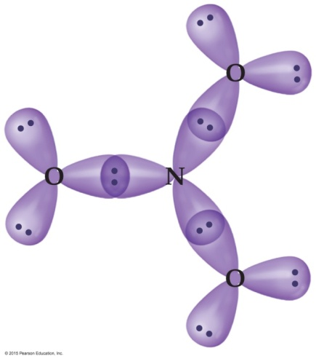
Sample Exercise 9.7 Delocalized Bonding
Continued
In each structure, the electron-domain geometry at nitrogen is trigonal planar, which implies sp² hybridization of the N atom. It is helpful when considering delocalized π bonding to consider atoms with lone pairs that are bonded to the central atom to be sp² hybridized as well. Thus, we can envision that each of the O atoms in the anion has three sp² hybrid orbitals in the plane of the ion. Each of the four atoms has an unhybridized p_{π} orbital oriented perpendicular to the plane of the ion.
The NO₃– ion has 24 valence electrons. We can first use the sp² hybrid orbitals on the four atoms to construct the three N—O σ bonds. That uses all of the sp² hybrids on the N atom and one sp² hybrid on each O atom. Each of the two remaining sp² hybrids on each O atom is used to hold a nonbonding pair of electrons. Thus, for any of the resonance structures, we have the following arrangement in the plane of the ion:
Notice that we have accounted for a total of 18 electrons—six in the three N—O σ bonds, and 12 as nonbonding pairs on the O atoms. The remaining six electrons will reside in the π system of the ion.

Slide 22
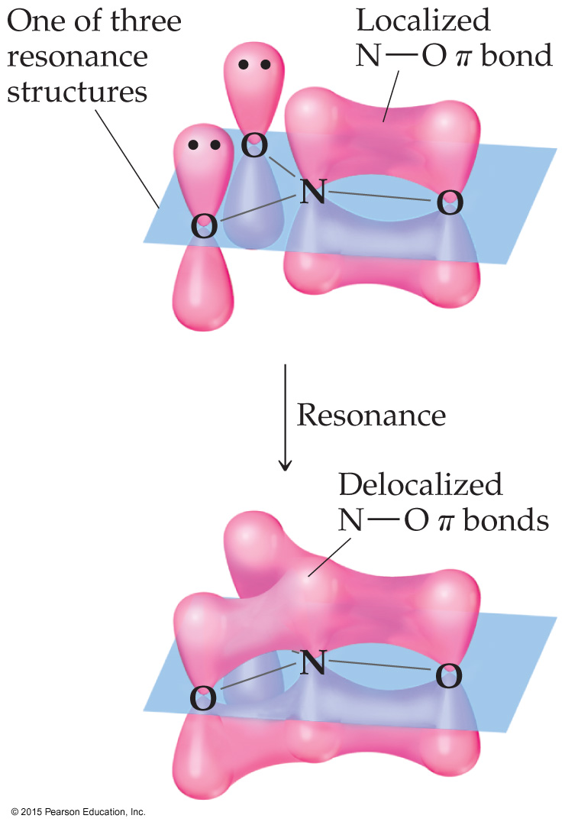
Sample Exercise 9.7 Delocalized Bonding
Continued
The four p_{π} orbitals—one on each of the four atoms — are used to build the p system. For any one of the three resonance structures shown, we might imagine a single localized N—O π bond formed by the overlap of the p_{π} orbital on N and a p_{π} orbital on one of the O atoms. The remaining two O atoms have nonbonding pairs in their p_{π} orbitals. Thus, for each of the resonance structures, we have the situation shown in Figure 9.28. Because each resonance structure contributes equally to the observed structure of NO₃–, however, we represent the π bonding as delocalized over the three N—O bonds, as shown in the figure. We see that the NO₃– ion has a six-electron π system delocalized among the four atoms in the ion.
Practice Exercise 1
How many electrons are in the π system of the ozone molecule, O₃?
(a) 2 (b) 4 (c) 6 (d) 14 (e) 18
Practice Exercise 2
Which of these species have delocalized bonding: SO₂, SO₃, SO₃^{2–}, H₂CO, NH₄⁺?

Slide 23
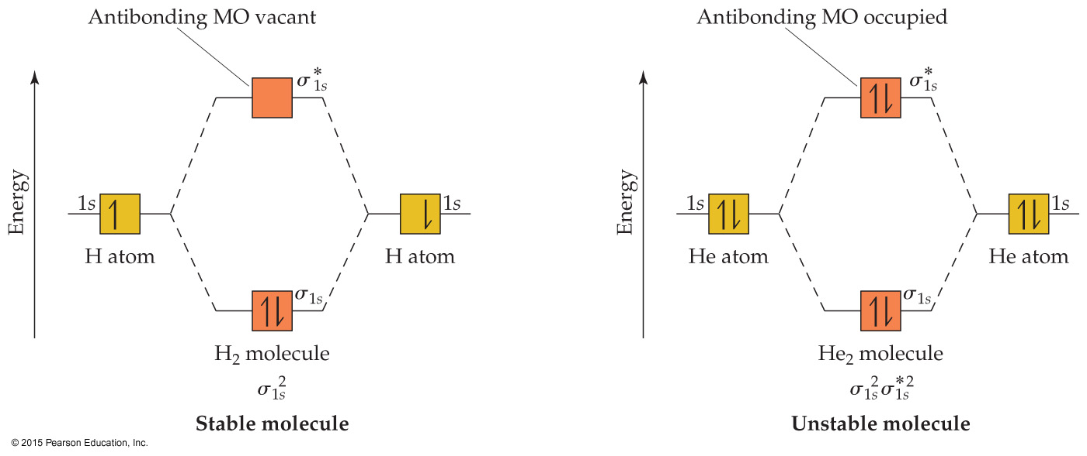
Sample Exercise 9.8 Bond Order
What is the bond order of the He₂⁺ ion? Would you expect this ion to be stable relative to the separated He atom and He⁺ ion?
Solution
Analyze We will determine the bond order for the He₂⁺ ion and use it to predict whether the ion is stable.
Plan To determine the bond order, we must determine the number of electrons in the molecule and how these electrons populate the available MOs. The valence electrons of He are in the 1s orbital, and the 1s orbitals combine to give an MO diagram like that for H₂ or He₂ (Figure 9.33). If the bond order is greater than 0, we expect a bond to exist, and the ion is stable.

Slide 24
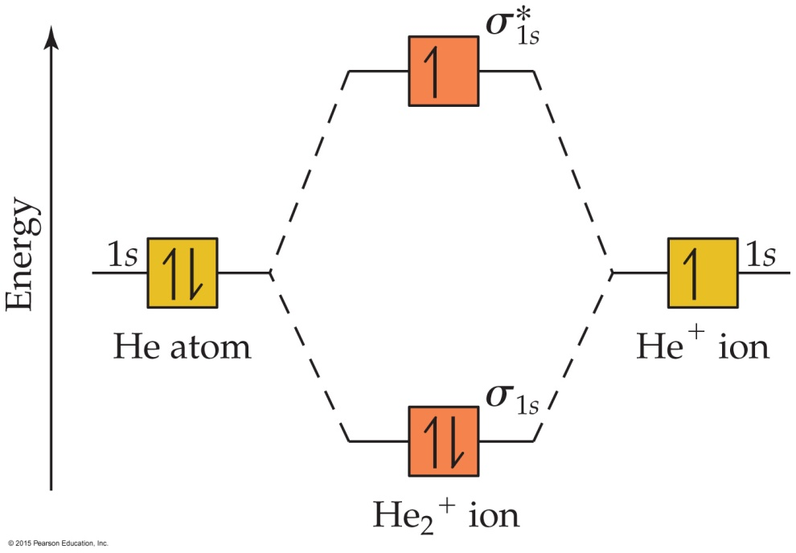
Sample Exercise 9.8 Bond Order
Continued
Solve The energy-level diagram for the He₂⁺ ion is shown in Figure 9.34. This ion has three electrons. Two are placed in the bonding orbital and the third in the antibonding orbital. Thus, the bond order is
Because the bond order is greater than 0, we predict the He₂⁺ ion to be stable relative to the separated He and He⁺. Formation of He₂⁺ in the gas phase has been demonstrated in laboratory experiments.

Slide 25
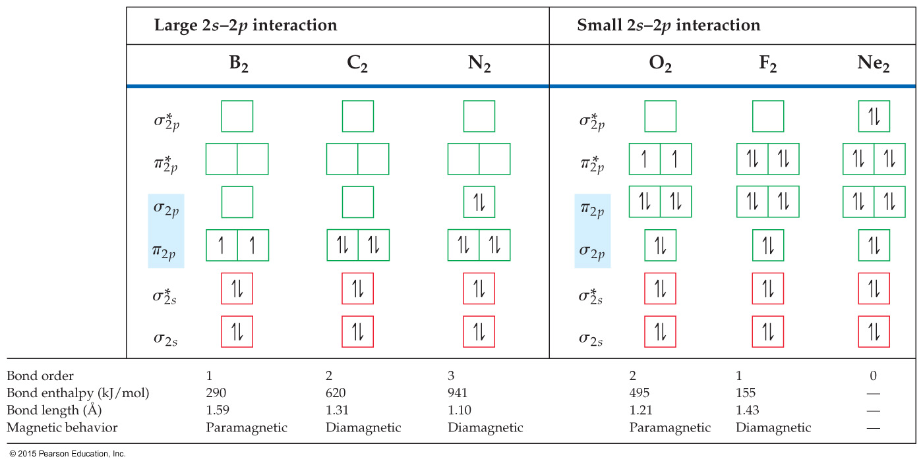
Sample Exercise 9.9 Molecular Orbitals of a Period 2 Diatomic Ion
For the O₂⁺ ion predict (a) number of unpaired electrons, (b) bond order, (c) bond enthalpy and bond length.
Solution
Analyze Our task is to predict several properties of the cation O₂⁺.
Plan We will use the MO description of O₂⁺ to determine the desired properties. We must first determine the number of electrons in O₂⁺ and then draw its MO energy diagram. The unpaired electrons are those without a partner of opposite spin. The bond order is one-half the difference between the number of bonding and antibonding electrons. After calculating the bond order, we can use Figure 9.43 to estimate the bond enthalpy and bond length.

Slide 26
Sample Exercise 9.9 Molecular Orbitals of a Period 2 Diatomic Ion
Continued
Solve
(a) The O₂⁺ ion has 11 valence electrons, one fewer than O₂. The electron removed from O₂ to form O₂⁺ is one of the two unpaired π*_{2p} electrons (see Figure 9.43). Therefore, O₂⁺ has one unpaired electron.
(b) The molecule has eight bonding electrons (the same as O₂) and three antibonding electrons (one fewer than O₂). Thus, its bond order is
(c) The bond order of O₂⁺ is between that for O₂ (bond order 2) and N₂ (bond order 3). Thus, the bond enthalpy and bond length should be about midway between those for O₂ and N₂, approximately 700 kJ ⁄ mol and 1.15 Å. (The experimentally measured values are 625 kJ ⁄ mol and 1.123 Å.)

Slide 27
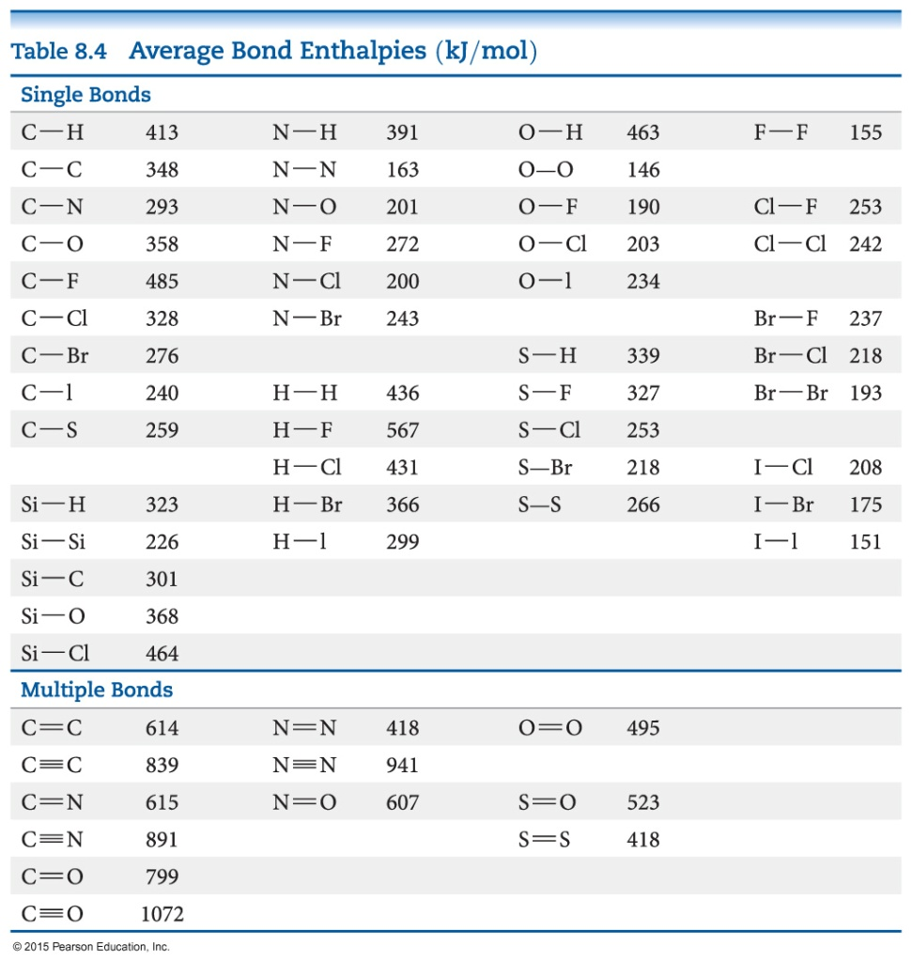
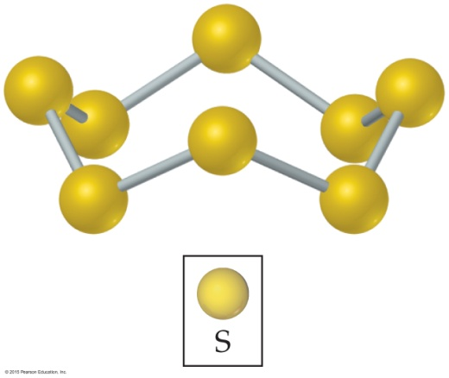
Sample Integrative Exercise Putting Concepts Together
Elemental sulfur is a yellow solid that consists of S₈ molecules. The structure of the S₈ molecule is a puckered, eight-membered ring (see Figure 7.27). Heating elemental sulfur to high temperatures produces gaseous S₂ molecules:
S₈(s) → 4 S₂(g)
(a) The electron configuration of which period 2 element is most similar to that of sulfur? (b) Use the VSEPR model to predict the S—S—S bond angles in S₈ and the hybridization at S in S₈. (c) Use MO theory to predict the sulfur–sulfur bond order in S₂. Do you expect this molecule to be diamagnetic or paramagnetic? (d) Use average bond enthalpies (Table 8.4) to estimate the enthalpy change for this reaction. Is the reaction exothermic or endothermic?

Slide 28
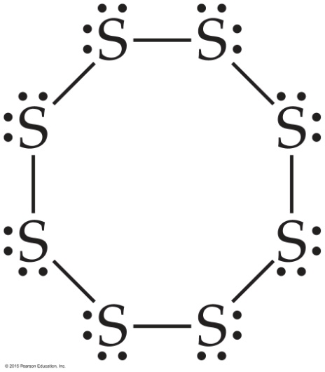
Sample Integrative Exercise Putting Concepts Together
Continued
Solution
(a) Sulfur is a group 6A element with an [Ne]3s²3p⁴ electron configuration. It is expected to be most similar electronically to oxygen (electron configuration, [He]2s²2p⁴), which is immediately above it in the periodic table.
(b) The Lewis structure of S₈ is
There is a single bond between each pair of S atoms and two nonbonding electron pairs on each S atom. Thus, we see four electron domains around each S atom and expect a tetrahedral electron-domain geometry corresponding to sp³ hybridization. Because of the nonbonding pairs, we expect the S—S—S angles to be somewhat less than 109.5°, the tetrahedral angle. Experimentally, the S—S—S angle in S₈ is 108°, in good agreement with this prediction. Interestingly, if S₈ were a planar ring, it would have S—S—S angles of 135°. Instead, the S₈ ring puckers to accommodate the smaller angles dictated by sp³ hybridization.

Slide 29
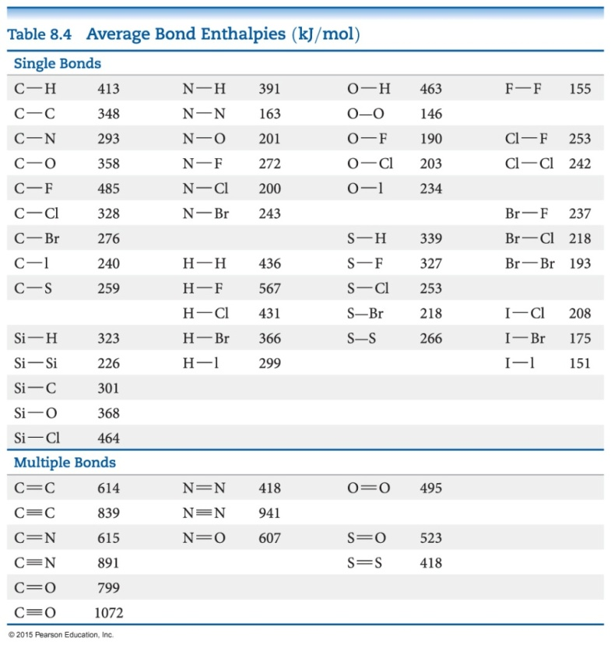
Sample Integrative Exercise Putting Concepts Together
Continued
(c) The MOs of S₂ are analogous to those of O₂, although the MOs for S₂ are constructed from the 3s and 3p atomic orbitals of sulfur. Further, S₂ has the same number of valence electrons as O₂. Thus, by analogy with O₂, we expect S₂ to have a bond order of 2 (a double bond) and to be paramagnetic with two unpaired electrons in the π*_{3p} molecular orbitals of S₂.
(d) We are considering the reaction in which an S₈ molecule falls apart into four S₂ molecules. From parts (b) and (c), we see that S₈ has S—S single bonds and S₂ has S S double bonds. During the reaction, therefore, we are breaking eight S—S single bonds and forming four S S double bonds. We can estimate the enthalpy of the reaction by using Equation 8.12 and the average bond enthalpies in Table 8.4:
ΔH_{rxn} = 8 D(S—S) – 4 D(S S) = 8(266 kJ) – 4(418 kJ) = +456 kJ
Recall that D(X—Y) represents the X—Y bond enthalpy. Because ΔH_{rxn} > 0, the reaction is endothermic. (Section 5.4) The very positive value of ΔH_{rxn} suggests that high temperatures are required to cause the reaction to occur.

