Slide 1
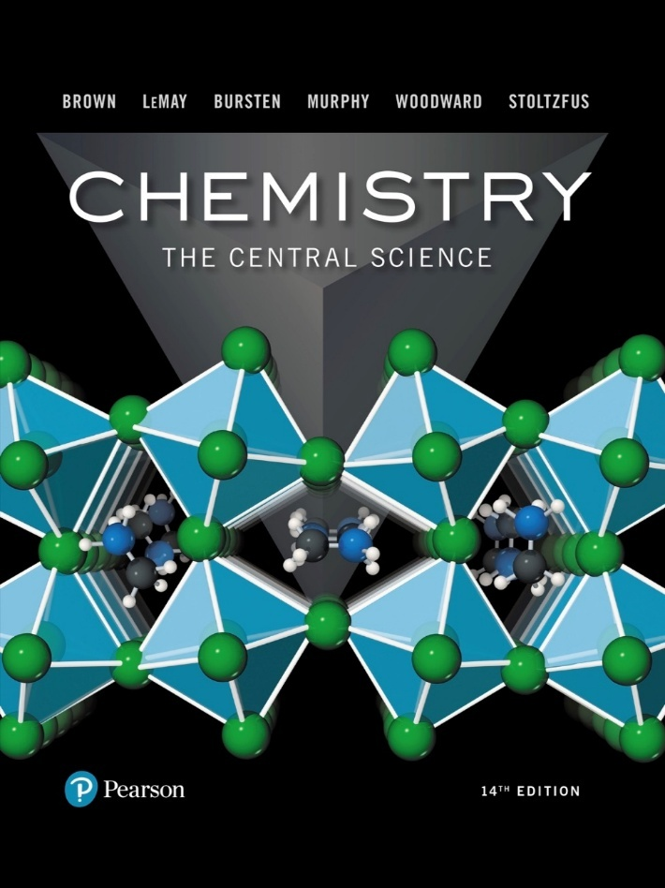
Chemistry: The Central Science
Fourteenth Edition
Chapter 16
Acid–Base Equilibria
Copyright © 2018, 2015, 2012 Pearson Education, Inc. All Rights Reserved
Notes:
If this PowerPoint presentation contains mathematical equations, you may need to check that your computer has the following installed:
1) MathType Plugin
2) Math Player (free versions available)
3) NVDA Reader (free versions available)

Slide 2
Some Definitions
Arrhenius
An acid is a substance that, when dissolved in water, increases the concentration of hydrogen ions.
A base is a substance that, when dissolved in water, increases the concentration of hydroxide ions.
Brønsted–Lowry
An acid is a proton donor.
A base is a proton acceptor.

Slide 3
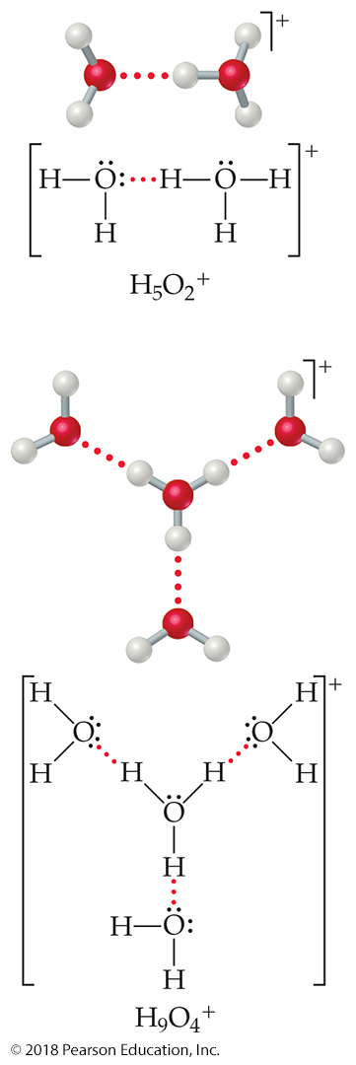
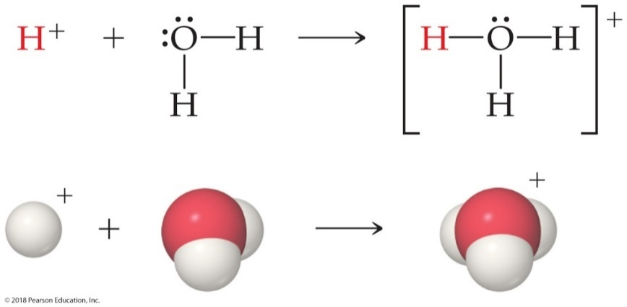
Water as a Proton Acceptor
When a hydrogen ion is formed in water, it does not exist alone for long!
H-bonds form with water.

Slide 4
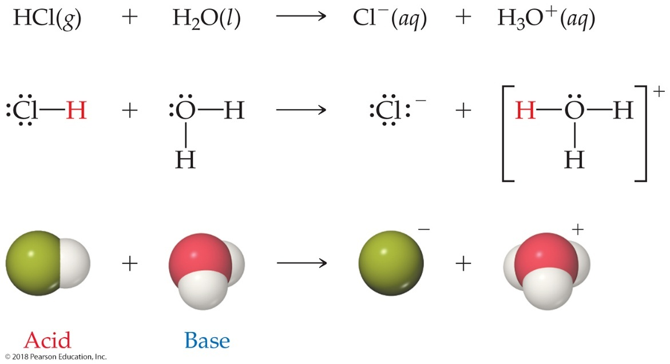
Brønsted–Lowry Acid and Base
A Brønsted–Lowry acid must have at least one removable (acidic) proton (H⁺) to donate.
A Brønsted–Lowry base must have at least one nonbonding pair of electrons to accept a proton (H⁺).

Slide 5
What Is Different about Water?
Water can act as a Brønsted–Lowry base and accept a proton (H⁺) from an acid, as on the previous slide.
It can also donate a proton and act as an acid, as is seen below.
This makes water amphiprotic.

Slide 6
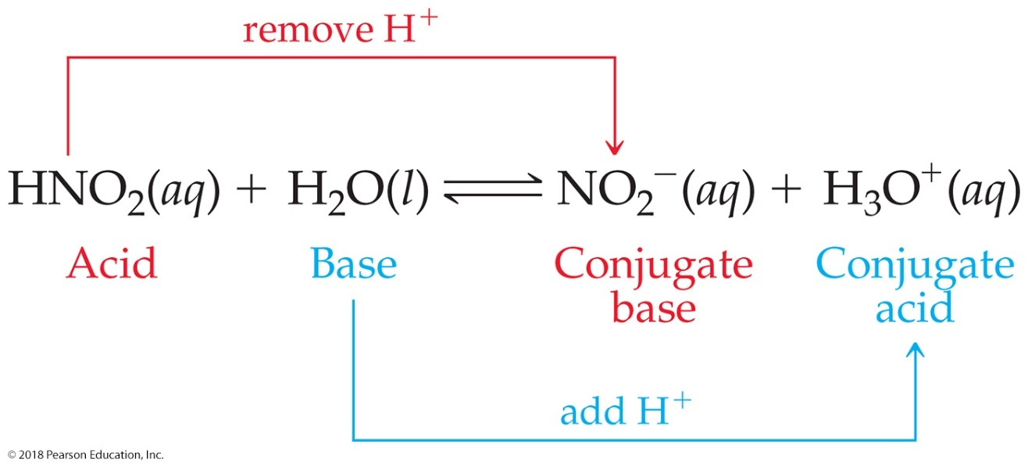
Conjugate Acids and Bases
Two formulas that differ by H⁺ are called a conjugate acid–base pair.
Reactions between acids and bases always yield their conjugate bases and acids.

Slide 7
Relative Strengths of Acids and Bases (1 of 2)
Acids above the line with
as a base are strong
acids; their conjugate bases do not act as acids in water.
Bases below the line with
as an acid are strong
bases; their conjugate acids do not act as acids in water.

Slide 8
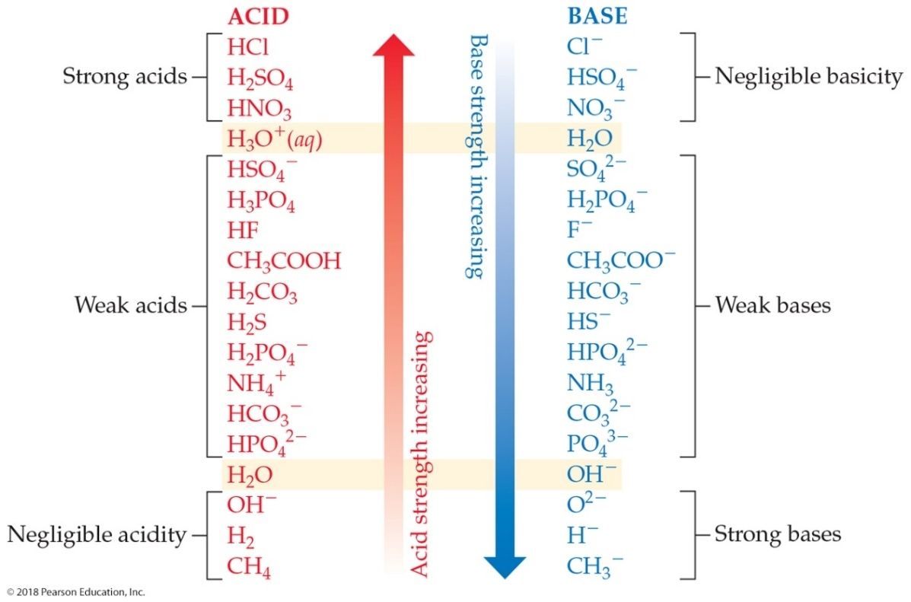
Relative Strengths of Acids and Bases (2 of 2)
The substances between the lines with
are
conjugate acid–base pairs in water.

Slide 9
Acid and Base Strength
In every acid–base reaction, equilibrium favors transfer of the proton from the stronger acid to the stronger base to form the weaker acid and the weaker base.
is a much stronger base than
so the equilibrium lies far to the right (K >> 1).
Acetate is a stronger base than
so the equilibrium
favors the left side (K < 1).

Slide 10
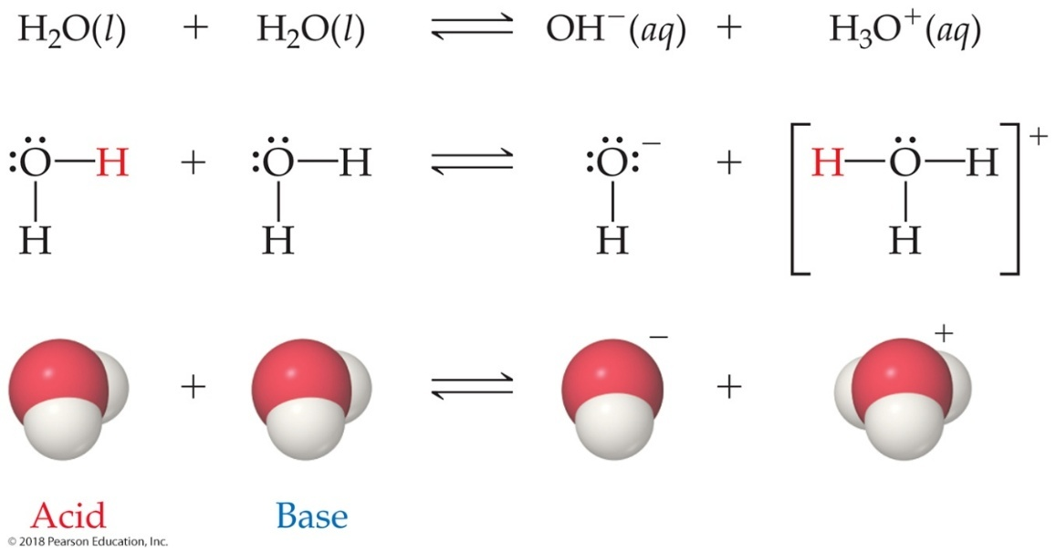
Autoionization of Water
Water is amphoteric.
In pure water, a few molecules act as bases and a few act as acids.
This is referred to as autoionization.

Slide 11
Ion Product Constant
The equilibrium expression for this process is
This special equilibrium constant is referred to as the
ion product constant for water,

Slide 12
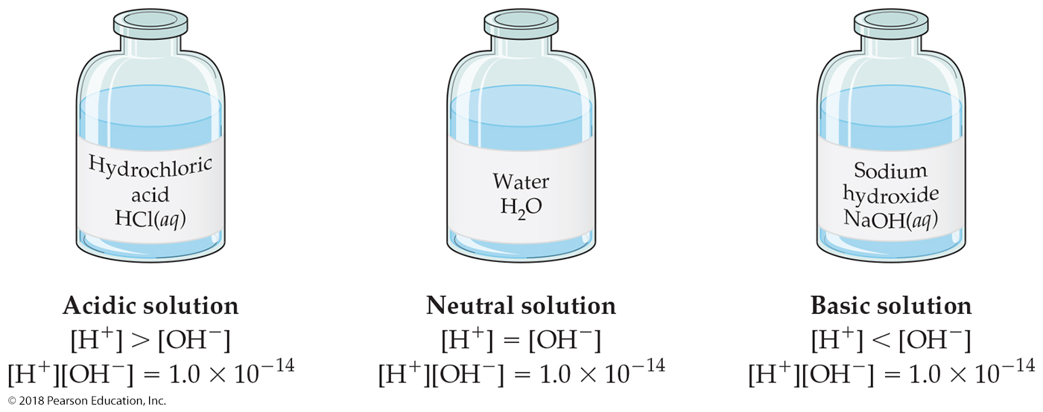
Aqueous Solutions Can Be Acidic, Basic, or Neutral
If a solution is neutral,
If a solution is acidic,
If a solution is basic,

Slide 13
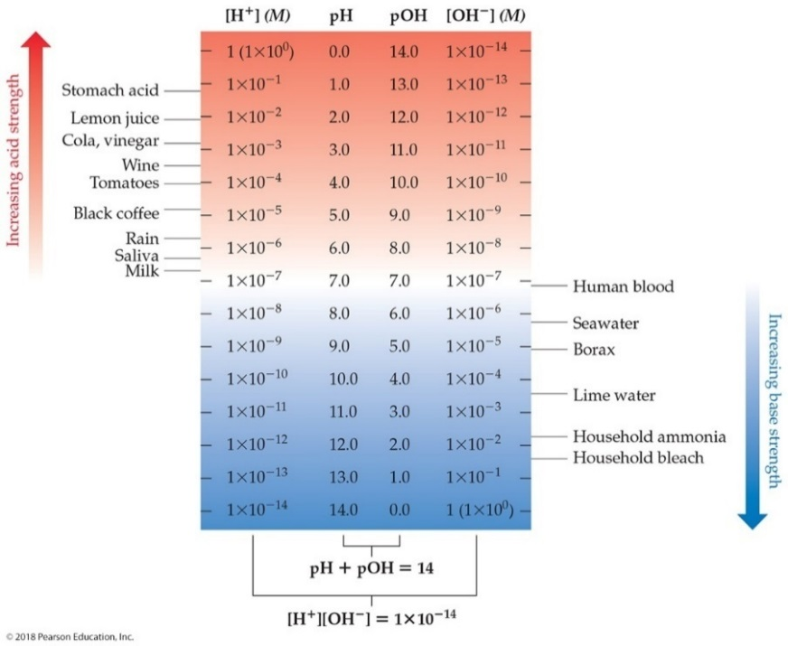
p H
p H is a method of reporting hydrogen ion concentration.
Neutral p H is 7.00.
Acidic p H is below 7.00.
Basic p H is above 7.00.
Only the digits After the decimal point are significant figures in logarithms.

Slide 14
Other “p” Scales
The “p” in p H tells us to take the −log of a quantity (in this case, hydrogen ions).
Some other “p” systems are

Slide 15
Relating p H and p O H
Because
we can take the −log of the equation
which results in

Slide 16
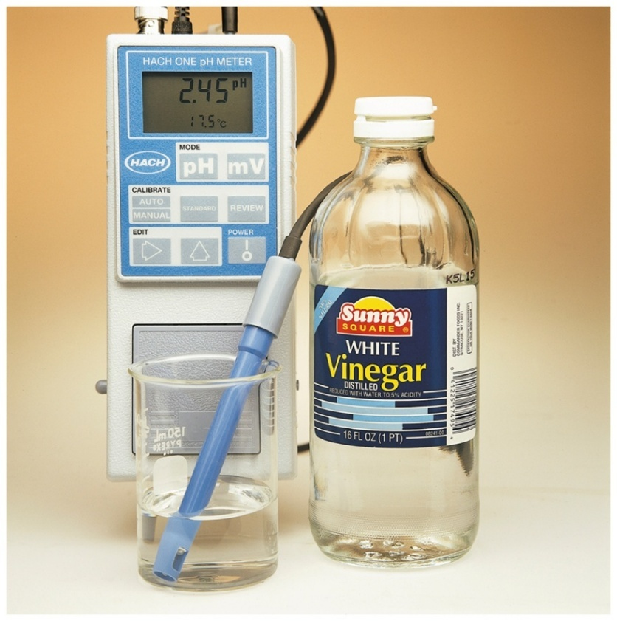
How Do We Measure p H? (1 of 2)
One way to measure p H is with a p H meter.
p H meters are used for accurate measurement of p H; electrodes indicate small changes in voltage to detect p H.

Slide 17
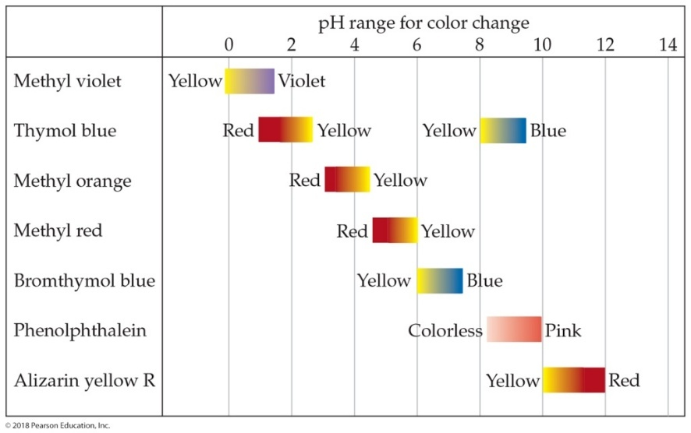
How Do We Measure p H? (2 of 2)
Another method is with indicators.
They give less accurate, but quick measurements.
An indicator is a compound that has one color in its acid form and another color in its basic form.

Slide 18
Strong Acids
You will recall that the seven strong acids are
These are, by definition, strong electrolytes and exist totally as ions in aqueous solution; for example,
So, for the monoprotic strong acids,

Slide 19
Strong Bases
Strong bases are the soluble hydroxides, which are the alkali metal and heavier alkaline earth metal hydroxides
but their solubilities are low).
Again, these substances dissociate completely in aqueous solution; for example,

Slide 20
Weak Acids (1 of 3)
For a weak acid, the equation for its dissociation is
Since it is an equilibrium, there is an equilibrium constant related to it, called the acid-dissociation
constant,
The larger the value of
the stronger the acid.

Slide 21
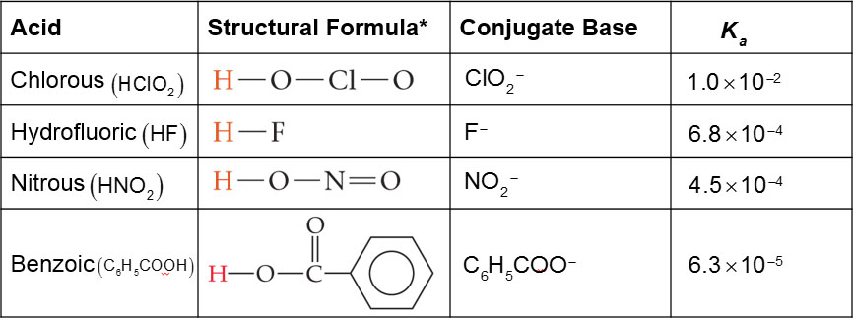
Weak Acids (2 of 3)
Table 16.2 Some Weak Acids in Water at 25 degree Celsius
*The proton that ionizes is shown in red.

Slide 22
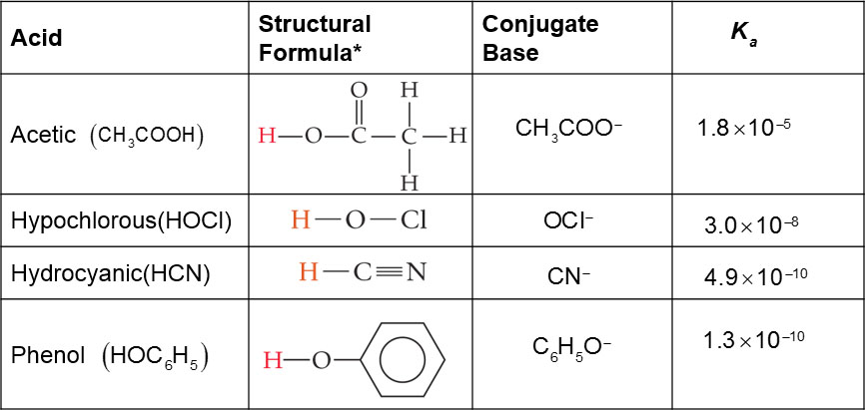
Weak Acids (3 of 3)
[Table 16.2 continued]
*The proton that ionizes is shown in red.

Slide 23
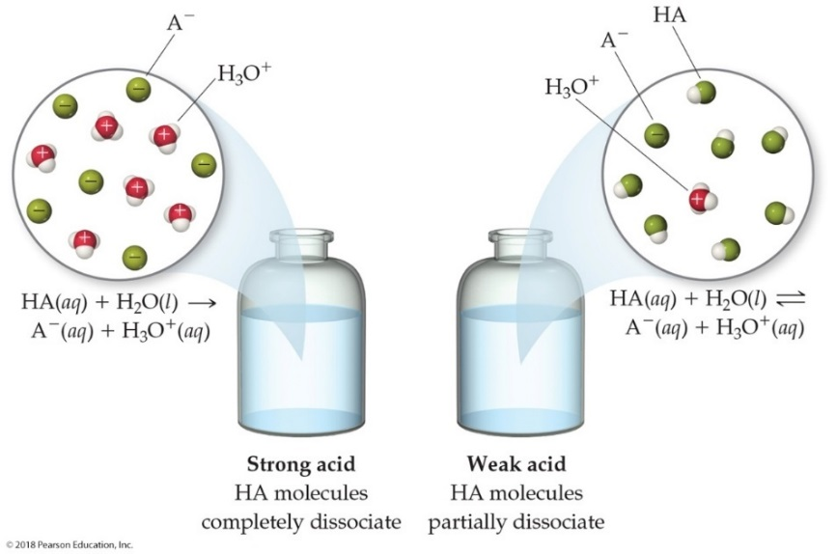
Comparing Strong and Weak Acids
What is present in solution for a strong acid versus a weak acid?
Strong acids completely dissociate to ions.
Weak acids only partially dissociate to ions.

Slide 24
Calculating K_{a} from the pH (1 of 2)
The pH of a 0.10 M solution of formic acid, H C O O H,
at 25 degree Celsius is 2.38. Calculate
for formic
acid at this temperature.
We know that
To calculate
we need the equilibrium
concentrations of all three things.

Slide 25
Calculating K_{a} from the pH (2 of 2)
We can find
which is the same as
from the p H.

Slide 26
Calculating K_{a} from pH (1 of 2)
Now we can set up a table for equilibrium concentrations. We know initial H C O O H (0.10 M) and ion concentrations (0 M); we found equilibrium ion
Concentrations
so we calculate the
change, then the equilibrium H C O O H concentration.

Slide 27
Calculating K_{a} from pH (2 of 2)
This allows us to calculate
by putting in the
equilibrium concentrations.

Slide 28
Calculating Percent Ionization
In this example,

Slide 29
Method to Follow to Calculate p H Using K_{a}
Write the chemical equation for the ionization equilibrium.
Write the equilibrium constant expression.
Set up a table for Initial/Change in/Equilibrium Concentration to determine equilibrium concentrations as a function of change (x).
Substitute equilibrium concentrations into the equilibrium constant expression and solve for x. (Make assumptions if you can!)

Slide 30
Example 1
Calculate the pH of a 0.30 M solution of acetic acid,
Blank | C H 3 C O O H in molals | H 3 O, plus, in molals | C H 3 C O O, minus, in molals
Initial Concentration (M) | 0.30 | 0 | 0
Change in Concentration (M) | negative x | plus x | plus x
Equilibrium Concentration (M) | 0.30−x | x | x

Slide 31
Example (concluded)
If we assume that x << 0.30, then 0.30 − x becomes 0.30. The problem becomes easier, since we don’t have to use the quadratic formula to solve it.

Slide 32
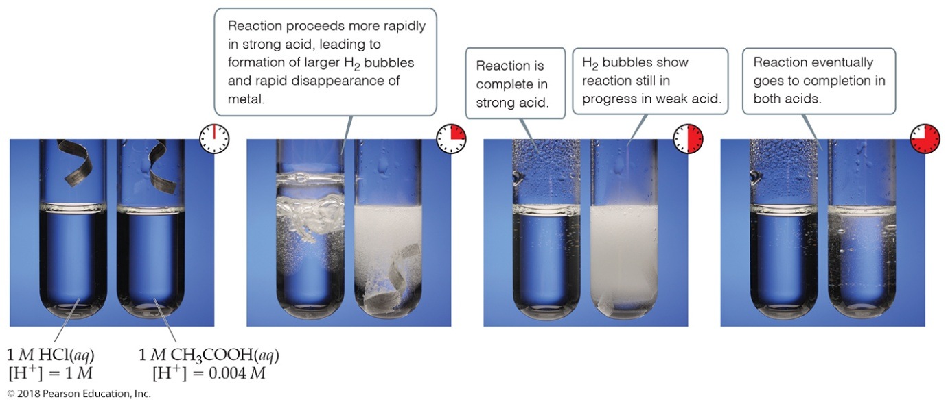
Strong vs. Weak Acids—Another Comparison
Strong acid:
Weak acid:
This creates a difference in conductivity and in rates of chemical reactions.

Slide 33
Polyprotic Acids (1 of 2)
Polyprotic acids have more than one acidic proton.
It is always easier to remove the first proton than any successive proton.
If the factor in the
values for the first and second
dissociation has a difference of 3 or greater, the pH generally depends only on the first dissociation.

Slide 34
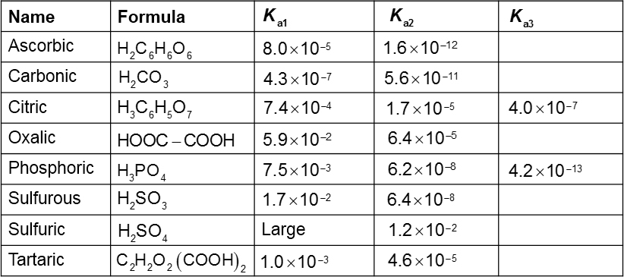
Polyprotic Acids (2 of 2)
Table 16.3 Acid-Dissociation Constants of Some Common Polyprotic Acids

Slide 35
Weak Bases
Ammonia,
is a weak base.
Like weak acids, weak bases have an equilibrium constant called the base-dissociation constant.
Equilibrium calculations work the same as for acids, using the base-dissociation constant instead.
Many bases contain N as an element due to the lone pair; organic derivatives of ammonia are called amines.

Slide 36
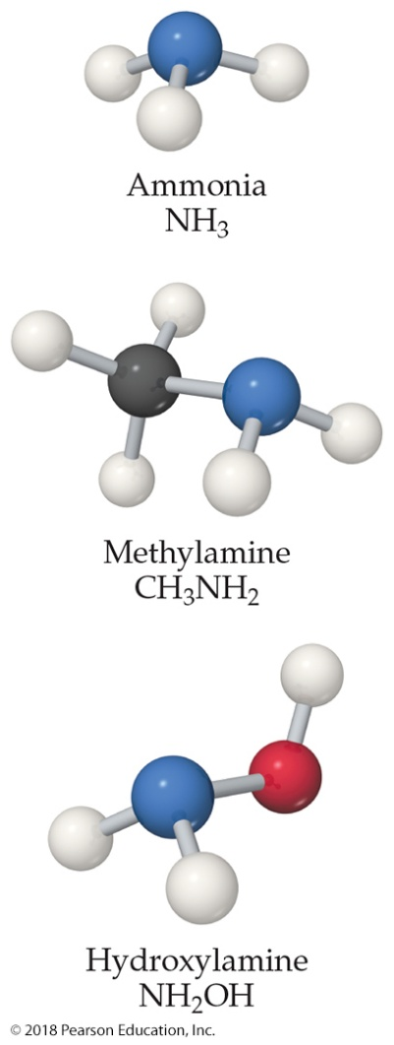
Types of Weak Bases
Two main categories
Neutral substances with an atom that has a nonbonding pair of electrons that can accept H⁺ (like ammonia and the amines)
Anions of weak acids, which are their conjugate bases

Slide 37
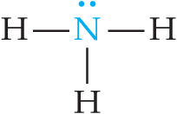
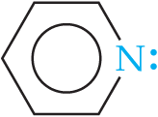
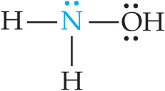
Base-Dissociation Constants (1 of 2)
Table 16.4 Some Weak Bases in Water at 25 degree Celsius
Base | Structural Formula* | Conjugate Acid | K sub b
Ammonia N H 3 | Structural formula, N with a lone pair single bonded leftward, rightward, and downward to H atoms. N is the atom that accepts the proton, shown in blue. | N H 4, plus | 1.8 times 10 to the negative fifth
Pyridine C 5 H 5 N | Structural formula, N with a lone pair is shown on the right side of a hexagonal ring. N is the atom that accepts the proton, shown in blue. | C 5 H 5 N H, plus | 1.7 times 10 to the negative ninth
Hydroxylamine H O N H 2 | Structural formula, N with a lone pair single bonded leftward and downward to H atoms, and rightward to O H. The O has 2 lone pairs. N is the atom that accepts the proton, shown in blue. | H O N H 3, plus | 1.1 times 10 to the negative eighth
*The atom that accepts the proton is shown in blue.

Slide 38
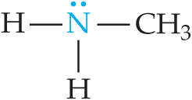
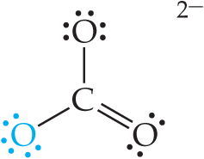
Base-Dissociation Constants (2 of 2)
[Table 16.4 continued]
Base | Structural Formula* | Conjugate Acid | K sub b
Methylamine C H 3, N H 2 | Structural formula, N with one lone pair single bonded leftward and downward to H atoms, and rightward to C H 3. N is the atom that accepts the proton, shown in blue. | C H 3, N H 3, plus | 4.4 times 10 to the negative fourth
Hydrosulfide ion H S, minus | Structural formula, H single bonded to S, with 3 lone pairs. The structure has a negative charge. S is the atom that accepts the proton, shown in blue. | H 2 S | 1.8 times 10 to the negative seventh
Carbonate ion C O 3, 2 minus | Structural formula, a central C single bonded upward to O with 3 lone pairs, downward and leftward to O with 3 lone pairs, and double bonded downward and rightward to O with 2 lone pairs. The structure has a charge of 2 minus. The O with 3 lone pairs on the lower left is the atom that accepts the proton, shown in blue. | H C O 3, minus | 1.8 times 10 to the negative fourth
Hypochlorite ion C l O, minus | Structural formula, C l with 3 lone pairs single bonded to O with 3 lone pairs. The structure has a negative charge. O is the atom that accepts the proton, shown in blue. | H C l O | 3.3 times 10 to the negative seventh

Slide 39
Example 2 (1 of 2)
What is the pH of
Blank | N H 3 in molals | N H 4, plus, in molals | O H, minus, in molals
Initial Concentration (M) | 0.15 | 0 | 0
Change in Concentration (M) | minus x | plus x | plus x
Equilibrium Concentration (M) | 0.15−x | x | x

Slide 40
Example 2 (2 of 2)
If we assume that
Then:
and:
Note: x is the molarity of O H–, so –log(x) will be the pOH (pOH = 2.80) and [14.00 – pOH] is pH (pH = 11.20).

Slide 41
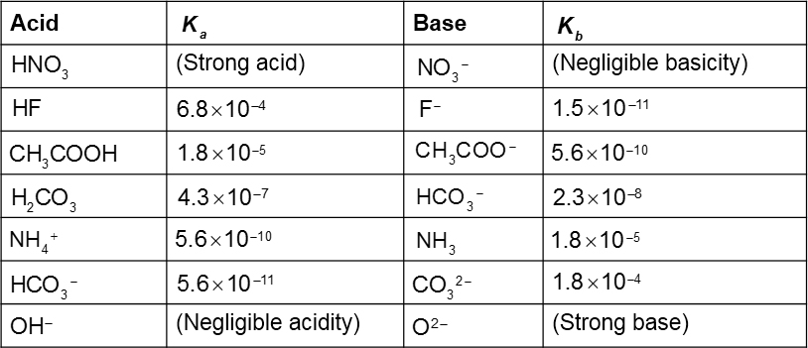
Relationship between K_{a} and K_{b} (1 of 2)
Table 16.5 Some Conjugate Acid-Base Pairs

Slide 42
Relationship between K_{a} and K_{b} (2 of 2)
For a conjugate acid–base pair,
are related
in this way:
Therefore, if you know one of them, you can calculate the other.

Slide 43
Acid–Base Properties of Salts
Many ions react with water to create
The reaction with water is often called hydrolysis.
To determine whether a salt is an acid or a base, you need to look at the cation and anion separately.
The cation can be acidic or neutral.
The anion can be acidic, basic, or neutral.

Slide 44
Anions
Anions of strong acids are neutral. For example,
will not react with water, so
can’t be formed.
Anions of weak acids are conjugate bases, so they create
in water; for example,
Protonated anions from polyprotic acids can be acids
or bases: If
for the ion, the anion will be
acidic; if
the anion will be basic.

Slide 45
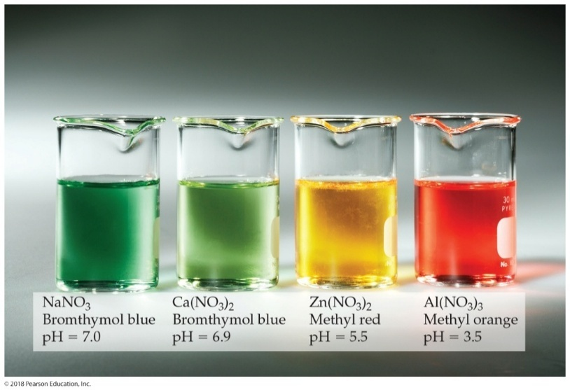
Cations
Group I or group II metal cations are neutral.
Polyatomic cations are typically the conjugate acids of
a weak base; for example,
Transition and post-transition metal cations are acidic. Why? (There are no H atoms in these cations!)

Slide 46
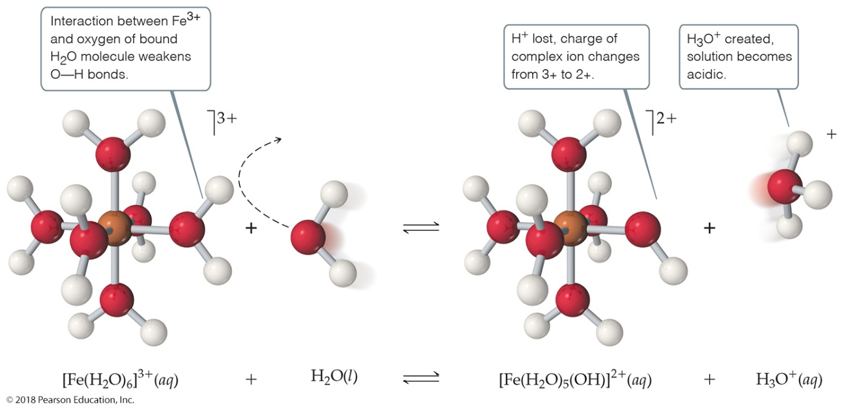
Hydrated Cations (1 of 2)
Transition and post-transition metals form hydrated cations.
The water attached to the metal is more acidic than free water molecules, making the hydrated ions acidic.

Slide 47
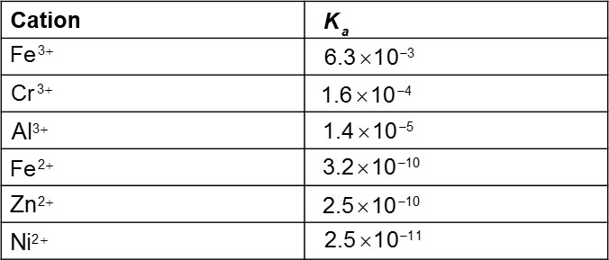
Hydrated Cations (2 of 2)
Table 16.6 Acid-Dissociation Constants for Metal Cations in Aqueous Solution at 25 degree Celsius

Slide 48
Salt Solutions—Acidic, Basic, or Neutral?
Group I/II metal cation with anion of a strong acid: neutral
Group I/II metal cation with anion of a weak acid: basic (like the anion)
Transition/post-transition metal cation or polyatomic cation with anion of a strong acid: acidic (like the cation)
Transition/post-transition metal cation or polyatomic
cation with anion of a weak acid: compare
whichever is greater dictates what the salt is.

Slide 49
Factors That Affect Acid Strength
H—A bond must be polarized with δ+ on the H atom and δ– on the A atom.
Bond strength: Weaker bonds can be broken more easily, making the acid stronger.
Stability of A–: More stable anion means stronger acid.

Slide 50
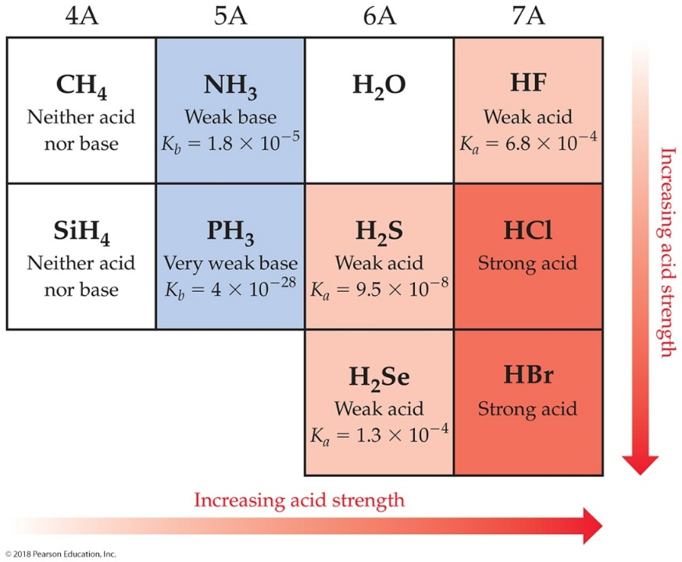
Binary Acids
Binary acids consist of H and one other element.
Within a group, H—A bond strength is generally the most important factor.
Within a period, bond polarity is the most important factor to determine acid strength.

Slide 51
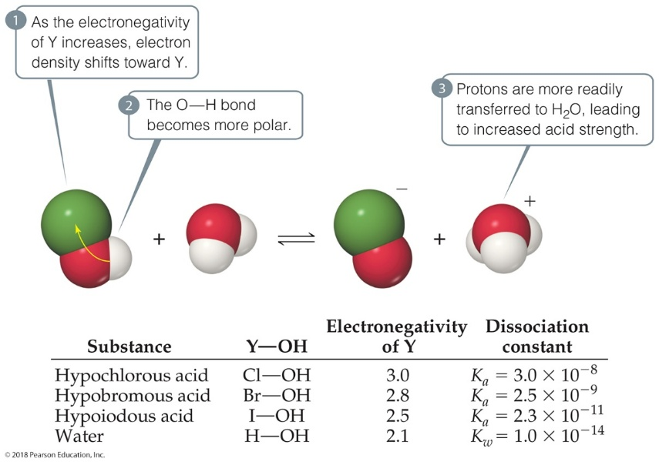
Oxyacids
Oxyacids consist of H, O, and one other element, which is a nonmetal.
Generally, as the electronegativity of the nonmetal increases, the acidity increases for acids with the same structure.

Slide 52
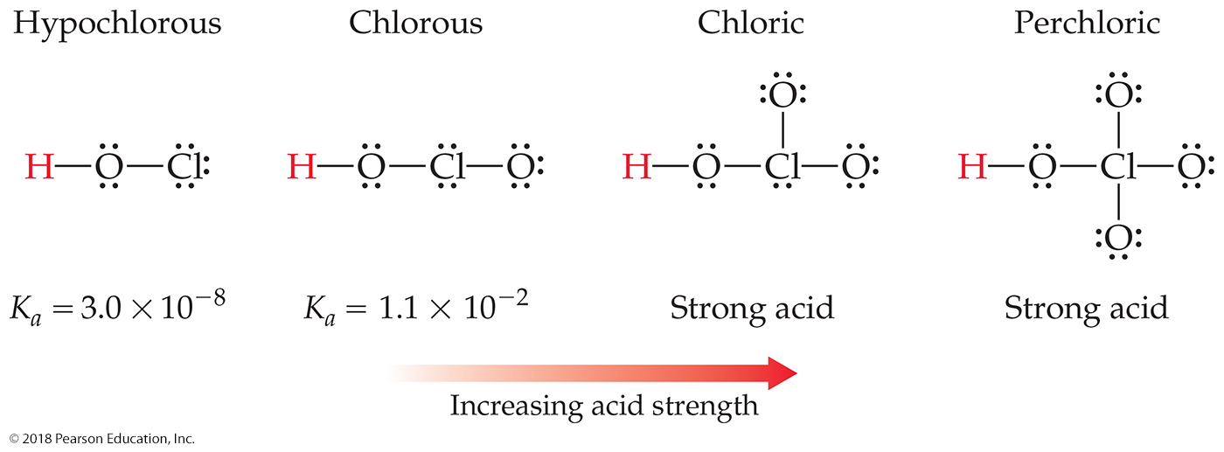
Oxyacids with Same “Other” Element
If an element can form more than one oxyacid, the oxyacid with more O atoms is more acidic; for example, sulfuric acid versus sulfurous acid.
Another way of saying it: If the oxidation number increases, the acidity increases.

Slide 53
Carboxylic Acids
Carboxylic acids are organic acids containing the —C O O H group.
Factors contributing to their acidic behavior:
Other O attached to C draws electron density from O—H bond, increasing polarity.
Its conjugate base (carboxylate anion) has resonance forms to stabilize the anion.

Slide 54
Lewis Acid/Base Chemistry
Lewis acids are electron pair acceptors.
Lewis bases are electron pair donors.
All Brønsted–Lowry acids and bases are also called Lewis acids and bases.
There are compounds that do not meet the Brønsted–Lowry definition that meet the Lewis definition.

Slide 55
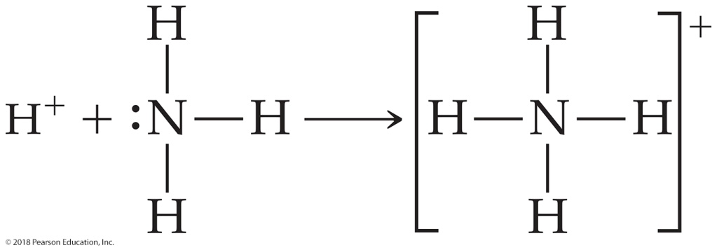
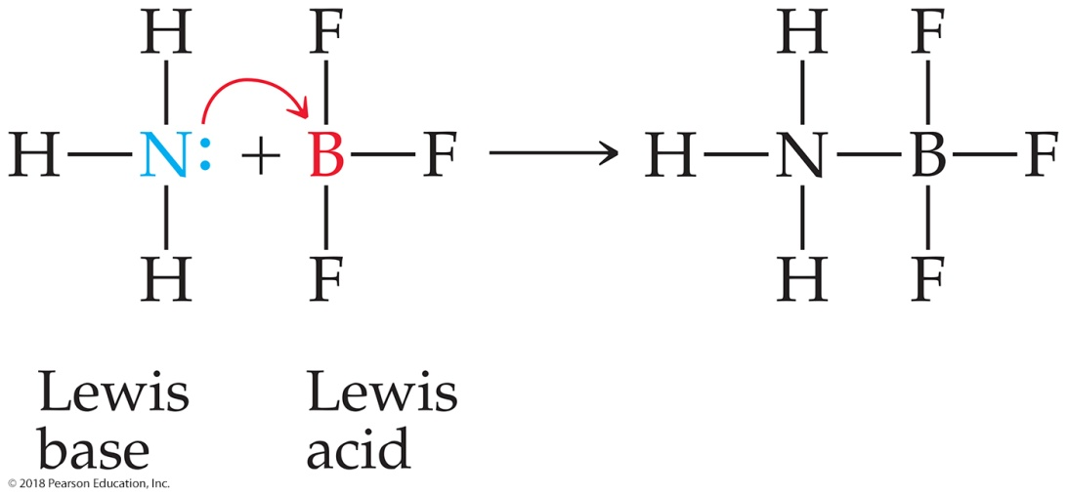
Comparing Ammonia’s Reaction with H⁺ and B F₃

Slide 56
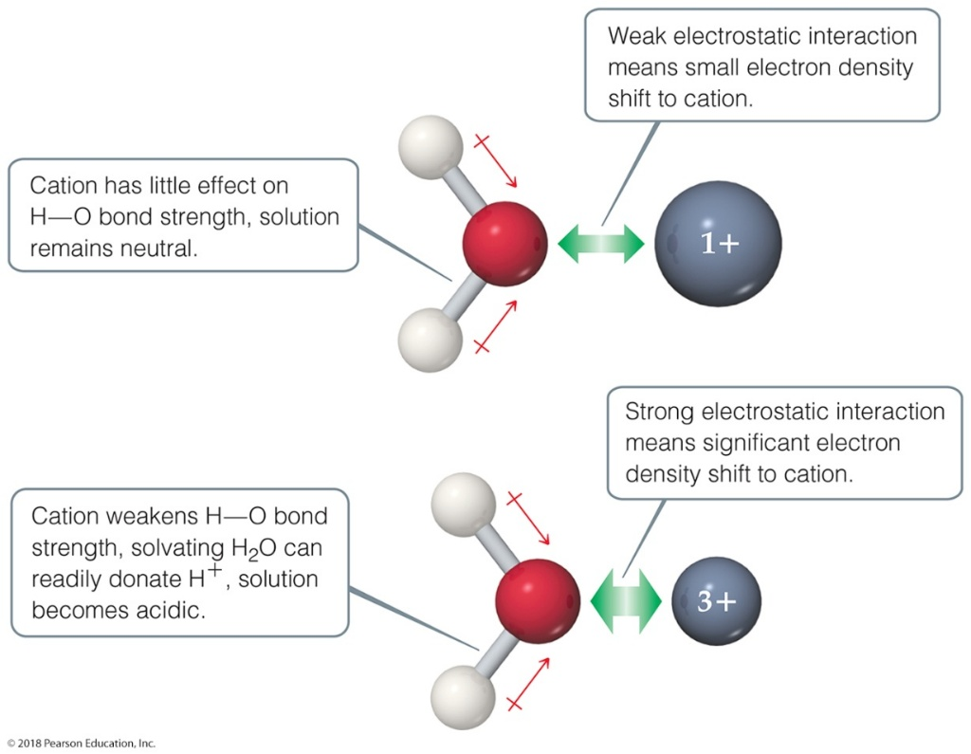
Lewis Acid–Base Chemistry and Hydrated Metal Cations
The hydrated metal cations are primary examples of electron pair donor/acceptor chemistry.
Higher charges result in stronger water to metal bonds, making them stronger acids.

Slide 57
Copyright

