Slide 1
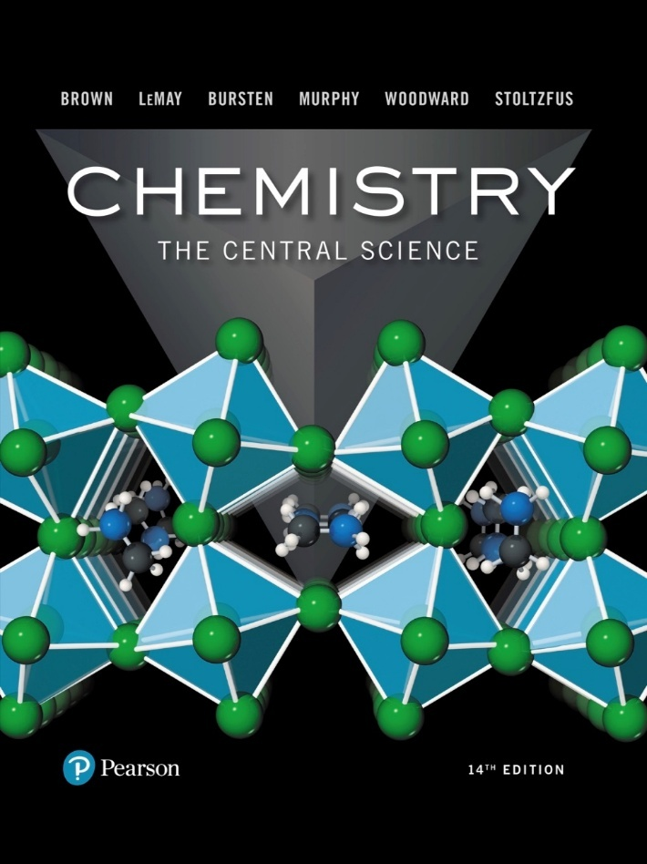
Chemistry: The Central Science
Fourteenth Edition
Chapter 17
Additional Aspects of Aqueous Equilibria
Copyright © 2018, 2015, 2012 Pearson Education, Inc. All Rights Reserved
Notes:
If this PowerPoint presentation contains mathematical equations, you may need to check that your computer has the following installed:
1) MathType Plugin
2) Math Player (free versions available)
3) NVDA Reader (free versions available)

Slide 2
Effect of Acetate on the Acetic Acid Equilibrium (1 of 2)
Acetic acid is a weak acid:
Sodium acetate is a strong electrolyte:

Slide 3
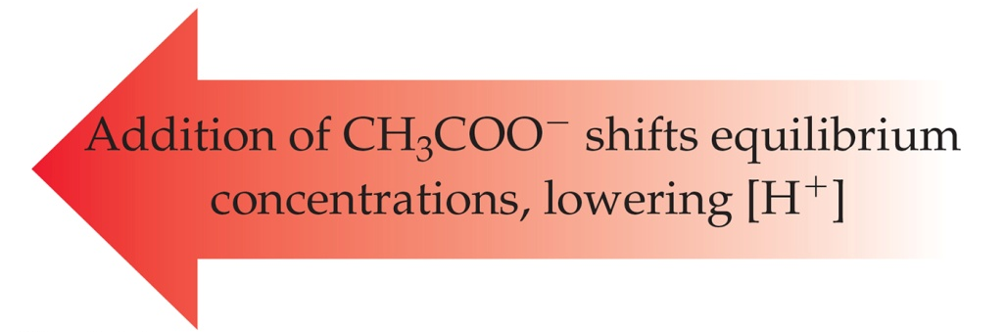
Effect of Acetate on the Acetic Acid Equilibrium (2 of 2)
The presence of acetate from sodium acetate in an acetic acid solution will shift the equilibrium, according to Le Châtelier’s principle:

Slide 4
The Common-Ion Effect
“Whenever a weak electrolyte and a strong electrolyte containing a common ion are together in solution, the weak electrolyte ionizes less than it would if it were alone in solution.”
This affects acid–base equilibria.
We will also see (later in the chapter) how it affects solubility.

Slide 5
An Acid–Base Example (1 of 2)
What is the pH of a solution made by adding 0.30 mol of acetic acid and 0.30 mol of sodium acetate to enough water to make 1.0 L of solution?

Slide 6
An Acid–Base Example (2 of 2)
Blank | C H 3 C O O H in molality | H, plus, in molality | C H 3 C O O, minus, in molality.
Initial Concentration (M) | 0.30 | 0 | 0.30
Change In Concentration (M) | −x | +x | +x
Equilibrium Concentration (M) | 0.30−x | x | 0.30+x

Slide 7
Example (completed)
Assume that adding or subtracting x from 0.30 will not change 0.30 enough to matter and the equation becomes
which results in:
So:

Slide 8
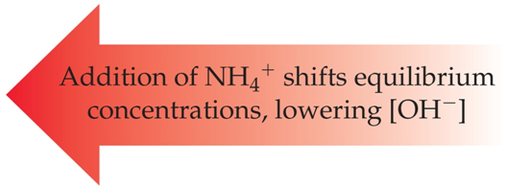
Weak Bases Work the Same Way
The common-ion effect applies to weak bases the same way.
If a solution contains a weak base and a salt of its conjugate acid, the base won’t dissociate as much as if it is alone in solution.

Slide 9
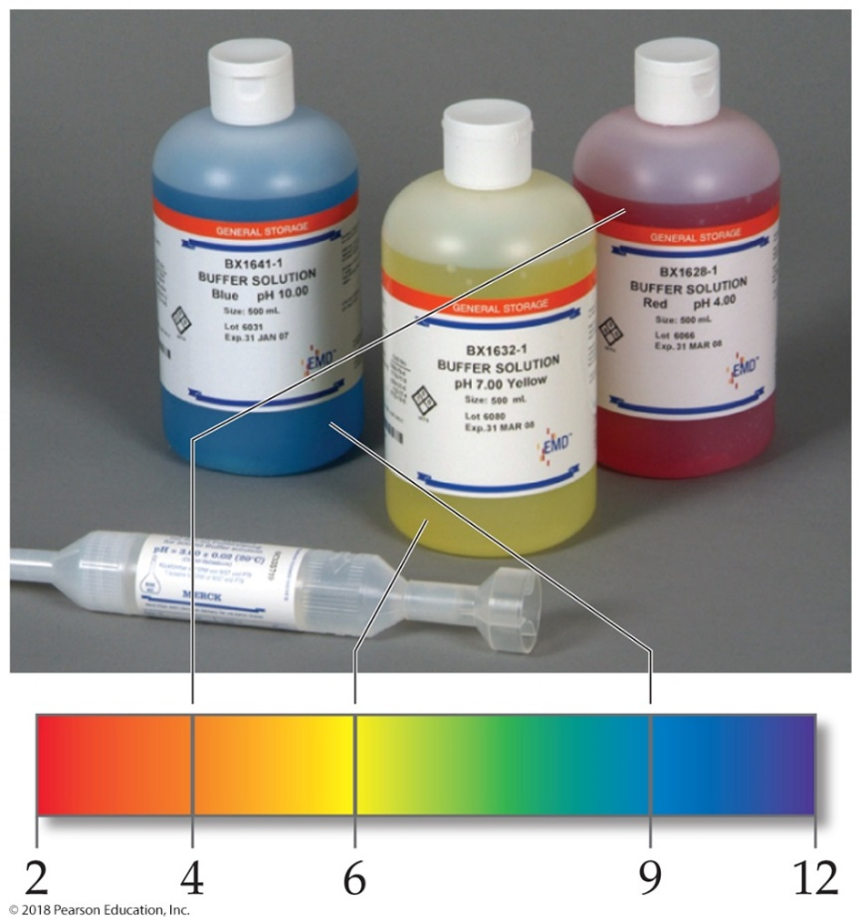
Buffers
Solutions of a weak conjugate acid–base pair that resist drastic changes in pH are called buffers.
These solutions contain relatively high concentrations
of both the acid and base. Their concentrations are approximately equal.

Slide 10
Ways to Make a Buffer
Mix a weak acid and a salt of its conjugate base or a weak base and a salt of its conjugate acid.
Add strong acid and partially neutralize a weak base or add strong base and partially neutralize a weak acid.

Slide 11
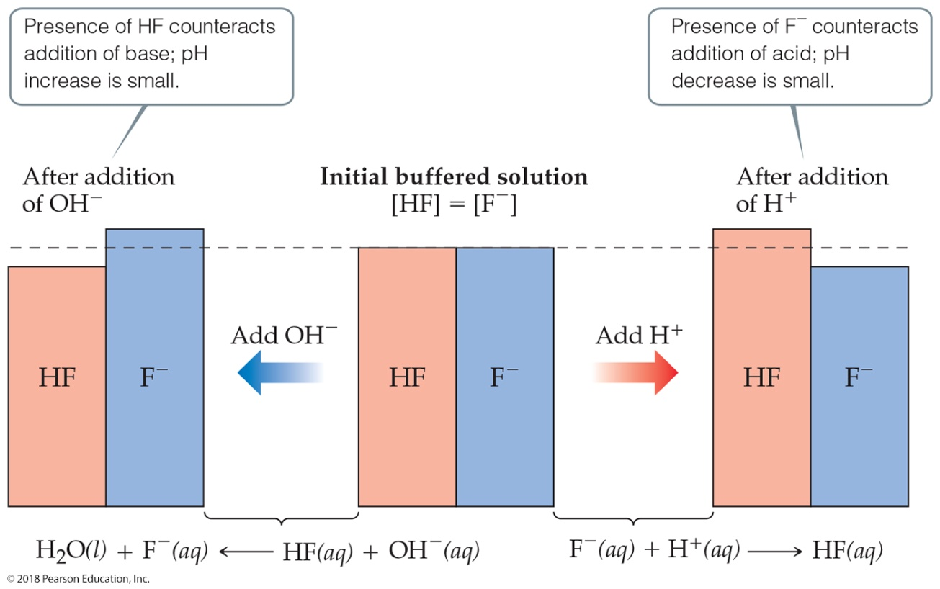
How a Buffer Works
Adding a small amount of acid or base only slightly neutralizes one component of the buffer, so the pH doesn’t change much.

Slide 12
Calculating the pH of a Buffer (1 of 2)
For a weak acid:
Take −log of both sides:
Rearrange:

Slide 13
Calculating the pH of a Buffer (2 of 2)
Which is:
This equation is known as the Henderson–Hasselbalch equation. This applies only to buffers.

Slide 14
Henderson–Hasselbalch Equation
What is the pH of a buffer that is 0.12 M in lactic acid,
and 0.10 M in sodium lactate?
for lactic acid is

Slide 15
Buffer Capacity
The amount of acid or base the buffer can neutralize before the p H begins to change to an appreciable degree.
Using the Henderson–Hasselbalch equation, p H will be the same for a conjugate acid–base pair of 1 M each or 0.1 M each; however, the buffer that is 1 M can neutralize more acid or base before the p H changes.

Slide 16
pH Range
The range of p H values over which a buffer system works effectively
Optimal p H: where
If one concentration is more than 10 times the other, the buffering action is poor; this means that the p H
range of a buffer is usually ±1 pH unit from

Slide 17
Addition of a Strong Acid or a Strong Base to a Buffer (1 of 2)
Addition of the strong acid or base is a neutralization reaction; calculate like stoichiometry problem to find
when all of the added acid or base
reacts.
Use the Henderson–Hasselbalch equation to find p H.

Slide 18
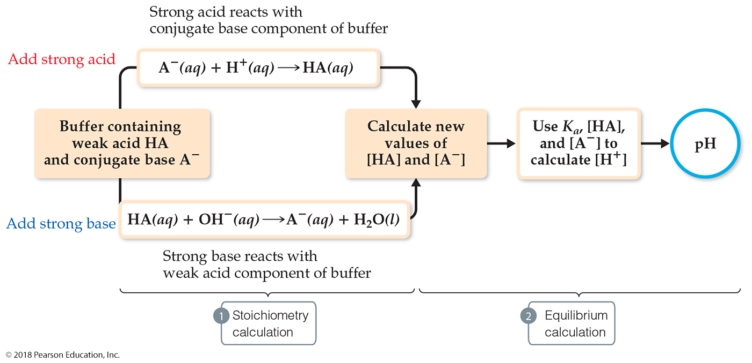
Addition of a Strong Acid or a Strong Base to a Buffer (2 of 2)

Slide 19
Example (1 of 4)
A buffer is made by adding
to enough water to make 1.00 L
of solution. Calculate the pH after 0.020 mol of N a O H is added.

Slide 20
Example (2 of 4)
Blank | C H 3 C O O H | O H, minus | C H 3 C O O, minus
Before reaction (mol) | 0.300 | 0.020 | 0.300
Change (mol) | −0.020 | −0.020 (LR) | +0.020
After reaction (mol) | 0.280 | 0 | 0.320

Slide 21
Example (3 of 4)
Use the Henderson–Hasselbalch equation:
Since this is a buffer, the volume for each concentration is the same, so the ratio of molarity can be calculated using a ratio of moles.

Slide 22
Example (4 of 4)

Slide 23
Effect of Base on a Buffer vs. Water
What is the p H if 5.00 mL of 4.0 M N a O H is added to: a) 1.000 L of water; b) 1.000 L of a buffer that is 0.300

Slide 24
Example Solved (1 of 2)

Slide 25
Example Solved (2 of 2)
Same moles of
added to 0.300 mol of
will give us 0.298 mol of
it will increase the moles of
(from the original buffer pH of 4.74)

Slide 26
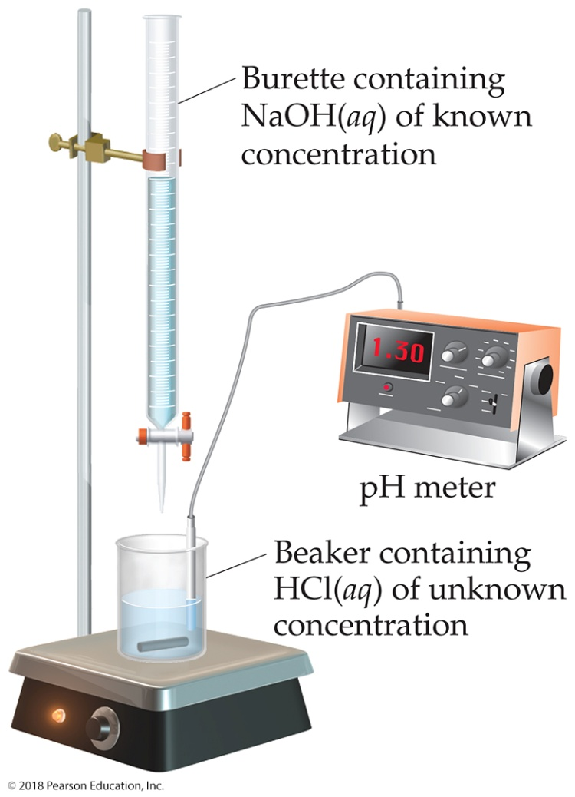
Titration (1 of 2)
In this technique, an acid (or base) solution of known concentration is slowly added to a base (or acid) solution of unknown concentration.

Slide 27
Titration (2 of 2)
A p H meter or indicators are used to determine when the solution has reached the equivalence point: The amount of acid equals that of base.

Slide 28
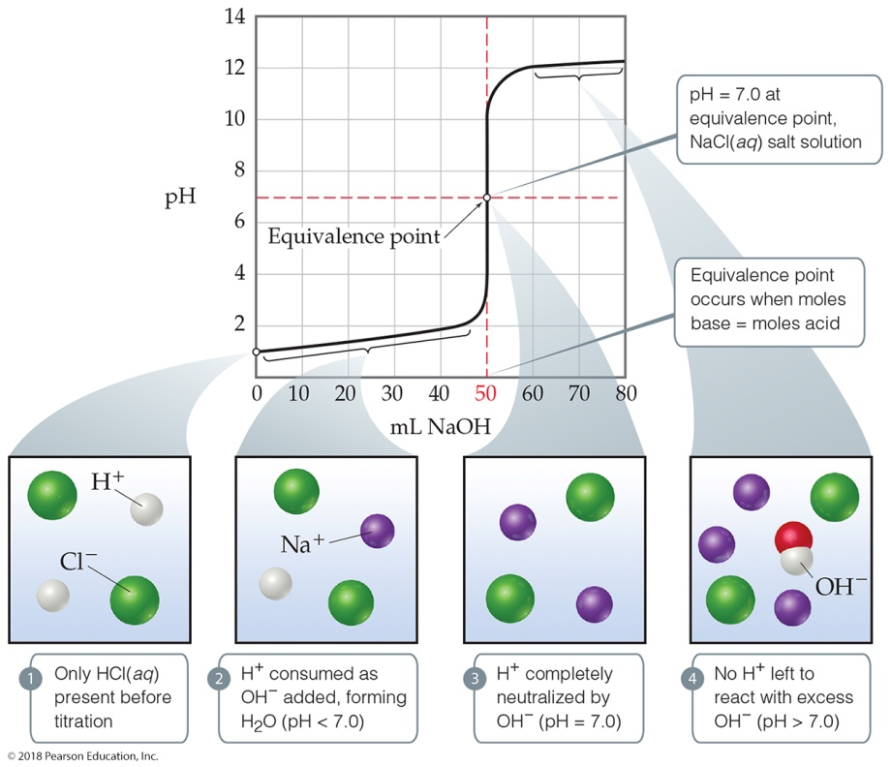
Titration of a Strong Acid with a Strong Base (1 of 3)
From the start of the titration to near the equivalence point, the pH goes up slowly.
Just before (and after) the equivalence point, the pH rises rapidly.

Slide 29
Titration of a Strong Acid with a Strong Base (2 of 3)
At the equivalence point, p H = 7.
As more base is added, the p H again levels off.

Slide 30
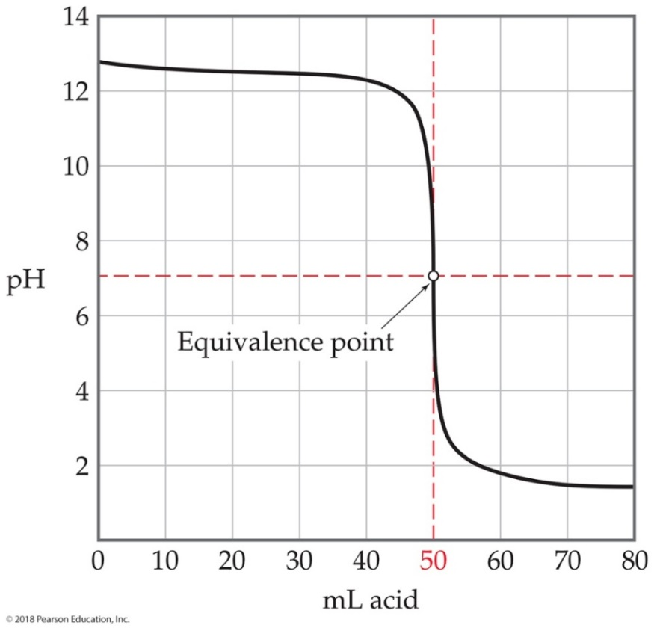
Titration of a Strong Acid with a Strong Base (3 of 3)
It looks like you “flipped over” the strong acid being titrated by a strong base.
Start with a high p H (basic solution); the p3H = 7 at the equivalence point; low p H to end.

Slide 31
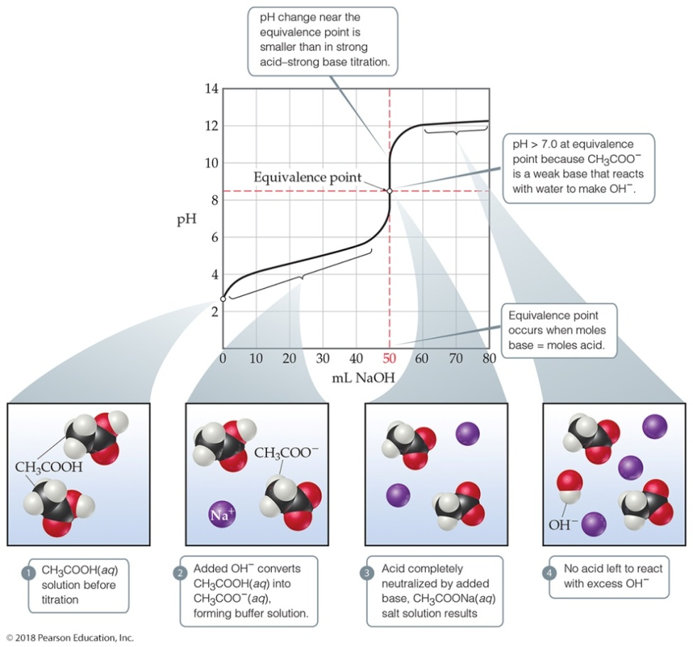
Titration of a Weak Acid with a Strong Base (1 of 2)
Use
to find initial p H.
Find the p H in the “buffer region” using stoichiometry followed by the Henderson–Hasselbalch equation.
At the equivalence point the p H is >7. Use the conjugate base of the weak acid to determine the p H.

Slide 32
Titration of a Weak Acid with a Strong Base (2 of 2)
As more base is added, the p H levels off. This is exactly the same as for strong acids.

Slide 33
Calculating pH When SOME Weak Acid Is Neutralized
Calculate Moles of weak acid.
Calculate Moles of base added; this is the moles of anion formed; subtract it from mole acid to see how much acid is left.
Use Henderson-Hasselbalch equation to find pH.

Slide 34
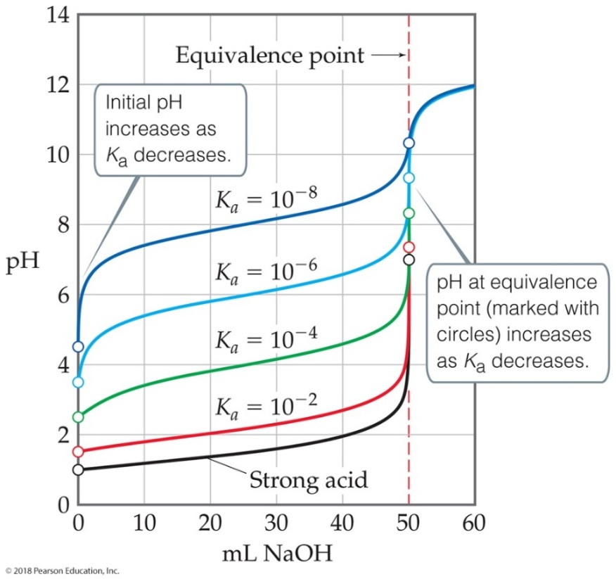
Ways That a Weak Acid Titration Differs from a Strong Acid Titration
A solution of weak acid has a higher initial p H than a strong acid.
The p H change near the equivalence point is smaller for a weak acid. (This is at least partly due to the buffer region.)
The p H at the equivalence point is greater than 7 for a weak acid.

Slide 35
Use of Indicators (1 of 2)
Indicators are weak acids that have a different color than their conjugate base form.
Each indicator has its own p H range over which it changes color.
An indicator can be used to find the equivalence point in a titration as long as it changes color in the small volume change region where the p H rapidly changes.

Slide 36
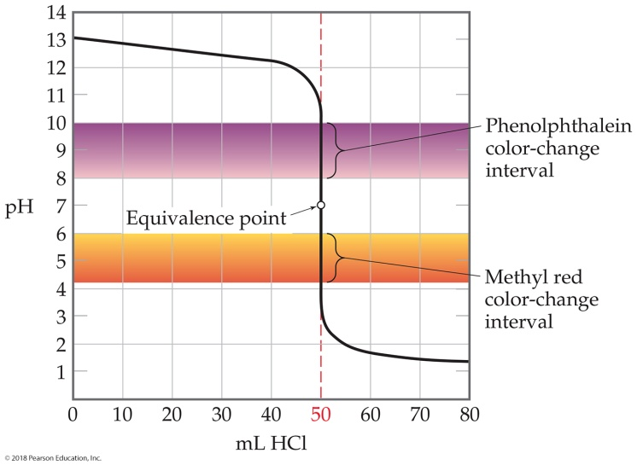
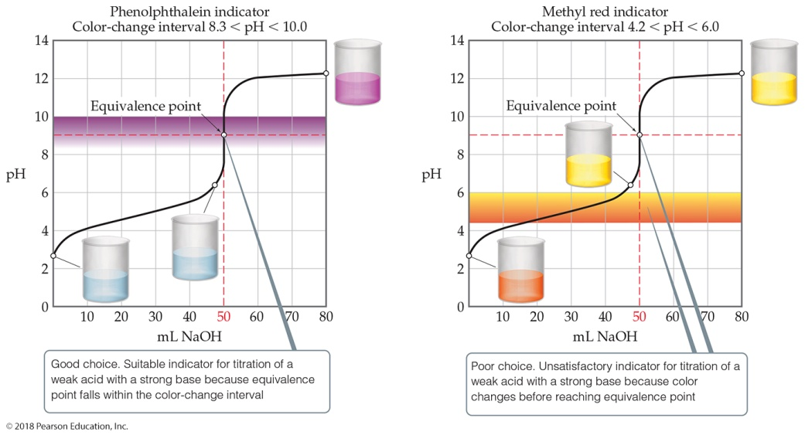
Use of Indicators (2 of 2)

Slide 37
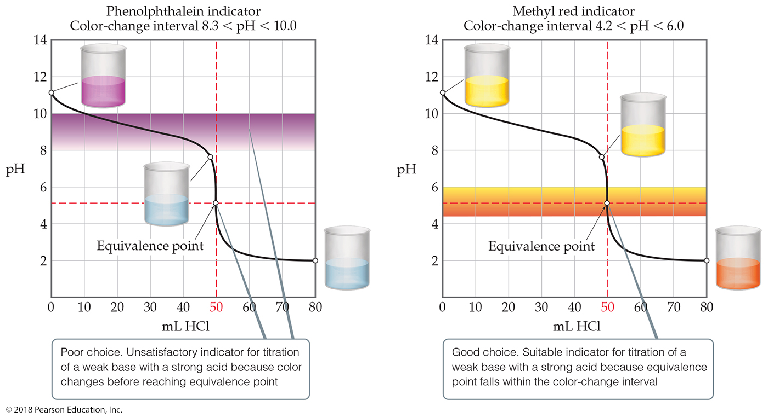
Indicator Choice Can Be Critical!

Slide 38
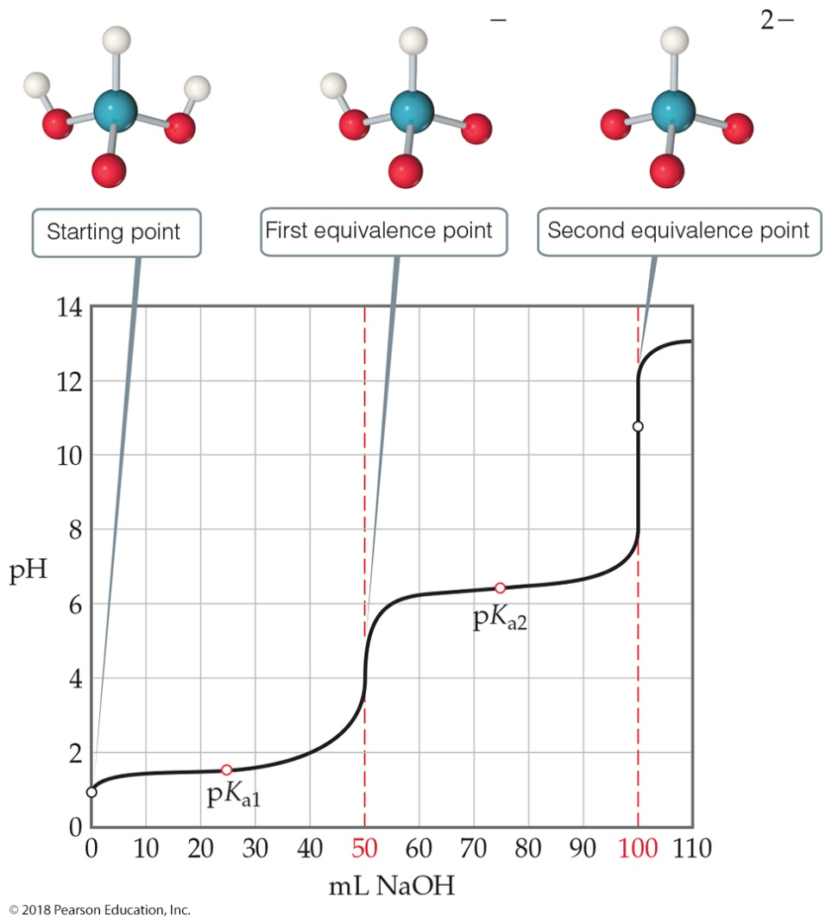
Titrations of Polyprotic Acids
When a polyprotic acid is titrated with a base, there is an equivalence point for each dissociation.
Using the Henderson–Hasselbalch equation, we can see that half way to each equivalence point
gives us the
for that
step.

Slide 39
Solubility Equilibria
Because ionic compounds are strong electrolytes, they dissociate completely to the extent that they dissolve.
When an equilibrium equation is written, the solid is the reactant and the ions in solution are the products.
The equilibrium constant expression is called the
solubility-product constant. It is represented as

Slide 40
Solubility Product
For example:
The equilibrium constant expression is
Another example:
The equilibrium constant expression is

Slide 41
Solubility vs. Solubility Product (1 of 2)
is not the same as solubility.
Solubility is the quantity of a substance that dissolves to form a saturated solution.
Common units for solubility:
Grams per liter (g/L)
Moles per liter (mol/L)

Slide 42
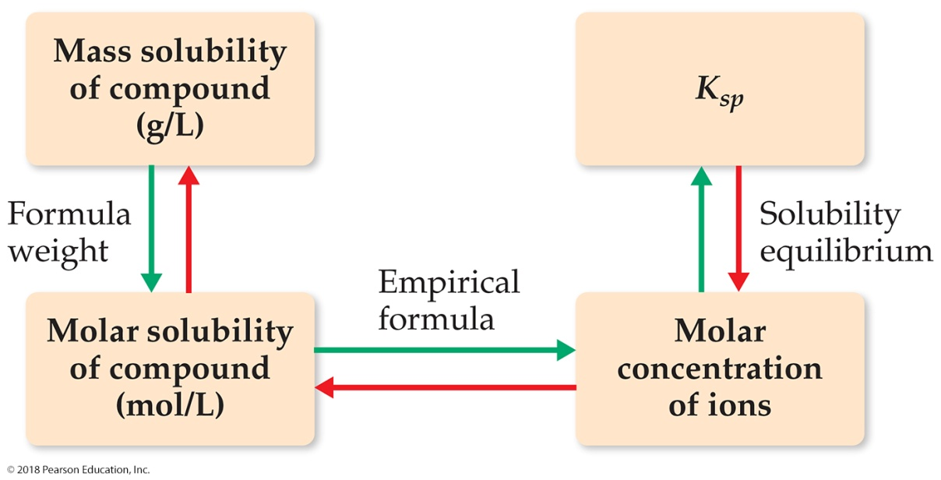
Solubility vs. Solubility Product (2 of 2)

Slide 43
Calculating Solubility from K_{sp} (1 of 2)
The
What is its
molar solubility?
Follow the same format as before:

Slide 44
Calculating Solubility from K_{sp} (2 of 2)
Blank | C ay F 2, solid, | C ay, 2 plus, in molality | F, minus, in molality
Initial concentration (M) | --- | 0 | 0
Change in concentration (M) | --- | +x | +2x
Equilibrium concentration (M) | --- | x | 2x

Slide 45
Example 1 (completed)
Solve: Substitute the equilibrium concentration values from the table into the solubility-product equation:
(If you want the answer in g/L, multiply by molar mass; this would give 0.016 g/L.)

Slide 46
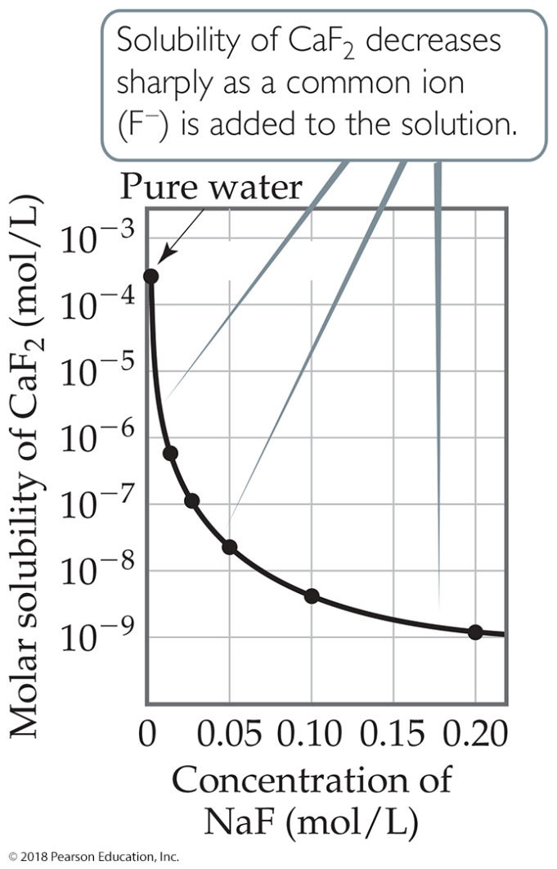
Factors Affecting Solubility
The common-ion effect
If one of the ions in a solution equilibrium is already dissolved in the solution, the solubility of the salt will decrease.
If either calcium ions or fluoride ions are present, then calcium fluoride will be less soluble.

Slide 47
Calculating Solubility with a Common Ion (1 of 2)
What is the molar solubility
in
Follow the same format as before:

Slide 48
Calculating Solubility with a Common Ion (2 of 2)
Blank | C ay F 2, solid | C ay, 2 plus, in molality | F, minus, in molality
Initial concentration (M) | --- | 0.010 | 0
Change in concentration (M) | --- | +x | +2x
Equilibrium concentration (M) | --- | 0.010+ x | 2x

Slide 49
Example 2 (completed)
Solve: Substitute the equilibrium concentration values from the table into the solubility-product equation:
(We assume that x << 0.010, so that 0.010 + x = 0.010!)

Slide 50
p H Affects Solubility (1 of 2)
If a substance has a basic anion, it will be more soluble in an acidic solution.
Remember that buffers control p H. When a buffer is used, there is no change in concentration of hydroxide ion!

Slide 51
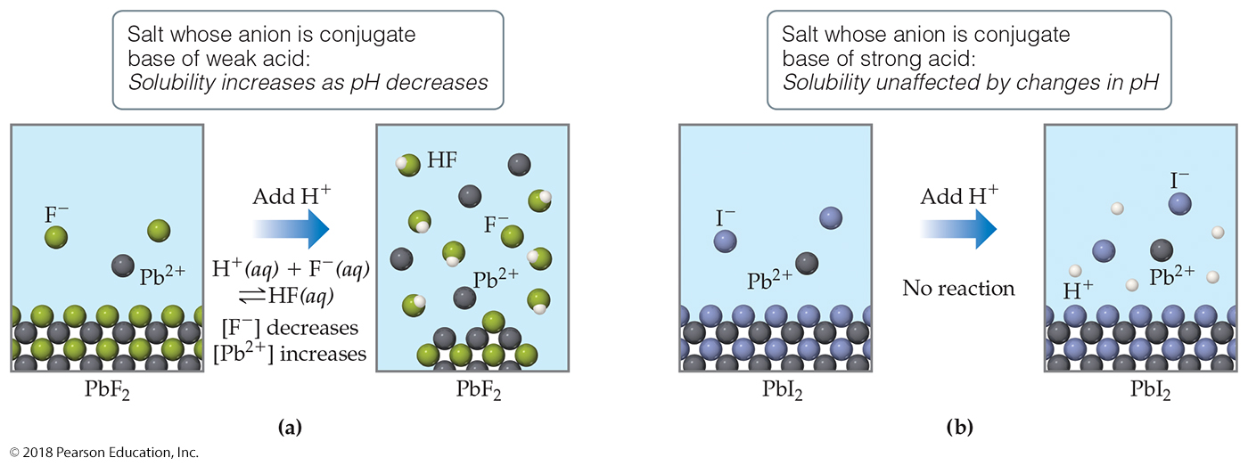
p H Affects Solubility (2 of 2)

Slide 52
Complex Ion Formation (1 of 3)
Metal ions can act as Lewis acids and form complex ions with Lewis bases in the solvent.
The formation of these complex ions increases the solubility of these salts.

Slide 53
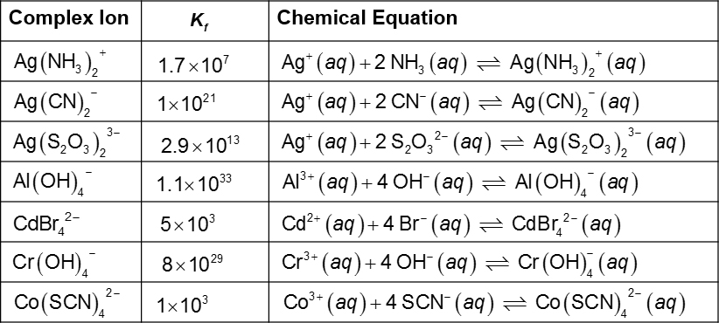
Complex Ion Formation (2 of 3)
Table 17.1 Formation Constants for Some Metal Complex Ions in Water at 25 degree Celsius

Slide 54
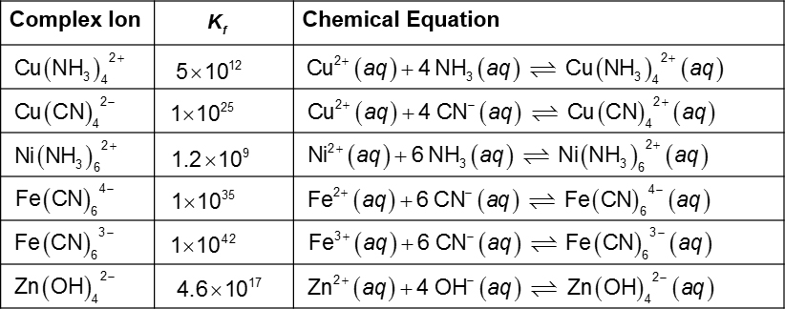
Complex Ion Formation (3 of 3)
[Table 17.1 continued]

Slide 55
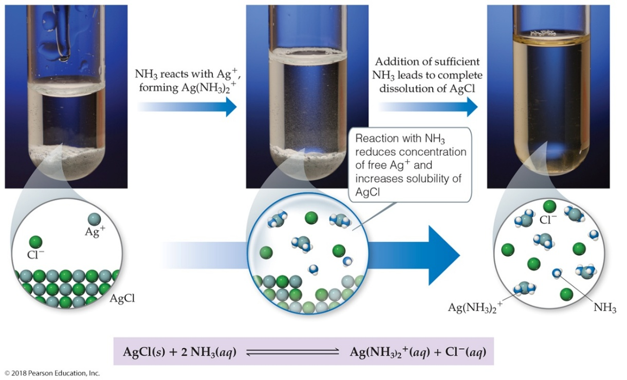
How Complex Ion Formation Affects Solubility
Silver chloride is insoluble. It has a
In the presence of
the solubility greatly increases
because
will form complex ions with

Slide 56
Amphoterism and Solubility (1 of 2)
Amphoteric oxides and hydroxides are soluble in strong acids or base, because they can act either as acids or bases.
Examples are oxides and hydroxides of

Slide 57
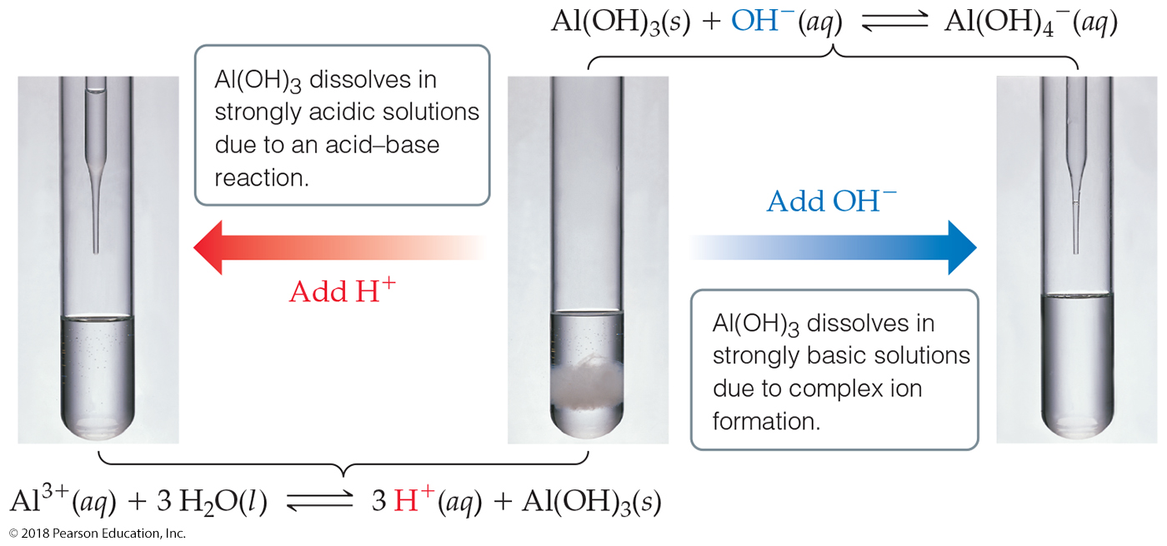
Amphoterism and Solubility (2 of 2)

Slide 58
Will a Precipitate Form?
To decide, we calculate the reaction quotient, Q, and
compare it to the solubility product constant,
If
the system is at equilibrium and the
solution is saturated.
If
more solid can dissolve, so no
precipitate forms.
If
a precipitate will form.

Slide 59
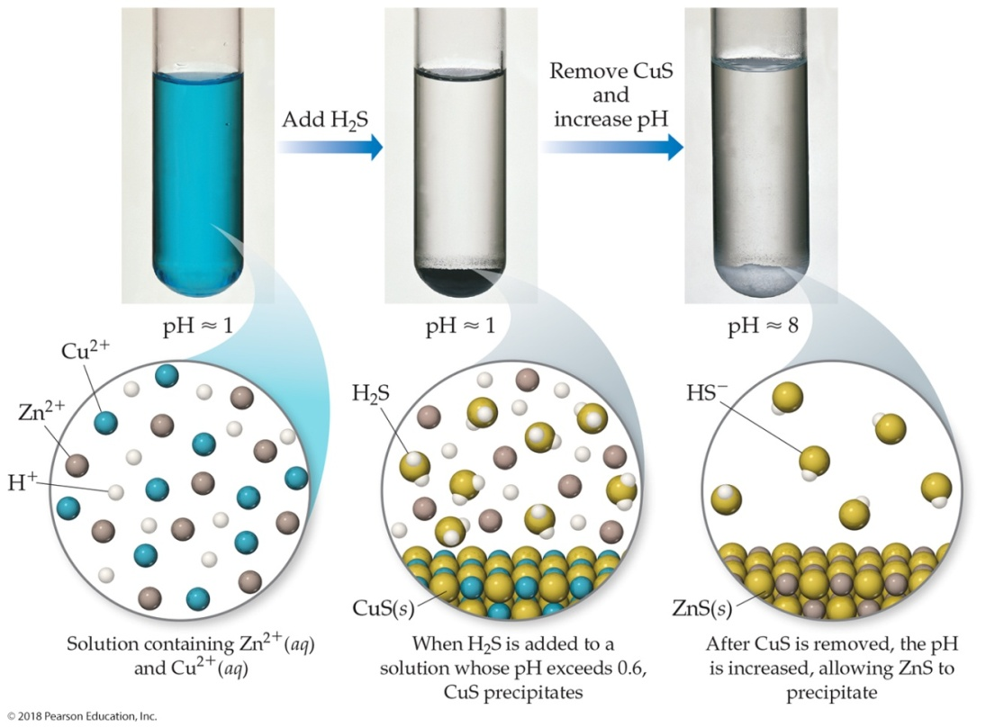
Selective Precipitation of Ions
Ions can be separated from solution based on their
solubilities in the presence of different ions

Slide 60
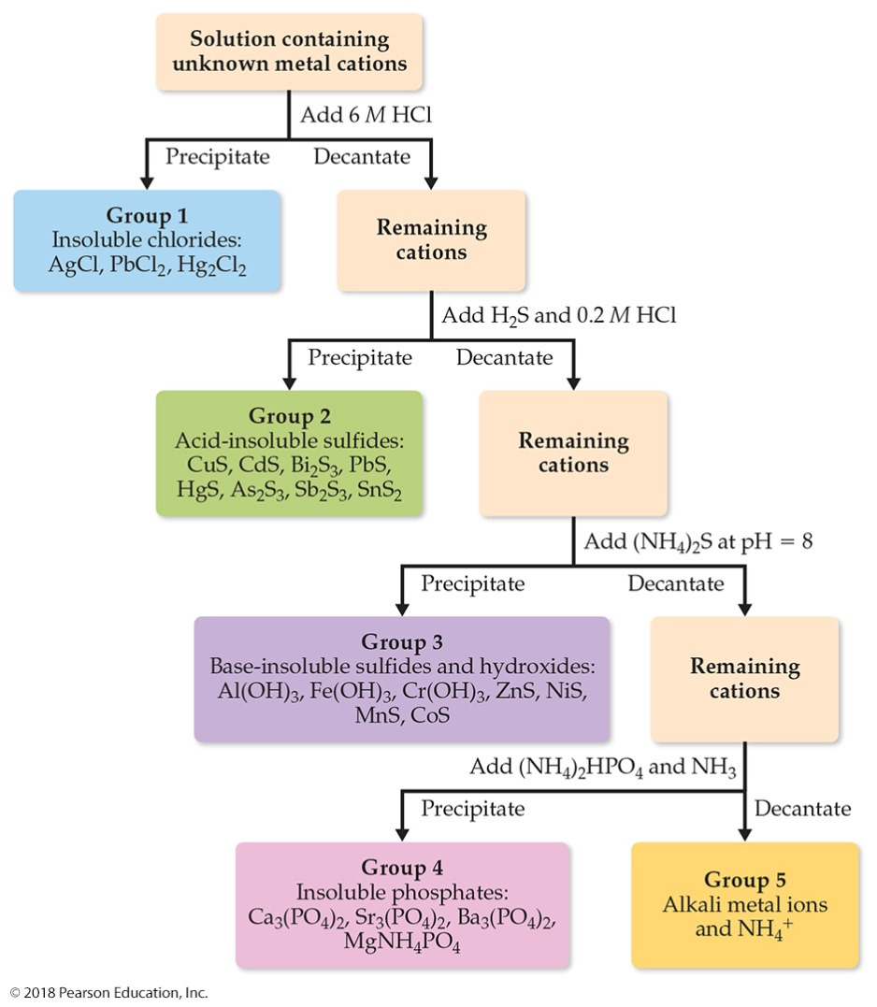
Qualitative Analysis of Ions
One can use differences in solubilities of salts to separate ions in a mixture. This has been used for qualitative analysis of the presence of ions in a solution.

Slide 61
Copyright

