Slide 1
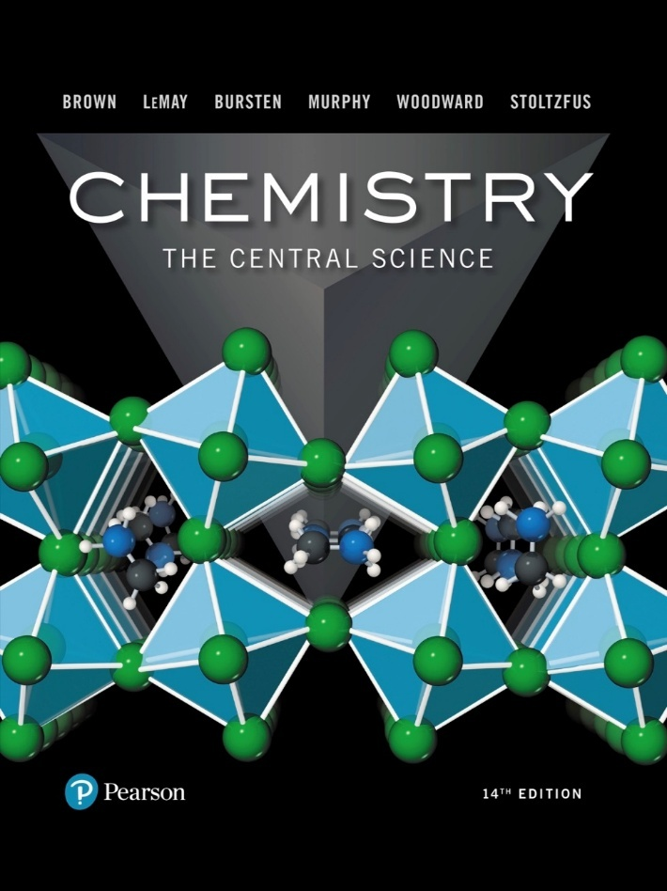
Chemistry: The Central Science
Fourteenth Edition
Chapter 20
Electrochemistry
Copyright © 2018, 2015, 2012 Pearson Education, Inc. All Rights Reserved
Notes:
If this PowerPoint presentation contains mathematical equations, you may need to check that your computer has the following installed:
1) MathType Plugin
2) Math Player (free versions available)
3) NVDA Reader (free versions available)

Slide 2
Electrochemistry
Electrochemistry is the study of the relationships between electricity and chemical reactions. It includes the study of both spontaneous and nonspontaneous processes.

Slide 3
Synopsis of Assigning Oxidation Numbers (As a Reminder)
Elements = 0
Monatomic ion = charge
F: −1
O: −2 (unless peroxide = −1)
H: +1 (unless a metal hydride = −1)
The sum of the oxidation numbers equals the overall charge (0 in a compound).

Slide 4
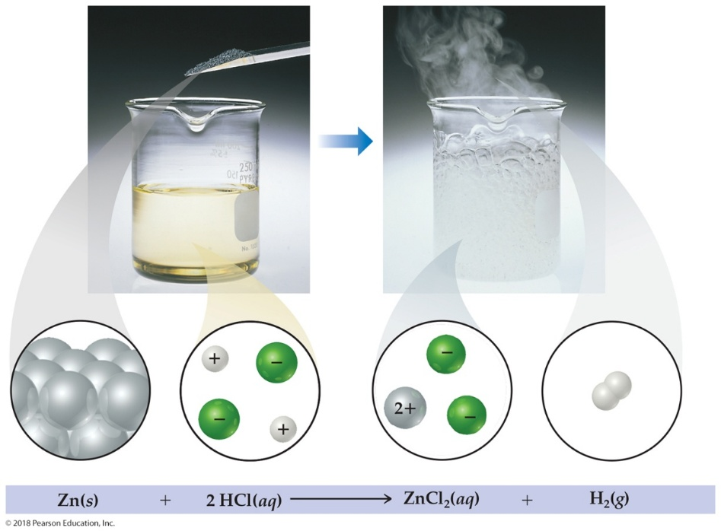
Oxidation Numbers
To keep track of what loses electrons and what gains them, we assign oxidation numbers.
If the oxidation number increases for an element, that element is oxidized.
If the oxidation number decreases for an element, that element is reduced.

Slide 5
Oxidation and Reduction (1 of 2)
A species is oxidized when it loses electrons.
Zinc loses two electrons, forming the
A species is reduced when it gains electrons.
H⁺ gains an electron, forming
An oxidizing agent (H⁺) causes something else to be oxidized; a reducing agent (Z n) causes something else to be reduced.

Slide 6
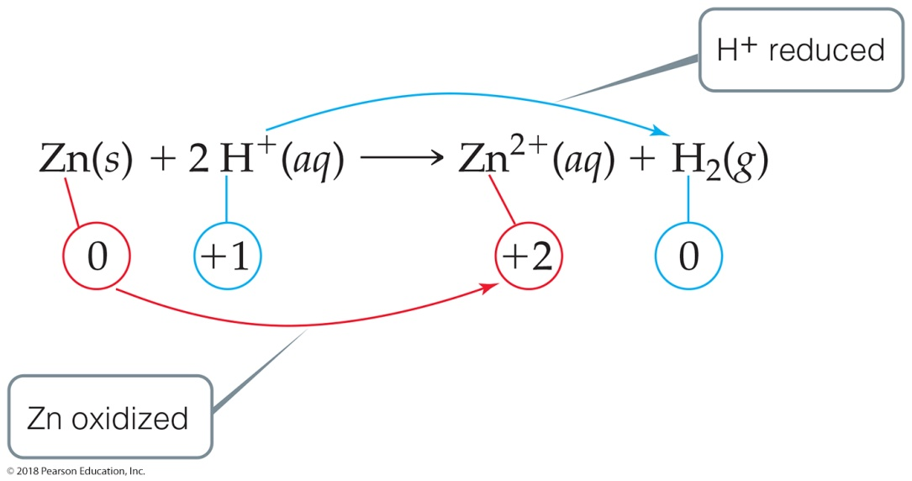
Oxidation and Reduction (2 of 2)

Slide 7
Half-Reactions
The oxidation and reduction are written and balanced separately.
We will use them to balance a redox reaction.
For example, when
react,

Slide 8
Balancing Redox Equations: The Half-Reactions Method (a Synopsis) (1 of 2)
Make two half-reactions (oxidation and reduction).
Balance atoms other than O and H. Then, balance O
and H using
Add electrons to balance charges.
Multiply by common factor to make electrons in half-reactions equal.
Add the half-reactions.

Slide 9
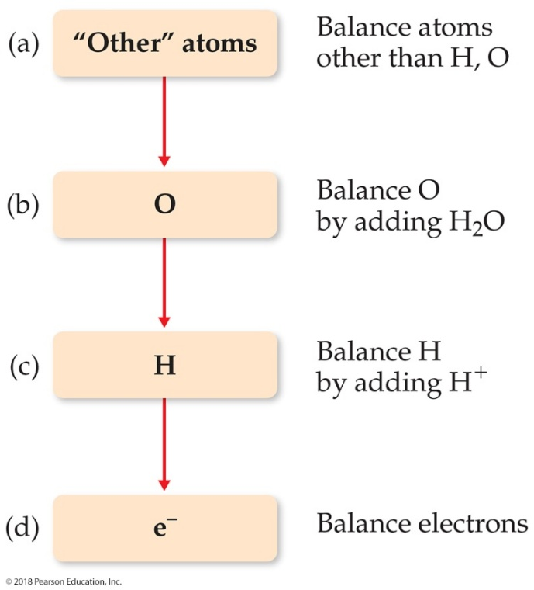
Balancing Redox Equations: The Half-Reactions Method (a Synopsis) (2 of 2)
Simplify by dividing by common factor or converting
Double-check atoms and charges balance!

Slide 10
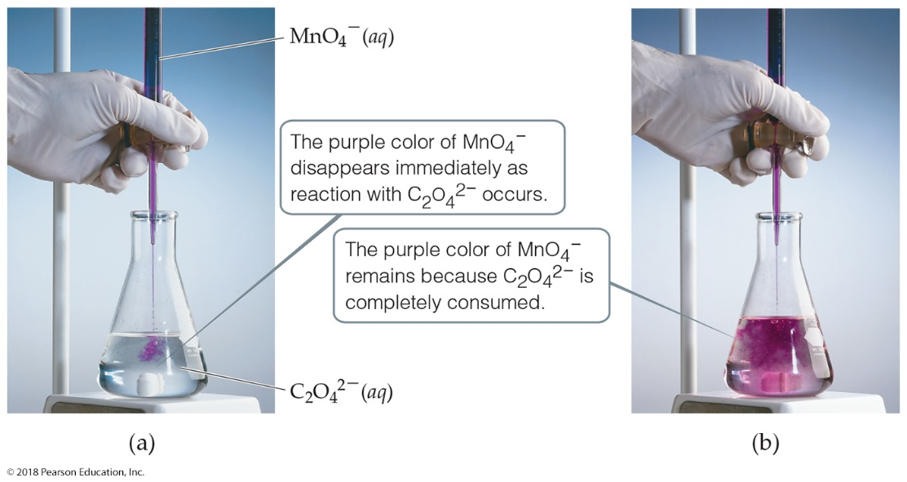
The Half-Reaction Method
Consider the reaction between
Assigning oxidation numbers shows that Mn is reduced (+7 → +2) and C is oxidized (+3 → +4).

Slide 11
Oxidation Half-Reaction (1 of 2)
To balance the carbon, we add a coefficient of 2:

Slide 12
Oxidation Half-Reaction (2 of 2)
The oxygen is now balanced as well. To balance the charge, we must add two electrons to the right side:

Slide 13
Reduction Half-Reaction (1 of 3)
The manganese is balanced; to balance the oxygen, we must add four waters to the right side:

Slide 14
Reduction Half-Reaction (2 of 3)
To balance the hydrogen, we add 8H⁺ to the left side:

Slide 15
Reduction Half-Reaction (3 of 3)
To balance the charge, we add 5e– to the left side:

Slide 16
Combining the Half-Reactions (1 of 3)
Now we combine the two half-reactions together:
To make the number of electrons equal on each side, we will multiply the first reaction by 5 and the second by 2 to give the least common multiple:

Slide 17
Combining the Half-Reactions (2 of 3)
When we add these together, we get

Slide 18
Combining the Half-Reactions (3 of 3)
The only thing that appears on both sides is the electrons. Subtracting them, we are left with
(Verify that the equation is balanced by counting atoms and charges on each side of the equation.)

Slide 19
Balancing in Basic Solution
A reaction that occurs in basic solution can be balanced as if it occurred in acid.
Once the equation is balanced, add
to each side to “neutralize” the
in the equation and create water in its place.
If this produces water on both sides, subtract water from each side so it appears on only one side of the equation.

Slide 20
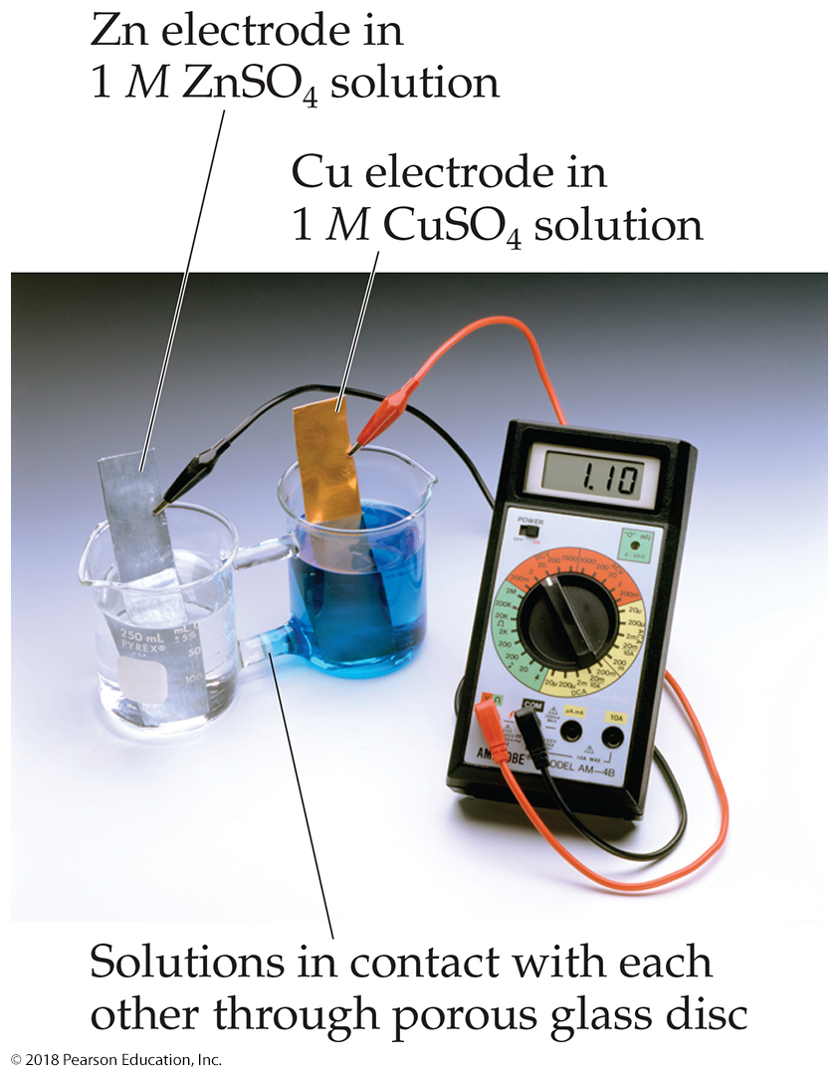
Voltaic Cells (1 of 3)
In spontaneous redox reactions, electrons are transferred and energy is released.
That energy can do work if the electrons flow through an external device.
This is a voltaic cell.

Slide 21
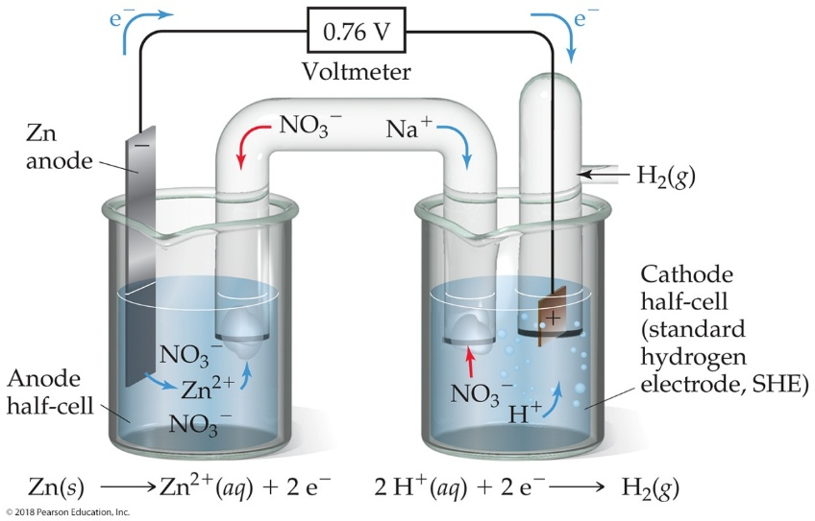
Voltaic Cells (2 of 3)
The oxidation occurs at the anode.
The reduction occurs at the cathode.
When electrons flow, charges aren’t balanced. So, a salt bridge, usually a U-shaped tube that contains a salt/agar solution, is used to keep the charges balanced.

Slide 22
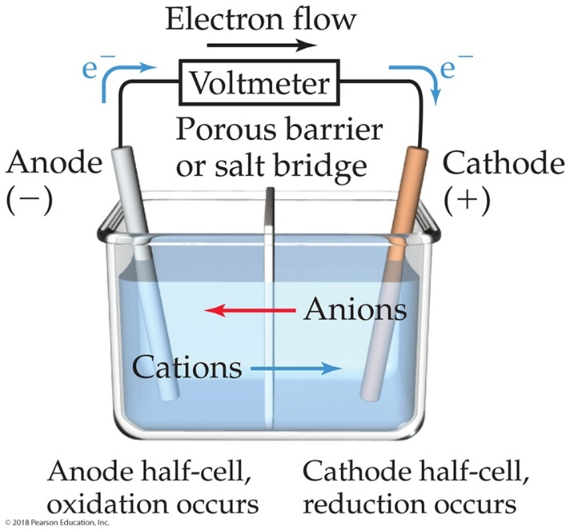
Voltaic Cells (3 of 3)
In the cell, electrons leave the anode and flow through the wire to the cathode.
Cations are formed in the anode compartment.
As the electrons reach the cathode, cations in solution are attracted to the now negative cathode.
The cations gain electrons and are deposited as metal on the cathode.

Slide 23
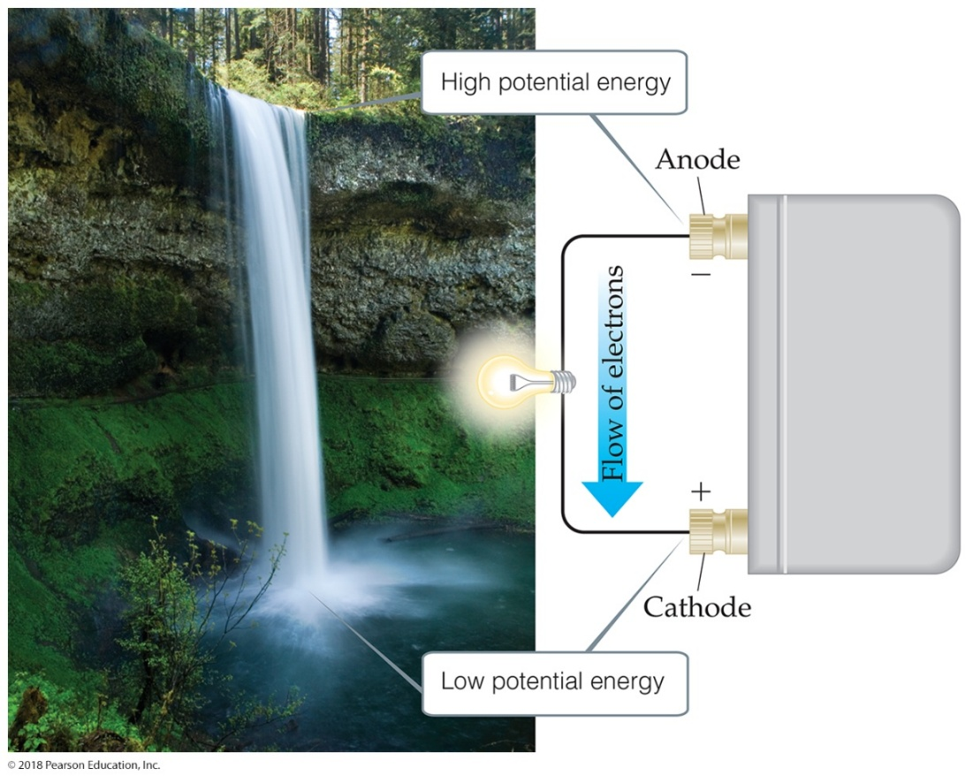
Electromotive Force (emf) (1 of 2)
Water flows spontaneously one way in a waterfall.
Comparably, electrons flow spontaneously one way in a redox reaction, from high to low potential energy.

Slide 24
Electromotive Force (emf) (2 of 2)
The potential difference between the anode and cathode in a cell is called the electromotive force (emf).
It is also called the cell potential and is designated
It is measured in volts (V). One volt is one joule per coulomb (1 V = 1 J/C).

Slide 25
Standard Reduction Potentials (1 of 4)
Reduction potentials for many electrodes have been measured and tabulated.
The values are compared to the reduction of hydrogen as a standard.
Standard condition are 1 M, 1 atm, 25 degree Celsius.

Slide 26
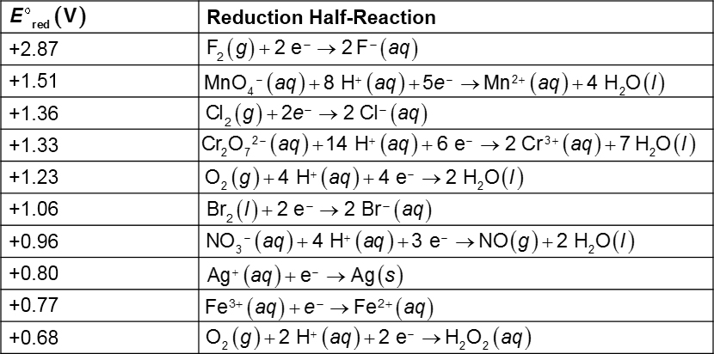
Standard Reduction Potentials (2 of 4)
Table 20.1 Standard Reduction Potentials in Water at 25 degree Celsius

Slide 27
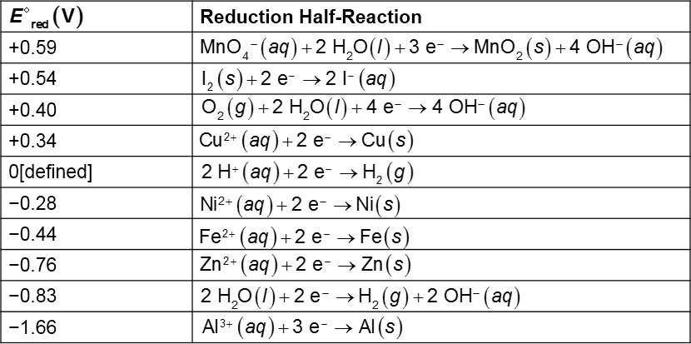
Standard Reduction Potentials (3 of 4)
[Table 20.1 continued]

Slide 28
Standard Reduction Potentials (4 of 4)
[Table 20.1 continued]

Slide 29
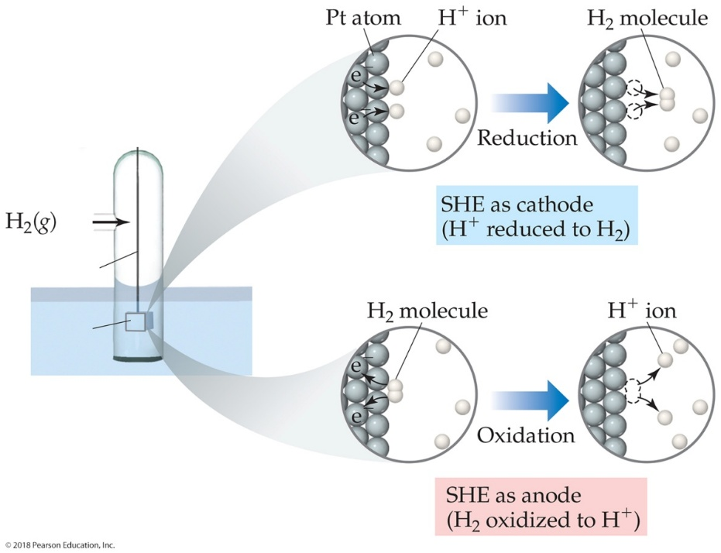
Standard Hydrogen Electrode
Their reference is called the standard hydrogen electrode (SHE).
By definition as the standard, the reduction potential for hydrogen is 0 V:

Slide 30
Standard Cell Potentials
The cell potential at standard conditions can be found through this equation:
Because cell potential is based on the potential energy per unit of charge, it is an intensive property.

Slide 31
Cell Potentials (1 of 2)
For the anode in this cell,
For the cathode,
So, for the cell,

Slide 32
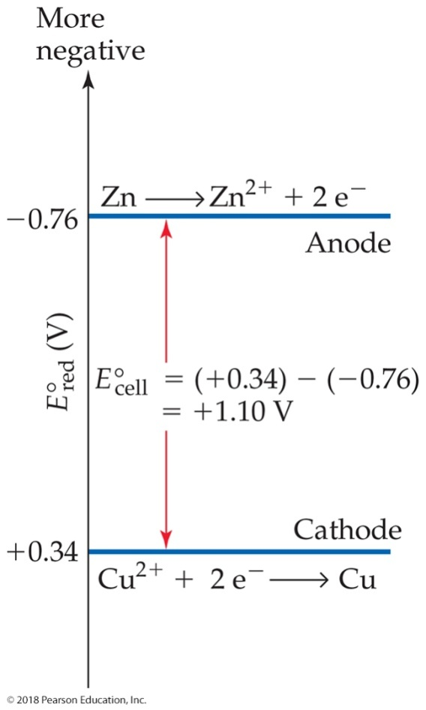
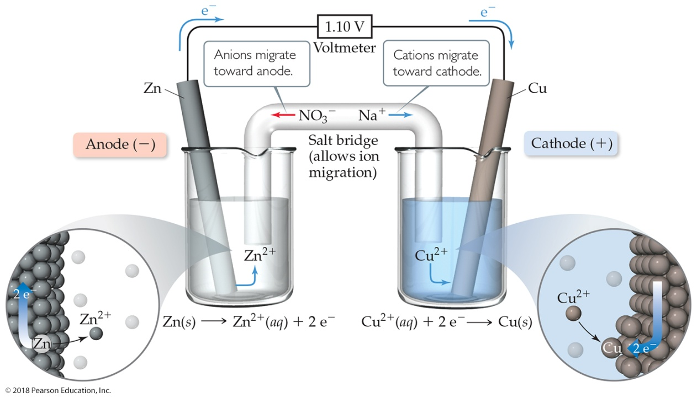
Cell Potentials (2 of 2)

Slide 33
Oxidizing and Reducing Agents (1 of 2)
The more positive the value of
the greater the
tendency for reduction under standard conditions.
The strongest oxidizers have the most positive reduction potentials.
The strongest reducers have the most negative reduction potentials.

Slide 34
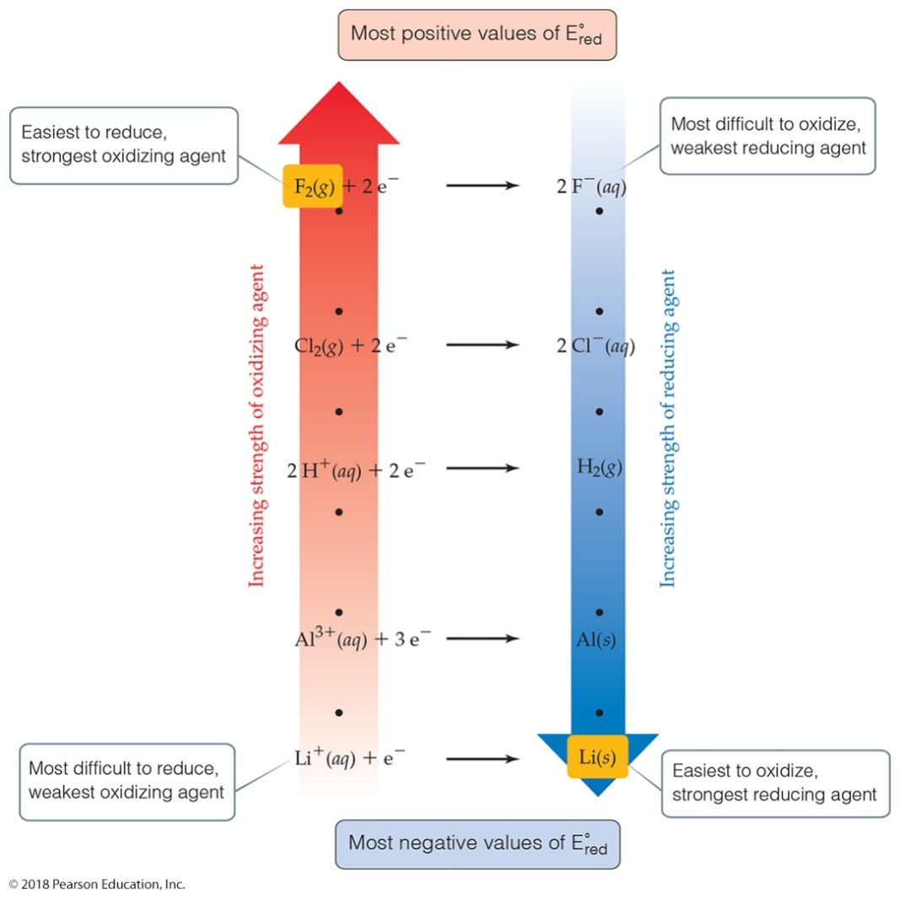
Oxidizing and Reducing Agents (2 of 2)

Slide 35
Free Energy and Redox
Spontaneous redox reactions produce a positive cell potential, or emf.
Note that this is true for ALL redox reactions, not only for voltaic cells.
Since Gibbs free energy is the measure of spontaneity, positive emf corresponds to negative ΔG.
How do they relate? ΔG = −nFE (F is the Faraday constant, 96,485 C/m o l.)

Slide 36
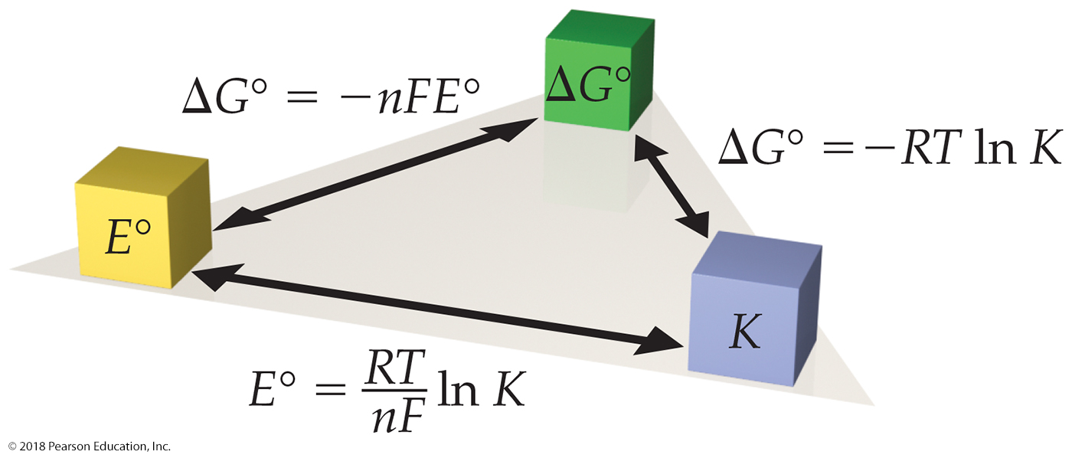
Free Energy, Redox, and K
How is everything related?

Slide 37
Nonstandard Conditions
Remember, ΔG = ΔG° + RT ln Q
So, −nFE = nFE° + RT ln Q
Dividing both sides by −nF, we get the Nernst equation:
OR E = E° − (2.303 RT/nF) log Q
Using standard thermodynamic temperature and the constants R and F, E = E° − (0.0592/n) log Q

Slide 38
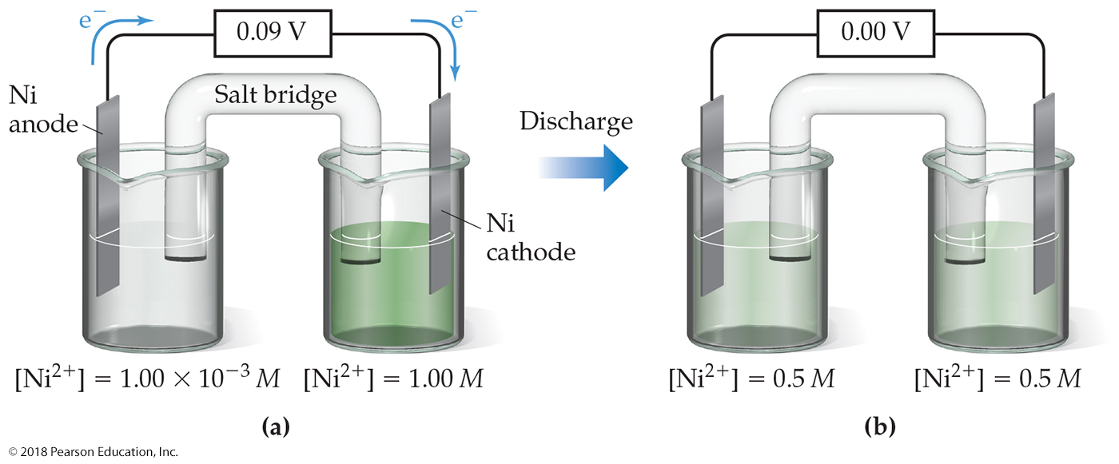
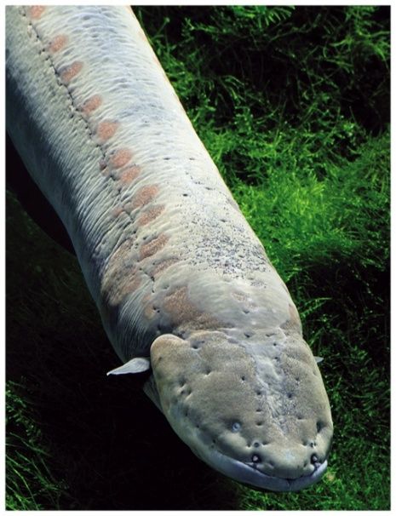
Concentration Cells (1 of 2)

Slide 39
Concentration Cells (2 of 2)
Notice that the Nernst equation implies that a cell could be created that has the same substance at both electrodes, called a concentration cell.
For such a cell,
would be 0, but Q would not.
Therefore, as long as the concentrations are different, E will not be 0.

Slide 40
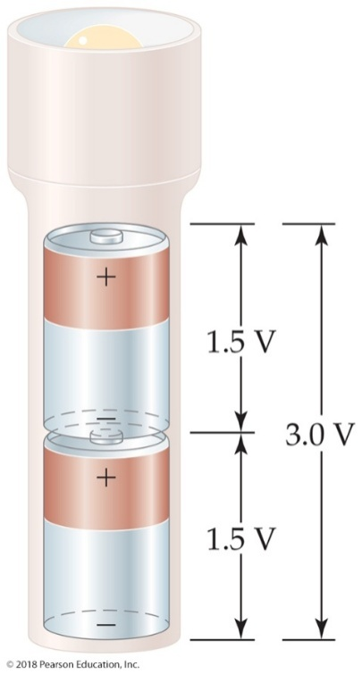
Some Applications of Cells
Electrochemistry can be applied as follows:
Batteries: a portable, self-contained electrochemical power source that consists of one or more voltaic cells.
Batteries can be primary cells (cannot be recharged when “dead”—the reaction is complete) or secondary cells (can be recharged).
Prevention of corrosion (“rust-proofing”)
Electrolysis

Slide 41
Some Examples of Batteries
Lead–acid battery: reactants and products are solids, so Q is 1 and the potential is independent of concentrations; however, made with lead and sulfuric acid (hazards).
Alkaline battery: most common primary battery.
N i–C d and N i–metal hydride batteries: lightweight, rechargeable; C d is toxic and heavy, so hydrides are replacing it.
Lithium-ion batteries: rechargeable, light; produce more voltage than N i-based batteries.

Slide 42
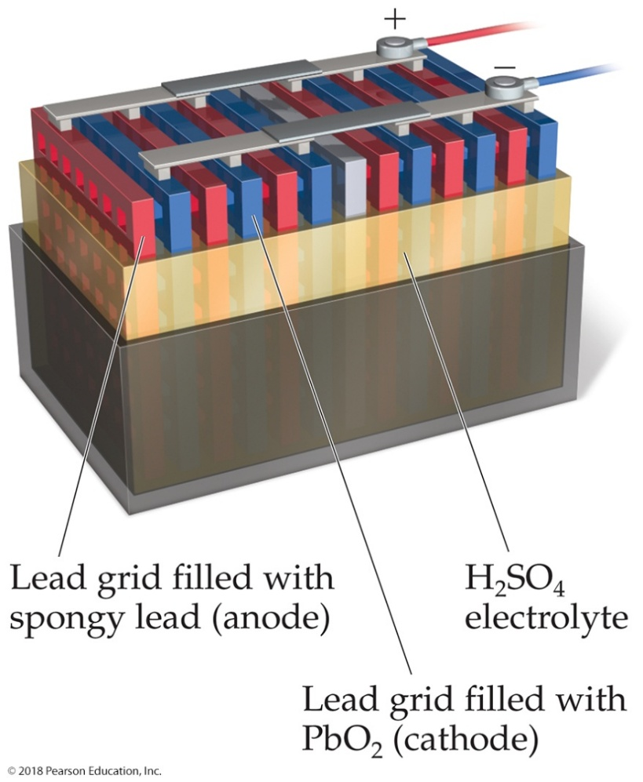
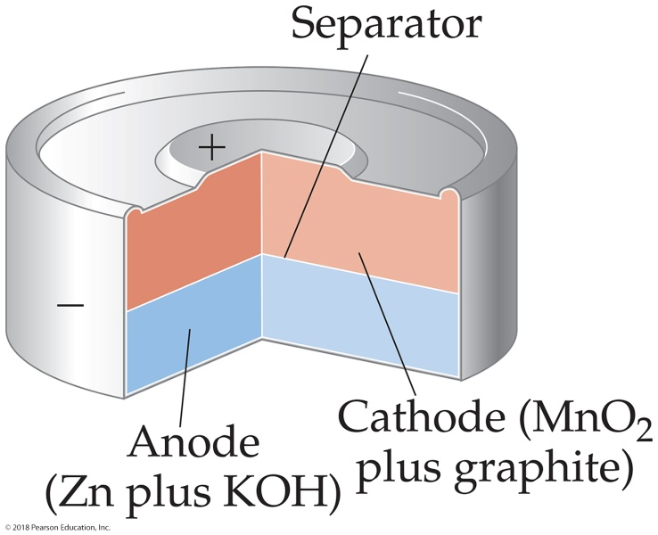
Some Batteries
Lead–Acid Battery
Alkaline Battery

Slide 43
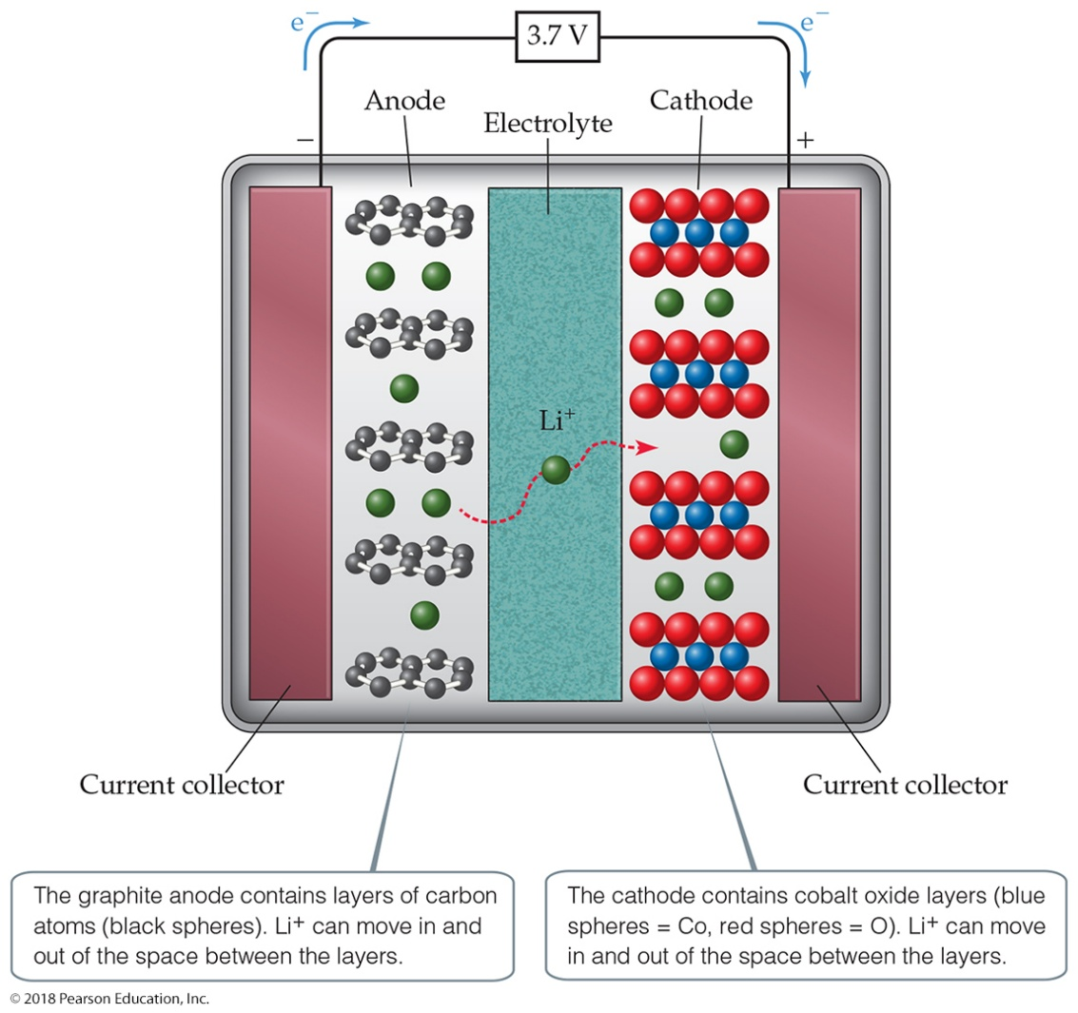
Lithium-Ion Battery

Slide 44
Fuel Cells
When a fuel is burned, the energy created can be converted to electrical energy.
Usually, this conversion is only 40% efficient, with the remainder lost as heat.
The direct conversion of chemical to electrical energy is expected to be more efficient and is the basis for fuel cells.
Fuel cells are Not batteries; the source of energy must be continuously provided.

Slide 45
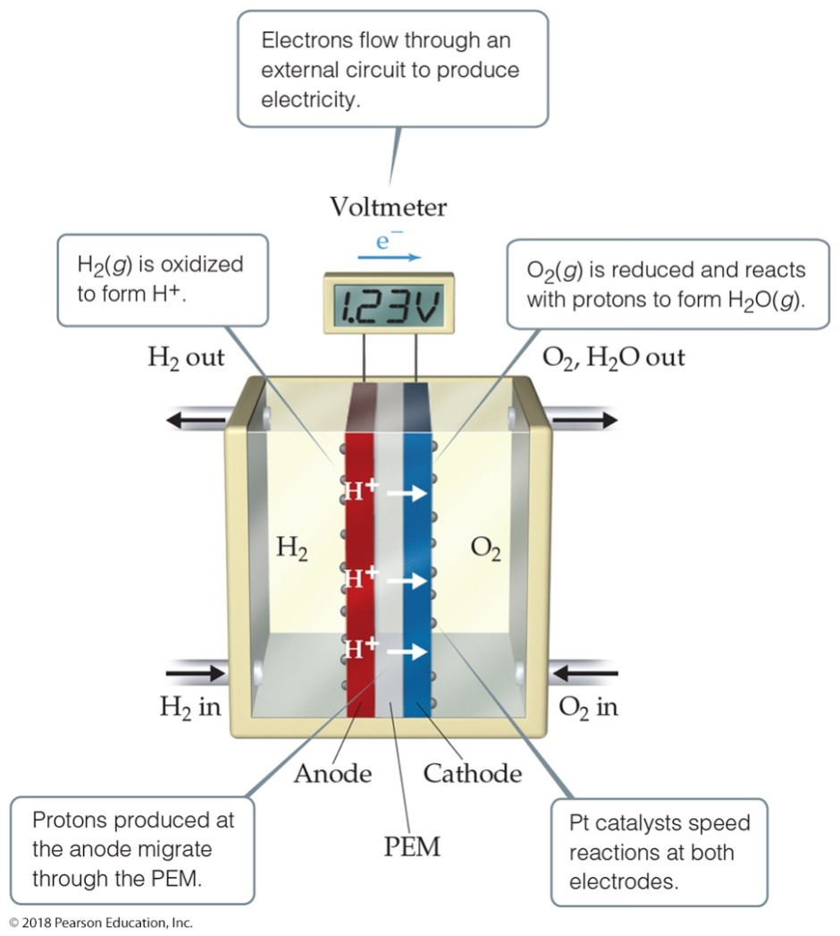
Hydrogen Fuel Cells
In this cell, hydrogen and oxygen form water.
The cells are twice as efficient as combustion.
The cells use hydrogen gas as the fuel and oxygen from the air.

Slide 46
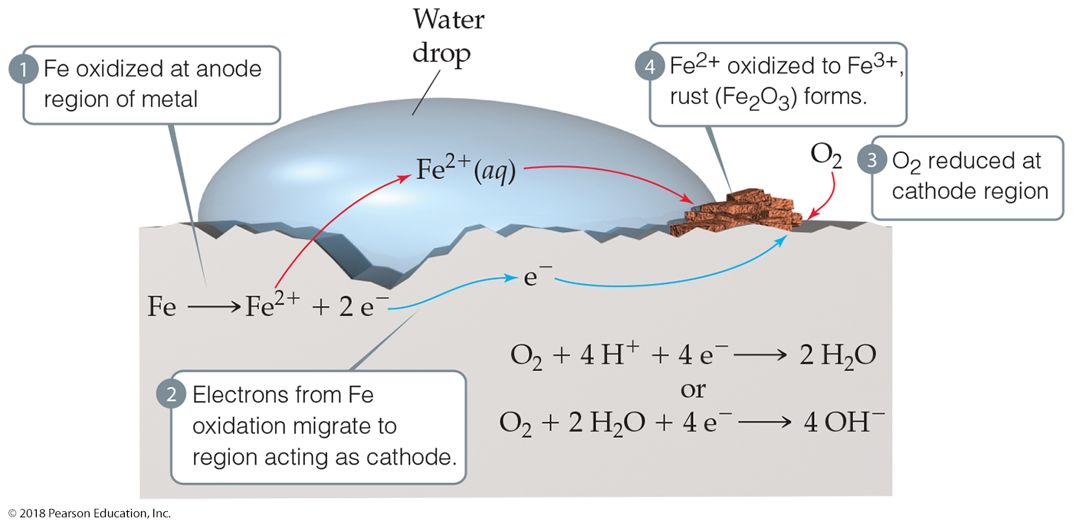
Corrosion
Corrosion is oxidation.
Its common name is rusting.

Slide 47
Preventing Corrosion (1 of 2)
Cathodic protection occurs because zinc is more easily oxidized, so that metal is sacrificed to keep the iron from rusting.
Another method to prevent corrosion is used for underground pipes. A sacrificial anode is attached to the pipe. The anode is oxidized before the pipe.

Slide 48
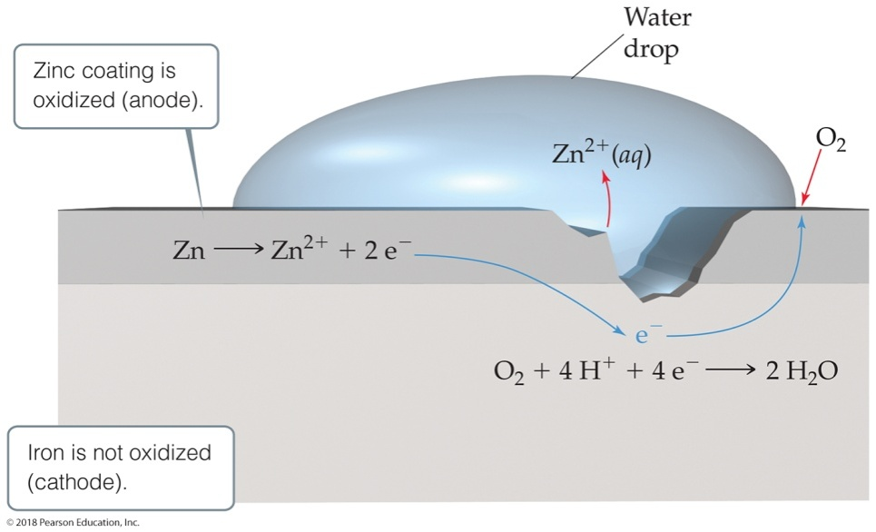
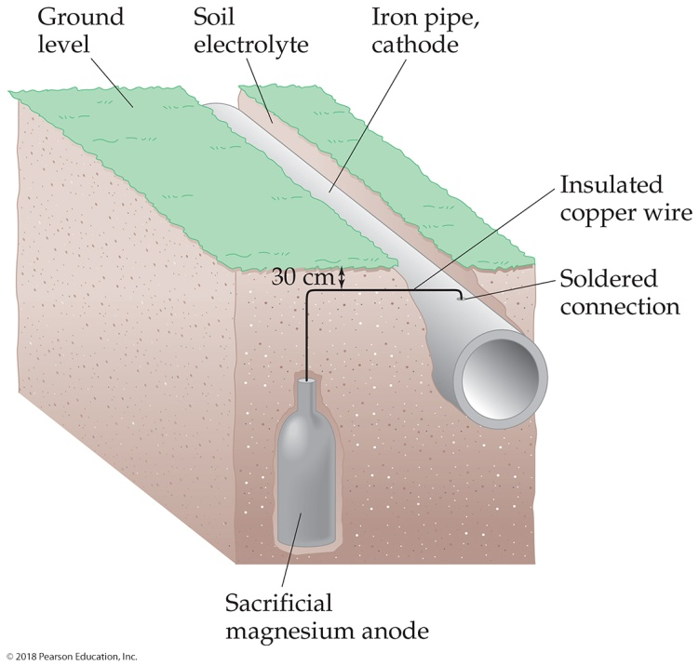
Preventing Corrosion (2 of 2)

Slide 49
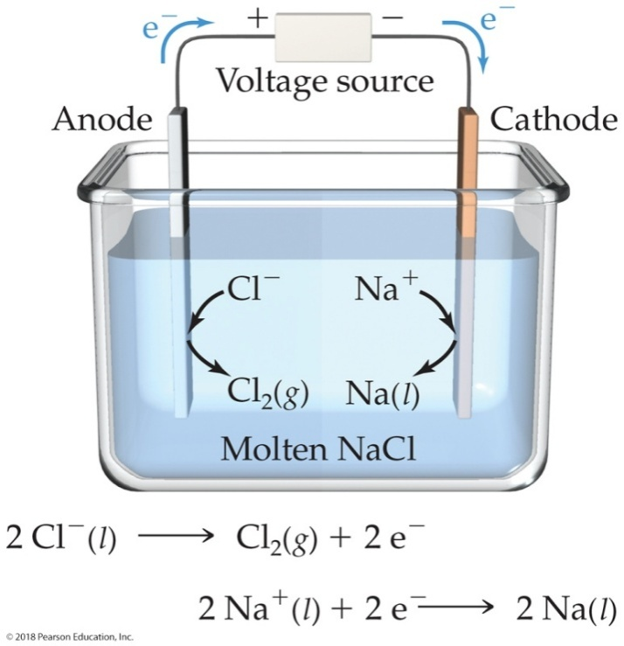
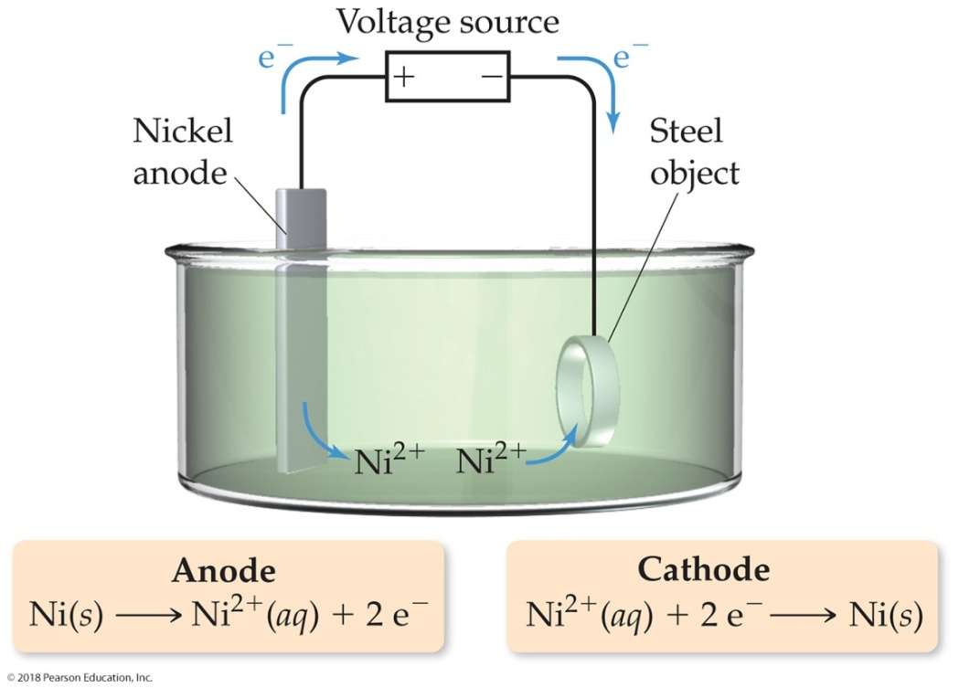
Electrolysis (1 of 2)

Slide 50
Electrolysis (2 of 2)
Nonspontaneous reactions can occur in electrochemistry I F outside electricity is used to drive the reaction.
Use of electrical energy to create chemical reactions is called electrolysis.

Slide 51
Electrolysis and “Stoichiometry” (1 of 2)
1 coulomb = 1 ampere × 1 second
Q = I t = n F
Q = charge (C)
I = current (A)
t = time (s)
n = moles of electrons that travel through the wire in the given time
F = Faraday’s constant
Note: n is different than that for the Nernst equation!

Slide 52
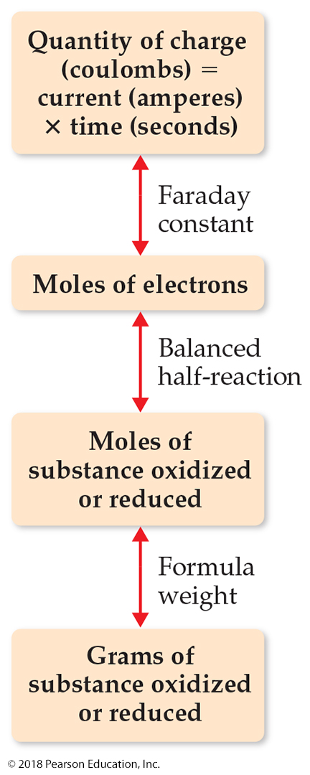
Electrolysis and “Stoichiometry” (2 of 2)

Slide 53
Copyright

