Slide 1
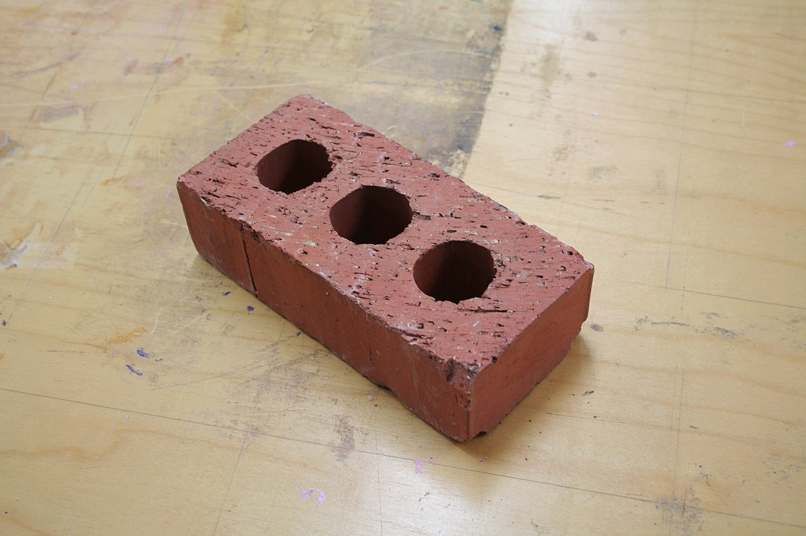
Brick
A fired clay masonry product.

Slide 2
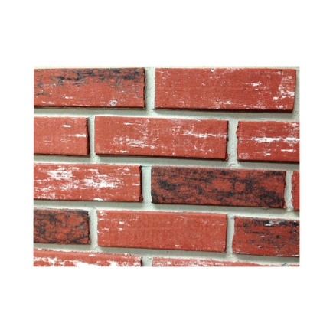
Face Brick
Brick that is uniform in size and has sharp corners and lines.

Slide 3
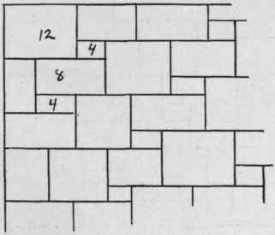
Ashlar stonework
Stonework that uses dressed, cut, or squared stones to provide a regular pattern or finished appearance.

Slide 4
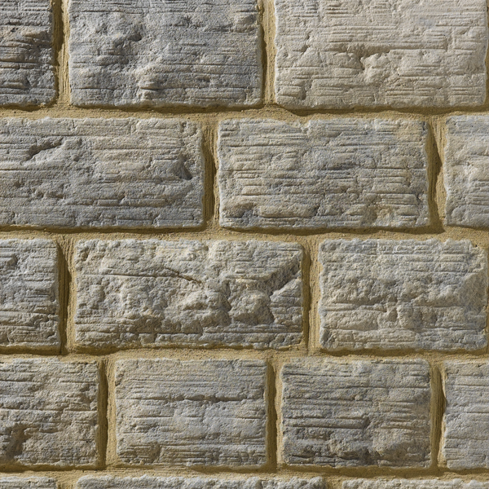
Coursed Rubble
Rubble stonework in which all of the stones are generally flat or rectangular, so that the result looks like courses (rows) of stone.

Slide 5
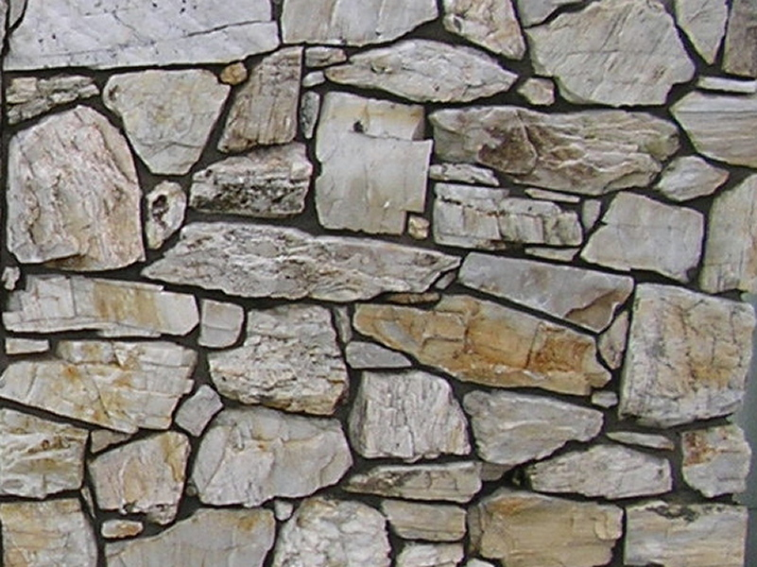
Rubble Stonework
Stonework made up of undresses stones of irregular shapes.

Slide 6
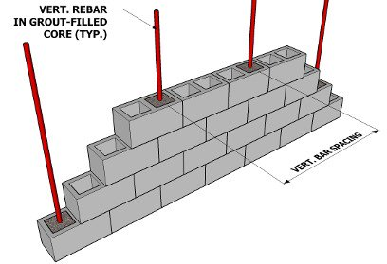
Masonry wall
A wall constructed entirely of brick, concrete block, stone, clay tile, terra cotta, or a combination of these materials.

Slide 7
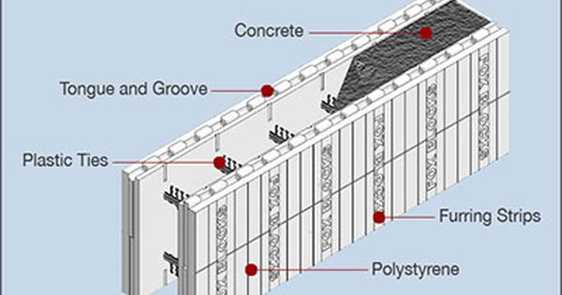
Insulated concrete forms (ICFs)
Concrete wall forms made of foam insulation that are filled with concrete and remain in place to become part of the exterior wall structure.

Slide 8
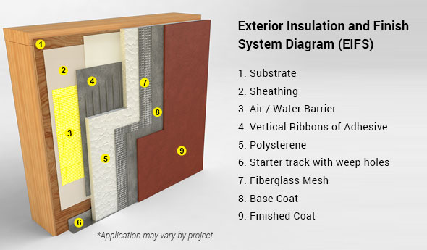
Exterior insulation finish system (EIFS):
A wall covering system that provides thermal insulation and a durable external finish resembling stucco or stone.

Slide 9
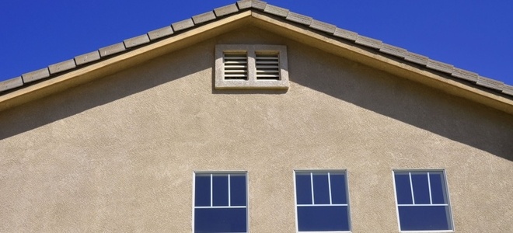
Stucco
A coating applied to the outside of a structure that forms a protective, low maintenance, yet decorative shell around the structure; consist of Portland cement, lime, sand, and water.

Slide 10
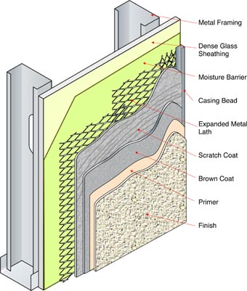
Scratch Coat
The first stucco layer in the three-coat stucco system, which covers the lath and provides support for the second coat.

Slide 11
Brown coat
The second stucco layer in the three-coat process; covers any lath not covered by the scratch coat, adds strength to the shell, trues up the surface, and provides an appropriate surface for the final coat.

Slide 12
Brown coat
The second stucco layer in the three-coat process; covers any lath not covered by the scratch coat, adds strength to the shell, trues up the surface, and provides an appropriate surface for the final coat.

Slide 13
Finish Coat
The third stucco layer in the three-coat process; a thin layer in which texture or design patterns are applied.

Slide 14
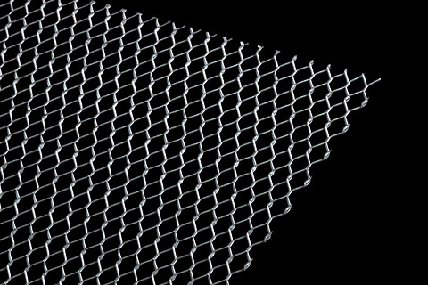
Lath
A wire or ribbed material that provides support and attachment for the layers of stucco applied to a wall.

Slide 15
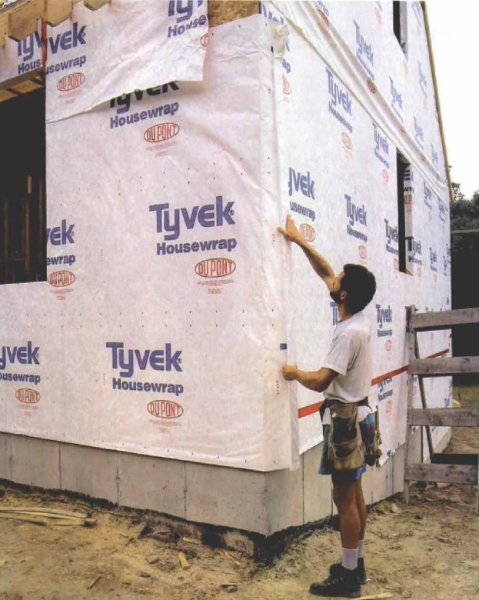
Moisture barrier
A membrane places under a stucco finish that protects most of the wall area from moisture accumulation between the structure and the stucco.

Slide 16
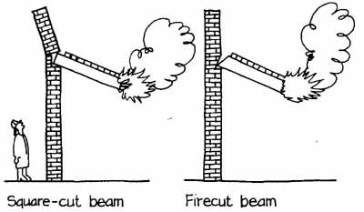
Firecut
An angles cut on a joist end in solid brick and stone walls to prevent toppling the wall if the house should catch fire.

Slide 17
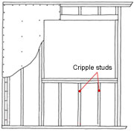
Cripple stud
A structural member, also called a jack stud that is not full length due to a wall opening.

Slide 18
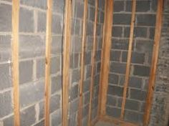
Furring strip
Strips of 2x2 or 1x3 lumber affixed to a masonry wall to provide a nailing surface for drywall, plaster, or paneling.

Slide 19
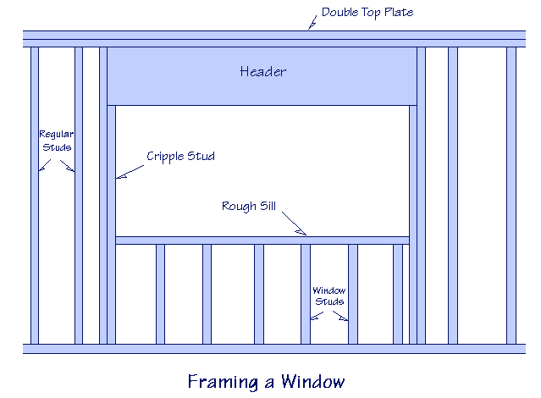
Header- and- Stud framing
A method of constructing headers for window and door opening in which shorter studs and jack studs are firmly nailed to the sole and top of the opening.

Slide 20
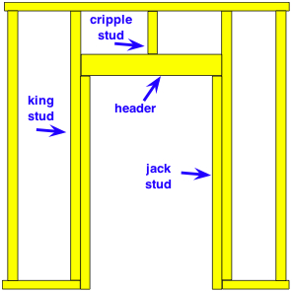
Jack stud
A structural member positioned inside a wall opening to help support the header over the opening.

Slide 21
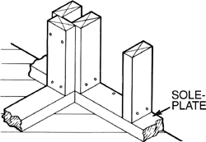
Sole plate
The bottom horizontal member of a frame wall, on which the studs rest.

Slide 22
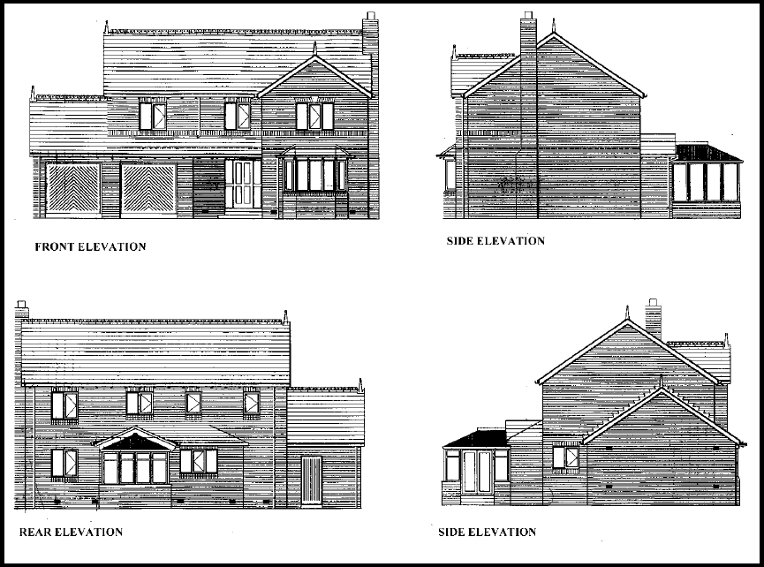
Elevation
A drawing, typically made as an orthographic projection, that shows the exterior features of one side of a structure

Slide 23
Grade Line
The line or level of the finished grade (earth) around the structure.

