Slide 1
Chapter 7 Alkenes: Structure and Reactivity

Slide 2
Learning Objectives
(7.1)
Industrial preparation and use of alkenes
(7.2)
Calculating degree of unsaturation
(7.3)
Naming alkenes
(7.4)
Cis-Trans Isomerism in Alkenes
(7.5)
Alkene Stereochemistry and the E,Z Designation

Slide 3
Learning Objectives
(7.6)
Stability of alkenes
(7.7)
Electrophilic addition reactions of alkenes
(7.8)
Orientation of electrophilic additions: Markovnikov’s rule
(7.9)
Carbocation structure and stability

Slide 4
Learning Objectives
(7.10)
The Hammond Postulate
(7.11)
Evidence for the mechanism of electrophilic additions: Carbocation rearrangements

Slide 5
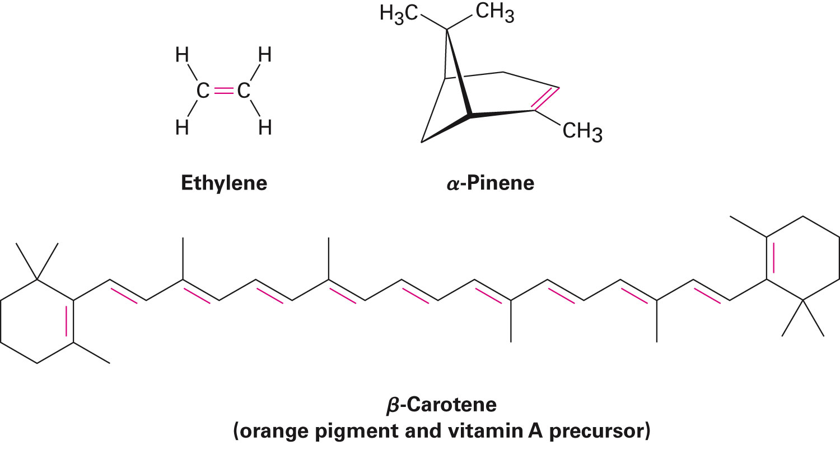
Alkene-Hydrocarbon With Carbon–Carbon Double Bond
Alkene: Hydrocarbon containing a carbon-carbon double bond
Sometimes called olefin

Slide 6
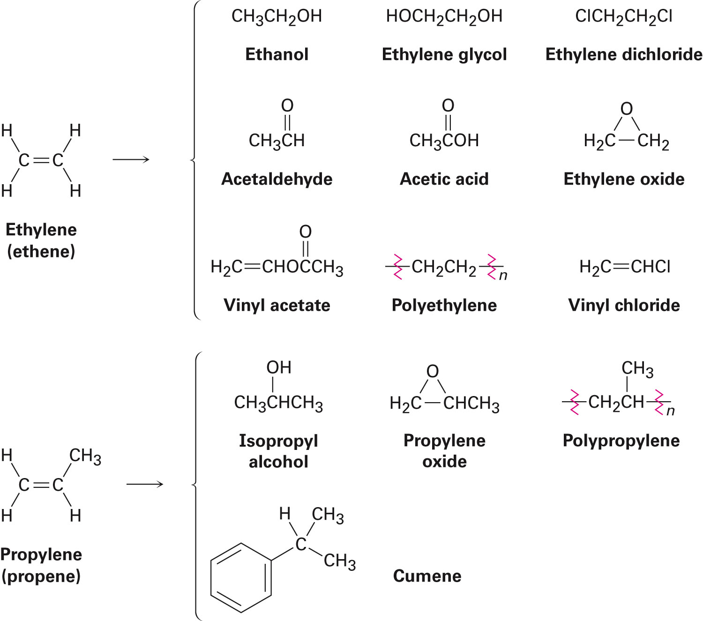
Industrial Preparation and Use of Alkenes
Ethylene and propylene are the least complex alkenes
Important organic chemicals produced industrially
Notes:
Industrial preparation and use of alkenes

Slide 7
Thermal Cracking
Ethylene, propylene, and butane are synthesized by steam cracking of light alkanes
Notes:
Industrial preparation and use of alkenes

Slide 8
Calculating Degree of Unsaturation
Alkenes have fewer hydrogens than alkanes with the same number of carbons
Referred to as unsaturated
Degree of unsaturation: Number of multiple bonds or rings present in the molecule
Formula for a saturated acyclic compound is C_{n}H_{2n+2}
Each ring or multiple bond replaces 2 H's
Notes:
Calculating degree of unsaturation

Slide 9
Calculating Degree of Unsaturation
C₆H₁₄ saturated C₆ alkane
Degree of saturation is two
Notes:
Calculating degree of unsaturation

Slide 10
Calculating Degree of Unsaturation
Organohalogens (C,H,X, where X = F, Cl, Br, I)
Halogen replaces hydrogen
C₄H₆Br₂ equals hydrocarbon formula C₄H₈ have one degree of unsaturation
Notes:
Calculating degree of unsaturation

Slide 11
Calculating Degree of Unsaturation
Organoxygen compounds (C, H, O)
Oxygen forms 2 bonds
Does not affect the formula of equivalent hydrocarbons
May be ignored in calculating degrees of unsaturation
Notes:
Calculating degree of unsaturation

Slide 12
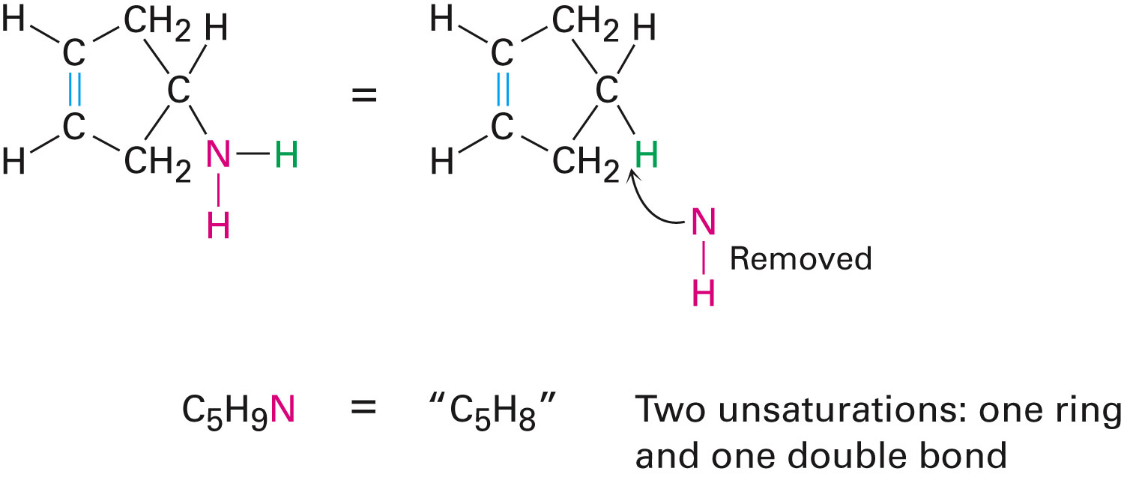
Calculating Degree of Unsaturation
Organonitrogen compounds (C, H, N)
Nitrogen forms three bonds
Has one more H than a related hydrocarbon
Subtracting number of N from number of H yields equivalent hydrocarbon formula
Notes:
Calculating degree of unsaturation

Slide 13
Worked Example
Calculate the degree of unsaturation in each of the following formulas
Draw the maximum number of structures for each
a) C₄H₈
b) C₄H₆
c) C₃H₄
Solution:
a) C₄H₈
Degree of saturation = 1
Structures:
Notes:
Calculating degree of unsaturation

Slide 14
Worked Example
b) C₄H₆
Degree of saturation = 2
Structures:
c) C₃H₄
Degree of saturation = 2
Structures:
Notes:
Calculating degree of unsaturation

Slide 15
Naming Alkenes
Name the parent hydrocarbon
Number the carbons in the chain so that double bond carbons have lowest possible numbers
Notes:
Naming alkenes

Slide 16
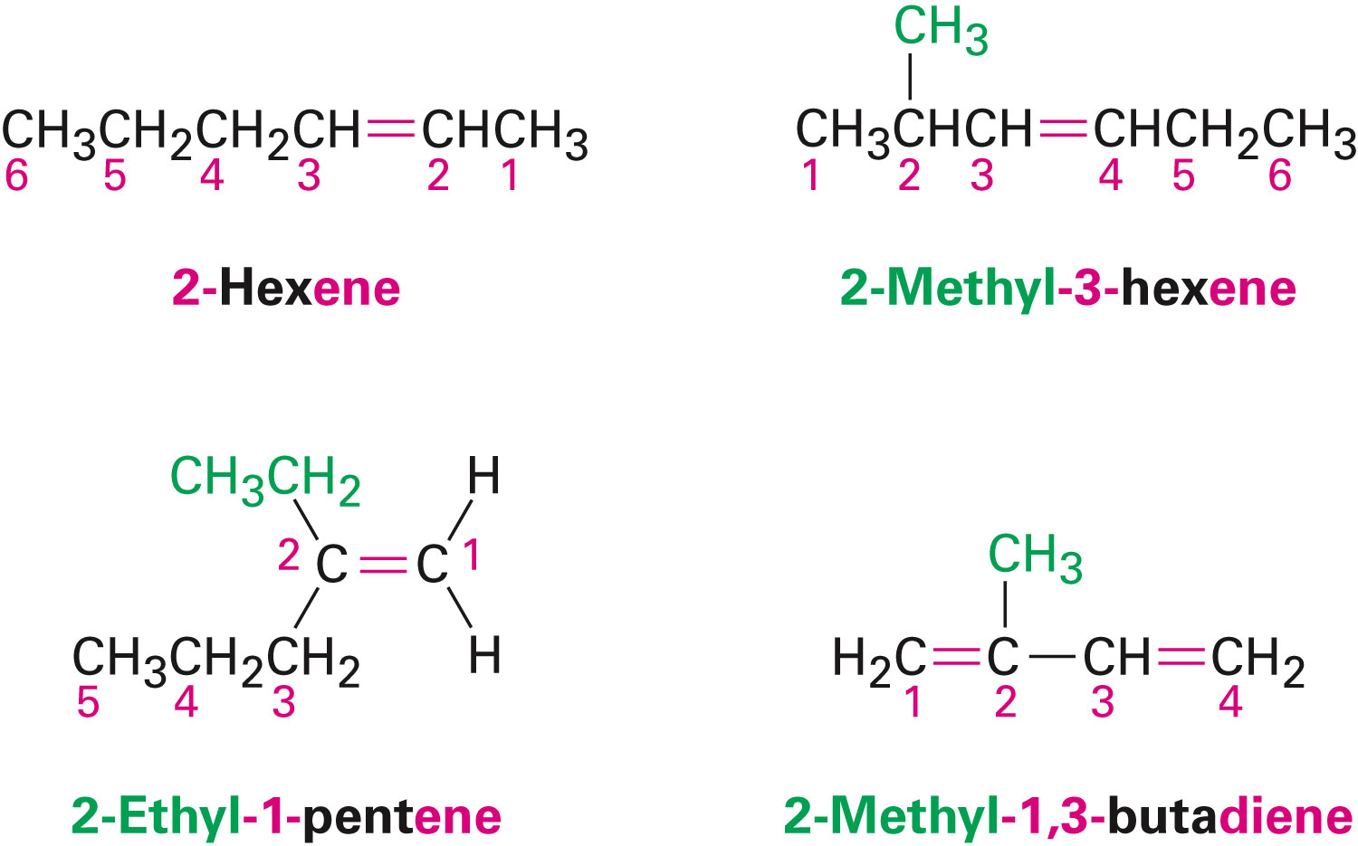
Naming Alkenes
Write the full name
Number substituents:
According to position in chain
Alphabetically
Rings have cyclo as prefix
Notes:
Naming alkenes

Slide 17
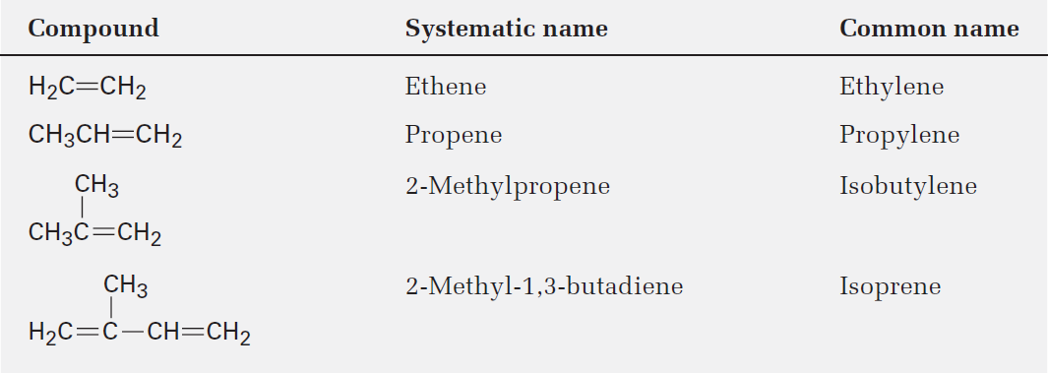
Table 7.1 - Common Names of Some Alkenes
Notes:
Naming alkenes

Slide 18
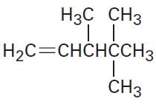
Worked Example
Give IUPAC names for the following compounds
a)
b)
Notes:
Naming alkenes

Slide 19
Worked Example
Solution:
a)
The longest chain is a pentene
Consists of three methyl groups
The methyl groups are attached to C3 and C4
Using tri- before methyl and using numbers to signify the location of the double bond
The compound is 3,4,4-Trimethyl-1-pentene
Notes:
Naming alkenes

Slide 20
Worked Example
b)
The longest chain is a hexane
The methyl group is attached to C3
Using numbers to signify the location of the double bond
The compound is 3-Methyl-3-hexene
Notes:
Naming alkenes

Slide 21
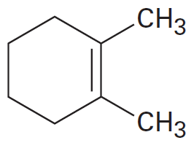
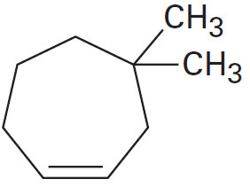
Worked Example
Name the following cycloalkenes:
a)
b)
Notes:
Naming alkenes

Slide 22
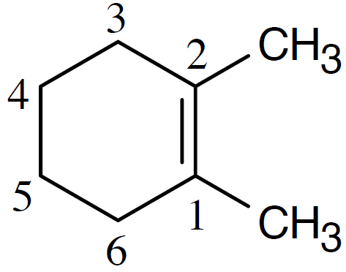
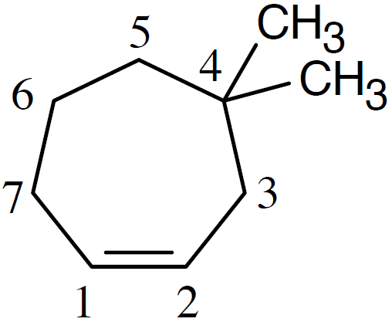
Worked Example
Solution:
a)
1,2-Dimethylcyclohexene
b)
4,4-Dimethylcycloheptene
Notes:
Naming alkenes

Slide 23
Cis-Trans Isomerism in Alkenes
Carbon atoms in a double bond are sp²-hybridized
Three equivalent orbitals at 120°separation in the plane
Interaction of p orbitals, one bonding and one antibonding π molecular orbital
Rotation prevented by π bond
Barrier to double-bond rotation must be as great as the strength of p bond
About 350 kJ/mol
Notes:
Cis-Trans Isomerism in Alkenes

Slide 24
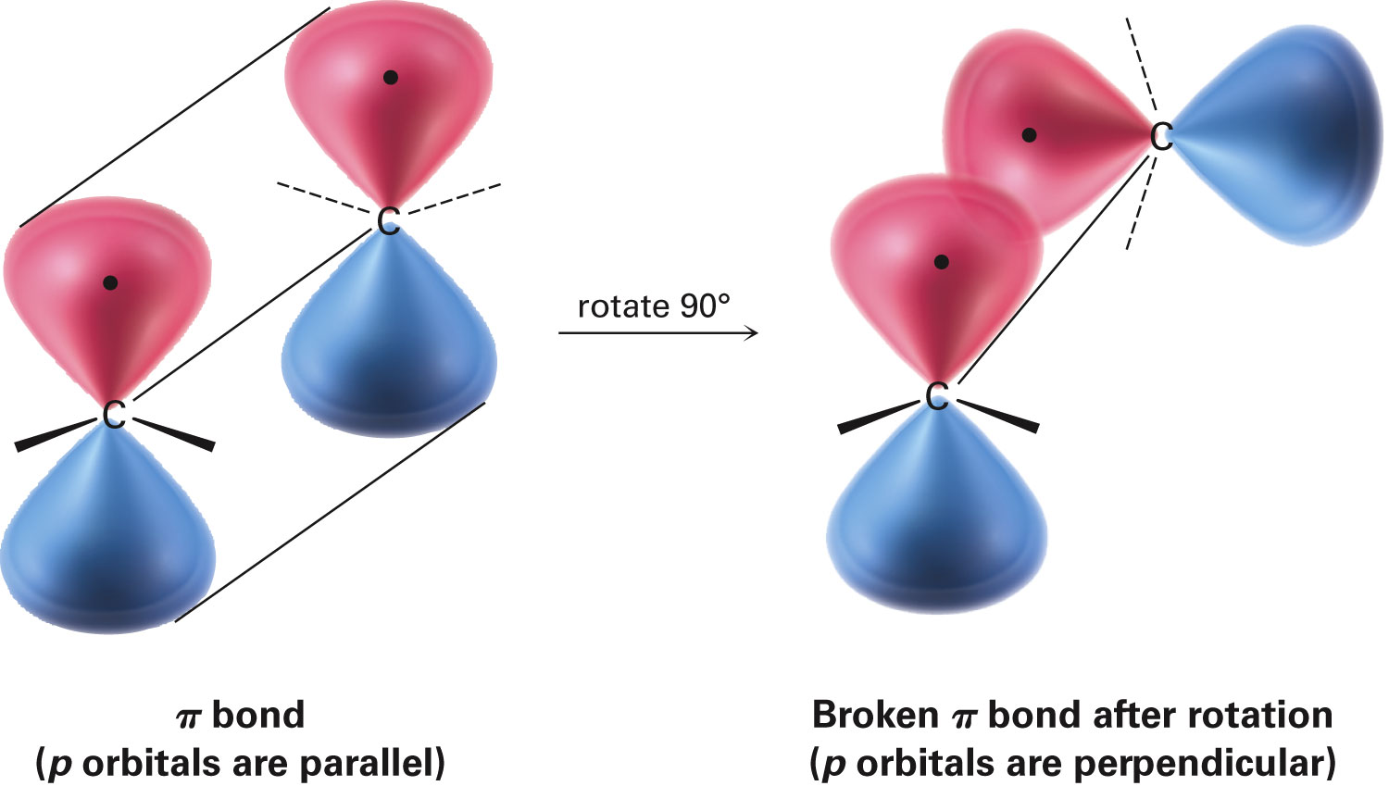
Cis-Trans Isomerism in Alkenes
Rotation of π bond is prohibitive
This prevents rotation about a carbon–carbon double bond
Notes:
Cis-Trans Isomerism in Alkenes

Slide 25
Cis-Trans Isomerism in Alkenes
Methyl groups in 2-butene are either on the same side of the double bond or on opposite sides
Compound with substituents on the same side of double bond is called cis-2-butene
Isomer with substituents on opposite sides is trans-2-butene
Cis-trans isomerism occur whenever both double-bond carbons are attached to two different groups
Notes:
Cis-Trans Isomerism in Alkenes

Slide 26
Figure 7.3 - Cis and Trans Isomers of 2-Butene
Notes:
Cis-Trans Isomerism in Alkenes

Slide 27
Cis-Trans Isomerism in Alkenes
Cis-trans isomerization requires end groups to differ in pairs
Not possible if one of the double-bond carbons is attached to two identical groups
Notes:
Cis-Trans Isomerism in Alkenes

Slide 28
Worked Example
Draw the structure of cis-9-tricosene
Solution:
Cis-9-tricosene
Notes:
Cis-Trans Isomerism in Alkenes

Slide 29
Alkene Stereochemistry and the E,Z Designation
Tri- and tetra-substituted double bonds require more general method
E,Z system: Method used for describing alkene stereochemistry
Uses Cahn–Ingold–Prelog sequence rules
Notes:
Alkene Stereochemistry and the E,Z Designation

Slide 30
Alkene Stereochemistry and the E,Z Designation
Rule 1
Rank the substituent atoms according to the atomic number of the first atom
Higher atomic number gets higher priority
Notes:
Alkene Stereochemistry and the E,Z Designation

Slide 31
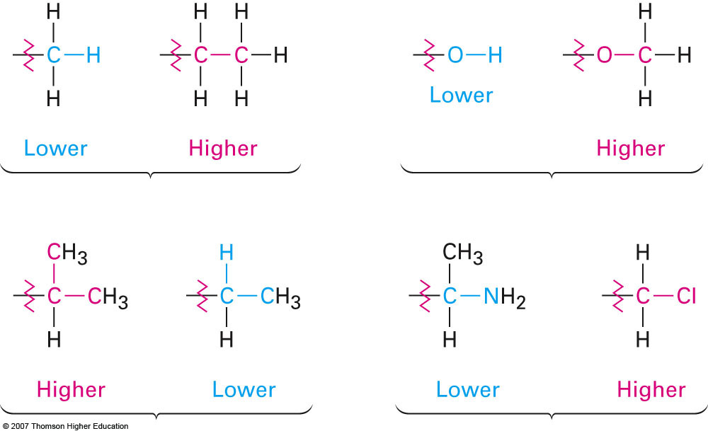
Alkene Stereochemistry and the E,Z Designation
Rule 2
If atomic numbers are the same, compare at next connection point at same distance
Notes:
Alkene Stereochemistry and the E,Z Designation

Slide 32
Alkene Stereochemistry and the E,Z Designation
Rule 3
Multiple-bonded atoms are equivalent to the same number of single-bonded atoms
Notes:
Alkene Stereochemistry and the E,Z Designation

Slide 33
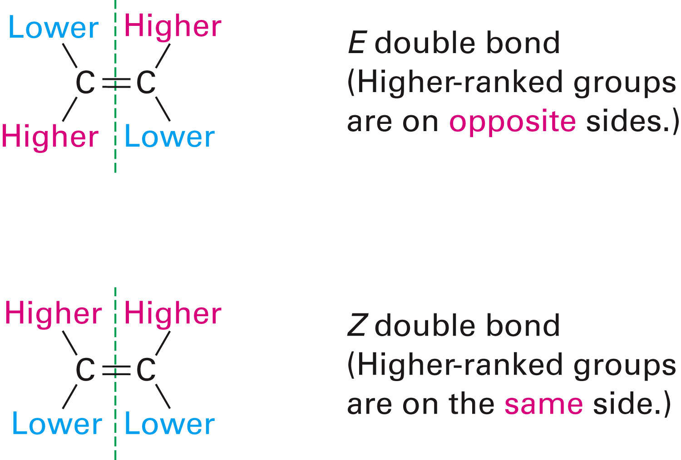
Alkene Stereochemistry and the E,Z Designation
Z geometry: Molecules which have higher ranked groups on each carbon are on the same side of the double bond
E geometry: Molecules which have higher-ranked groups are on opposite sides
Notes:
Alkene Stereochemistry and the E,Z Designation

Slide 34
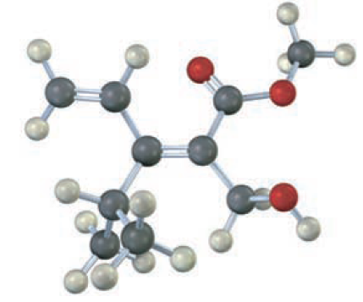
Worked Example
Assign stereochemistry (E or Z) to the double bond in the following compound
Convert the drawing into a skeletal structure (red = O)
Notes:
Alkene Stereochemistry and the E,Z Designation

Slide 35
Worked Example
Solution:
Notes:
Alkene Stereochemistry and the E,Z Designation

Slide 36
Stability of Alkenes
Cis alkenes are less stable than trans alkenes
Less stable isomer is higher in energy and gives off more heat
Tetrasubstituted > trisubstituted > disubstituted > monosusbtituted
Notes:
Stability of alkenes

Slide 37
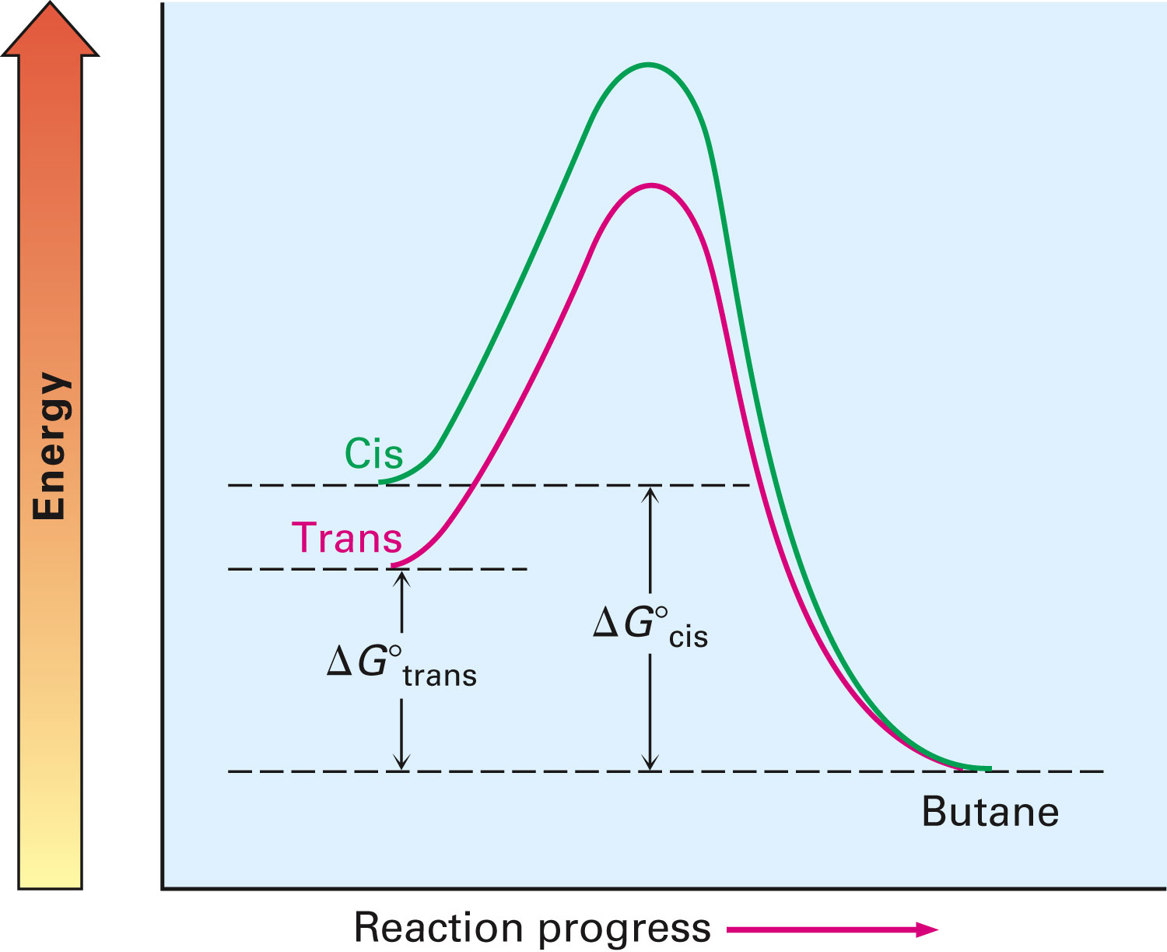
Figure 7.5 - Energy Diagrams for Hydrogenation of cis- and trans-2-Butene
Notes:
Stability of alkenes

Slide 38
Table 7.2 - Heats of Hydrogenation of Some Alkenes
Notes:
Stability of alkenes

Slide 39
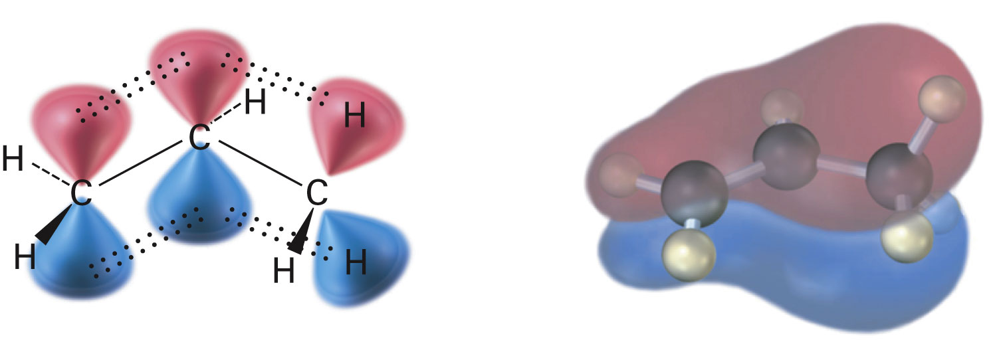
Hyperconjugation
Electrons in neighboring filled σ orbital stabilize vacant antibonding π orbital
Net positive interaction
Stability of the alkene depends on the number of hyperconjugation that occurs
Notes:
Stability of alkenes

Slide 40
Worked Example
Which compound in each pair is more stable
a)
b)
Notes:
Stability of alkenes

Slide 41
Worked Example
Solution:
a)
b)
Notes:
Stability of alkenes

Slide 42
Electrophilic Addition of Alkenes
General reaction mechanism of electrophilic addition
Attack on electrophile, such as HBr, by π bond of alkene
Produces carbocation and bromide ion
Carbocation is an electrophile, reacting with a nucleophilic bromide ion
Notes:
Electrophilic addition reactions of alkenes

Slide 43
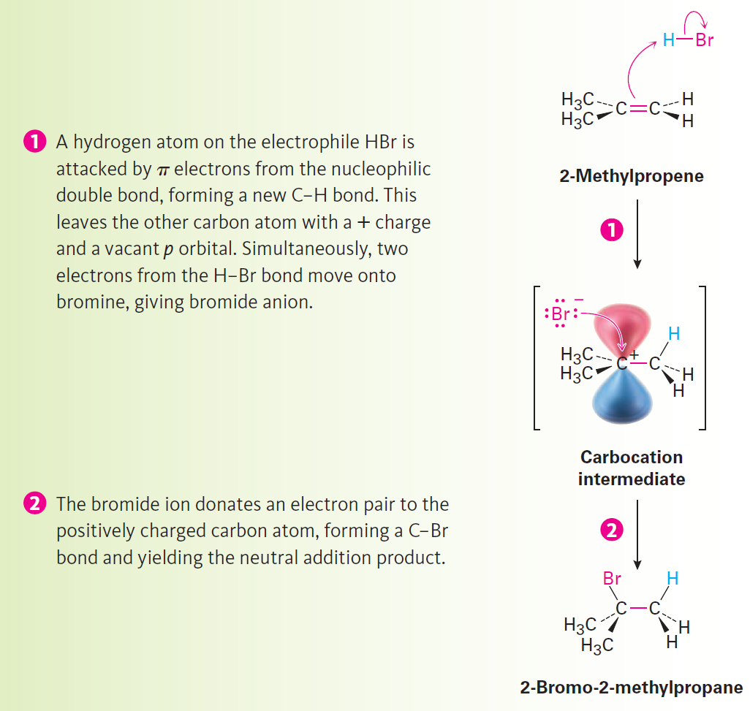
Figure 7.7 - Mechanism
Notes:
Electrophilic addition reactions of alkenes

Slide 44
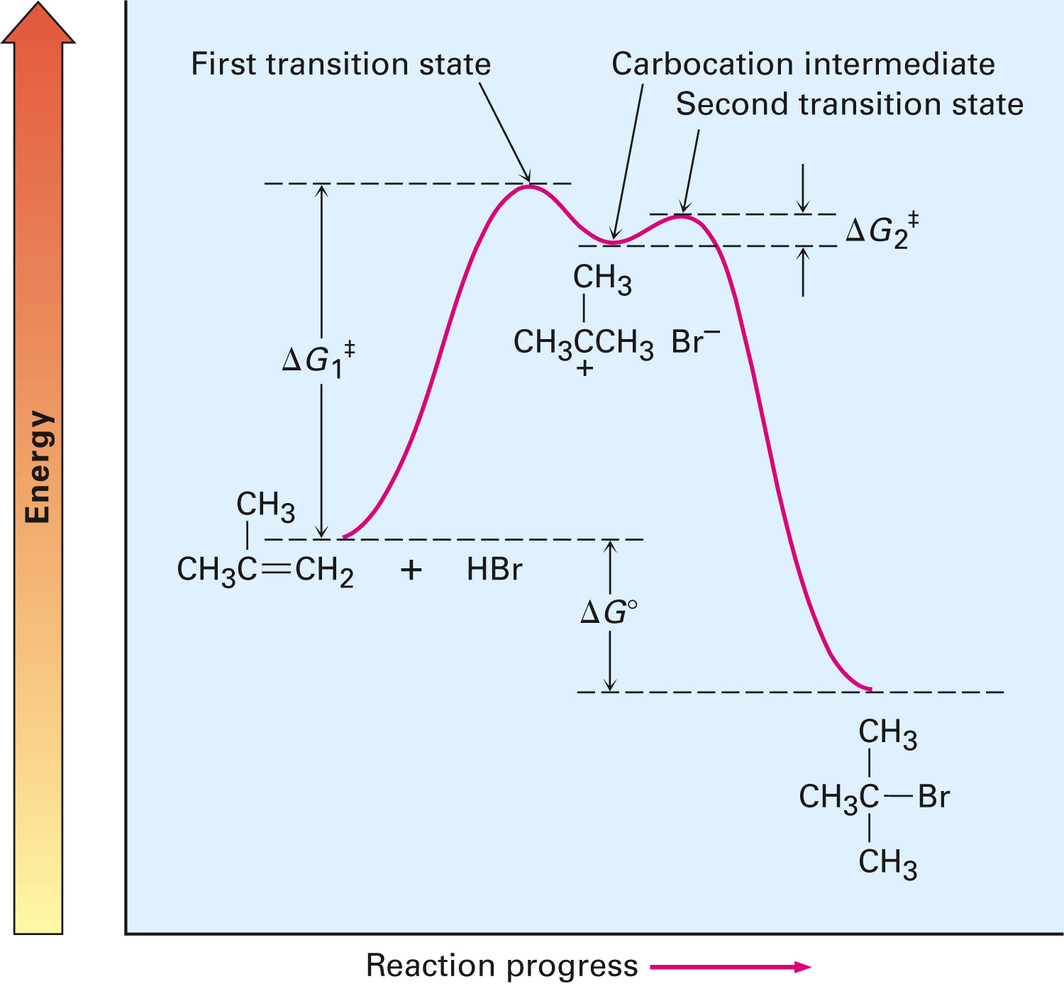
Figure 7.8 - Energy Diagram for the Two-step Electrophilic Addition of HBr to 2-Methylpropene
Notes:
Electrophilic addition reactions of alkenes

Slide 45
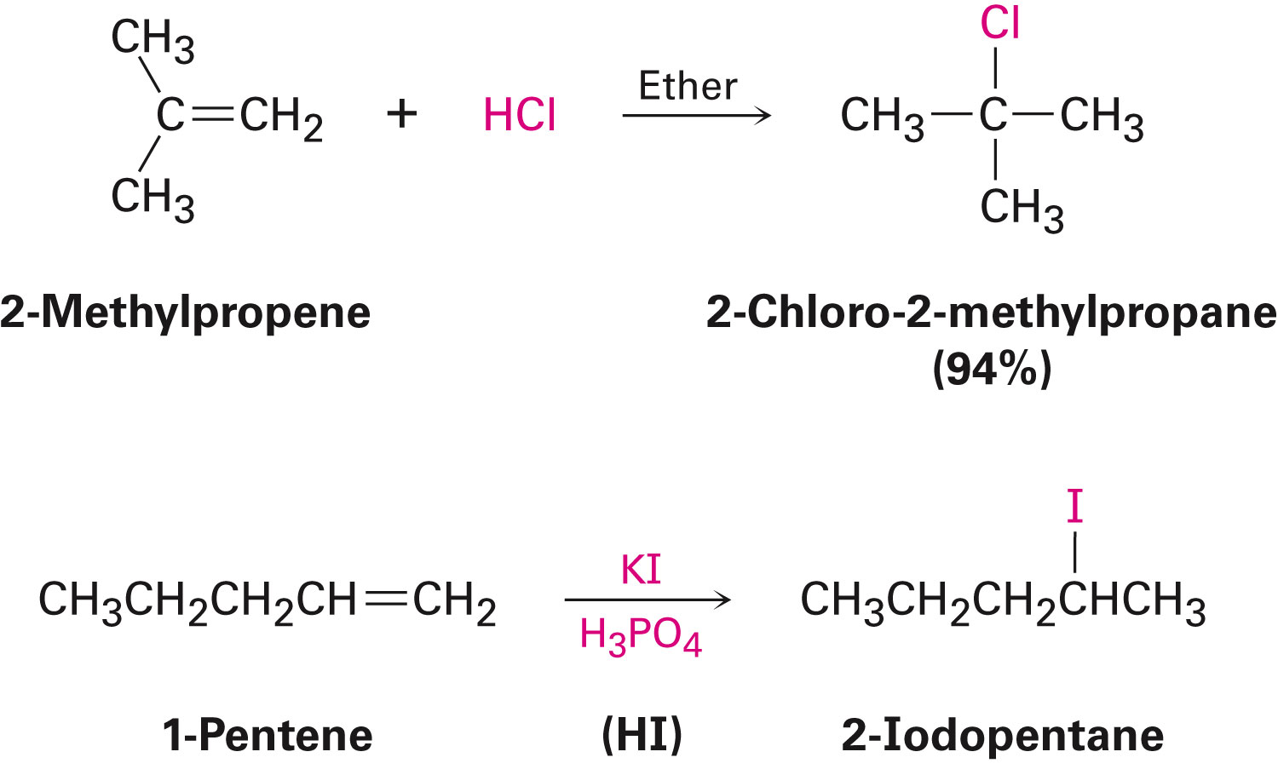
Electrophilic Addition of Alkenes
Reaction is also successful with HCl, HI, and H₂O
HI is generated from KI and phosphoric acid
Notes:
Electrophilic addition reactions of alkenes

Slide 46
Orientation of Electrophilic Additions: Markovnikov’s Rule
In electrophilic addition reactions, unsymmetrical substituted alkenes give a single product
Regiospecific: Reaction in which only one of two possible orientations of an addition occur
Notes:
Orientation of electrophilic additions: Markovnikov’s rule

Slide 47
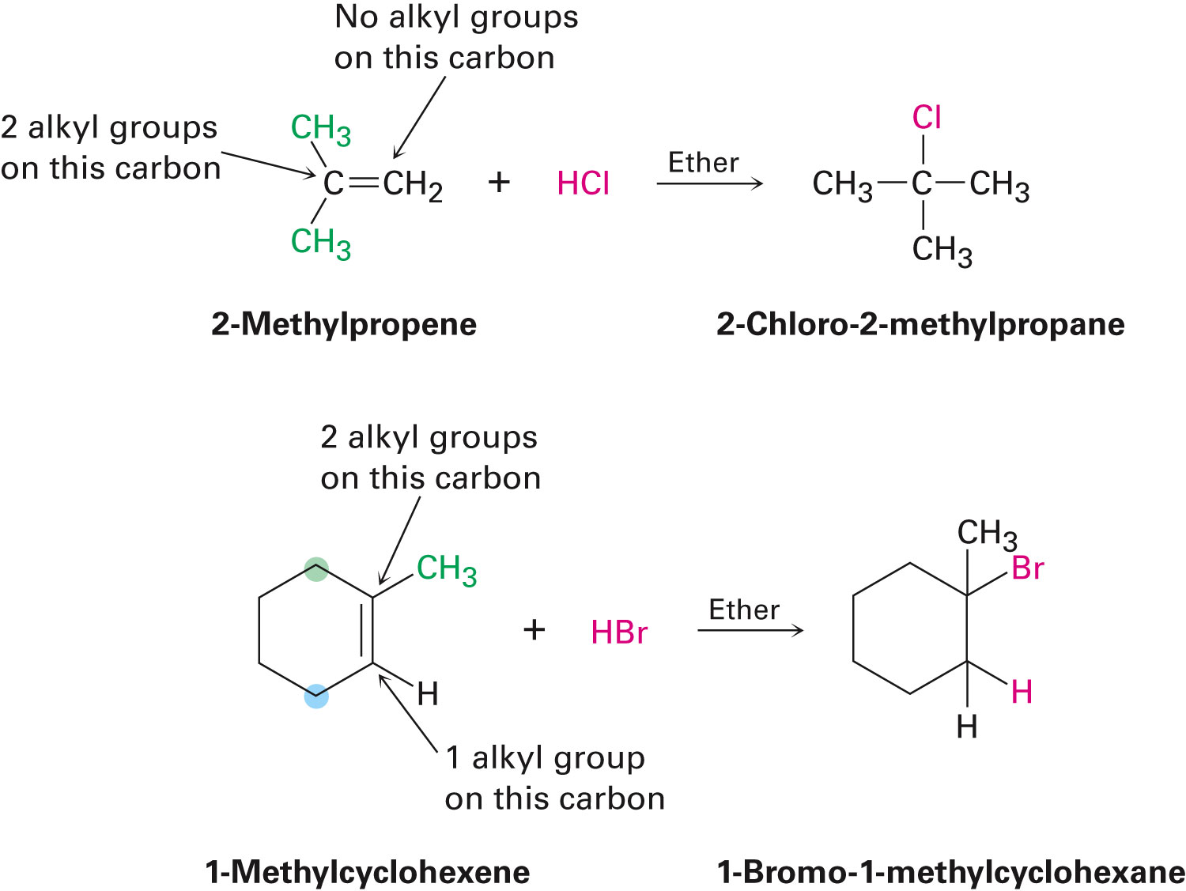
Markovnikov’s Rule
In the addition of HX to an alkene
H attaches to the carbon with fewer alkyl substituents
X attaches to the carbon with more alkyl substituents
Notes:
Orientation of electrophilic additions: Markovnikov’s rule

Slide 48
Markovnikov’s Rule (restated)
In the addition of HX to an alkene, more highly substituted carbocation forms as the intermediate rather than the less highly substituted one
Notes:
Orientation of electrophilic additions: Markovnikov’s rule

Slide 49
Markovnikov’s Rule (restated)
Notes:
Orientation of electrophilic additions: Markovnikov’s rule

Slide 50
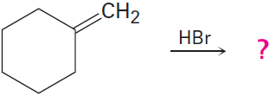
Worked Example
Predict the products of the following reaction:
Solution:
The reaction is electrophilic addition of HX to an alkene
Using Markovnikov's rule to predict orientation
Notes:
Orientation of electrophilic additions: Markovnikov’s rule

Slide 51
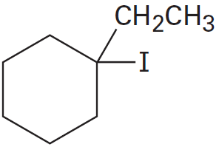
Worked Example
What alkene is required to prepare the following product:
Notes:
Orientation of electrophilic additions: Markovnikov’s rule

Slide 52
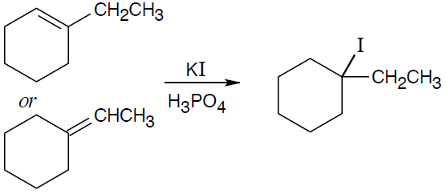
Worked Example
Solution:
Choose the alkene starting material for synthesis of the desired haloalkane
Notes:
Orientation of electrophilic additions: Markovnikov’s rule

Slide 53
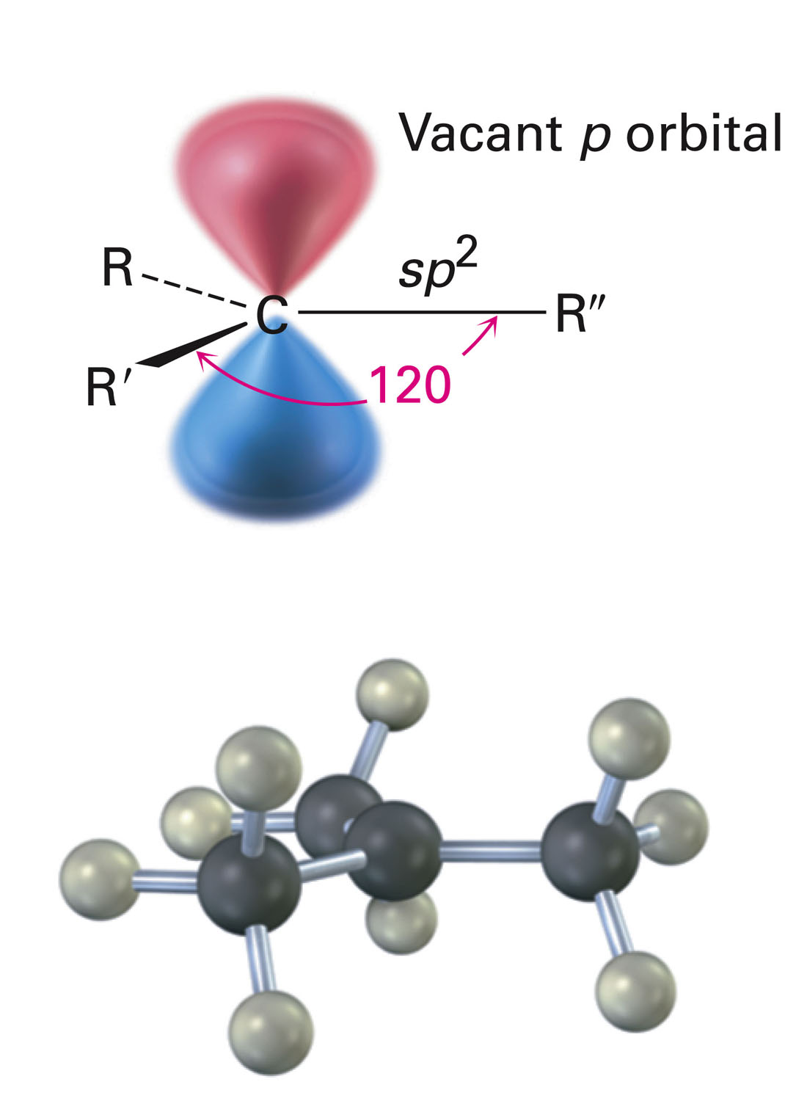
Carbocation Structure and Stability
Carbocations are planar
The trivalent carbon is sp²-hybridized
The six valence electrons on carbon are used in the three s bonds
The p orbital is unoccupied
Stability increases with increasing substitution
Notes:
Carbocation structure and stability

Slide 54
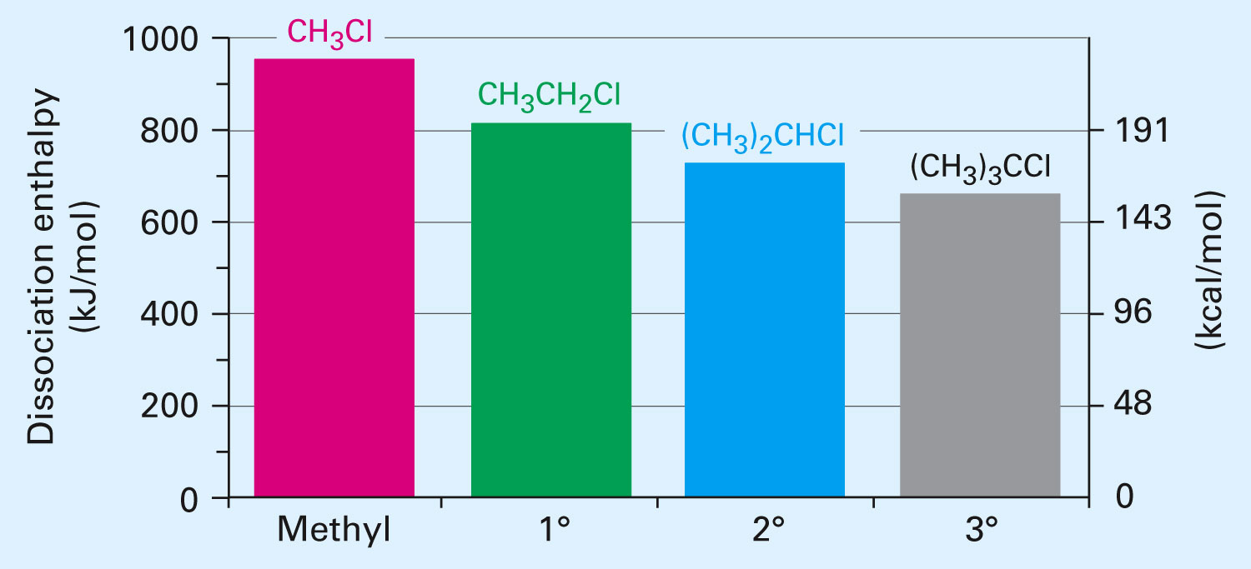
Carbocation Structure and Stability
Plot of dissociation enthalpy shows
Highly substituted alkyl halides dissociate more easily than less substituted ones
Notes:
Carbocation structure and stability

Slide 55
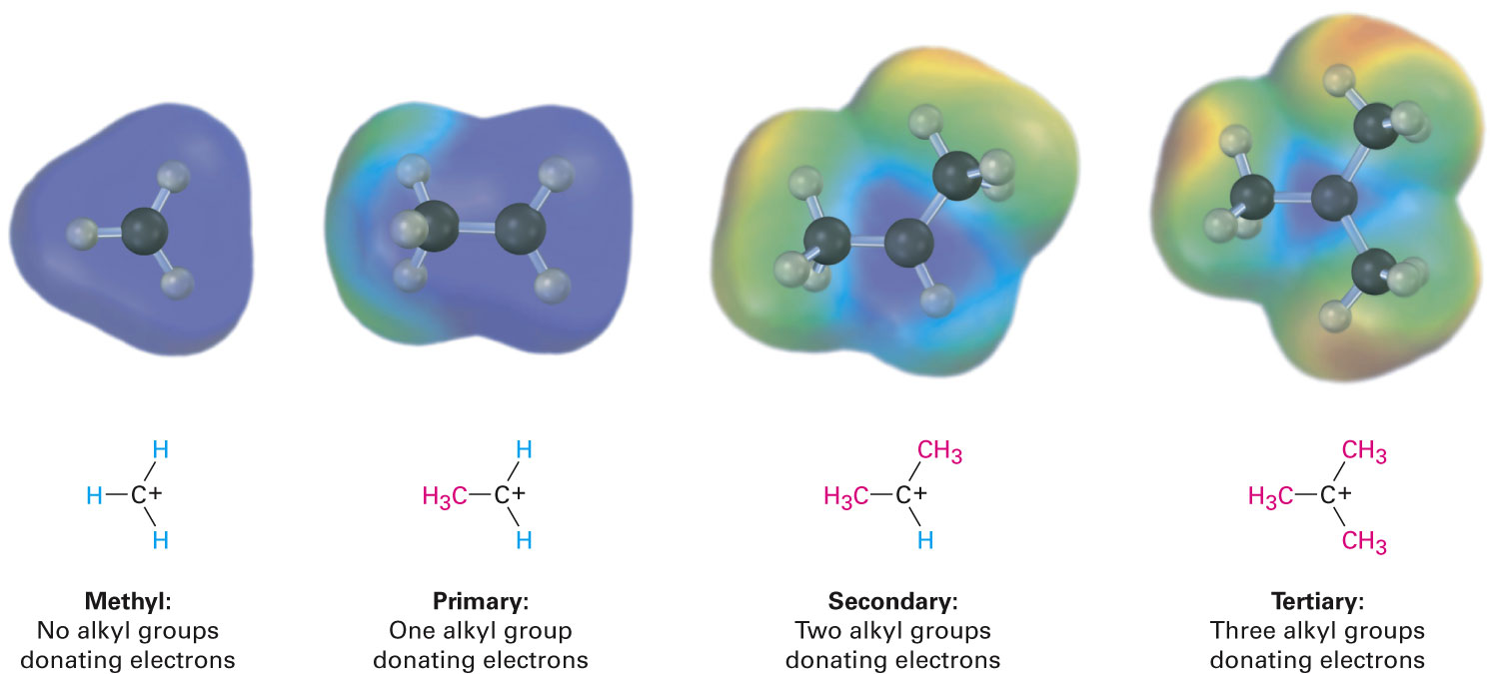
Carbocation Structure and Stability
Highly substituted carbocations are more stable than less substituted ones due to:
Inductive effects
Notes:
Carbocation structure and stability

Slide 56
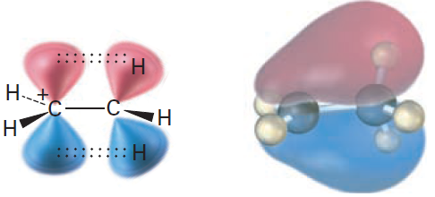
Carbocation Structure and Stability
Hyperconjugation
Higher the number of alkyl groups, more possibilities for hyperconjugation and more stable the carbocation
Notes:
Carbocation structure and stability

Slide 57
Worked Example
Show the structures of the carbocation intermediates expected in the reaction
Solution:
Notes:
Carbocation structure and stability

Slide 58
The Hammond Postulate
It is possible to get a picture of what a given transition state looks like by analysing the structure of the nearest stable species
Exergonic reactions have transition states that resemble a reactant
Endergonic reactions have transition states that resemble a product
Transition state is the highest energy species in a reaction step
Notes:
The Hammond Postulate

Slide 59
Figure 7.13 - Energy Diagrams for Two Similar Competing Reactions
Notes:
The Hammond Postulate

Slide 60
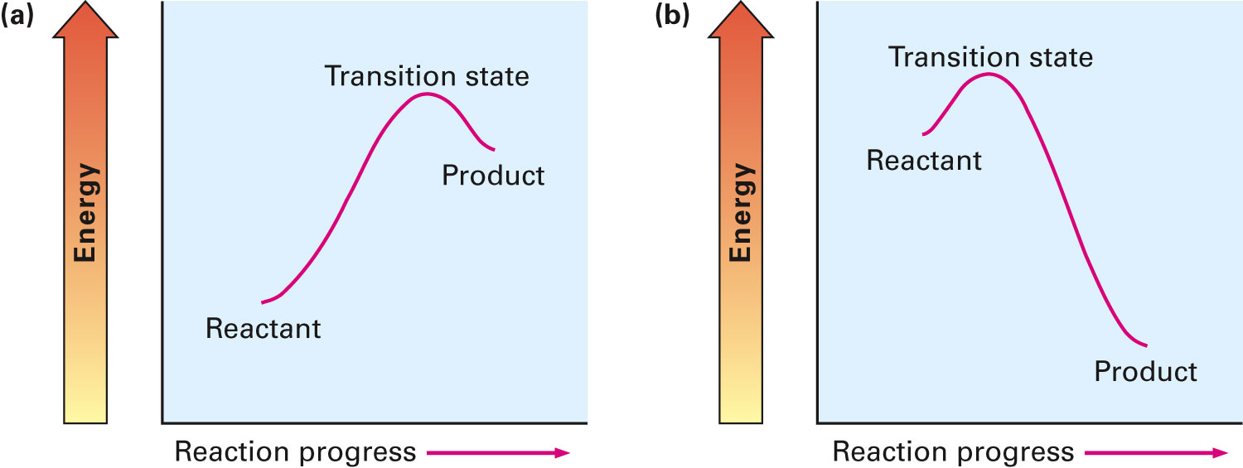
The Hammond Postulate
Transition state for an endergonic reaction step structurally resembles the product of that step
Conversely, transition state for an exergonic reaction step structurally resembles the reactant for that step
Notes:
The Hammond Postulate

Slide 61
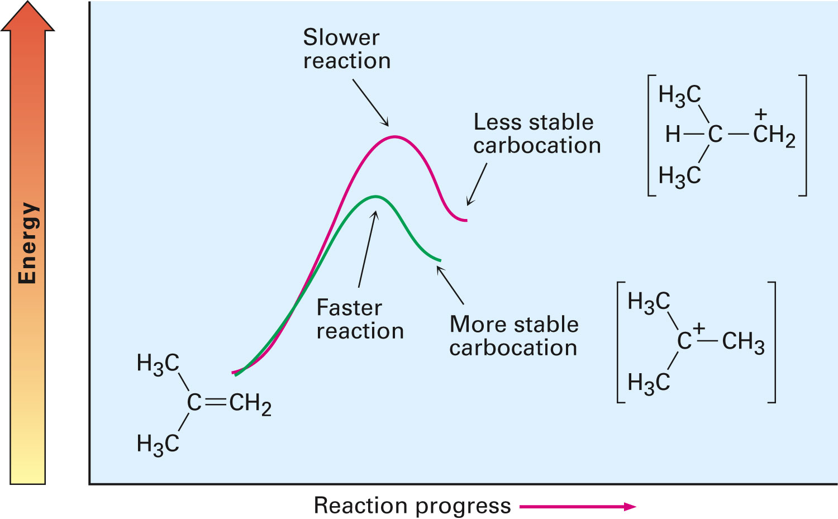
The Hammond Postulate
Faster reaction gives more stable intermediate
Stability is reflected in the lower-energy transition state
More the alkyl groups that are present:
Greater the extent of stabilization
Faster the transition state forms
Notes:
The Hammond Postulate

Slide 62
Worked Example
What about the the second step of electrophilic addition of HCl to an alkene – the reaction of chloride ion with the carbocation intermediate?
Is this step exergonic or endergonic?
Does the transition state for this second step resemble the reactant or product?
Draw what the transition-state structure might look like
Solution:
The second step in the electrophilic addition of HCl to an alkene is exergonic
According to the Hammond postulate, the transition state should resemble the carbocation intermediate
Notes:
The Hammond Postulate

Slide 63
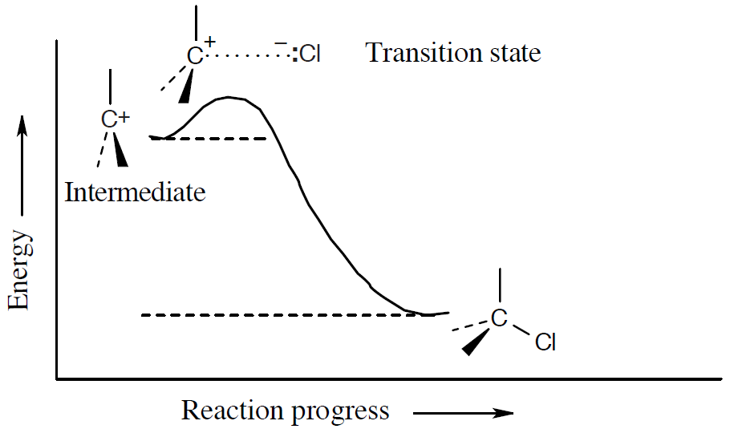
Worked Example
Transition-state structure
Notes:
The Hammond Postulate

Slide 64
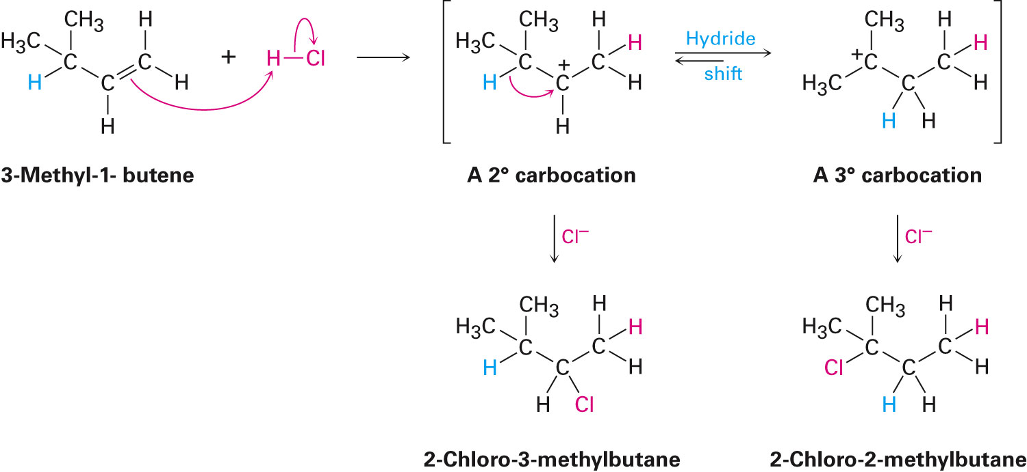
Evidence for the Mechanism of Electrophilic Addition: Carbocation Rearrangements
Carbocations undergo structural rearrangements during reaction of HX with an alkene
Hydride shift: Shift of a hydrogen atom and its electron pair between neighboring carbons
Notes:
Evidence for the mechanism of electrophilic additions: Carbocation rearrangements

Slide 65
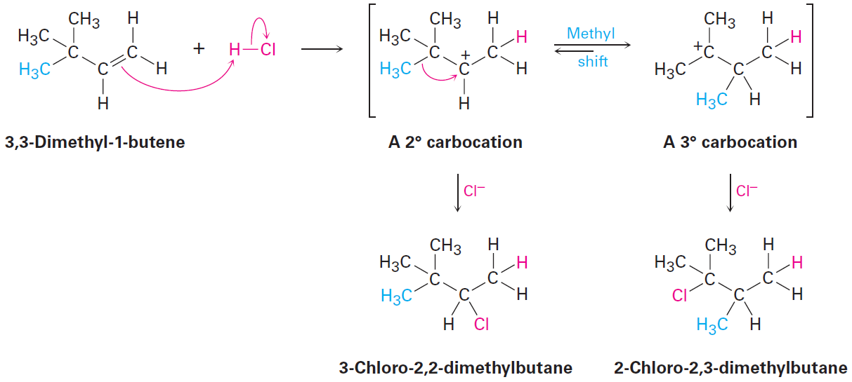
Evidence for the Mechanism of Electrophilic Addition: Carbocation Rearrangements
Carbocation rearrangements can occur by the shift of an alkyl group with its electron pair
Secondary carbocation rearranges to a more stable tertiary carbocation by the shift of a methyl group
Notes:
Evidence for the mechanism of electrophilic additions: Carbocation rearrangements

Slide 66
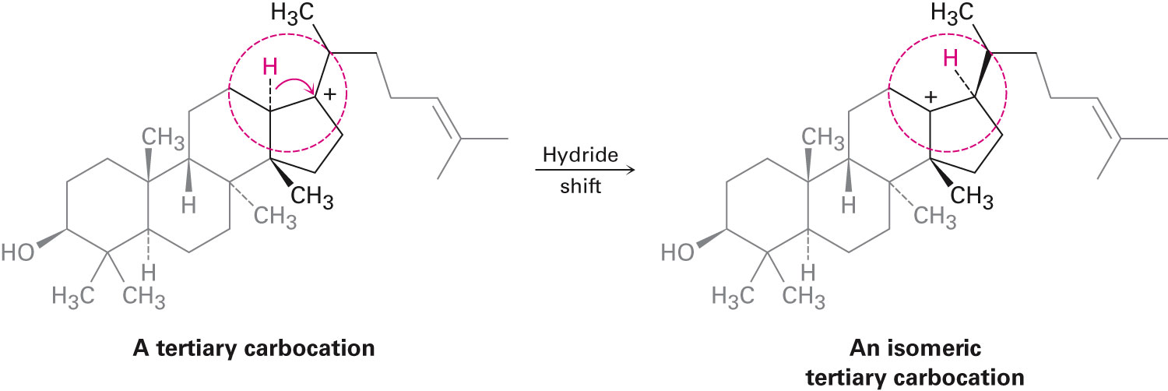
Hydride Shift in Biological Molecules
Notes:
Evidence for the mechanism of electrophilic additions: Carbocation rearrangements

Slide 67
Worked Example
On treatment with HBr, vinylcyclohexane undergoes addition and rearrangement to yield 1-bromo-1-ethylcyclohexane
Using curved arrows, propose a mechanism to account for this result
Notes:
Evidence for the mechanism of electrophilic additions: Carbocation rearrangements

Slide 68
Worked Example
Solution:
Step 1 - Electrophilic addition of H⁺ to double bond
Step 2 - Hydride shift that forms a more stable tertiary carbocation
Step 3 - Reaction of carbocation with Br⁻
Notes:
Evidence for the mechanism of electrophilic additions: Carbocation rearrangements

Slide 69
Summary
Alkene is a hydrocarbon that contains a carbon-carbon double bond
Alkenes are said to be unsaturated because they contain fewer hydrogens than alkanes with the same number of carbons
If the higher-ranking groups on each carbon are on the same side of the double bond, the geometry is Z
If the higher-ranking groups on each carbon are on opposite sides of the double bond, the geometry is E
Alkene chemistry is dominated by electrophilic addition reactions

Slide 70
Summary
Markovnikov’s rule predicts that the H group will add to the carbon having fewer alkyl substituents and the X group will add to the carbon having more alkyl substituent
Hammond postulate states that the transition state of an exergonic reaction step structurally resembles the reactant, whereas the transition state of an endergonic reaction step structurally resembles the product
Rearrangements occur by shift of either a hydride ion, :H⁻ (a hydride shift), or an alkyl anion, :R⁻, from a carbon atom to the neighboring positively charged carbon

