Slide 1
Basics on Molecular Spectroscopy
& Ultraviolet Spectroscopy

Slide 2
Molecular Orbitals
The following topic will help you to understand bonding
Molecular orbitals (MOs) are mathematical equations that describe the regions in a molecule where there is a high probability of finding electrons
Molecular orbitals (MOs) are essentially combinations of atomic orbitals – two types exist, bonding and antibonding orbitals
Molecular orbitals (MOs) are built up (Aufbau principle) in the same way as atomic orbitals

Slide 3
Sigma and pi bonds:
Types of Molecular Orbitals
There are three important types of molecular orbitals
  sigma (σ)
  pi (π)
  n
Each of these types of orbitals will be discussed further...

Slide 4
Sigma and Pi Bonds
Sigma Bonds
symmetric to
rotation about
internuclear
axis
σ
1s-2p
END-TO-END
OVERLAP
σ
2p-2p
Pi Bonds
not symmetric
SIDE-TO-SIDE
OVERLAP
π
2p-2p

Slide 5
Pi (π) Bonds
In a multiple bond, the first bond is a sigma (σ) bond
and the second and third bonds are pi (π) bonds.
π
π
π
σ
σ
Pi bonds are formed differently than sigma bonds.
..
:
n
Non-Bonded Pairs : n
σ
π

Slide 6
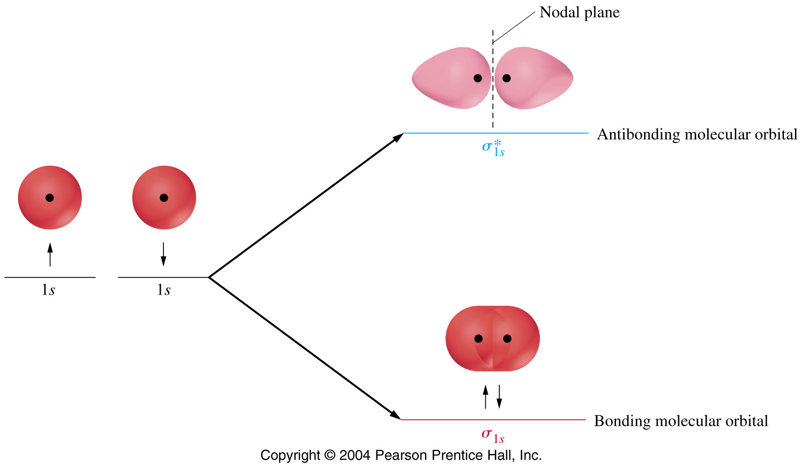
Visualizing MOs
The hydrogen molecule
Antibonding MO = region of diminished electron density
Bonding MO = enhanced region of electron density

Slide 7
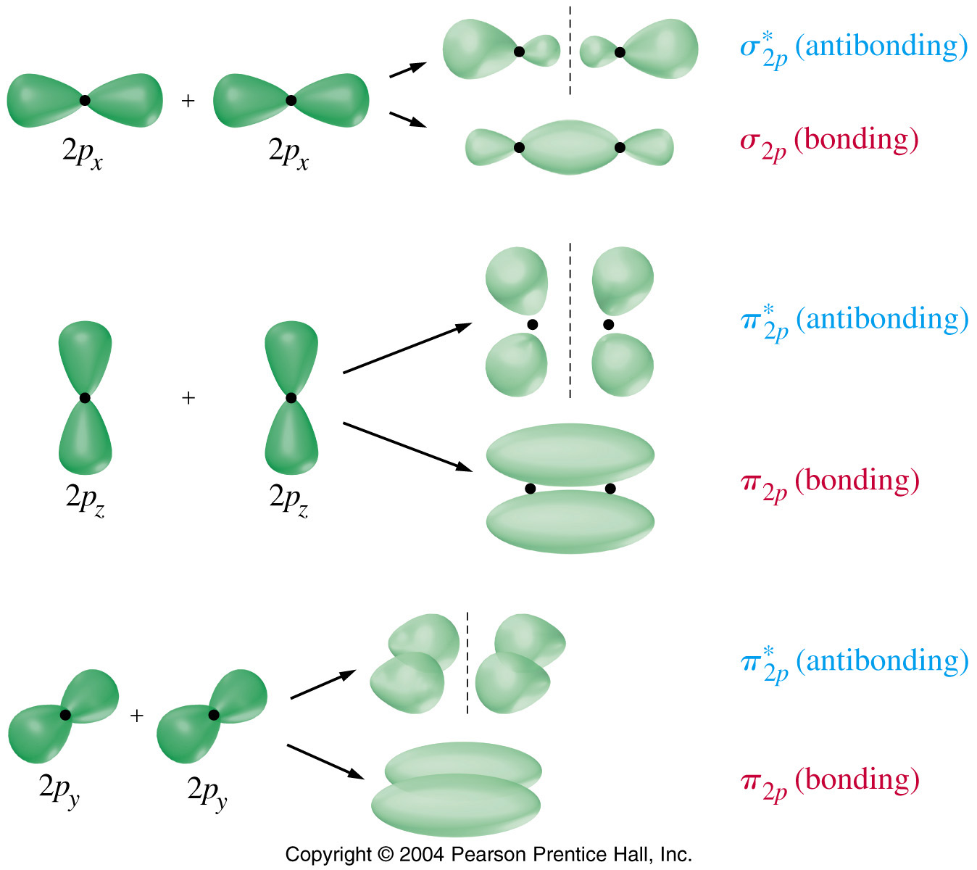
MOs for the 2p Electrons
The two p_{x} orbitals combine to form sigma bonding and antibonding MOs.
The two p_{y} orbitals and the two p_{z} orbitals give pi bonding and antibonding MOs.

Slide 8
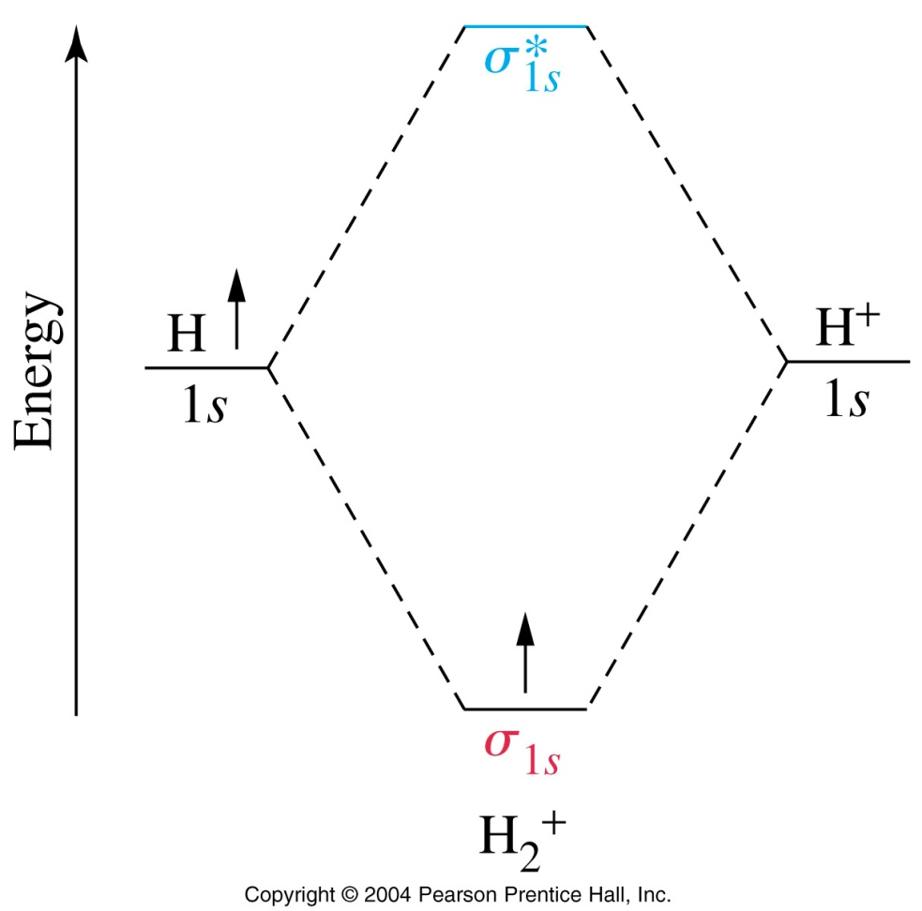
Molecular Orbital Diagram
Antibonding MOs
= higher energy
σ∗ and π∗ MOs
Bonding MOs
s AOs = σ MOs
p AOs = π MOs

Slide 9
MO diagram for He₂⁺ and He₂
σ*_{1s}
σ*_{1s}
Energy
1s
1s
Energy
1s
1s
σ_{1s}
σ_{1s}
AO of He
MO of He⁺
AO of He⁺
AO of He
MO of He₂
AO of He
He₂⁺ bond order = 1/2
He₂ bond order = 0
He₂ does not exist!

Slide 10

SPECTROSCOPY
Interaction of Radiation with a sample
The study of molecular or atomic structure of a substance by observation of its interaction with electromagnetic radiation
QUANTITATIVELY - For determining the amount of material in a sample
QUALITATIVELY – For identifying the chemical structure of a sample

Slide 11
THE ELECTROMAGNETIC SPECTRUM
Most of us are aware of many different ways of transmitting energy and these phenomena come together in one physical entity called the ELECTROMAGNETIC SPECTRUM
The difference between these sources of radiation is the amount of energy they radiate.
The radiation from these and other sources covers a range of energies

Slide 12
The Electromagnetic Spectrum
Gamma rays
X-rays
Ultraviolet
Visible
Infra-red
Microwave
Radio waves
Long
Low
Low
Wavelength
Energy
Frequency
Short
High
High

Slide 13
RADIATION IS TRANSMITTED IN A WAVEFORM
  LOW ENERGY RADIATION has a LONG WAVELENGTH
  HIGH ENERGY RADIATION has a SHORT WAVELENGTH

Slide 14
Radiation Energy
The strength of the radiation energy will interect with the molecules in different ways:
  High energy sources produce breaking of bonds
    X-Ray, γ Rays, …
  Medium energy sources excite electrons
    UV / VISIBLE Spectroscopy
  Low energy sources produce vibrations in chemical bonds
    Infrared Energy
  Very low energy sources produce rotation of the chemical bonds
    Microwaves and Radio waves

Slide 15
EFFECT OF ENERGY ON A MOLECULE
ELECTROMAGNETIC SPECTRUM
ENERGY
( kJ/mol)
1.2 x10⁵
1.2 x10⁷
12000
310
150
0.12
0.0012
e⁻
Electronic excitation
FREQUENCY
(Hz)
10²⁰
10¹⁸
10¹⁶
10¹⁴
10¹²
10⁸
Cosmic rays
γ
rays
x
rays
Ultra violet
visible
Infrared
Microwave
Radio waves
WAVELENGTH
(m)
10⁻¹²
10⁻¹¹
10⁻⁹
10⁻⁶
10⁻³
10⁻¹

Slide 16
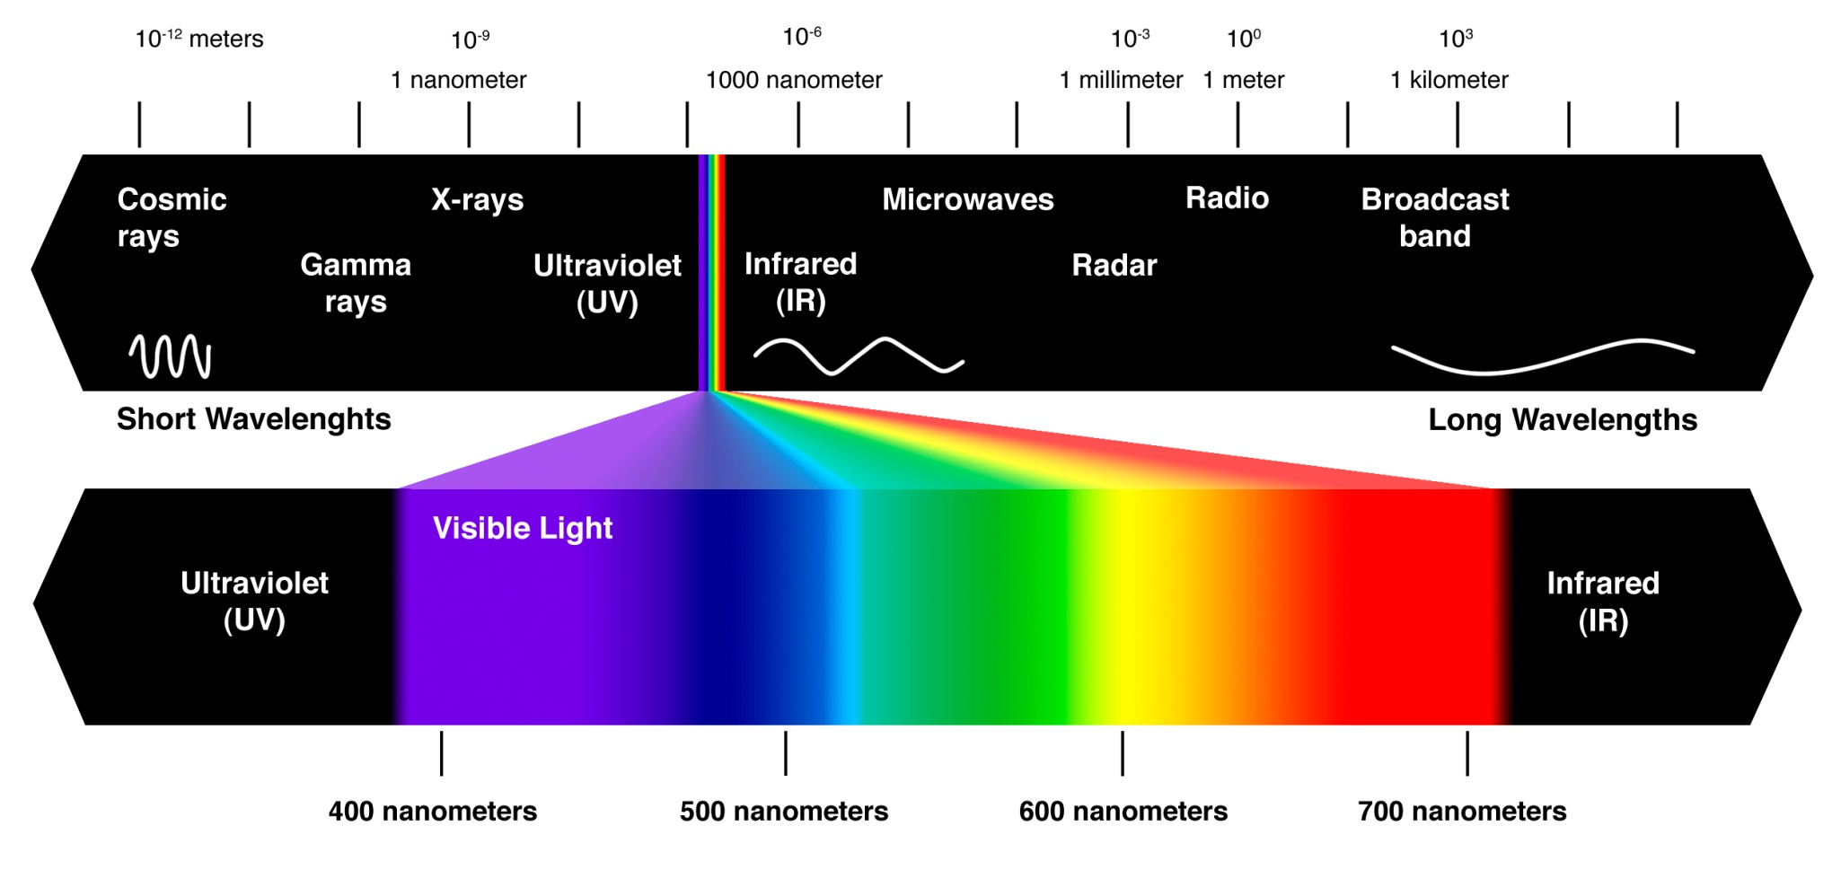
Absorption Spectroscopy
Source
Detector
hν
Sample

Slide 17
VISIBLE SPECTROSCOPY
WHAT IS COLOUR?
Colour is a sensation which occurs when light enters the eye and focuses on the retina at the back of the eye. The light actually initiates a photochemical reaction in the nerve cells attached to the retina. These transmit impulses to the brain and stimulate our sense of colour
CONES - Give colour and three types which pick up red, blue and green
RODS - Give grey/black and also used for night vision.
All the colours we actually sense are made up of these three colours
together with white and grey and black.

Slide 18
VISIBLE SPECTROSCOPY
COMPOSITION OF WHITE LIGHT
Sunlight is white light and covers a wavelength range of 380-750nm. A simple physics experiment shows that white light is actually a composition of a range of colours i.e., light of different energies and hence wavelengths.
When white light falls on an
object the colour detected by
the eye will depend upon the
ABSORPTION/REFLECTION
properties of the material
in the object;
If the material completely REFLECTS all light it appears WHITE
If the material absorbs a constant fraction of the light across the spectrum it appears GREY.
If the material completely ABSORBS all the light it appears BLACK
R
ed
WHITE
O
range
LIGHT
Y
ellow
G
reen
B
lue
I
ndigo
V
iolet

Slide 19
VISIBLE SPECTROSCOPY
When a sample only absorbs light of a single wavelength the eye sees COMPLEMENTARY colours.
Wavelength Range Absorbed | Colour Absorbed | Colour Seen By Eye
380 - 430 | Violet | Yellow - Green
430 - 480 | Blue | Yellow
480 - 490 | Green - Blue | Orange
490 - 500 | Blue - Green | Red
500 - 560 | Green | Purple
560 - 580 | Yellow - Green | Violet
580 - 590 | Yellow | Blue
590 - 610 | Orange | Green - Blue
610 - 750 | Red | Blue - Green
LOW HIGH

Slide 20
Vibrational Energy Levels
Vibrational levels
S1
rotational levels
Effects of the energy levels
depending on the nature of
the energy received
Energy
absorption
Vibrational levels
rotational levels
S0
Ground state
IR
mW
UV-Vis

Slide 21
UV / VISIBLE SPECTROSCOPY
UV Radiation – Wavelength range 220 - 380nm
VISIBLE Radiation – Wavelength range 380 - 780nm
Substances can absorb varying amounts of UV and/or Visible radiation at
particular wavelengths – Coloured compounds absorb energy in both UV
and visible region of the electromagnetic spectrum.
Substances can be liquids or solids and measurements are made with
instruments called SPECTROPHOTOMETERS or SPECTROMETERS.
Modern instruments can be coupled to microscopes which allow solid
samples and very small samples of solids and liquids to be analysed both
qualitatively and quantitatively.

Slide 22
UV / VISIBLE SPECTROSCOPY - THEORY
INCIDENT LIGHT
254nm
SAMPLE
TRANSMITTED LIGHT
254nm
Intensity (I _{o} )
Intensity (I _{t} )
If a particular wavelength of UV or Visible radiation can be isolated from the source and passed through a sample which can ABSORB some of the radiation then the TRANSMITTED light intensity (I t ) will less than the INCIDENT light intensity (I o).
The amount of light transmitted with respect to the incident light is called TRANSMITTANCE (T) ie.,
Sample can absorb all or none of the incident light and therefore
transmittance often quoted as a percentage eg.,
T =
I _{t}
I _{o}
T =
I _{t}
%
X 100
I _{o}

Slide 23
UV / VISIBLE SPECTROSCOPY - THEORY
ABSORBANCE A = - log₁₀ T
I _{t}
2
A = - log₁₀
I _{o}
B
I _{o}
A
A = log₁₀
0
I _{t}
220 380
Wavelength(nm)
For of %T = 0 and 100 the corresponding absorbance
values will be 0 and 2 respectively
By plotting Absorbance vs wavelength an ABSORBANCE SPECTRUM is
generated. The absorbance spectra for the same compounds A and B are
shown.
With the advantage that absorbance measurements are usually linear with
Concentration, absorbance spectra are now used

Slide 24

THE LAWS OF SPECTROPHOTOMETRY
There are two very important basic laws and a third one which is a
combination of the two.
LAMBERTS LAW – ABSORBANCE (A) proportional to the PATHLENGTH (l)
of the absorbing medium.
BEERS LAW - ABSORBANCE (A) proportional to the CONCENTRATION (c)
of the sample.
BEER- LAMBERT LAW - ABSORBANCE (A) proportional to c x l
A ∝ cl
A = Ecl (A is a ratio and therefore has no units)
The constant E is called the MOLAR EXTINCTION COEFFICIENT
Link to “Beer-Lambert law” video

Slide 25
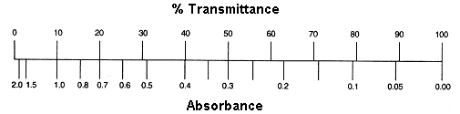
Absorption by the Numbers
hν
hν
Sample
We don’t measure absorbance. We measure transmittance.
Sample
Transmittance:
T = P/P₀
P₀
P
Absorbance:
A = -log T = log P₀/P
(power in)
(power out)

Slide 26
Beer’s Law
The Beer-Lambert Law (λ specific):
A = ε c l
Sample
  A = absorbance (unitless, A = log₁₀ P₀/P)
  ε = molar absorptivity (L mol⁻¹ cm⁻¹)
  l = path length of the sample (cm)
  c = concentration (mol/L or M)
P₀
P
(power in)
(power out)
l in cm
Concentration
Absorbance
Path length
Absorbance
Molar Abs.
Absorbance

Slide 27
UV / VISIBLE SPECTROSCOPY - THEORY
UNITS OF THE MOLAR EXTINCTION COEFFICIENT
CONCENTRATION (c) - Moles litre⁻¹
PATHLENGTH (l) - cm
A = Ecl Hence E = A
c l
E = 1 ˛
mole litre-1 x cm
E = mole-1 litre x cm ⁻¹
But 1 litre = 1000cm3
E = 1000 mole -1 cm3 x cm ⁻¹
Hence Units of E = 1000 cm2 mole ⁻¹

Slide 28
UV / VISIBLE SPECTROSCOPY - THEORY
IMPORTANCE OF THE BEER LAMBERT LAW
A = Ecl but if E and l are constant
ABSORBANCE ∝ CONCENTRATION and should be linear relationship
Prepare standards of the analyte to be quantified at known concentrations
and measure absorbance at a specified wavelength.
Prepare calibration curve.
From measuring absorbance of sample
Concentration of analyte in sample
can be obtained from the calibration curve
E can be obtained from the slope of the
calibration curve for a given wavelength (λ)
x
x
ABSORBANCE AT 300nm
x
x
x
CONCENTRATION (moles litre⁻¹ )

Slide 29
UV / VISIBLE SPECTROSCOPY - THEORY
RULES FOR QUANTITATIVE ANALYSES
At high concentrations the calibration curve may deviate from linearity – Always ensure your concentration of the sample falls within the linear range – if necessary dilute sample
Absorbance not to exceed 1 to reduce error*
CHOOSE CORRECT WAVELENGTH
An analyte may give more than one absorbance maxima (λ_{max}) value.
Many compounds absorb at 220-230nm hence do not use A
Need to choose wavelength more specific
to compound (SELECTIVITY) and if more
than one select one with highest absorbance
as this gives less error – hence use C
x
x
ABSORBANCE AT 300nm
x
x
x
CONCENTRATION (moles litre⁻¹ )
A
C
λ_{max}
B
0.6
0
220 380
Wavelength (nm)

Slide 30
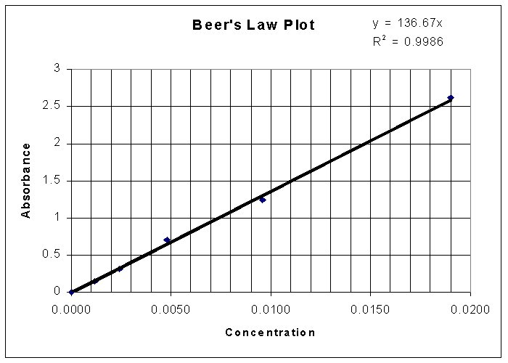
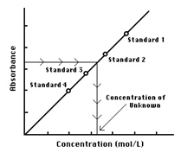
Beer’s Law
The Beer-Lambert Law:
  A = absorbance (unitless, A = log₁₀ P₀/P)
  ε = molar absorbtivity (L mol⁻¹ cm⁻¹)
  l = path length of the sample (cm)
  c = concentration (mol/L or M)
A = ε c l
Find ε
Make a solution of know concentration (C)
Put in a cell of known length (l)
Measure A by UV-Vis
Calculate ε
A = ε c l
y = m x + b
Find Concentrations
Know ε
Put sample in a cell of known length (l)
Measure A by UV-Vis
Calculate C
A = ε c l

Slide 31
Beer’s Law Applied to Mixtures
N719
RuP2
A₁ = ε₁ c₁ l
A_{total} = A₁ + A₂ + A₃…
A_{total} = ε₁ c₁ l + ε₂ c₂ l + ε₃ c₃ l
A_{total} = l(ε₁ c₁ + ε₂ c₂ + ε₃ c₃)

Slide 32
Let’s play a bit !
A couple of things to take into account…
The intensity of incident light from the light source is always 110.0 photons/sec
You have to calculate Transmittance T= It / Io and Absorbance A=–Log T by yourself and supply the website with the values you obtain
Now you can play with the virtual spectrophotometer changing the path length,
concentration, calculate the Molar Absorptivity (or Molar Extinction Coefficient)
And run a calibration curve….
Enjoy!!

Slide 33
Example of calculations for photometry
Given the following set of data for a compound C:
Can you give the least square equation better fitting the curve?
(Conc=X, Abs=Y)
Conc (M) | Abs
0.1 | 0.2322
0.2 | 0.3456
0.3 | 0.4532
0.4 | 0.5331
0.5 | 0.6453

Slide 34
Is the fitting of the curve to the equation acceptable? How can you tell?
What is the concentration of C when we obtain an Absorbance of 0.3321?
The concentration is: Abs= 1.0137 * Conc + 0.1378
Abs= 0.3321 – Abs blank= 0.3321- 0.13800 = 0.1941
Conc= Abs – 0.1378 = 0.1941 – 0.1378 = 0.055 M
1.0137 1.0137

Slide 35
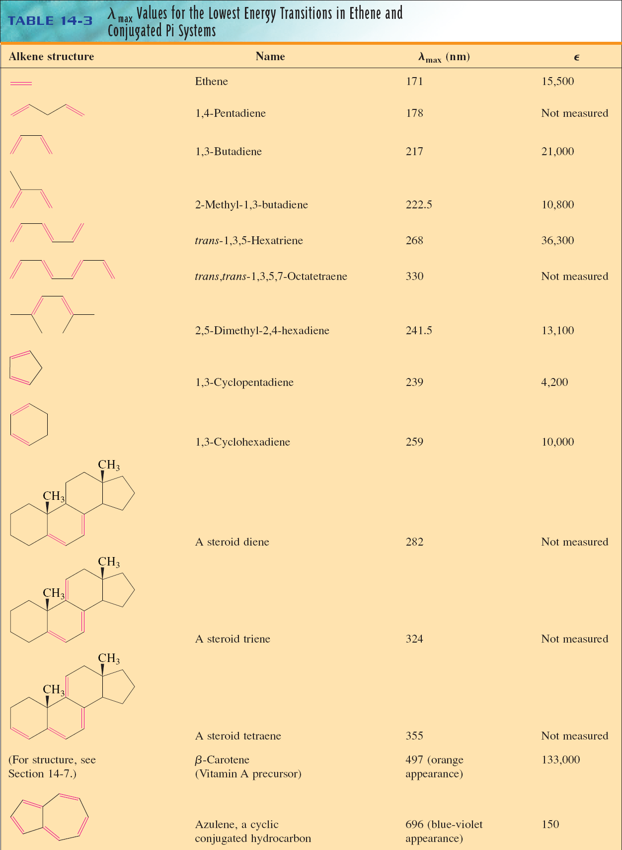

Beer- Lambert Law
Absorbance is directly proportional to concentration

Slide 36
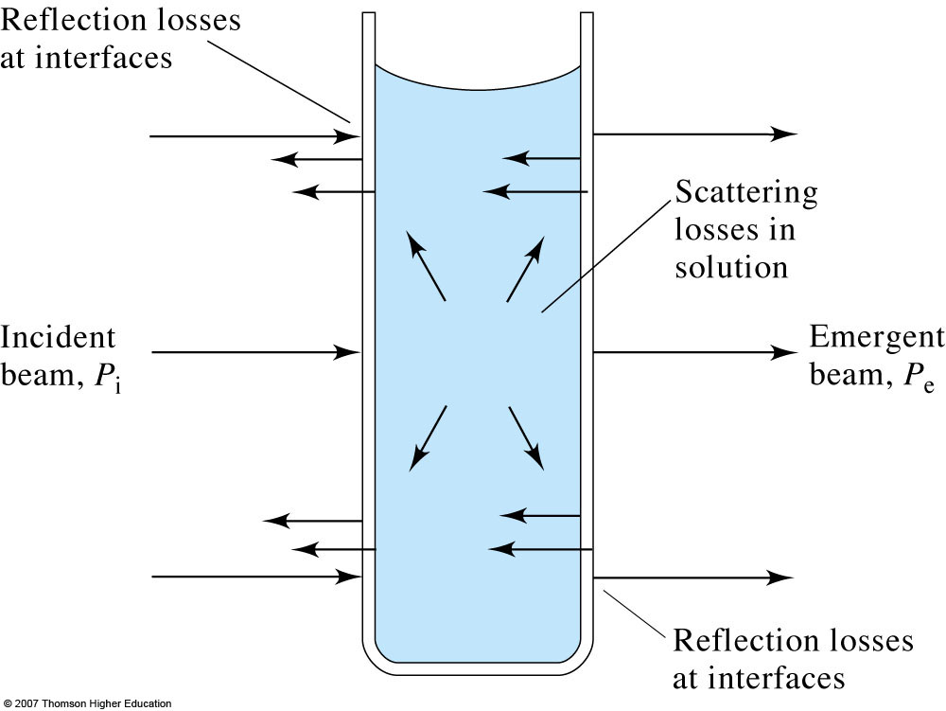
Transmission and absorbance and losses
The reduction in the intensity of light transmitted through a sample can be used to quantitate the amount of an unknown material.

Slide 37
Beer’s Law
Quantitative relationship between absorbance and concentration of analyte
  See derivation in text (Skoog: pages 337-338)
Absorption is additive for mixtures
Really: A_{λ} = ε_{λ}bc
Beer’s Law is always wavelength-specific

Slide 38
Limitations and deviations from Beer’s Law
Real limitations
  Non-linearities due to intermolecular interactions
    Self aggregation effects and electrolyte effects
Apparent
  Dynamic dissociation or association of analyte
Instrumental
  Polychromatic radiation
    Different molar absorptivities at different wavelength leads to non-linearities in Beer’s Law
  Stray radiation
  Mistmatched cells
    Non-zero intercept in calibration curve
How might one avoid?

Slide 39
How to make a UV-vis absorption measurement
Make a 0%T (dark current) measurement
Make a 100%T (blank) measurement
Measure %T of sample
Determine %T ratio and thus the absorbance value

Slide 40
Instrument configurations
Single-beam
Double-beam
Multichannel

Slide 41
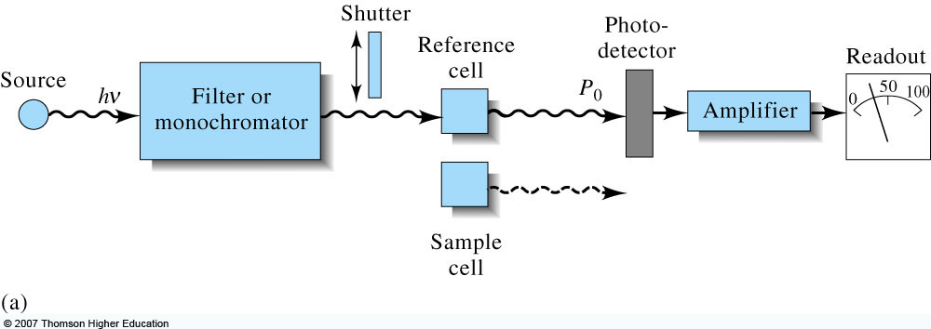
Single-beam UV-vis spectrometers
Skoog, Fig. 13-13
Good light throughput, but
what if the source
power fluctuates?

Slide 42
Double-beam in time UV vis spectrometers
Beam is split in two, but measured by same detector
“in time” because
the beam appears in 2 places over one cycle in time
- Sample
- Reference
Sample
Reference
What if the source
power fluctuates?
Skoog, Fig. 13-13

Slide 43
Double-beam in space UV-vis spectrometers
Beam is split into two paths and measured by matched detectors
  Difficult to find perfectly matched detectors
“in space” because
two beams are always
present in space
Continuous
Reference
What if the source
power fluctuates?
Continuous
Sample

Slide 44
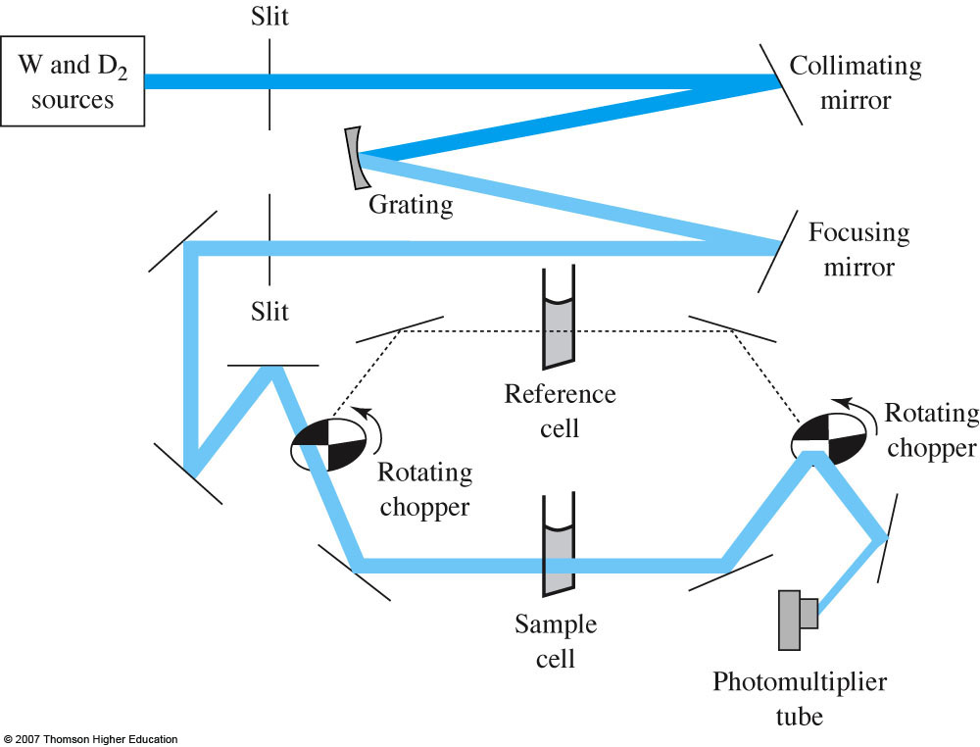
Cary 100 double beam spectrometer
- Sample
- Dark
- Reference
- Dark

Slide 45
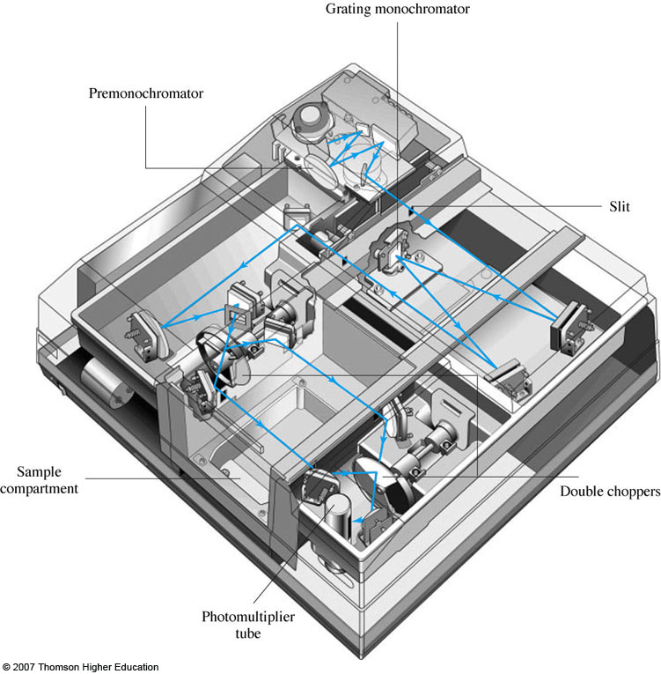
Cary 300 double-dispersing spectrophotometer
Why does double dispersion help with extending absorption to ~5.0 absorbance units?
Two gratings
Reduced stray light
  0.00008% or less
Improved spectral resolution
  Bandwidth < 4 nm
If Abs = 5.0, %T = ?

Slide 46
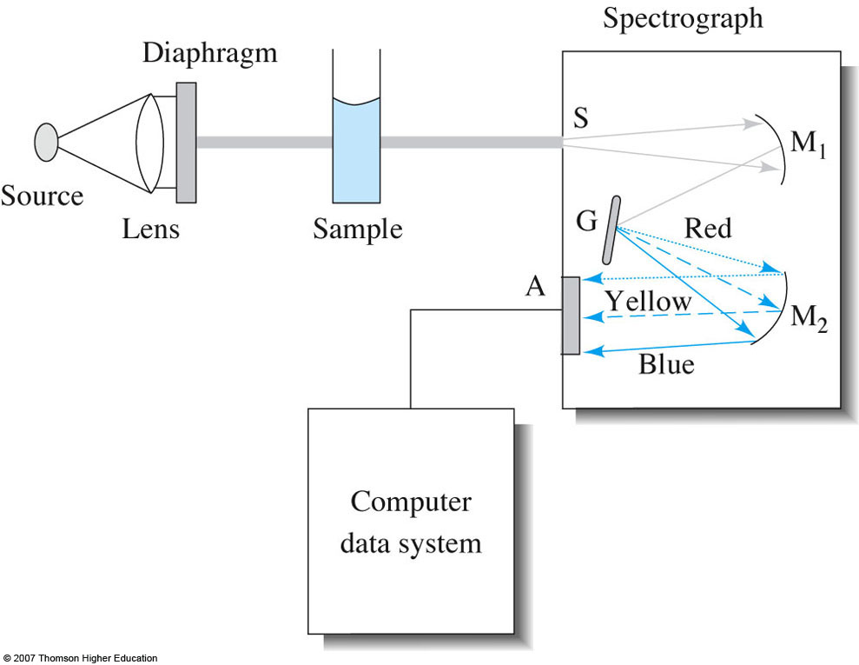
Multichannel UV-vis spectrometers
Dispersing optic (grating or prism) used to separate different wavelengths in space.
Detection with diode array or CCD
Fast acquisition of entire spectrum

Slide 47
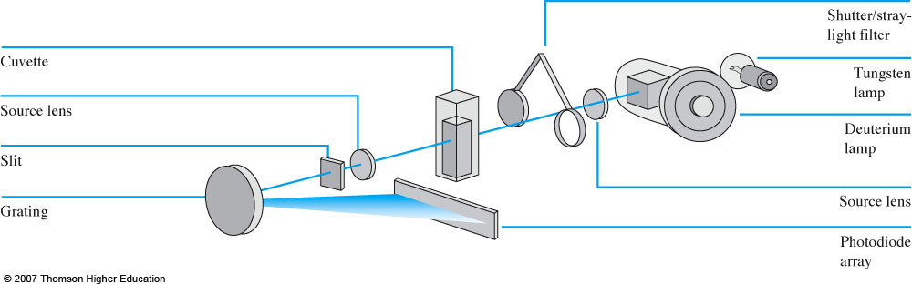
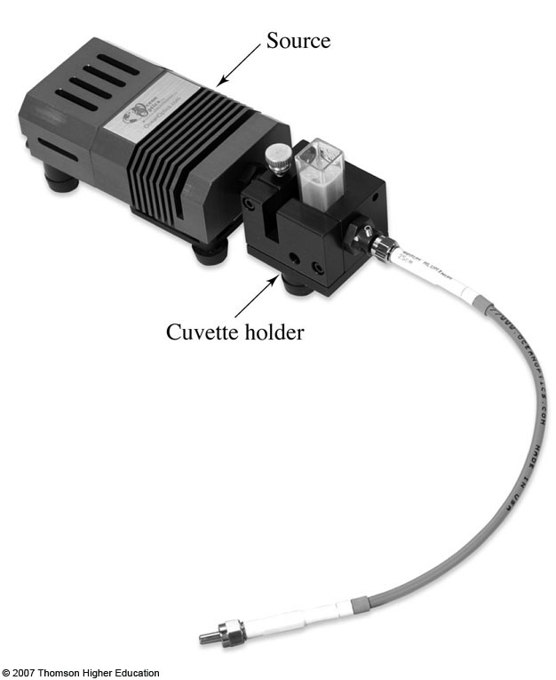
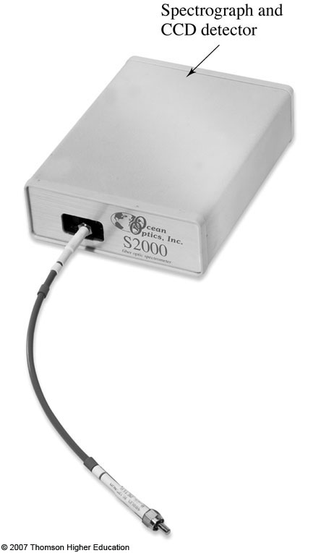
Diode array spectrophotometers
Fairly inexpensive, but good quality fiber optic models available for ~$3000.
Ocean Optics
StellarNet

Slide 48
QUANTIZED MO ENERGEY LEVELS FOUND IN ORGANIC MOLECULES

Slide 49
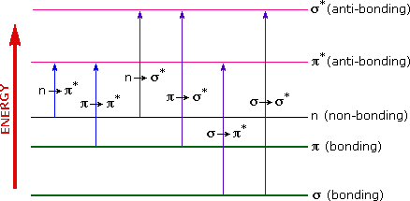
Vacuum UV or Far UV
(λ<190 nm )
UV/VIS

Slide 50
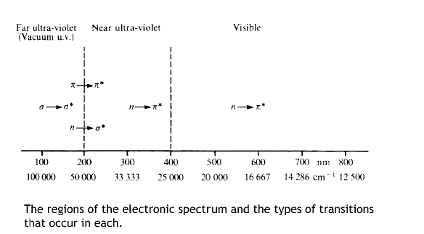

Slide 51
UV Spectroscopy
Introduction
  Observed electronic transitions
    From the molecular orbital diagram, there are several possible electronic transitions that can occur, each of a different relative energy:
σ∗
σ
σ
π
n
n
σ∗
π∗
π∗
σ∗
π∗
alkanes
carbonyls
unsaturated cmpds.
O, N, S, halogens
carbonyls
π∗
Energy
n
π
σ

Slide 52
    Although the UV spectrum extends below 100 nm (high energy), oxygen in the atmosphere is not transparent below 200 nm
    Special equipment to study vacuum or far UV is required
    Routine organic UV spectra are typically collected from 200-700 nm
    This limits the transitions that can be observed:
  Observed electronic transitions
σ
σ
π
n
n
σ∗
π∗
π∗
σ∗
π∗
alkanes
carbonyls
unsaturated cmpds.
O, N, S, halogens
carbonyls
150 nm
170 nm
180 nm √ - if conjugated!
190 nm
300 nm √

Slide 53
Chromophore | Excitation | λ_{max}, nm | Solvent
C=C | π→π* | 171 | hexane
C=O | n→π* π→π* | 290 180 | hexane hexane
N=O | n→π* π→π* | 275 200 | ethanol ethanol
C-X X=Br, I | n→σ* n→σ* | 205 255 | hexane hexane

Slide 54
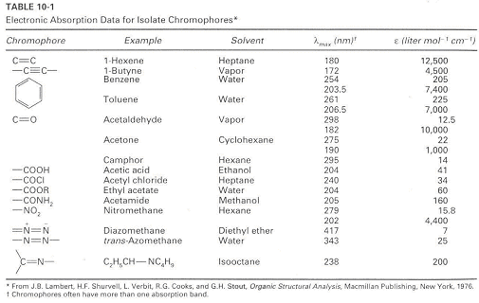

Slide 55
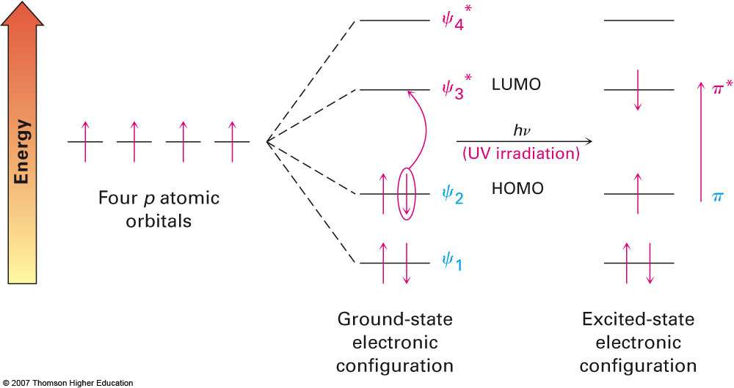
Ultraviolet Spectrum of 1,3-Butadiene
Example: 1,4-butadiene has four π molecular orbitals with the lowest two occupied
Electronic transition is from HOMO to LUMO at 217 nm (peak is broad because of combination with stretching, bending)

Slide 56
Electron transition in organic compounds

Slide 57
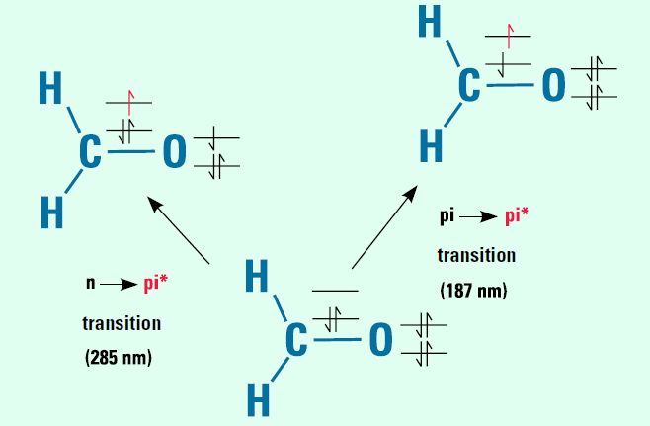
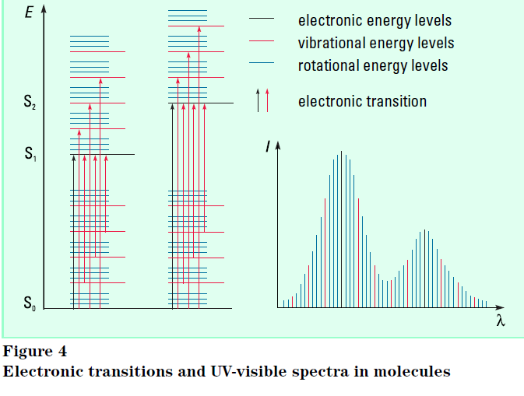
Electronic transition in Formaldehyde

Slide 58
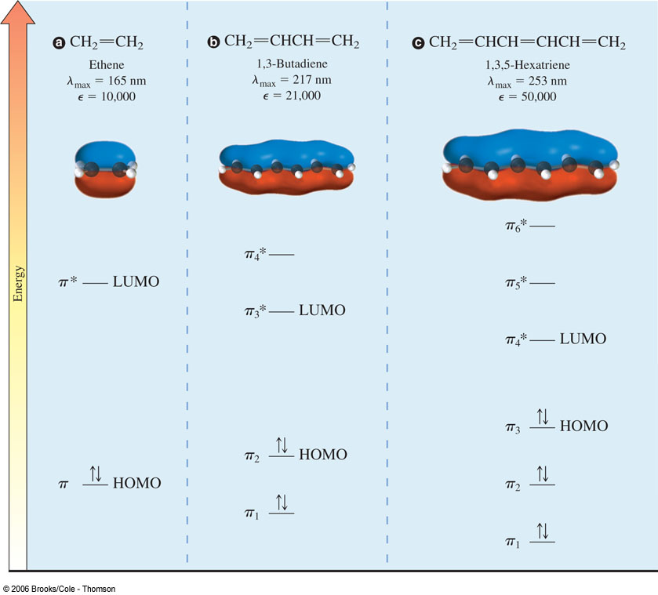
As the
chromophore
becomes more
conjugated, the
absorption max
moves to longer
wavelengths.
Notes:
Delocalized pi MO’s must be used to describe conjugated systems. The energy of the HOMO (pi) increases and the energy of the LUMO (pi*) decreases as the number of conjugated pi bonds increases. This results in an absorption at lower energy (longer wavelength).
These are all π → π* transitions. Note they have large extinction coefficients.

Slide 59
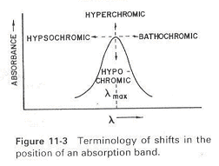
Terms describing UV absorptions
1. Chromophores: functional groups that give
electronic transitions.
2. Auxochromes: substituents with unshared pair e's like OH, NH, SH ..., when attached to π chromophore they generally move the absorption max. to longer λ.
3. Bathochromic shift: shift to longer λ, also called red shift.
4. Hysochromic shift: shift to shorter λ, also called blue shift.
5. Hyperchromism: increase in ε of a band.
6. Hypochromism: decrease in ε of a band.

Slide 60
  Organic Chromophores
    Alkanes – only posses σ-bonds and no lone pairs of electrons, so only the high energy σ → σ* transition is observed in the far UV
    This transition is destructive to the molecule, causing cleavage of the σ-bond
Chromophores
σ∗
σ

Slide 61
  Organic Chromophores
    Alcohols, ethers, amines and sulfur compounds – in the cases of simple, aliphatic examples of these compounds the n → σ* is the most often observed transition; like the alkane σ → σ* it is most often at shorter λ than 200 nm
    Note how this transition occurs from the HOMO to the LUMO
Chromophores
σ∗_{CN}
n_{N sp}3
σ_{CN}

Slide 62
Chromophores
  Organic Chromophores
    Alkenes and Alkynes – in the case of isolated examples of these compounds the π → π* is observed at 175 and 170 nm, respectively
    Even though this transition is of lower energy than σ → σ*, it is still in the far UV – however, the transition energy is sensitive to substitution
π∗
π

Slide 63
Chromophores
  Organic Chromophores
    Carbonyls – unsaturated systems incorporating N or O can undergo n → π* transitions (~285 nm) in addition to π → π*
    Despite the fact this transition is forbidden by the selection rules (ε = 15), it is the most often observed and studied transition for carbonyls
    This transition is also sensitive to substituents on the carbonyl
    Similar to alkenes and alkynes, non-substituted carbonyls undergo the π → π* transition in the vacuum UV (188 nm, ε = 900); sensitive to substitution effects

Slide 64
  Organic Chromophores
    Carbonyls – n → π* transitions (~285 nm); π → π* (188 nm)
Chromophores
π∗
It has been determined from spectral studies, that carbonyl oxygen more approximates sp rather than sp² !
n
π
σ_{CO} transitions omitted for clarity

Slide 65
Chromophores
  Substituent Effects
    General – from our brief study of these general chromophores, only the weak n → π* transition occurs in the routinely observed UV
    The attachment of substituent groups (other than H) can shift the energy of the transition
    Substituents that increase the intensity and often wavelength of an absorption are called auxochromes
    Common auxochromes include alkyl, hydroxyl, alkoxy and amino groups and the halogens

Slide 66
  Substituent Effects
    General – Substituents may have any of four effects on a chromophore
      Bathochromic shift (red shift) – a shift to longer λ; lower energy
      Hypsochromic shift (blue shift) – shift to shorter λ; higher energy
      Hyperchromic effect – an increase in intensity
      Hypochromic effect – a decrease in intensity
Chromophores
Hyperchromic
ε
Hypsochromic
Bathochromic
Hypochromic
200 nm
700 nm

Slide 67
  Substituent Effects
    Conjugation – most efficient means of bringing about a bathochromic and hyperchromic shift of an unsaturated chromophore:
Chromophores
λ_{max} nm ε
175 15,000
217 21,000
258 35,000
465 125,000
n → π* 280 12
π → π* 189 900
n → π* 280 27
π → π* 213 7,100

Slide 68
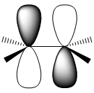
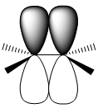
  Substituent Effects
    Conjugation – Alkenes
    The observed shifts from conjugation imply that an increase in conjugation decreases the energy required for electronic excitation
    From molecular orbital (MO) theory two atomic p orbitals, φ₁ and φ₂ from two sp² hybrid carbons combine to form two MOs Ψ₁ and Ψ₂* in ethylene
Chromophores
Ψ₂∗
φ₁
φ₂
Ψ₁
π

Slide 69
Chromophores
  Substituent Effects
    Conjugation – Alkenes
    When we consider butadiene, we are now mixing 4 p orbitals giving 4 MOs of an energetically symmetrical distribution compared to ethylene
Ψ₄∗
Ψ₂∗
Ψ₃∗
Ψ₂
Ψ₁
π
Ψ₁
ΔE for the HOMO → LUMO transition is reduced

Slide 70
Chromophores
  Substituent Effects
    Conjugation – Alkenes
    Extending this effect out to longer conjugated systems the energy gap becomes progressively smaller:
Energy
Lower energy =
Longer wavelenghts
ethylene
butadiene
hexatriene
octatetraene

Slide 71
  Substituent Effects
    Conjugation – Alkenes
    Similarly, the lone pairs of electrons on N, O, S, X can extend conjugated systems – auxochromes
    Here we create 3 MOs – this interaction is not as strong as that of a conjugated π-system
Chromophores
Ψ₃∗
π∗
Ψ₂
Energy
π
n_{A}
Ψ₁

Slide 72
Chromophores
  Substituent Effects
    Conjugation – Alkenes
    Methyl groups also cause a bathochromic shift, even though they are devoid of π- or n-electrons
    This effect is thought to be through what is termed “hyperconjugation” or sigma bond resonance

Slide 73
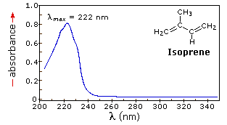
π π∗

Slide 75
UV-Visible Spectroscopy
  Table 20.3 Wavelengths and energies required for π to π* transitions of ethylene and three conjugated polyenes

Slide 76
UV-Visible Spectroscopy
  The visible spectrum of β-carotene (the orange pigment in carrots) dissolved in hexane shows intense absorption maxima at 463 nm and 494 nm, both in the blue-green region.

Slide 77
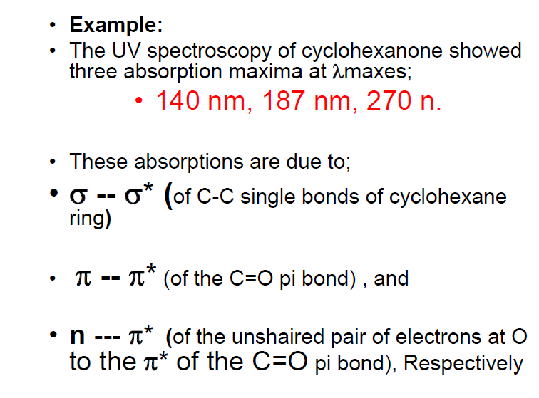
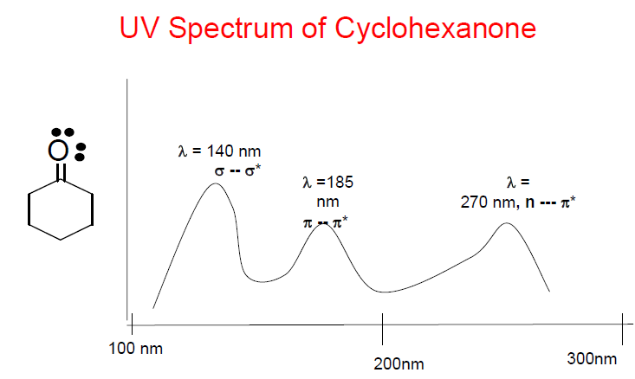

Slide 78
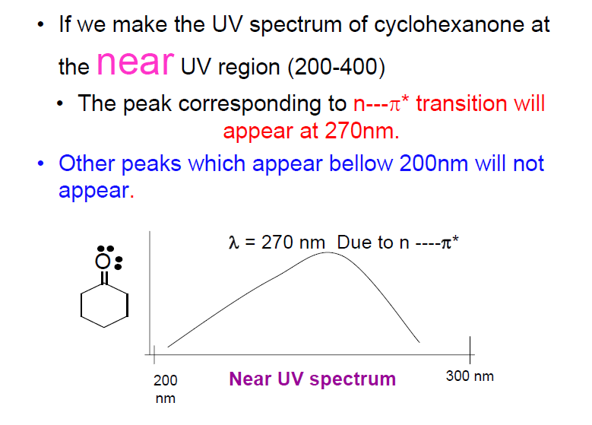

Slide 79
