Slide 1
BENZENE & its Aromaticity
CHEM 2425
Chapter 15

Slide 2
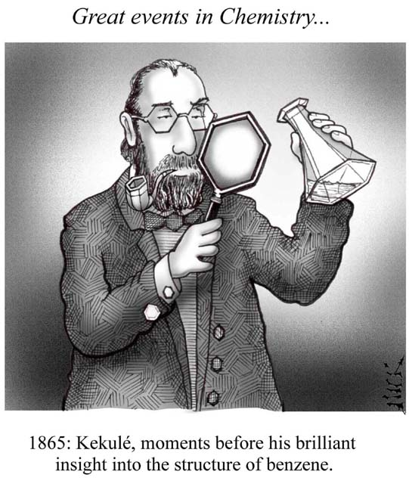
Benzene and Its Derivatives

Slide 3
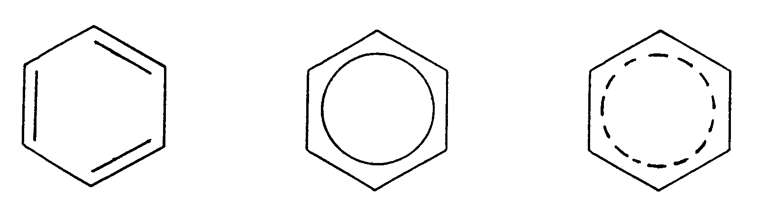
Symbols for Benzene
Kekulé structure…keeps π electrons clearly in mind
2 delocalized representations
H’s not usually written in either

Slide 4
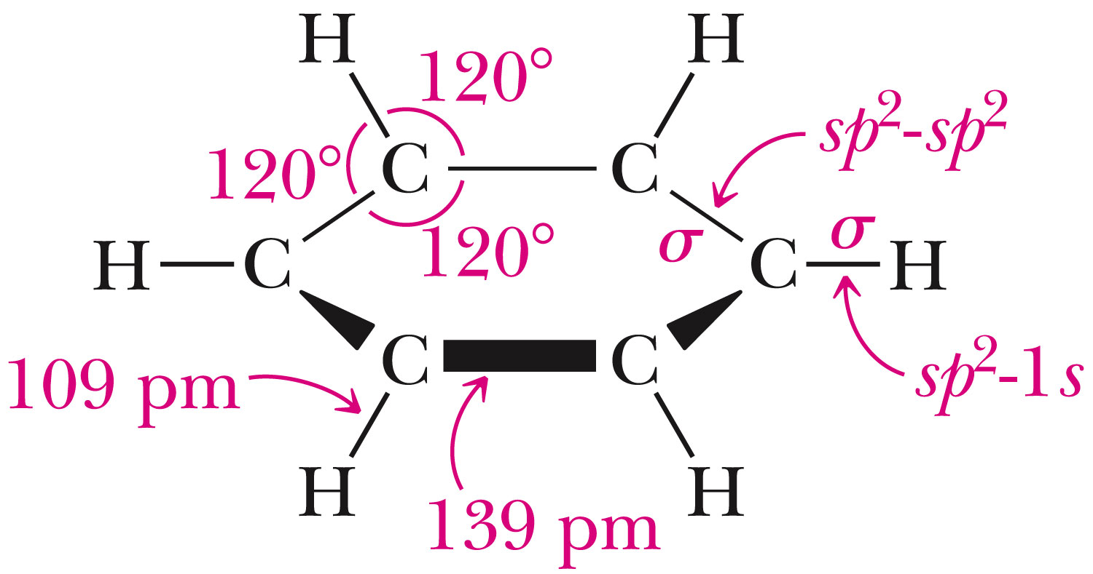
Benzene Structure

Slide 5
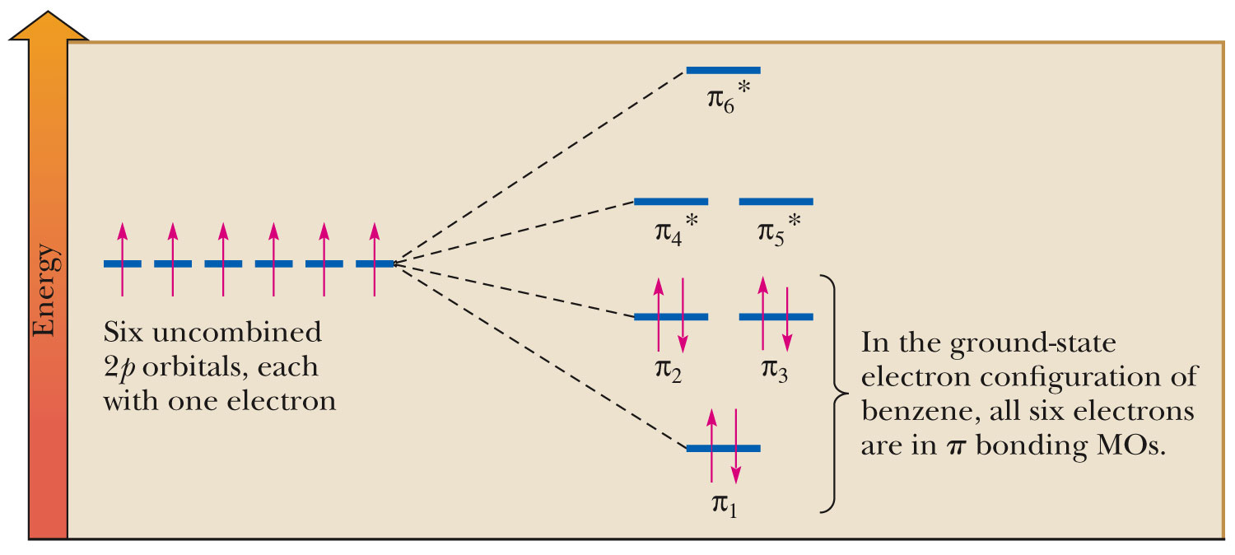
Benzene MOs

Slide 6
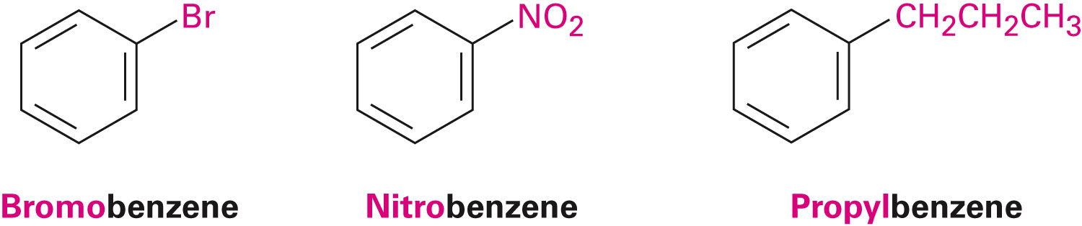
I. Nomenclature
Monosubstituted benzenes
  Substituent name + “benzene”

Slide 7
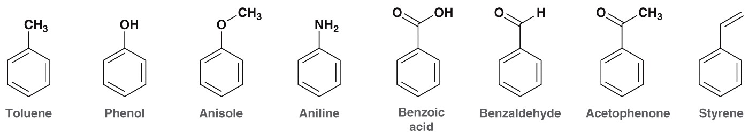
Common Benzene Compounds

Slide 8
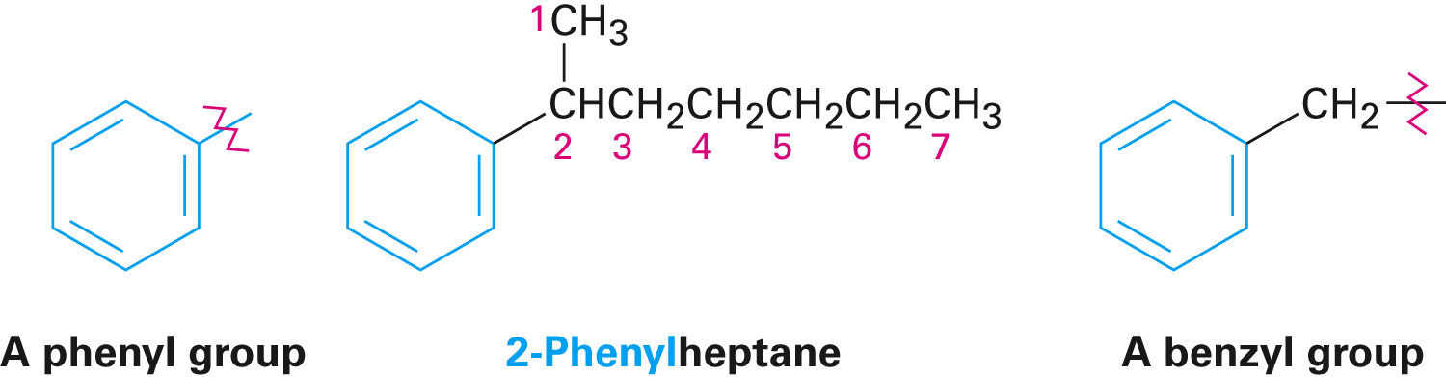
Benzene Nomenclature
If substituent has greater than 6 carbons, it becomes the parent, and benzene is called a phenyl group
Benzene substituents:
(Ph‒ or Φ‒)

Slide 9
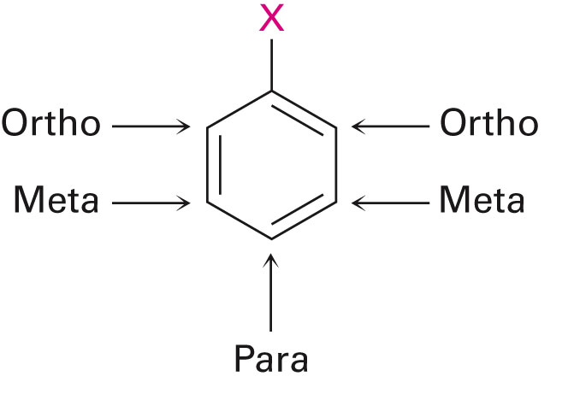
Disubstituted Benzenes
ortho (1,2)
meta (1,3)
para (1,4)

Slide 10
Naming Disubstituted Benzenes
If one substituent is part of a common name, that name is the parent and that substituent is at carbon 1
If neither substituent is part of a common name, list the substituents in alphabetical order (first alphabetically is at carbon 1)
If both substituents are part of common name, use this order of priority to determine the parent name:
-CO₂H > -CHO > -OH > -NH₂ > -CH₃

Slide 11
Naming Polysubstituted Benzenes
With 3 or more substituents do not use ortho, meta, para
Number ring to give smallest set of numbers
If a common name, use as parent (substituent at carbon 1)
List substituents in alphabetical order

Slide 12
II. Physical Properties
Melting point
  Based on “packing”
  Benzene packs easily, so has a higher mp than other hydrocarbons
  Substituted benzenes: para > ortho and meta due to packing
Boiling point
  Polarity depends on substituents
  Higher polarity = higher boiling point
mp (°C) | -17 | -25 | 54
bp (°C) | 181 | 173 | 170

Slide 13
Physical Properties
Melting points: More symmetrical than corresponding alkane, pack better into crystals, so higher melting points.
Boiling points: Dependent on dipole moment, so ortho > meta > para, for disubstituted benzenes.
Density: More dense than nonaromatics, less dense than water.
Solubility: Generally insoluble in water.

Slide 14
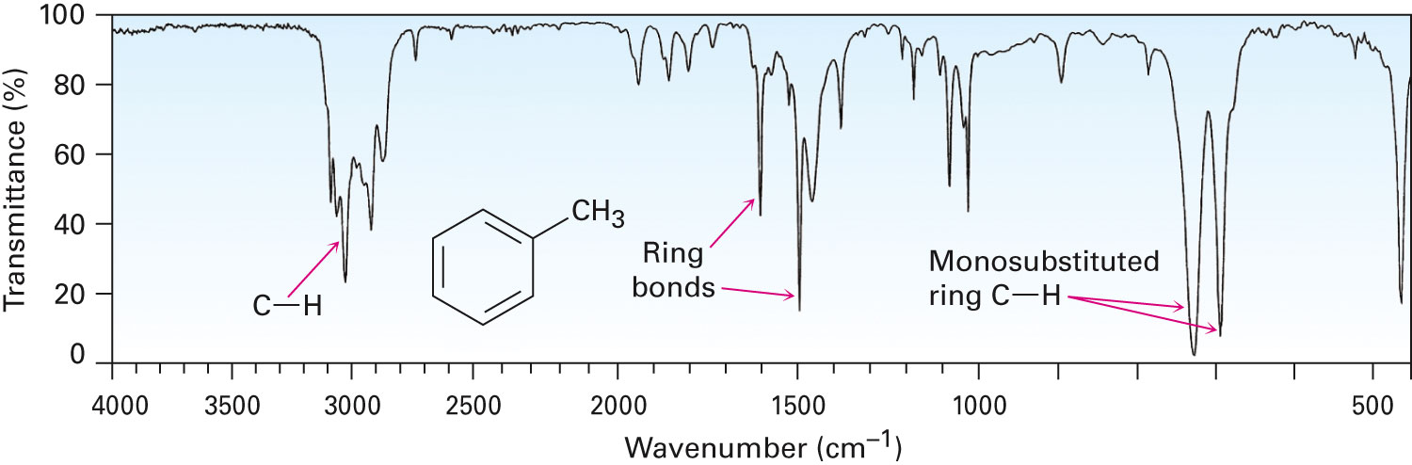
III. Spectroscopy of Aromatics: IR
sp² C-H absorption at 3030 cm⁻¹
Ring absorptions at 1450-1600 and 1660-2000 cm⁻¹
Also peaks in fingerprint region can differentiate substitution pattern

Slide 15
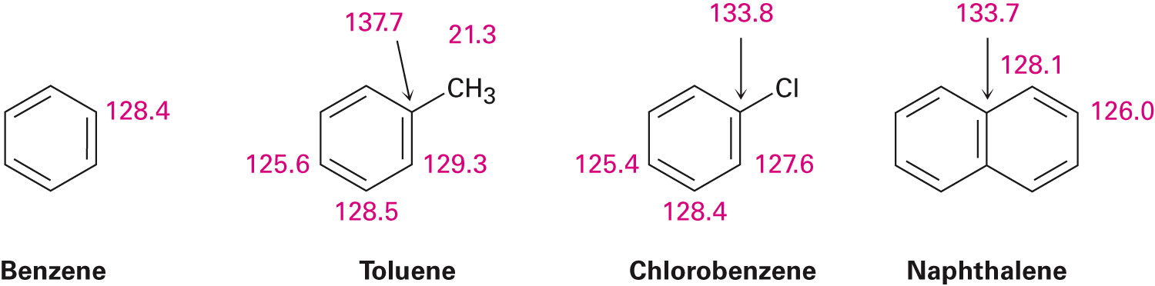
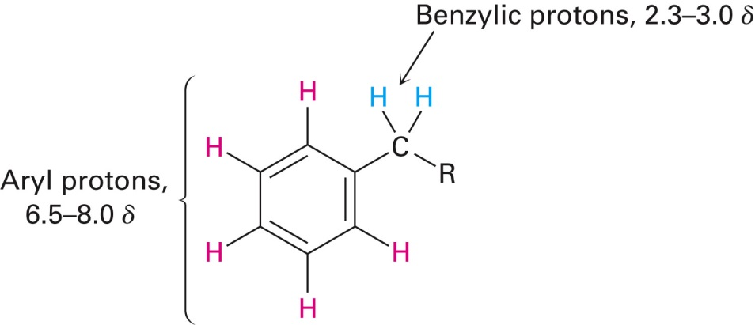
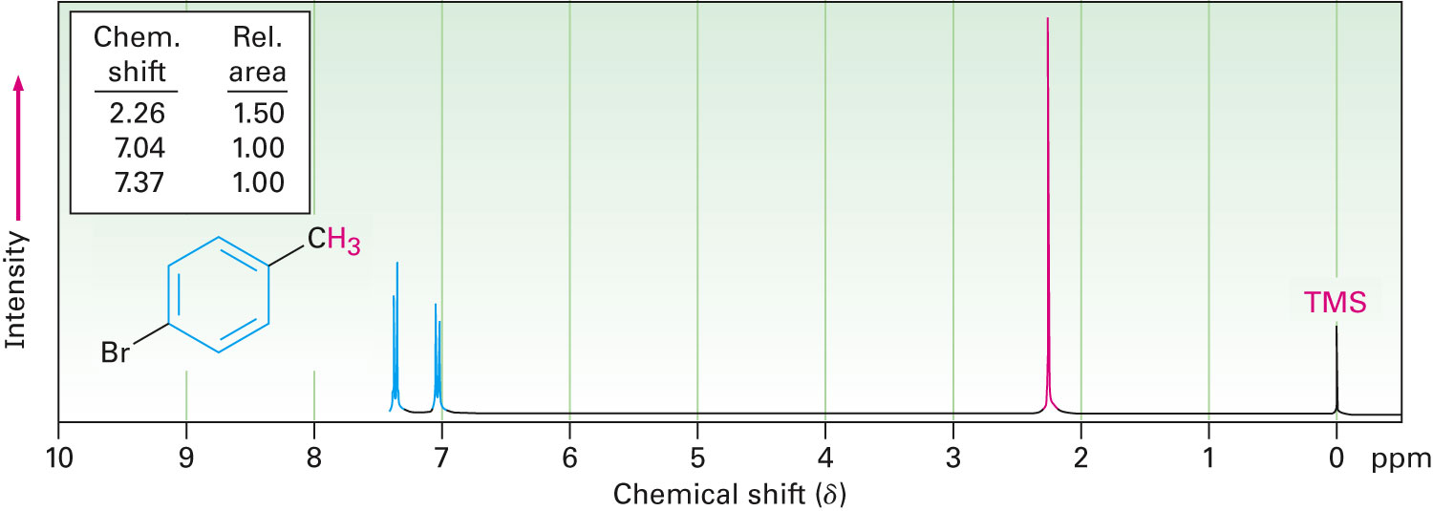
III. Spectroscopy of Aromatics: NMR
¹³C-NMR:
¹H-NMR:

Slide 16
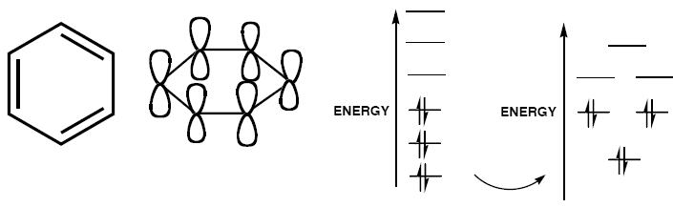
What is principle underlie aromaticity ?
- Molecular Orbital (MO)!!! -
* Six overlapping p orbitals must form six molecular orbitals
* Three will be bonding, three antibonding
* As energy of MO increases, the number of nodes increases
* System symmetric so 2 pairs of degenerate orbitals

Slide 17
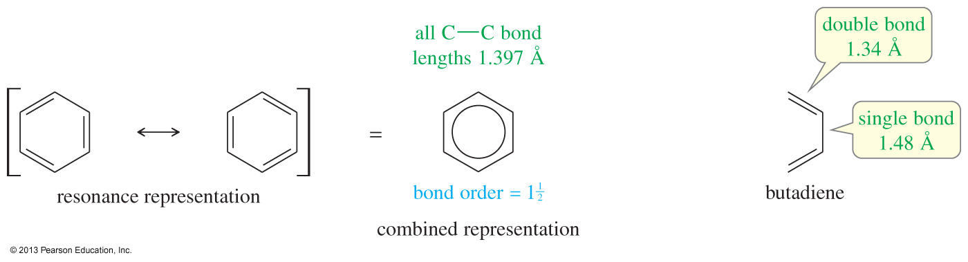
Resonance Structures of Benzene
Benzene is actually a resonance hybrid between the two Kekulé structures.
The C—C bond lengths in benzene are shorter than typical single-bond lengths, yet longer than typical double-bond lengths (bond order 1.5).
Benzene's resonance can be represented by drawing a circle inside the six-membered ring as a combined representation.

Slide 18
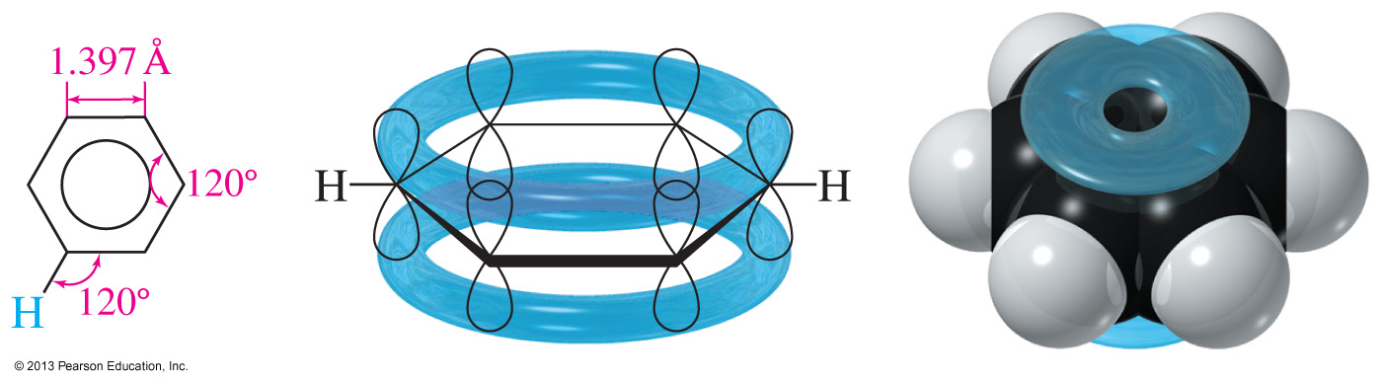
Structure of Benzene
Each sp² hybridized C in the ring has an unhybridized p orbital perpendicular to the ring that overlaps around the ring.
The six pi electrons are delocalized over the six carbons.

Slide 19
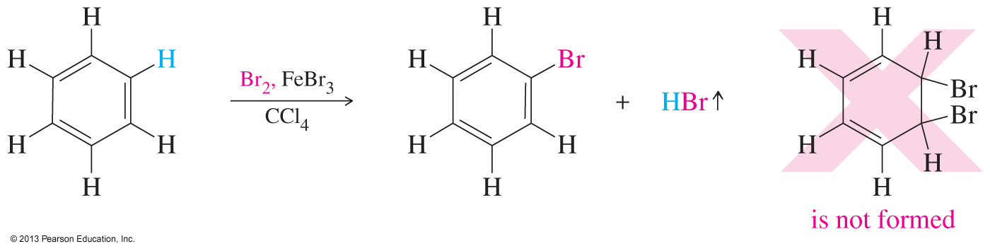
Unusual Addition of Bromine to Benzene
When bromine adds to benzene, a catalyst such as FeBr₃ is needed.
The reaction that occurs is the substitution of a hydrogen atom by a bromine.
Addition of Br₂ to the double bond is not observed.

Slide 20
There are TWO FACTS about BENZENE beyond our expectation
1. Reaction Behaviors Unlike Other Alkenes
2. Unexpected Stabilization Energy

Slide 21
Resonance Energy
Benzene does not have the predicted heat of hydrogenation of –359 kJ/mol.
The observed heat of hydrogenation is
–208 kJ/mol, a difference of 151 kJ.
This difference between the predicted and the observed value is called the resonance energy.

Slide 22
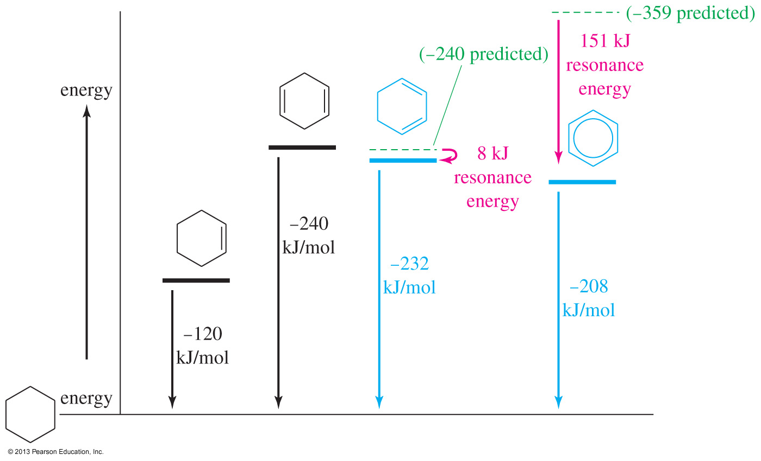
Molar Heats of Hydrogenation

Slide 23
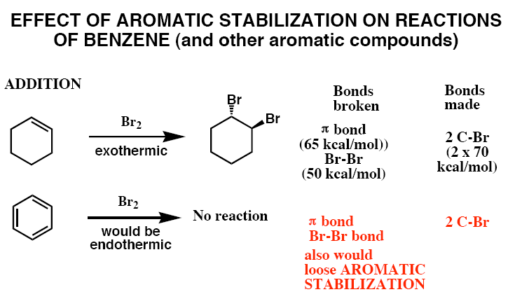
Benzene has 3 double bonds, so we would expect addition reaction as with other alkenes, BUT

Slide 24

Then, What could happen to BENZENE ???

Slide 25
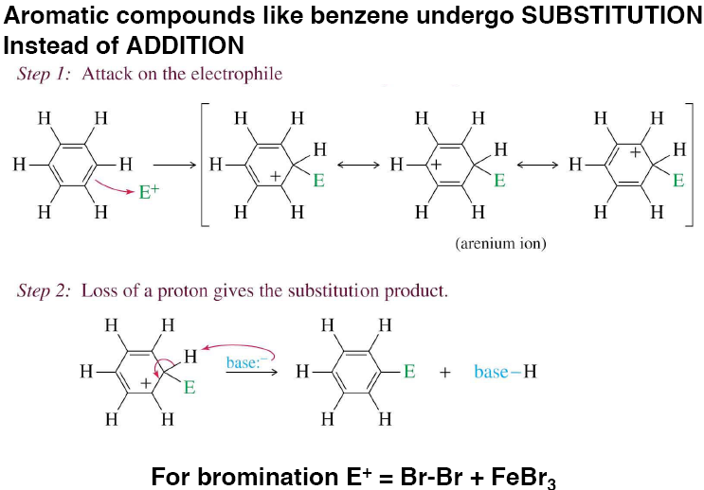
It is Unbelievable, but TRUE

Slide 26
The Point is
that BENZENE is Unexpected STABLE !!
WHY???
Aromaticity

Slide 27
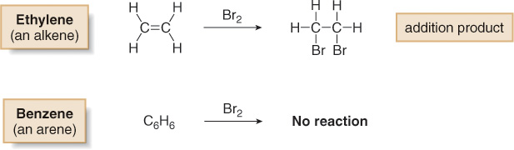
Benzene
Benzene (C₆H₆) is the simplest aromatic hydrocarbon (or arene).
Benzene has four degrees of unsaturation, making it a highly unsaturated hydrocarbon.
Whereas unsaturated hydrocarbons such as alkenes, alkynes and dienes readily undergo addition reactions, benzene does not.

Slide 28
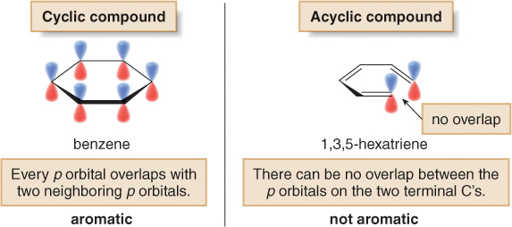
The Criteria for Aromaticity—Hückel’s Rule
Four structural criteria must be satisfied for a compound to be aromatic.
[1] A molecule must be cyclic.
To be aromatic, each p orbital must overlap with p orbitals on adjacent atoms.

Slide 29
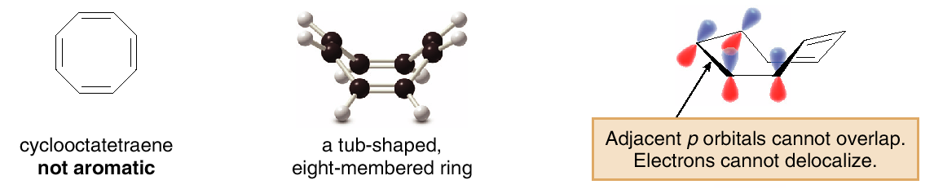
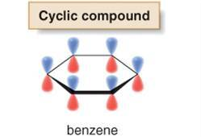
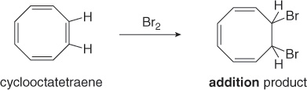
[2] A molecule must be planar.
All adjacent p orbitals must be aligned so that the π electron density can be delocalized.
Since cyclooctatetraene is non-planar, it is not aromatic, and it undergoes addition reactions just like those of other alkenes.

Slide 30
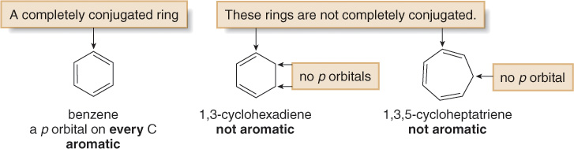
[3] A molecule must be completely conjugated.
Aromatic compounds must have a p orbital on every atom.

Slide 31
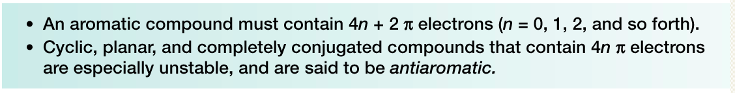
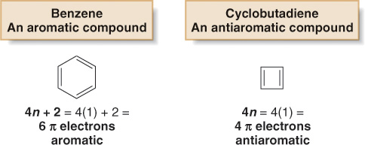
[4] A molecule must satisfy Hückel’s rule, and contain
a particular number of π electrons.
Hückel's rule:
Benzene is aromatic and especially stable because it contains 6 π electrons. Cyclobutadiene is antiaromatic and especially unstable because it contains 4 π electrons.

Slide 32
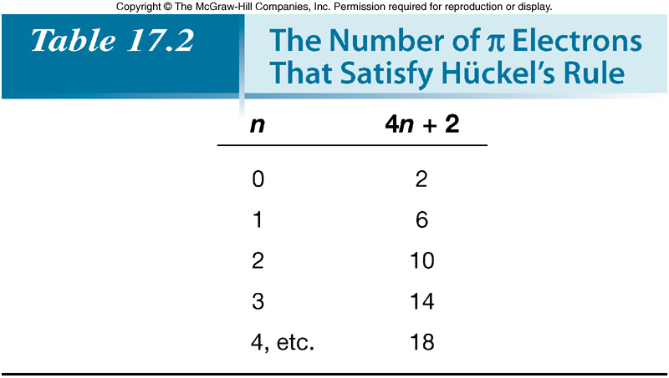
Note that Hückel’s rule refers to the number of π electrons, not the number of atoms in a particular ring.

Slide 33
Considering aromaticity, a compound can be classified in one of three ways:
Aromatic—A cyclic, planar, completely conjugated compound with 4n + 2 π electrons.
Antiaromatic—A cyclic, planar, completely conjugated compound with 4n π electrons.
Not aromatic (nonaromatic)—A compound that lacks one (or more) of the following requirements for aromaticity: being cyclic, planar, and completely conjugated.

Slide 34
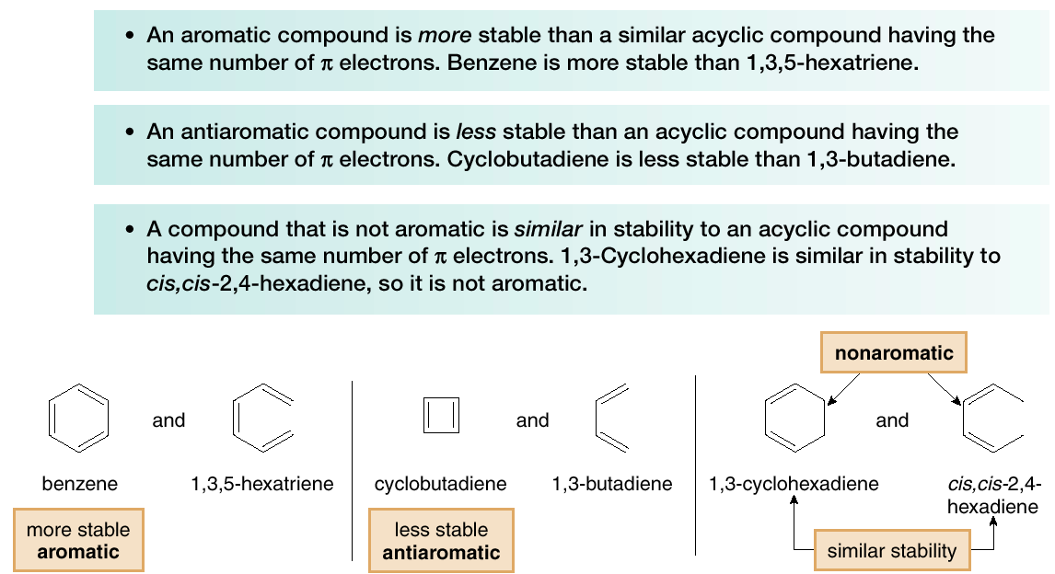
Note the relationship between each compound type and a similar open-chained molecule having the same number of π electrons.

Slide 35
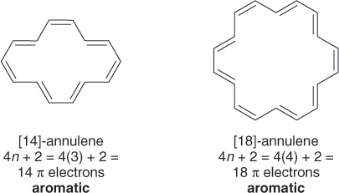
Examples of Aromatic Rings
Completely conjugated rings larger than benzene are also aromatic if they are planar and have 4n + 2 π electrons.
Hydrocarbons containing a single ring with alternating double and single bonds are called annulenes.
To name an annulene, indicate the number of atoms in the ring in brackets and add the word annulene.

Slide 36
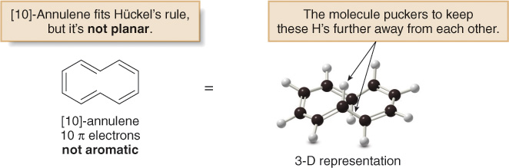
[10]-Annulene has 10 π electrons, which satisfies Hückel's rule, but a planar molecule would place the two H atoms inside the ring too close to each other. Thus, the ring puckers to relieve this strain.
Since [10]-annulene is not planar, the 10 π electrons can’t delocalize over the entire ring and it is not aromatic.

Slide 37
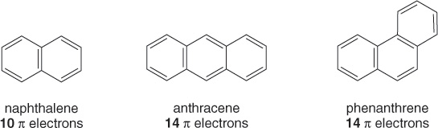
Two or more six-membered rings with alternating double and single bonds can be fused together to form polycyclic aromatic hydrocarbons (PAHs).
There are two different ways to join three rings together, forming anthracene and phenanthrene.
As the number of fused rings increases, the number of resonance structures increases. Naphthalene is a hybrid of three resonance structures whereas benzene is a hybrid of two.

Slide 38
Which of these is aromatic?
A) Is aromatic. Count the number of pi bonds in the outer ring. A has 5 which means 10 pi electrons, 4(2)+2=10. While B has 6 pi bonds and 12 pi electrons, 4(3)=12. Doesn’t meet the Huckel rule requirements for aromaticity.

Slide 39
Is this compound aromatic or antiaromatic?
Antiaromatic – cyclic, planar, conjugated , but does not meet Huckel’s rule.
4 doulbe bonds and 2 triple bonds so 4(2) + 2(4)=16 pi electons. 4n+2 or 4n? 4(4)=16

Slide 40
Indicate which of the following are aromatic and antiaromatic?
C is aromatic 4(3)+2=14
A is antiaromatic 4(2)=8

Slide 41
Which of the following is aromatic?
C is aromatic 10 pi electrons, 4(2)+2=10 and completely conjugated b/c lone pair is in a p orbital.
Which are antiaromatic?

Slide 42
Which of these is antiaromatic?
B 8 pi electrons 4(2)=8
C and D as well, 8 and 4 respectively

Slide 43
electrophile
In chemistry, an electrophile (electron-lover) is a reagent attracted to electrons that participates in a chemical reaction by accepting an electron pair in order to bond to a nuclephile.
Because electrophiles accept electrons, they are Lewis acids.

Slide 44
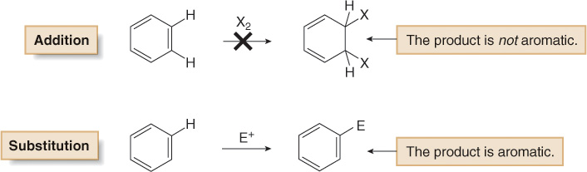
Background
Benzene does not undergo addition reactions like other unsaturated hydrocarbons, because addition would yield a product that is not aromatic.
Substitution of a hydrogen keeps the aromatic ring intact.

Slide 45
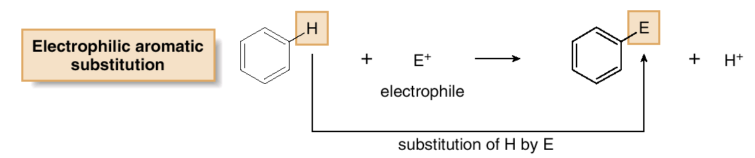
Background
The characteristic reaction of benzene is electrophilic aromatic substitution —a hydrogen atom is replaced by an electrophile.

Slide 46
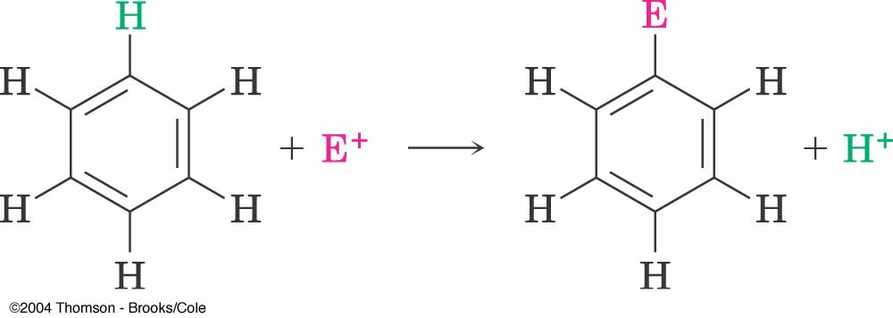
Electrophilic Aromatic Substitution
H
E
δ+
δ–
+
E
Y
+
H
Y

Slide 47
Electrophilic Aromatic Substitution
Nitration
Sulfonation
Halogenation
Friedel-Crafts alkylation
Friedel-Crafts Acylation

Slide 48
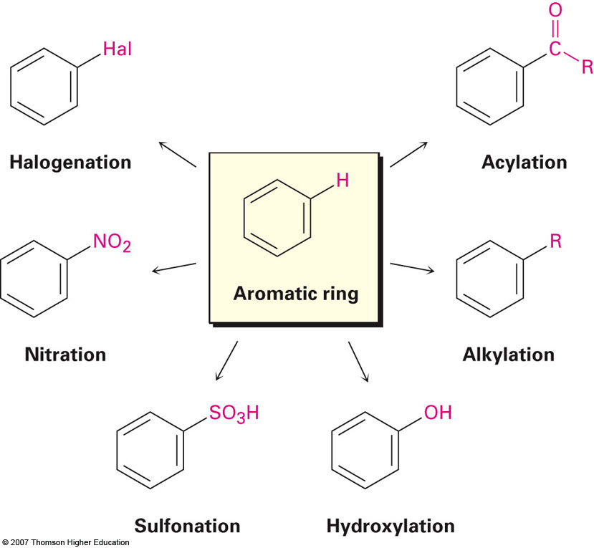
Electrophilic Aromatic Substitution

Slide 49
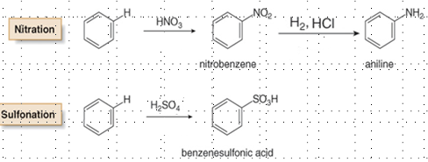
Nitration and Sulfonation
Nitration and sulfonation introduce two different functional groups into the aromatic ring.
Nitration is especially useful because the nitro group can be reduced to an NH₂ group.

Slide 50
Nitration of Benzene
H
H₂SO₄
NO₂
+
HONO₂
+
H₂O
Nitrobenzene
Notes:
6

Slide 51
Sulfonation of Benzene
H
heat
SO₂OH
+
HOSO₂OH
+
H₂O
Benzenesulfonic acid
Notes:
6

Slide 52
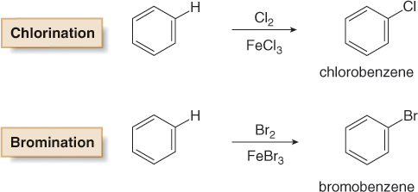
Halogenation
In halogenation, benzene reacts with Cl₂ or Br₂ in the presence of a Lewis acid catalyst (electron pair acceptor), such as FeCl₃ or FeBr₃, to give chlorobenzene or bromobenzene, respectively.
Halogenation reactions with I₂ and F₂ are not synthetically useful because I₂ is too un-reactive and F₂ reacts too violently.

Slide 53
Friedel - Crafts reactions
Friedel - Crafts alkylation
Ar-R + HCl
ArH + RCl/AlCl₃
Friedel - Crafts acylation
ArH + RCOCl/AlCl₃
Ar-COR + HCl

Slide 54
Friedel-Crafts Alkylation of Benzene
H
AlCl₃
C(CH₃)₃
+
(CH₃)₃CCl
+
HCl
2-chloro, 2-methyl propane
tert-Butylbenzene
Notes:
6

Slide 55
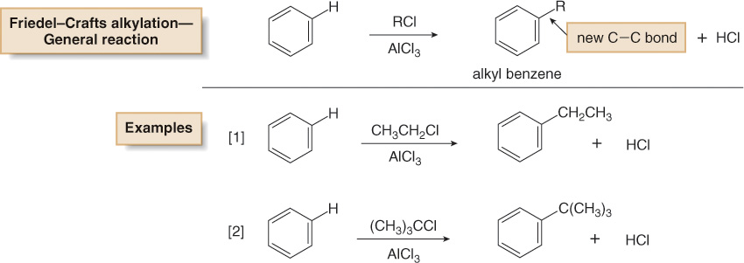
Friedel-Crafts Alkylation of benzene
In Friedel-Crafts alkylation, treatment of benzene with an alkyl halide and a Lewis acid (AlCl₃) forms an alkyl benzene.

Slide 56
Friedel-Crafts Acylation of Benzene
O
O
H
AlCl₃
CCH₂CH₃
+
CH₃CH₂CCl
+
HCl
1-Phenyl-1-propanone
Notes:
6

Slide 57
Mechanistic Principles of
Electrophilic Aromatic Substitution
Notes:
11

Slide 58
Step 1: attack of electrophile on π-electron system of aromatic ring
E⁺
H
H
H
H
E
H
H
H
+
H
H
H
H
H
Notes:
12

Slide 59
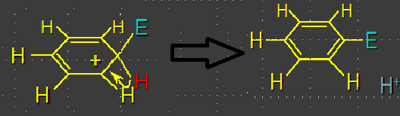
Step 2: loss of a proton from the carbocation intermediate
this step restores aromaticity of ring
Notes:
12

Slide 60
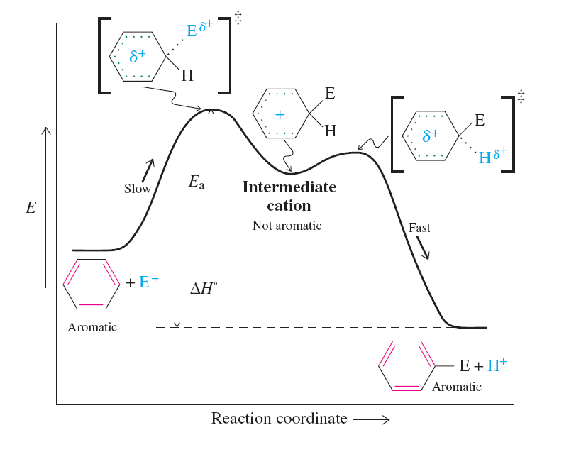
  The overall reaction is exothermic because the bonds formed are stronger than the bonds broken.

Slide 61
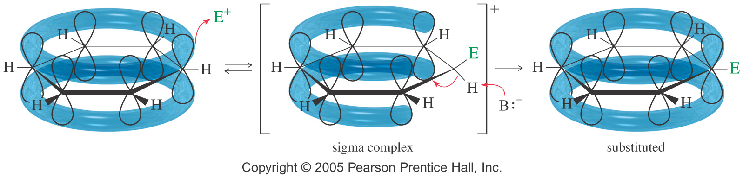
4.2 Electrophilic Aromatic Substitution
Electrophile substitutes for a hydrogen on the benzene ring.
Chapter 17
61
Notes:
61

Slide 62
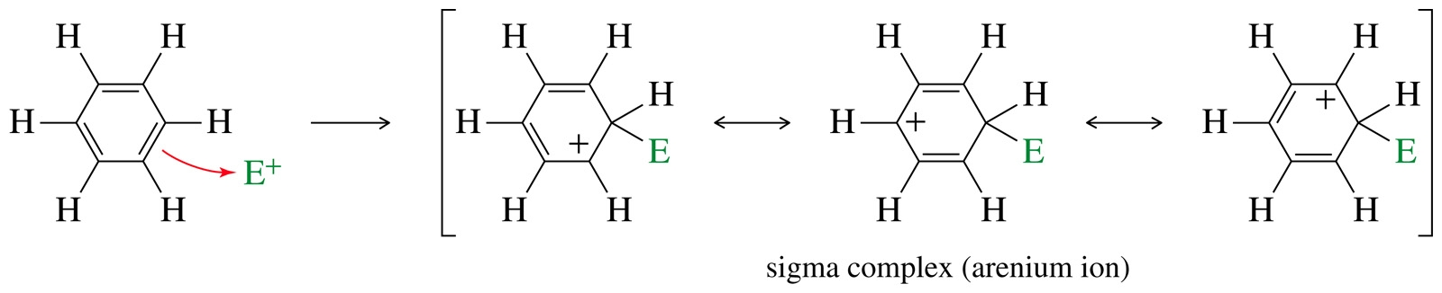
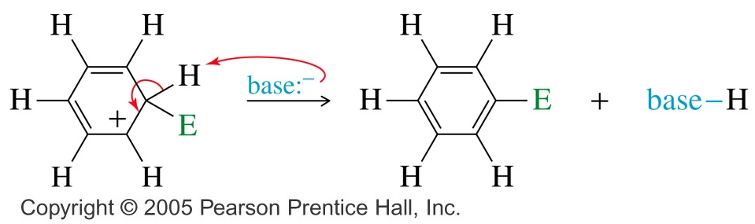
Mechanism
Step 1: Attack on the electrophile forms the sigma complex.
Step 2: Loss of a proton gives the substitution product.
Chapter 17
62
Notes:
62

Slide 63
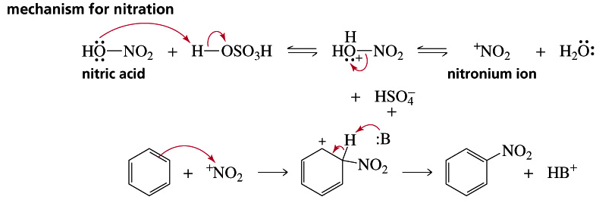
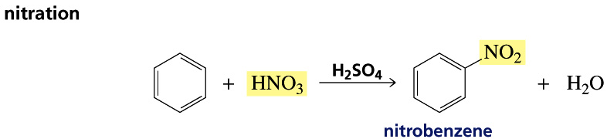
Nitration of Benzene

Slide 64
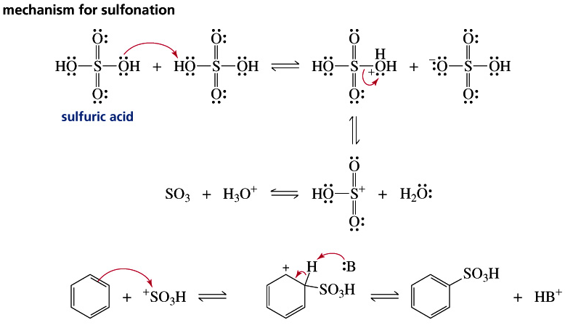
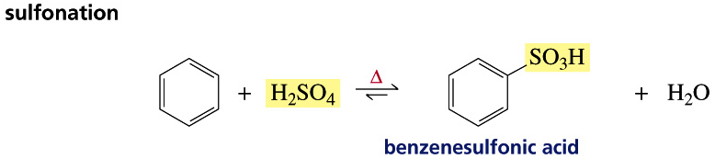
Sulfonation of Benzene

Slide 65
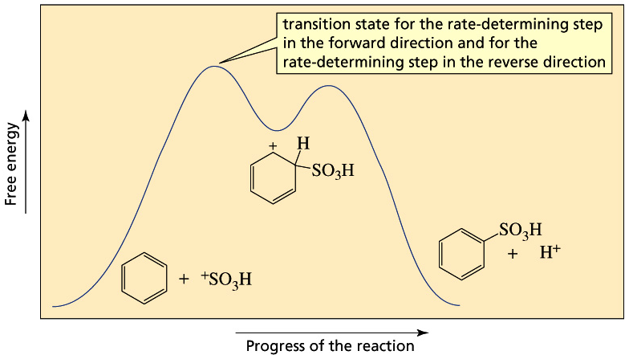
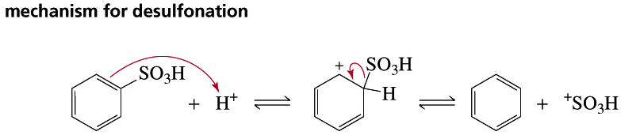
Sulfonation of Benzene
65

Slide 66



Halogenations of Benzene
66

Slide 67


Halogenations of Benzene

Slide 68

Nitration of Toluene
Toluene reacts 25 times faster than benzene. The methyl group is an activating group.
The product mix contains mostly ortho and para substituted molecules.
Chapter 17
68
Notes:
68

Slide 69


Sigma Complex
Intermediate is more stable if nitration occurs at the ortho
or para position.
=>
Chapter 17
69
Notes:
69

Slide 70

Energy Diagram
Chapter 17
70
Notes:
70

Slide 71
Activating, O-, P-Directing Substituents
Alkyl groups stabilize the sigma complex by induction, donating electron density through the sigma bond.
Substituents with a lone pair of electrons stabilize the sigma complex by resonance.
71
Notes:
71

Slide 72

Substitution on Anisole
72
Notes:
72

Slide 73

The Amino Group
Aniline, like anisole, reacts with bromine water (without a catalyst) to yield the tribromide. Sodium bicarbonate is added to neutralize the HBr that’s also formed.
73
Notes:
73

Slide 74

Summary of Activators
74
Notes:
74

Slide 75
Deactivating Meta-Directing Substituents
Electrophilic substitution reactions for nitrobenzene are 100,000 times slower than for benzene.
The product mix contains mostly the meta isomer, only small amounts of the ortho and para isomers.
Meta-directors deactivate all positions on the ring, but the meta position is less deactivated.
75
Notes:
75

Slide 76

Ortho Substitutionon Nitrobenzene
76
Notes:
76

Slide 77

Para Substitution on Nitrobenzene
77
Notes:
77

Slide 78

Meta Substitution on Nitrobenzene
78
Notes:
78

Slide 79

Energy Diagram
Chapter 17
79
Notes:
79

Slide 80
Structure of Meta-Directing Deactivators
The atom attached to the aromatic ring will have a partial positive charge.
Electron density is withdrawn inductively along the sigma bond, so the ring is less electron-rich than benzene.
80
Notes:
80

Slide 81

Summary of Deactivators
81
Notes:
81

Slide 82

More Deactivators
82
Notes:
82

Slide 83
Halobenzenes
Halogens are deactivating toward electrophilic substitution, but are ortho, para-directing!
Since halogens are very electronegative, they withdraw electron density from the ring inductively along the sigma bond.
But halogens have lone pairs of electrons that can stabilize the sigma complex by resonance.
83
Notes:
83

Slide 84


Sigma Complex for Bromobenzene
Ortho and para attacks produce a bromonium ion
and other resonance structures.
No bromonium ion
possible with meta attack.
84
Notes:
84

Slide 85

Energy Diagram
Chapter 17
85
Notes:
85

Slide 86

Summary of Directing Effects
86
Notes:
86

Slide 87
Multiple Substituents
The most strongly activating substituent will determine the position of the next substitution. May have mixtures.
87
Notes:
87

Slide 88
Friedel-Crafts Alkylation
Synthesis of alkyl benzenes from alkyl halides and a Lewis acid, usually AlCl₃.
Reactions of alkyl halide with Lewis acid produces a carbocation which is the electrophile.
Other sources of carbocations:
alkenes + HF, or alcohols + BF_{3.}
88
Notes:
88

Slide 89
Examples ofCarbocation Formation
89
Notes:
89

Slide 90
Formation of Alkyl Benzene
-
+
90
Notes:
90

Slide 91
Limitations of Friedel-Crafts
Reaction fails if benzene has a substituent that is more deactivating than halogen.
Carbocations rearrange. Reaction of benzene with n-propyl chloride and AlCl₃ produces isopropylbenzene.
The alkylbenzene product is more reactive than benzene, so polyalkylation occurs.
91
Notes:
91

Slide 92
Friedel-CraftsAcylation
Acyl chloride is used in place of alkyl chloride.
The acylium ion intermediate is resonance stabilized and does not rearrange like a carbocation.
The product is a phenyl ketone that is less reactive than benzene.
92
Notes:
92

Slide 93


Mechanism of Acylation
93
Notes:
93

Slide 94

Nucleophilic Aromatic Substitution
Aryl halides with electron-withdrawing substituents ortho and para react with nucleophiles
Form addition intermediate (Meisenheimer complex) that is stabilized by electron-withdrawal
Halide ion is lost to give aromatic ring

Slide 95

Nucleophilic Aromatic Substitution
A nucleophile replaces a leaving group on the aromatic ring.
This is an addition–elimination reaction.
Electron-withdrawing substituents activate the ring for nucleophilic substitution.
95

Slide 96



Mechanism of Nucleophilic Aromatic Substitution
Step 1: Attack by hydroxide gives a resonance-stabilized complex.
Step 2: Loss of chloride gives the product.
Step 3: Excess base deprotonates the product.
96

Slide 97

Activated Positions
Nitro groups ortho and para to the halogen stabilize the intermediate (and the transition state leading to it).
Electron-withdrawing groups are essential for the reaction to occur.

Slide 98

Benzyne Reaction: Elimination-Addition
Reactant is halobenzene with no electron-withdrawing groups on the ring.
Use a very strong base like NaNH₂.
98

Slide 99

Benzyne Mechanism
Sodium amide abstract a proton.
The benzyne intermediate forms when the bromide is expelled and the electrons on the sp² orbital adjacent to it overlap with the empty sp² orbital of the carbon that lost the bromide.
Benzynes are very reactive species due to the high strain of the triple bond.
99

Slide 100

Nucleophilic Substitution on the Benzyne Intermediate
100

Slide 101
Q.P
1 Mark:-
a) Complete the following reactions
2 Marks:-
Explain how does the –NH₂ group in C₆H₅NH₂ influence the orientation
of the benzene ring towards electrophilic aromatic substitution
b) Mechanism for Nitration of Benzoic acid

Slide 102
Q.P
c) Explain how –OCH₃ groups behaves as ortho, para director in Electrophilic Substitution reaction?
d) Write the mechanism of sulphonation of toluene ?
e) Identify A,B in the given reaction
3 Marks:-
a) Explain in detail about Mechanism for Nucleophilic Subsitution
Reaction of benzene? *
b) Briefly discuss the Elimination Addition mechanism for Nucleophilic
Aromatic substitution. Give two evidence to support the same?
c) Identify A,B,C in the given reaction

Slide 103
Q.P
4 Marks:-
a) Identify Aromatic/Non Aromatic/Anti-Aromatic

