Slide 1
Organic Chemistry II
Chapter 18
Ethers and Epoxides; Thiols and Sulfides

Slide 2
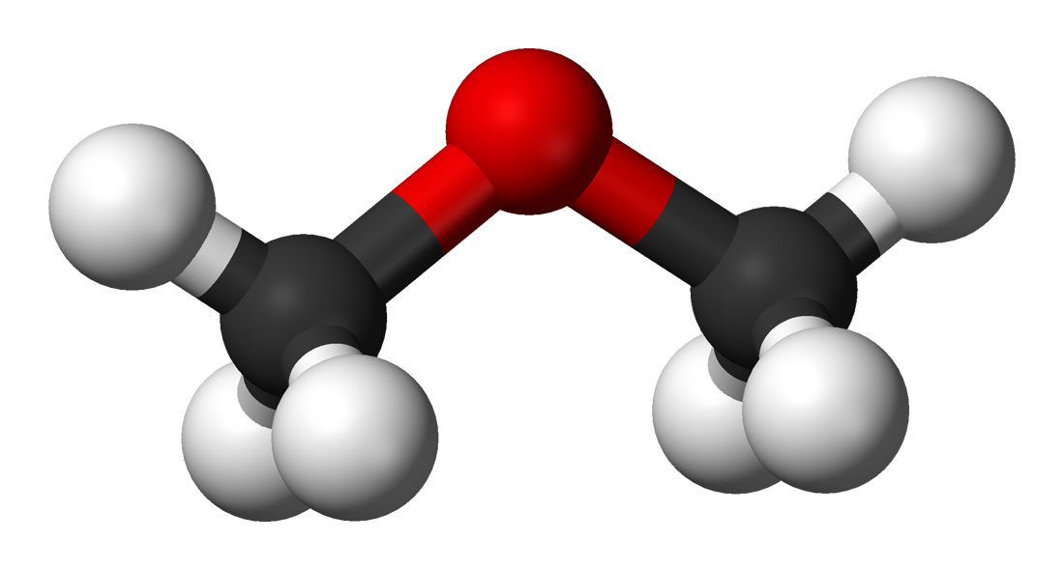
Ethers
23.2

Slide 3
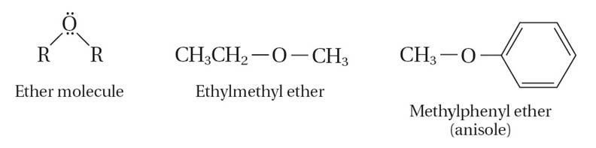
Ethers
23.2
    An ether is a compound in which oxygen is bonded to two carbon groups.

Slide 4
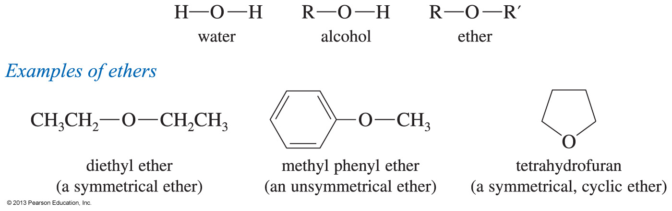
Ethers
Formula is R—O—R′, where R and R′ are alkyl or aryl.
Symmetrical or unsymmetrical

Slide 5
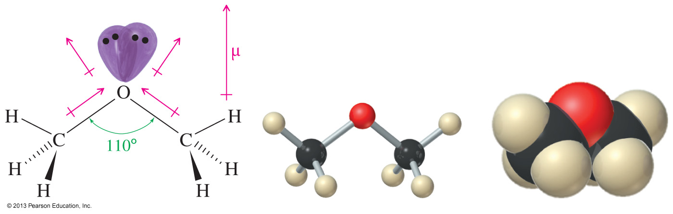
Structure and Polarity
Oxygen is sp³ hybridized.
Bent molecular geometry.
Tetrahedral C—O—C angle is 110°.
Polar C—O bonds.

Slide 6
Learning Objectives
Ethers
Know the structure of ethers
Know the different methods of naming ethers
Know the physical properties of ethers
Know the different methods…preparation of ethers
Know the reactions of opened ethers with HX

Slide 7
Ether: is a class of organic compounds in which an OXYGEN atom connected to two organic groups (Alkyl or Aryl "benzene ring") by σ bonds.

Slide 8
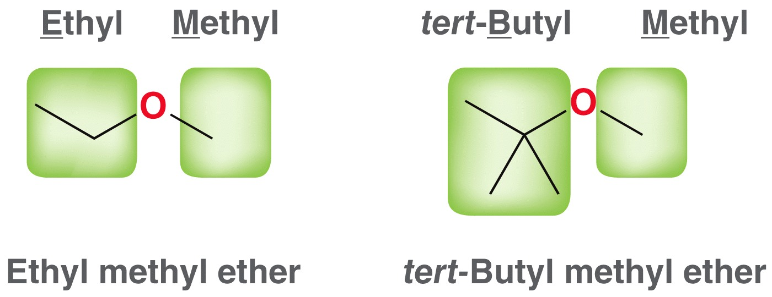
Naming Ethers
Common names are used frequently
  Name each –R group
  Arrange them alphabetically
  End with the word, “ether”

Slide 9
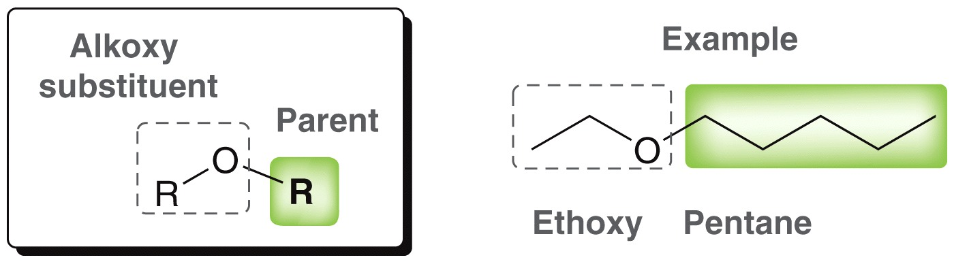
Naming Ethers
IUPAC systematic names are often used as well
  Make the larger of the –R groups the parent chain
  Name the smaller of the –R groups as an alkoxy substituent

Slide 10
Ethers
The common alkoxy substituents are given names derived from their alkyl component
Alkyl group | Name | Alkoxy | Group Name
CH₃– | Methyl | CH₃O– | Methoxy
CH₃CH₂– | Ethyl | CH₃CH₂O– | Ethoxy
(CH₃)₂CH– | Isopropyl | (CH₃)₂CHO– | Isopropoxy
(CH₃)₃C– | tert-Butyl | (CH₃)₃CO– | tert-Butoxy
C₆H₅– | Phenyl | C₆H₅O– | Phenoxy

Slide 11
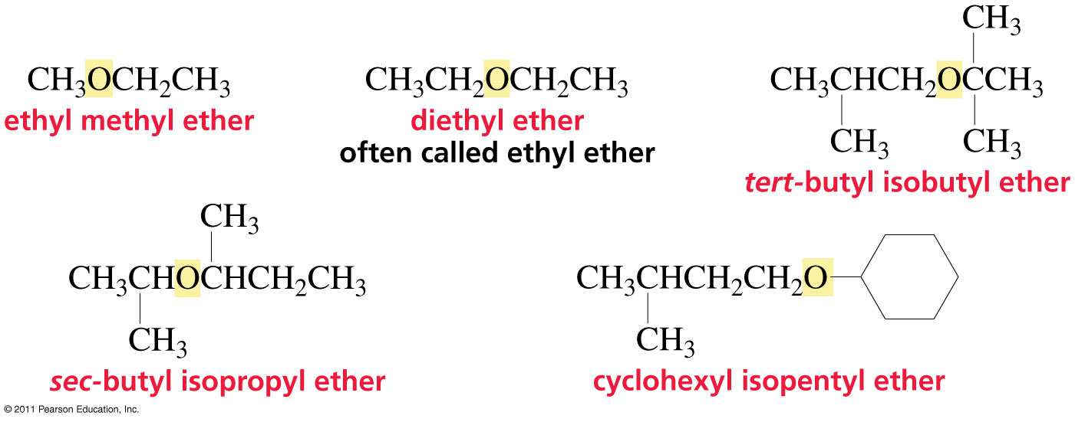
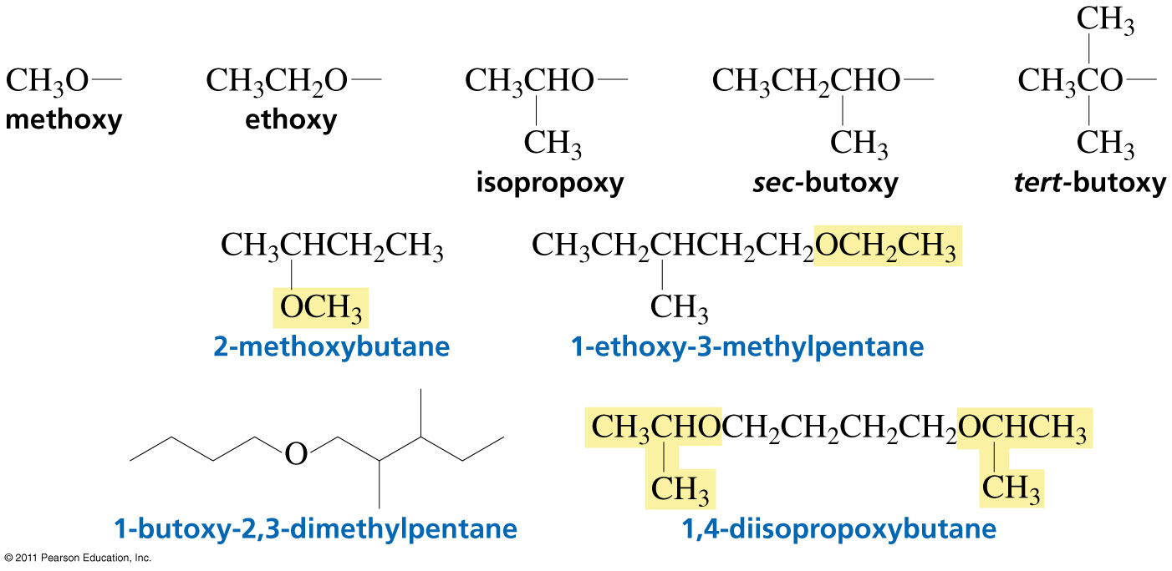
Nomenclature of Ethers
As substituents:

Slide 12
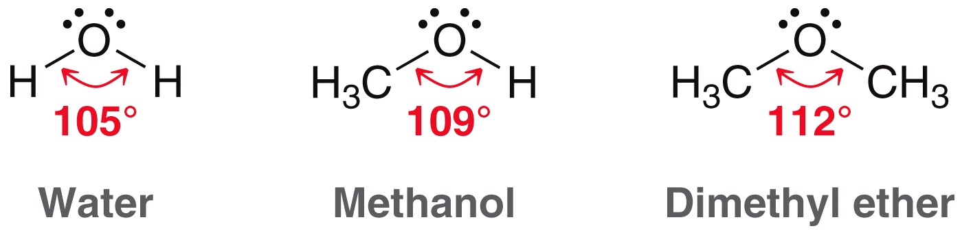
Structure and Properties of Ethers
The bond angle in ethers is very similar to that found in water and in alcohols
Is the oxygen atom in an ether sp³, sp², or sp hybridized?
How do the –R groups affect the bond angle?

Slide 13
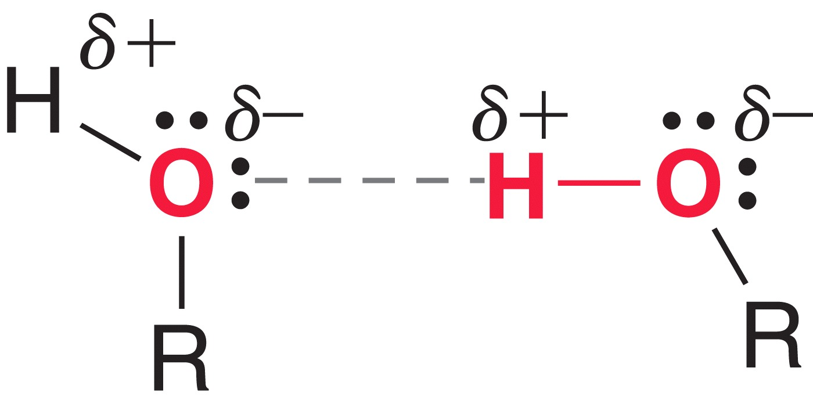
Structure and Properties of Ethers
Due to H-bonding, alcohols have relatively high boiling points
What is the maximum number of H-bonds an alcohol can have?
Draw an H-bond between an ether and an alcohol
What is the maximum number of H-bonds an ether can have?

Slide 14
Structure and Properties of Ethers
Would you expect the boiling point of an ether to be elevated similar to alcohols?
WHY or WHY not?

Slide 15
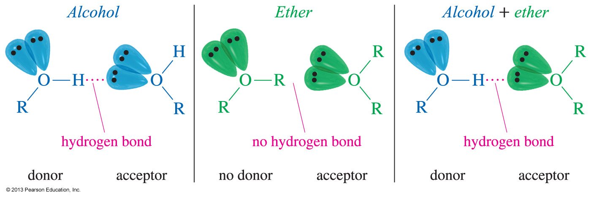
Hydrogen Bond Acceptor
Ethers cannot hydrogen bond with other ether molecules, so they have a lower boiling point than alcohols.
Ether molecules can hydrogen bond with water and alcohol molecules.
They are hydrogen bond acceptors.

Slide 16
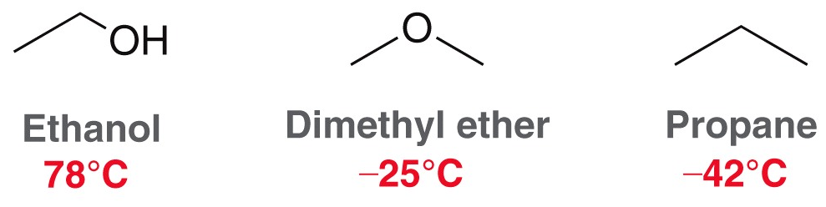
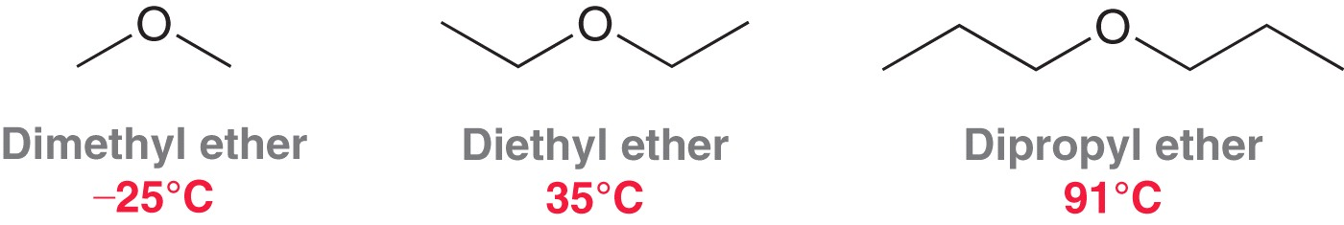
Structure and Properties of Ethers
Explain the boiling point trends below using all relevant intermolecular attractions
  Trend 1
  Trend 2
  Trend 2

Slide 17
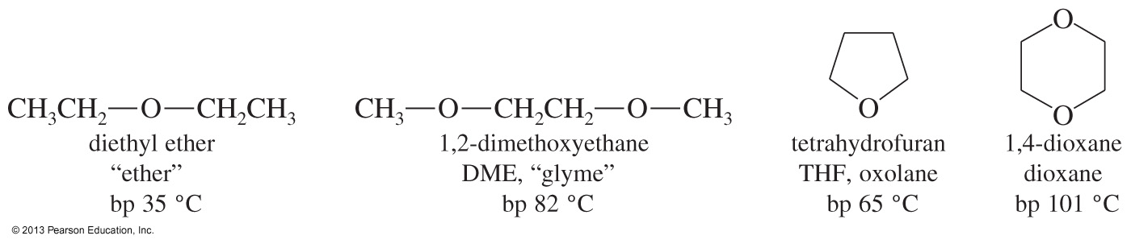
Ethers as Solvents
Ethers are widely used as solvents because
  they can dissolve nonpolar and polar substances.
  they are unreactive toward strong bases.

Slide 18
Structure and Properties of Ethers
Ethers are often used by organic chemists as solvents
  Relatively low boiling points allow them to be evaporated after the reaction is complete
  Their dipole moment allows them to stabilize charged or partially charged transition states. HOW?
  They are NOT protic. WHY is that an advantage for a solvent in many reactions?

Slide 19
Physical Properties of Ether
Ethers
1) Boiling Points
The boiling points of ethers are lower than those of alcohols having the same molecular weights.
2) Solubility in water
Ethers are much less soluble in water than alcohols (Because they don’t have –OH group, So they are not hydrogen bond donors).
More water-soluble than hydrocarbons of similar molecular weight (Because they are polar).
compound | Formula | MW | Bp (°C)
ethanol | CH₃-CH₂-OH | 46 | 78
Dimethyl ether | CH₃-O-CH₃ | 46 | -25
propane | CH₃-CH₂-CH₃ | 44 | -42

Slide 20
Ethers
Preparation of Ethers
Dehydration of alcohols: (only Symmetric ether)
The dehydration of alcohols takes place in the presence of acid catalysts (H₂SO₄, H₃PO₄) under controlled temperature (140 ºC). The general reaction for ether formation is
Examples
symmetric ether

Slide 21
Ethers
Preparation of Ethers
2)The Williamson synthes
This method is usually used for preparation of unsymmetrical ethers

Slide 22
Ethers
3)Alkoxide from alcohol
The alkoxide is commonly made by adding Na or K to the alcohol
The phenoxide is commonly made by adding NaOH to the phenol
Examples
22

Slide 23
Ethers
Reactions Of Ethers
Cleavage of ethers by hot concentrated acids
Ethers are quite stable compounds. Ethers react only under strongly acidic condition.When ethers are heated in concentrated acid solutions, the ether linkage is broken
General equation:
Specific example
The acids most often used in this reaction are HI, HBr, and HCl

Slide 24
Ethers
If an excess of acid is present, the alcohol initially produced
is converted to alkyl halide thus the net products will be 2 moles of alkyl halide.
For example

Slide 25
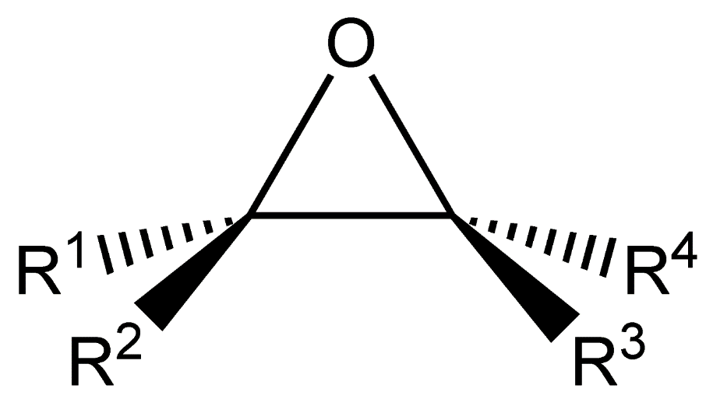
Epoxides
Cyclic Ethers-Epoxides:
An epoxide is a cyclic ether with a three-atom ring. This ring approximates an equilateral triangle, which makes it strained, and hence highly reactive, more so than other ethers.

Slide 26
Epoxides
Cyclic Ethers-Epoxides:
In cyclic ethers (heterocyclic), one or more carbons are replaced with oxygen.
Epoxides are cyclic ethers in which the ether oxygen is part of a three-membered ring.
The simplest and most important epoxide is ethylene oxide.

Slide 27
Cyclic Ethers (Heterocycles)
Heterocyclic: Oxygen is part of the ring.
Epoxides (oxiranes)
Oxetanes
Furans (Oxolanes )
Pyrans (Oxanes )
Dioxanes

Slide 28
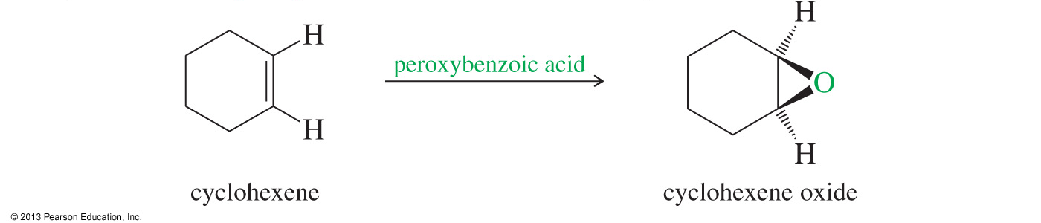
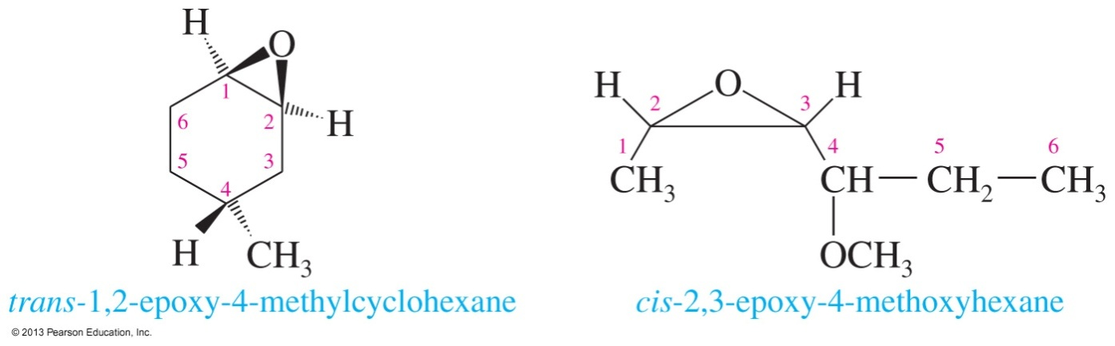
Epoxide Nomenclature
Name the starting alkene and add “oxide.”
The oxygen can be treated as a substituent (epoxy) on the compound. Use numbers to specify position.

Slide 29
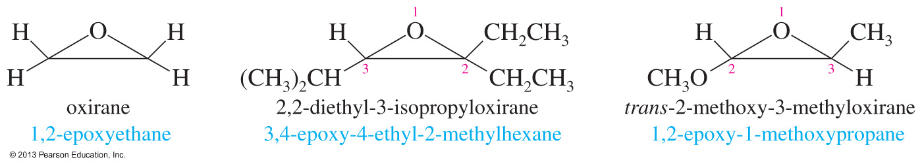
Epoxide Nomenclature (Continued)
The three-membered oxirane ring is
the parent (oxygen is 1, the carbons
are 2 and 3). Substituents are named
in alphabetical order.

Slide 30
Epoxides
Peroxyacid Epoxidation
Peroxyacids (sometimes called peracids) are used to convert alkenes to epoxides. If the reaction takes place in aqueous acid, the epoxide opens to a glycol. Because of its desirable solubility properties, meta-chloroperoxybenzoic acid (MCPBA) is often used for these epoxidations.
Example

Slide 31
Epoxides
Epoxides are much more reactive than common dialkyl ether, because of the strain in the three-membered ring, which is relieved when the epoxide ring is opened after a reaction has taken place.
Examples of ring-opening reactions(cleavage carbon-oxygen bond) of ethylene oxide that form commercially important products are:
1- Acid –Catalyzed ring opening of epoxides in water to form glycols.

Slide 32
Epoxides
2- Acid –Catalyzed ring opening of epoxides in alcohol to form alkoxy alcohols
3- Acid –Catalyzed ring opening of epoxides with a hydrohalic acid
(HCl, HBr, or HI), a halide ion attacks the protonated epoxide to give halo alcohol .
32

Slide 33
Epoxides
4- Ring opening of epoxides with Grignard and Organolithium Reagents to give longer alcohols
5- Ring opening of epoxides with amines

Slide 34
Ethers and Epoxides
Exercise 1
Give a correct name for each of the following compounds.
Exercice 2
Propose a Williamson synthesis of 3-butoxy-1,1-dimethylcyclohexane from 3,3-dimethylcyclohexanol and butanol

Slide 35
Epoxides
Exercise 3
Predict the products of the following reactions.

Slide 36
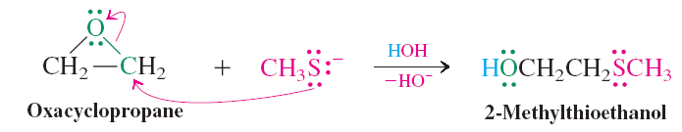
Reactions of Epoxides
Nucleophilic ring opening of EPOXIDES by S_{N}2 is regioselective and stereospecific.
  EPOXIDES can be ring-opened by anionic nucleophiles. Because the molecule is symmetric, nucleophilic attack can be at either carbon atom.
  The driving force for this reaction is the release of ring strain.

Slide 37
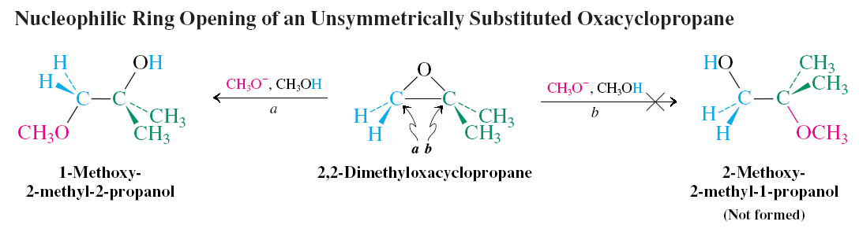
  With unsymmetric systems, attack will be at the less substituted carbon center. This selectivity is referred to as “regioselectivity.”
  If the ring opens at a stereocenter, inversion is observed.

Slide 38
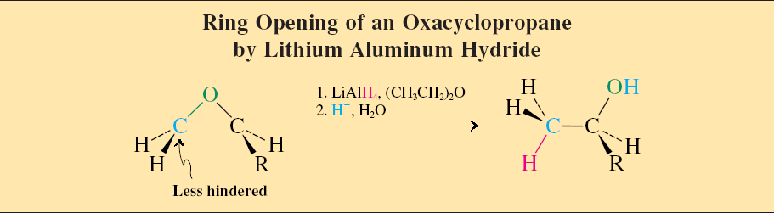
Hydride and organometallic reagents convert strained ethers into alcohols.
  LiAlH₄ can open the rings of EPOXIDES to yield alcohols. (Ordinary ethers do not react.)
  In asymmetrical systems, the hydride attacks the less substituted side.

Slide 39
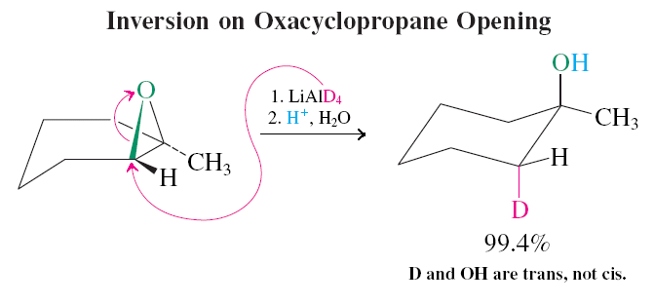
  If the reacting carbon is a stereocenter, inversion is observed.

Slide 40
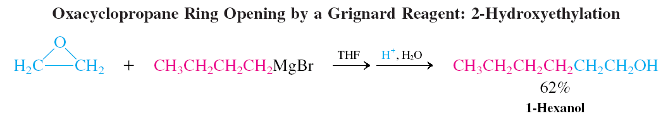
  Epoxides are sufficiently reactive electrophiles to be attacked by organometallic compounds.

Slide 41
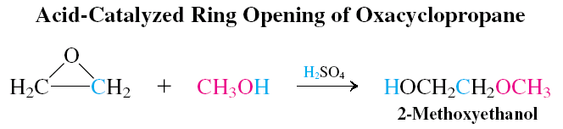
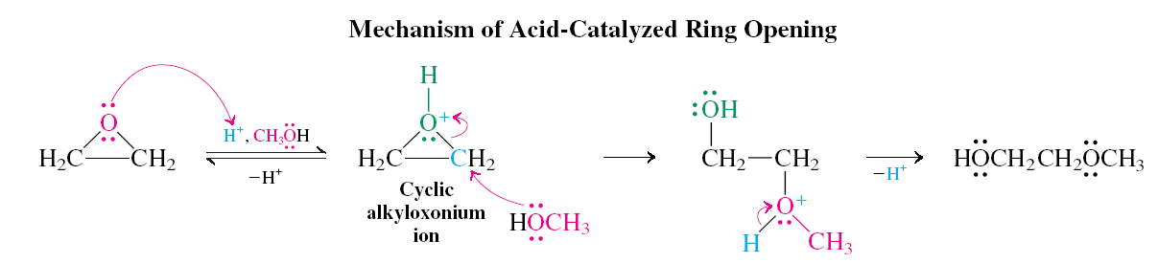
Acids catalyze EPOXIDE ring opening.
  Ring opening of EPOXIDE by acid catalysis proceeds through an initial cyclic alkyloxonium ion.
  This acid catalyzed ring opening is both regioselective and stereospecific.

Slide 42
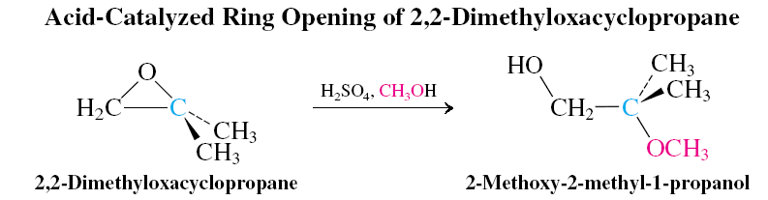
  The acid catalyzed methanolysis of 2,2-dimethylEPOXIDE is ring-opened at the more hindered carbon.

Slide 43
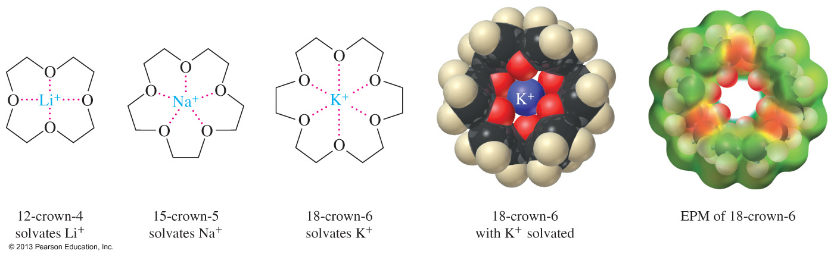
Crown Ether Complexes
Crown ethers can complex metal cations in the center of the ring.
The size of the ether ring will determine which cation it can solvate better.
Complexation by crown ethers often allows polar inorganic salts to dissolve in nonpolar organic solvents.

Slide 44
Crown Ethers Synthesis
Crown ethers are cyclic compounds containing several ether linkage around a central cavity
A crown ether specifically binds certain metal ions or organic molecules.
The crown ether is called the “host” and the species it binds is called the “guest”

Slide 45
Crown Ethers Synthesis
Crown ethers are named [X]-Crown-Y, where X is the total number of atoms in the ring and Y is the number of oxygen atoms in the ring.
Binding of Na+ and crown ethers are thru interaction of the positively charged ion with lone pair electrons of oxygen atoms that point into the cavity.
Crown ethers are soluble in nonpolar solvents because the outside of the crown is composed of primarily C-H bonds.

Slide 46
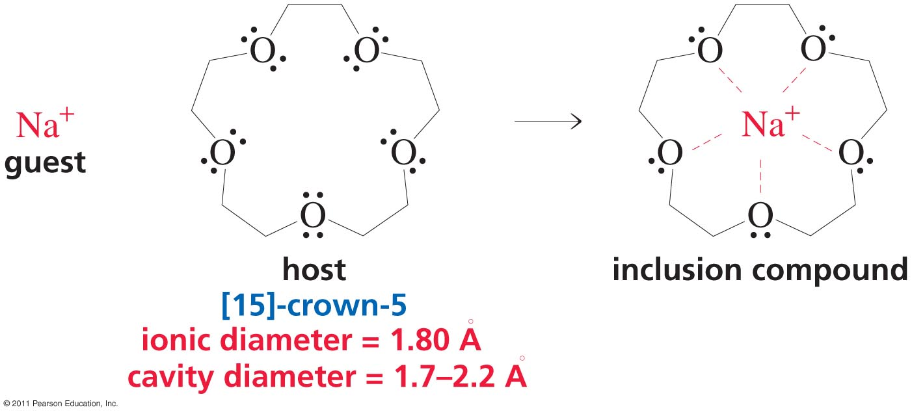
Crown Ethers
Because the ether linkages are chemically inert, the crown ether can bind the guest without reacting with it.
The crown-guest complex is called INCLUSION COMPOUND
The ability of a host to bond only certain guests is an
example of molecular recognition.
The recognition of 1 molecule for another as a result of specific interactions.

Slide 47
THIOL

Slide 48
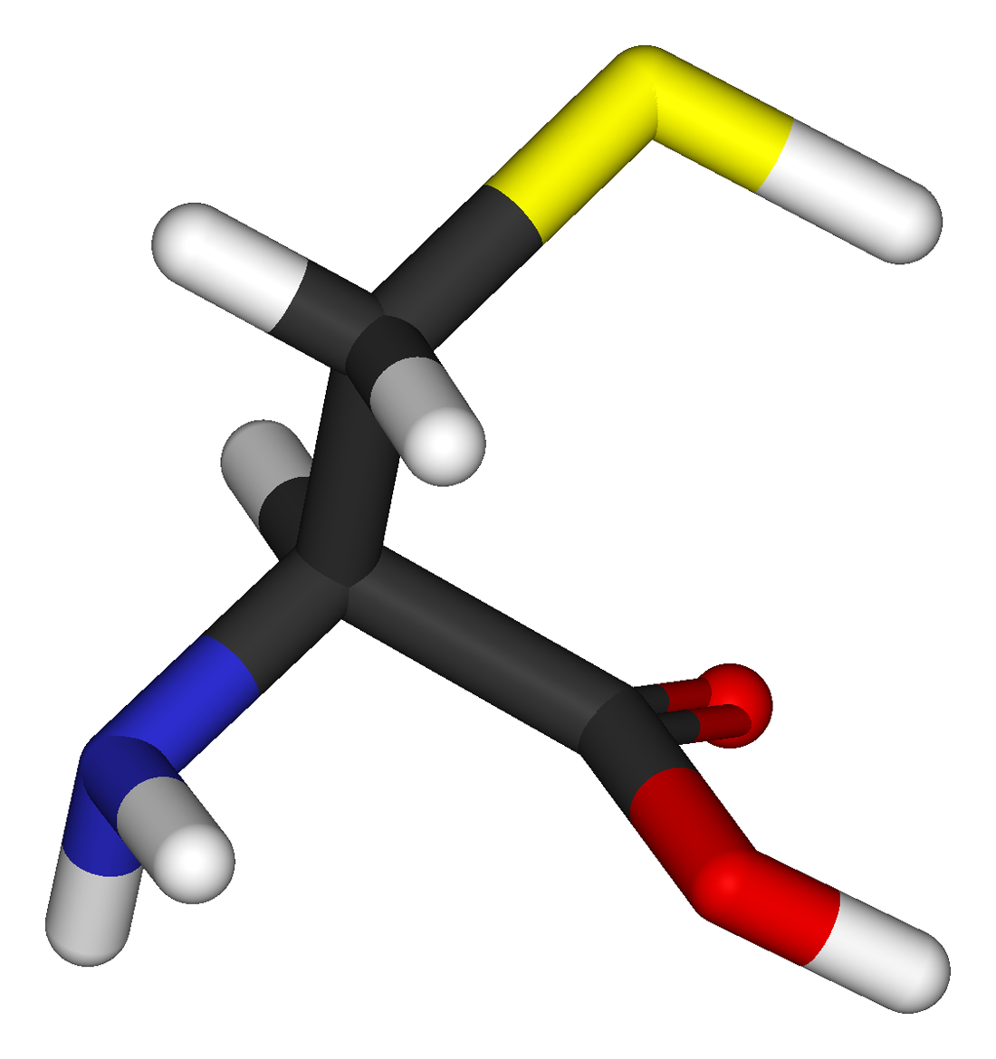
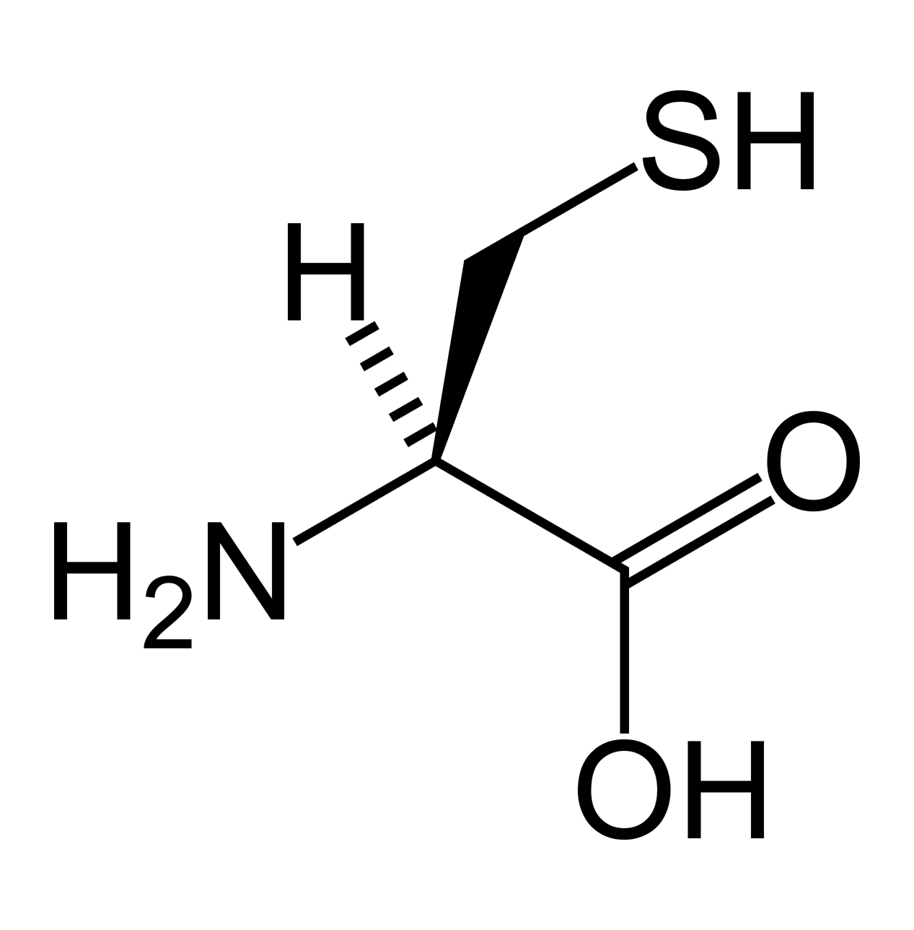
Cysteine
Cysteine (Cys)

Slide 49
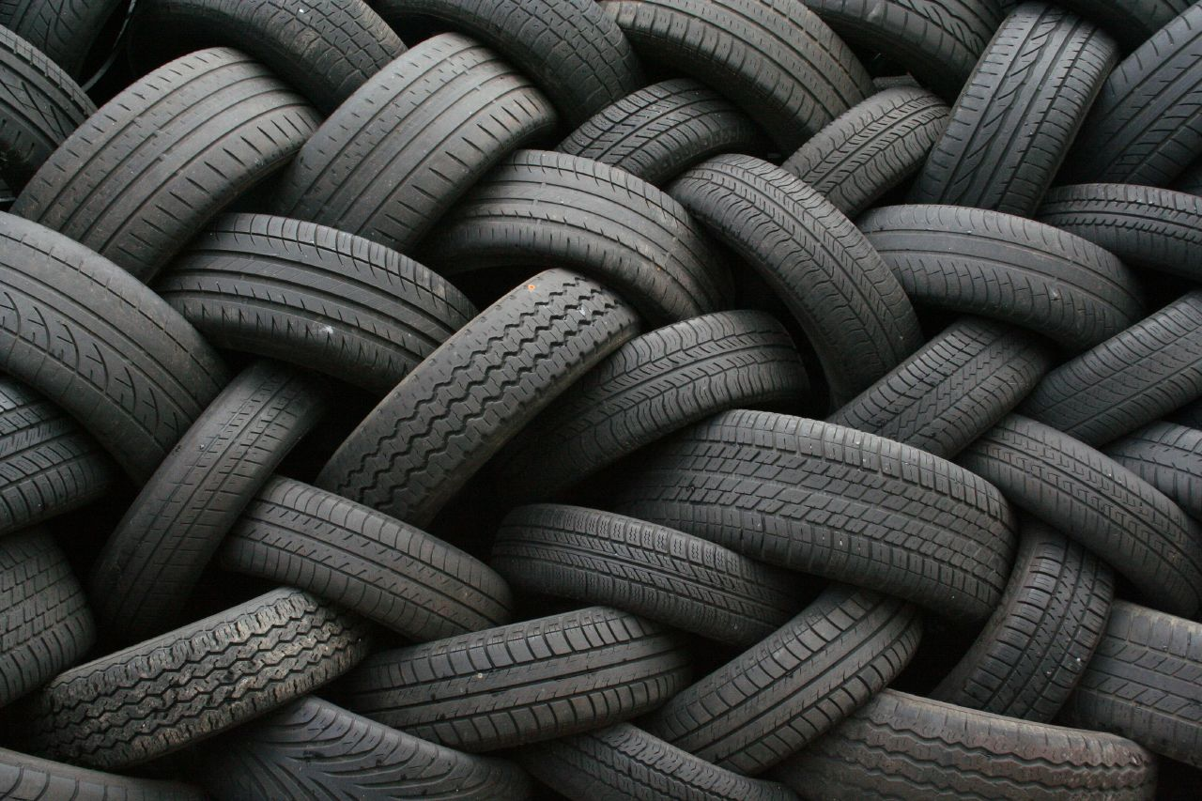
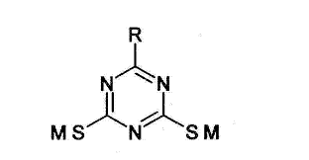
Dibutyl amino triazine thiol

Slide 50
DEFINITION
Organic compounds having SH or Sulfhydryl (R-S-H) functional group with strong and disagreeable odors.
“ Also called mercaptans “
Derivatives of hydrogen sulfide.

Slide 51
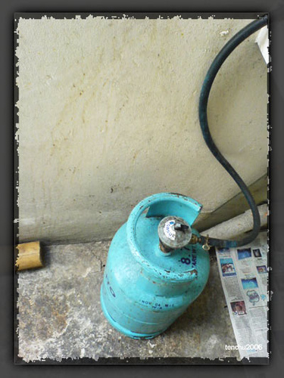
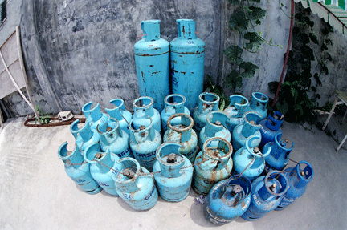

Slide 52
CH3 – SH
IUPAC
methanethiol
methyl mercaptan
COMMON
CH3CH2 – SH
ethanethiol
IUPAC
COMMON
ethyl mercaptan

Slide 53
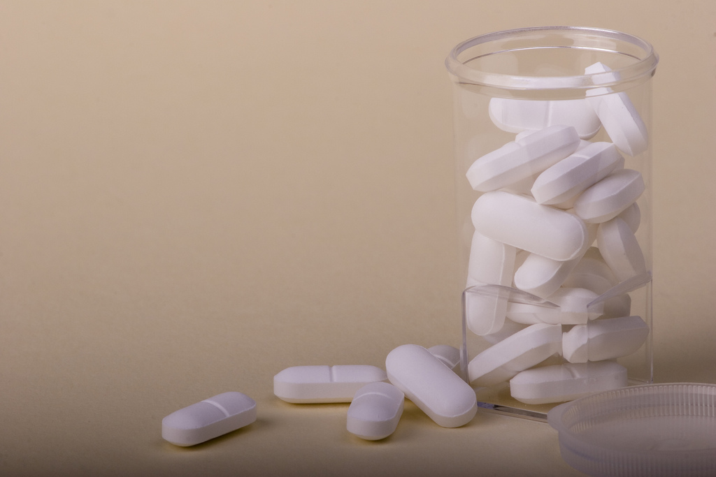
Glutathione
(GSH)

Slide 54
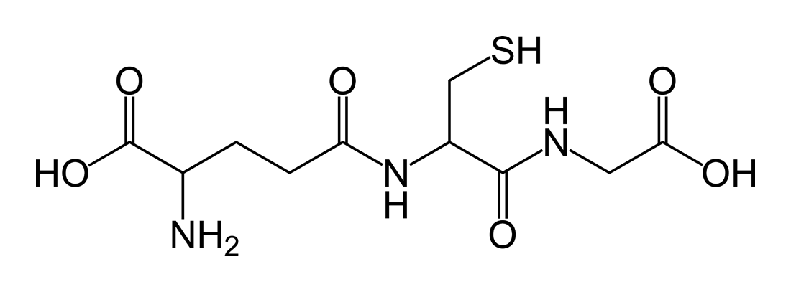
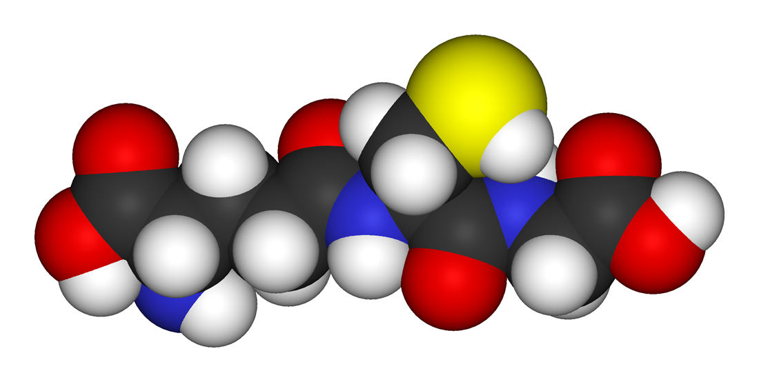
2-amino-5-{[2-[(carboxymethyl)amino]-1-(mercaptomethyl)-2-oxoethyl]amino}-5-oxopentanoic acid

Slide 55
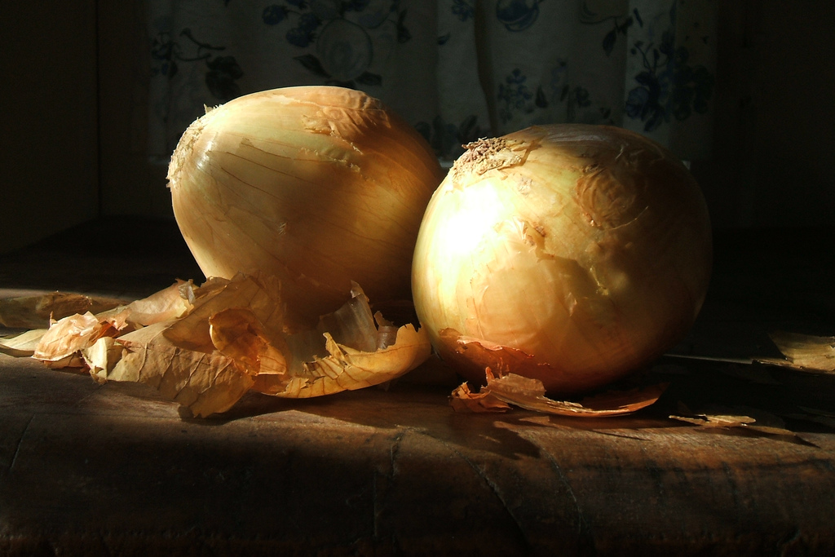


Slide 56
CH3CH2CH2 – SH
propanethiol
Lachcrymator
Substances that will make our
eyes to tear………………………………

Slide 57
Physical Properties

Slide 58
Physical Properties
THIOLS tend to be a clear liquid or white crystalline form.
Characteristic of other sulfur-containing compounds, THIOLS have a stench that smells similar to rotten eggs.
The odor of THIOLS is often strong and repulsive, particularly for those of low molecular weight.
THIOLS show little association by hydrogen bonding.
They have lower boiling points.
Less soluble in water and other polar solvents than alcohols of similar molecular weight.

Slide 59
Nomenclature

Slide 60
NOMENCLATURE OF THIOLS
When a thiol group is a substituent on an ALKANE, there are several ways of naming the resulting THIOL:
The preferred method (used by the IUPAC) is to add the suffix -thiol to the name of the alkane.
The common name is obtained by writing the alkyl group name followed by the word mercaptan.

Slide 61
EXAMPLEs:
CH3 – SH
methanethiol
CH3 – CH2 – SH
ethanethiol
CH3 – CH2 – CH2 – SH
propanethiol

Slide 62
EXAMPLE:
OH
CH3 – CH2 – C – CH2 – CH2 – SH
CH3
3 - hydroxy - 3- methyl - 1 - pentanethiol

Slide 63
EXAMPLE:
SH
cyclohexanethiol
CH2 ═ CH – CH2 – CH2 – SH
3 - butene - 1 - thiol

Slide 64
EXAMPLE:
1 - cyclobutene - 1 - thiol
SH
NO2
CH2 ═ CH – C – C ≡ CH
SH
(3 - nitro - 1 - pentene - 4 - yne) 3 - thiol

Slide 65
EXAMPLE:
SH
thiophene
SH
O - hydroxythiophene
OH

Slide 66
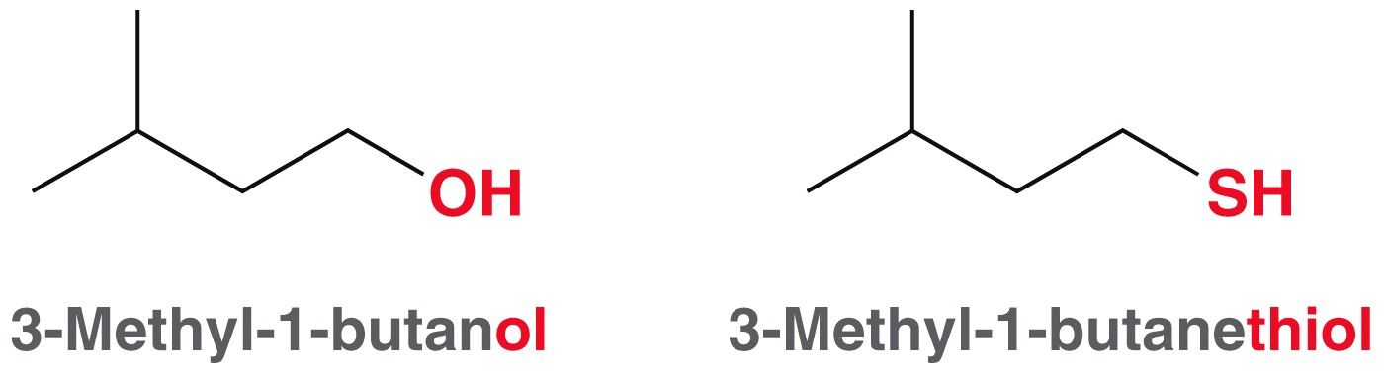
Alcohol and Thiols

Slide 67
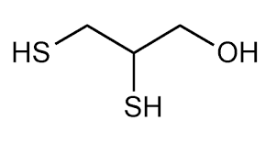
2,3-dimercapto-1-propanol

Slide 68
chemical Properties

Slide 69
oXidation reaction
General formula
(O)
Thiol + Thiol ------------→ Disulfide + Water
Pt/Ni
EXAMPLE:
(O)
CH3– CH2 – SH + HS – 2HC – CH3 --------→ CH3CH2 – S – S – 2HCCH3 + H2O
Pt/Ni
diethyl disulfide

Slide 70
EXAMPLE:
SH
S – S – CH3
(O)
H2O
+ HS – CH3 ---→
Pt/Ni
cyclopentylmethyl disulfide

Slide 71
disulfides

Slide 72
DEFINITION
Organic compounds containing - S - S - functional group.

Slide 73
Nomenclature

Slide 74
EXAMPLE:
CH3 – CH2 – CH2 – S – S – CH2 – CH3
ethylpropyl disulfide
CH3
CH3
CH3 – CH – S – S – HC – CH3
diisopropyl disulfide

Slide 75
EXAMPLE:
S
S
cyclohexylphenyl disulfide
S
S
NO2
4 - nitrodiphenyl disulfide

Slide 76
chemical Properties

Slide 77
reduction reaction
General formula
Disulfides + Hydrogen --------→ 2 Thiols
Pt/Ni
EXAMPLE:
SH
H – H
Pt/Ni
2
S
S
+ H2 -------→

Slide 78
EXAMPLE:
CH3
H – H
Pt/Ni
2
CH3 – CH – S – S – HC – CH3
+ H2 -------→
HS – HC – CH3
CH3
CH3
SH
H – H
S
S
CH3
Pt/Ni
+ H2 -------→
+ CH3SH
Thiophene & methanethiol

Slide 79
sulfides

Slide 80
DEFINITION
Sulfur analogs of ETHER containing the – S – functional group and they are name by using the word SULFIDE to show the presence of the - S – group.

Slide 81
Nomenclature

Slide 82
EXAMPLE:
CH3 – CH2 – CH2 – S – CH2 – CH3
ethylpropyl sulfide
S
(CH2)3 – CH3
butylcyclobutyl sulfide

Slide 83
EXAMPLE:
S
(CH2)5 – CH3
4 – hexyldiphenyl sulfide
S
dicyclopropyl sulfide

Slide 84
Thiols and Sulfides
The hydrosulfide ion (HS⁻) is a strong nucleophile and a weak base.
HS⁻ promotes S_{N}2 rather than E2

Slide 85
Thiols and Sulfides
Thiols have a pK_{a} of about 10.5
Recall that water has a pK_{a} of 15.7
Predict whether the equilibrium below will favor products or reactants and draw the mechanism
Thiolates are excellent nucleophiles
thiolate ion

Slide 86
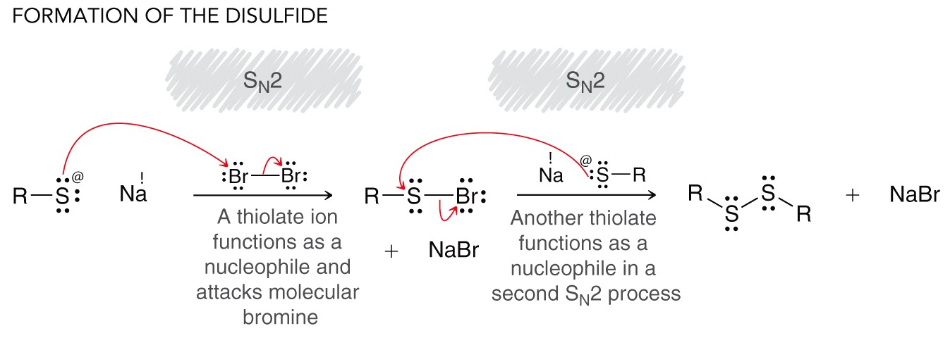
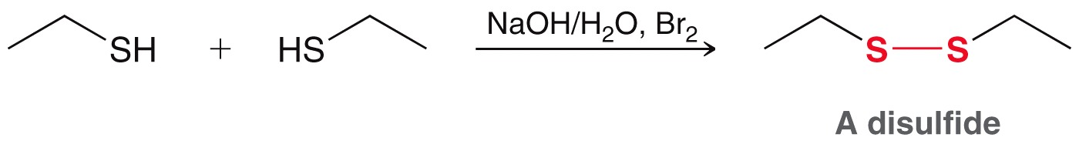
Thiols and Sulfides
A thiolate can attack Br₂ to produce a disulfide

Slide 87
Thiols and Sulfides
Predict the outcome of the following reactions, and draw a complete mechanism

Slide 88
Thiols and Sulfides
Disulfides can be reduced by the reverse reaction
The interconversion between thiol and disulfide can also occur directly via a free radical mechanism. Propose a mechanism
The bond dissociation energy of a S-S bond is only about 53 kcal/mol. WHY is that significant?

Slide 89
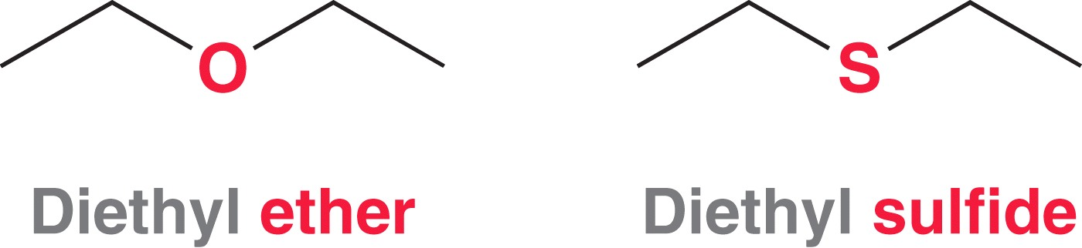
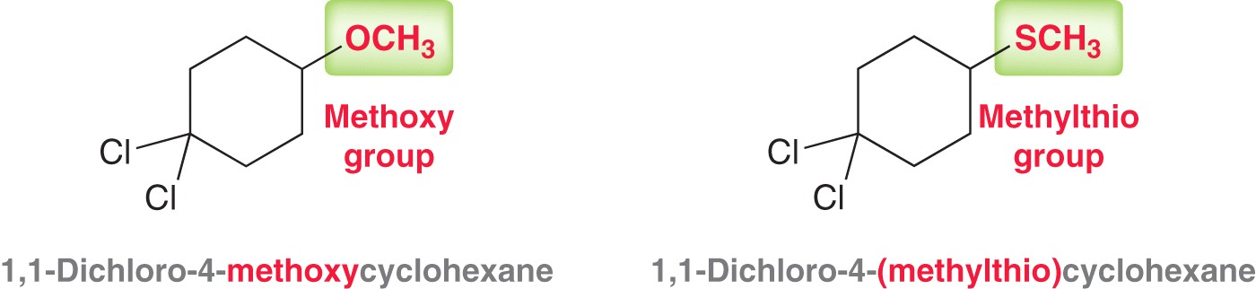
Thiols and Sulfides
Sulfur analogs of ethers are called sulfides or thioethers
Sulfides can also be named as a side group

Slide 90
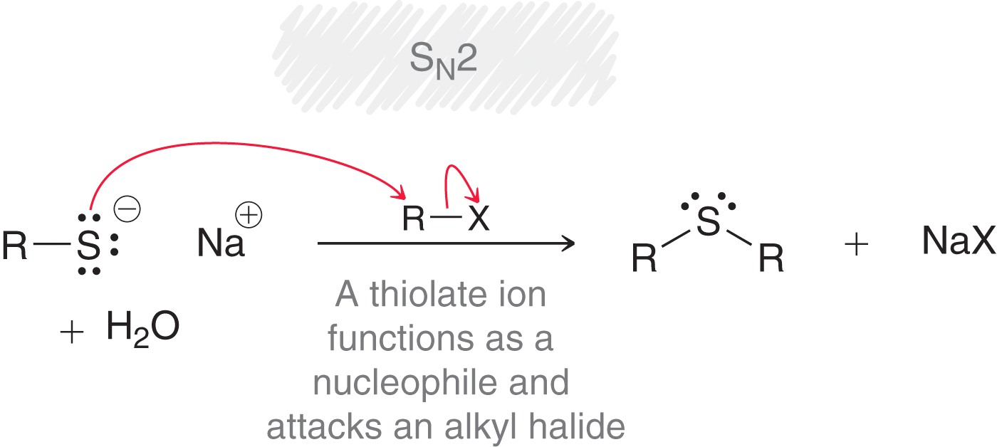
Thiols and Sulfides
Sulfides are generally prepared by nucleophilic attack of a thiolate on an alkyl halide
How are thiolates generally prepared?

Slide 91
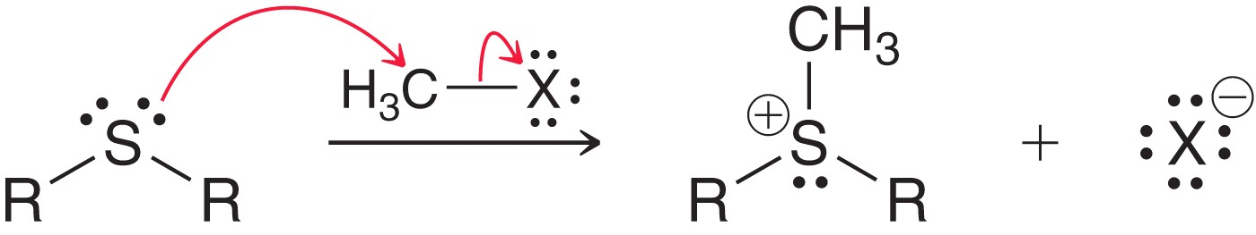
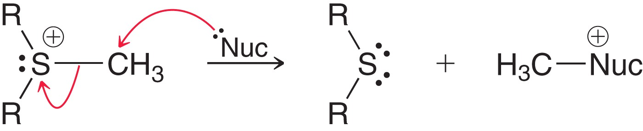
Thiols and Sulfides
Sulfides undergo a number of reactions
Attack on an alkyl halide
  The process produces a strong alkylating reagent that can add an alkyl group to a variety of nucleophiles

Slide 92
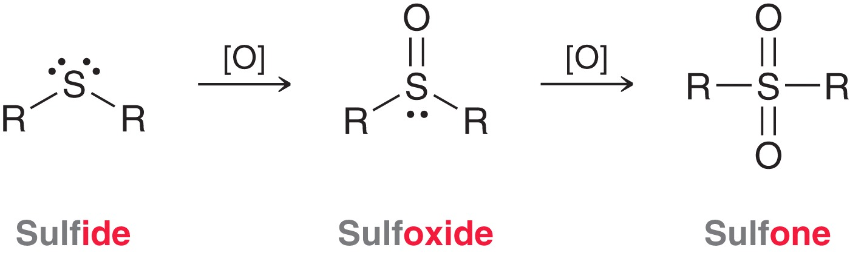
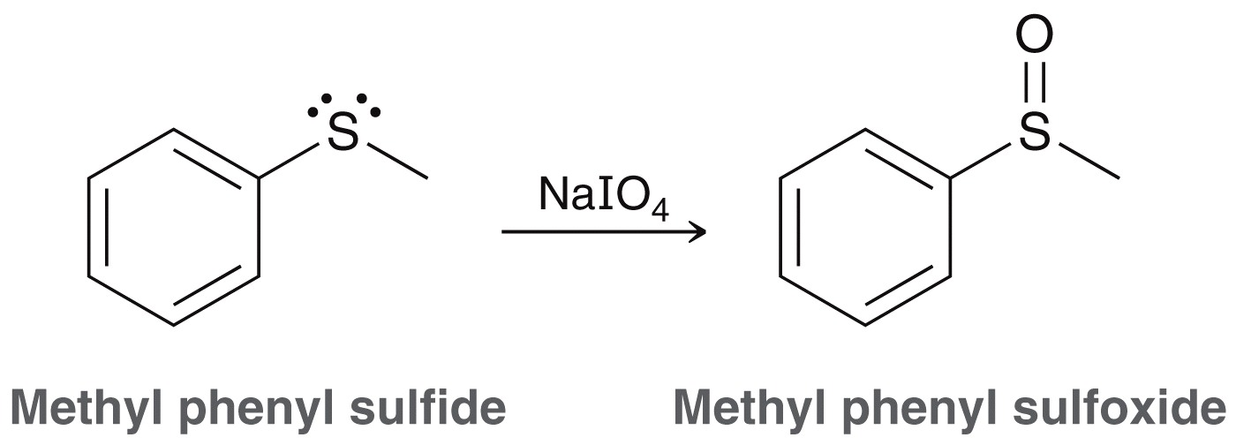
Thiols and Sulfides
Sulfides can also be oxidized
Sodium meta-periodiate can be used to form the sulfoxide

Slide 93
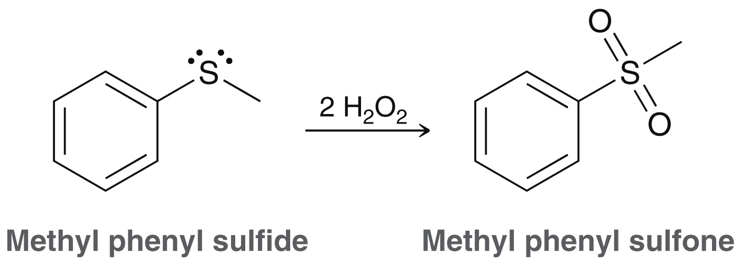
Thiols and Sulfides
Sulfides can also be oxidized
Hydrogen peroxide can be used to give the sulfone

Slide 94

Thiols and Sulfides
Sulfoxides and sulfones have very little double bond character
Which resonance contributor for each is the major contributor, and WHY?

Slide 95

Thiols and Sulfides
Because sulfides are readily oxidized, they make good reducing agents

Slide 96
Thiols and Sulfides
Predict any products or necessary reagents in the reaction sequence below
Verify the formal charge on the sulfur in the final product above

Slide 97

Synthetic Strategies Involving Epoxides
Epoxides can be used to install functional groups on adjacent carbons
Give necessary reagents for the reaction below

Slide 98


Synthetic Strategies Involving Epoxides
By reacting an epoxide with a Grignard reagent, the carbon skeleton can be modified
You may think of an epoxide as the starting material

Slide 99


Synthetic Strategies Involving Epoxides
An epoxide can be used to install a two carbon chain between an R group and an OH group
Recall that a carbonyl can be used to install a one carbon chain between an R group and an OH group

Slide 100
Synthetic Strategies Involving Epoxides
Give necessary reagents for the reaction below

Slide 101
Additional Practice Problems
Name the following molecule
Draw the structure for (4-methylcyclohexyl)phenylether

Slide 102
Additional Practice Problems
Fill in the missing intermediates and reagents in the scheme below

Slide 103
Additional Practice Problems
Fill in the missing intermediates and reagents in the scheme below

Slide 104
Additional Practice Problems
Give necessary reagents to complete the synthesis below

Slide 105
IR Spectroscopy of Ethers
IR: The C—O stretch is in the fingerprint region around 1000–1200 cm⁻¹.
Many compounds have the C—O stretch.
If the IR spectrum has the C—O stretch but does not have a C═O or an OH stretch, then the compound is most likely an ether.

Slide 106

MS Spectrometry of Ethers
Main fragmentation is the α cleavage to form the resonance-stabilized oxonium ion.
Either alkyl group can be cleaved this way.

Slide 107

Loss of an Alkyl Group
The C—O bond can be cleaved to produce a carbocation.

Slide 108

MS Spectra of Diethyl Ether

Slide 109

NMR Spectroscopy of Ethers
The typical chemical shifts for ethers in NMR are:
¹³C—O signal between δ 65 and 90.
¹H—C—O signal between δ 3.5 and 4.

Slide 110

Williamson Ether Synthesis
This method involves an S_{N}2 attack of the alkoxide on an unhindered primary halide or tosylate.
The alkoxide is commonly made by adding Na, K, or NaH to the alcohol

Slide 111
Examples of the Williamson Synthesis

Slide 112

Phenyl Ethers
Phenoxide ions are easily produced for because the alcohol proton is acidic.
Phenyl halides or tosylates cannot be used in this synthesis method.

Slide 113
Hint
To convert two alcohols to an ether, convert the more hindered alcohol to its alkoxide. Convert the less hindered alcohol to its tosylate (or an alkyl halide). Make sure the tosylate (or halide) is a
good S_{N}2 substrate.

Slide 114

Alkoxymercuration–Demercuration Reaction
Use mercuric acetate with an alcohol. The alcohol will react with the intermediate mercurinium ion by attacking the more substituted carbon.

Slide 115
Industrial Synthesis of Ethers
Bimolecular condensation of alcohols.
Industrial method, not good lab synthesis.
If temperature is too high, alkene forms.
H
2
S
O
4
C
H
3
C
H
2
O
H
+
H
O
C
H
2
C
H
3
C
H
C
H
O
C
H
C
H
3
2
2
3
140°C

Slide 116

Examples of Industrial Synthesis of Ethers

Slide 117
Cleavage of Ethers by HBr and HI
Ethers are unreactive, which makes them ideal solvents for a lot of different reactions.
They can be cleaved by heating with concentrated HBr and HI.
Reactivity: HI > HBr

Slide 118


Mechanism of Ether Cleavage
Step 1: Protonation of the oxygen.
Step 2: The halide will attack the carbon and displace the alcohol (S_{N}2).

Slide 119

Mechanism of Ether Cleavage
Step 3: The alcohol reacts further with the acid to produce another mole of alkyl halide.
This does not occur with aromatic alcohols (phenols).

Slide 120

Phenyl Ether Cleavage
Phenol cannot react further to become a halide because an S_{N}2 reaction cannot occur on an sp² carbon.

Slide 121
Hint
HBr and HI convert both alkyl groups (but not aromatic groups) of an ether to alkyl
halides. Phenolic products are unreactive, however.

Slide 122
Autoxidation of Ethers
In the presence of atmospheric oxygen, ethers slowly oxidize to hydroperoxides and dialkyl peroxides.
Both are highly explosive.
Precautions:
  Do NOT distill to dryness.
  Store in full bottles with tight caps.

Slide 123

Mechanism of Autoxidation

Slide 124

Thioethers
R—S—R′, analog of ether.
Name sulfides like ethers, replacing “sulfide” for “ether” in common name, or “alkylthio” for “alkoxy” in IUPAC system.

Slide 125

Thiols and Thiolates
Thioethers are easily synthesized by the Williamson ether synthesis, using a thiolate ion as the nucleophile.

Slide 126
Sulfide Reactions
Sulfides are easily oxidized to sulfoxides and sulfones.
O
O
H
2
O
2
H
2
O
2
C
H
3
S
C
H
3
C
H
S
C
H
C
H
3
S
C
H
3
C
H
C
O
O
H
3
3
C
H
C
O
O
H
3
3
O
Sulfides react with unhindered alkyl halides
to give sulfonium salts.
+
_
C
H
3
S
C
H
3
+
C
H
3
I
C
H
S
C
H
I
3
3
C
H
3

Slide 127

Thioethers as Reducing Agents
Because sulfides are easily oxidized, they are often used as mild reducing agents.

Slide 128

Silyl Ethers
Resistant to some acids, bases, and oxidizing agents.
More easily formed and more easily hydrolyzed. These properties
Used as protecting groups for alcohols.

Slide 129

Alcohol-Protecting Groups
If the molecule has more than one functional group, sometimes their reactivity can interfere with the desired reaction.

Slide 130

Silyl Ethers as Protecting Groups
Protecting the alcohol as a silyl ether will ensure the Grignard will react with the carbonyl.
The silyl ether group can be removed in aqueous or organic solvents.

Slide 131

Sulfonium Salts as Alkylating Agents
Used as alkylating agents because the leaving group that forms is neutral.

Slide 132

Synthesis of Epoxides
Peroxyacids are used to convert alkenes to epoxides.
Most commonly used peroxyacid is meta-chloroperoxybenzoic acid (MCPBA).
The reaction is carried out in an aprotic acid to prevent the opening of the epoxide.

Slide 133

Selectivity of Epoxidation
The most electron-rich double bond reacts faster, making selective epoxidation possible.

Slide 134

Halohydrin Cyclization
If an alkoxide and a halogen are located in the same molecule, the alkoxide may displace a halide ion and form a ring.
Treatment of a halohydrin with a base leads to an epoxide through this internal S_{N}2 attack.

Slide 135

Epoxides via Halohydrins

Slide 136



Acid-Catalyzed Opening of Epoxides
Step1: Protonation of the oxygen.
Step 2: Water attacks the protonated epoxide.
Step 3: Deprotonation of the trans-1,2-diol

Slide 137



Acid-Catalyzed Opening of Epoxides in Alcohol Solution
A molecule of alcohol acts as the nucleophile and attacks and opens the epoxide.
This reaction produces an alkoxy alcohol with anti stereochemistry.

Slide 138
Hint
In proposing mechanisms for acid-catalyzed opening of epoxides, imagine that the protonated epoxide opens to
the more stable (more substituted) carbocation.

Slide 139

Base-Catalyzed Opening of Epoxides
The hydroxide ion attacks and opens the ring.
The diol is obtained after protonation of the alkoxide with water.

Slide 140

Ring Opening in Base
An epoxide is higher in energy than an acyclic ether by about 25 kcal/mol ring strain.
Release of the ring strain makes the opening of an epoxide thermodynamically favored.

Slide 141

Ring Opening with Hydrohalic Acids
After protonation the halide ion attacks the protonated epoxide.
The halohydrin initially formed reacts further with HX to give a 1,2-dihalide.

Slide 142

Regioselectivity of Epoxidation

Slide 143

Reaction of Epoxides with
Grignard and Organolithiums
Strong bases, such as Grignards and organolithiums, open the epoxide ring by attacking the less hindered carbon.

