Slide 1
Carboxylic acids and derivatives
CHEM 2425
Chapter 20

Slide 2
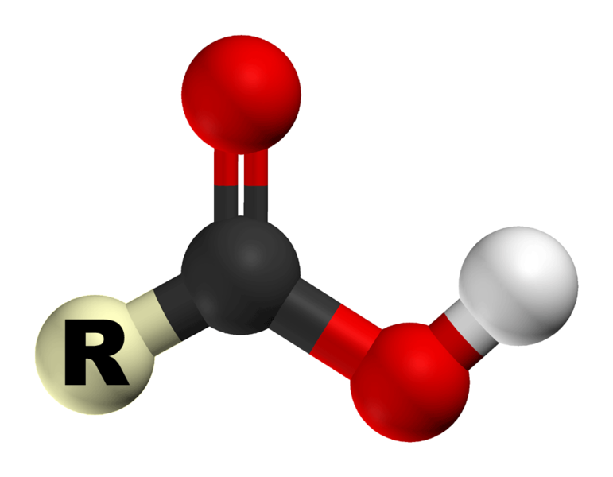
Alkanoic (Carboxylic) Acids
General Formula: R-COOH
Naming: Suffix -anoic acid
CH₃COOH ethanoic acid
ClCH₂CH₂COOH 3-chloropropanoic acid

Slide 3
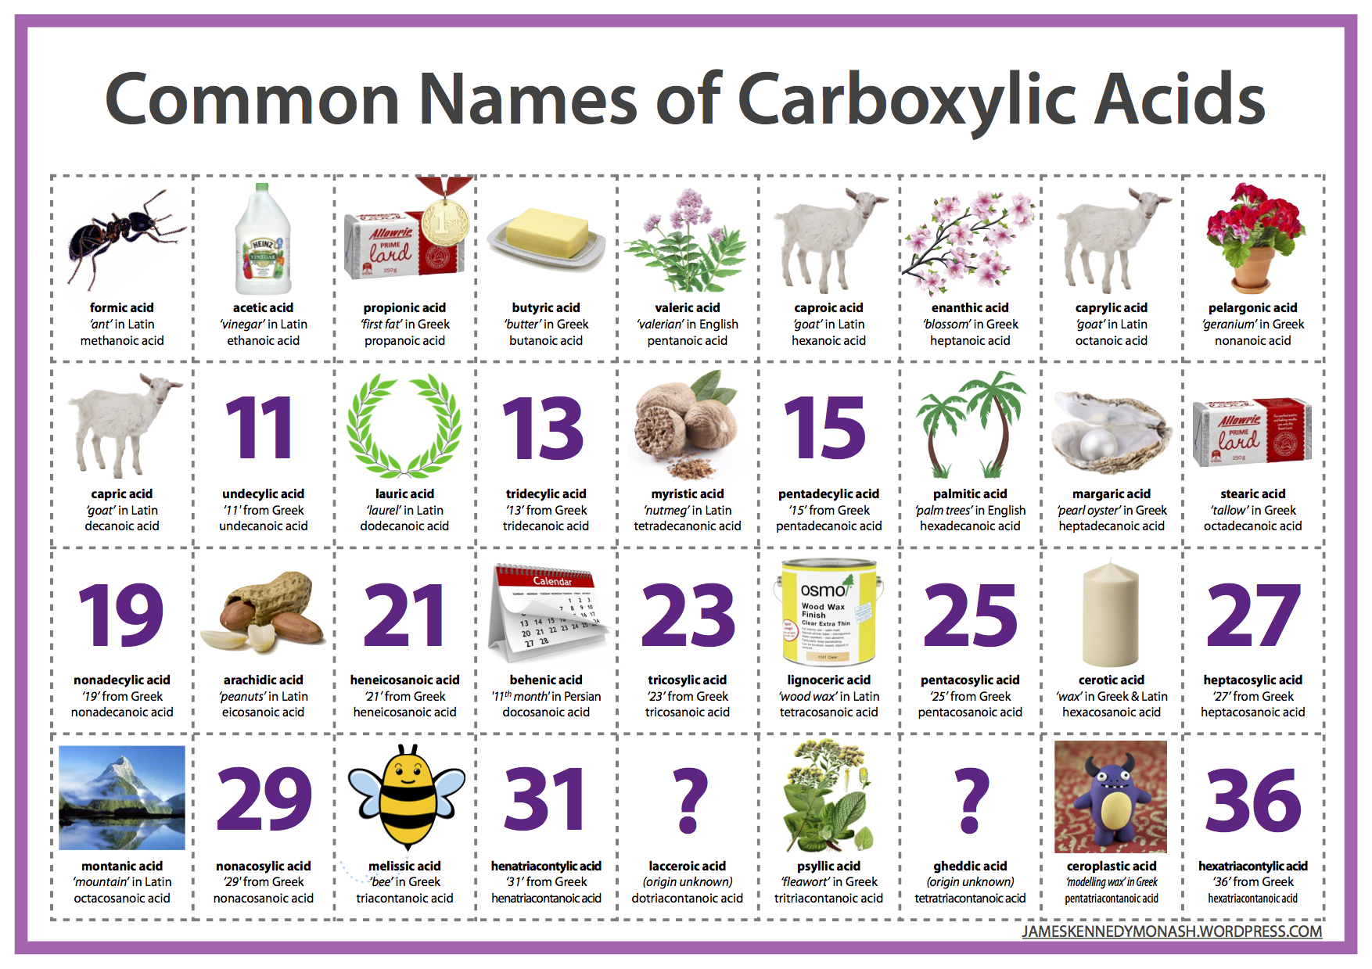

Slide 4
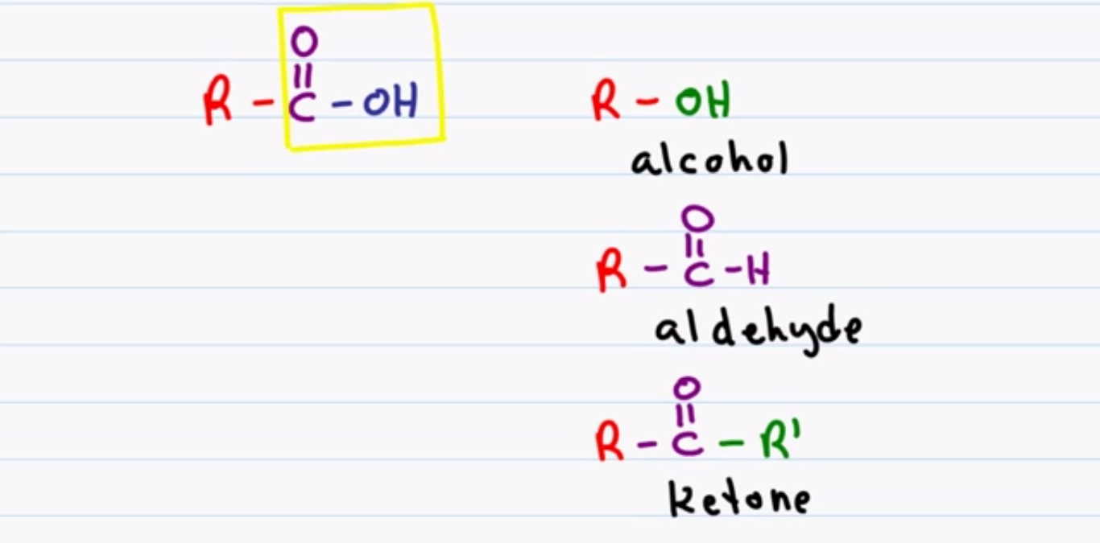
Structure & Functional Group
Differences:

Slide 5
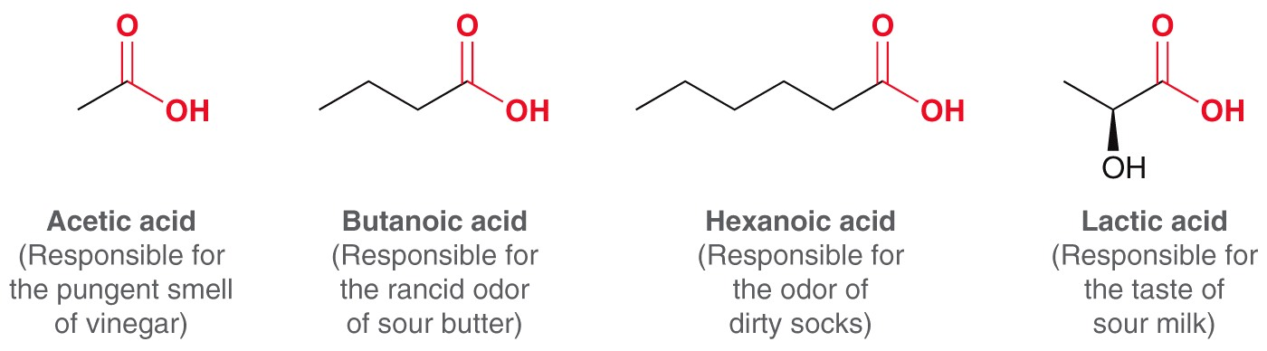
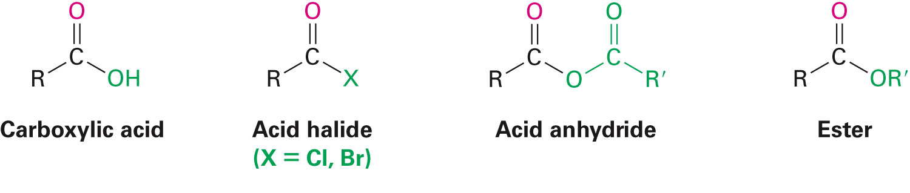
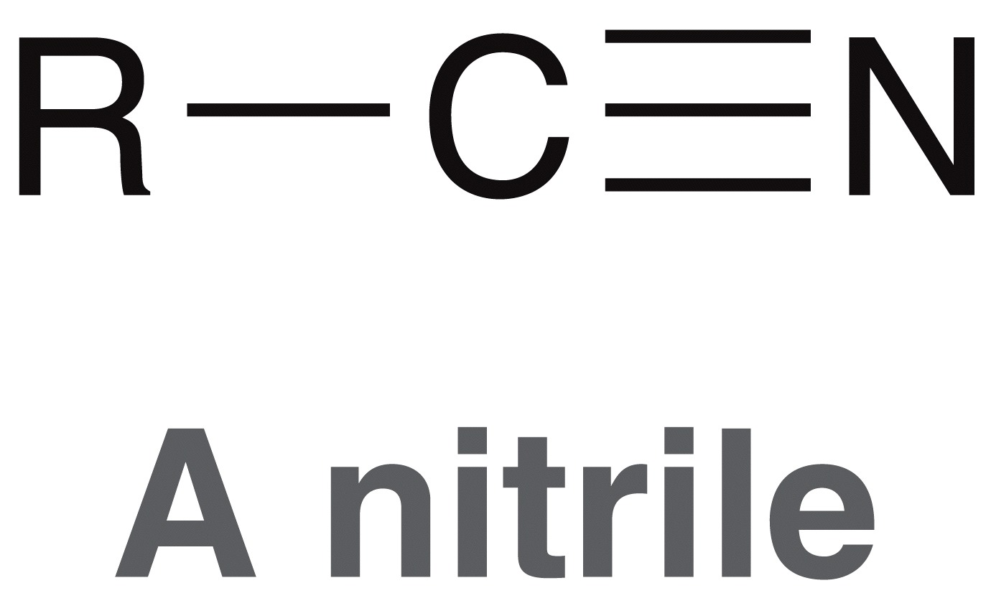
Carboxylic Acids and Derivatives
Carboxylic acids
  Found in nature
Carboxylic acid derivatives:

Slide 6
Carboxylic Acids and Derivatives
Nomenclature
Physical Properties
Acidity of Carboxylic Acids
Spectroscopy
Preparation of Carboxylic Acids
Reactions of Carboxylic Acids

Slide 7
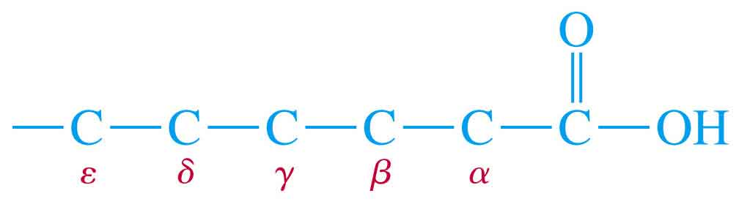
Common Names
Many aliphatic acids have historical names.
Positions of substituents on the chain are labeled with Greek letters.
β-phenylcaproic acid
α-chlorobutyric acid

Slide 8
Nomenclature
Common names you need to know:
  Formic acid (methanoic acid)
  Acetic Acid (ethanoic acid)
  Benzoic Acid

Slide 9
Propionic Acid (propanoic acid)
Butyric acid (butanoic acid)
Valeric acid (pentanoic acid)

Slide 10
IUPAC Names
Remove -e from alkane (or alkene) name, add -oic acid.
The carbon of the carboxyl group is #1.
2-chlorobutanoic acid
trans-3-phenyl-2-propenoic acid

Slide 11
Naming Cyclic Acids
Cycloalkanes bonded to -COOH are named as cycloalkanecarboxylic acids.
Aromatic acids are named as benzoic acids.
o-hydroxybenzoic acid
2-isopropylcyclopentanecarboxylic acid

Slide 12
Dicarboxylic Acids
Aliphatic diacids are usually called by their common names.
For IUPAC name, number the chain from the end closest to a substituent.
Two carboxyl groups on a benzene ring indicate a phthalic acid.
3-bromohexanedioic acid
β-bromoadipic acid (common)

Slide 13
Carboxylic Acids And Their Derivatives
Nomenclature Of Carboxylic Acids
Common Nomenclature
Some carboxylic acids are called after characteristic properties or their origin.
All common names ending -ic acid
Formula Common name origin of name
HCOOH formic acid Latin for ant
CH₃COOH acetic acid Latin for vinegar
CH₃CH₂COOH propionic acid Greek for milk
CH₃ (CH₂)₂COOH butyric acid Latin for butter
CH₃ (CH₂)₃COOH valeric acid valerian root
The positions of the carbons present on the acid chain, are located by the Greek letters α indicating the carbon atom next to COOH group (C2), β (C3), etc.
5 4 3 2 1
-C—C—C—C—COOH
δ γ β α

Slide 14
Carboxylic Acids And Their Derivatives
Example of dicarboxylic acids
Succinic acid
Some aromatic acids have common names

Slide 15

Carboxylic Acids And Their Derivatives
IUPAC Nomenclature
Find the longest continuous carbon chain contains the COOH group to get the root name of the parent hydrocarbon, then replace the ending -e by the suffix –oic acid.
Number the chain starting with the carbon of COOH group as C-1
If there are substituents identify their names, positions and list them as prefixes in alphabetical order.
Examples: (CH₃)₂CH - CH(CH₃) - CH₂ - CH₂ - COOH is called
4,5-Dimethylhexanoic acid
Butanoic acid
Pentanoic acid

Slide 16
Carboxylic Acids And Their Derivatives
3-Bromo-2-hydroxy-4-hexenoic acid
3-Aminobutanoic acid
1,4-Butandioic acid
Cyclic compounds containing one or more COOH groups attached to the ring are named by identifying the name of the ring followed by the word carboxylic acid or dicarboxylic acids etc. The carbon atom bearing the carboxylic group is numbered 1 and the substituents are numbered relative to it.

Slide 17
Carboxylic Acids And Their Derivatives
Some aromatic compounds have common names accepted by the IUPAC also they can be named as benzene carboxylic acids

Slide 18
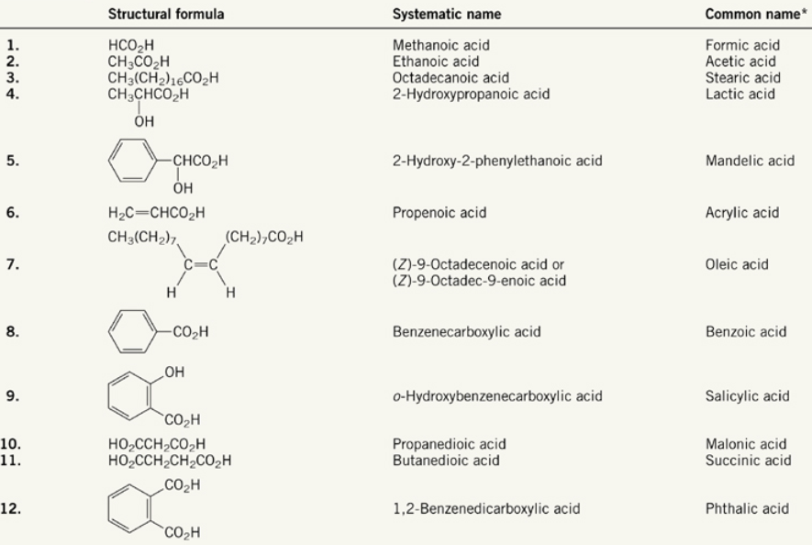

Slide 19
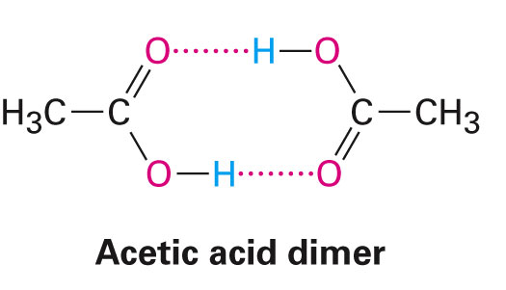
II. Physical Properties
Carboxylic acids form a hydrogen bond dimer
Boiling points
  Carboxylic acids are very high
  CA > alcohols > aldehyde/ketones > hydrocarbons
  Carboxylic acid derivatives are less predictable
  Generally amides > carboxylic acids > acid halides/esters
  Tertiary amides < primary and secondary amides
    no H-bonding in liquid phase (neat)

Slide 20
Physical Properties OF Carboxylic Acids
Carboxylic Acids And Their Derivatives
1) Boiling Points
Carboxylic acids have exceptionally high boiling points than alcohols of identical relative molecular masses, For example:
M.F. M.W bp / °C
Propanol C₃H₈O 60.01 97.2
Ethanoic acid C₂H₄O₂ 60.05 118
Carboxylic acids have higher boiling points than alcohols and aldehydes, because their dimeric structures.
Hydrogen-bonded acid dimer

Slide 21
Carboxylic Acids And Their Derivatives
2)Solubility
Carboxylic acids are polar, they can form hydrogen bonds with water molecules
The first four aliphatic acids are completely miscible in water. Higher members are less soluble
Aromatic acids are insoluble in water

Slide 22
Solubility
Water solubility decreases with the length of the carbon chain.
Up to 4 carbons, acid is miscible in water.
More soluble in alcohol.
Also soluble in relatively nonpolar solvents like chloroform because it dissolves as a dimer.

Slide 23
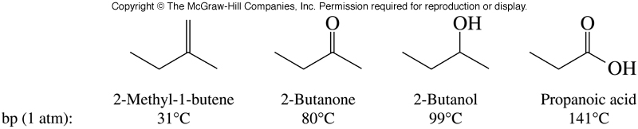
Physical Properties…boiling points

Slide 24
Melting Points
Aliphatic acids with more than 8 carbons are solids at room temperature.
Double bonds (especially cis) lower the melting point.
Note these 18-C acids:
  Stearic acid (saturated): 72°C
  Oleic acid (one cis double bond): 16°C
  Linoleic acid (two cis double bonds): -5°C

Slide 25
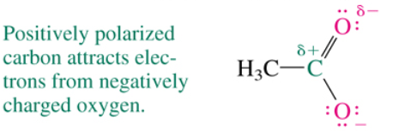
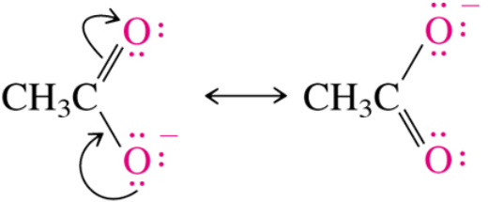
Acidity

Slide 26
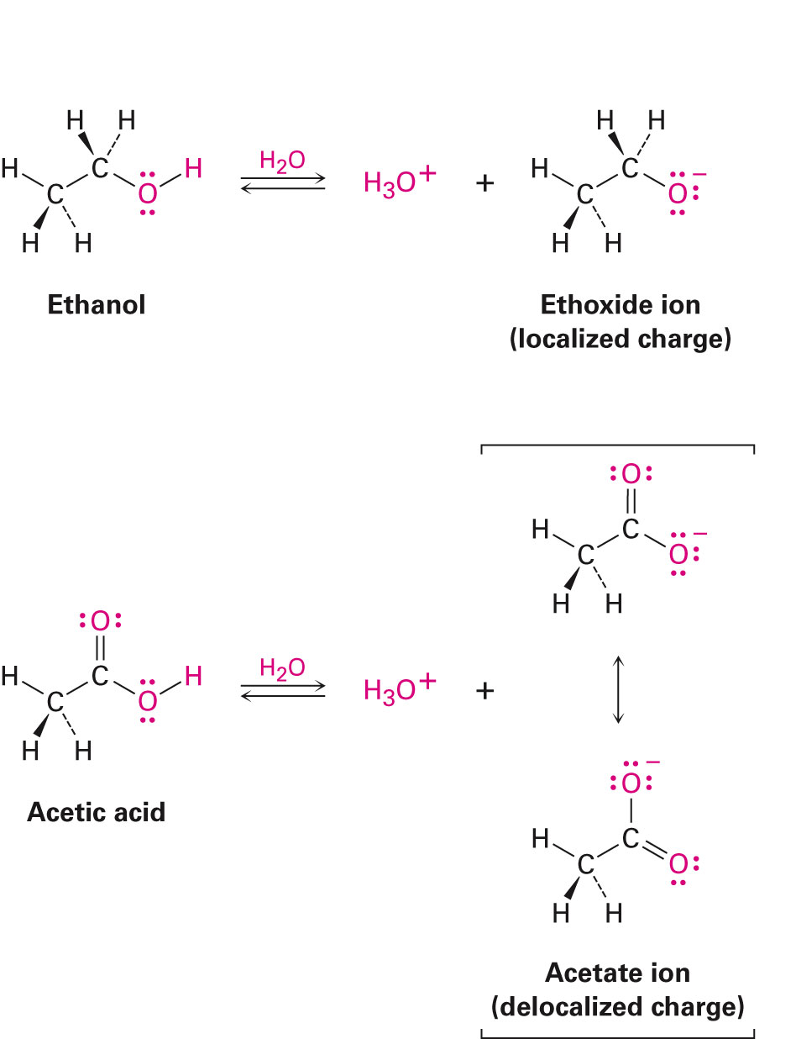
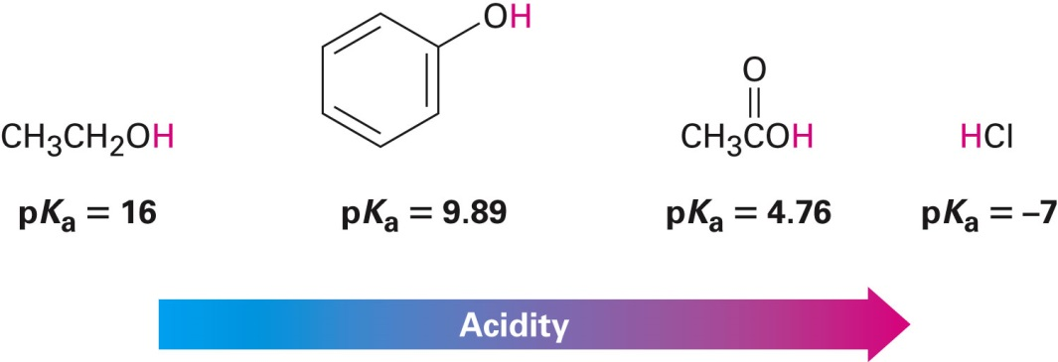
III. Acidity of Carboxylic Acids
Weak acids (pK_{a} ~ 4-5)
Stronger than alcohols because conjugate base is resonance-stabilized

Slide 27
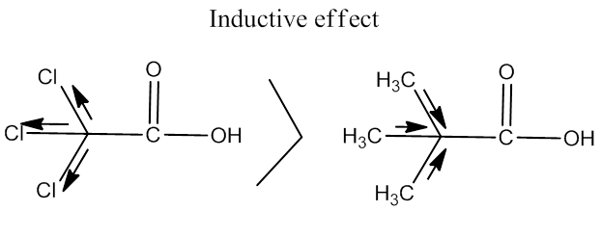
Carboxylic Acids And Their Derivatives
3) Acid Strength
Carboxylic acids are stronger acids compared to alcohols and phenols
Electron withdrawing substituents near the carboxyl group increase the acidity
Whereas electron donating substituents decrease the acidity .
HCOOH > CH₃COOH > CH₃CH₂COOH > CH₃CH₂CH₂CH₂COOH ( size of R group)
Cl₃CCOOH > Cl₂CHCOOH > ClCH₂COOH > CH₃COOH ( number of e.w.g.)

Slide 28
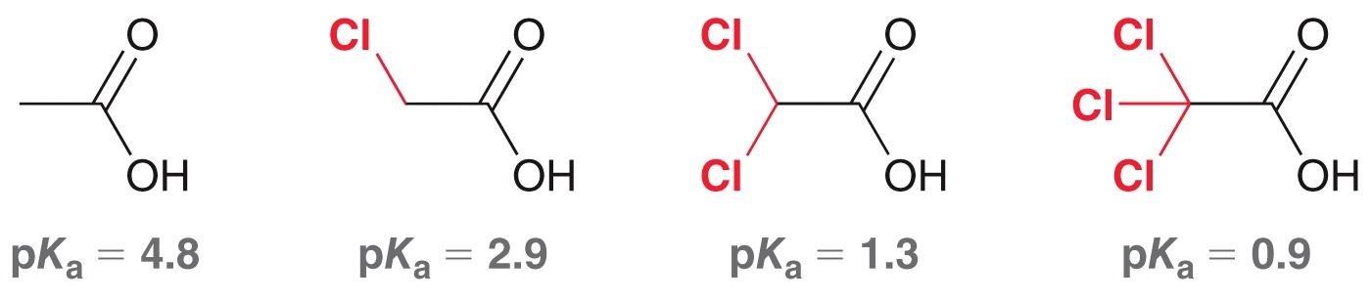
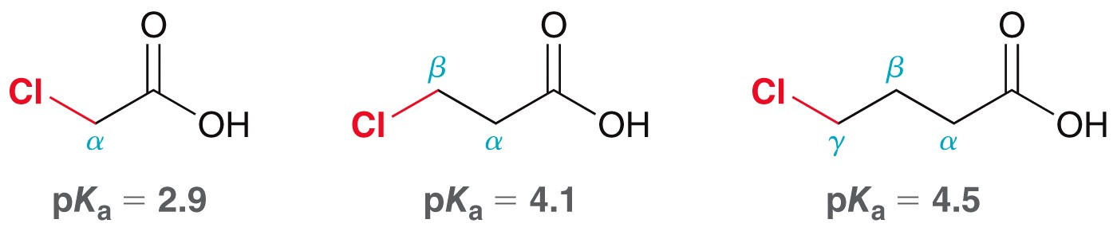
III. Acidity of Carboxylic Acids
Conjugate base can be further stabilized if electronegative atom is present
  Inductive effect
  Position of en atom affects pK_{a}

Slide 29
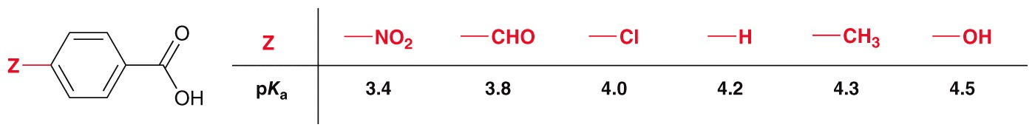
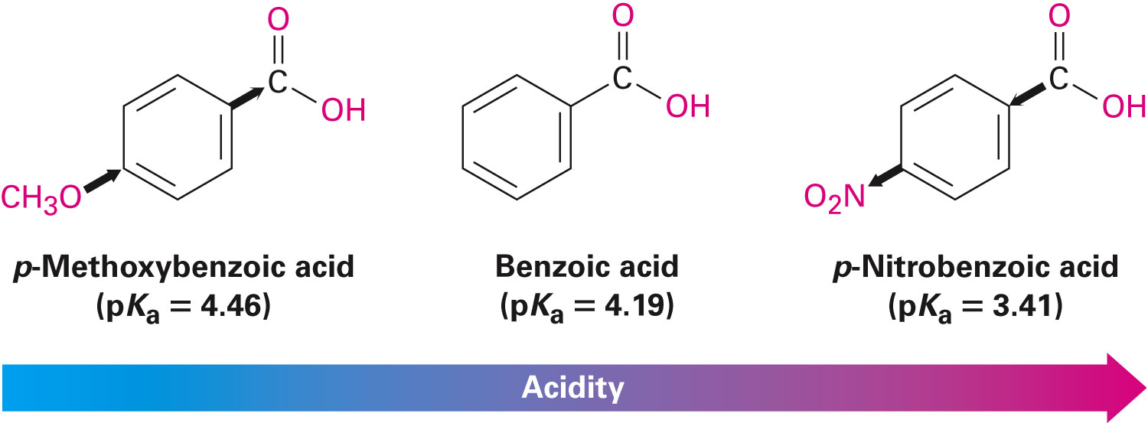
III. Acidity of Carboxylic Acids
Substituted benzoic acids
  If Z = electron-donating group, acid is weaker
  If Z = electron-withdrawing group, acid is stronger

Slide 30
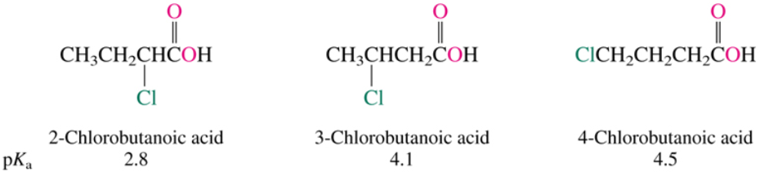
Acidity of Carboxylic Acids

Slide 31
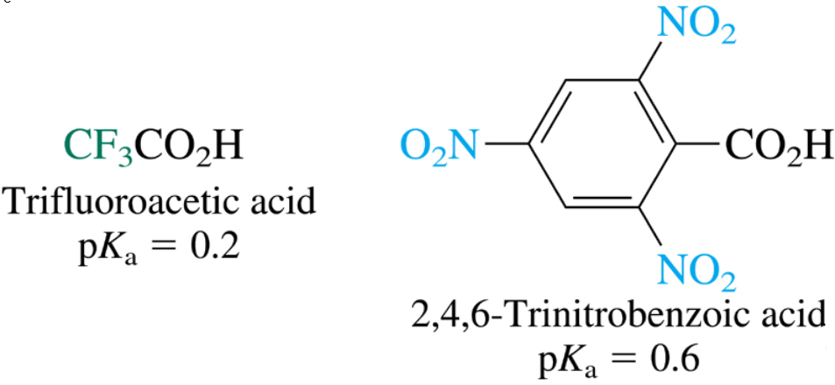
Acidity of Carboxylic Acids

Slide 32
Acidity of Carboxylic Acids

Slide 33
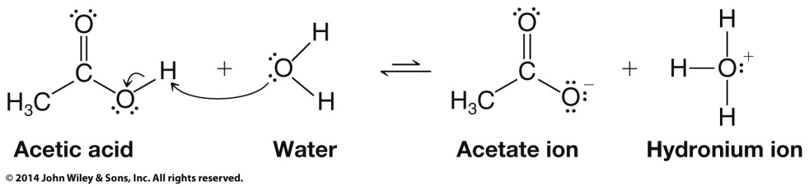
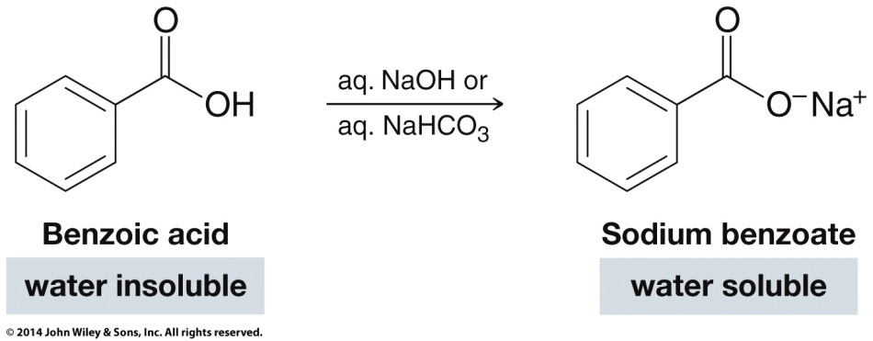
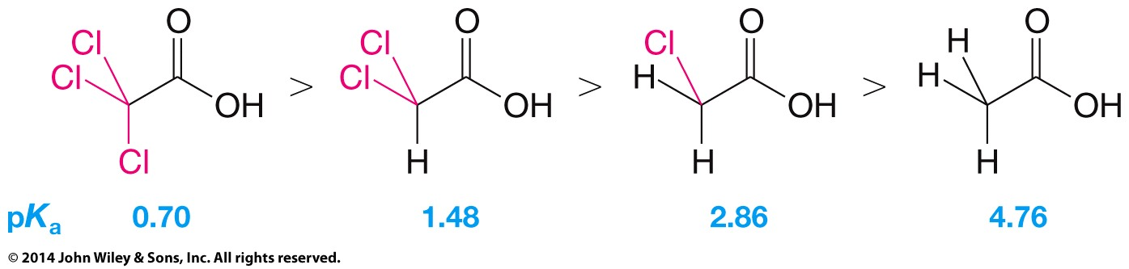
Carboxylic Acids are Weak Acids
pK_{a} = 4.7
(vineger)

Slide 34
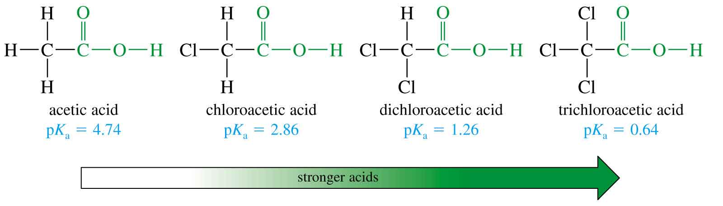
Substituent Effects on Acidity
=>

Slide 35
Substituent Effects on Acidity
pK_{a} = 4.46
pK_{a} = 4.19
pK_{a} = 3.47
pK_{a} = 3.41
pK_{a} = 2.16
=>

Slide 36
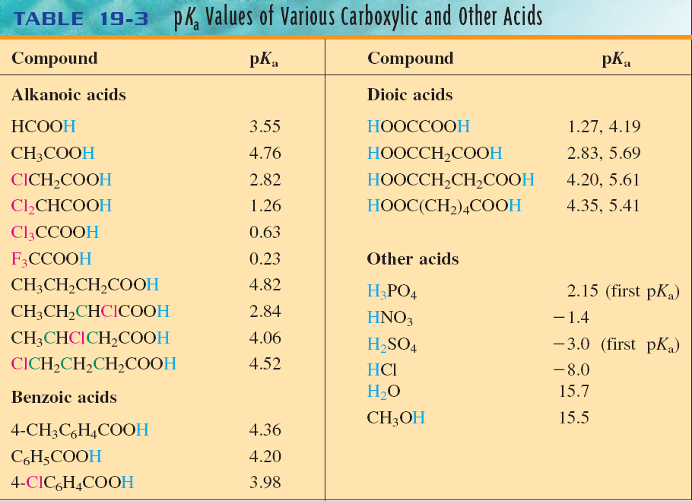
Acidity

Slide 37
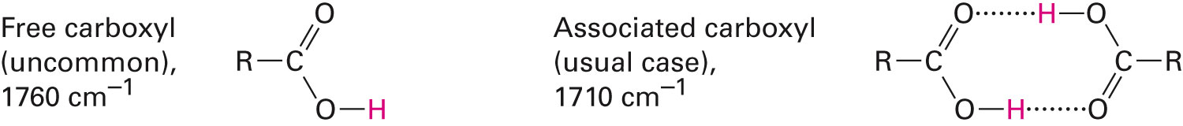
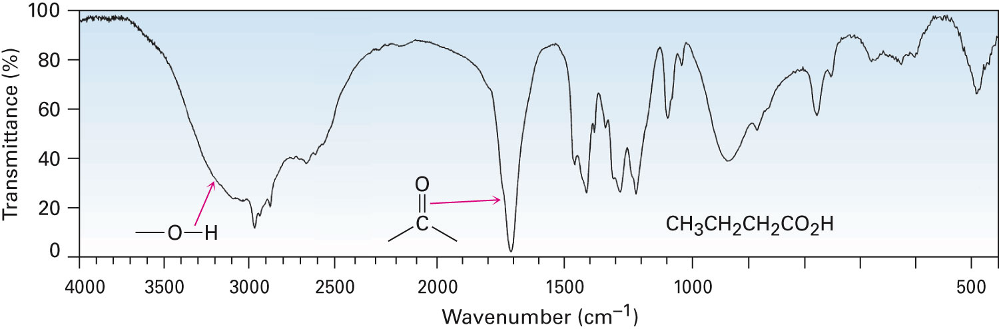
Spectroscopy of CAs: IR
Absorption at 2500-3300 cm⁻¹ for COOH
Absorption at 1710-1760 cm⁻¹ for C=O

Slide 38
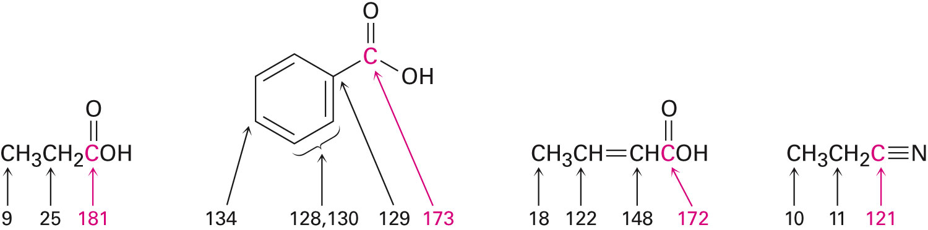
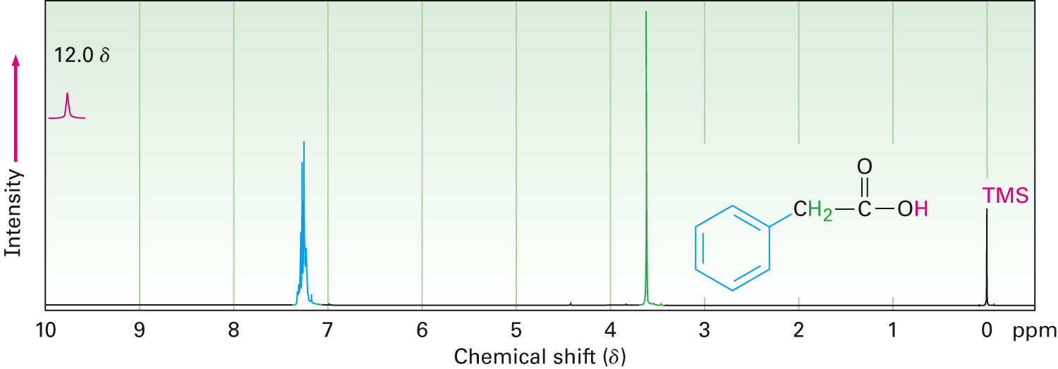
Spectroscopy of CAs: NMR
¹³C-NMR:
¹H-NMR:
  COOH signal δ11-12

Slide 39

Oxidation

Slide 40
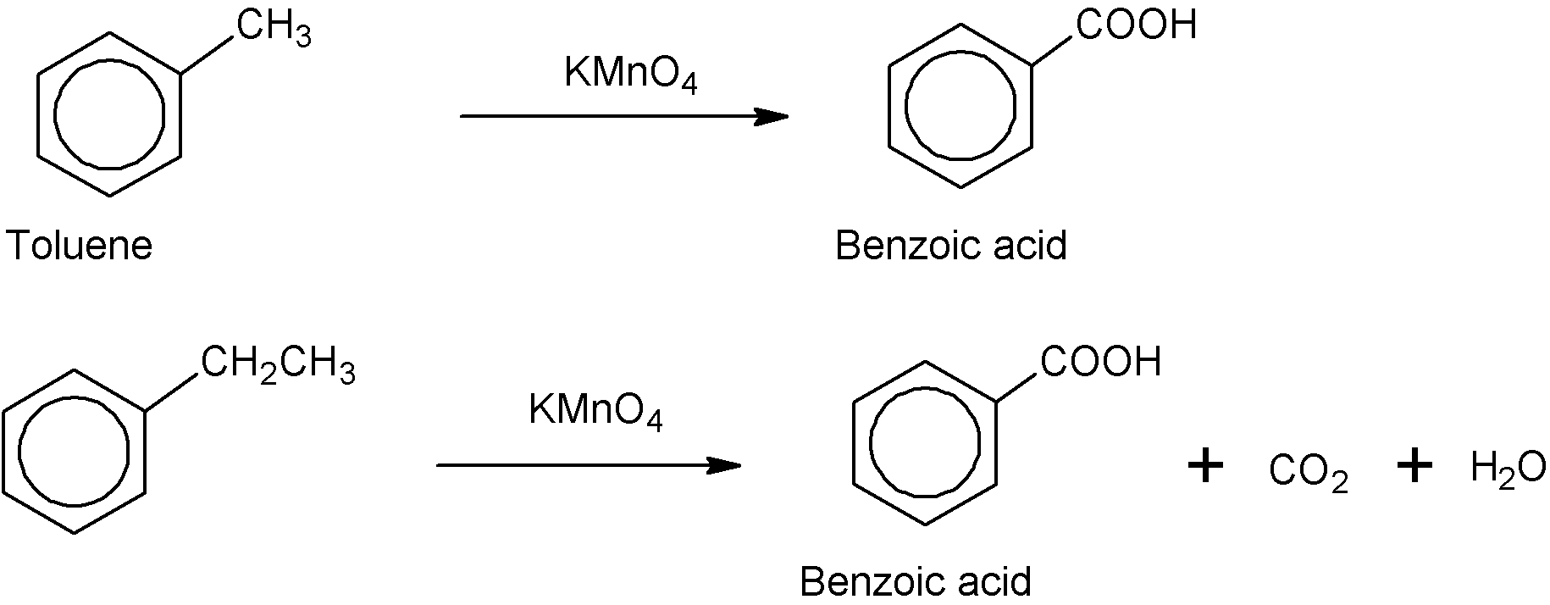
Carboxylic Acids And Their Derivatives
Preparation Of Carboxylic acids
1- Oxidation Of Primary Alcohols or aldehydes
2- Oxidation Of Alkyl Benzenes

Slide 41
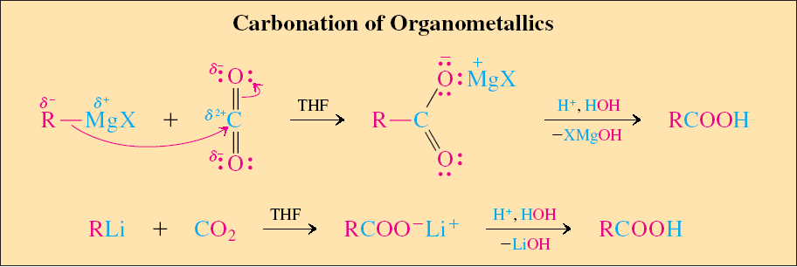
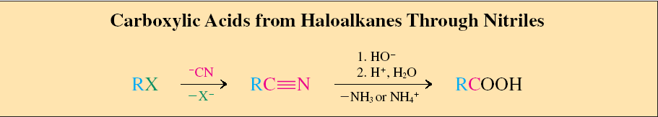

Slide 42
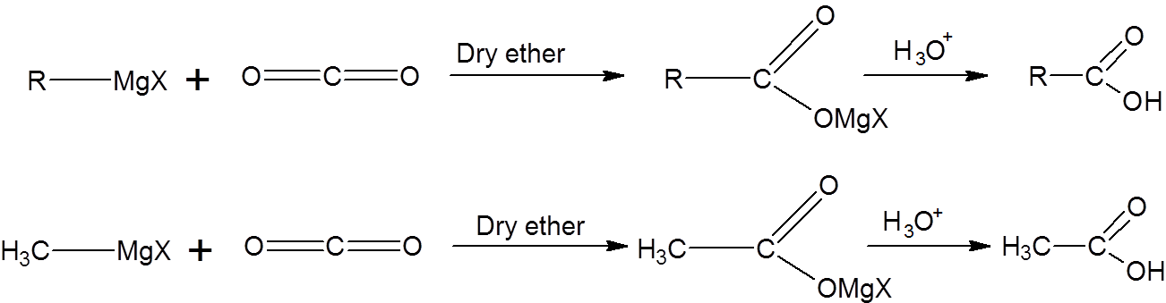
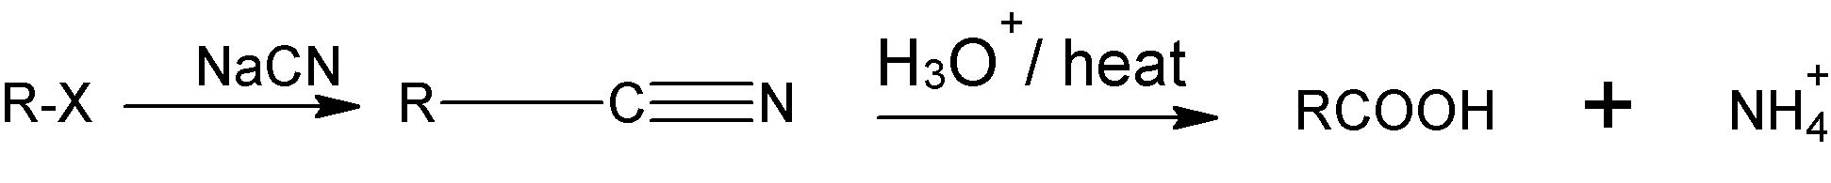
Carboxylic Acids And Their Derivatives
3- Carboxylation Of Grignard Reagents
4- Hydrolysis Of Nitriles
or i) KOH
ii) H₃O⁺

Slide 43
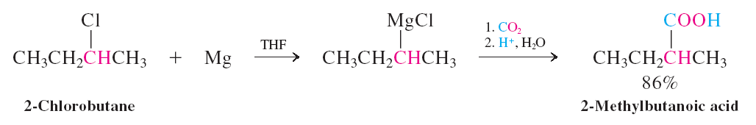
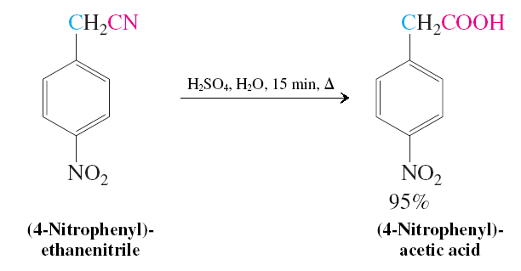

Slide 44
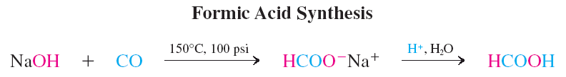
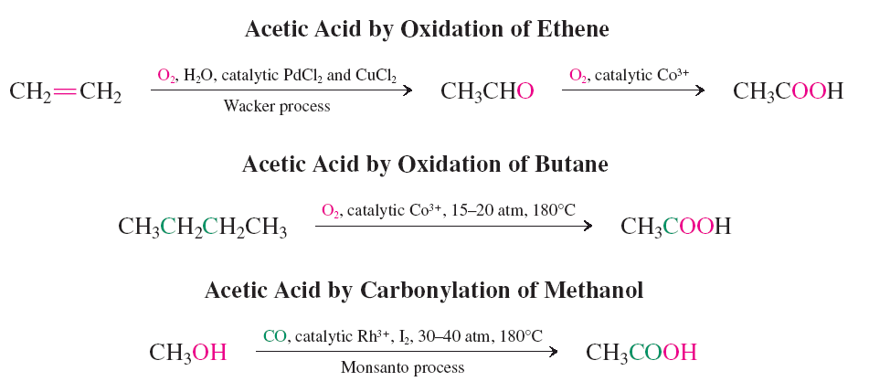
Carboxylic Acid Synthesis in Industry
  Formic acid and acetic acid are manufactured on a large scale industrially.

Slide 45
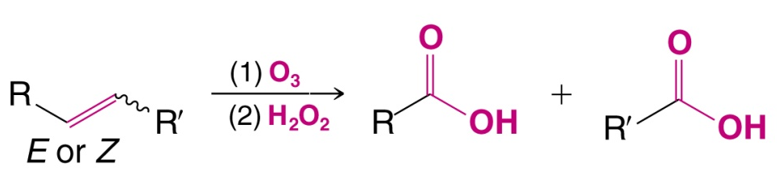
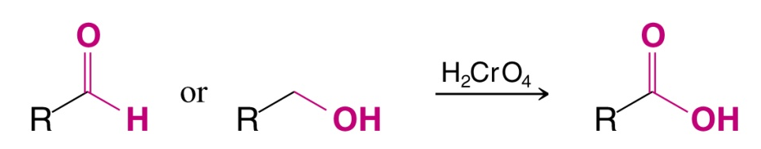
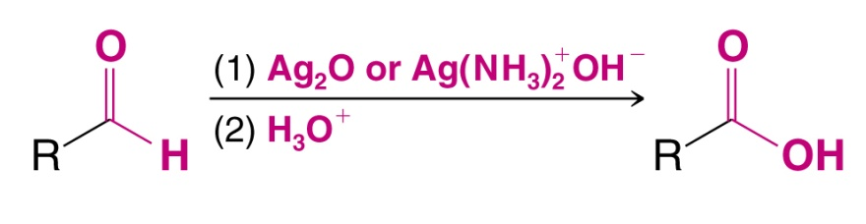
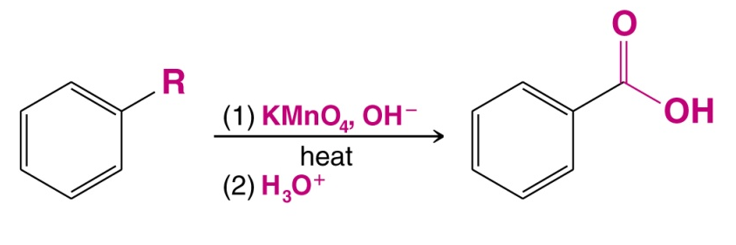
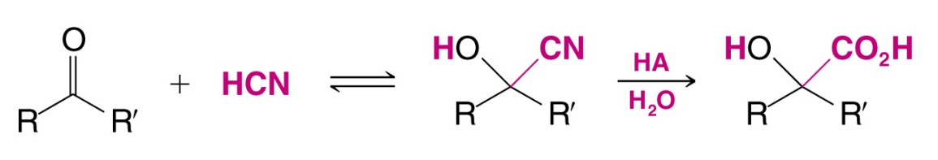
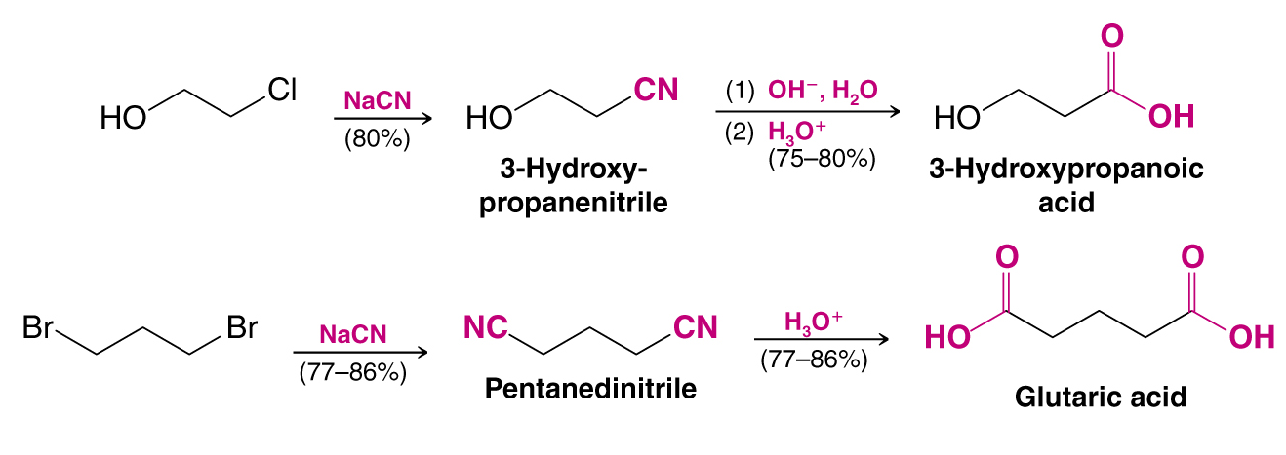
Synthesis of Carboxylic Acids

Slide 46
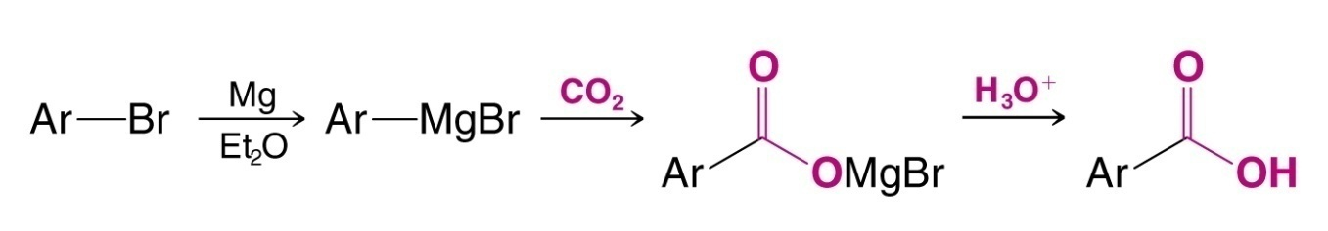
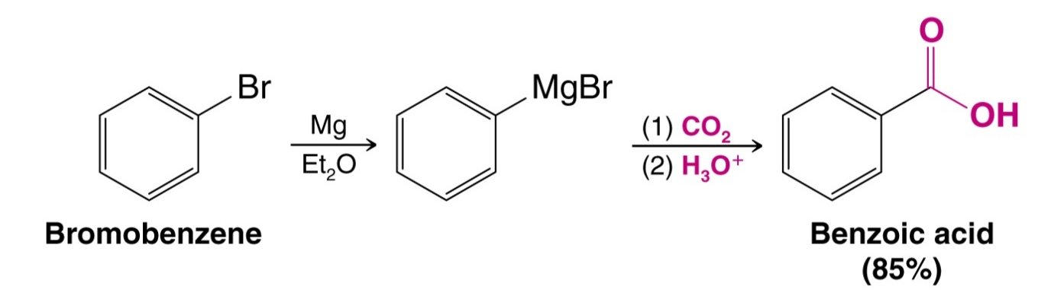
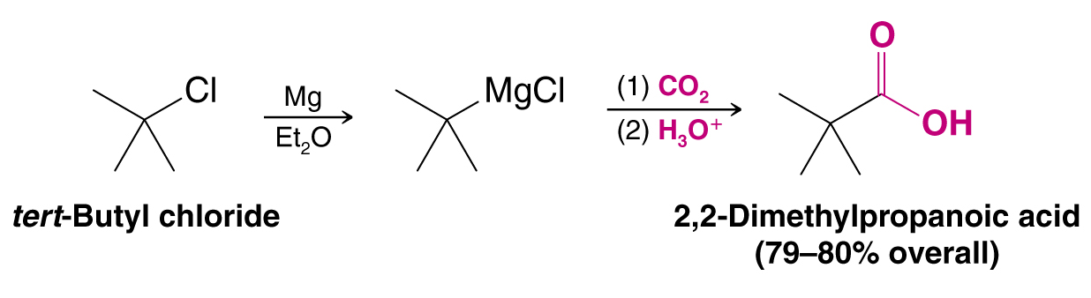
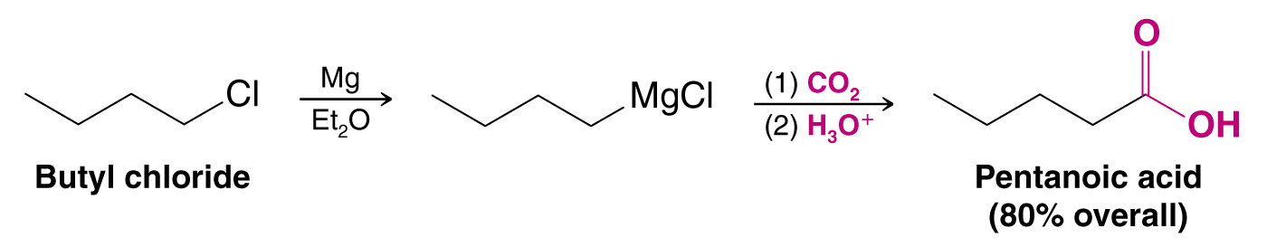
Synthesis of Carboxylic Acids via Carboxylation
using Grignard reagent

Slide 47
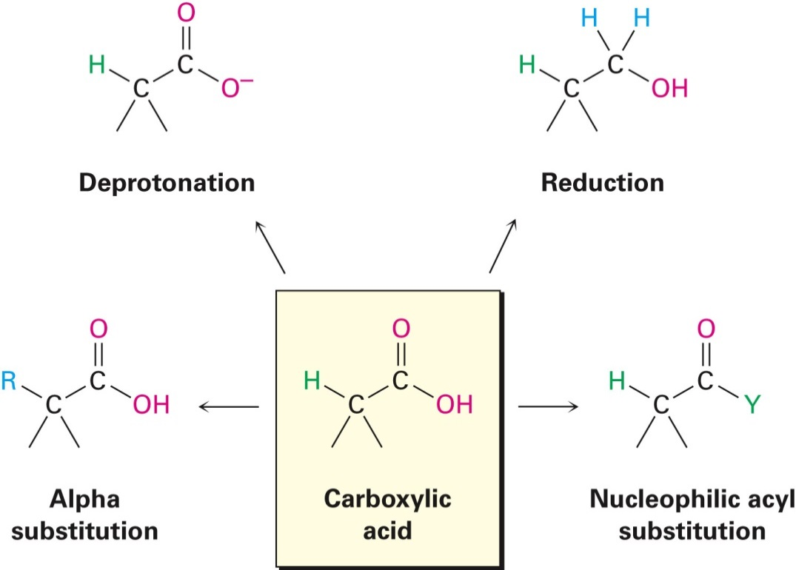

Reactions of Carboxylic Acids
Types of reactions
Deprotonation
α-Substitution
Oxidation
Reduction
Conversion to CADs

Slide 48

Reactions Of Carboxylic Acids
Carboxylic Acids And Their Derivatives
Salts Formation

Slide 49


Slide 50

Carboxylic Acids And Their Derivatives
2- Nucleophilic Substitution Of Hydroxyl Group

Slide 51
Carboxylic Acids And Their Derivatives

Slide 52
Carboxylic Acids And Their Derivatives
Reaction of Derivatives of carboxylic acid
On hydrolysis (reaction with H₂O) all carboxylic acid derivatves convert to carboxylic acid.

Slide 53
Questions
Carboxylic Acids And Their Derivatives
1- Reaction of with CO₂ under heat and pressure gives:
2- Oxidation of C₆H₅CH₂OH with KMnO₄ gives:

Slide 54
Carboxylic Acids And Their Derivatives
3- The most acidic compound is?
4- The common name of this compound is?
A) N,N-Dimethylacetamide B) N,N-Dimethyl propanamide
C) N,N-Dimethylpropionamide D) N,N-Dimethylbutanamide
5- Acid halide react with ammonia to give?
A) Amines B)Amides C) Phenols D) Alcohols

Slide 55

Reduction
Need a strong reducing agent
  LAH
Reduce to primary alcohol
  Remember reducing agent chart from alcohol chapter

Slide 56


Conversion to CADs
Fischer esterification
    Carboxylic acid + alcohol → ester + water
    Needs acid catalyst (H₂SO₄ or HCl)
    Reaction is reversible
      Push to the right with excess alcohol or remove water

Slide 57

Esterification of Carboxylic Acids
(Acids and esters have an intimate relationship)
Forward reaction: Esterification
Reverse reaction:
Hydrolysis

Slide 58


Esterification and Hydroylsis Mechanisms
Acid-catalyzed esterification and hydrolysis:
Base-catalyzed hydrolysis:

Slide 59

Conversion to CADs
Formation of acid chlorides
    Reagent = SOCl₂
    Where have we seen this reagent before?

Slide 60

Conversion to CADs
Formation of acid anhydrides
    Anhydride = without water
    Apply heat to carboxylic acids to remove water

Slide 61
Conversion to CADs
Formation of amides
    Reaction is difficult with N nucleophile because the N (base) reacts with the carboxylic acid (acid)

Slide 62

Nitriles

Slide 63

Preparation of Nitriles by Dehydration
Reaction of primary amides RCONH₂ with SOCl₂ or POCl₃ (or other dehydrating agents)
Not limited by steric hindrance or side reactions (as is the reaction of alkyl halides with NaCN)

Slide 64

Mechanism of Dehydration of Amides
Nucleophilic amide oxygen atom attacks SOCl₂ followed by deprotonation and elimination

Slide 65

Reactions of Nitriles
RC≡N is strongly polarized and with an electrophilic carbon atom
Attacked by nucleophiles to yield sp²-hybridized imine anions

Slide 66

Hydrolysis: Conversion of Nitriles into Carboxylic Acids
Hydrolyzed in with acid or base catalysis to a carboxylic acid and ammonia

Slide 67

Reduction: Conversion of Nitriles into Amines
  Reduction of a nitrile with LiAlH₄ gives a primary amine
Nucleophilic addition of hydride ion to the polar C≡N bond, yielding an imine anion
The C=N bond undergoes a second nucleophilic addition of hydride to give a dianion, which is protonated by water

Slide 68

Reaction of Nitriles with Organometallic Reagents
Grignard reagents add to give an intermediate imine anion that is hydrolyzed by addition of water to yield a ketone

Slide 69
IR of Nitriles
Nitriles show an intense C≡N bond absorption near 2250 cm⁻¹ for saturated compounds and 2230 cm⁻¹ for aromatic and conjugated molecules
This is highly diagnostic for nitriles

Slide 70
Nuclear Magnetic Resonance Spectroscopy
¹³C ≡ N signal δ 115 to δ 130

Slide 71
H₂O
H₂O
Amide
Carboxylic Acid
Chemistry of Nitriles
LiAlH₄
R’MgX
Nitrile
Amine
Ketone

Slide 72
A nitrile can be hydrolyzed in either basic or acidic aqueous solution to yield a carboxylic acid and ammoniz or an amine
H₃O⁺
Or NaOH, H₂O
Basic hydrolysis of a nitrile
Chemistry of Nitriles
⁻⁻OH
Dianion
H₂O
⁻⁻OH
Amide
⁻⁻OH
NH₂⁻
Carboxylate

Slide 73
A nitrile can be reduced with LiAlH₄ to give a primary amine
Chemistry of Nitriles
H₂O
LiAlH₄
LiAlH₄
ether
ether
Nitrile
Imine anion
Dianion
Amine

Slide 74
A nitrile can add a Grignard reagent to give an intermediate imine anion that is further hydrolyzed by water to yield a ketone:
Chemistry of Nitriles
:R’⁻ ⁺MgX
H₂O
NH₃
Nitrile
Imine anion
Ketone

