Slide 1
Organic Chemistry II
Chapter 22
Carbonyl Alpha-Substitution Reactions

Slide 2
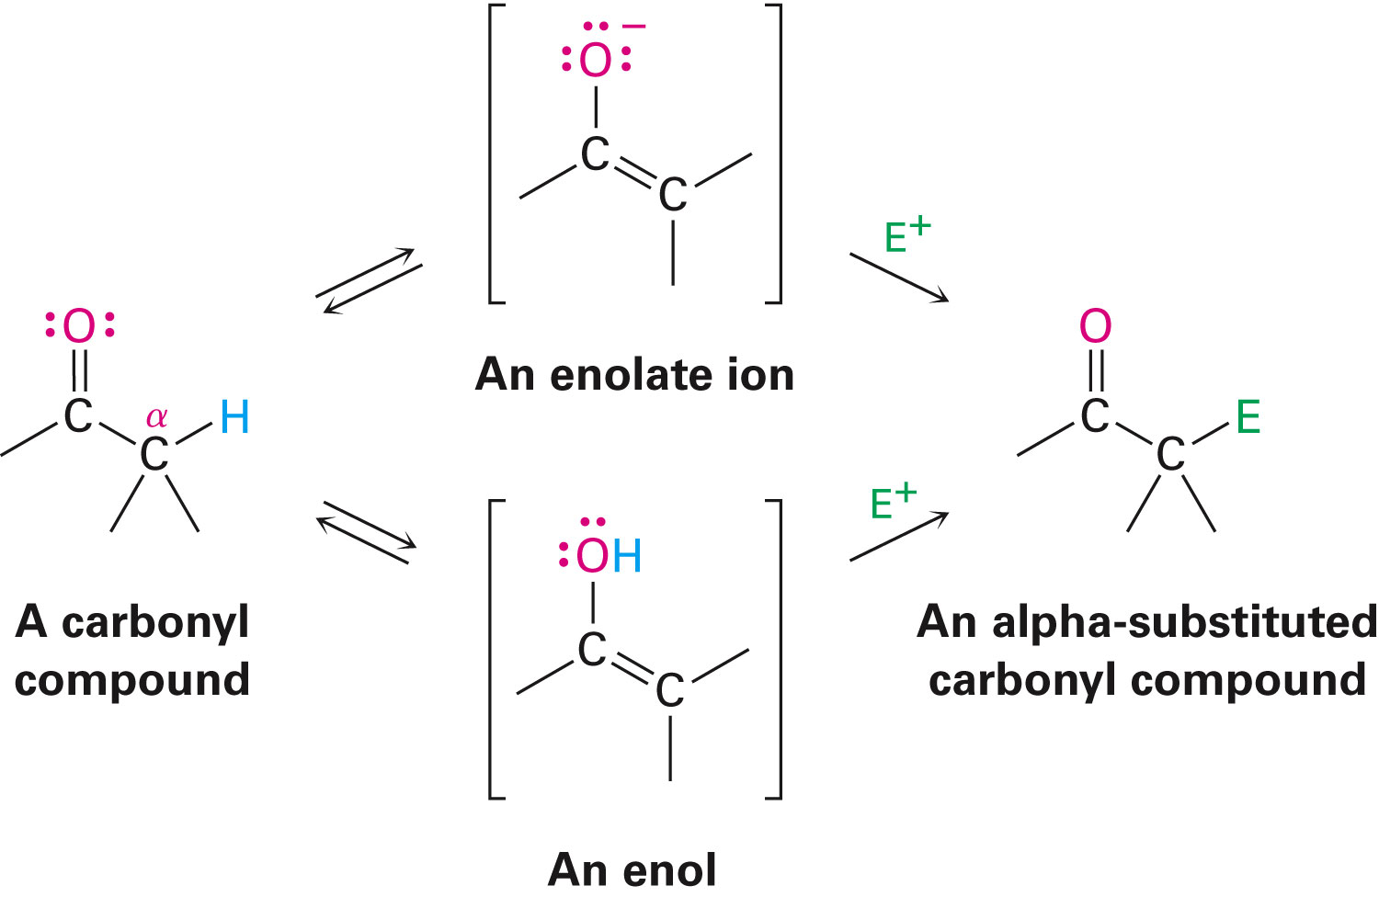
The α Position
The carbon next to the carbonyl group is designated as being in the α position
Electrophilic substitution occurs at this position through either an enolate or enol ion
These reaction are one the few general methods for making C-C bonds.

Slide 3
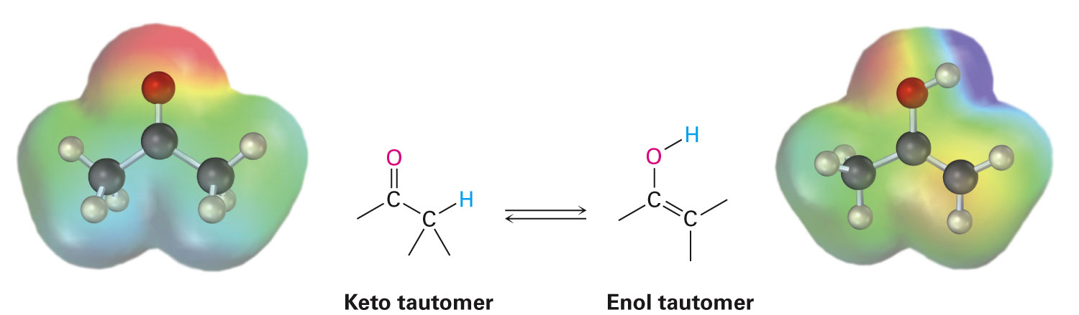
Keto–Enol Tautomerism
A carbonyl compound with a hydrogen atom on its alpha carbon rapidly equilibrates with its corresponding enol
Compounds that differ only by the position of a moveable proton are called tautomers

Slide 4
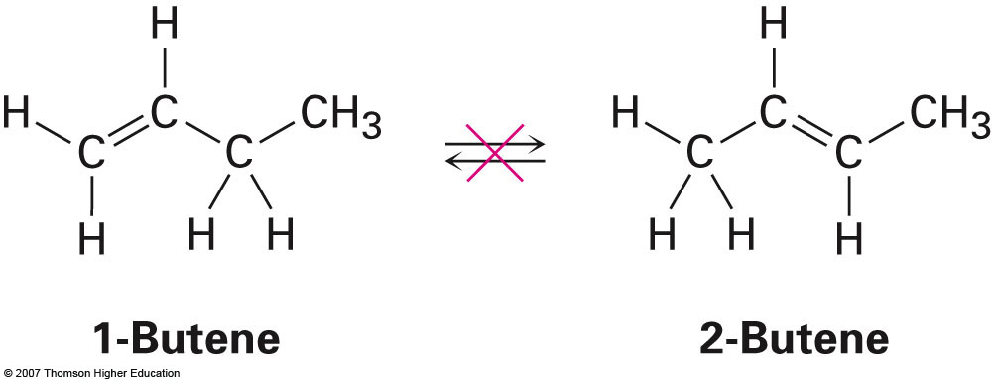
Tautomers Are Not Resonance Forms
Tautomers are structural isomers
Resonance forms are representations of contributors to a single structure
Tautomers interconvert rapidly while ordinary isomers do not

Slide 5
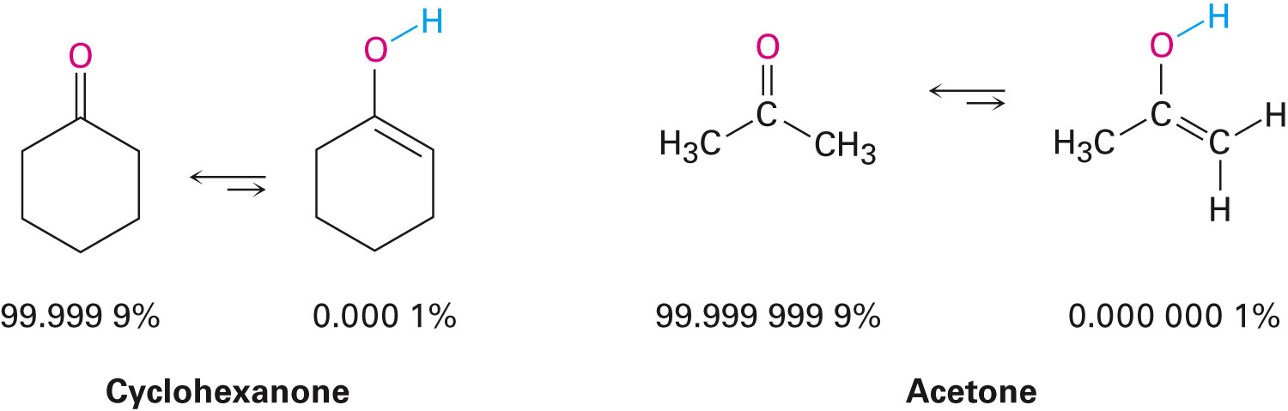
Enols
The enol tautomer is usually present to a very small extent and cannot be isolated
However, since it is formed rapidly, it can serve as a reaction intermediate

Slide 6
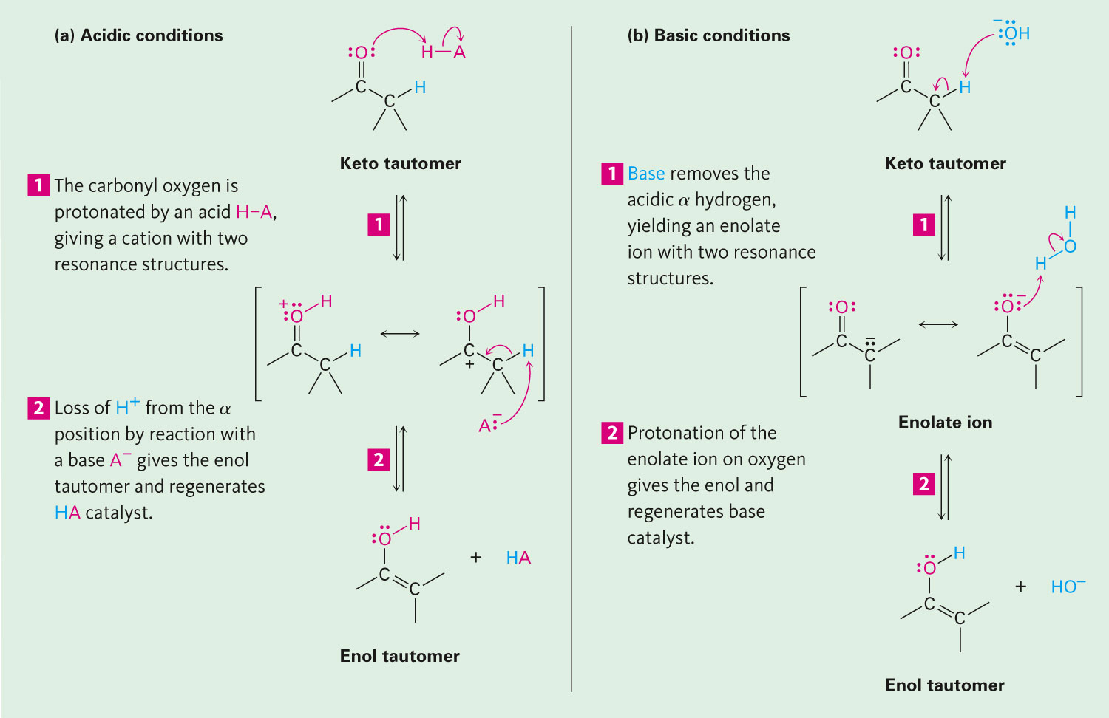
Acid Catalysis of Enolization
Brønsted acids catalyze keto-enol tautomerization by protonating the carbonyl and activating the α protons

Slide 7
Base Catalysis of Enolization
Brønsted bases catalyze keto-enol tautomerization
The hydrogens on the α carbon are weakly acidic and transfer to water is slow
In the reverse direction there is also a barrier to the addition of the proton from water to enolate carbon

Slide 8
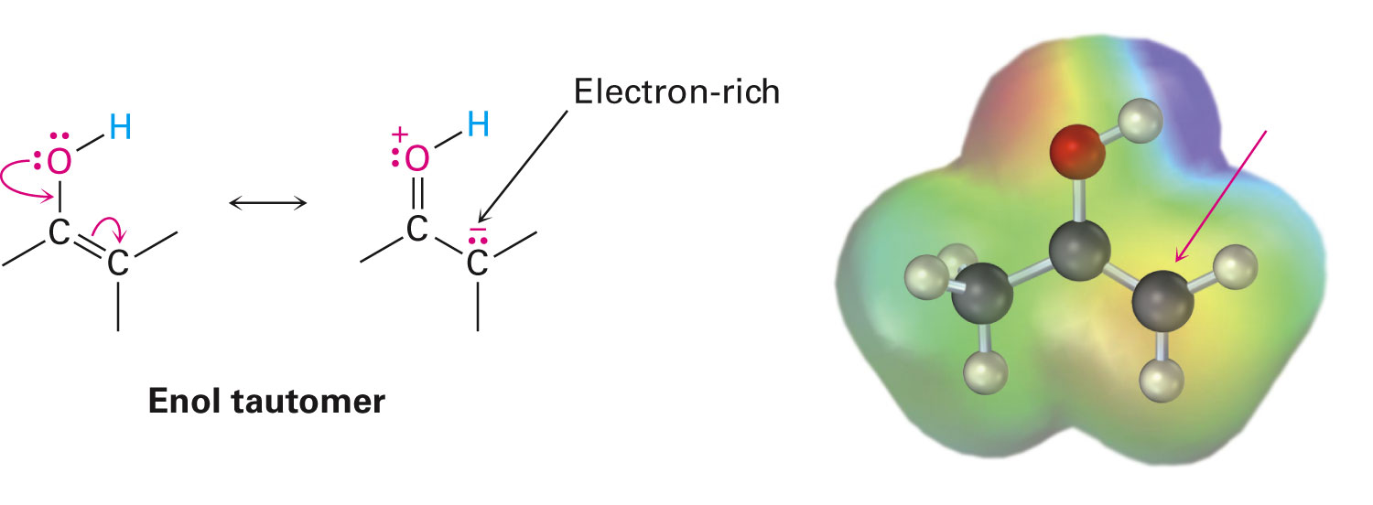
Reactivity of Enols: The Mechanism of Alpha-Substitution Reactions
Enols behave as nucleophiles and react with electrophiles because the double bonds are electron-rich compared to alkenes

Slide 9
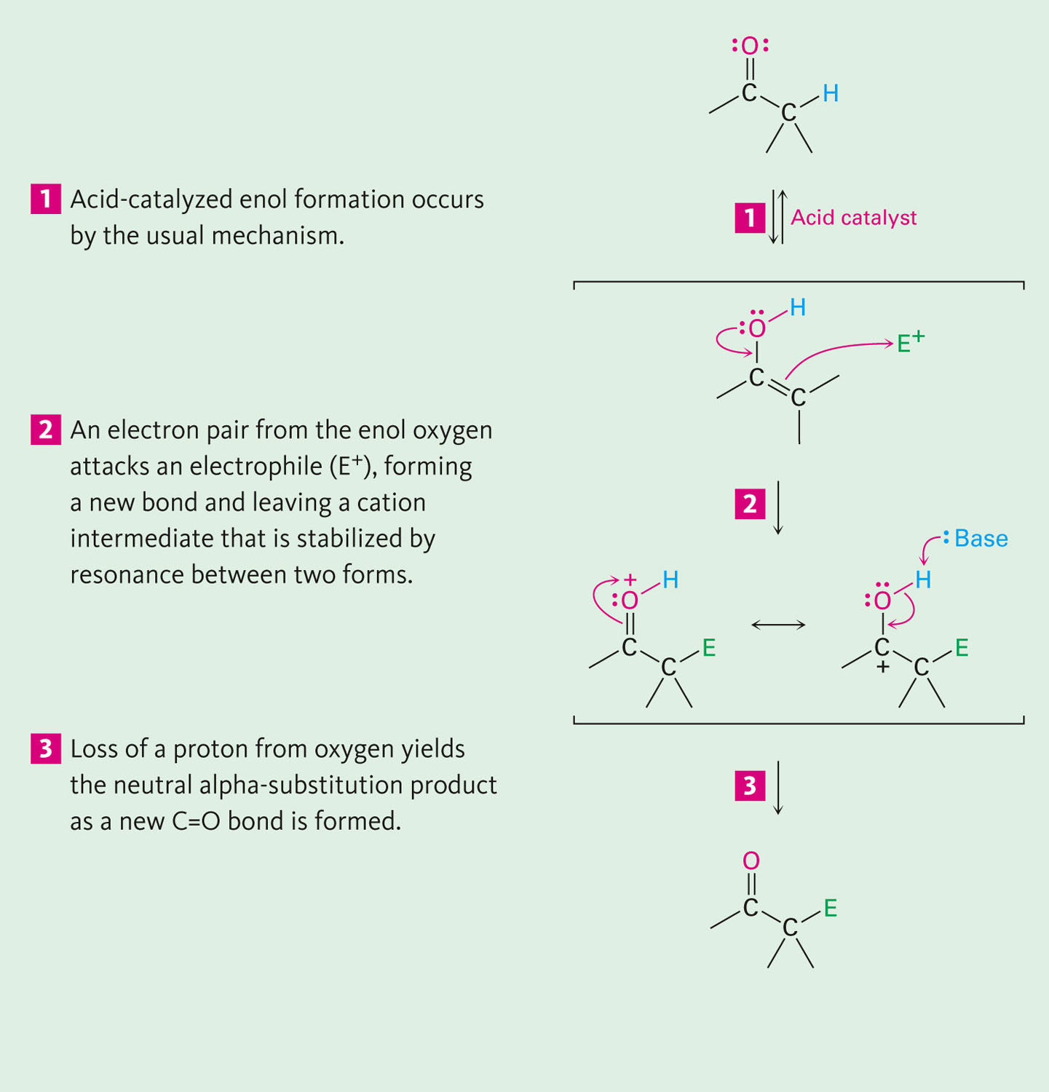
General Mechanism of Addition to Enols
When an enol reacts with an electrophile the intermediate cation immediately loses the –OH proton to give a substituted carbonyl compound

Slide 10
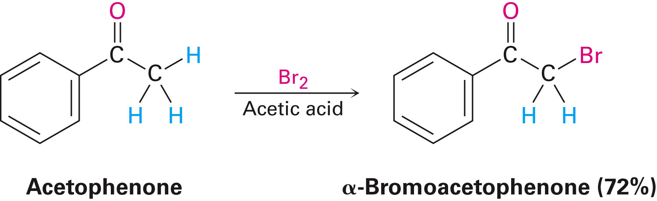
Alpha Halogenation of Aldehydes and Ketones
Aldehydes and ketones can be halogenated at their α positions by reaction with Cl₂, Br₂, or I₂ in acidic solution

Slide 11
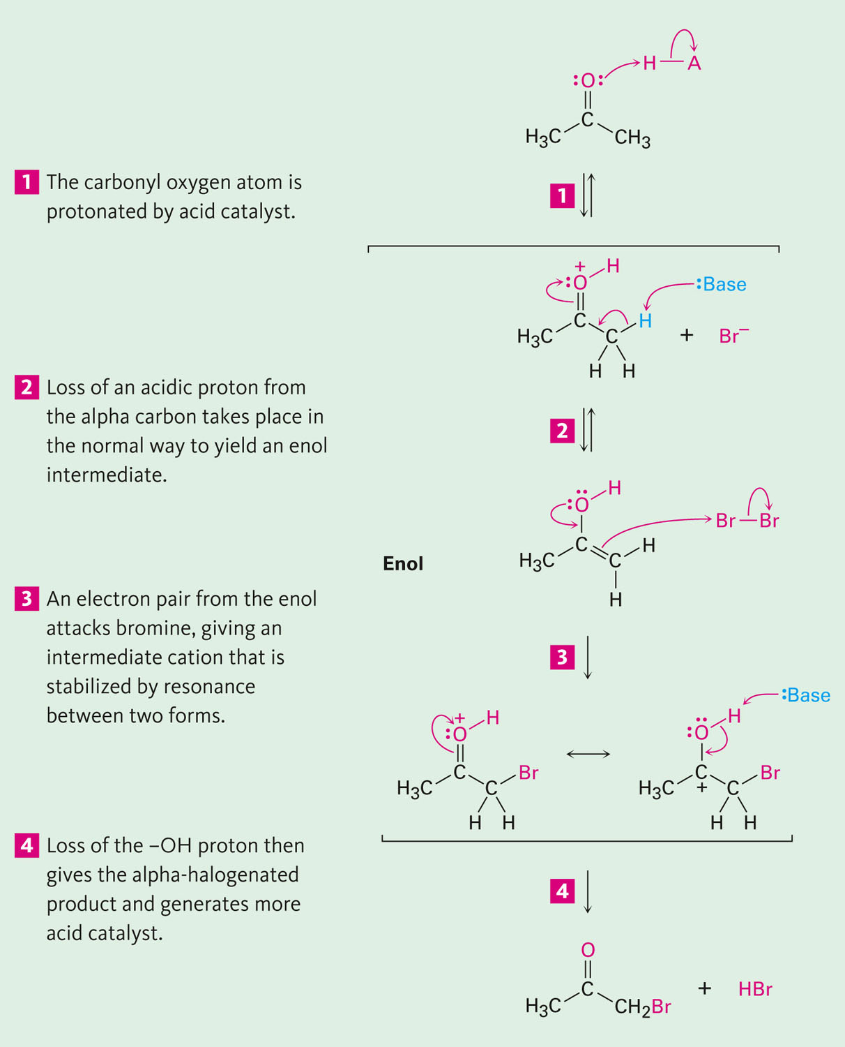
Mechanism of Acid-Catalyzed Bromination
The enol tautomer reacts with an electrophile
The keto tautomer loses a proton

Slide 12
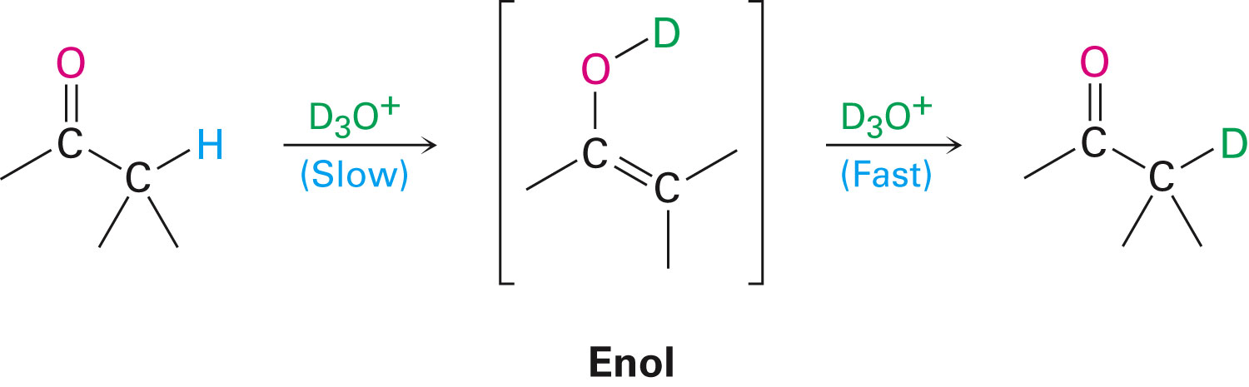
Evidence for Rate-Limiting Enol Formation
The rate of halogenation is independent of the halogen's identity and concentration
In D₃O⁺ the α H’s are replaced by D’s at the same rate as halogenation
This is because the barrier to formation of the enol goes through the highest energy transition state in the mechanism

Slide 13
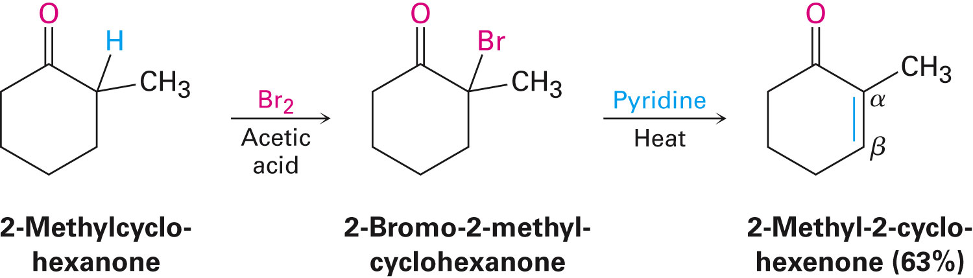
Elimination Reactions of α-Bromoketones
α-Bromo ketones can be dehydrobrominated by base treatment to yield α,β-unsaturated ketones

Slide 14
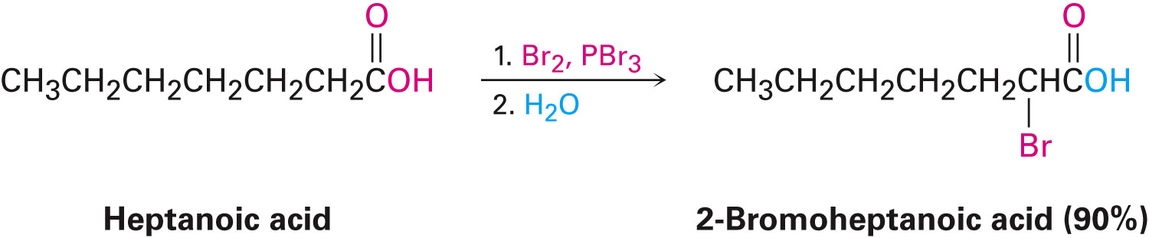
Alpha Bromination of Carboxylic Acids
Carboxylic acids do not react with Br₂ (unlike aldehydes and ketones)
They are brominated by a mixture of Br₂ and PBr₃ (Hell–Volhard–Zelinskii reaction)

Slide 15
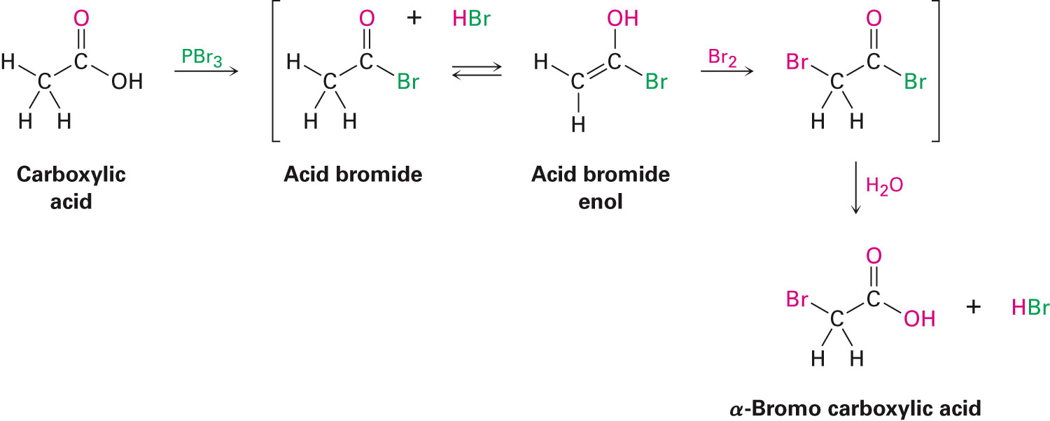
Mechanism of Bromination
PBr₃ converts –COOH to –COBr, which can enolize and add Br₂

Slide 16
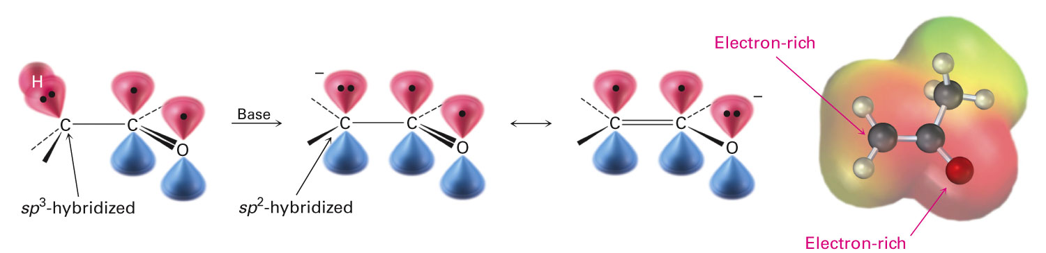
Acidity of Alpha Hydrogen Atoms: Enolate Ion Formation
Carbonyl compounds can act as weak acids (pK_{a} of acetone = 19.3; pK_{a} of ethane = 60)
The conjugate base of a ketone or aldehyde is an enolate ion - the negative charge is delocalized onto oxygen

Slide 17
Reagents for Enolate Formation
Ketones are weaker acids than the OH of alcohols so a more powerful base than an alkoxide is needed to form the enolate
Sodium hydride (NaH) or lithium diisopropylamide [LiN(i-C₃H₇)₂] are strong enough to form the enolate

Slide 18
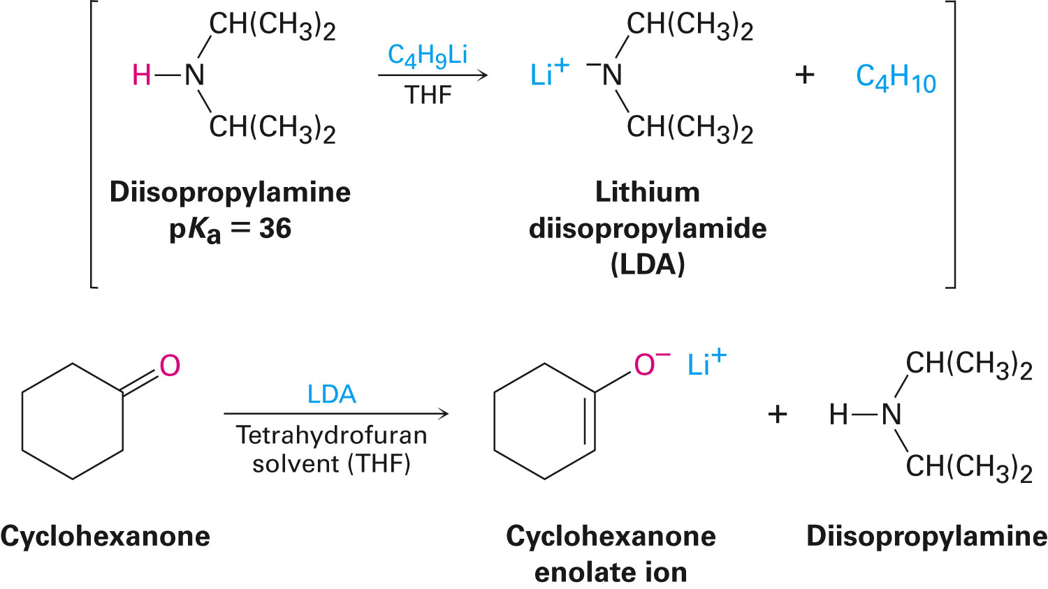
Lithium Diisopropylamide (LDA)
LDA is from butyllithium (BuLi) and diisopropylamine (pK_{a} ≈ 40)
Soluble in organic solvents and effective at low temperature with many compounds
Not nucleophilic

Slide 19
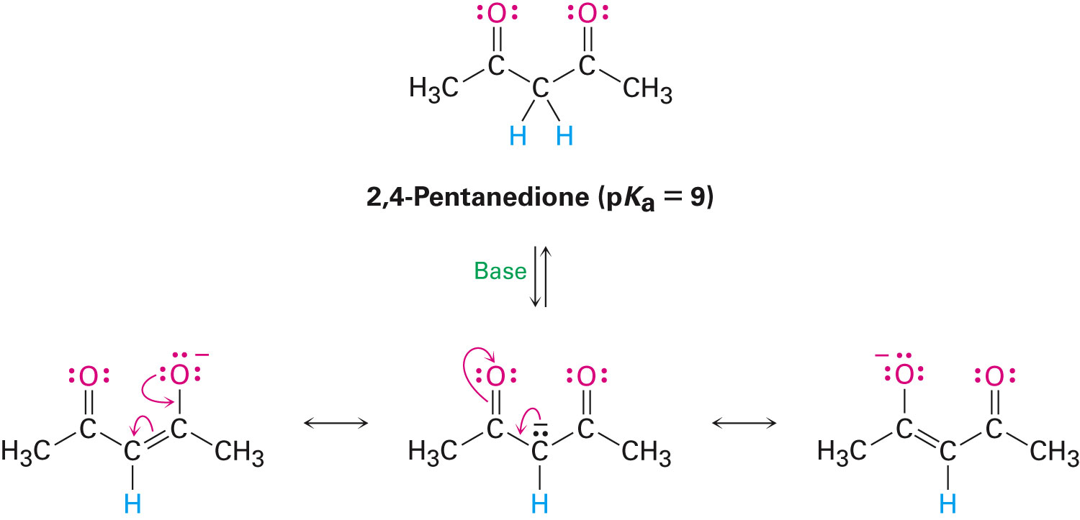
β-Dicarbonyls Are More Acidic
When a hydrogen atom is flanked by two carbonyl groups, its acidity is enhanced (Table 22.1)
Negative charge of enolate delocalizes over both carbonyl groups

Slide 20
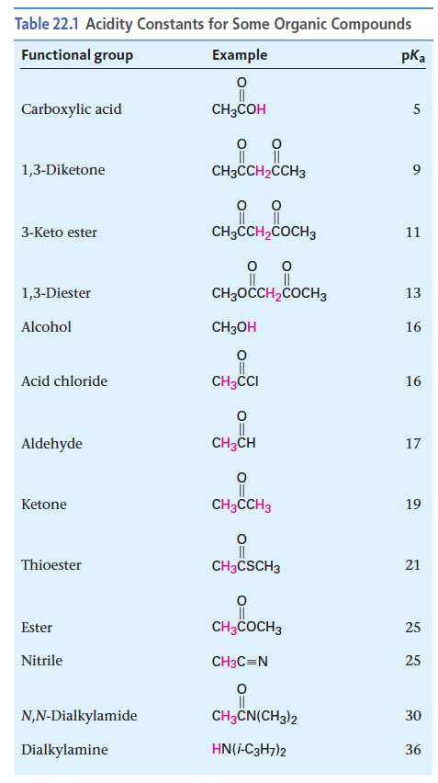
Acidities of Organic Compounds

Slide 21
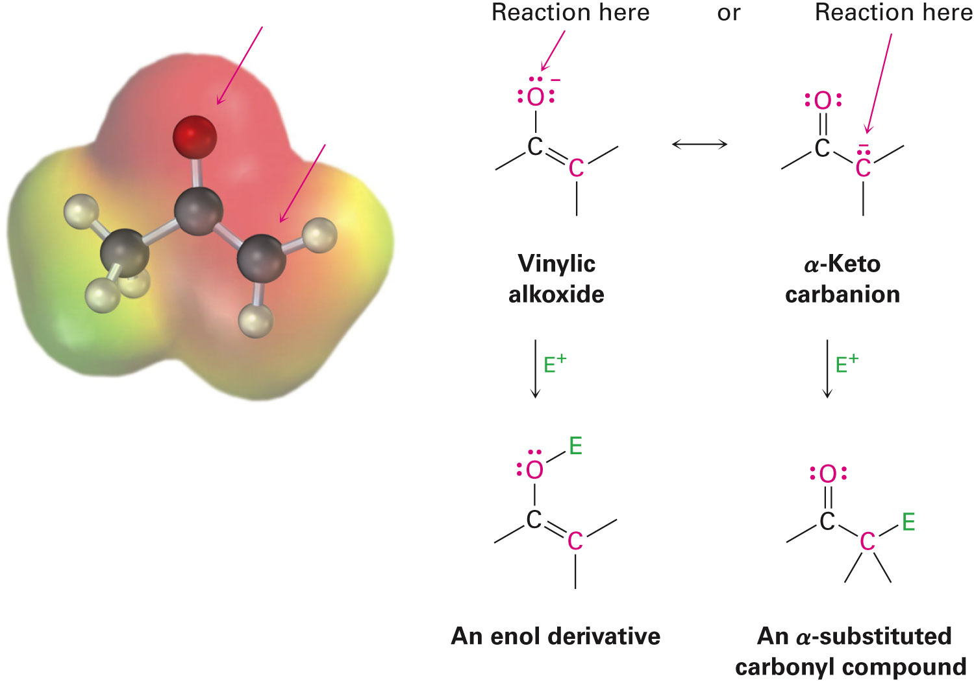
Reactivity of Enolate Ions
The carbon atom of an enolate ion is electron-rich and highly reactive toward electrophiles (enols are not as reactive)
Reaction on oxygen yields an enol derivative
Reaction on carbon yields an α-substituted carbonyl compound

Slide 22
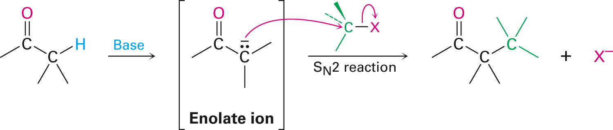
Alkylation of Enolate Ions
Base-promoted reaction occurs through an enolate ion intermediate

Slide 23
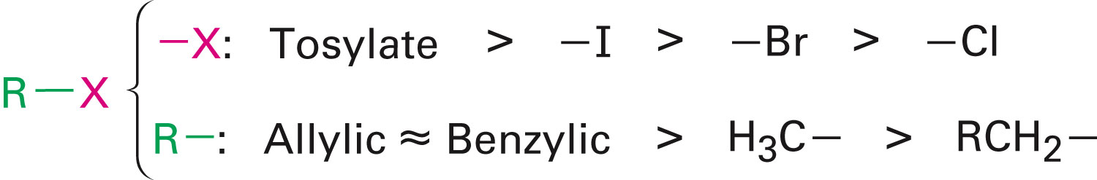
Constraints on Enolate Alkylation
S_{N}2 reaction: the leaving group X can be chloride, bromide, iodide, or tosylate
R should be primary or methyl and preferably should be allylic or benzylic
Secondary halides react poorly, and tertiary halides don't react at all because of competing elimination

Slide 24
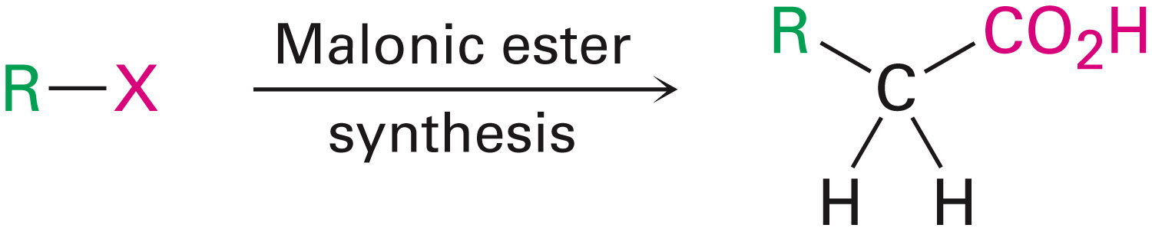
The Malonic Ester Synthesis
For preparing a carboxylic acid from an alkyl halide while lengthening the carbon chain by two atoms

Slide 25
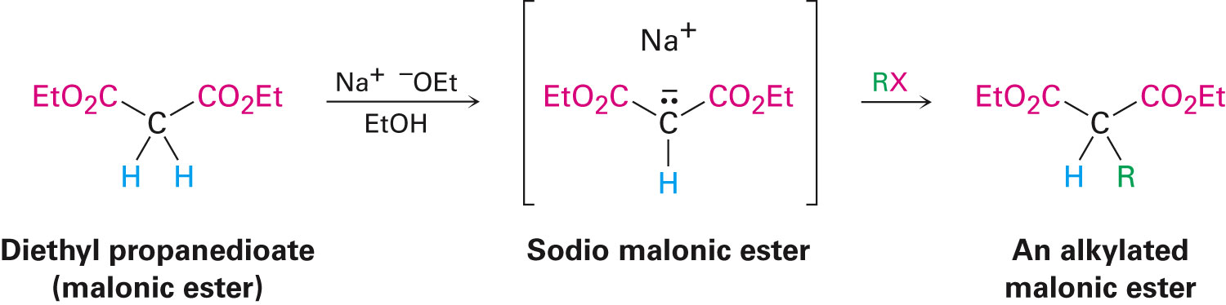
Formation of Enolate and Alkylation
Malonic ester (diethyl propanedioate) is easily converted into its enolate ion by reaction with sodium ethoxide in ethanol
The enolate is a good nucleophile that reacts rapidly with an alkyl halide to give an α-substituted malonic ester

Slide 26
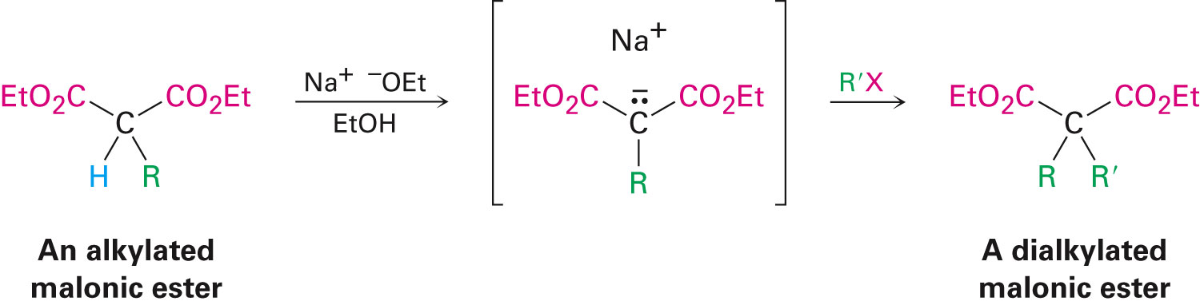
Dialkylation
The product has an acidic α-hydrogen, allowing the alkylation process to be repeated

Slide 27
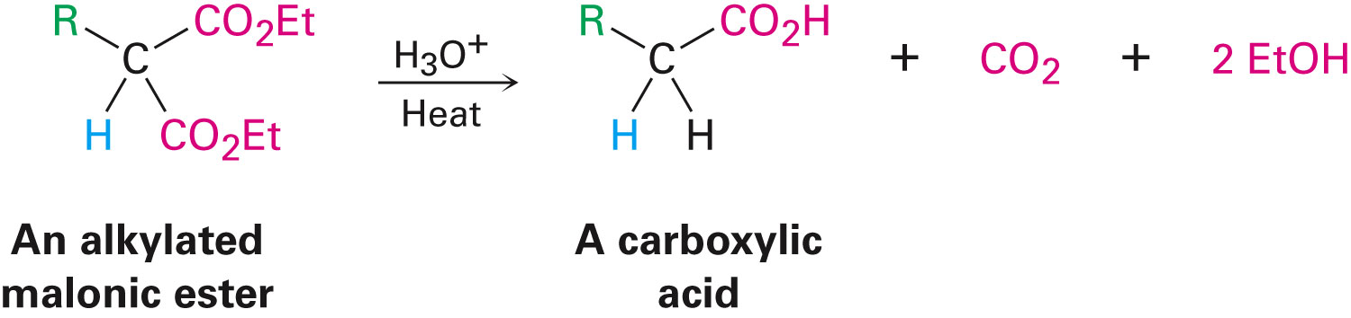
Hydrolysis and Decarboxylation
The malonic ester derivative hydrolyzes in acid and loses CO₂ (“decarboxylation”) to yield a substituted monoacid

Slide 28
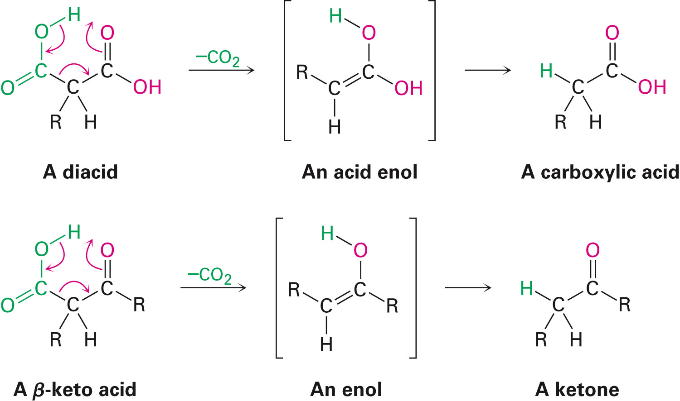
Decarboxylation of β-Ketoacids
Decarboxylation requires a carbonyl group two atoms away from the –CO₂H

Slide 29
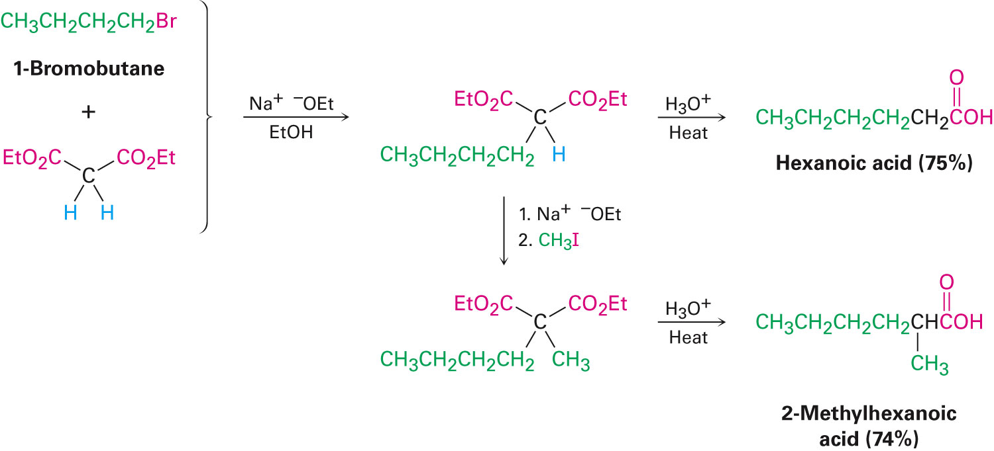
Overall Conversion
The malonic ester synthesis converts an alkyl halide into a carboxylic acid while lengthening the carbon chain by two atoms

Slide 30
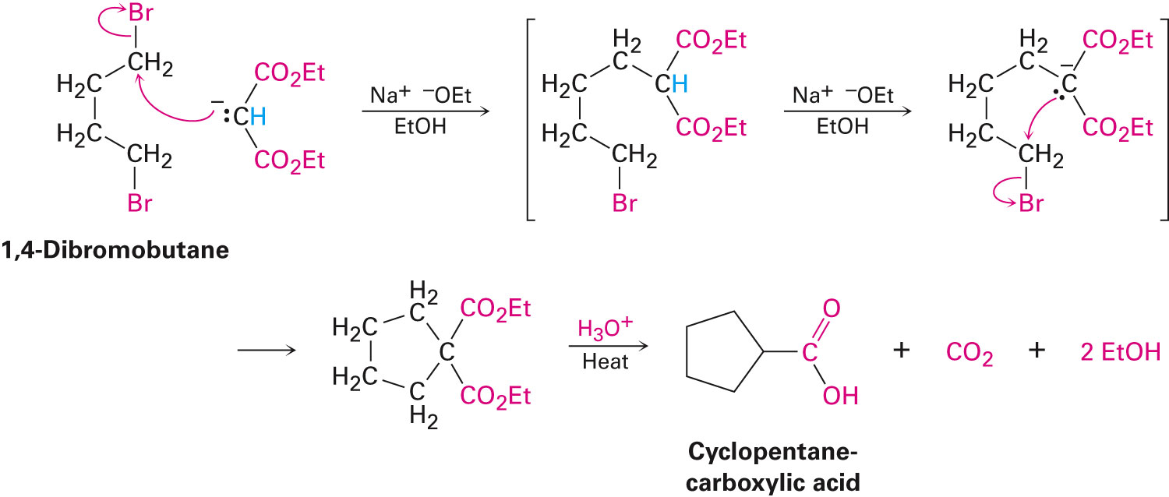
Preparation of Cycloalkane Carboxylic Acids
1,4-dibromobutane reacts twice, giving a cyclic product
Three-, four-, five-, and six-membered rings can be prepared in this way

Slide 31
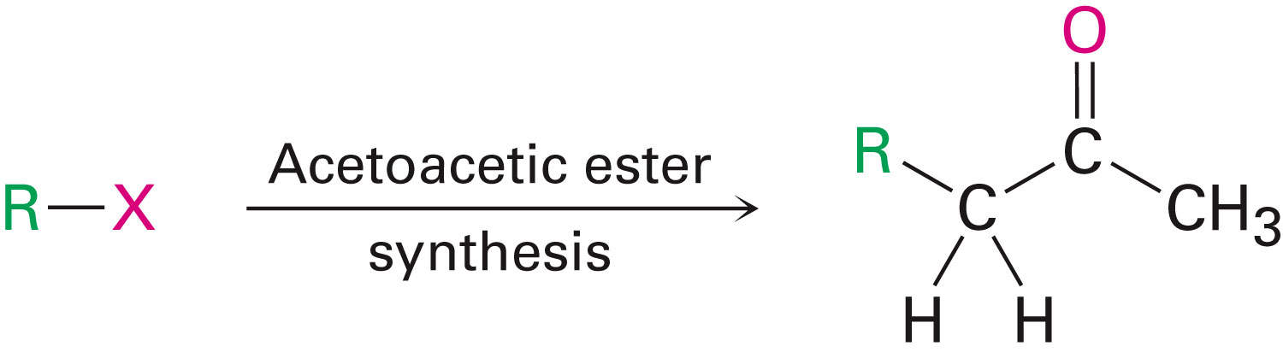
Acetoacetic Ester Synthesis
Overall: converts an alkyl halide into a methyl ketone

Slide 32
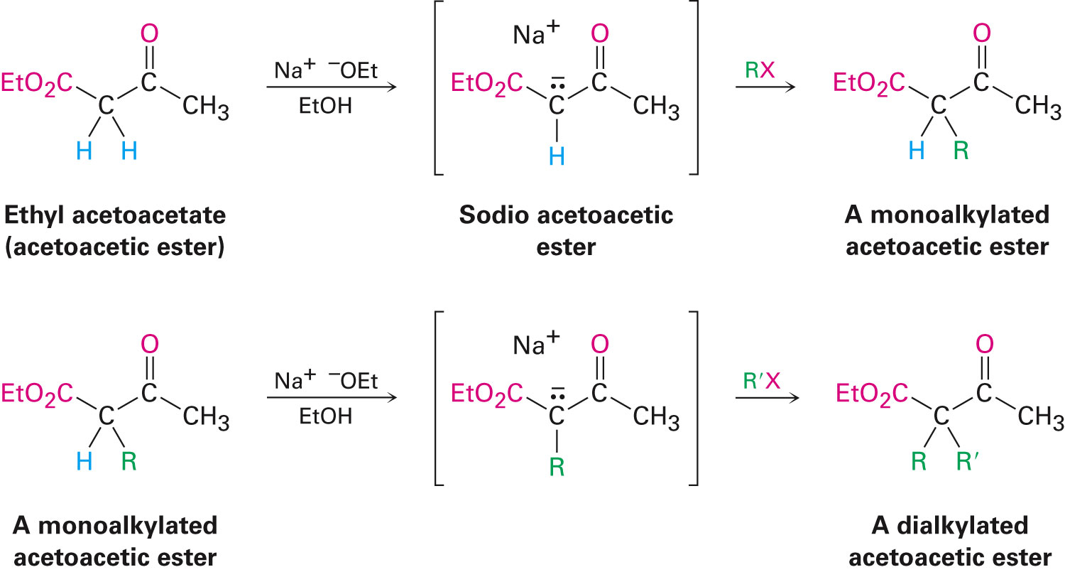
Acetoacetic Ester (Ethyl Acetoacetate)
α carbon is flanked by two carbonyl groups, so it readily becomes an enolate ion
This can be alkylated by an alkyl halide and also can react with a second alkyl halide

Slide 33
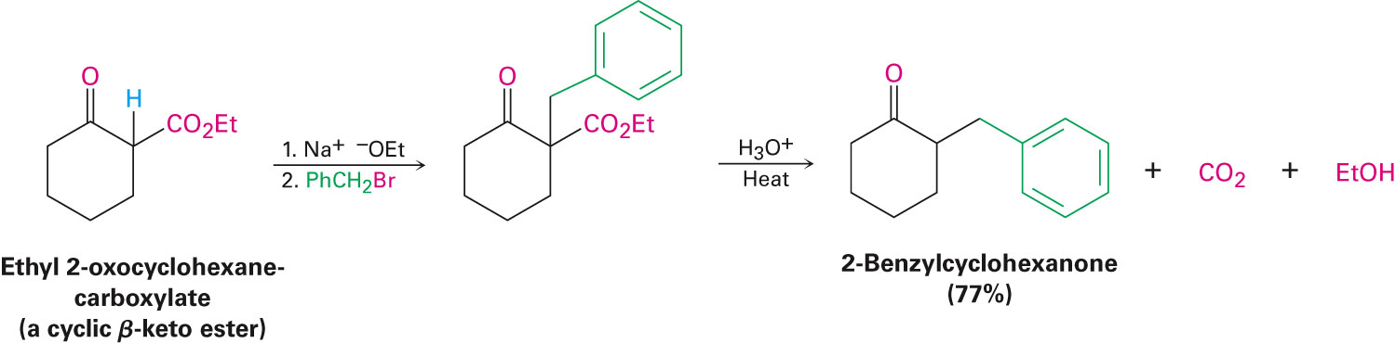
Generalization: β-Keto Esters
The sequence: enolate ion formation, alkylation, hydrolysis/decarboxylation is applicable to β-keto esters in general
Cyclic β-keto esters give 2-substituted cyclohexanones

