Slide 1
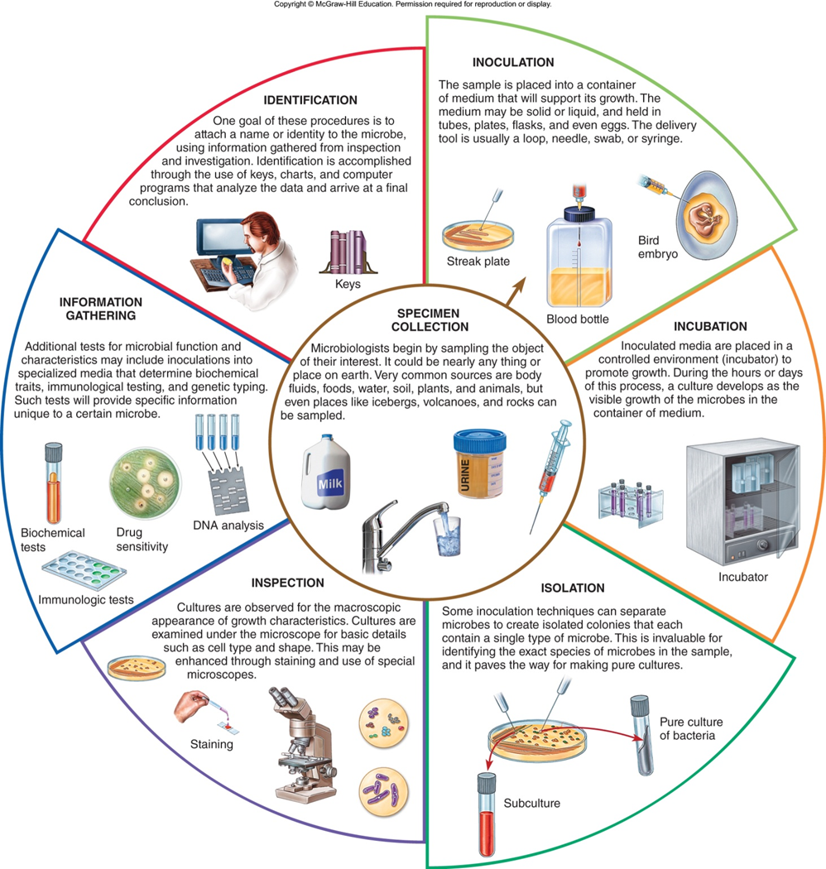

Slide 2
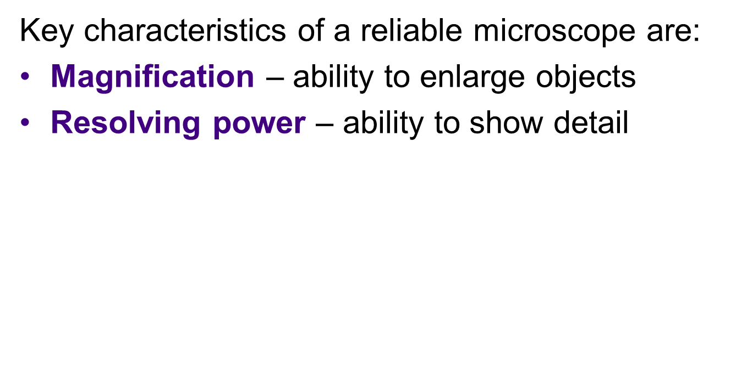
The Microscope

Slide 3
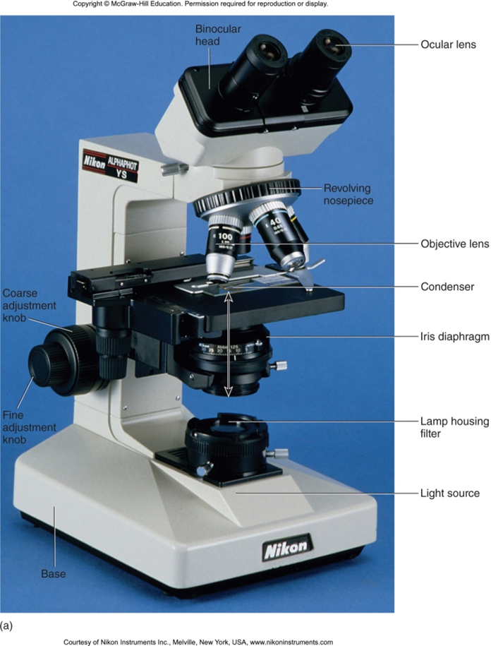

Slide 4
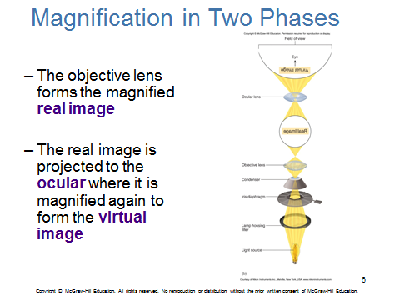

Slide 5
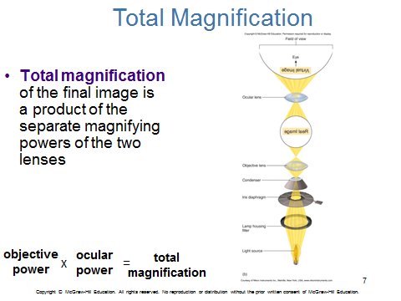

Slide 6
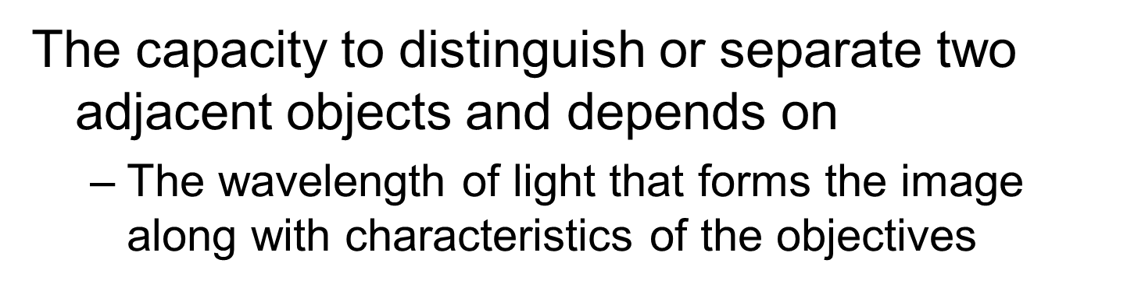
Resolution

Slide 7
Basic Rules for Caring for Microscopes
EVERYTHING on a microscope is unbelievably expensive, so be careful.
Hold a microscope firmly by the stand, only. Never grab it by the eyepiece holder, for example.
Hold the plug (not the cable) when unplugging the illuminator.

Slide 8
Basic Rules for Caring for Microscopes
Since bulbs are expensive, and have a limited life, turn the illuminator off when not in use.
If used constantly on full power the bulb will overheat and blow (or gently melt the inside of the housing). This is not a good idea!

Slide 9
Basic Rules for Caring for Microscopes
Always make sure the stage and lenses are clean before putting the microscope away.
NEVER use anything but good quality lens tissue on any optical surface, with appropriate lens cleaner or distilled water; organic solvents may separate or damage the lens elements or coatings.

Slide 10
Basic Rules for Caring for Microscopes
Cover the instrument with a dust jacket when not in use.
Focus smoothly; don't try to speed through the focusing process or force anything.
If it isn't working DON'T try to fix it unless you really know what you are doing. Make a note of the symptoms and ask someone who knows.

Slide 11
Microscopy with Oil Immersion
When light passes from a material of one refractive index to material of another, as from glass to air or from air to glass, it bends.
Light of different wavelengths bends at different angles, so that as objects are magnified the images become less and less distinct.

Slide 12
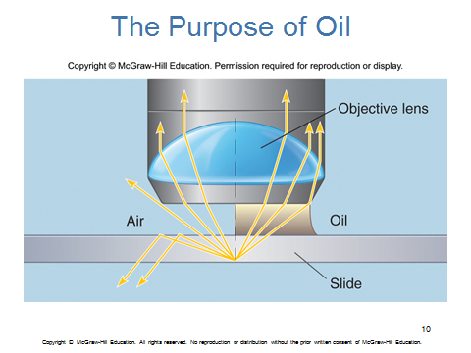

Slide 13
Placing a drop of oil on the objective lens eliminates this problem and enhances resolution
Magnifications of 1000x or greater can be achieved.
Oil immersion is essential for viewing individual bacteria

Slide 14
the oil must stay in contact
Oil immersion lenses are used only with oil, and oil can't be used with dry lenses
Oil on non-oil lenses will distort viewing and possibly damage the coatings.

Slide 15
http://www.geog.ucl.ac.uk/resources/laboratory/light-microscopy/basic-rules-for-caring-for-microscopes

