Slide 1
Chapter 2
The Chemical Context of Life

Slide 2
Overview: Chemical Foundations of Biology
Biology is a multidisciplinary science
Living organisms are subject to basic laws of physics and chemistry
One example is the bombardier beetle, which uses chemistry to defend itself

Slide 3
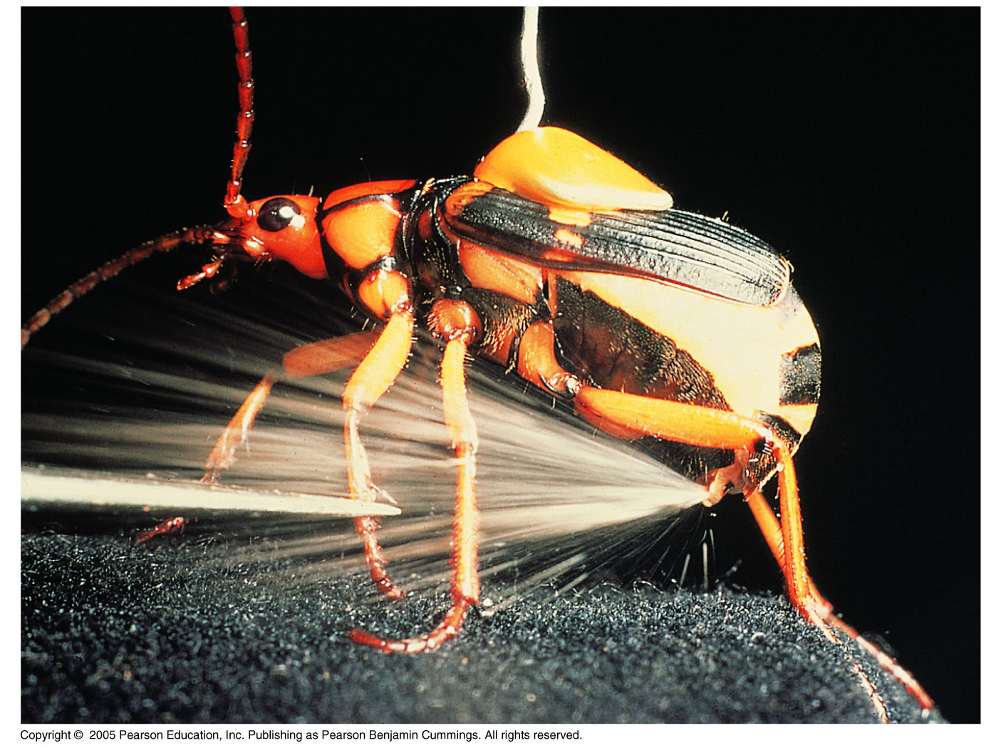

Slide 4
Concept 2.1: Matter consists of chemical elements in pure form and in combinations called compounds
Organisms are composed of matter
Matter is anything that takes up space and has mass
Matter is made up of elements

Slide 5
Elements and Compounds
An element is a substance that cannot be broken down to other substances by chemical reactions
A compound is a substance consisting of two or more elements in a fixed ratio

Slide 6
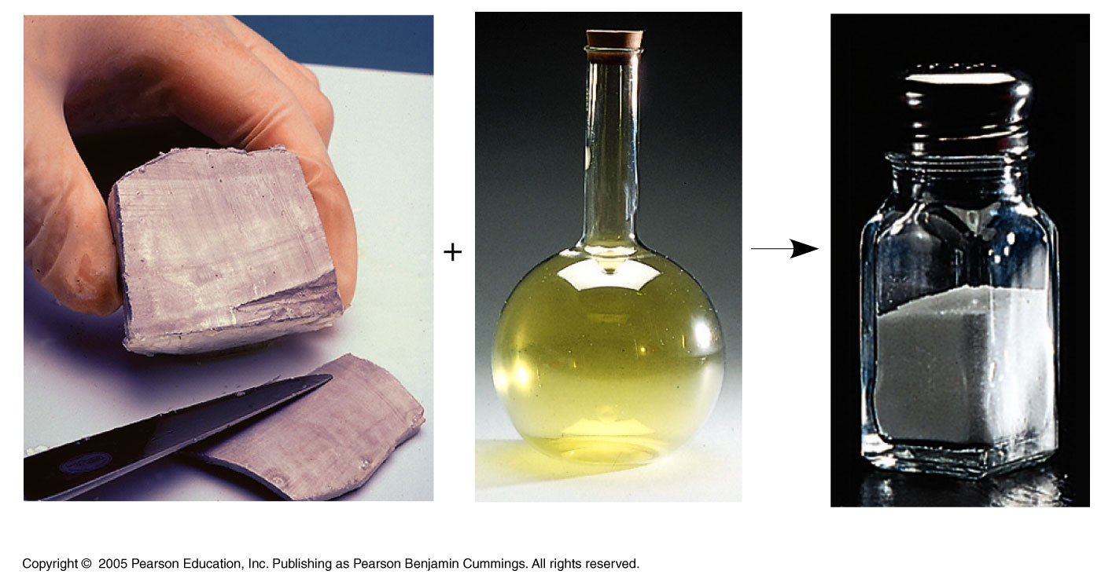
LE 2-2
Sodium
Chlorine
Sodium chloride

Slide 7
Essential Elements of Life
About 25 of the 92 elements are essential to life
Carbon, hydrogen, oxygen, and nitrogen make up 96% of living matter
Most of the remaining 4% consists of calcium, phosphorus, potassium, and sulfur
Trace elements are those required by an organism in minute quantities

Slide 8
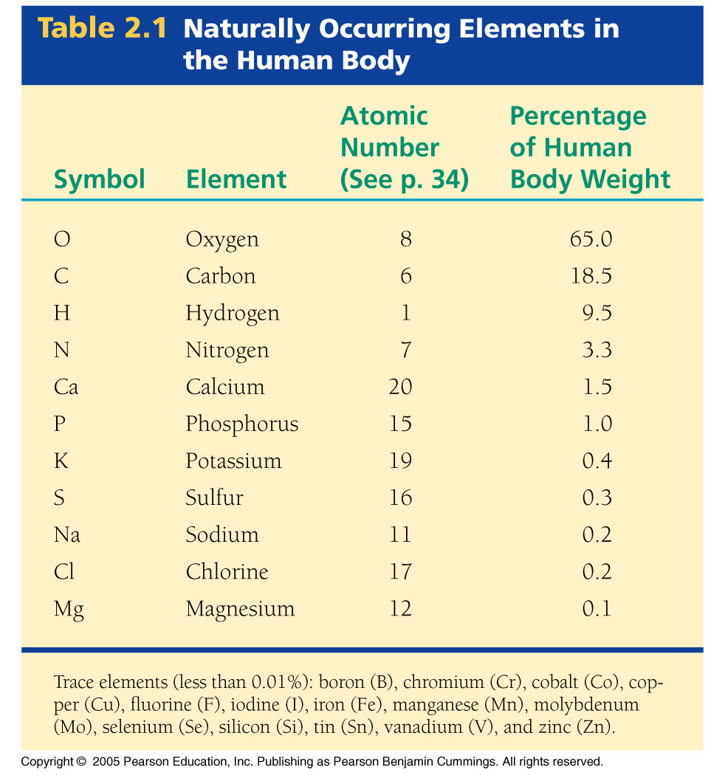

Slide 9
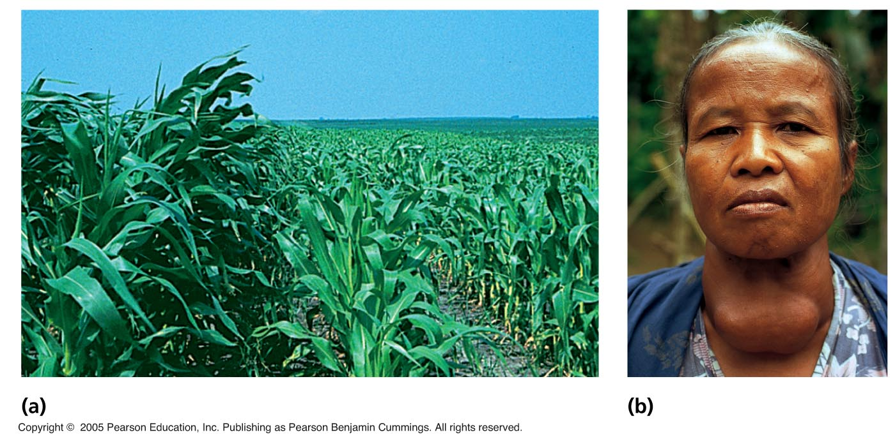
LE 2-3
Nitrogen deficiency
Iodine deficiency

Slide 10
Concept 2.2: An element’s properties depend on the structure of its atoms
Each element consists of unique atoms
An atom is the smallest unit of matter that still retains the properties of an element

Slide 11
Subatomic Particles
Atoms are composed of subatomic particles
Relevant subatomic particles include:
Neutrons (no electrical charge)
Protons (positive charge)
Electrons (negative charge)
Neutrons and protons form the atomic nucleus
Electrons form a cloud around the nucleus

Slide 12
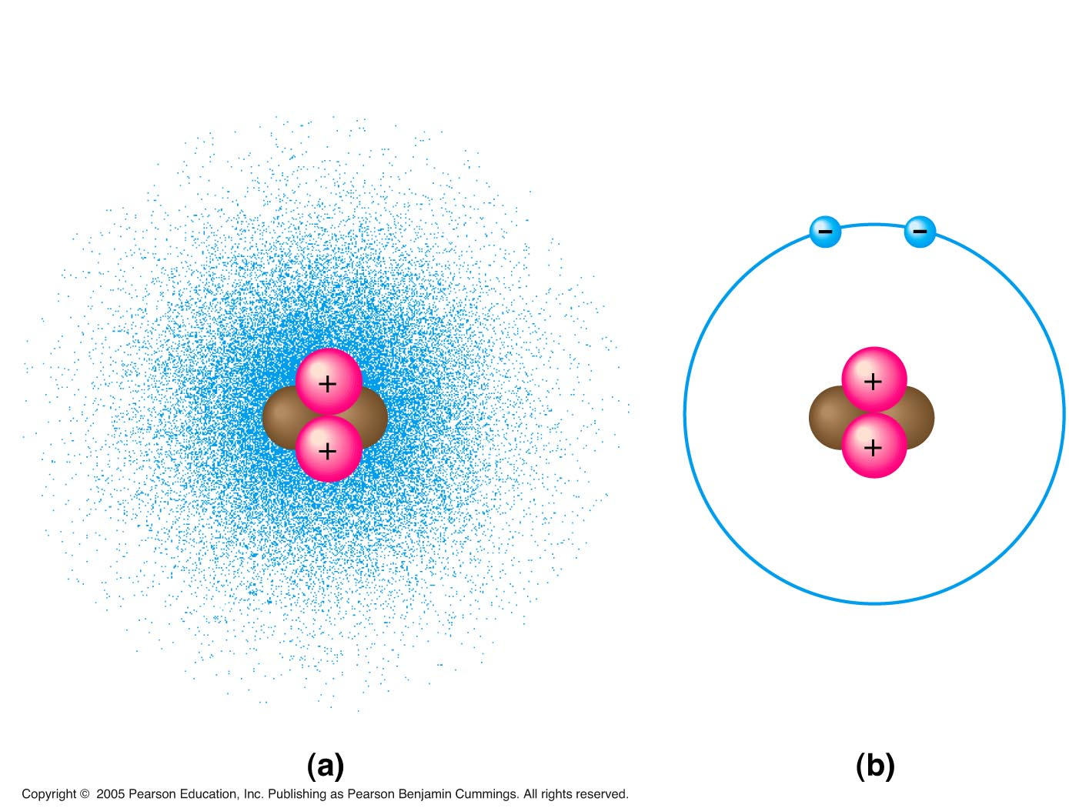
LE 2-4
Cloud of negative
charge (2 electrons)
Electrons
Nucleus

Slide 13
Atomic Number and Atomic Mass
Atoms of the various elements differ in number of subatomic particles
An element’s atomic number is the number of protons
An element’s mass number is the sum of protons plus neutrons in the nucleus
Atomic mass, the atom’s total mass, can be approximated by the mass number

Slide 14
Isotopes
Atoms of an element have the same number of protons but may differ in number of neutrons
Isotopes are two atoms of an element that differ in number of neutrons
Most isotopes are stable, but some are radioactive, giving off particles and energy

Slide 15
The Energy Levels of Electrons
Energy is the capacity to cause change
Potential energy is the energy that matter has because of its location or structure
The electrons of an atom differ in their amounts of potential energy
An electron’s state of potential energy is called its energy level, or electron shell

Slide 16
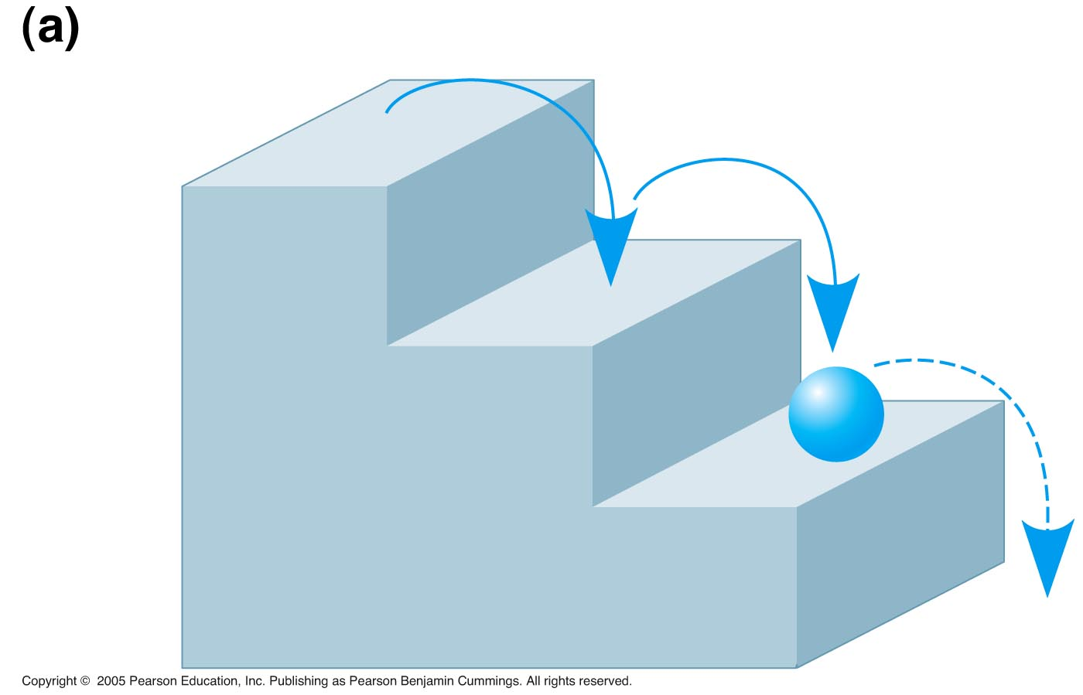
LE 2-7a
A ball bouncing down a flight
of stairs provides an analogy for
energy levels of electrons.

Slide 17
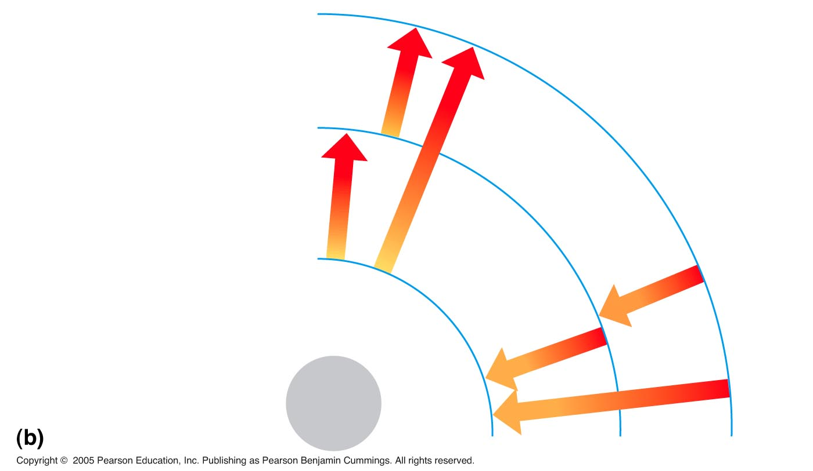
LE 2-7b
Third energy level (shell)
Second energy level (shell)
Energy
absorbed
First energy level (shell)
Energy
lost
Atomic
nucleus

Slide 18
Electron Configuration and Chemical Properties
The chemical behavior of an atom is determined by the distribution of electrons in electron shells
The periodic table of the elements shows the electron distribution for each element

Slide 19
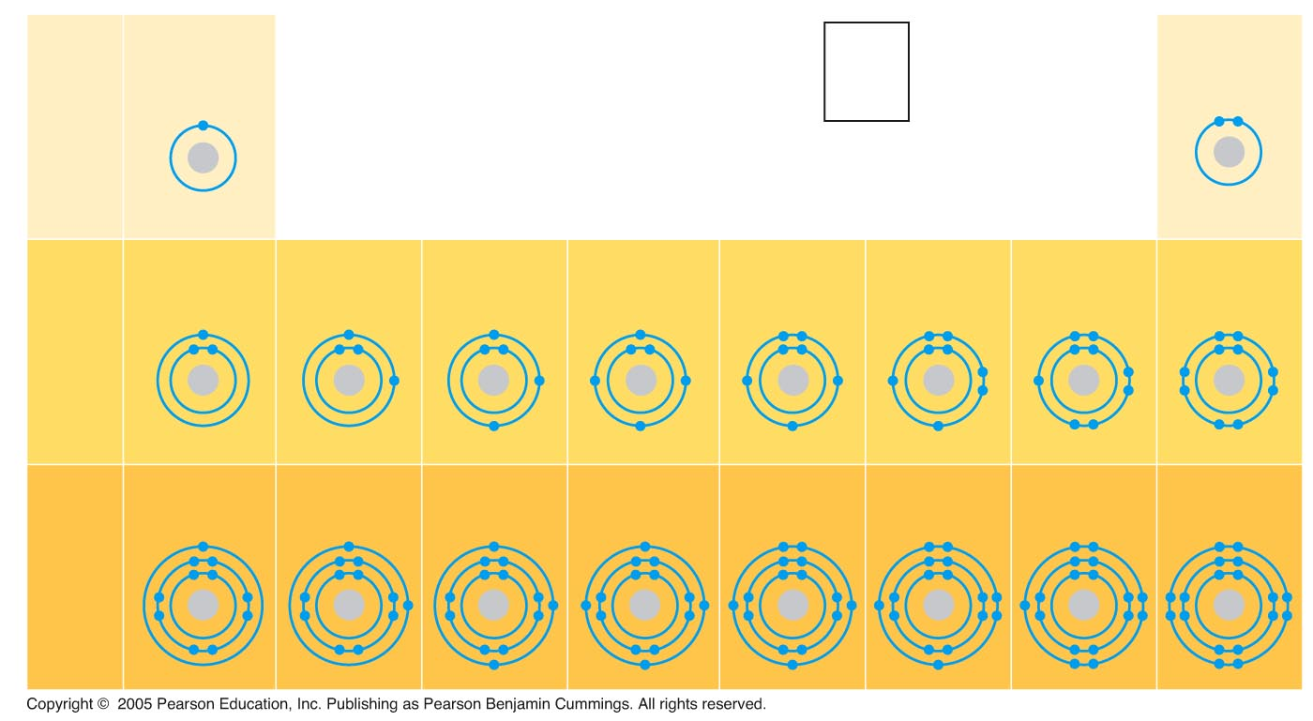
LE 2-8
Hydrogen
₁H
2
He
4.00
Atomic number
Helium
₂He
First
shell
Atomic mass
Element symbol
Electron-shell
diagram
Lithium
₃Li
Beryllium
₄Be
Boron
₅B
Carbon
₆C
Nitrogen
₇N
Oxygen
₈O
Fluorine
₉F
Neon
₁₀Ne
Second
shell
Sodium
₁₁Na
Magnesium
₁₂Mg
Aluminum
₁₂Al
Silicon
₁₄Si
Phosphorus
₁₅P
Sulfur
₁₆S
Chlorine
₁₇Cl
Argon
₁₈Ar
Third
shell

Slide 20
Valence electrons are those in the outermost shell, or valence shell
The chemical behavior of an atom is mostly determined by the valence electrons

Slide 21
Electron Orbitals
An orbital is the three-dimensional space where an electron is found 90% of the time
Each electron shell consists of a specific number of orbitals

Slide 22
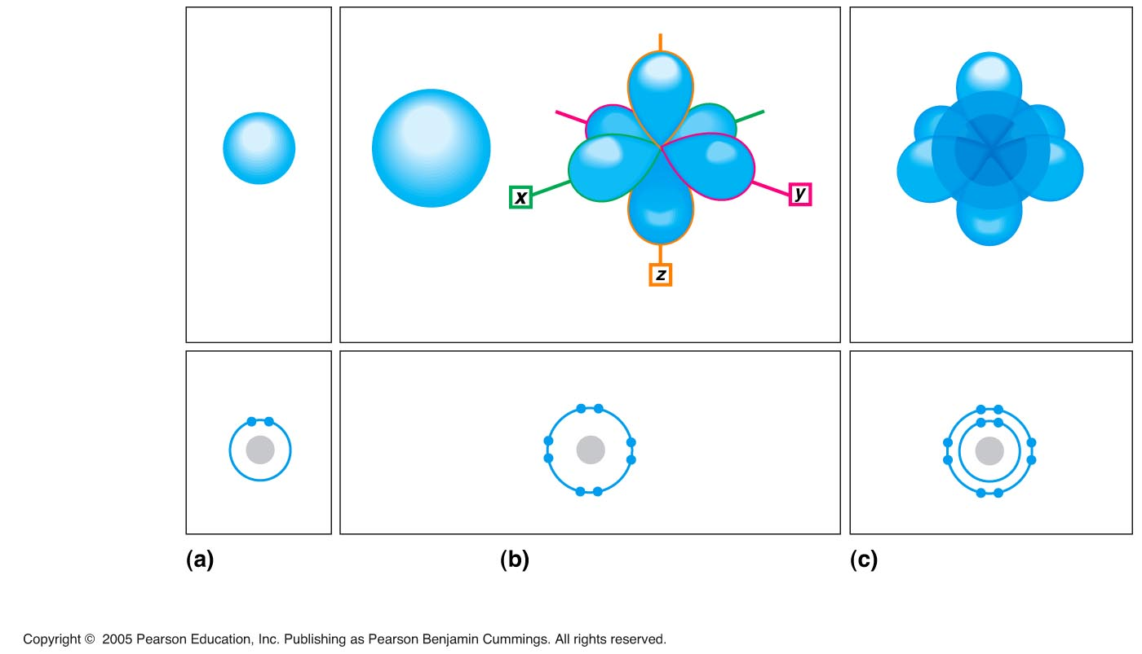
LE 2-9
Electron
orbitals
x
y
z
1s orbital
2s orbital
Three 2p orbitals
1s, 2s, and 2p orbitals
Electron-shell
diagrams
First shell
(maximum
2 electrons)
Second shell
(maximum
8 electrons)
Neon, with two
filled shells
(10 electrons)

Slide 23
Concept 2.3: The formation and function of molecules depend on chemical bonding between atoms
Atoms with incomplete valence shells can share or transfer valence electrons with certain other atoms
These interactions usually result in atoms staying close together, held by attractions called chemical bonds

Slide 24
Covalent Bonds
A covalent bond is the sharing of a pair of valence electrons by two atoms
In a covalent bond, the shared electrons count as part of each atom’s valence shell

Slide 25
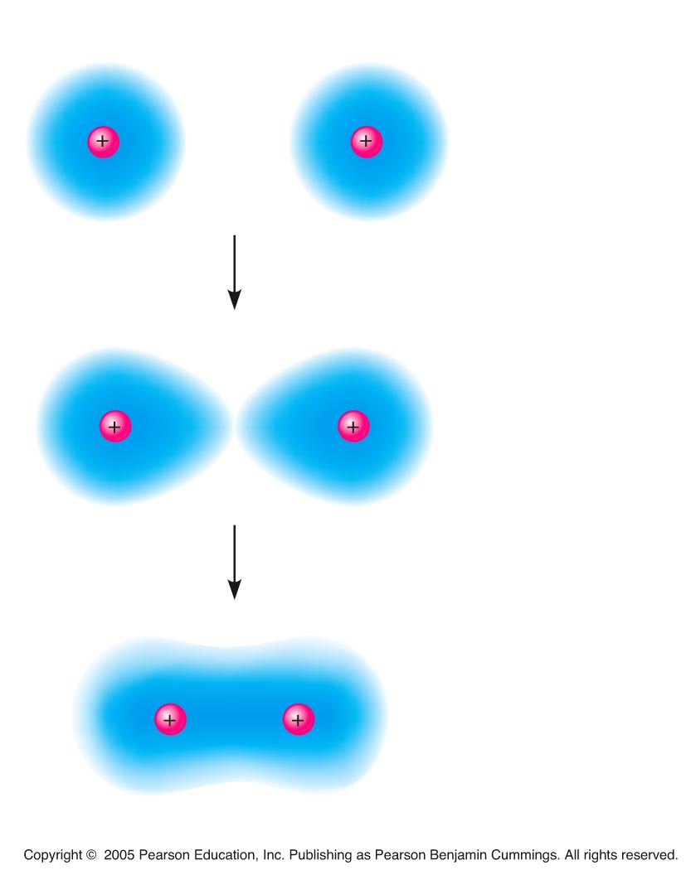
LE 2-10
Hydrogen atoms (2 H)
Hydrogen
molecule (H₂)

Slide 26
A molecule consists of two or more atoms held together by covalent bonds
A single covalent bond, or single bond, is the sharing of one pair of valence electrons
A double covalent bond, or double bond, is the sharing of two pairs of valence electrons
Covalent bonds can form between atoms of the same element or atoms of different elements
Animation: Covalent Bonds

Slide 28
LE 2-11b
Name
(molecular
formula)
Electron-
shell
diagram
Structural
formula
Space-
filling
model
Oxygen (O₂)

Slide 29
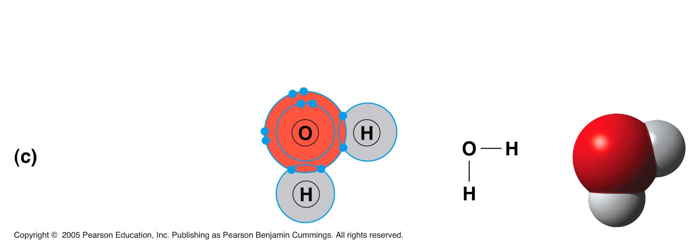
LE 2-11c
Name
(molecular
formula)
Electron-
shell
diagram
Structural
formula
Space-
filling
model
Water (H₂O)

Slide 30
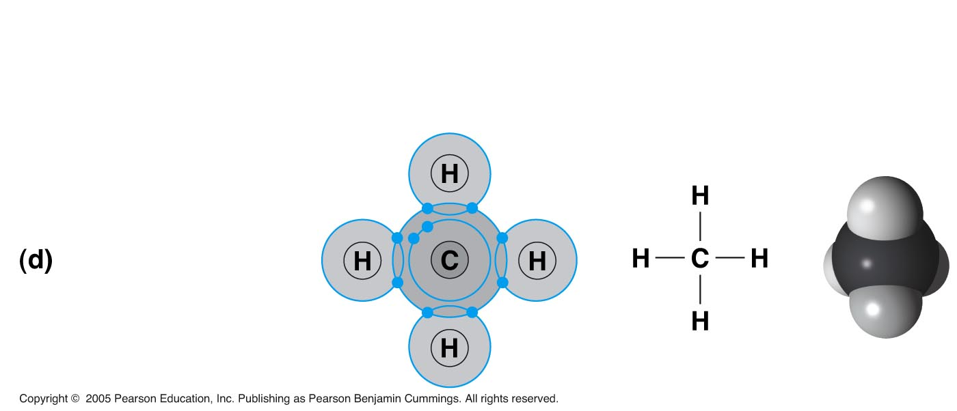
LE 2-11d
Name
(molecular
formula)
Electron-
shell
diagram
Structural
formula
Space-
filling
model
Methane (CH₄)

Slide 31
Electronegativity is an atom’s attraction for the electrons in a covalent bond
The more electronegative an atom, the more strongly it pulls shared electrons toward itself

Slide 32
In a nonpolar covalent bond, the atoms share the electron equally
In a polar covalent bond, one atom is more electronegative, and the atoms do not share the electron equally

Slide 33
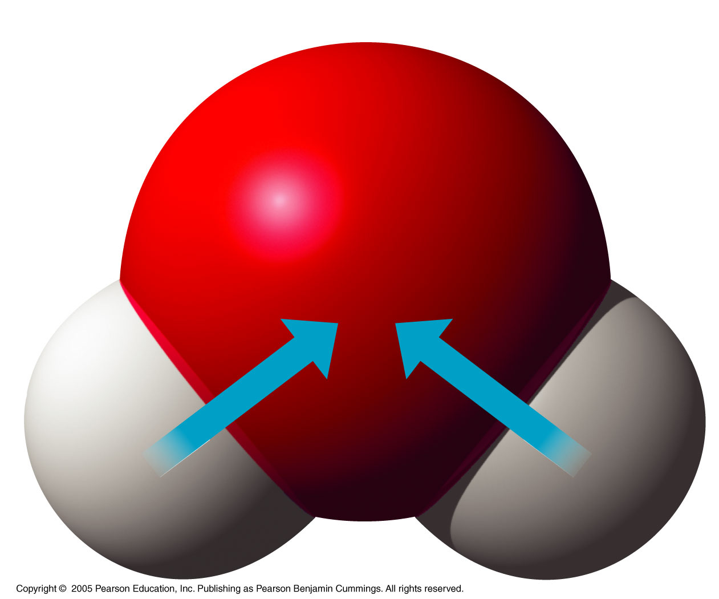
LE 2-12
δ–
O
H
H
δ+
δ+
H₂O

Slide 34
Ionic Bonds
Atoms sometimes strip electrons from their bonding partners
An example is the transfer of an electron from sodium to chlorine
After the transfer of an electron, both atoms have charges
A charged atom (or molecule) is called an ion

Slide 35
An anion is a negatively charged ion
A cation is a positively charged ion
An ionic bond is an attraction between an anion and a cation
Animation: Ionic Bonds

Slide 36
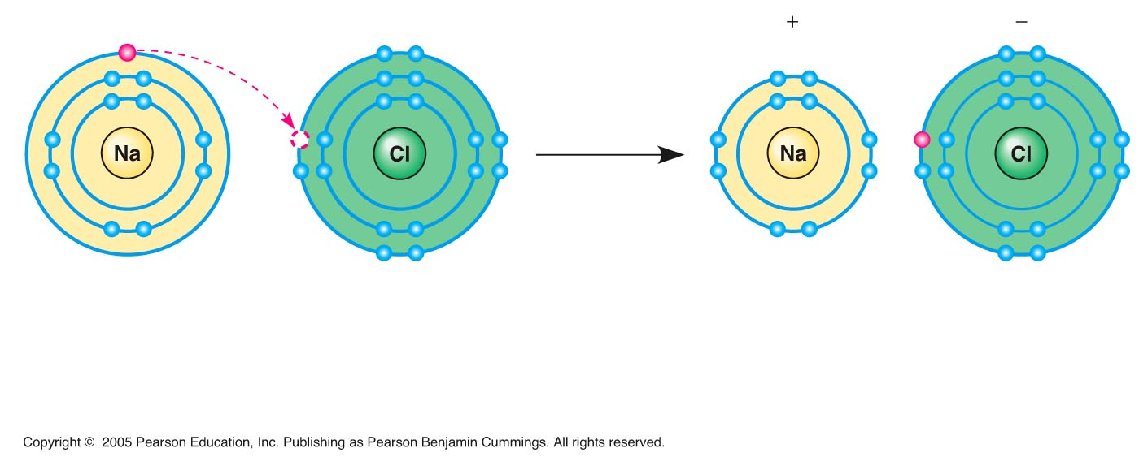
LE 2-13
Na
Cl
Na⁺
Cl–
Sodium atom
(an uncharged
atom)
Chlorine atom
(an uncharged
atom)
Sodium ion
(a cation)
Chlorine ion
(an anion)
Sodium chloride (NaCl)

Slide 37
Compounds formed by ionic bonds are called ionic compounds, or salts
Salts, such as sodium chloride (table salt), are often found in nature as crystals

Slide 38
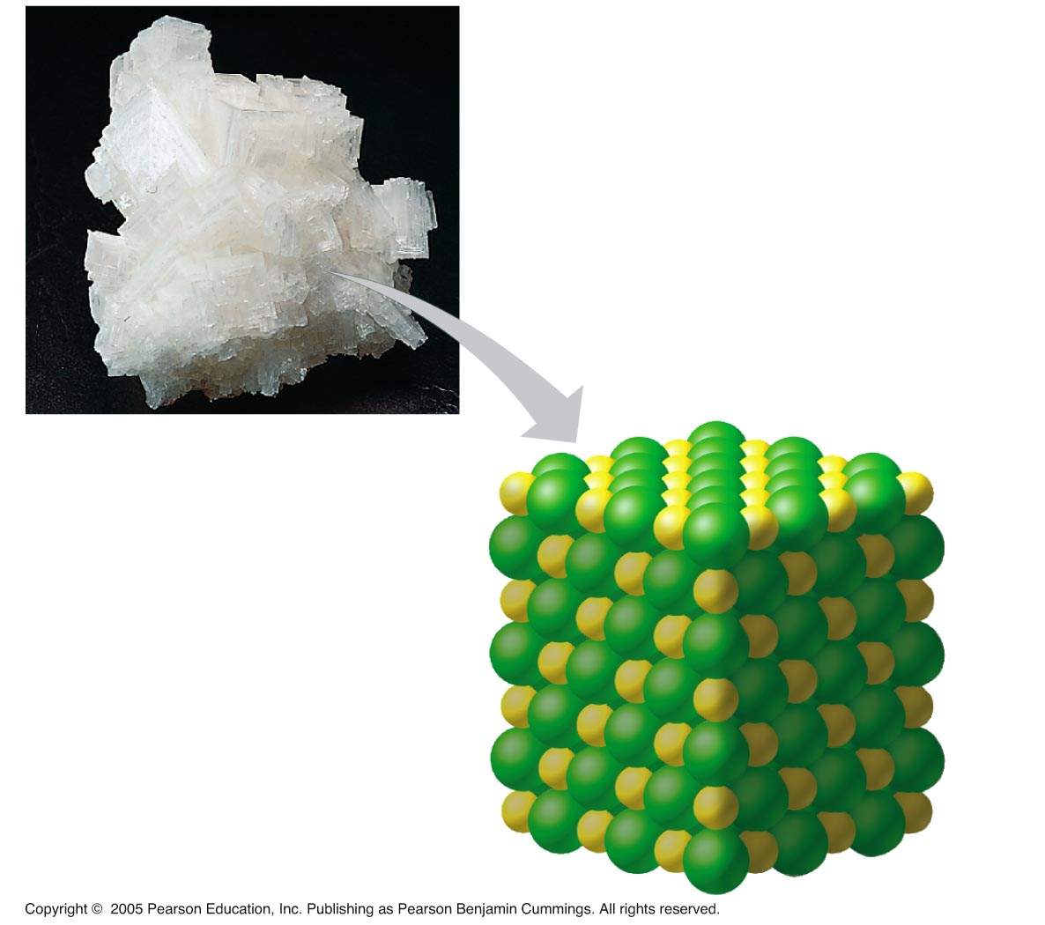
LE 2-14
Na⁺
Cl–

Slide 39
Weak Chemical Bonds
Most of the strongest bonds in organisms are covalent bonds that form a cell’s molecules
Weak chemical bonds, such as ionic bonds and hydrogen bonds, are also important
Weak chemical bonds reinforce shapes of large molecules and help molecules adhere to each other

Slide 40
Hydrogen Bonds
A hydrogen bond forms when a hydrogen atom covalently bonded to one electronegative atom is also attracted to another electronegative atom
In living cells, the electronegative partners are usually oxygen or nitrogen atoms

Slide 41
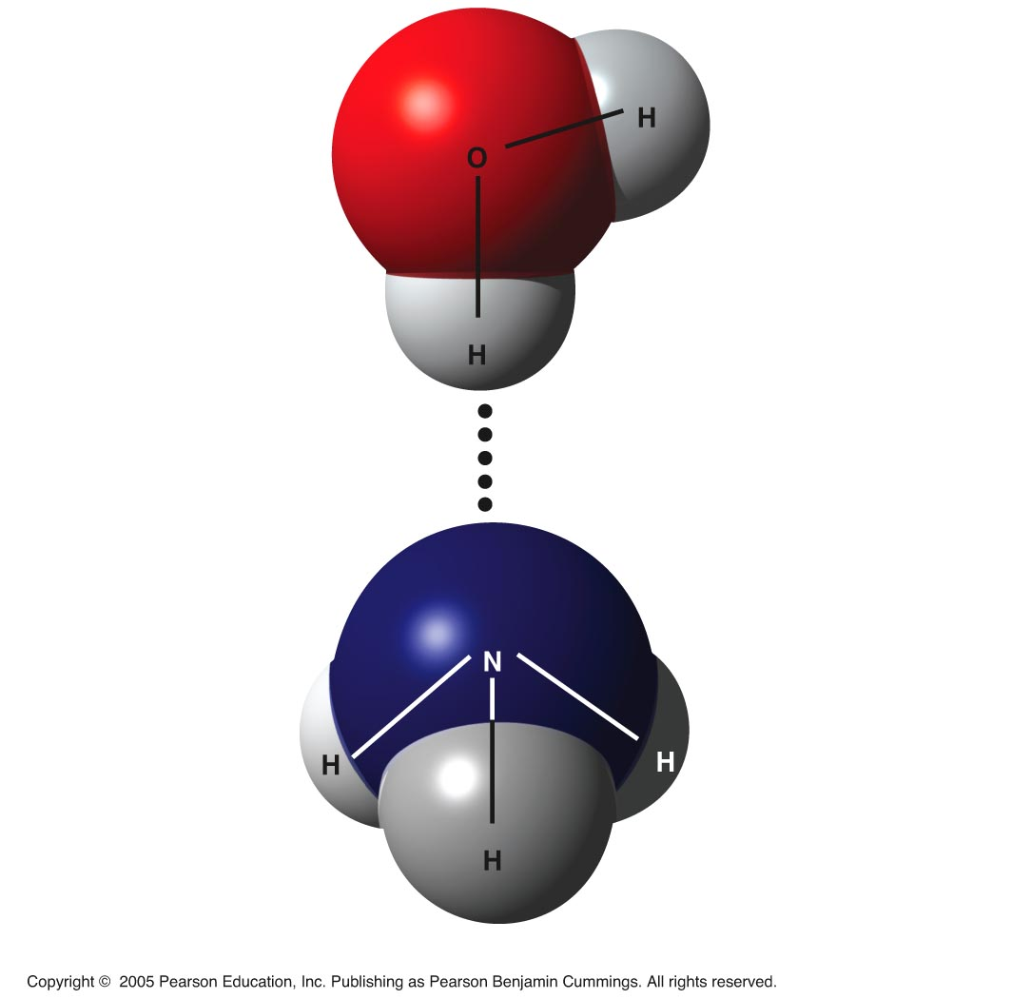
LE 2-15
δ–
δ+
Water
(H₂O)
δ+
Hydrogen bond
δ–
Ammonia
(NH₃)
δ+
δ+
δ+

Slide 42
Molecular Shape and Function
A molecule’s shape is usually very important to its function
A molecule’s shape is determined by the positions of its atoms’ valence orbitals
In a covalent bond, the s and p orbitals may hybridize, creating specific molecular shapes

Slide 43
Biological molecules recognize and interact with each other with a specificity based on molecular shape
Molecules with similar shapes can have similar biological effects

Slide 44
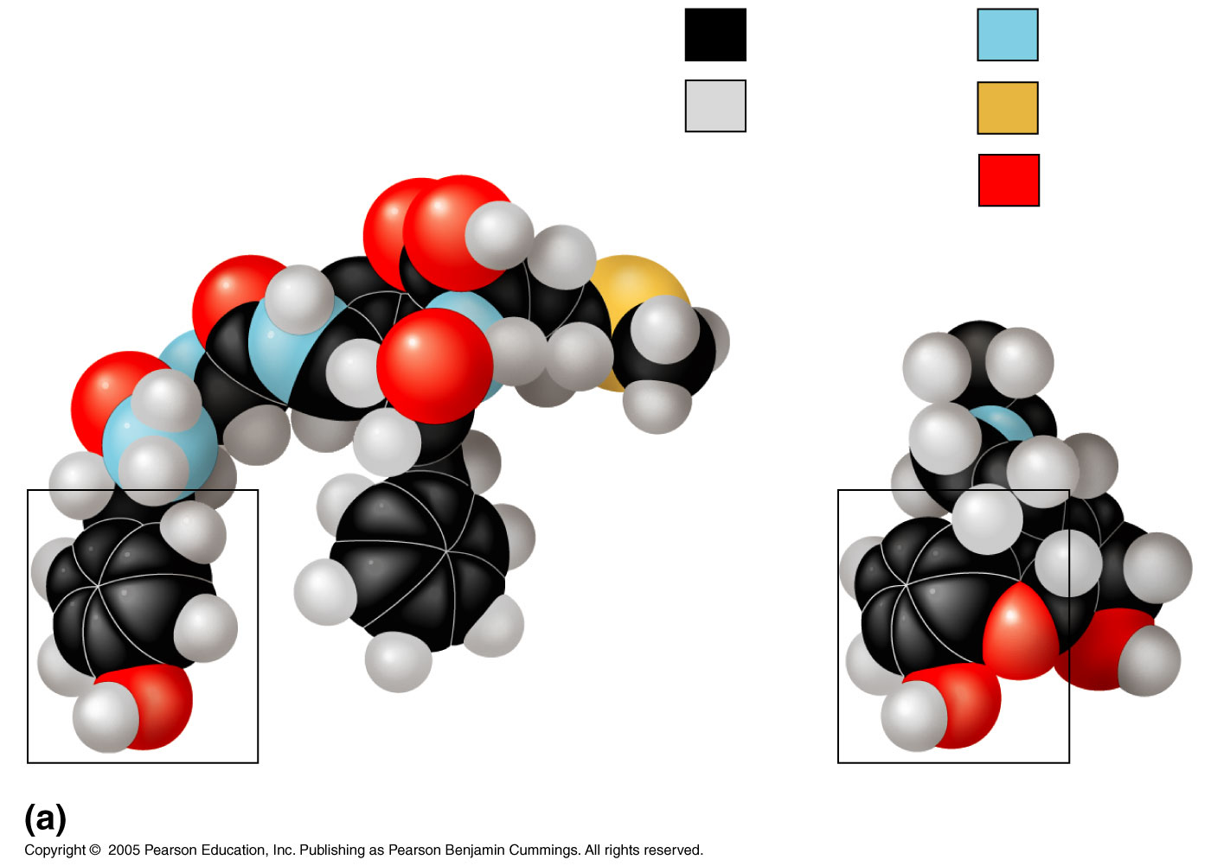
LE 2-17a
Carbon
Nitrogen
Hydrogen
Sulfur
Natural
endorphin
Oxygen
Morphine
Structures of endorphin and morphine

Slide 45
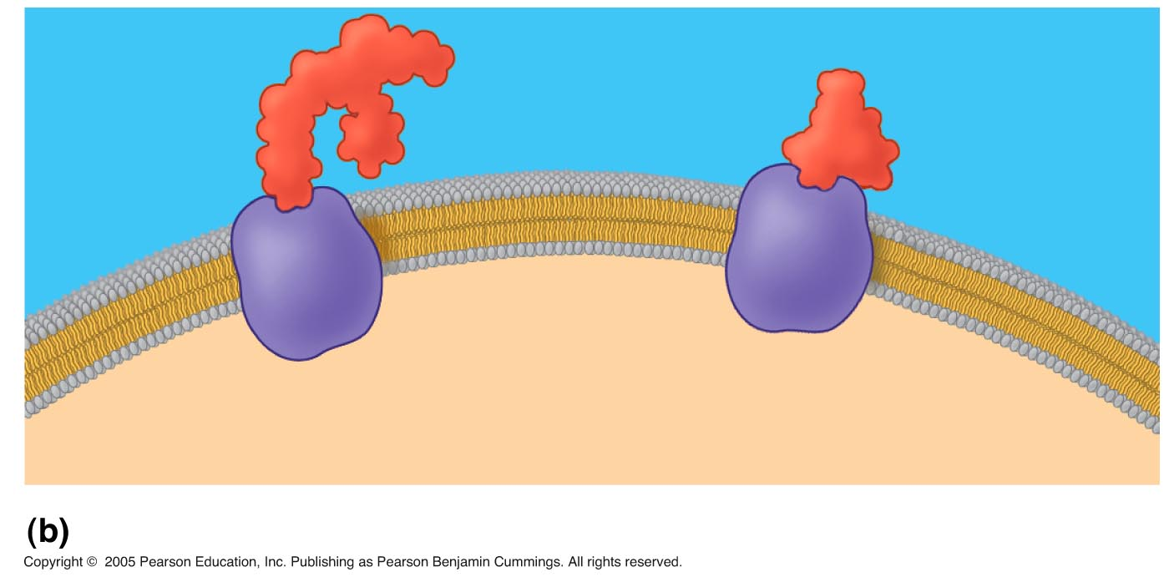
LE 2-17b
Natural
endorphin
Morphine
Endorphin
receptors
Brain cell
Binding to endorphin receptors

Slide 46
Concept 2.4: Chemical reactions make and break chemical bonds
Chemical reactions lead to new arrangements of atoms
The starting molecules of a chemical reaction are called reactants
The final molecules of a chemical reaction are called products

Slide 47
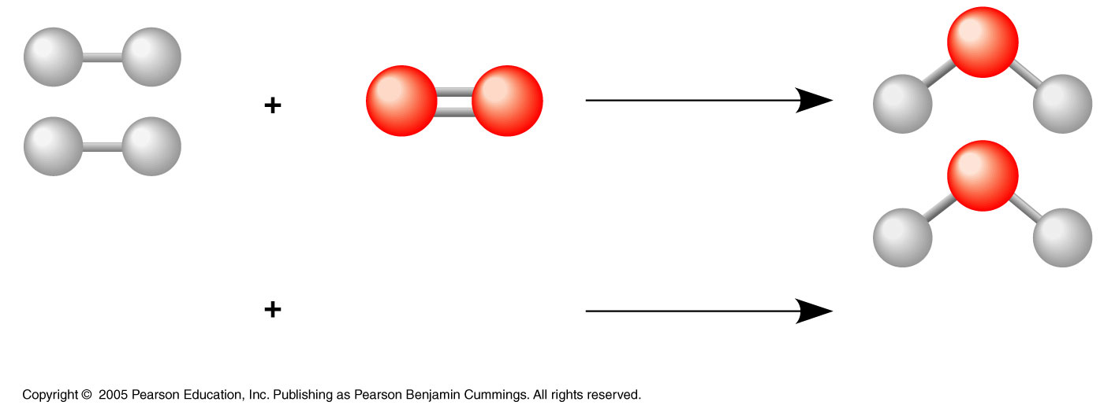
LE 2-UN44
2 H₂
O₂
2 H₂O
Reactants
Reaction
Products

Slide 48
Photosynthesis is an important chemical reaction
In photosynthesis, sunlight powers the conversion of CO₂ and H₂0 to glucose (C₆H₁₂O₆) and O₂

Slide 50
Some chemical reactions go to completion: All reactants are converted to products
Most chemical reactions are reversible: Products of the forward reaction become reactants for the reverse reaction
Chemical equilibrium is reached when the forward and reverse reaction rates are equal

