Slide 1
Chapter 23 Carbonyl Condensation Reactions

Slide 2
Learning Objectives
(23.1)
Carbonyl condensations: The aldol reaction
(23.2)
Carbonyl condensations versus alpha substitutions
(23.3)
Dehydration of aldol products: Synthesis of enones
(23.4)
Using aldol reactions in synthesis

Slide 3
Learning Objectives
(23.5)
Mixed aldol reactions
(23.6)
Intramolecular aldol reactions
(23.7)
The Claisen condensation reaction
(23.8)
Mixed Claisen condensations

Slide 4
Learning Objectives
(23.9)
Intramolecular Claisen condensations: The Dieckmann cyclization
(23.10)
Conjugate carbonyl additions: The Michael reaction
(23.11)
Carbonyl condensations with enamines: The stork reaction

Slide 5
Learning Objectives
(23.12)
The Robinson annulation reaction
(23.13)
Some biological carbonyl condensation reactions

Slide 6
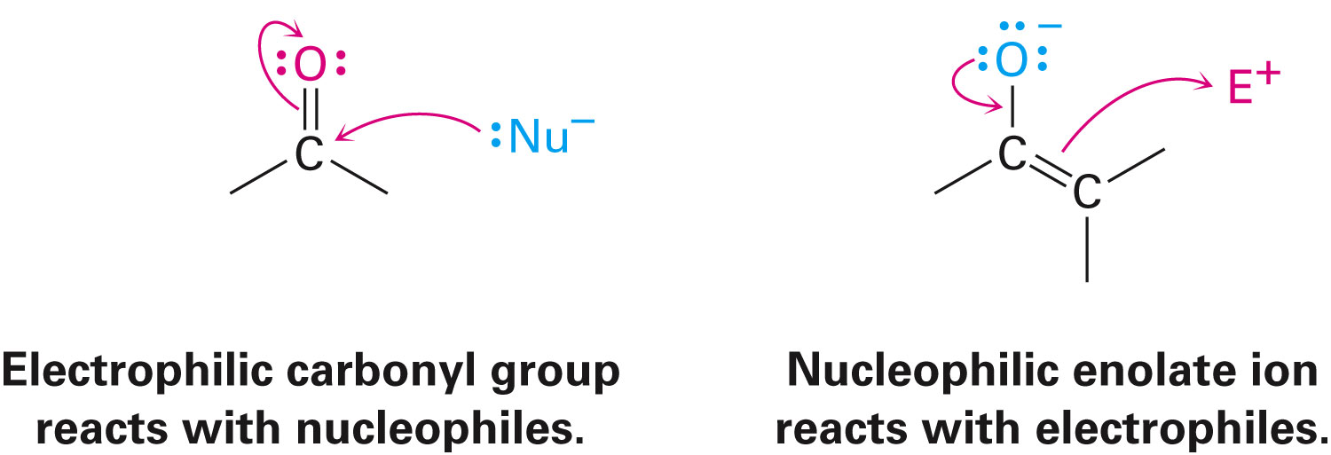
Condensation Reactions
Carbonyl compounds are both the electrophile and nucleophile in carbonyl condensation reactions
Notes:
Carbonyl condensations: The aldol reaction

Slide 7
Carbonyl Condensations: The Aldol Reaction
Carbonyl condensation reactions involve:
Two carbonyl partners
A series of nucleophilic addition and α-substitution steps
In a carbonyl condensation reaction, one partner is converted into an enolate-ion nucleophile and adds to the electrophilic group of the second partner
An α-substitution reaction occurs in the nucleophilic partner and a nucleophilic addition occurs in the electrophilic partner
Notes:
Carbonyl condensations: The aldol reaction

Slide 8
Figure 23.1 - The General Mechanism of a Carbonyl Condensation Reaction
Notes:
Carbonyl condensations: The aldol reaction

Slide 9
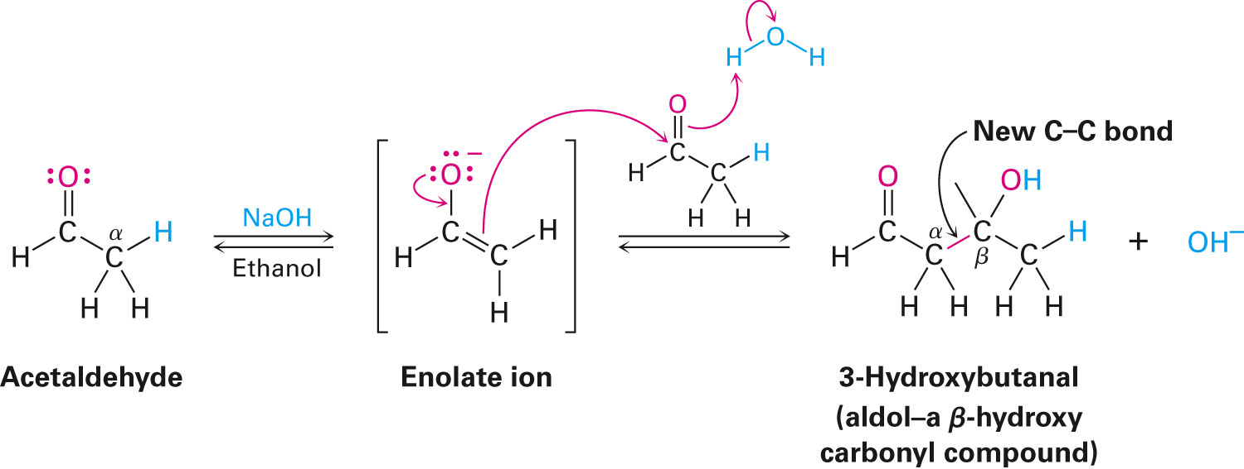
Carbonyl Condensations: The Aldol Reaction
An aldol reaction is a base-catalysed carbonyl condensation reaction that occurs in aldehydes and ketones with an α hydrogen atom
The term aldol comes from the product formed, which contains an aldehyde and an alcohol
Notes:
Carbonyl condensations: The aldol reaction

Slide 10
The Equilibrium of the Aldol
Structure of the substrate and the reaction conditions determine aldol equilibrium
In the absence of an α-substituent, the product is favored and in cases of disubstituted aldehydes, the reactant is favored
Steric factors are believed to be the cause as steric congestion in the product is caused by increased substitution
Notes:
Carbonyl condensations: The aldol reaction

Slide 11
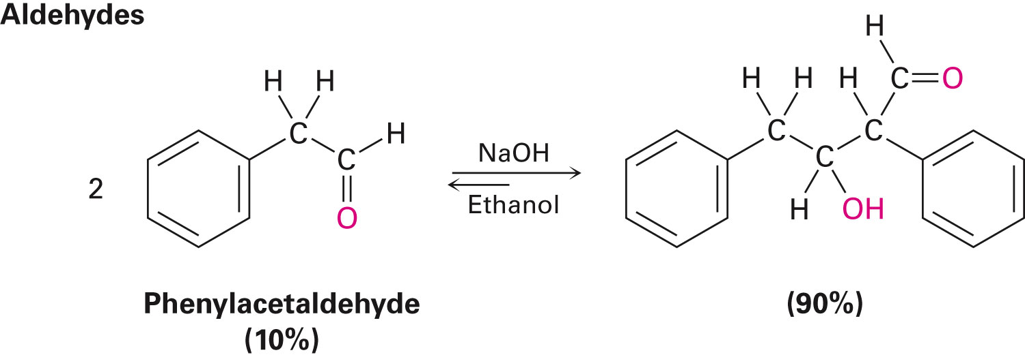
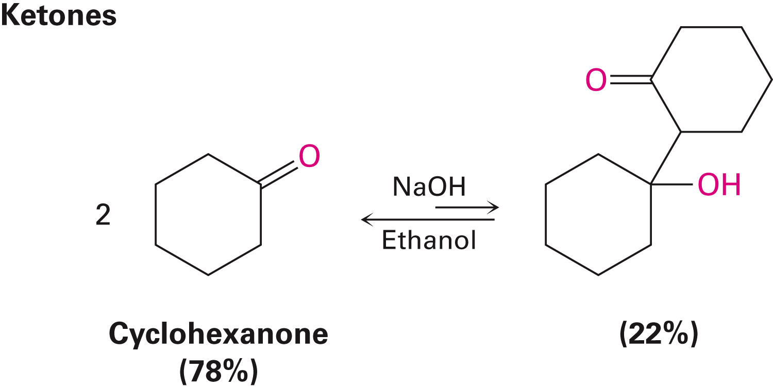
Aldehydes and Ketones and the Aldol Equilibrium
Notes:
Carbonyl condensations: The aldol reaction

Slide 12
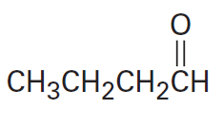
Worked Example
Predict the aldol reaction product in the compound below:
Notes:
Carbonyl condensations: The aldol reaction

Slide 13
Worked Example
Solution:
Forming the enolate of one molecule of the carbonyl compound
Notes:
Carbonyl condensations: The aldol reaction

Slide 14
Carbonyl Condensations versus Alpha Substitutions
Carbonyl condensations and α substitutions have similar experimental conditions
Control of experimental conditions is necessary in determining the outcome of a reaction
In an α-substitution reaction, a strong base used and the conditions created ensure that the carbonyl compound quickly converts to an enolate ion at a low temperature
Notes:
Carbonyl condensations versus alpha substitutions

Slide 15
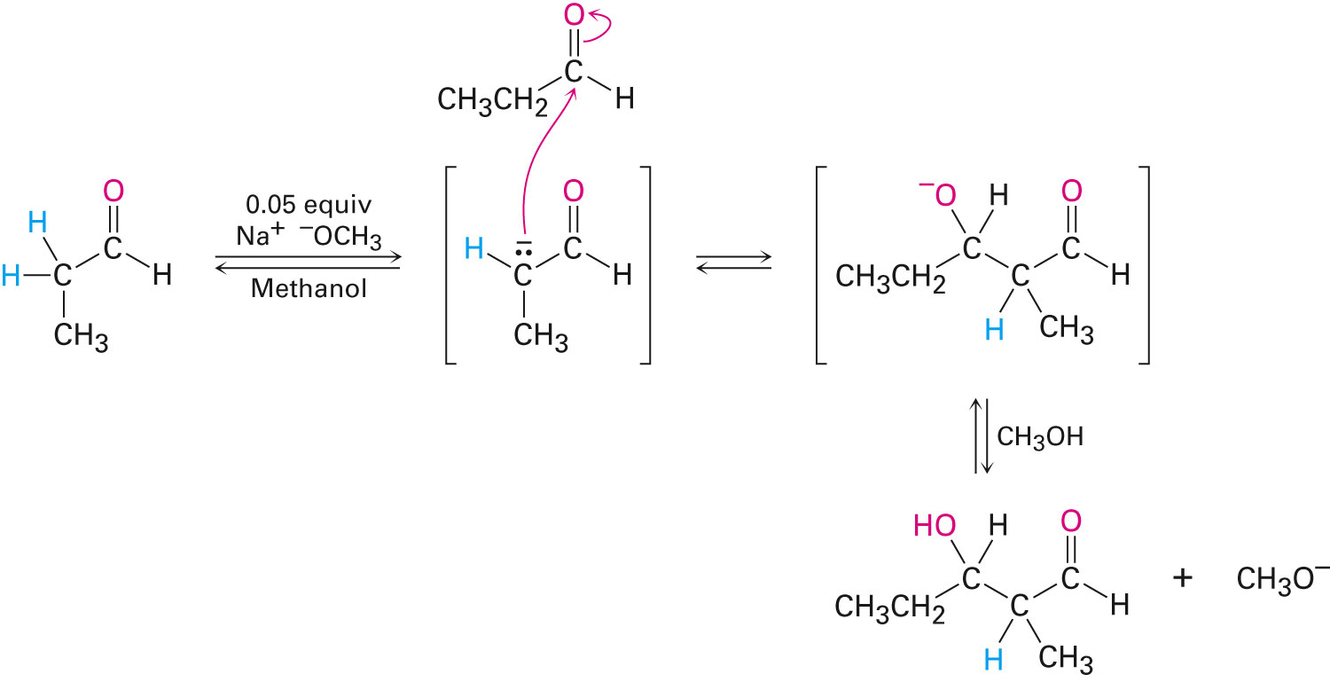
Carbonyl Condensations versus Alpha Substitutions
In a carbonyl condensation, a catalytic amount of a relatively weak base is required
Result is the formation of a small amount of enolate ion in the presence of unreacted carbonyl compound
Notes:
Carbonyl condensations versus alpha substitutions

Slide 16
Dehydration of Aldol Products: Synthesis of Enones
The β-hydroxy carbonyl products dehydrate to yield conjugated enones
The term condensation is based on the fact that that water condenses during the formation of an enome product
Notes:
Dehydration of aldol products: Synthesis of enones

Slide 17
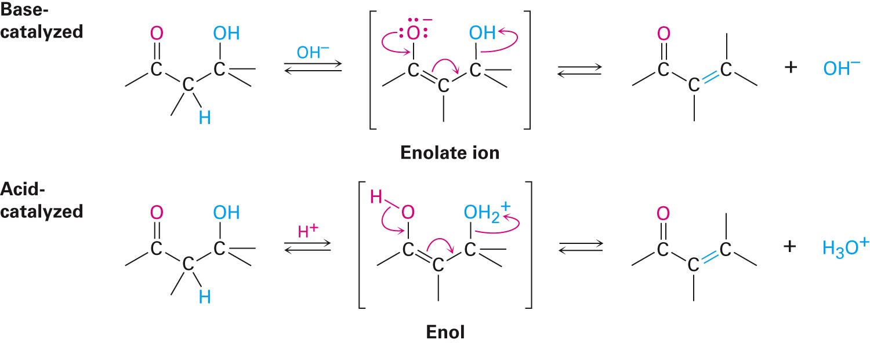
Dehydration of Aldol Products: Synthesis of Enones
Dehydration in aldol products is due to their carbonyl group
The α hydrogen is removed by a base yielding an enolate ion that expels the –OH leaving group
In acidic conditions, the –OH group is protonated and water is expelled
Notes:
Dehydration of aldol products: Synthesis of enones

Slide 18
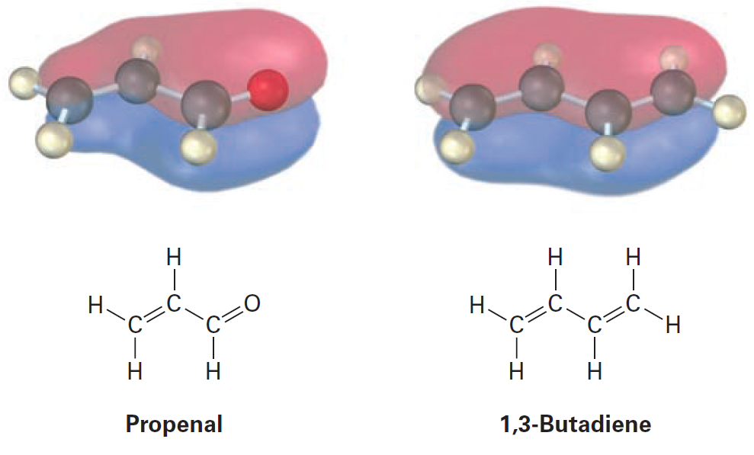
Dehydration of Aldol Products: Synthesis of Enones
Conjugated enones are more stable than nonconjugated enones
Notes:
Dehydration of aldol products: Synthesis of enones

Slide 19
Controlling Aldol Equilibrium
Removal of water from the aldol reaction mixture can be used to drive the aldol equilibrium toward the product
Despite the unfavourable initial aldol step, the following dehydration step results in the many aldol condensations
Notes:
Dehydration of aldol products: Synthesis of enones

Slide 20
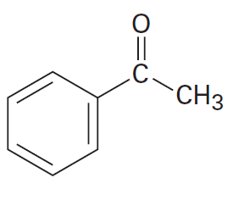
Worked Example
Draw the two enone products, excluding double-bond isomers, that result in the aldol condensation of 3-methylcyclohexanone
Notes:
Dehydration of aldol products: Synthesis of enones

Slide 21
Worked Example
Solution:
Including double bond isomers, 4 products can be formed
The major product is formed by the reaction of the enolate formed by abstraction of a proton at position “a”
Position “b” has more steric hindrance
Notes:
Dehydration of aldol products: Synthesis of enones

Slide 22
Worked Example
Notes:
Dehydration of aldol products: Synthesis of enones

Slide 23
Using Aldol Reactions in Synthesis
Experimental conditions determine the product of the aldol reaction
Working backwards may help to foresee when the aldol reaction may be useful in synthesis
If a desired molecule contains either a β-hydroxy carbonyl or a conjugated enone, it might come from an aldol reaction
Notes:
Using aldol reactions in synthesis

Slide 24
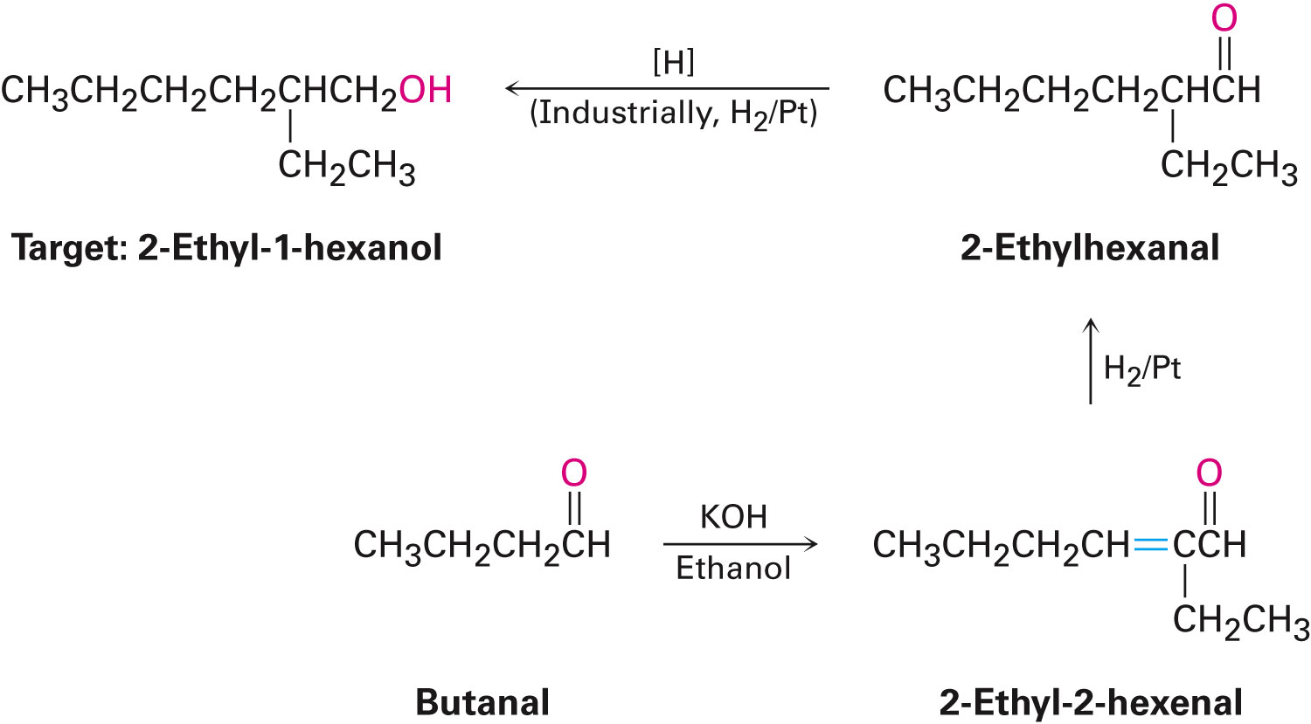
Extending the Synthesis
Subsequent transformations can be carried out on the aldol products
Notes:
Using aldol reactions in synthesis

Slide 25
Worked Example
Determine whether 2-Hydroxy-2-methylpentanal is an aldol condensation product
Identify its aldehyde or ketone precursor
Solution:
This product results from the aldol self-condensation of 3-pentanone, followed by dehydration
Notes:
Using aldol reactions in synthesis

Slide 26
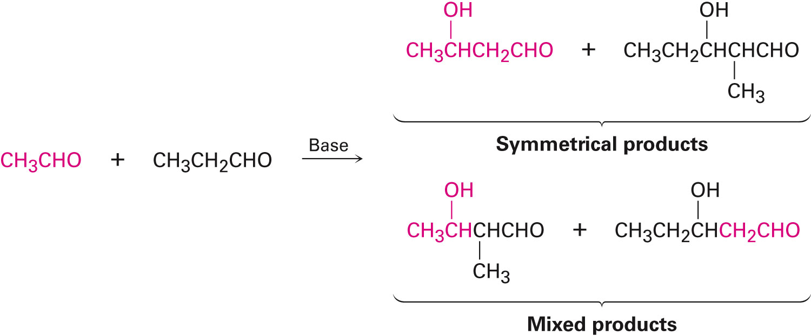
Mixed Aldol Reactions
A mixed aldol reaction between two similar aldehyde or ketone partners leads to a mixture of four possible products
Notes:
Mixed aldol reactions

Slide 27
Practical Mixed Aldols
A mixed aldol reaction is possible when:
One of the carbonyl partners have no α hydrogens
An unhindered carbonyl group is present
Notes:
Mixed aldol reactions

Slide 28
Practical Mixed Aldols
A successful mixed aldol reaction is also possible when one of the carbonyl partners is transformed into its enolate ion on account of a higher acidic nature than the other carbonyl partner
Notes:
Mixed aldol reactions

Slide 29
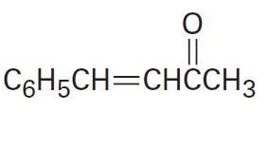
Practical Mixed Aldols
Determine if the following compound can be prepared by a mixed aldol reaction
Show the reactant that can be used
Notes:
Mixed aldol reactions

Slide 30
Worked Example
Solution:
This mixed aldol will succeed because one of the components, benzaldehyde, is a good acceptor of nucleophiles, yet has no α-hydrogen atoms
Although it is possible for acetone to undergo self-condensation, the mixed aldol reaction is favored more
Notes:
Mixed aldol reactions

Slide 31
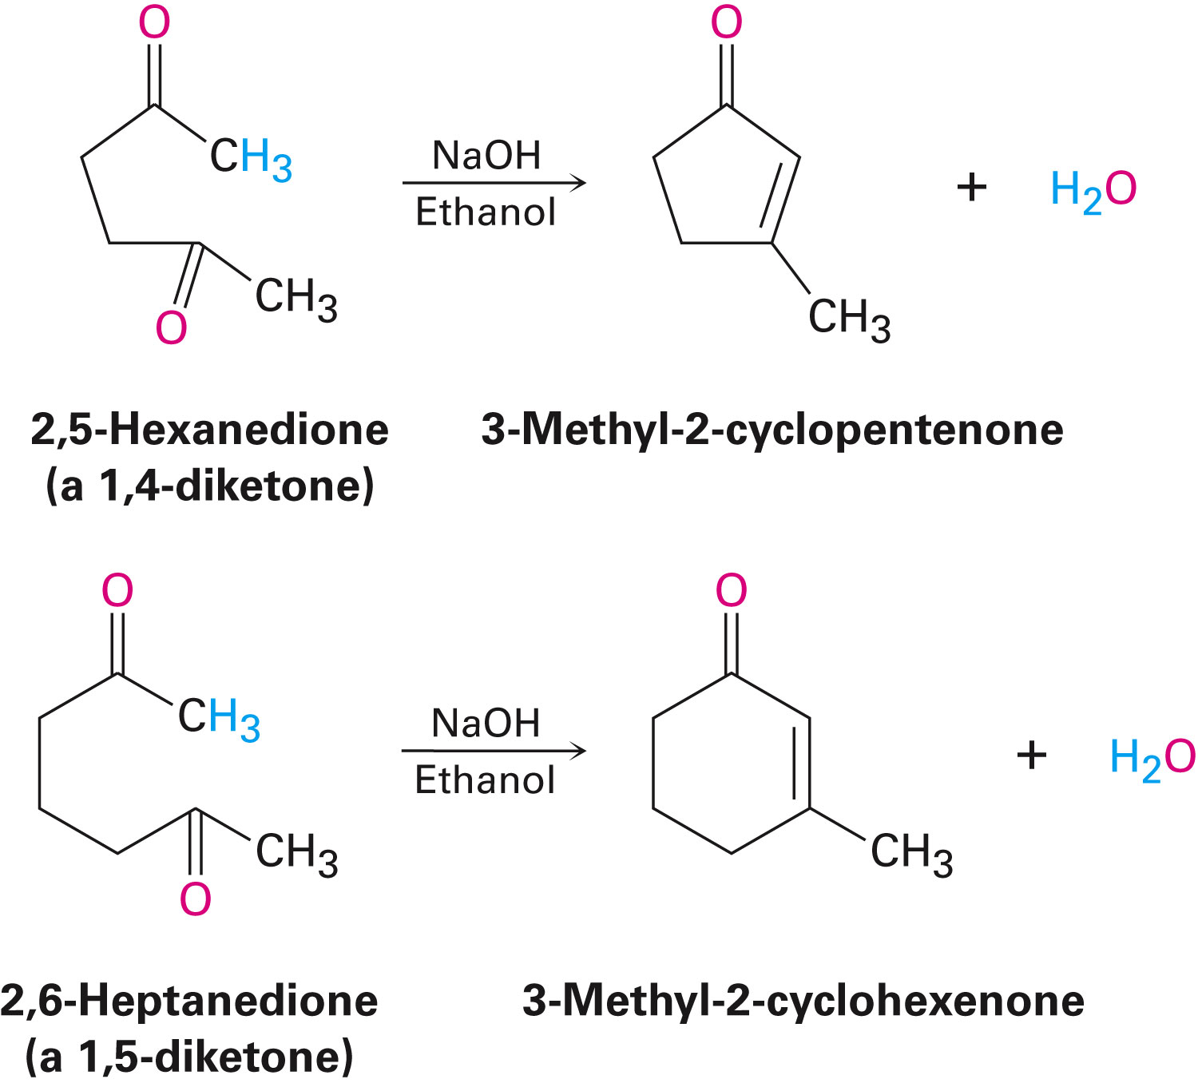
Intramolecular Aldol Reactions
Treatment of certain dicarbonyl compounds with base produces cyclic products by intramolecular reaction

Slide 32
Mechanism of Intramolecular Aldol Reactions
Similar to that of intermolecular reactions
Difference is that the same molecule houses both the nucleophilic carbonyl donor and the electrophilic carbonyl acceptor
The characteristics of the enolate formed controls the end result of the reaction
A mixture of products can be formed
Notes:
Intramolecular aldol reactions

Slide 33
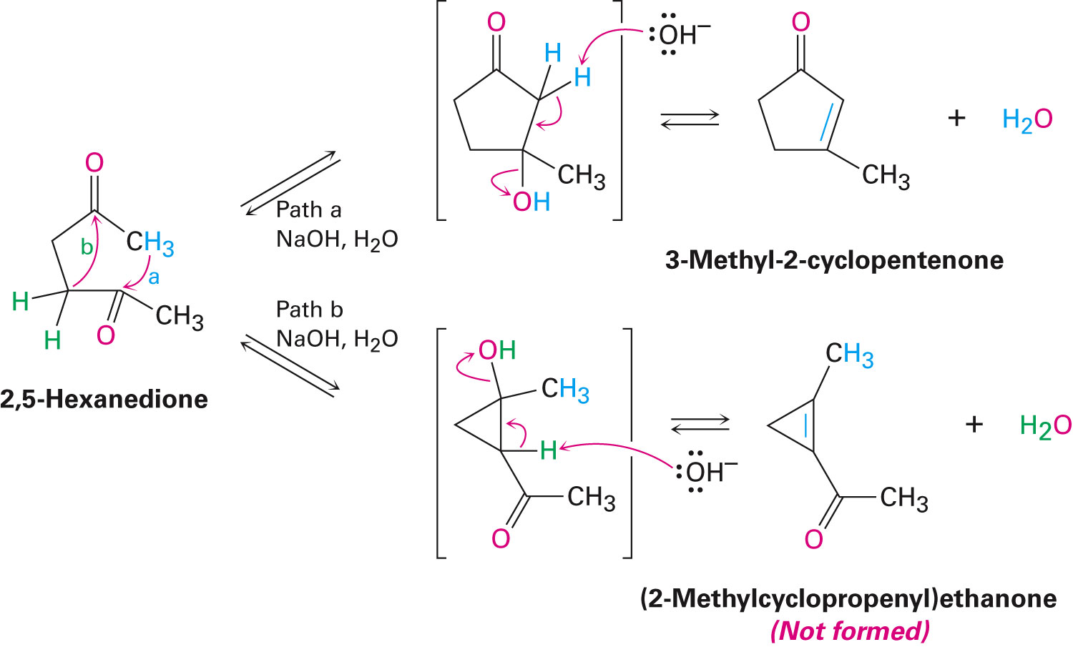
Figure 23.3 - Intramolecular Aldol Reaction of 2,5-hexanedione
Notes:
Intramolecular aldol reactions

Slide 34
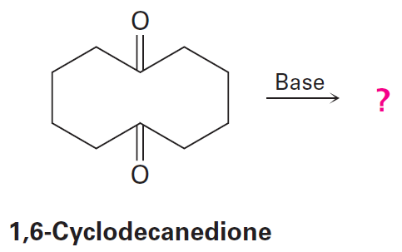
Worked Example
Determine the product from base treatment of 1,6-cyclodecanedione
Notes:
Intramolecular aldol reactions

Slide 35
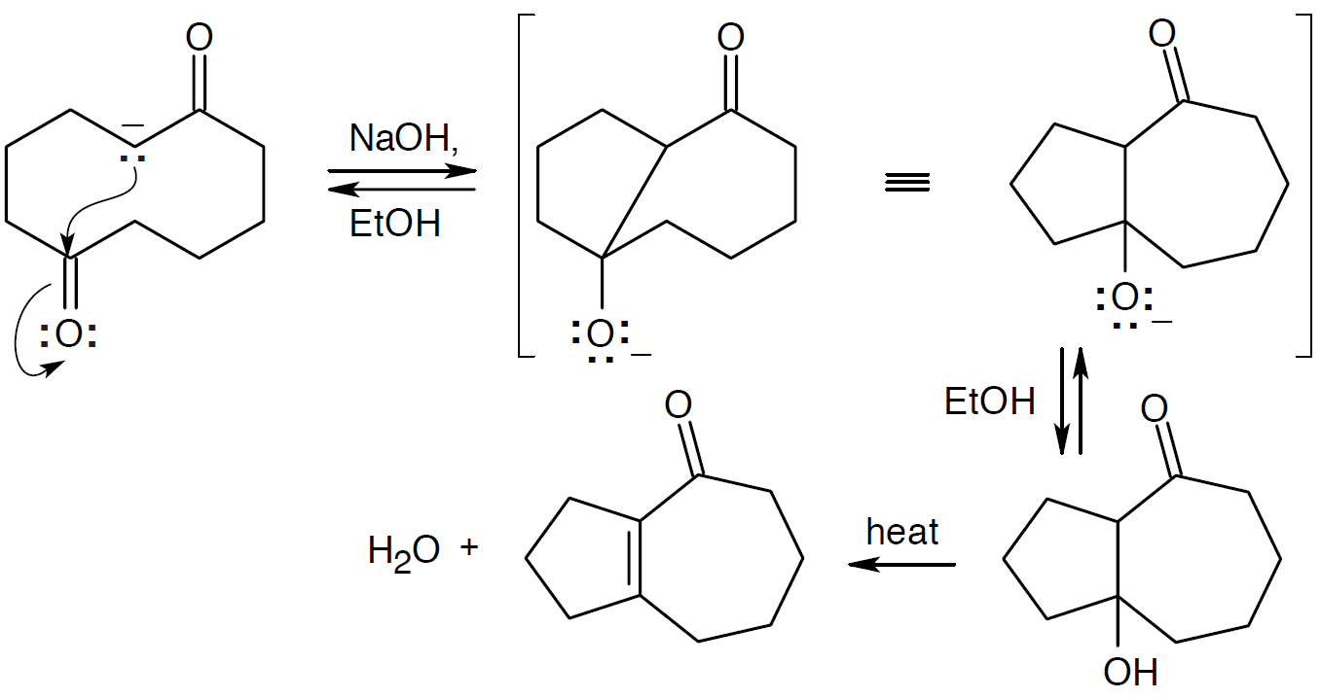
Worked Example
Solution:
This intramolecular aldol condensation gives a product with a seven-membered ring fused to a five-membered ring
Notes:
Intramolecular aldol reactions

Slide 36
Claisen Condensation Reaction
Occurs between two ester molecules
An ester with an α hydrogen undergoes reversible carbonyl condensation reaction when treated with 1 equivalent of a base resulting in a β-keto ester
Notes:
The Claisen condensation reaction

Slide 37
Figure 23.4 - Mechanism of the Claisen Condensation Reaction
Notes:
The Claisen condensation reaction

Slide 38
Figure 23.4 - Mechanism of the Claisen Condensation Reaction
Notes:
The Claisen condensation reaction

Slide 39
Features of the Claisen Condensation
If the starting ester has more than one acidic α hydrogen, the product β-keto ester has a doubly activated hydrogen atom that can be abstracted by base
Requires a full equivalent of base rather than a catalytic amount
Deprotonation of the product causes a shift in equilibrium over to the side of the product, resulting in high yields
Notes:
The Claisen condensation reaction

Slide 40
Worked Example
Determine the product obtained by Claisen condensation of (CH₃)₂CHCH₂CO₂Et
Solution:
Writing the two Claisen components in the correct orientation makes it easier to predict the product
Notes:
The Claisen condensation reaction

Slide 41
Mixed Claisen Condensations
Successful when one of the two esters cannot form an enolate ion as it does not possess α hydrogens
Notes:
Mixed Claisen condensations

Slide 42
Causing Claisen-like Reactions in Esters and Ketones
Reactions between esters and ketones result in β-diketones
An ester component with no α hydrogens is favorable
Notes:
Mixed Claisen condensations

Slide 43
Worked Example
Predict the product in the following Claisen-like mixed reaction
Notes:
Mixed Claisen condensations

Slide 44
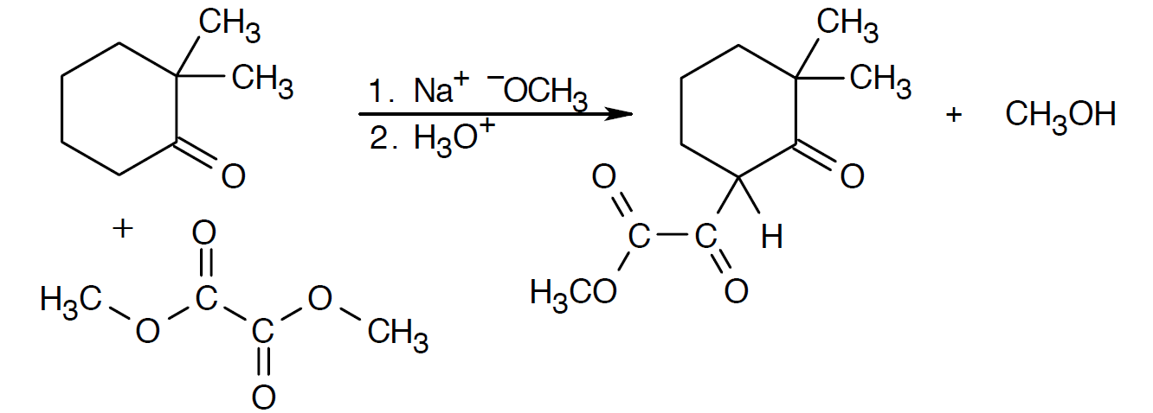
Worked Example
Solution:
Dimethyl oxalate is a very efficient reagent in mixed Claisen reactions
Notes:
Mixed Claisen condensations

Slide 45
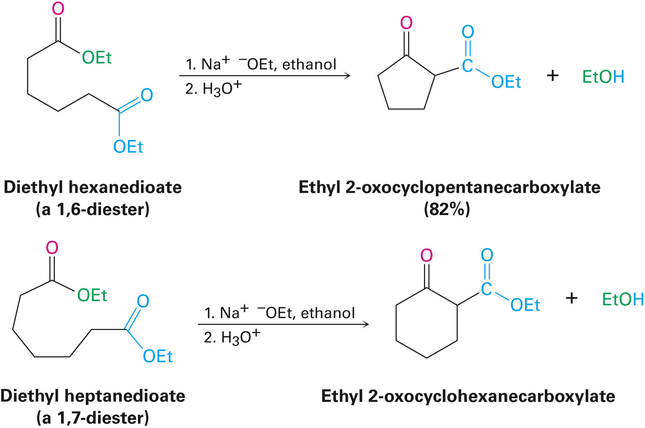
Intramolecular Claisen Condensations: The Dieckmann Cyclization
It can occur in diketones
Effective Dieckmann cyclization reactions occur in 1,6-diesters and 1,7-diesters
Notes:
Intramolecular Claisen condensations: The Dieckmann cyclization

Slide 46
Figure 13.5 - Mechanism of the Dieckmann Cyclization
Notes:
Intramolecular Claisen condensations: The Dieckmann cyclization

Slide 47
Figure 13.5 - Mechanism of the Dieckmann Cyclization
Notes:
Intramolecular Claisen condensations: The Dieckmann cyclization

Slide 48
Alkylating the Product of the Dieckmann Reaction
The cyclic β-keto ester can be further alkylated and decarboxylated as in the acetoacetic ester synthesis
Notes:
Intramolecular Claisen condensations: The Dieckmann cyclization

Slide 49
Worked Example
Determine the product of the reaction below
Notes:
Intramolecular Claisen condensations: The Dieckmann cyclization

Slide 50
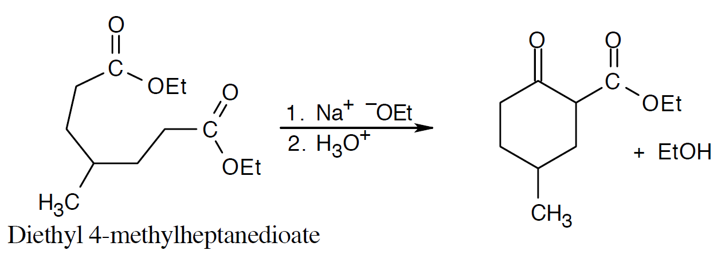
Worked Example
Solution:
Notes:
Intramolecular Claisen condensations: The Dieckmann cyclization

Slide 51
Conjugate Carbonyl Additions: The Michael Reaction
Process in which a nucleophilic enolate ion reacts with an α,β-unsaturated compound, producing a conjugate addition product
Notes:
Conjugate carbonyl additions: The Michael reaction

Slide 52
Optimal Conditions for the Michael Reaction
Involve a particularly stable ion and an unhindered α,β-unsaturated ketone
Notes:
Conjugate carbonyl additions: The Michael reaction

Slide 53
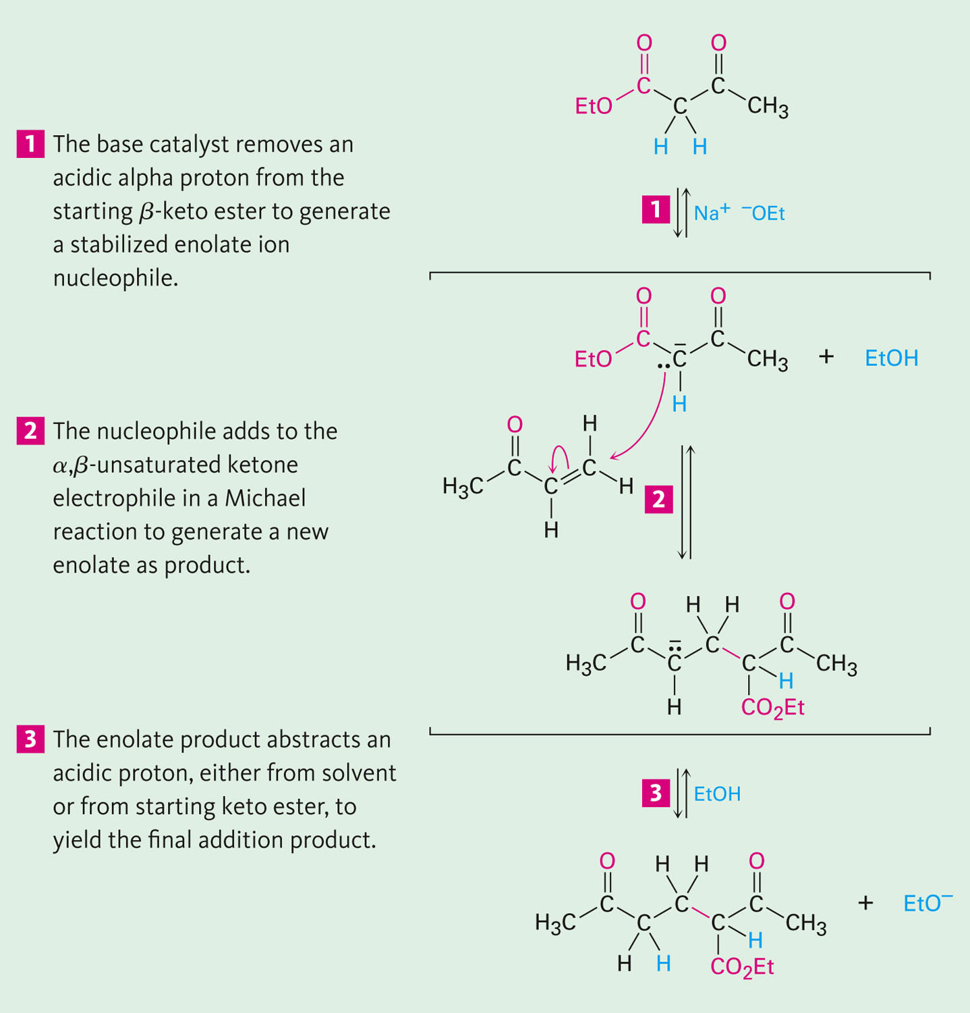
Figure 23.6 - Mechanism of the Michael Reaction
Notes:
Conjugate carbonyl additions: The Michael reaction

Slide 54
Generality of the Michael Reaction
Occurs with a variety of α,β-unsaturated carbonyl compounds (aldehydes, esters, nitriles, amides, and nitro compounds)
Donors include β-diketones, β-keto esters, malonic esters, β-keto nitriles, and nitro compounds
Notes:
Conjugate carbonyl additions: The Michael reaction

Slide 55
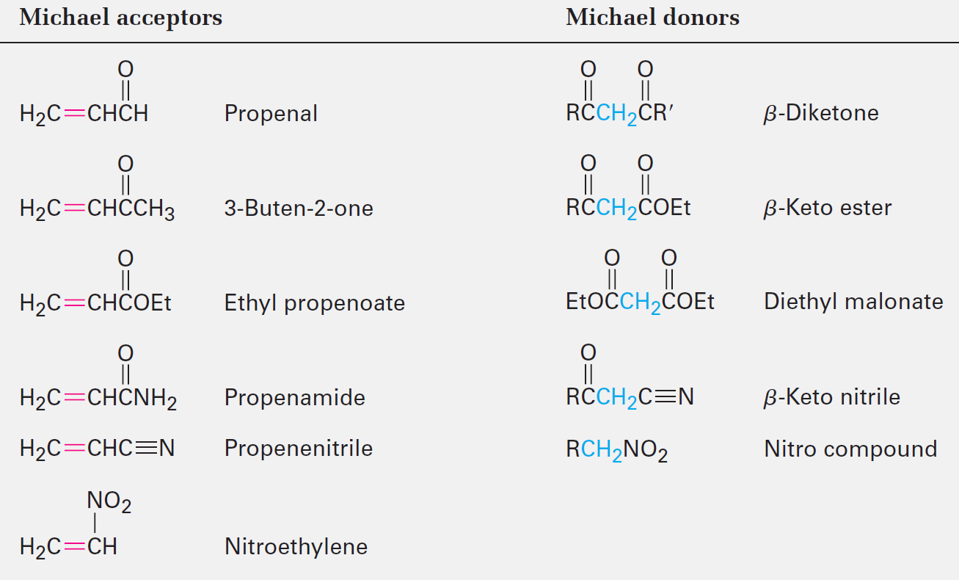
Table 23.1 - Some Michael Acceptors and Some Michael Donors
Notes:
Conjugate carbonyl additions: The Michael reaction

Slide 56
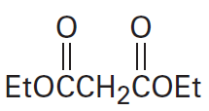
Worked Example
Predict the product obtained from a base-catalysed Michael reaction of 3-buten-2-one with the nucleophilic donor below
Notes:
Conjugate carbonyl additions: The Michael reaction

Slide 57
Worked Example
Solution:
Notes:
Conjugate carbonyl additions: The Michael reaction

Slide 58
Carbonyl Condensations with Enamines: The Stork Reaction
Enamines are prepared from a ketone and a secondary amine
Notes:
Carbonyl condensations with enamines: The Stork reaction

Slide 59
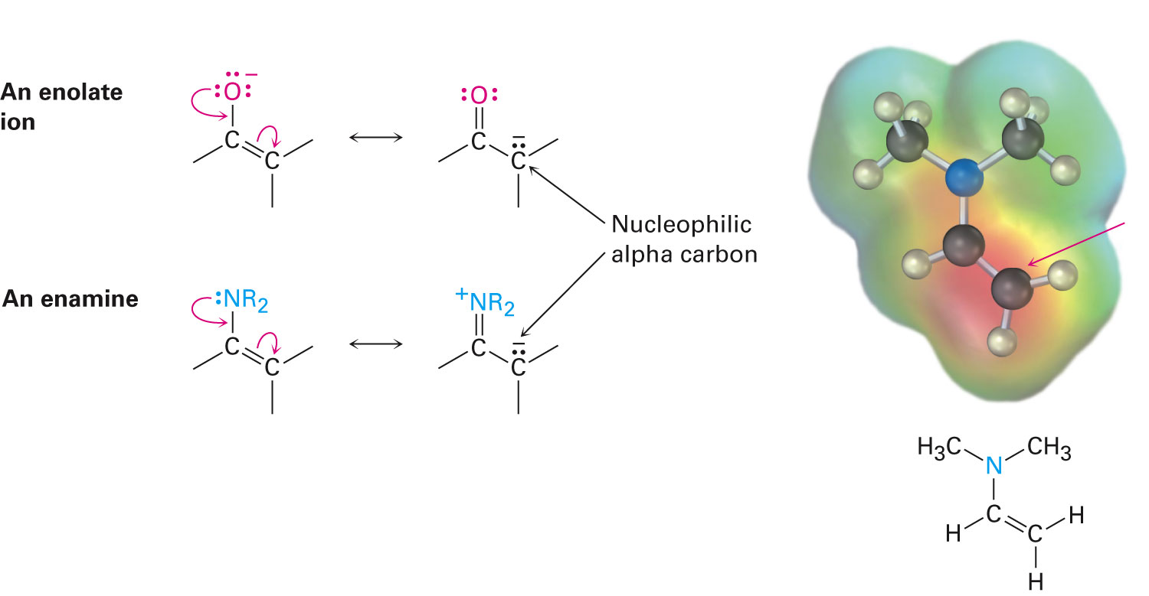
Enamines Are Nucleophilic
Overlap of the nitrogen lone-pair orbital with the double-bond π orbitals increases electron density on the α carbon atom
Notes:
Carbonyl condensations with enamines: The Stork reaction

Slide 60
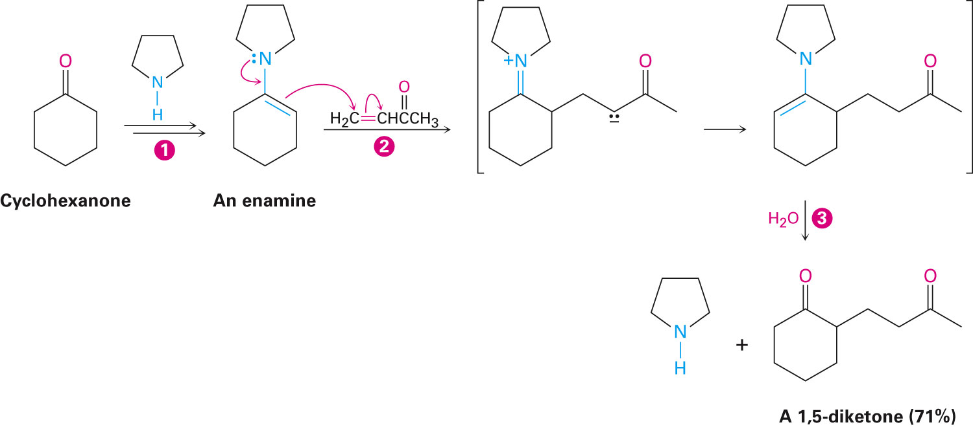
Enamine Addition and Hydrolysis
Enamine adds to an α,β-unsaturated carbonyl acceptor
Product is hydrolyzed to a 1,5-dicarbonyl compound
Notes:
Carbonyl condensations with enamines: The Stork reaction

Slide 61
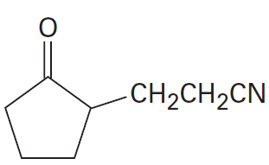
Worked Example
Use an enamine reaction to prepare the compound below
Notes:
Carbonyl condensations with enamines: The Stork reaction

Slide 62
Worked Example
Solution:
Analyze the product for the Michael acceptor and the ketone
The Michael acceptor is propenenitrile
The ketone is cyclopentanone, which is treated with pyrrolidine to form the enamine
Notes:
Carbonyl condensations with enamines: The Stork reaction

Slide 63
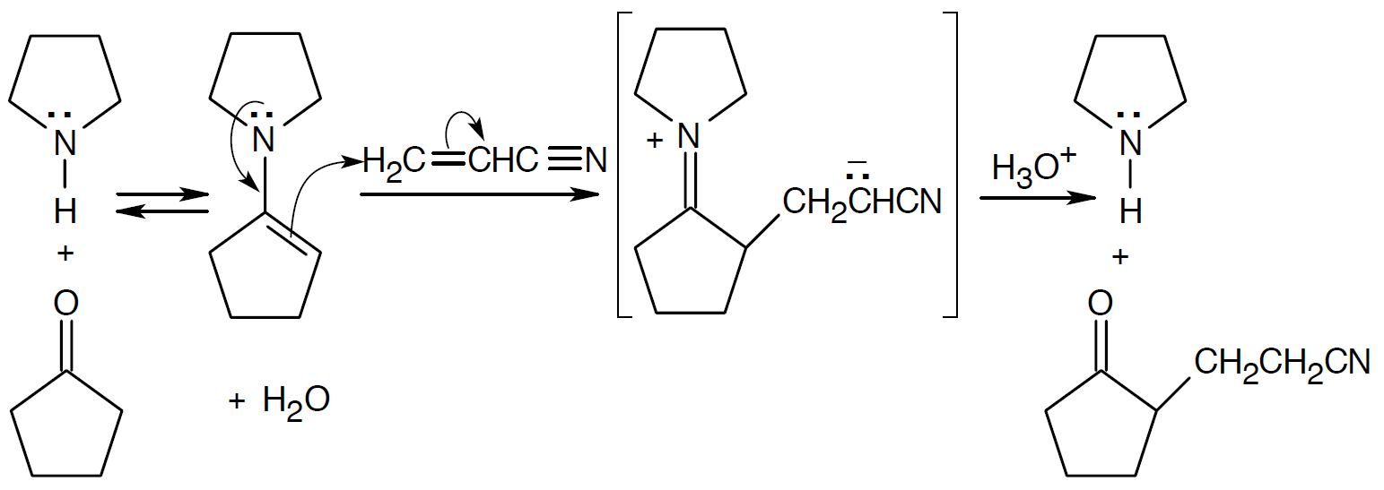
Worked Example
Notes:
Carbonyl condensations with enamines: The Stork reaction

Slide 64
The Robinson Annulation Reaction
A two-step process
It combines a Michael reaction with an intramolecular aldol reaction
The reactants required are a nucleophilic donor, an enamine, and an α,β-unsaturated ketone acceptor
Notes:
The Robinson annulation reaction

Slide 65
Figure 23.8 - Synthesis of the Steroid Hormone Estrone
Notes:
The Robinson annulation reaction

Slide 66
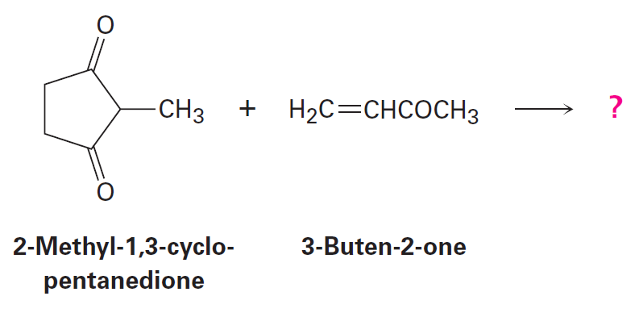
Worked Example
Determine the product of a Robinson annulation reaction of 2-methyl-1,3-cyclopentanedione with 3-buten-2-one
Notes:
The Robinson annulation reaction

Slide 67
Worked Example
Solution:
The Robinson annulation is a combination of:
A Michael reaction
Reaction between a nucleophilic donor (diketone) and an α,β-unsaturated carbonyl compound (enone)
An aldol reaction
Involves the product of the Michael reaction
Notes:
The Robinson annulation reaction

Slide 68
Worked Example
Notes:
The Robinson annulation reaction

Slide 69
Some Biological Carbonyl Condensation Reactions
Biological aldol reactions are widely found in carbohydrate metabolism
Type I aldolases are present mostly in animals and higher plants
Notes:
Some biological carbonyl condensation reactions

Slide 70
Some Biological Carbonyl Condensation Reactions
Type II aldolases are present mostly in fungi and bacteria
Aldolase-catalysed reactions are mixed aldol reactions that occur between two different partners
Notes:
Some biological carbonyl condensation reactions

Slide 71
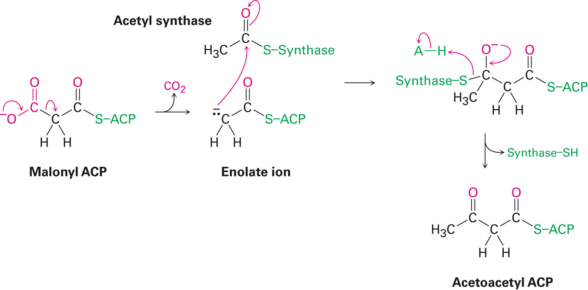
Biological Claisen Condensations
They are prevalent in many biological pathways
Fatty acid biosynthesis
Notes:
Some biological carbonyl condensation reactions

Slide 72
Summary
A carbonyl condensation reaction comprises two carbonyl partners and involves nucleophilic and α-subtitution processes
An aldol reaction is a reversible reaction that involves two aldehyde or ketone molecules
The Claisen condensation reaction is a carbonyl condensation that produces a β-keto ester product
Dieckmann cyclization reactions are intermolecular Claisen condensations that yield five- and six-membered cyclic β-keto esters

Slide 73
Summary
The Michael reaction involves a conjugate addition of a carbon nucleophile to an α,β-unsaturated acceptor
The Robinson annulation reaction comprises a Michael addition and an intramolecular aldol cyclization

