Slide 1
Critique
A critique is a detailed analysis and assessment of something, esp. a literary works, artistic endeavors, and philosophical or political theory.
A critique can be a written or can be a verbal assessment of visual work.

Slide 2
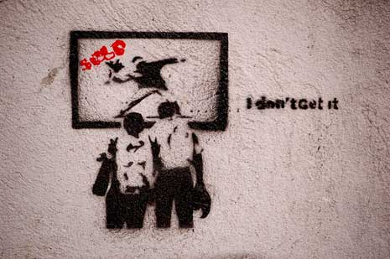

Slide 3
Critiquing our Drawings

Slide 4
The student explains his/her experience with the project work by addressing his/her concepts, choices, compositional concerns, and overall personal view of the work created.

Slide 5
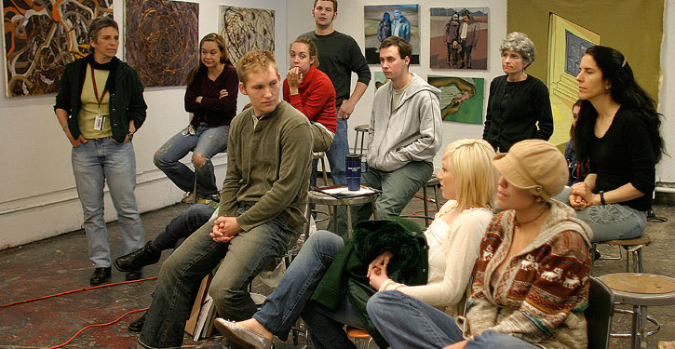
The peer group then asks questions of the student who made the work to better understand the intention of the artist and his/her work.

Slide 6
Tips for Constructive Critiquing
Tip #1: Prepare before you present your work to others.
Don’t wait for them to “fix” it for you

Slide 7
Tips for Constructive Critiquing
Tip #2: Always find something positive to say when you are critiquing even if the work needs improvement.
You want to build up your classmates to improve and succeed, not tear them down-hence the term constructive.

Slide 8
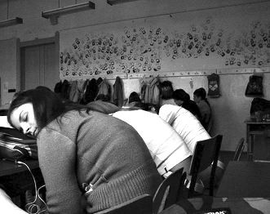
Tips for Constructive Critiquing
How do you engage the class and turn your peers’ attention from this to…
This?!!?

Slide 9
Stick with the main points!

Slide 10
Tips for Constructive Critiquing
Describe
Analyze
Interpret

Slide 11
