Slide 1
Design Principles
Line

Slide 2
A Point Set in Motion
.
3 Parts of Form:
Point – no dimensions, no height and no width.
Line – a point in motion, capable of infinite variety
* Line is the most common design element!
Contours—shapes bounded or bordered by line; an outline

Slide 3
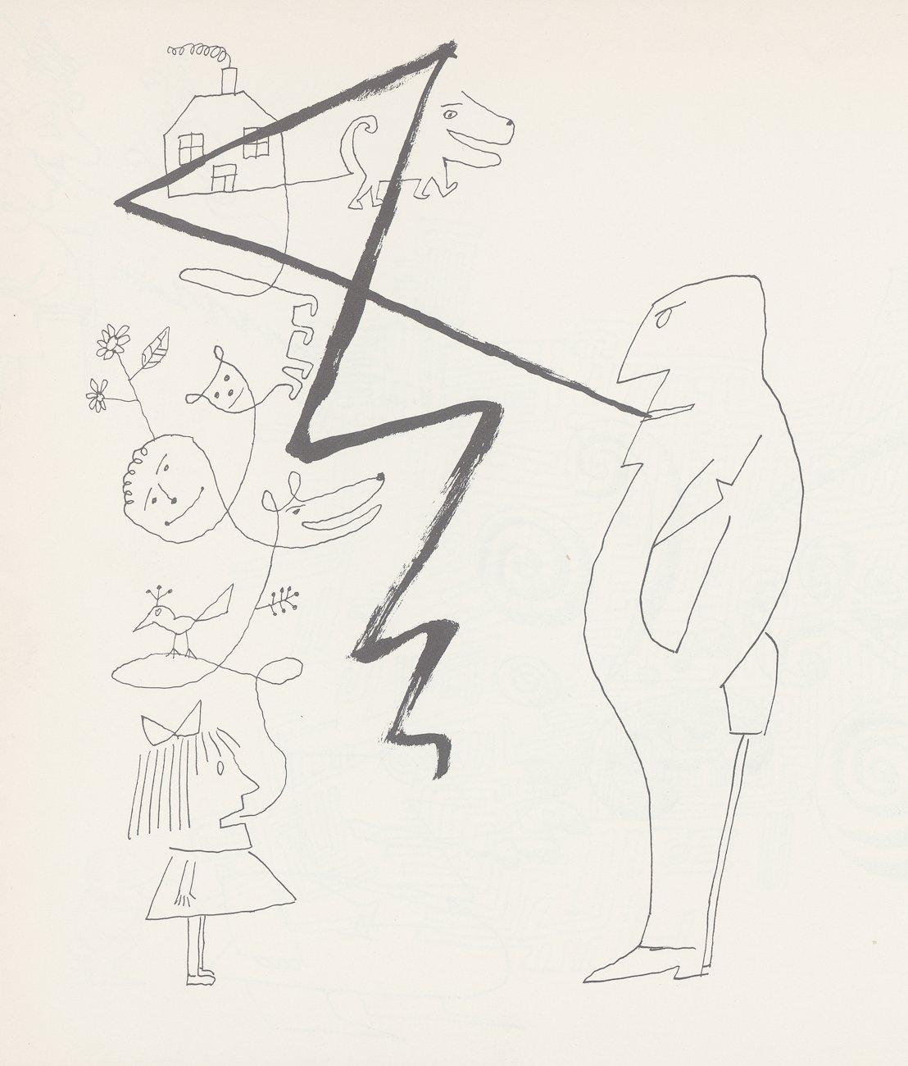
Lines Convey Mood and Feeling
Line is created by movement
Line is capable of infinite variety.
Our eye tends to follow line.
Descriptions for line:
Nervous
Excited
Calm
Graceful
Dancing
Artful
C Line has almost unlimited variations.
D Saul Steinberg. Untitled. c. 1959. Ink on paper. Originally published in The New Yorker, March 14, 1959. The Saul Steinberg Foundation/Artists Rights Society (ARS), New York. Brush and ink on paper, 1’ 7 5/8” x 2ﾕ” 2” (49.7x 66 cm). The Museum of Modern Art, New York (gift of Mr. and Mrs. Peter A. Rubel).

Slide 4
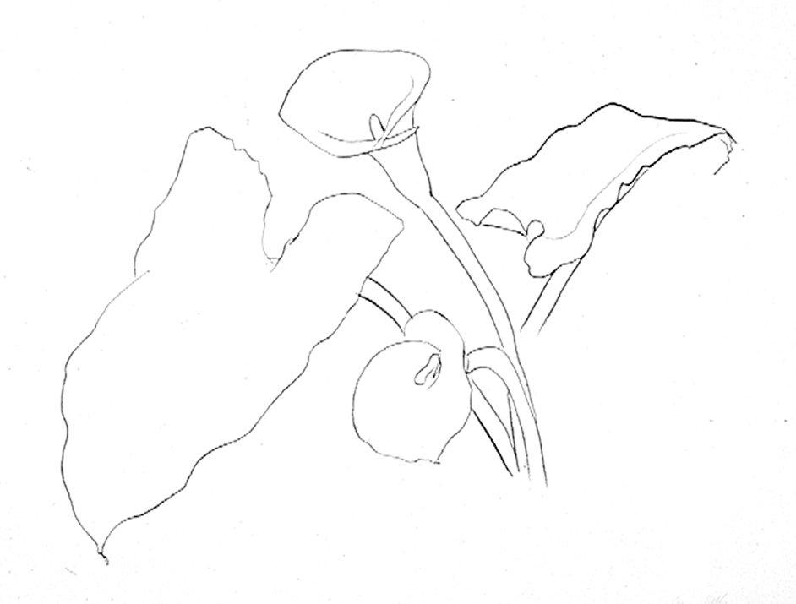
Line and Shape
Defining Shape and Form
Line describes shape,
and shapes describes objects.
Artistic Shorthand - Line is a quick way to show or define a shape.
Ellsworth Kelly. Calla Lily 1. 1984. Lithograph on Rives BFK paper, 2’ 6 1/4” x 3’ 3” (77 x 99 cm). Edition of 30. Courtesy of the artist and Gemini G.E.L.

Slide 5
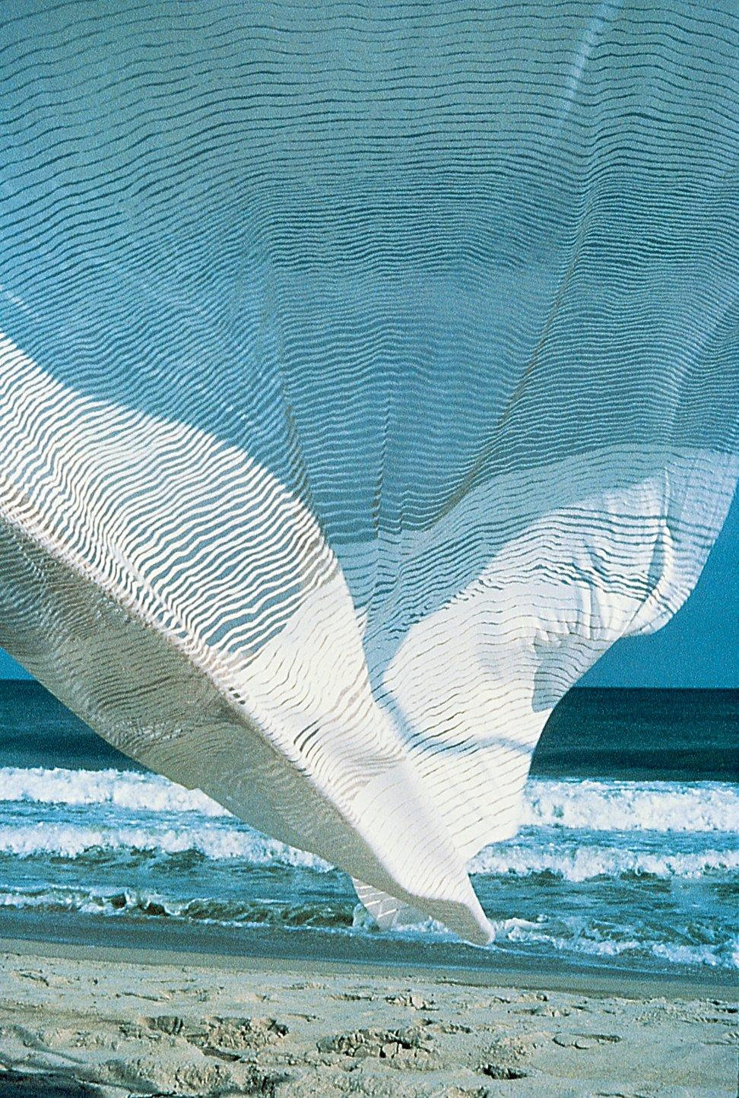
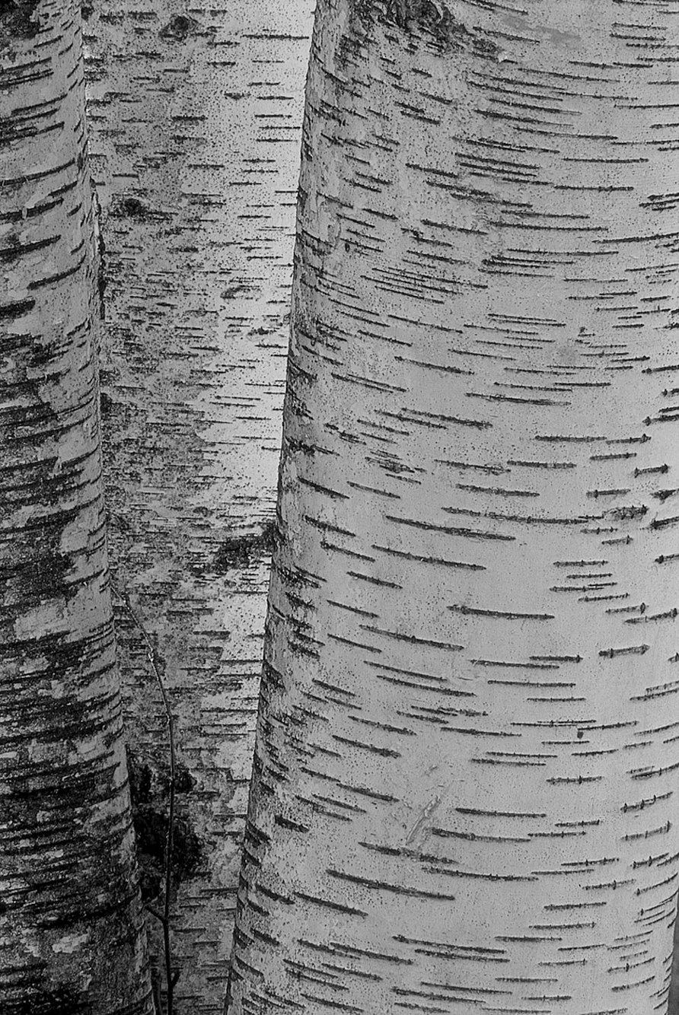
Cross Contour Describes Form
Jack Lenor Larsen. Seascape. 1977.
Lines in the bark reveal the cross contours of the tree. Mark Newman/www.bciusa.com.

Slide 6
Types of Line
There are many types of actual lines, each varying in weight and character.
The points in an implied line are automatically connected by the eye.
When one object points to another, the eye connects the two in a psychic line.

Slide 7
3 Types of Line
Actual Line – The line itself can have many different properties.
Implied Line –an automatically connected series of unconnected points creating an implied line.
Psychic Line– created when there is no real line, but the placement of the objects causes the viewer to look in a certain direction.

Slide 8
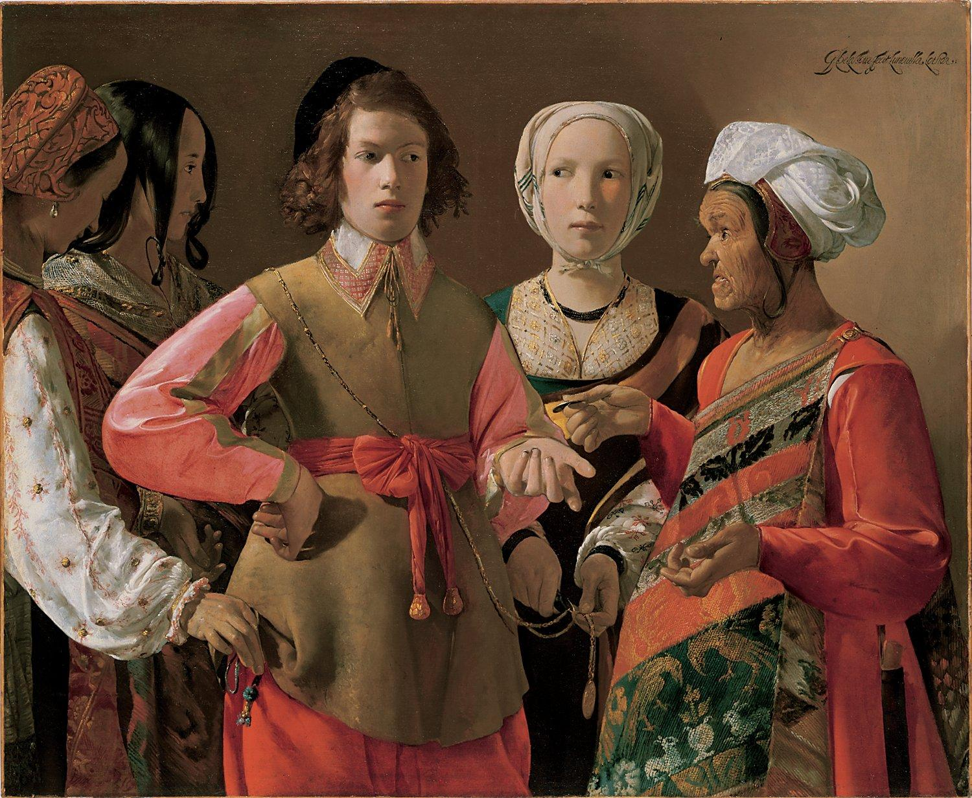
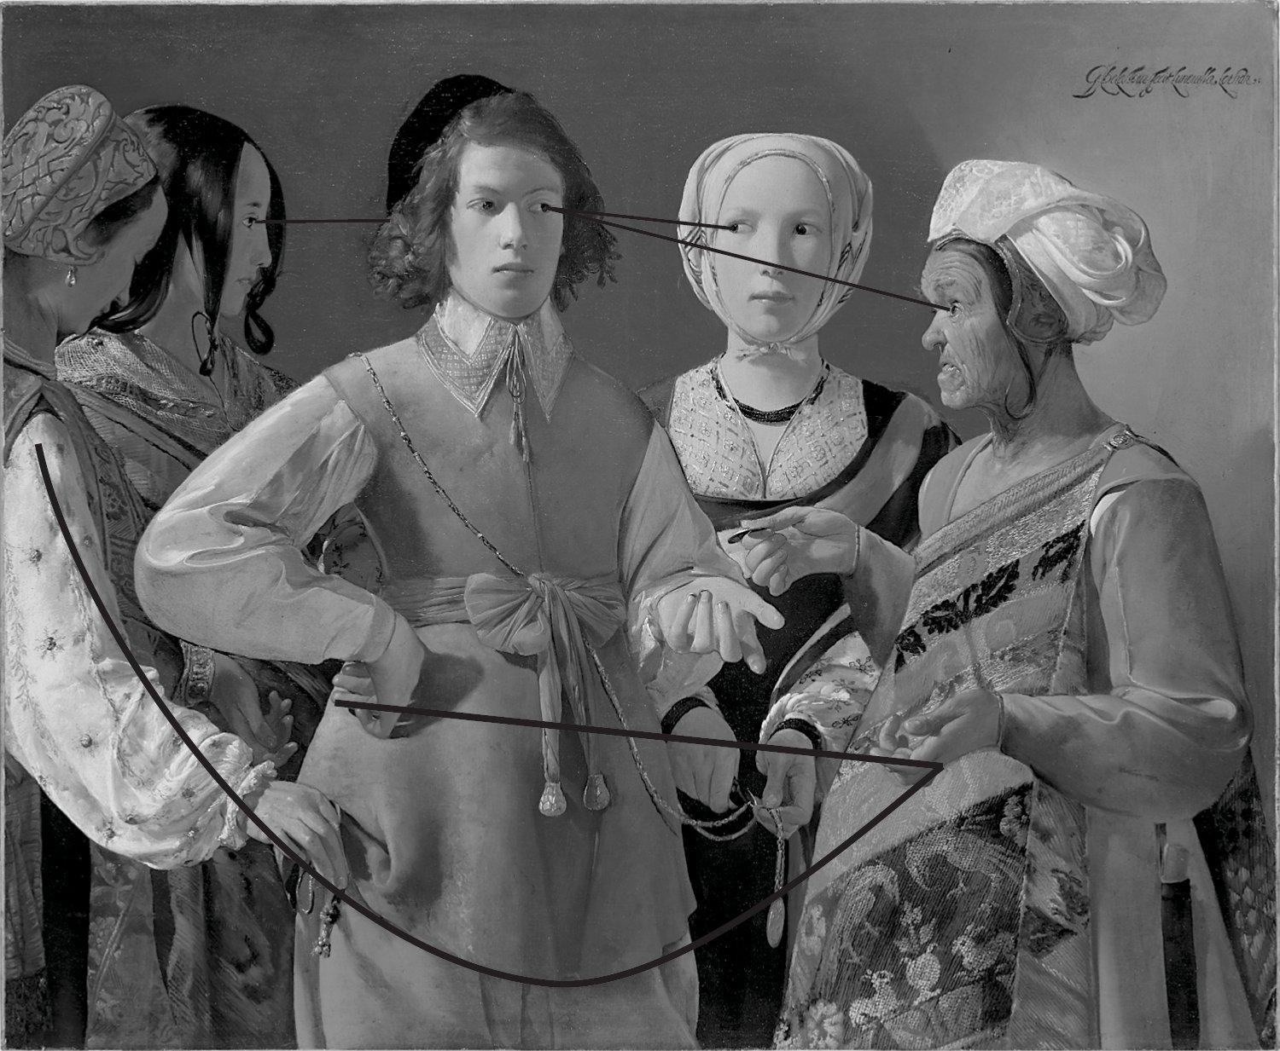
Interpreting Line
The direction of a line can lead the eye of a viewer.
E Actual, implied, and psychic lines organize the composition.Georges de La Tour. The Fortune Teller. Probably 1630s. Oil on canvas, 3’ 4 1/8” 4’ 5/8” (102 x 123.5 cm). The Metropolitan Museum of Art, Rogers Fund, 1960 (60.30).

Slide 9
Line Directions
The 3 Directions of Line:
Horizontal - implies quiet and repose.
Vertical - implies strength and stability
Diagonal lines - motion and action

Slide 10
Reinforcing the Format
The format of the picture can affect the artist’s choice of line and direction.
Most paintings are rectangular.
“The horizontal and vertical lines within a design are stabilizing elements that reduce any feeling of movement.”

Slide 11
Discussion:
The framing of the composition in most pictures is rectangular, how does this affect your line?

Slide 12
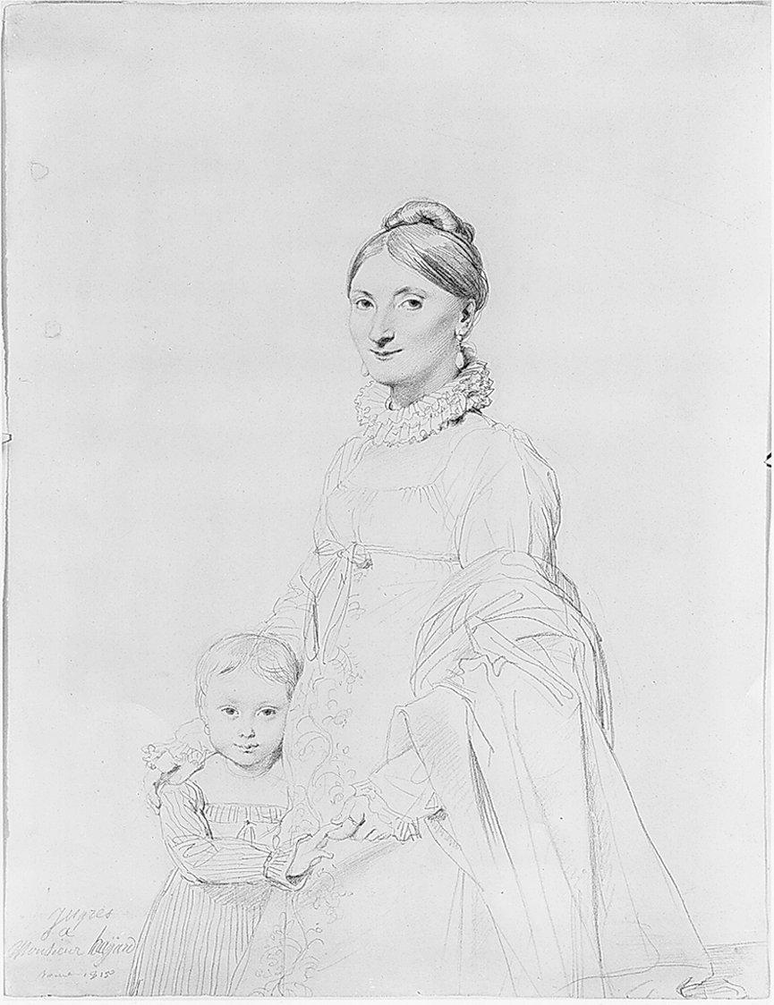
Contour and Gesture
Precision or Spontaneity?
Two Types of Drawing:
Contour Line - used to define the outside of the form
Gesture – describing the shape is less important then showing the dynamics or action of a pose.
Jean-Auguste-Dominique Ingres. Portrait of Mme. Hayard and Her Daughter Caroline. 1815. Graphite on white wove paper, 11 1/2” 8 11/16” (29.2 x 22 cm). University of Harvard Art Museums, Fogg Art Museum (bequest of Grenville L. Winthrop) (1943.843).

Slide 13
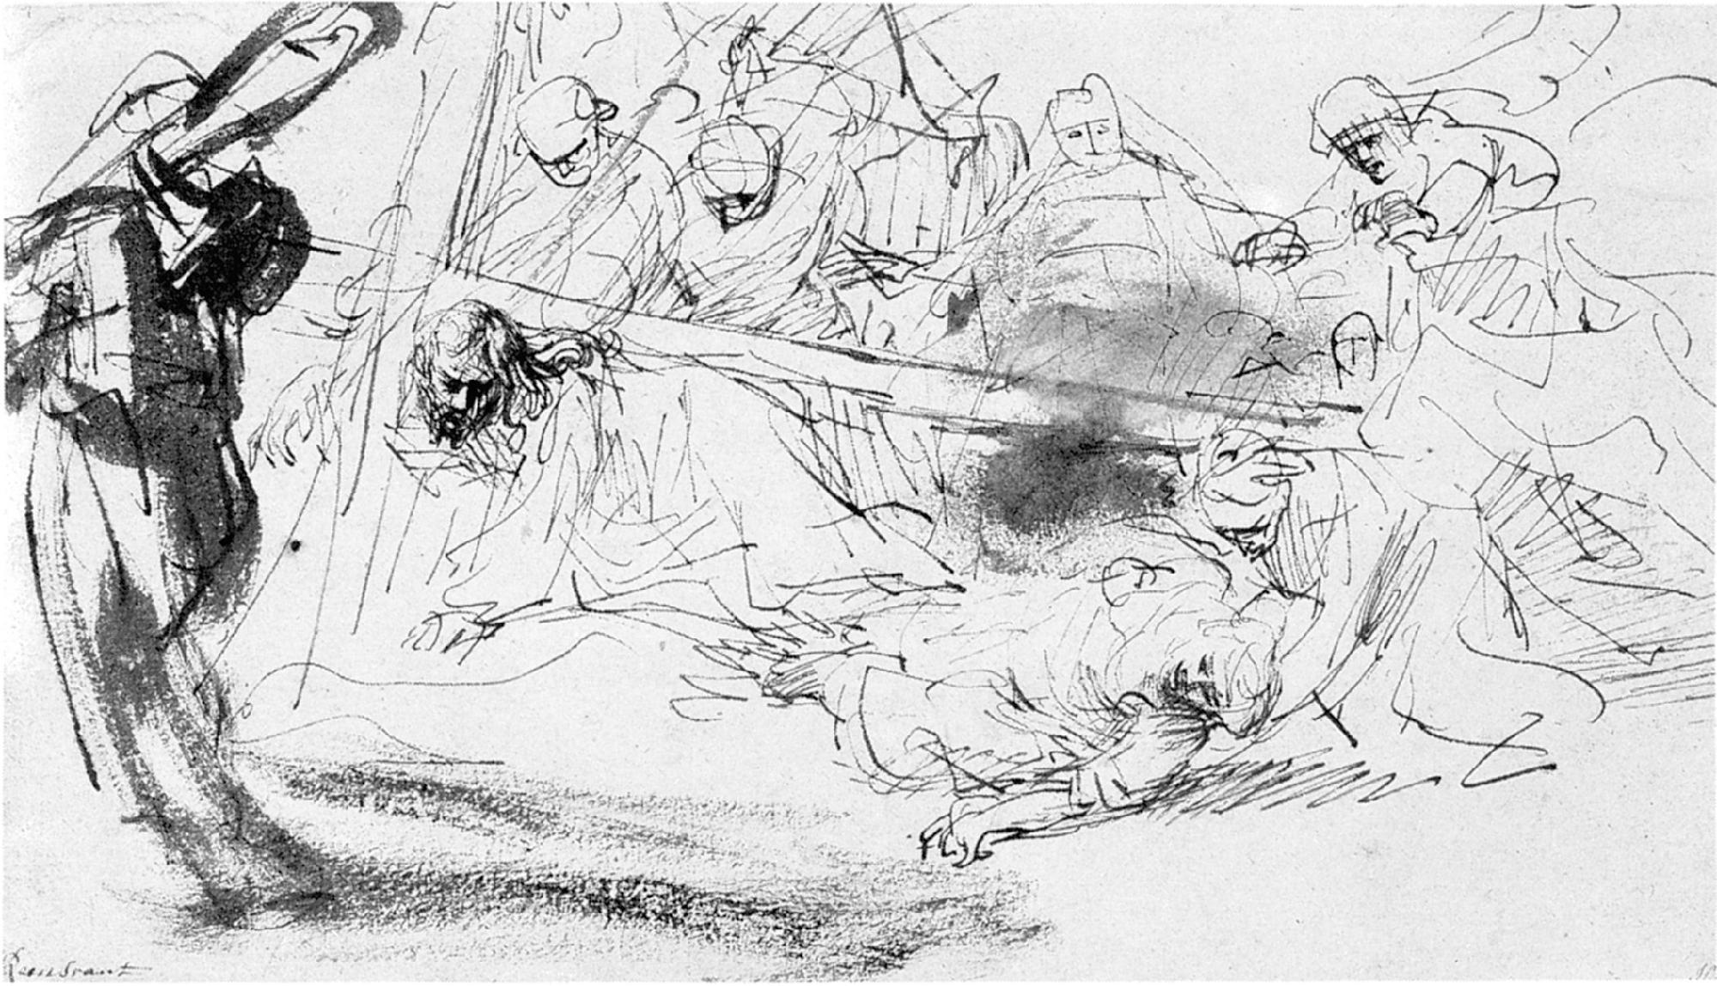
Combining Styles
You don’t have to just use contour or gesture; you can combine the two for a very different feel.
C Rembrandt. Christ Carrying the Cross. c. 1635. Pen and ink with wash, 5 5/8” x 10 1/8” (14 x 26 cm). Kupferstichkabinett, Staatliche Museen, Berlin.

Slide 14
Line Quality
Creating Variety and Emphasis
There are infinite possibilities in line!
Things to Vary:
Volume – line can be used to imply volume or 3-dimensional depth in an object.
Line quality - Any one of a number of characteristics of line determined by its weight, direction, uniformity or other features.

Slide 15
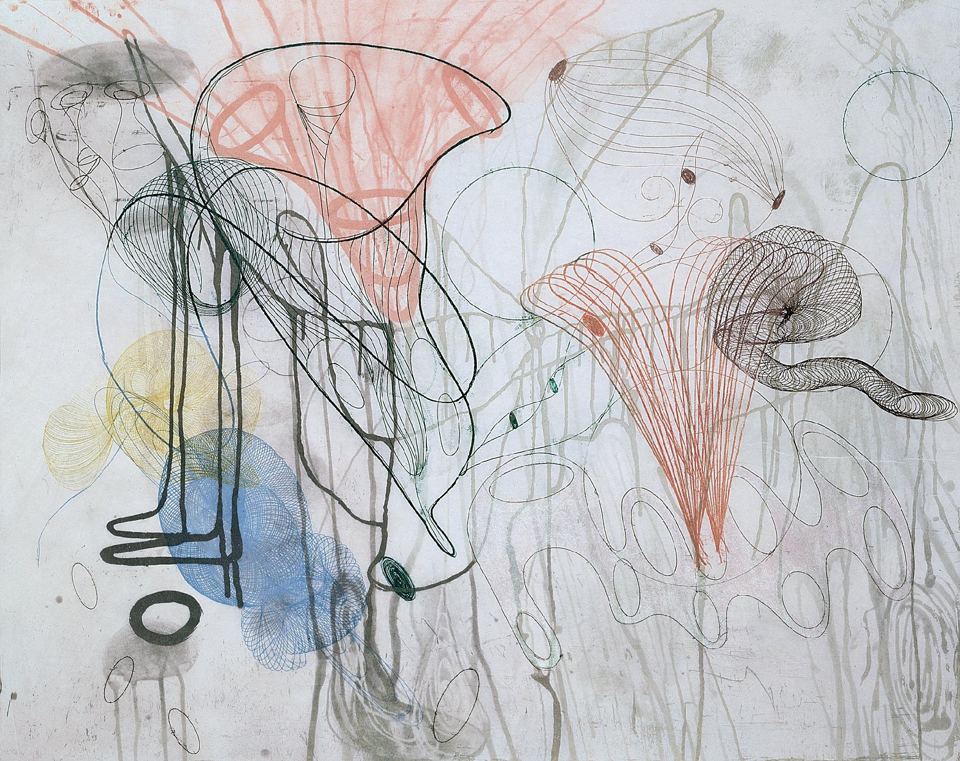
Expressing Mood and Motion
The quality of a line can imply a mood or emotion.
Types of line:
Thick (heavy)
Thin (delicate)
Rough
Smooth
Judy Pfaff. Che Cosa Acqua from Half a Dozen of the Other. 1992. Color drypoint with spit bite and sugar lift aquatints, and soft ground etching, 3’ x 3’ 9” on 3’ 6 7/8” x 4’ 2 3/4” sheet. Edition of 20. Printed by Lawrence Hamlin.

Slide 16
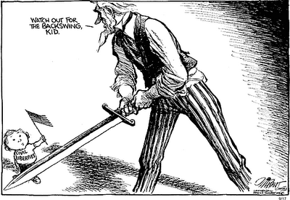
Line as Value
You can use lines to create dark and light.
Tip: An outlined shape is essentially flat.
A Oliphant. © 2001 Universal Press Syndicate.
Reprinted with permission. All rights reserved.

Slide 17
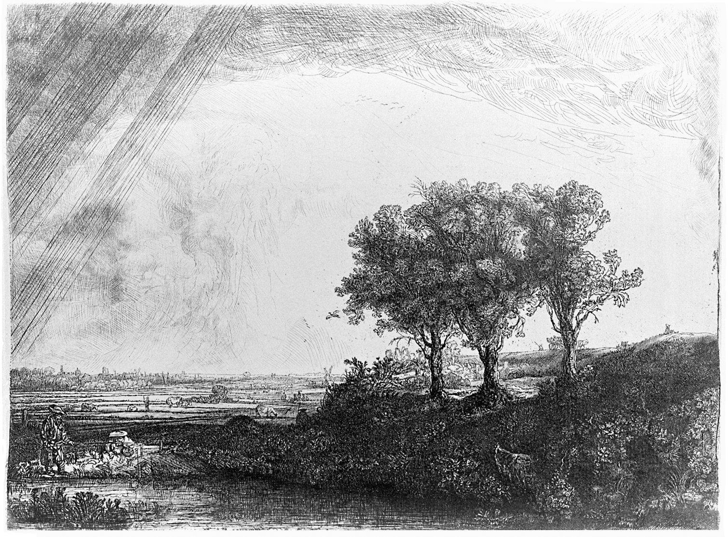
Cross Hatching
Cross-hatching - Crisscrossed lines often used for shading.
Tip: To create gray, place a series of lines close together, the closer the lines are together the darker it appears.
This can also be used to create a 3-dimensional quality.
B Rembrandt. The Three Trees. 1643. Etching with drypoint and burin, only state. Courtesy of Wetmore Print Collection of Connecticut College.

Slide 18
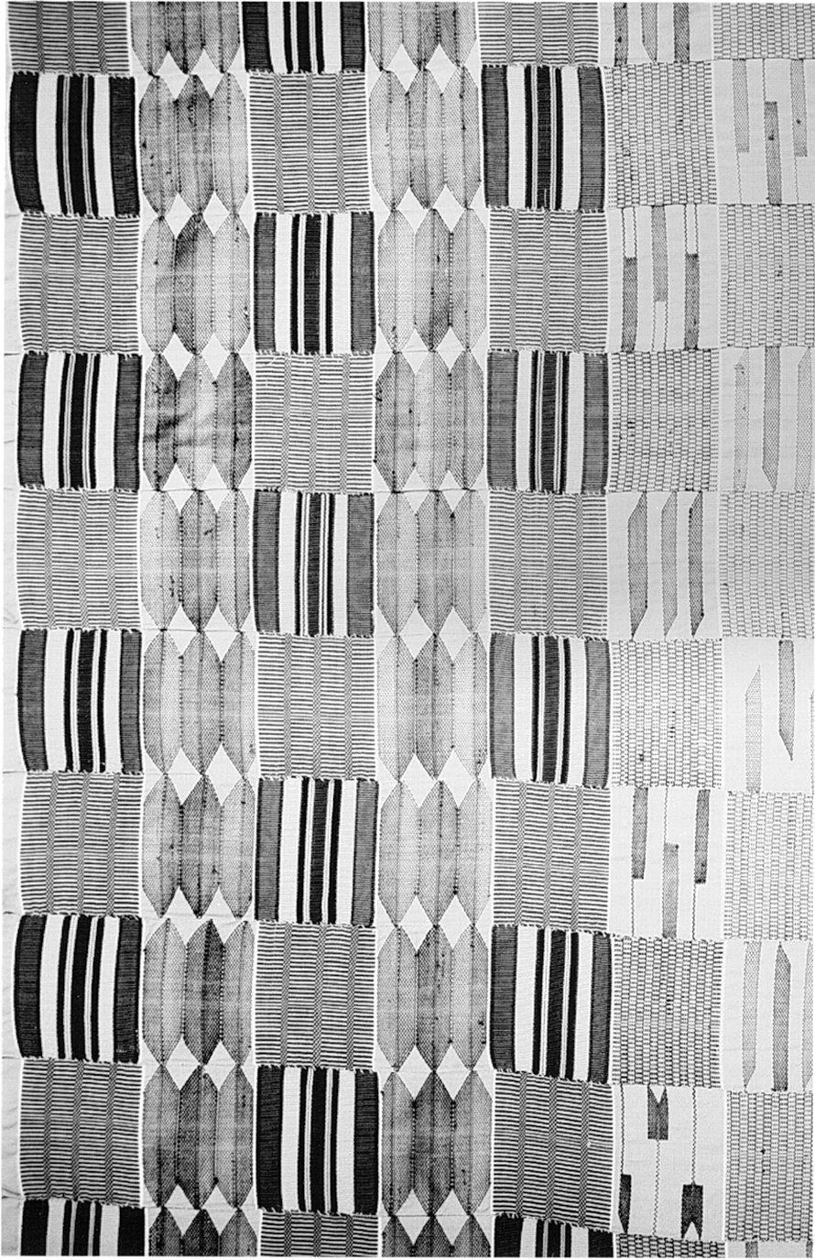
Applying Line as Value to Textiles
Line is obviously used in the form of string and stitches in fabric to create pattern and texture.
C West African Kente cloth. No date. Cotton, 6’ 10 1/4” x 11’ 1/2” (23 × 3.5 m). Anacostia Community Museum, Smithsonian Institution, Washington, D.C.

Slide 19
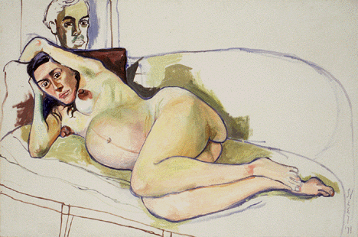
Line in Painting
1. Outline of Forms
The type of line used in a painting can really effect the impression of the overall image.
The impact of dark, bold lines has been used to illustrate weight.

Slide 20
Adapting Techniques to Theme
Line quality should reflect the theme and emotion that you want to depict in your image.
Dark Line Technique
Using a dark outline in a design can add emphasis

Slide 21
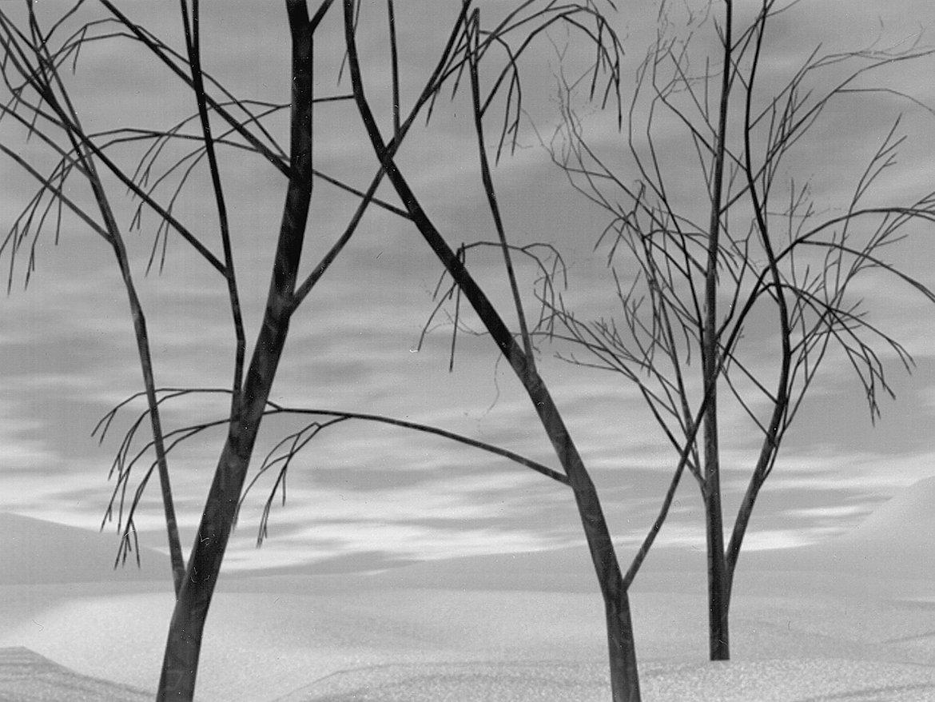
Explicit Line
Defining Shapes and Forms
Linear Painting is distinguished by the clarity of line; an emphasis on edges creates explicit lines.
A Janet Lucroy. Computer-generated image.

Slide 22
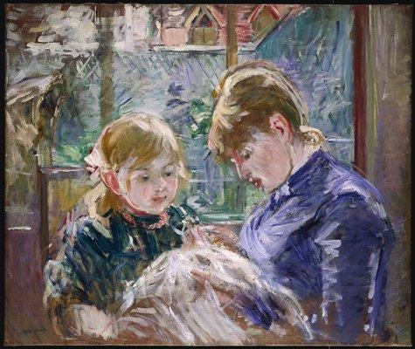
Applying Color
Impressionism - An artistic style that sought to recreate the artist’s perception of the changing quality of light and color in nature.
C Berthe Morisot. The Artist’s Daughter, Julie, with her Nanny. c. 1884. Oil on canvas, 1’ 11” x 2’ 4”. The Minneapolis Institute of Arts (John R. Van Derlip Fund).

Slide 23
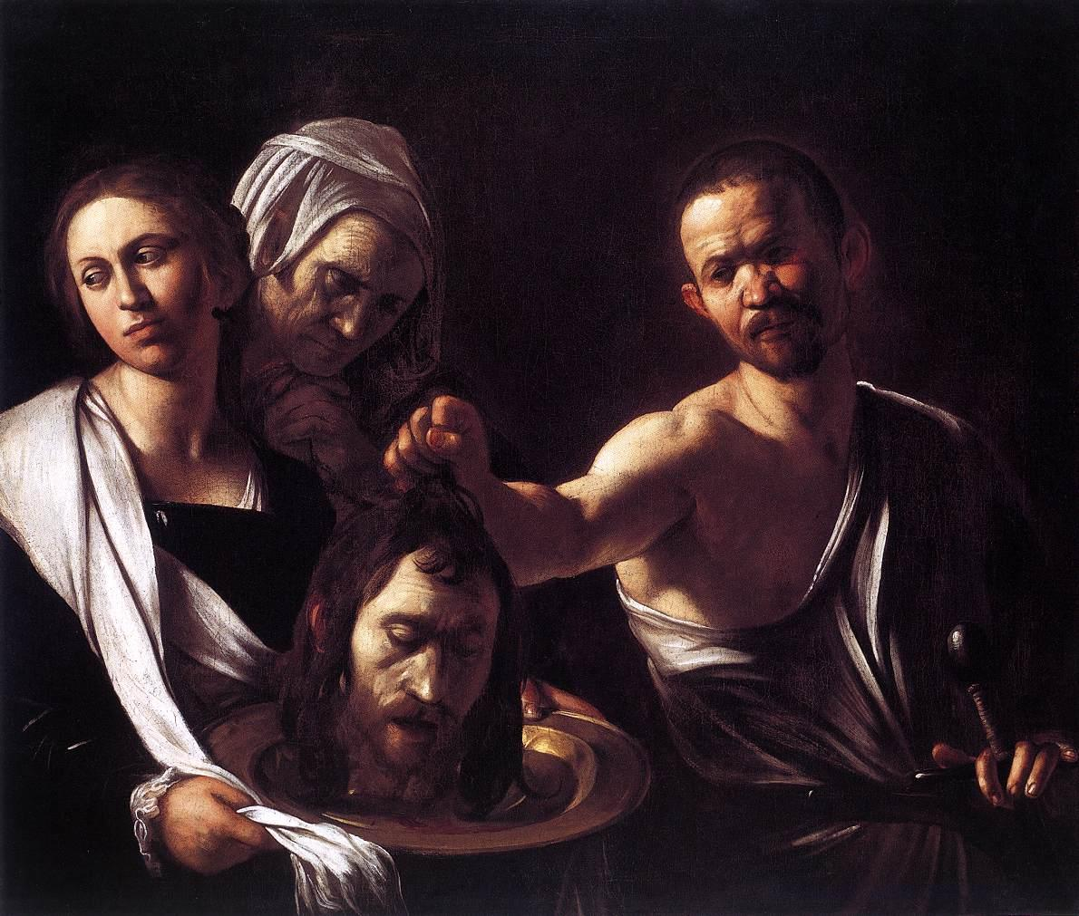
Lost-and-found Contour
One part of the body is revealed by sharp contour, but the edge then disappears into a mysterious darkness.
Also called Chiaroscuro
A Caravaggio. Salome with the Head of John the Baptist. c. 1609. Oil on canvas, 116 x 140 cm. National Gallery, London, Great Britain.

Slide 24
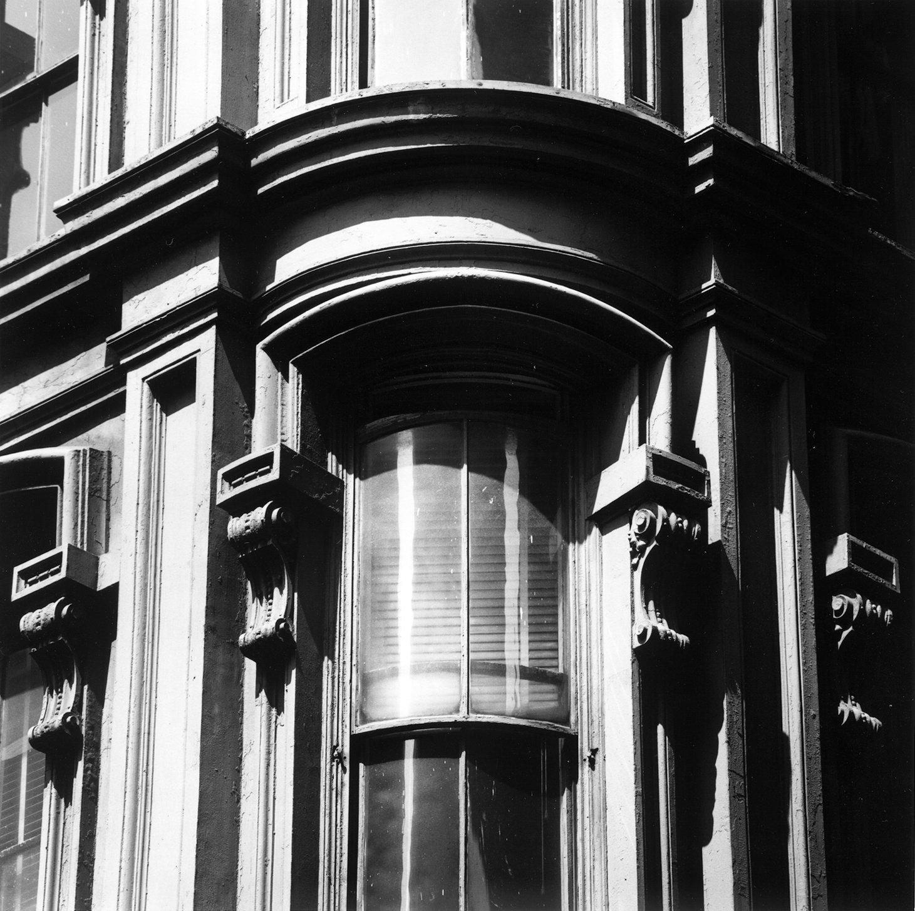
Suggestions of Form
Relative Clarity
A strong line, contour line, provides clear outlines and edges.
Lost-and-Found contour may give less clear outlines and edges, but this is in fact closer to the way we really see things.
Mark Feldstein. Untitled. Photograph.

Slide 25
Selected Lighting
“Photographers often chose the lighting for a subject to exploit the emotional and expressive effects of lost-and-found contour.”
In other words, photographers use lighting that they set up to influence how you feel about the picture, or enhance the look of the subject.
Mark Feldstein. Untitled. Photograph.

Slide 26
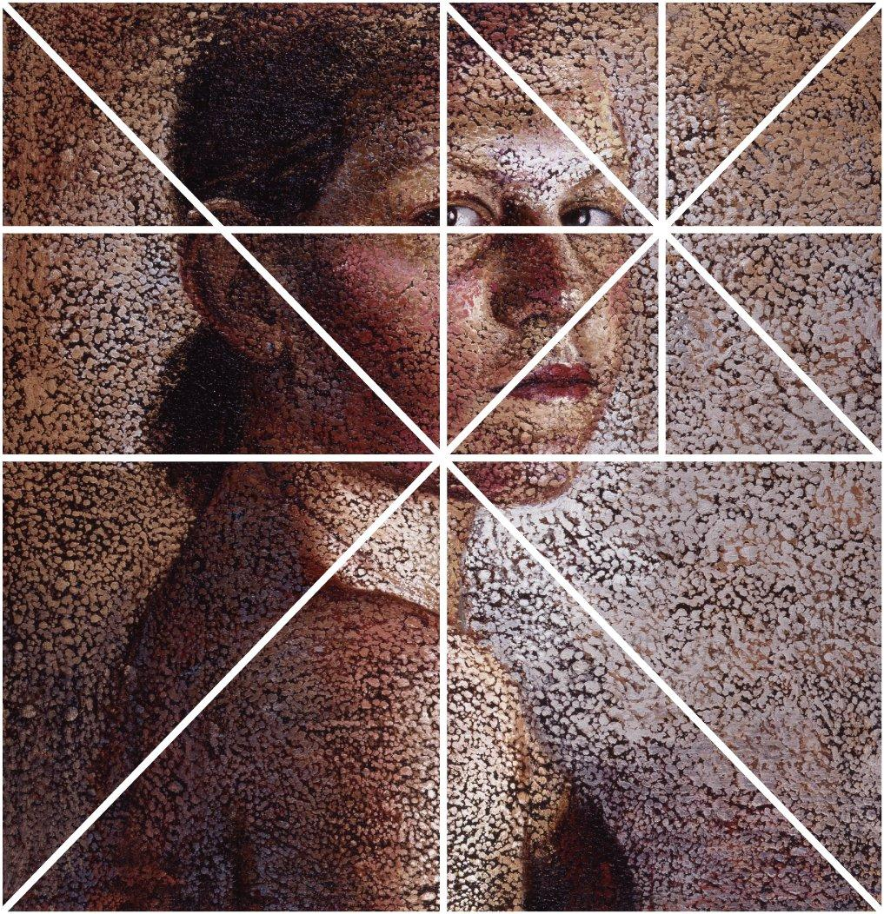
Inherent Line
Structure of the Rectangle
When you divide up a rectangular space you get get more rectangles, triangles and line!
Discuss the compositional analysis of the following image:
A Susan Moore. Vanity (Portrait 1). 2000. Oil stick on canvas, 4’ x 3’ 11”. Diagram.

