Slide 1
Reduction Block Printing

Slide 2
Reduction Block Printing
Always print from light to dark.
Plan ahead.
Tear down enough paper-10-12 pieces.
Consider your registration process.
Is your design simple enough to complete within the time constraints of the project?
Which colors help your images convey your concept?

Slide 3
Draw on the block with a sharpie marker. Remember-it will print backwards.

Slide 4
Cut away everything you designed to be the color of your paper. If you are cutting wood, coat block with 1 thin layer of poly-acrylic varnish.

Slide 5
Print your lightest color first. You will need to make 10-12 prints of this color.

Slide 6
Clean your block of ink. Cut away everything you want to stay your lightest color. If you are cutting wood, coat again with a thin layer of poly-acrylic varnish

Slide 7
Print on all 10-12 printed papers your second (middle toned) color.

Slide 8
Clean your block of ink. Cut away everything you want to remain your 2nd middle toned color. If you are cutting wood, apply a thin layer of poly-acrylic varnish.

Slide 9
Print on all 10-12 printed papers your last and darkest ink color per your design.

Slide 10
Third Cut
First Cut
Second Cut

Slide 11
Second Printed Color
Third Printed Color
First Printed Color

Slide 12
The Power of Propaganda Project
3 or more color
Reduction block edition

Slide 13
Power of Propaganda
What is Propaganda?
Information that is spread for the purpose of promoting some cause.
Official government communications to the public that are designed to influence opinion. The information may be true or false, but it is always carefully selected for its political effect.
The systematic propagation of a doctrine or cause or of information reflecting the views and interests of those advocating such a doctrine or cause.
Material disseminated by the advocates or opponents of a doctrine or cause: wartime propaganda.

Slide 14
Power of Propaganda
Choose a cause or point of view and create your own work of propaganda without the use of text.
IMAGES only…no words should sway your viewer.
Look to preexisting works from history as guidance.
Do preliminary sketches in your sketchbook.
You must use a minimum of 3 colors.
Consider the objects within your composition and the meaning of them and the visual and symbolic weight they may hold.
Research, sketch, carve, proof, and print!

Slide 15
Historical Examples

Slide 22
Contemporary Examples

Slide 33
Student Examples

Slide 35
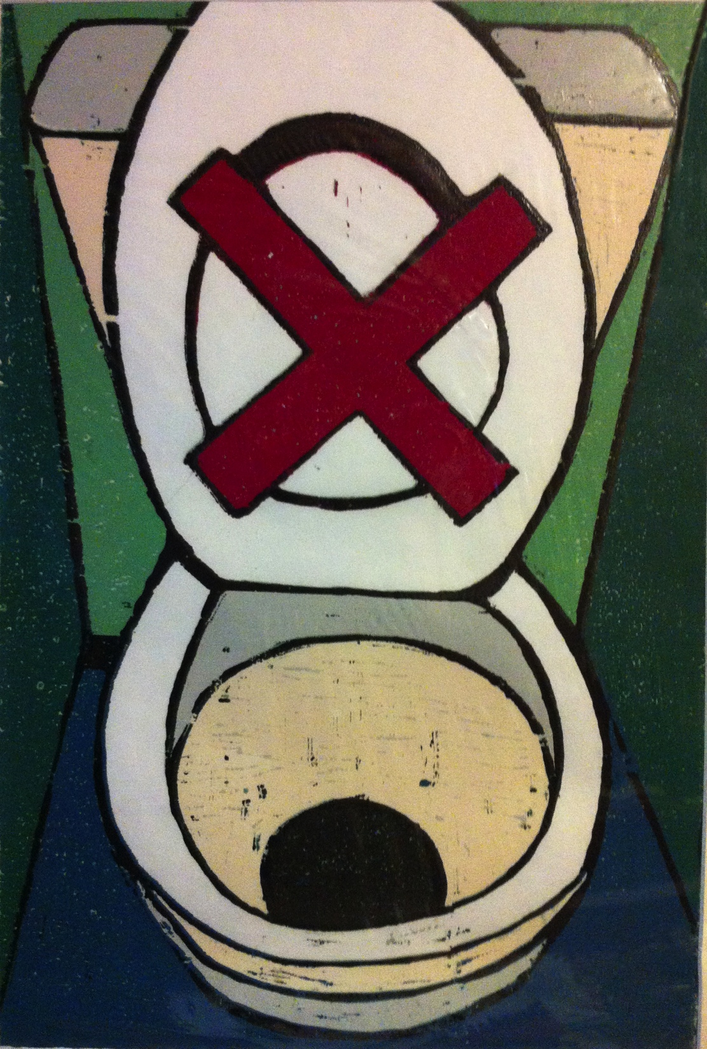

Slide 36
