Slide 1
ENVIRONMENTAL SCIENCE
A Study of Interrelationships
15th Edition
Environmental Interrelationships
Chapter 1
©2019 McGraw-Hill Education. All rights reserved. Authorized only for instructor use in the classroom. No reproduction or further distribution permitted without the prior written consent of McGraw-Hill Education.

Slide 2
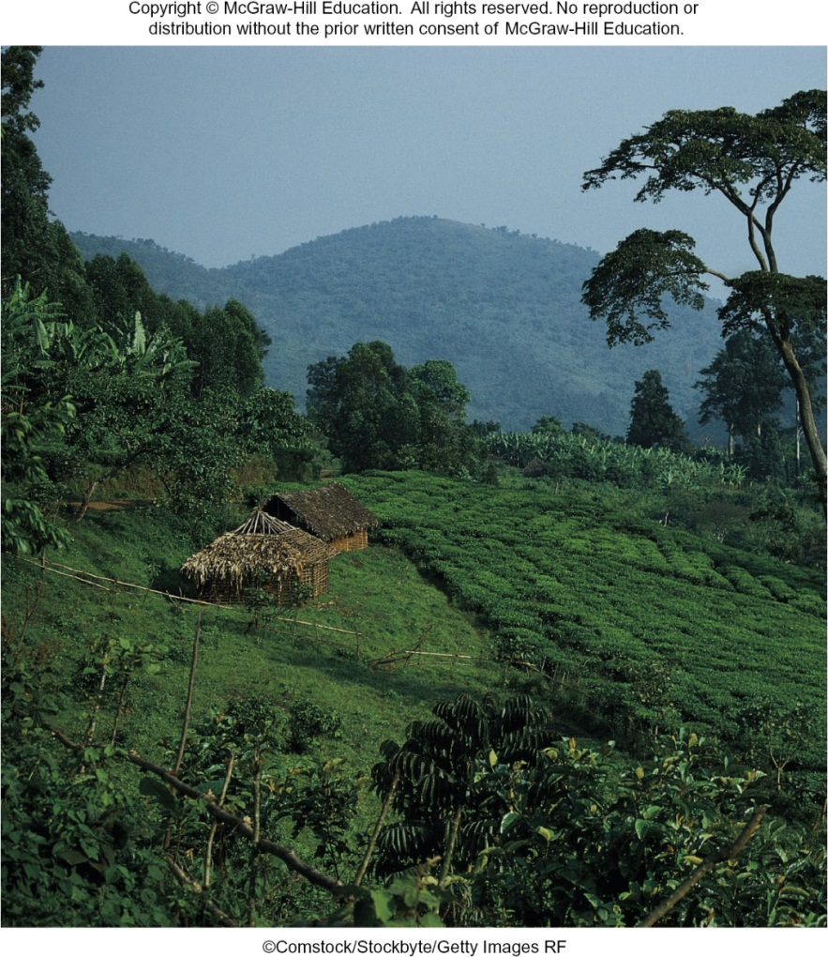
Outline
1.1 The Nature of Environmental Science
1.2 Emerging Global Issues

Slide 3
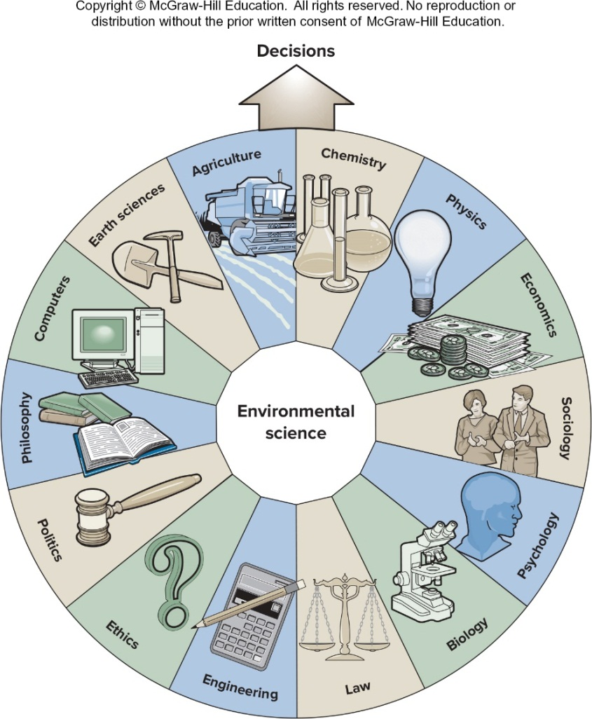
1.1 The Nature of Environmental Science
Environmental science is interdisciplinary, and includes scientific and social aspects of human impact on the world.
Environment is everything that affects an organism during its lifetime.

Slide 4
Interrelatedness Is a Core Concept (1 of 3)
The initial introduction of 31 wolves in 1995 and 1996 has resulted in a current population of about 100 wolves.
The reintroduction of wolves to Yellowstone National Park has resulted in many changes:

Slide 5
Interrelatedness Is a Core Concept (2 of 3)
Yellowstone National Park is a story that illustrates the point made by the early naturalist John Muir (1838—1914):
-Tug on anything at all and you’ll find it connected to everything else in the universe.

Slide 6
Interrelatedness Is a Core Concept (3 of 3)
This interrelatedness theme does not just relate to wildlife and plant actors.
There is an important human-dominated drama as well; one that involves philosophical, economic, and political actors.
Who might oppose wolf reintroduction, and why?

Slide 7
An Ecosystem Approach
An ecosystem is a region in which the organisms and the physical environment form an interacting unit.
The task of an environmental scientist is to:
Recognize and understand the natural interactions that take place, and
Integrate these natural interactions with the uses humans must make of the natural world.

Slide 8
Political and Economic Issues
Environmental problems do not necessarily coincide with these artificial human made political boundaries.
Air pollution generated in China affects air quality in western coastal states in the United States and in British Columbia, Canada.
Air pollution generated in Juarez, Mexico, causes problems in the neighboring city of El Paso, Texas.

Slide 9
1.2 Emerging Global Issues
“Humanity has the ability to make development sustainable.”
— World Commission on Environment and Development (Brundtland Commission)

Slide 10
Population Growth
Most of the increase in population is occurring in poor countries.
This growth puts pressure on resources and leads to the degrading of the environment and often locks people in a cycle of poverty.

Slide 11
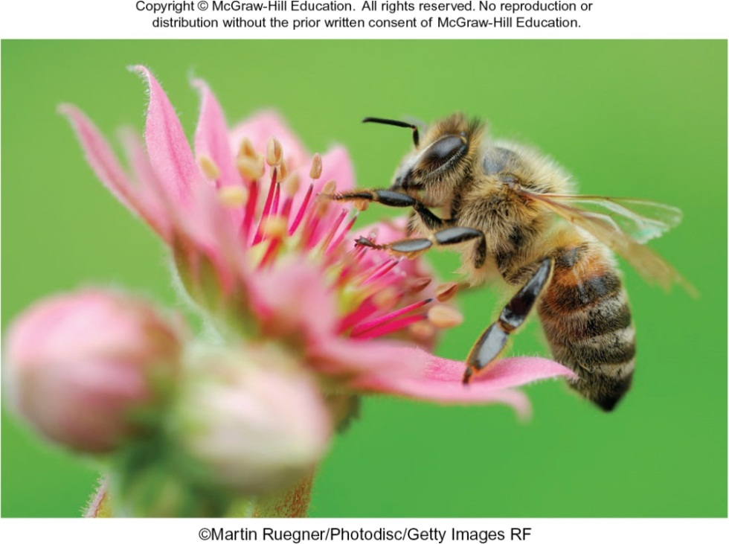
Maintaining Functional Ecosystems
Much of the Earth’s surface has been converted to agricultural use.
The accompanying loss of biodiversity and functional ecosystems has profound economic consequences.

Slide 12
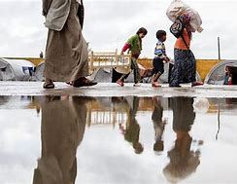
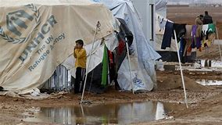
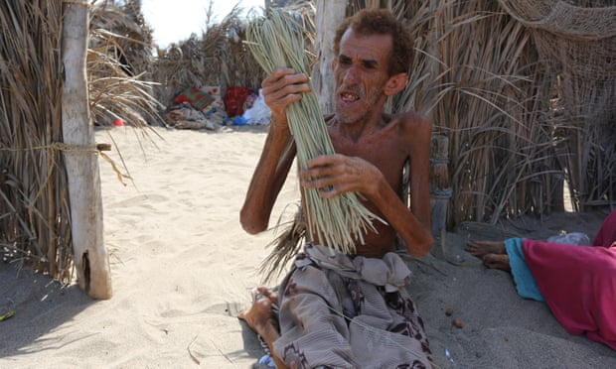
Food Security
The poor of the world rely on the food they grow to feed their families.
Floods, outbreaks of disease in animals or crops, conflict often result in a lack of food and malnutrition.

Slide 13
Environmental Governance (1 of 2)
Real progress toward sustainable development has been slow.
Strategies for economic development often ignore the need to maintain the ecosystem on which long-term development goals depend.

Slide 14
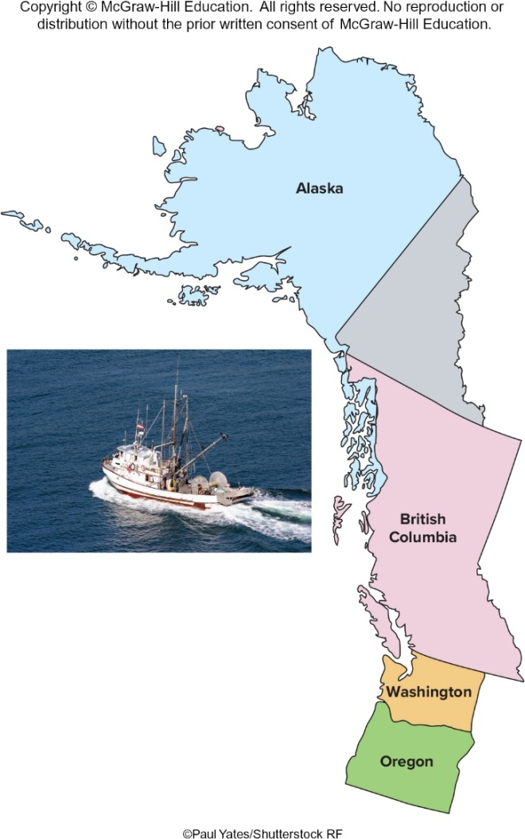
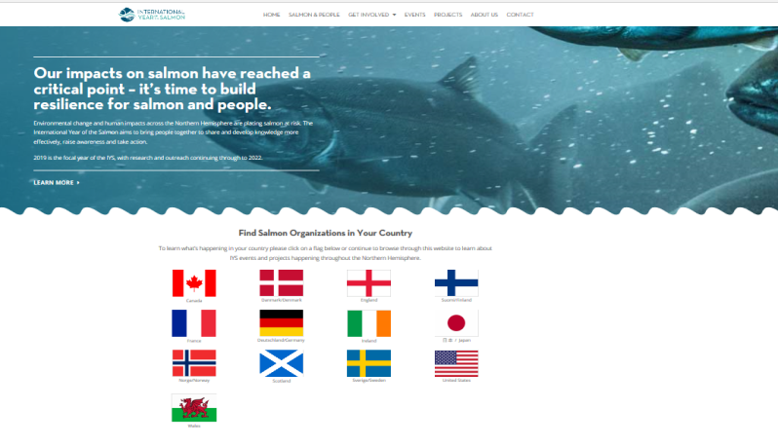
Environmental Governance (2 of 2)
Regulation of salmon fishing in the Northwest involves several states and the Canadian province of British Columbia.
https://yearofthesalmon.org/
Japan says it will resume commercial whaling in July 2019
Japan will withdraw from the International Whaling Commission (IWC) and resume commercial whaling from July, said Chief Cabinet Secretary Yoshihide Suga on Wednesday.
Commercial whaling will be limited to Japan's own territorial waters and its exclusive economic zone, Suga said.
The announcement drew criticisms: Australia said it was "extremely disappointed" and New Zealand said it regretted the resumption of the "outdated and unnecessary" commercial killing of the ocean mammals.
Published 1:59 AM ET Wed, 26 Dec 2018 Reuters

Slide 15
Environment and Health (1 of 4)
A major effort must be made to increase the productivity — the yield per hectare — of nutrient-rich foods such as fruits, vegetables, nuts, seeds and beans. By enhancing their productivity, we’ll make them more available and affordable. And we’ll see the benefits in a diminished obesity crisis and fewer victims of micronutrient deficiencies.
By Gerald C. Nelson, January 2, 2019, Washington Post.

Slide 16
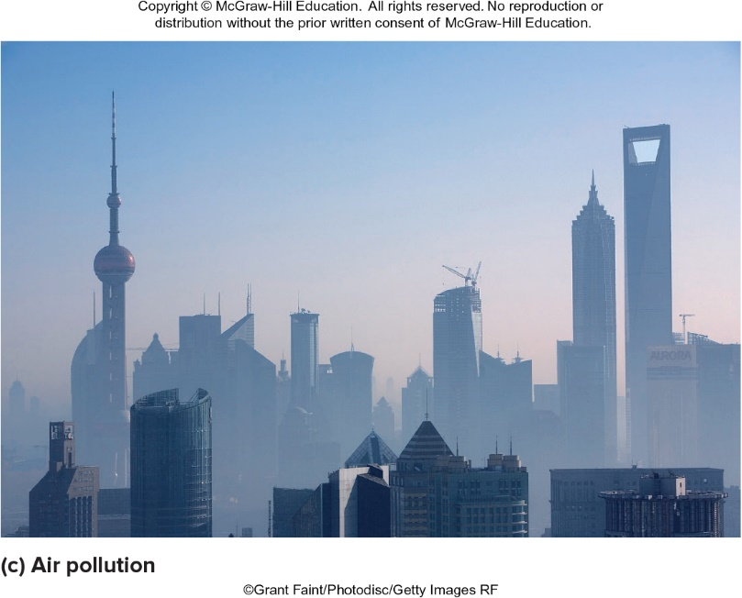
Environment and Health (2 of 4)
Air Quality

Slide 17
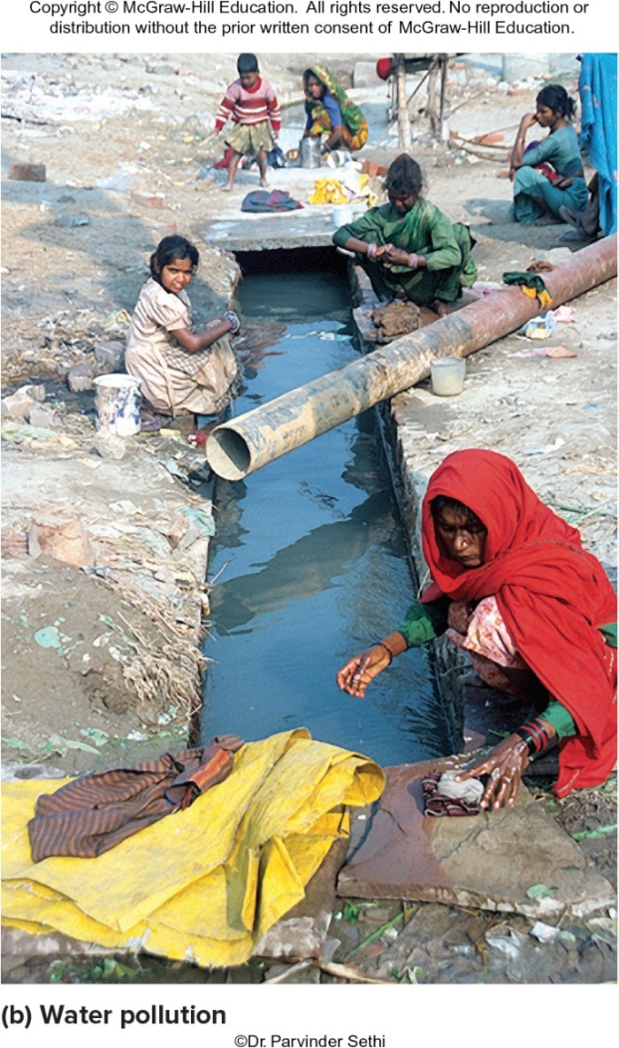
Environment and Health (3 of 4)
Water Quality

Slide 18
Environment and Health (4 of 4)
Malaria still results in over 400,000 deaths per year.
Accidents in the home, workplace, and traffic cause about 5 million deaths per year.
Cancer and Coronary Heart Disease cause about 25 million deaths per year.
Emerging Diseases result from new organisms or those that become a problem because of environmental changes.

Slide 19
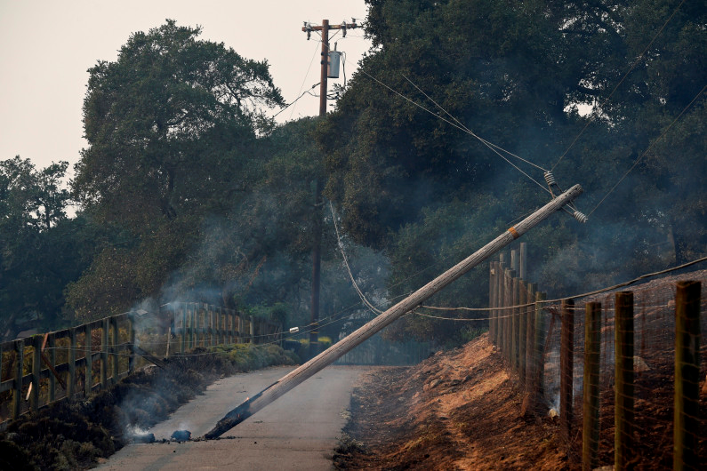
Environment and Security (1 of 3)
Security means having stable and reliable access to resources and the ability to be secure from natural and human disasters.
When access to natural resources and ecosystem services is threatened, conflict and social instability are common.
A downed power pole in Napa County in October 2017. Dozens of insurance companies have filed a lawsuit against PG&E in connection with the company’s role in wildfires that scorched the North Bay wine country and nearby regions, litigation that intensifies the financial pressure on the embattled utility.
By George Avalos | gavalos@bayareanewsgroup.com | Bay Area News Group
PUBLISHED: April 16, 2018 at 3:53 pm | UPDATED: April 17, 2018 at 5:01 am, The Mercury News.

Slide 20
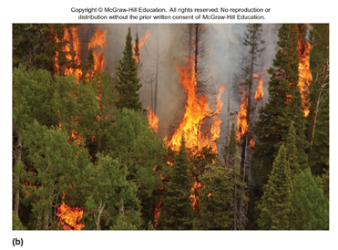
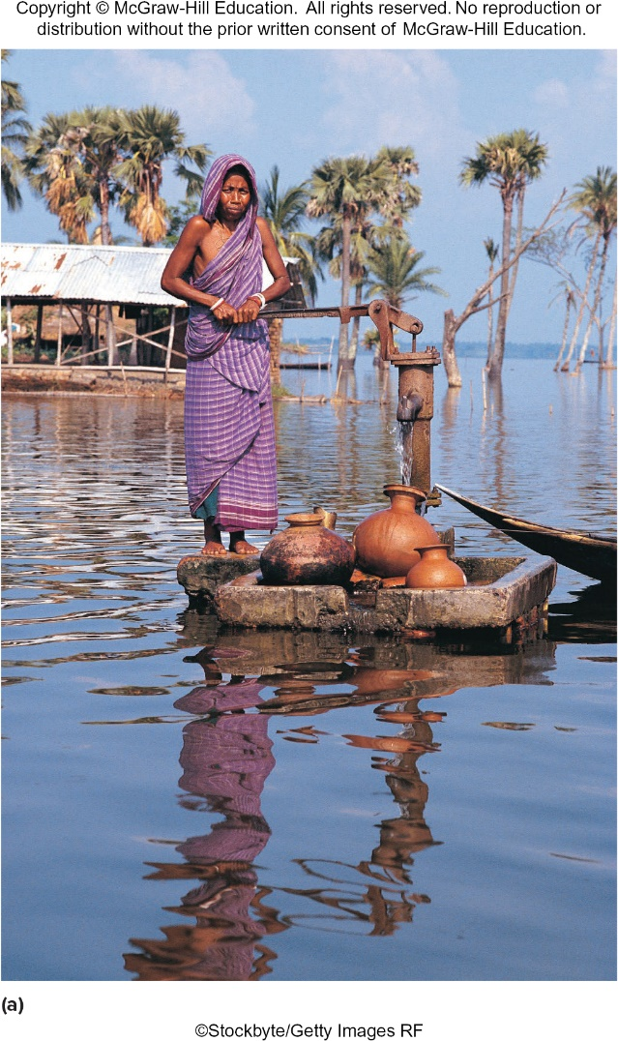
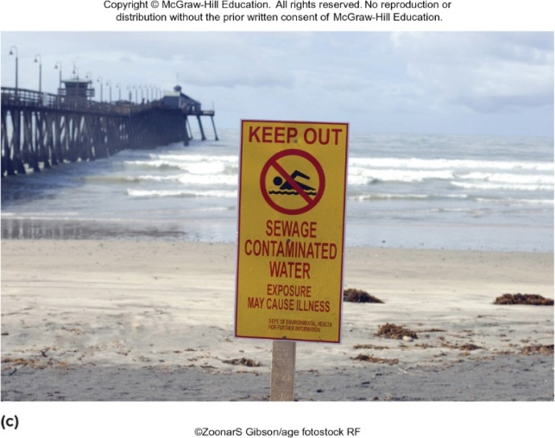
Environment and Security (2 of 3)
Source: Andrea Booher/FEMA News Photo

Slide 21
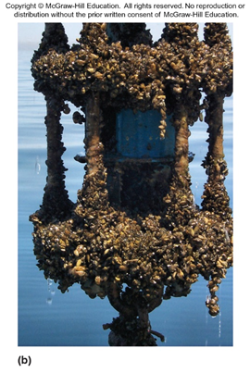
Environment and Security (3 of 3)
Globalization of trade has led to the spread of exotic species.
Zebra Mussel in North America
Source: NOAA

Slide 22
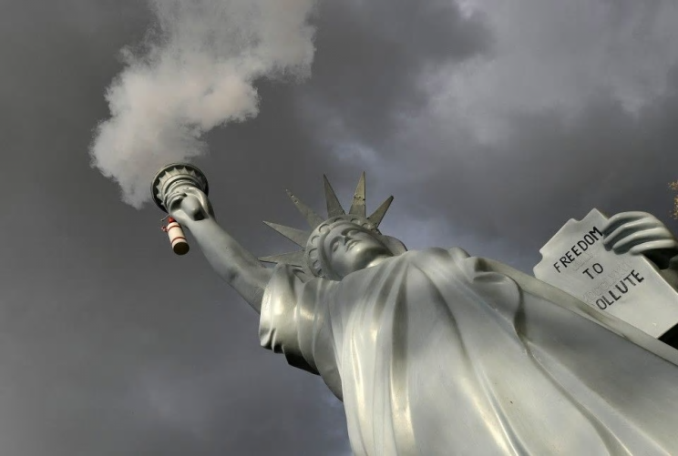
Environment and Globalization
In 1997, representatives from 125 nations met in Kyoto, Japan for the Third Conference of the United Nations Framework Convention on Climate Change.
The Kyoto Protocol is viewed as one of the most important steps to date in environmental protection and international diplomacy.
Trump’s withdrawal from the Paris agreement means other countries will spend less to fight climate change.
A replica of the Statue of Liberty by Danish artist Jens Galschiot emits smoke in a park outside the 23rd U.N. Conference of the Parties climate talks in Bonn, Germany, on Nov. 17. (Martin Meissner/AP). By Johannes Urpelainen
November 21, 2017, Washington Post

Slide 23
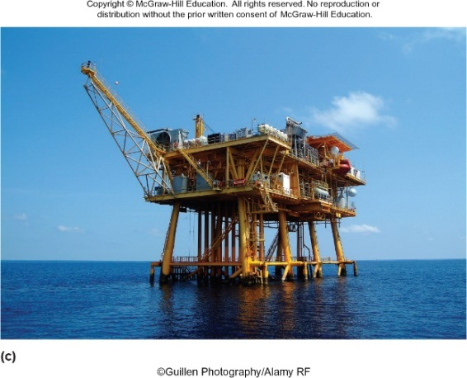
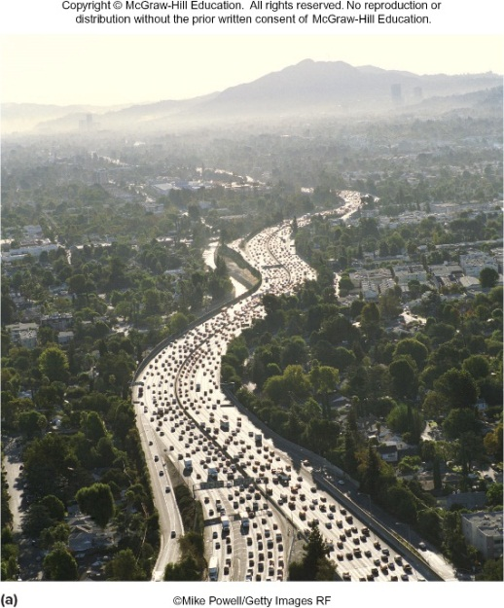
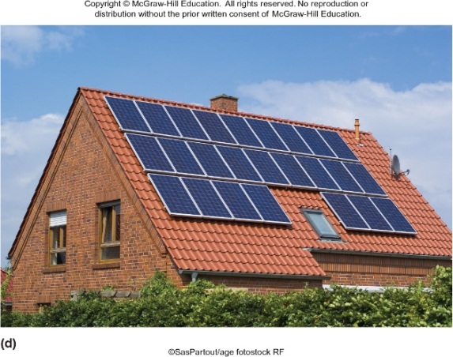
Energy and the Environment (1 of 2)
The world is facing twin threats: inadequate and insecure supplies of energy at affordable prices, and environmental damage due to overconsumption of energy.

Slide 24
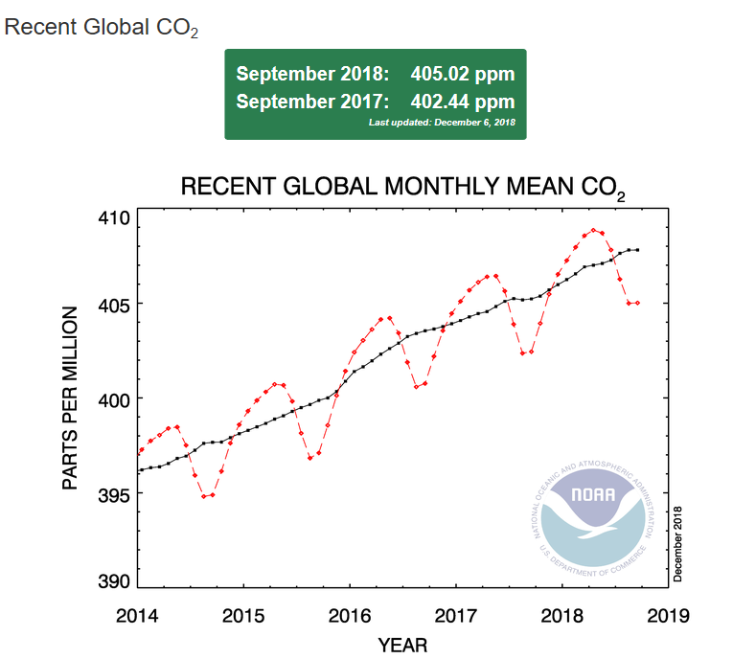
Energy and the Environment (2 of 2)
Global increases in carbon dioxide emissions are primarily due to fossil fuel use.
The need to curb growth in energy demand, increase fuel supply diversity, and mitigate climate destabilizing emissions is more urgent than ever.
https://www.esrl.noaa.gov/gmd/ccgg/trends/global.html#global

Slide 25
10 Things You Can Do to Protect Your Environment
Reduce driving
Save electricity
Recycle
Conserve water
Safely dispose of hazardous waste
Eat locally
Donate reusable items
Buy in bulk
Read product labels
Become an informed, active citizen

Slide 26
Summary
Environmental science involves the interrelationships among science, economics, ethics, and politics in arriving at solutions to environmental problems.
The concept of sustainability requires that we consider future generations when we make decisions about how to use resources.
This presents problems with how governments cooperate to assure that their citizens can be healthy, secure, and adequately fed, without compromising the environment that supports them.
Energy use continues to be a major issue related to sustainability.

