Slide 1
ENVIRONMENTAL SCIENCE
A Study of Interrelationships
15th Edition
Interrelated Scientific Principles: Matter, Energy, and Environment
Chapter 4
©2019 McGraw-Hill Education. All rights reserved. Authorized only for instructor use in the classroom. No reproduction or further distribution permitted without the prior written consent of McGraw-Hill Education.

Slide 2
Outline
4.1 The Nature of Science
4.2 Limitations of Science
4.3 Pseudoscience
4.4 The Structure of Matter
4.5 Energy Principles
4.6 Environmental Implications of Energy Flow

Slide 3
Wood Stoves and Air Pollution: A Cause and Effect Relationship
Smoke contains harmful pollutants
EPA set standards for wood stoves in 1990
However, three-quarters of the wood stoves in the U.S. were installed before 1990
Examples of community and state laws
Source: EPA, Burn Wise Campaign

Slide 4
4.1 The Nature of Science
Science is a process used to solve problems or develop an understanding of nature that involves testing possible answers.
The scientific method is a way of gaining information (facts) about the world by forming possible solutions to questions, followed by rigorous testing to determine if the proposed solutions are valid.

Slide 5
Basic Assumptions in Science
Specific causes exist for observed events.
These causes can be identified.
General rules or patterns can be used to describe observations.
Repeated events probably have the same cause.
Perceptions are not individualistic.
Fundamental rules of nature are universal.

Slide 6
Cause-and-Effect Relationships
Scientists distinguish between situations that are merely correlated (happen together) and those that are correlated and show cause-and-effect relationships.
Correlation ≠ Causation!

Slide 7
Elements of the Scientific Method (1 of 8)
The scientific method requires a systematic search for information and continual evaluation to determine if previous ideas are still supported.
Scientific ideas undergo constant reevaluation, criticism, and modification.

Slide 8
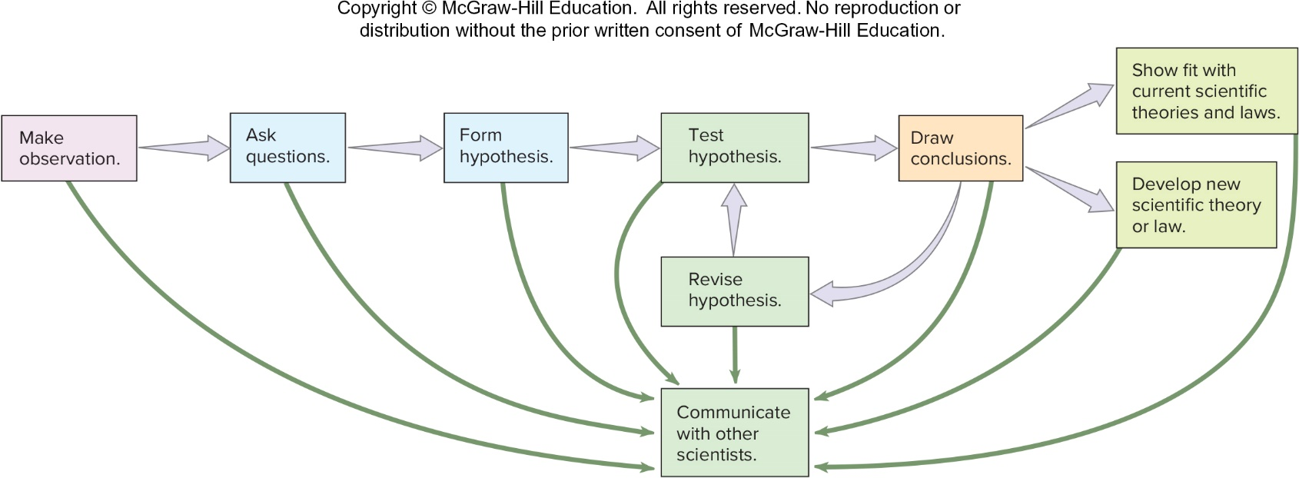
Elements of the Scientific Method (2 of 8)

Slide 9
Elements of the Scientific Method (3 of 8)
Observation occurs when we use our senses or extensions of our senses to record an event.
Scientists refer to observations as careful, thoughtful recognitions of events.
Observations often lead to additional questions about the observations.
The way questions are asked will determine how one goes about answering them.
Exploring other sources of knowledge is the next step to gain more information.

Slide 10
Elements of the Scientific Method (4 of 8)
A hypothesis is a testable statement that provides a possible answer to a question, or an explanation for an observation.
A good hypothesis must be logical, account for all relevant information currently available, allow prediction of related future events, and be testable.
Given a choice, the simplest hypothesis with the fewest assumptions is the most desirable.

Slide 11
Elements of the Scientific Method (5 of 8)
An experiment is a re-creation of an event that enables an investigator to support or disprove a hypothesis.
A controlled experiment divides the experiment into two groups (experimental and control) that differ by only one variable.
Reproducibility is important to the scientific method. A good experiment must be able to be repeated by independent investigators to ensure a lack of bias.

Slide 12
Elements of the Scientific Method (6 of 8)
When broad consensus exists about an area of science, it is known as a theory or law.
A theory is a widely accepted, plausible generalization about fundamental scientific concepts that explains why things happen.
A scientific law is a uniform or constant fact of nature that describes what happens in nature.

Slide 13
Elements of the Scientific Method (7 of 8)
Communication is a central characteristic of the scientific method.
An important part of the communication process involves the publication of articles in scientific journals about one’s research, thoughts, and opinions.
This provides other scientists with an opportunity to criticize, make suggestions, or agree.

Slide 14
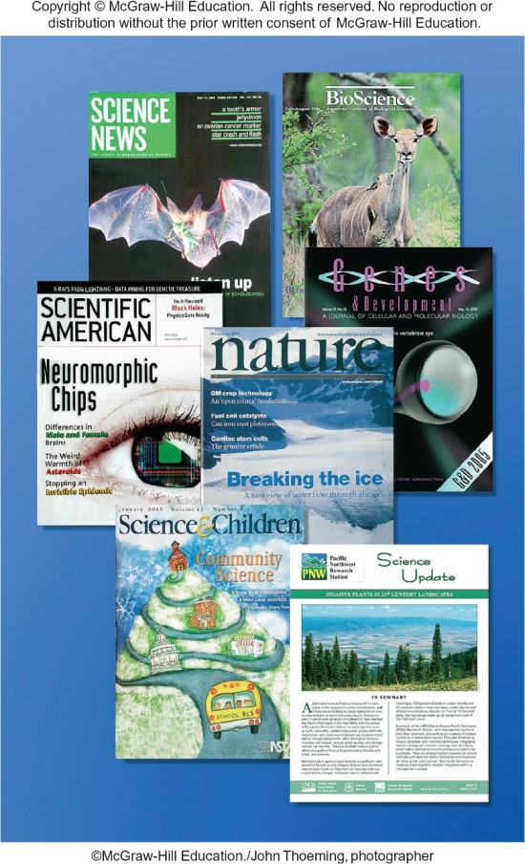
Elements of the Scientific Method (8 of 8)
Observation
Scientific inquiry often begins with an observation that an event has occurred.
Communication

Slide 15
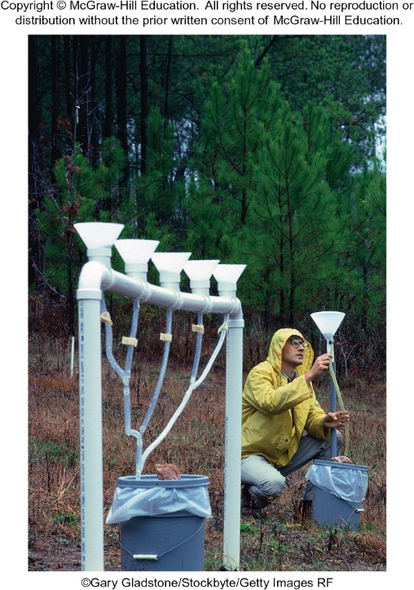
4.2 Limitations of Science
Scientists struggle with the same moral and ethical questions as other people.
It is important to differentiate between data collected during an investigation, and scientists’ opinions of what the data mean.
It is important to recognize that scientific knowledge can be used by different people to support opinions that may not be valid.

Slide 16
4.3 Pseudoscience
Pseudoscience is a deceptive practice that uses the appearance or language of science to convince, confuse, or mislead people into thinking that something has scientific validity when it does not.

Slide 17
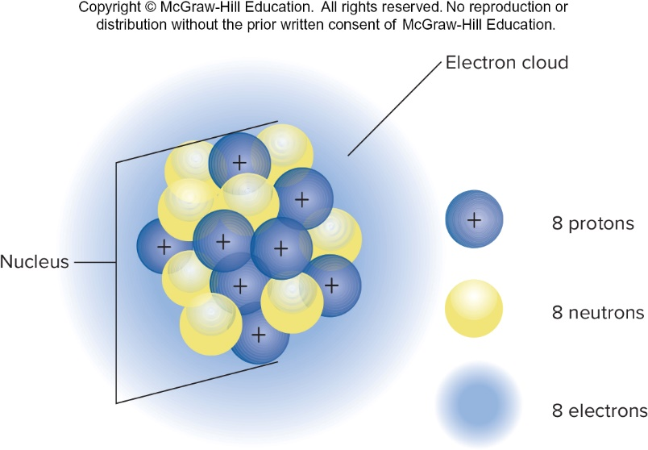
4.4 The Structure of Matter
Matter is anything that has mass and takes up space.
The kinetic molecular theory describes the structure and activity of matter.
It states that all matter is made up of one or more kinds of smaller sub-units (atoms) that are in constant motion.

Slide 18
Atomic Structure (1 of 2)
The atom is the fundamental unit of matter.
There are 92 types of atoms found in nature, with each being composed of:
Protons (Positively charged)
Neutrons (Neutral)
Electrons (Negatively charged)
Each kind of atom forms a specific type of matter known as an element.

Slide 19
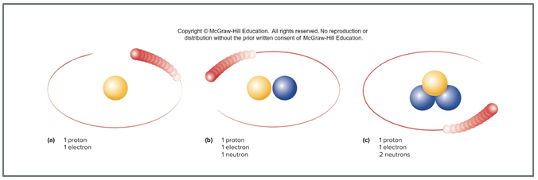
Atomic Structure (2 of 2)
All atoms of the same element have the same number of protons and electrons, but may vary in the number of neutrons.
Isotopes are atoms of the same element that differ from one another in the number of neutrons they contain.

Slide 20
The Molecular Nature of Matter (1 of 2)
Molecules are atoms bonded together into stable units.
Ions are electrically charged particles.
Atoms that lose electrons = positively charged
Atoms that gain electrons = negatively charged

Slide 21
The Molecular Nature of Matter (2 of 2)
Compounds are formed when two or more atoms or ions bind to one another.
Water (H₂O)
Table sugar (C₆H₁₂O₆)
Mixtures are variable combinations of atoms, ions, or molecules.
Honey (several sugars + water)
Concrete (cement, sand, and gravel)
Air (various gases including nitrogen and oxygen)

Slide 22
A Word About Water (1 of 2)
Water can exist in 3 phases: solid, liquid, and gas.
¾ of the Earth’s surface is covered with water.
Water determines the weather and climate of a region, and the flow of water and ice shape the Earth’s surface.
The most common molecule found in living things is water.

Slide 23
A Word About Water (2 of 2)
Water molecules are polar with positive and negative ends.
Unlike charges attract and water molecules tend to stick together.
Much energy is needed to separate water molecules and convert liquid water to vapor.
Thus, evaporation of water cools its surroundings.
Water is the universal solvent. Most things dissolve to some degree in it.

Slide 24
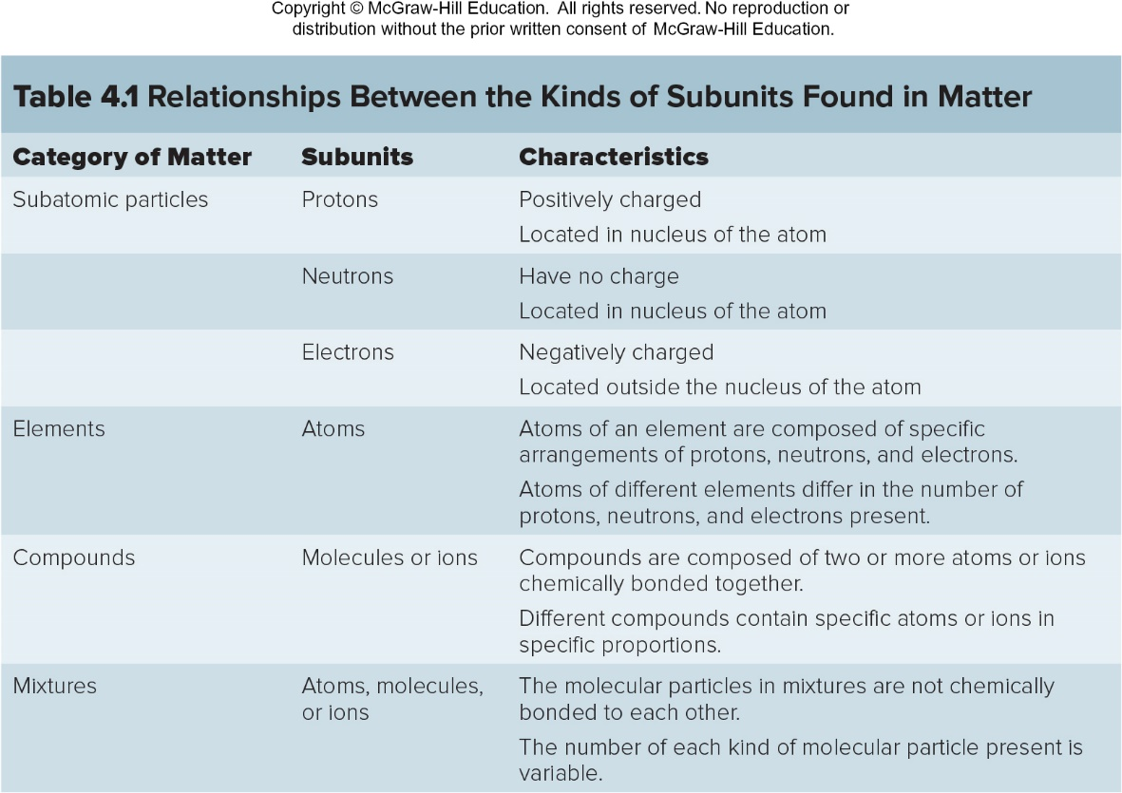
Relationships Between the Kinds of Subunits Found in Matter

Slide 25
Acids, Bases, and pH
An acid is any compound that releases hydrogen ions in a solution.
A base is any compound that accepts hydrogen ions in a solution.
The concentration of an acid or base solution is given by a number called its pH.
The pH scale measures hydrogen ion concentration.
The scale is inverse and logarithmic
7 = neutral
0-6 = acidic (fewer OH⁻ than H⁺)
8-14 = basic (more OH⁻ than H⁺)

Slide 26
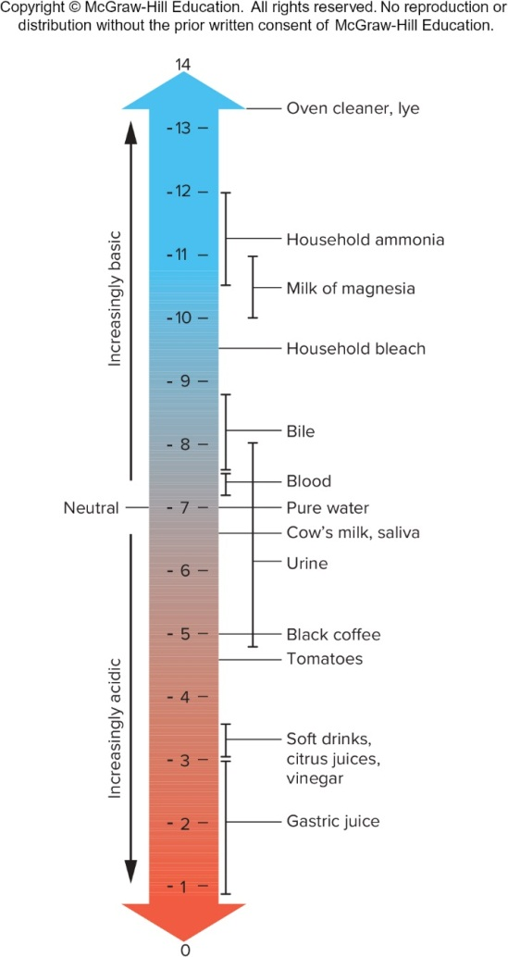
The pH Scale

Slide 27
Inorganic and Organic Matter
Organic matter consists of molecules that contain carbon atoms that are usually bonded to form rings or chains.
All living things contain molecules of organic compounds.
Typically, chemical bonds in organic molecules contain a large amount of chemical energy that can be released when the bonds are broken.

Slide 28
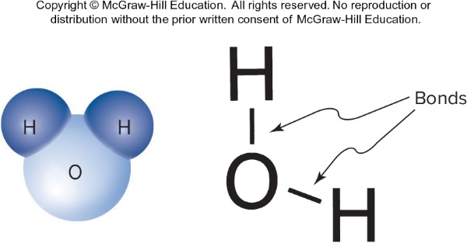
Chemical Reactions (1 of 2)
Chemical bonds are attractive forces between atoms resulting from the interaction of their electrons.
When chemical bonds are formed or broken, a chemical reaction occurs.
In exothermic reactions, chemical bonds in the new compounds contain less chemical energy than the previous compounds.
In endothermic reactions, the newly formed chemical bonds contain more energy than the previous compounds.

Slide 29
Chemical Reactions (2 of 2)
Activation energy is the initial input of energy required to start a reaction.
A catalyst is a substance that alters the rate of reaction, without being consumed or altered itself in the process.
Catalysts can reduce activation energy.
A catalytic converter in an automobile brings about more complete burning of fuel, resulting in less air pollution.

Slide 30
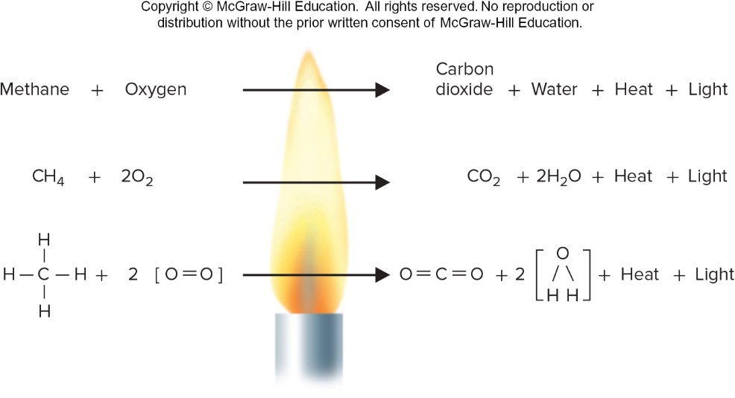
A Chemical Reaction

Slide 31
Chemical Reactions in Living Things (1 of 2)
Living organisms contain enzymes that reduce the activation energy needed to start reactions.
Photosynthesis is a process used by plants to convert inorganic material into organic material using light.
Carbon dioxide + water (in the presence of sunlight) produces glucose + oxygen.
6CO₂ + 6H₂O → C₆H₁₂O₆ + 6O₂

Slide 32
Chemical Reactions in Living Things (2 of 2)
Respiration is the process that uses oxygen to break down large, organic molecules into smaller inorganic molecules (releases energy organisms can use).
Glucose + oxygen produces carbon dioxide + water + energy
C₆H₁₂O₆ + 6O₂ → 6CO₂ + 6H₂O + energy

Slide 33
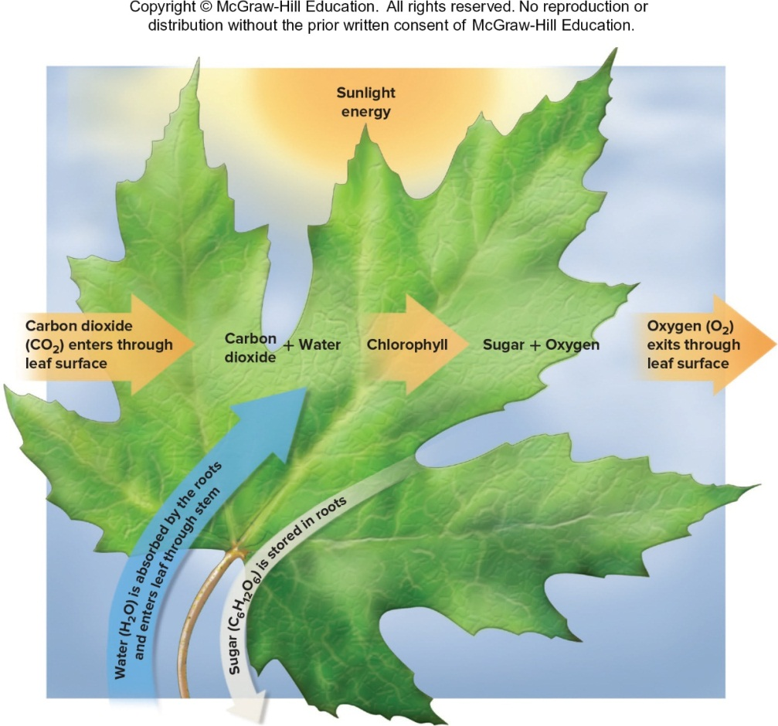
Photosynthesis

Slide 34
Respiration
All organisms, including plants, must carry on some form of respiration, since all organisms need a source of energy to maintain life.

Slide 35
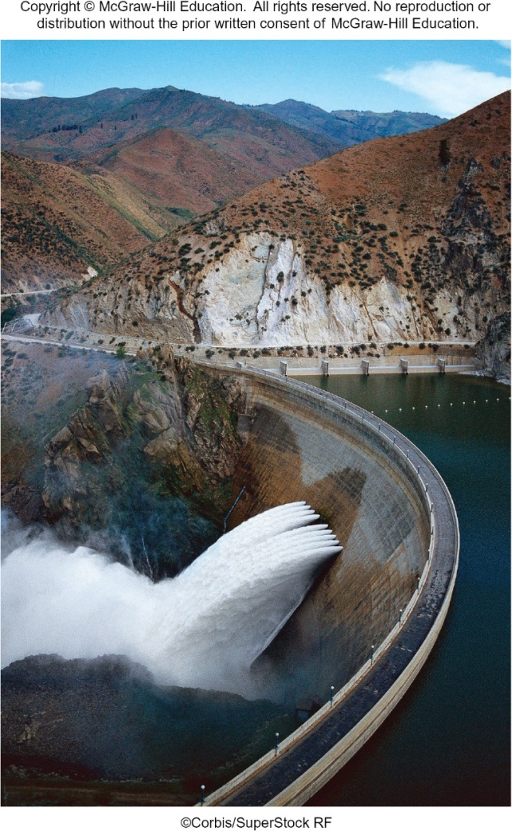
4.5 Energy Principles
Energy is the ability to perform work.
Work is done when an object is moved over a distance.
Kinetic energy is the energy contained by moving objects.
Potential energy is energy due to relative position.

Slide 36
States of Matter (1 of 3)
The state of matter depends on the amount of energy present.
The amount of kinetic energy contained in a molecule determines how rapidly it moves.
Solids: Molecular particles have low energy and vibrate in place very close to one another.
Liquids: More energy; molecules are farther apart from one another.
Gases: Molecular particles move very rapidly and are very far apart.

Slide 37
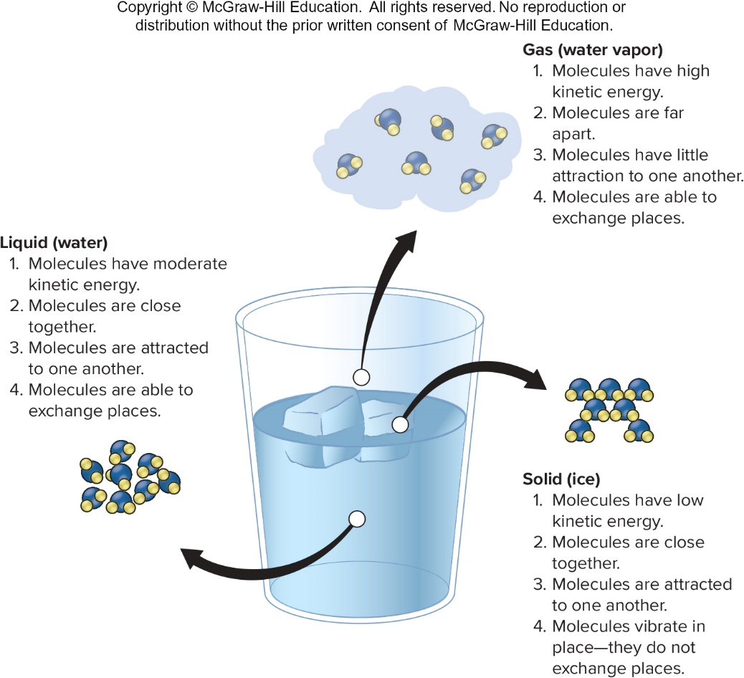
States of Matter (2 of 3)

Slide 38
States of Matter (3 of 3)
Sensible heat transfer occurs when heat energy flows from a warmer object to a cooler object.
The temperature of cooler matter increases and the temperature of warmer matter decreases.
Latent heat transfer occurs when heat energy is used to change the state of matter, but the temperature of matter does not change.

Slide 39
First and Second Laws of Thermodynamics
Energy can be converted from one form to another, but the amount remains constant.
1st Law: Energy cannot be created or destroyed; it can only be changed from one form to another.
2nd Law: When converting energy from one form to another, some of the useful energy is lost.
Entropy is the energy that cannot be used to do useful work.

Slide 40
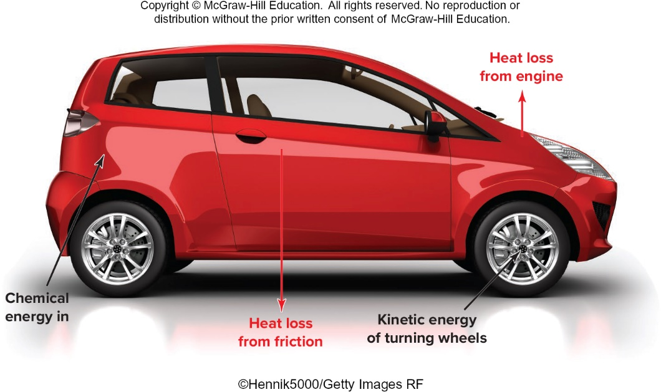
Second Law of Thermodynamics

Slide 41
4.6 Environmental Implications of Energy Flow (1 of 3)
Heat produced during energy conversion is dissipated into the environment.
Chemical reactions
Friction between moving objects
Orderly arrangements of matter tend to become disordered. The process of becoming disordered coincides with the constant flow of energy toward a dilute form of heat.
This results in an increase in entropy.

Slide 42
4.6 Environmental Implications of Energy Flow (2 of 3)
Some forms of energy are more useful than others.
High quality: Can be used to perform useful work (electricity).
Low quality: Cannot be used to perform useful work (heat in the ocean).
Temperature differential between two objects means that heat will flow from the warmer object to the cooler object.
The greater the temperature differential, the more useful work can be done.

Slide 43
4.6 Environmental Implications of Energy Flow (3 of 3)
Low-quality energy still has significance in the world.
The distribution of heat energy in the ocean moderates the temperature of coastal climates.
It contributes to weather patterns and causes ocean currents that are important in many ways.
We can sometimes figure new ways to convert low-quality energy to high-quality energy.
Improvements in wind turbines and photovoltaic cells allow us to convert low-quality light and wind to electricity.

Slide 44
Biological Systems and Thermodynamics
In accordance with the second law of thermodynamics, all organisms, including humans, are in the process of converting high-quality energy into low-quality energy.
When chemical-bond energy in food is converted into the energy needed to move, grow, or respond, waste heat is produced.
From an energy point of view, it is comparable to the process of combustion.

Slide 45
Pollution and Thermodynamics
A consequence of energy conversion is pollution.
Wearing of brakes used to stop cars.
Emissions from power plants.
If each person on Earth used less energy, there would be less waste heat and other forms of pollution that result from energy conversion.
The amount of energy in the universe is limited, and only a small portion of that energy is high-quality.

Slide 46
Summary (1 of 3)
Science is a method of gathering and organizing information.
A hypothesis is a logical prediction about how things work that must account for all the known information and be testable.
If a hypothesis is continually supported by the addition of new facts, it may be incorporated into a theory.
A law is a broad statement that describes what happens in nature.

Slide 47
Summary (2 of 3)
The fundamental unit of matter is the atom, which is made up of protons and neutrons in the nucleus surrounded by a cloud of moving electrons.
Chemical bonds are physical attractions between atoms resulting from the interaction of their electrons.
When chemical bonds are broken or formed, a chemical reaction occurs, and the amount of energy within the chemical bonds is changed.

Slide 48
Summary (3 of 3)
Matter can occur in three states: solid, liquid, and gas.
Kinetic energy is the energy contained by moving objects; potential energy is the energy an object has because of its position.
The first law of thermodynamics states that the amount of energy in the universe is constant.
The second law of thermodynamics states that when energy is converted from one form to another, some of the useful energy is lost.

