Slide 1
Chapter 4
Cell Structure & Function

Slide 2
Why is it important to learn about cells?
A cell is the smallest unit of a living thing. A living thing, whether made of one cell (like bacteria) or many cells (like a human), is called an organism.

Slide 3
Cell Theory
A cell is the smallest unit of life.
All living things are composed of one or more cells, the cell is the basic unit of life, and new cells arise from existing cells.

Slide 4
Microscopes
Microscopes are used to study cells
There are two primary types of modern microscopes used:
  light microscopes and
  electron microscopes.
    Electron microscopes provide higher magnification, higher resolution, and more detail than light microscopes.

Slide 5
Introduction to Prokaryotic and Eukaryotic Cells
Cells fall into one of two broad categories:
  prokaryotic and
  eukaryotic.
The predominantly single-celled organisms of the domains Bacteria and Archaea are classified as prokaryotes (pro– = before; –karyon– = nucleus).
Animal cells, plant cells, fungi, and protists are eukaryotes (eu– = true).

Slide 6
Common Components of All Cells
All cells share four common components:
  1) a plasma membrane, an outer covering that separates the cell’s interior from its surrounding environment;
  2) cytoplasm, consisting of a jelly-like region within the cell in which other cellular components are found;
  3) DNA, the genetic material of the cell; and
  4) ribosomes, particles that synthesize proteins.

Slide 7
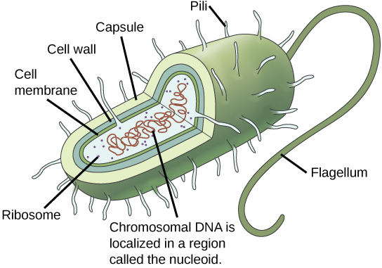
Components of Prokaryotic Cells

Slide 8
The Prokaryotic Cell
Prokaryotic cell is a simple, single-celled (unicellular) organism that lacks a nucleus, or any other membrane-bound organelle.
Prokaryotic DNA is found in the central part of the cell: a darkened region called the nucleoid .
All bacteria have a cell wall
The cell wall acts as an extra layer of protection, helps the cell maintain its shape, and prevents dehydration.
The capsule enables the cell to attach to surfaces in its environment.
Some prokaryotes have flagella, pili, or fimbriae.
  Flagella are used for locomotion.
  Pili are used to exchange genetic material during a type of reproduction called conjugation.
  Fimbriae are protein appendages used by bacteria to attach to other cells.

Slide 9
Cell Size
At 0.1–5.0 µm in diameter, prokaryotic cells are significantly smaller than eukaryotic cells, which have diameters ranging from 10–100 µm
The small size of prokaryotes allows ions and organic molecules that enter them to quickly spread to other parts of the cell. Similarly, any wastes produced within a prokaryotic cell can quickly move out.
However, larger eukaryotic cells have evolved different structural adaptations to enhance cellular transport.
As a cell becomes larger, it becomes more and more difficult for the cell to acquire sufficient materials to support the processes inside the cell, because the relative size of the surface area through which materials must be transported declines.

Slide 10
Eukaryotic Cells
A eukaryotic cell is a cell that has a membrane-bound nucleus and other membrane-bound compartments or sacs, called organelles, which have specialized functions.
The word eukaryotic means “true kernel” or “true nucleus,” alluding to the presence of the membrane-bound nucleus in these cells.
The word “organelle” means “little organ,” and, as already mentioned, organelles have specialized cellular functions, just as the organs of your body have specialized functions.

Slide 11
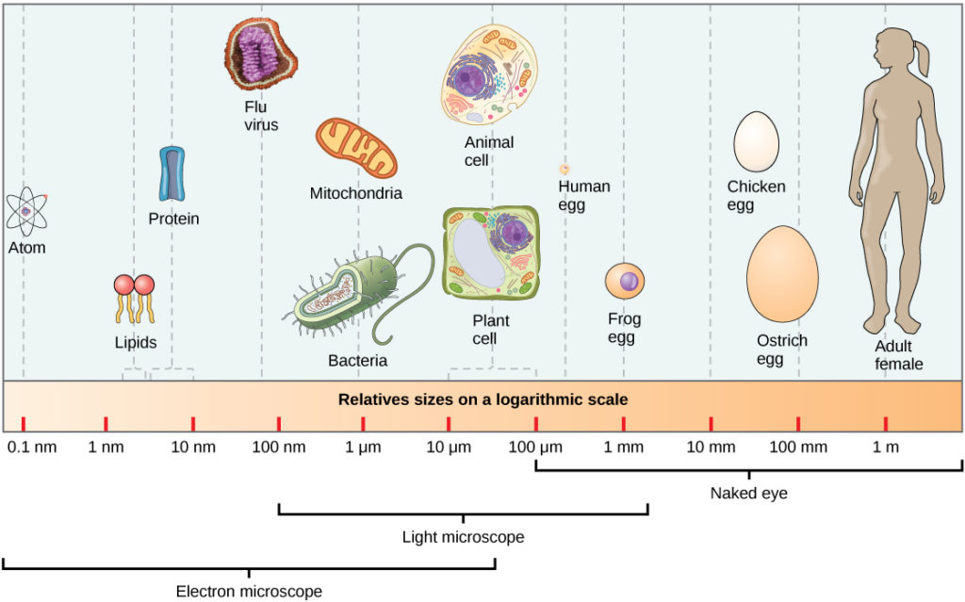

Slide 12
Characteristics of Eukaryotes
Cells with nuclei surrounded by a nuclear envelope with nuclear pores. This is the single characteristic that is both necessary and sufficient to define an organism as a eukaryote.
Mitochondria.
A cytoskeleton containing the structural and motility components called actin microfilaments and microtubules. All extant eukaryotes have these cytoskeletal elements.
Flagella and cilia, organelles associated with cell motility.
Chromosomes, each consisting of a linear DNA molecule coiled around basic (alkaline) proteins called histones.
Mitosis, a process of nuclear division wherein replicated chromosomes are divided and separated using elements of the cytoskeleton.

Slide 13
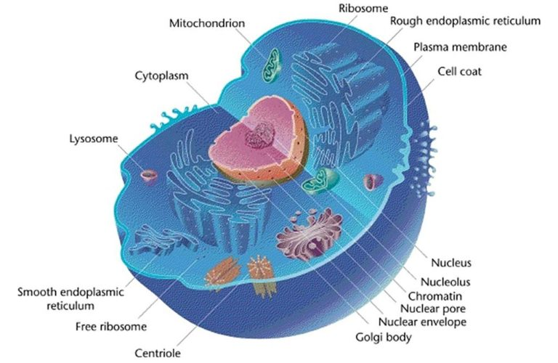
Animal Cell Structure

Slide 14
Introduction to Organelles
Eukaryotic cells have:
a membrane-bound nucleus
numerous membrane-bound organelles—such as the endoplasmic reticulum, Golgi apparatus, chloroplasts, mitochondria, and others
several, rod-shaped chromosomes
Because a eukaryotic cell’s nucleus is surrounded by a membrane, it is often said to have a “true nucleus.” The word “organelle” means “little organ,” and, as already mentioned, organelles have specialized cellular functions, just as the organs of your body have specialized functions.

Slide 15
Cytoplasm
The cytoplasm –
  In eukaryotic cells, which have a nucleus, the cytoplasm is everything between the plasma membrane and the nuclear envelope. It also includes membrane-bound organelles, which are suspended in the cytosol.
  In prokaryotes, which lack a nucleus, cytoplasm simply means everything found inside the plasma membrane
Cytosol, a water-based solution that contains ions, small molecules, and macromolecules
The cytoskeleton, a network of fibers that supports the cell and gives it shape, is also part of the cytoplasm and helps to organize cellular components.

Slide 16
The Plasma Membrane
All cells have a plasma membrane made up of:
  a phospholipid bilayer that separates the internal contents of the cell from its surrounding environment.
  with embedded proteins
  Cholesterol
  Oligosaccharides
The plasma membrane regulates the passage of some substances, such as organic molecules, ions, and water, preventing the passage of some to maintain internal conditions, while actively bringing in or removing others. Other compounds move passively across the membrane.

Slide 17
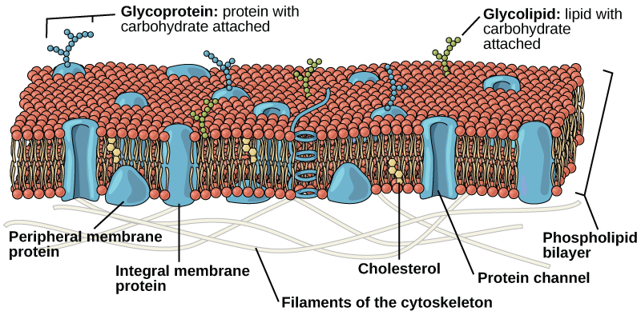
The Plasma Membrane

Slide 18
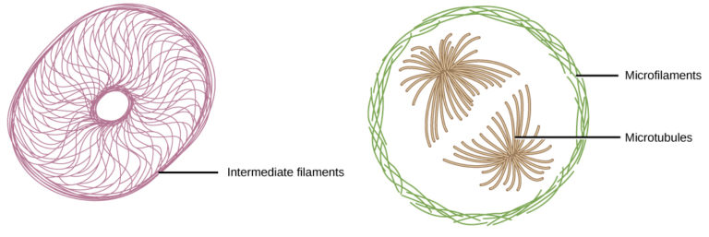
The Cytoskeleton
A network of protein fibers that helps to;
  maintain the shape of the cell,
  secures certain organelles in specific positions,
  allows cytoplasm and vesicles to move within the cell, and
  enables unicellular organisms to move independently.

Slide 19
Flagella and Cilia
Flagella (singular = flagellum) are long, hair-like structures that extend from the plasma membrane and are used to move an entire cell, (for example, sperm, Euglena).
  When present, the cell has just one flagellum or a few flagella.
Cilia are short, hair-like structures that are used to move entire cells (such as paramecium) or move substances along the outer surface of the cell.
  When cilia (singular = cilium) are present, they are many in number and extend along the entire surface of the plasma membrane.

Slide 20
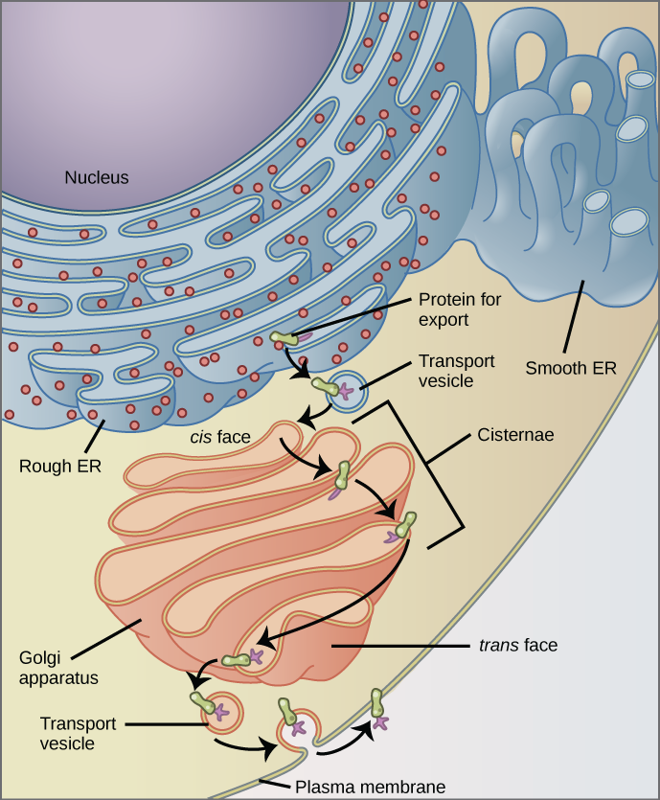
The Endomembrane System
The endomembrane system (endo = within) is a group of membranes and organelles (Figure 1) in eukaryotic cells that work together to modify, package, and transport lipids and proteins.
It includes:
  the nuclear envelope,
  the endoplasmic reticulum
  Golgi apparatus
  Lysosomes,
  Vesicles and
  the plasma membrane

Slide 21
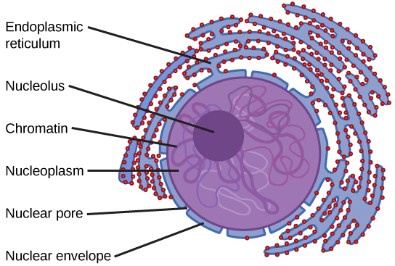
The nucleus
The nucleus (plural = nuclei) houses the cell’s DNA in the form of chromatin and directs the synthesis of ribosomes and proteins.

Slide 22
The nuclear envelope is a double-membrane structure that constitutes the outermost portion of the nucleus.
  It is punctuated with pores that control the passage of ions, molecules, and RNA between the nucleoplasm and the cytoplasm.
Chromosomes are structures within the nucleus that are made up of DNA, the hereditary material, and proteins.
  In eukaryotes, chromosomes are linear structures.
    Every species has a specific number of chromosomes in the nucleus of its body cells. For example, in humans, the chromosome number is 46, whereas in fruit flies, the chromosome number is eight.
The combination of DNA and proteins is called chromatin. - When the cell is in the growth and maintenance phases of its life cycle, the chromosomes resemble an unwound, jumbled bunch of threads, which is the chromatin.
Some chromosomes have sections of DNA that encode ribosomal RNA. A darkly staining area within the nucleus, called the nucleolus (plural = nucleoli), aggregates the ribosomal RNA with associated proteins to assemble the ribosomal subunits that are then transported through the nuclear pores into the cytoplasm.

Slide 23
The Endoplasmic Reticulum
The endoplasmic reticulum (ER) is a series of interconnected membranous tubules that collectively modify proteins and synthesize lipids
However, these two functions are performed in separate areas of the endoplasmic reticulum: the rough endoplasmic reticulum and the smooth endoplasmic reticulum, respectively.
The rough endoplasmic reticulum (RER) is so named because the ribosomes attached to its cytoplasmic surface give it a studded appearance when viewed through an electron microscope.
The smooth endoplasmic reticulum (SER) is continuous with the RER but has few or no ribosomes on its cytoplasmic surface (see Figure 1).
  The SER’s functions include synthesis of carbohydrates, lipids (including phospholipids), and steroid hormones; detoxification of medications and poisons; alcohol metabolism; and storage of calcium ions.

Slide 24
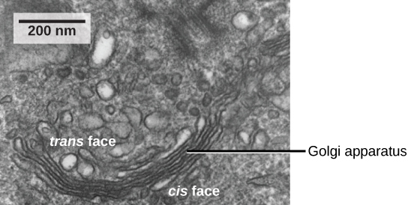
The Golgi Apparatus
The sorting, tagging, packaging, and distribution of lipids and proteins take place in the Golgi apparatus (also called the Golgi body)

Slide 25
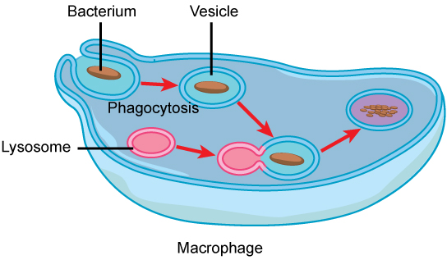
Lysosomes
The lysosomes are the cell’s “garbage disposal.”
Digestive enzymes within the lysosomes aid the breakdown of proteins, polysaccharides, lipids, nucleic acids, and even worn-out organelles.
Lysosomes also use their hydrolytic enzymes to destroy disease-causing organisms that might enter the cell.

Slide 26
Vesicles and Vacuoles
Vesicles and vacuoles are membrane-bound sacs that function in storage and transport.
  Vesicles can fuse with other membranes within the cell system.
Vacuoles are somewhat larger than vesicles
  the membrane of a vacuole does not fuse with the membranes of other cellular components.
  Additionally, enzymes within plant vacuoles can break down macromolecules.

Slide 27
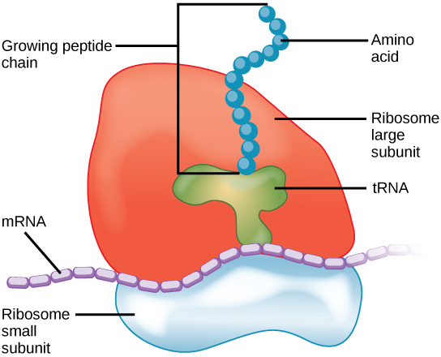
Ribosomes
Ribosomes are the cellular structures responsible for protein synthesis.
  They consist of large and small subunits.
  Ribosomes are enzyme complexes that are responsible for protein synthesis.
    Free ribosomes appear as either clusters or single tiny dots floating freely in the cytoplasm.
    Ribosomes may be attached to either the cytoplasmic side of the plasma membrane or the cytoplasmic side of the endoplasmic reticulum
Because protein synthesis is essential for all cells, ribosomes are found in practically every cell, although they are smaller in prokaryotic cells.

Slide 28
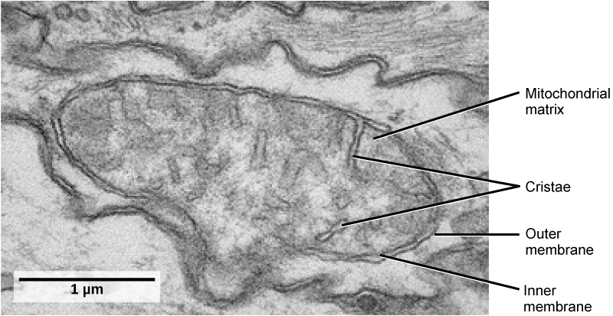
Mitochondria
Mitochondria (singular = mitochondrion) are called the “powerhouses” or “energy factories” of a cell because they are responsible for making adenosine triphosphate (ATP), the cell’s main energy-carrying molecule.
Mitochondria are oval-shaped, double-membrane organelles that have their own ribosomes and DNA.
Each membrane is a phospholipid bilayer embedded with proteins.
The inner layer has folds called cristae, which increase the surface area of the inner membrane.
The area surrounded by the folds is called the mitochondrial matrix. The cristae and the matrix have different roles in cellular respiration.
The formation of ATP from the breakdown of glucose is known as cellular respiration.

Slide 29
Peroxisomes
Peroxisomes are small, round organelles enclosed by single membranes.
They carry out oxidation reactions that break down fatty acids and amino acids.
They also detoxify many poisons that may enter the body.
  Alcohol is detoxified by peroxisomes in liver cells. A byproduct of these oxidation reactions is hydrogen peroxide, H2O2, which is contained within the peroxisomes to prevent the chemical from causing damage to cellular components outside of the organelle.
  Hydrogen peroxide is safely broken down by peroxisomal enzymes into water and oxygen.

Slide 30
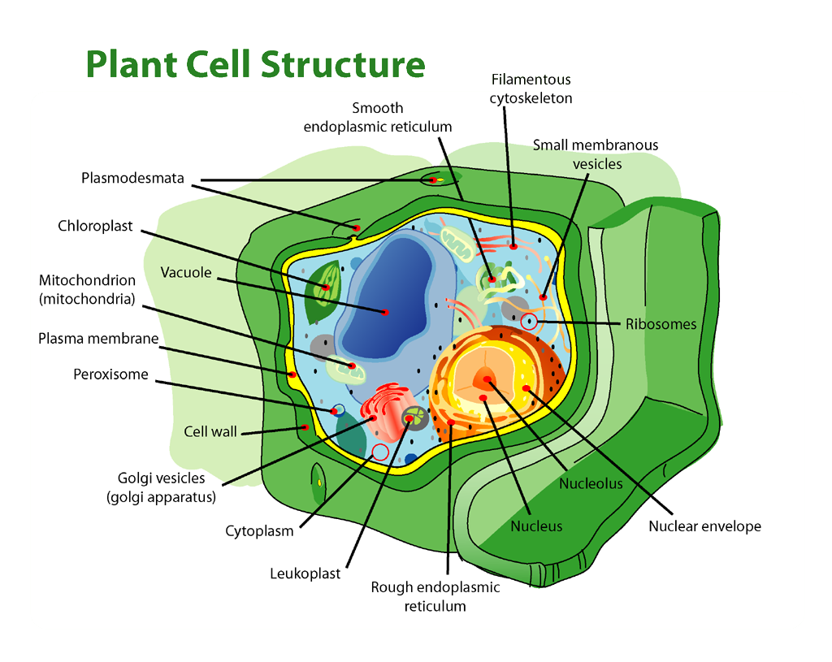
Plant Cell Structure

Slide 31
The Cell Wall
The cell wall is a rigid covering that protects the cell, provides structural support, and gives shape to the cell. Fungal and protist cells also have cell walls
The major organic molecule in the plant cell wall is cellulose

Slide 32
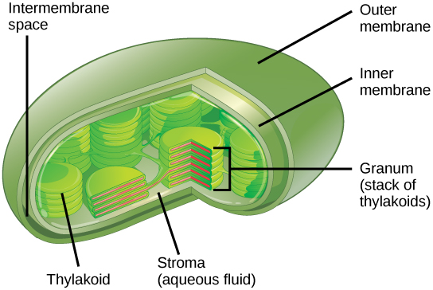
Chloroplasts
Chloroplasts function in photosynthesis and can be found in eukaryotic cells such as plants and algae.

Slide 33
The Central Vacuole
The central vacuole plays a key role in regulating the cell’s concentration of water in changing environmental conditions.
In plant cells, the liquid inside the central vacuole provides turgor pressure, which is the outward pressure caused by the fluid inside the cell
The central vacuole also functions to store proteins in developing seed cells.

Slide 34
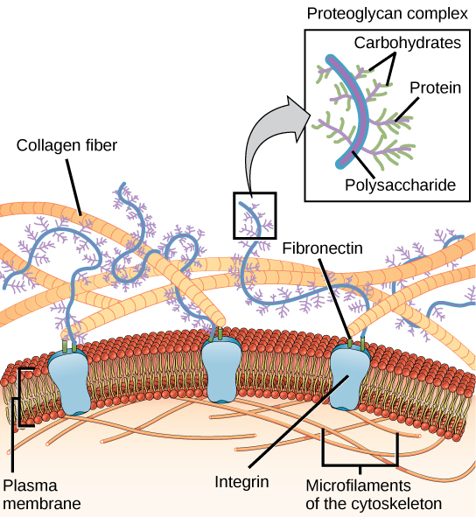
Extracellular Matrix of Animal Cells
Most animal cells release materials into the extracellular space.
  The primary components of these materials arcollagen.
  Collectively, these materials are called the extracellular e glycoproteins and the protein matrix.
The extracellular matrix hold the cells together to form a tissue
It also allows the cells within the tissue to communicate with each other.

Slide 35
Intercellular Junctions
Cells can also communicate with each other by direct contact, referred to as intercellular junctions.
There are some differences in the ways that plant and animal cells do this.
  Plasmodesmata (singular = plasmodesma) are junctions between plant cells, whereas
  animal cell contacts include:
    tight and gap junctions, and
    desmosomes.

Slide 36
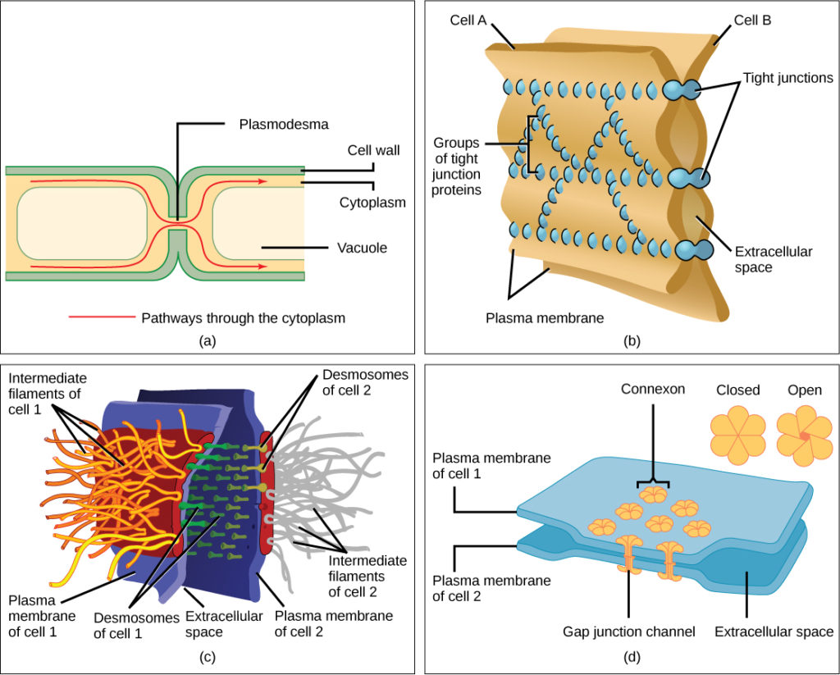
A tight junction is a watertight seal between two adjacent animal cells.
  prevents materials from leaking between the cells.
Also found only in animal cells are desmosomes, which act like spot welds between adjacent epithelial cells.
  They keep cells together in a sheet-like formation in organs and tissues that stretch, like the skin, heart, and muscles.
Gap junctions in animal cells are like plasmodesmata in plant cells in that they are channels between adjacent cells that allow for the transport of ions, nutrients, and other substances that enable cells to communicate.

Slide 37
Assignment for extra credit
Use Table 1 - Components of Prokaryotic and Eukaryotic Cells and Their Functions to construct a Venn diagram to compare plant and animal cells.

