Slide 1
Chapter 3
Important Biological Molecules

Slide 2
Why It Matters:
Important Biological Macromolecules

Slide 3
Biological Molecules
Biological macromolecules are large molecules, necessary for life, that are built from smaller organic molecules.
There are four major classes of biological macromolecules:
Carbohydrates,
Lipids,
Proteins, and
Nucleic acids (found in DNA and RNA).
Each is an important component of the cell and performs a wide array of functions.
Combined, these molecules make up the majority of a cell’s mass.
Biological macromolecules are organic, meaning that they contain carbon (with some exceptions, like carbon dioxide).
In addition, they may contain hydrogen, oxygen, nitrogen, phosphorus, sulfur, and additional minor elements.

Slide 4
Carbon
It is often said that life is “carbon-based.”
This means that carbon atoms, bonded to other carbon atoms or other elements, form the fundamental components of many, if not most, of the molecules found uniquely in living things.
Other elements play important roles in biological molecules, but carbon certainly qualifies as the “foundation” element for molecules in living things.
It is the bonding properties of carbon atoms that are responsible for its important role

Slide 5
Carbon Bonding
Carbon contains four electrons in its outer shell. Therefore, it can form four covalent bonds with other atoms or molecules.
The simplest organic carbon molecule is methane (CH4), in which four hydrogen atoms bind to a carbon atom. However, structures that are more complex are made using carbon.

Slide 6
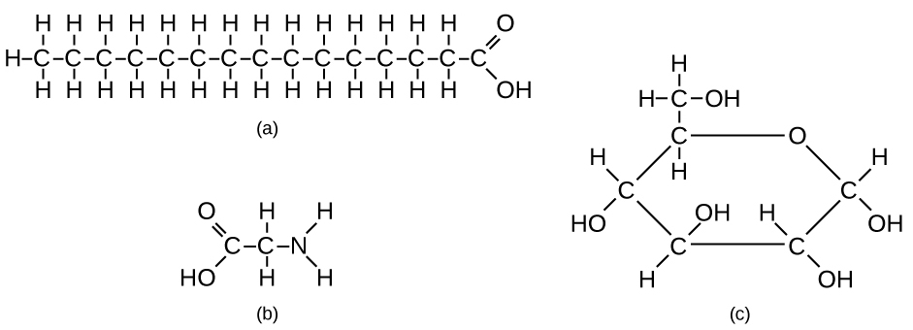
Diversity of Carbon Compounds
Any of the hydrogen atoms can be replaced with another carbon atom covalently bonded to the first carbon atom.
In this way, long and branching chains of carbon compounds can be made.
The carbon atoms may bond with atoms of other elements, such as nitrogen, oxygen, and phosphorus.
The molecules may also form rings, which themselves can link with other rings.
This diversity of molecular forms accounts for the diversity of functions of the biological macromolecules and is based to a large degree on the ability of carbon to form multiple bonds with itself and other atoms.

Slide 7
Introduction to Carbohydrates
Are carbohydrates good for you? People who wish to lose weight are often told that carbohydrates are bad for them and should be avoided. Some diets completely forbid carbohydrate consumption, claiming that a low-carbohydrate diet helps people to lose weight faster.
Eliminating carbohydrates from the diet is not the best way to lose weight. A low-calorie diet that is rich in whole grains, fruits, vegetables, and lean meat, together with plenty of exercise and plenty of water, is the more sensible way to lose weight.

Slide 8
Structure and Function of Carbohydrates
Molecular Structures
Carbohydrates can be represented by the formula (CH2O)n, where n is the number of carbons in the molecule.
In other words, the ratio of carbon to hydrogen to oxygen is 1:2:1 in carbohydrate molecules.
This formula also explains the origin of the term “carbohydrate”: the components are carbon (“carbo”) and the components of water (hence, “hydrate”).
Carbohydrates are classified into three subtypes:
monosaccharides,
disaccharides, and
polysaccharides.

Slide 9
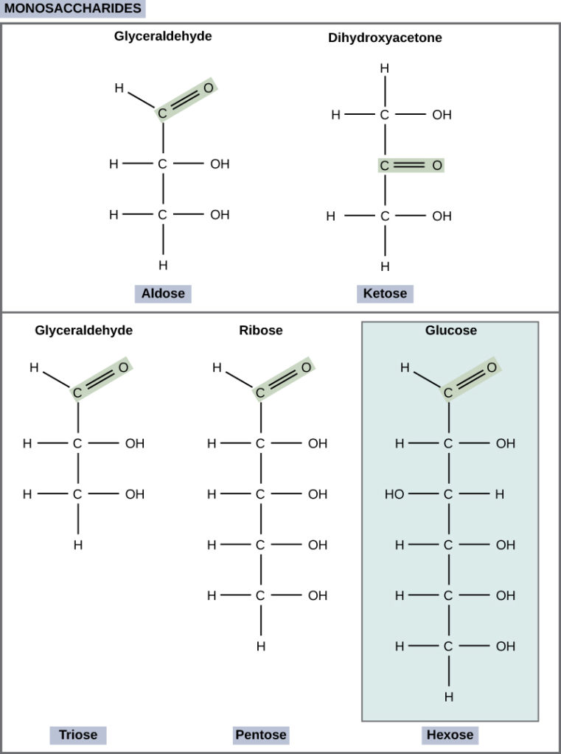
Monosaccharides
Monosaccharides (mono– = “one”; sacchar– = “sweet”) are simple sugars, the most common of which is glucose.
In monosaccharides, the number of carbons usually ranges from three to seven.
Most monosaccharide names end with the suffix –ose.
If the sugar has an aldehyde group (the functional group with the structure R-CHO), it is known as an aldose, and
if it has a ketone group (the functional group with the structure RC(=O)R′), it is known as a ketose.
Depending on the number of carbons in the sugar, they also may be known as
trioses (three carbons),
pentoses (five carbons), and or
hexoses (six carbons).

Slide 10
Disaccharides
Disaccharides (di– = “two”) form when two monosaccharides undergo a dehydration reaction
Condensation reaction or dehydration synthesis - During this process, the hydroxyl group of one monosaccharide combines with the hydrogen of another monosaccharide, releasing a molecule of water and forming a covalent bond
Common disaccharides include lactose, maltose, and sucrose.
Lactose is a disaccharide consisting of the monomers glucose and galactose. It is found naturally in milk.
Maltose, or malt sugar, is a disaccharide formed by a dehydration reaction between two glucose molecules.
The most common disaccharide is sucrose, or table sugar, which is composed of the monomers glucose and fructose.

Slide 11
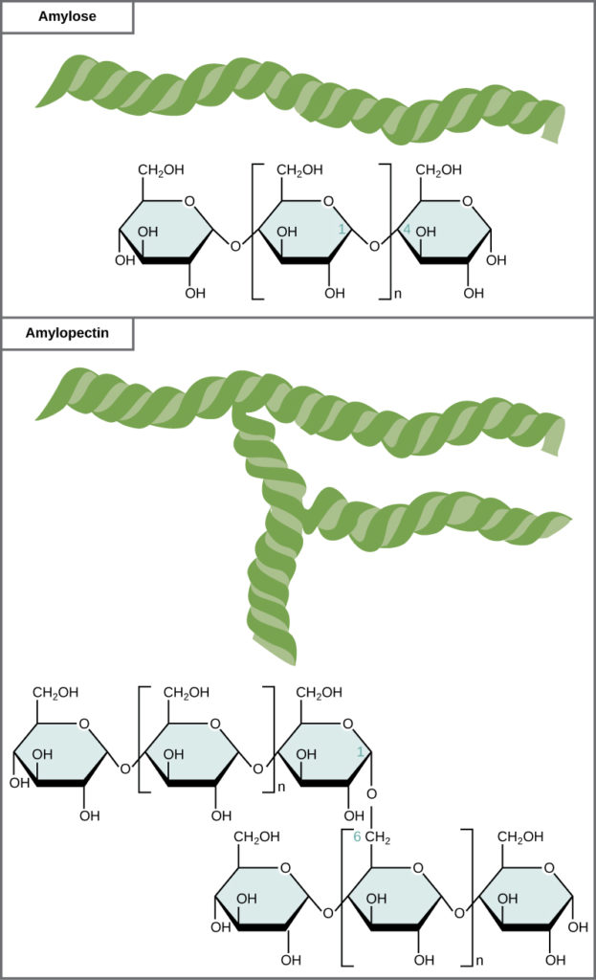
Polysaccharides
A long chain of monosaccharides linked by covalent bonds is known as a polysaccharide (poly- = “many”).
The chain may be branched or unbranched, and it may contain different types of monosaccharides.
Polysaccharides may be very large molecules.
Starch, glycogen, cellulose, and chitin are examples of polysaccharides.
Starch is the stored form of sugars in plants and is made up of amylose and amylopectin (both polymers of glucose).

Slide 12
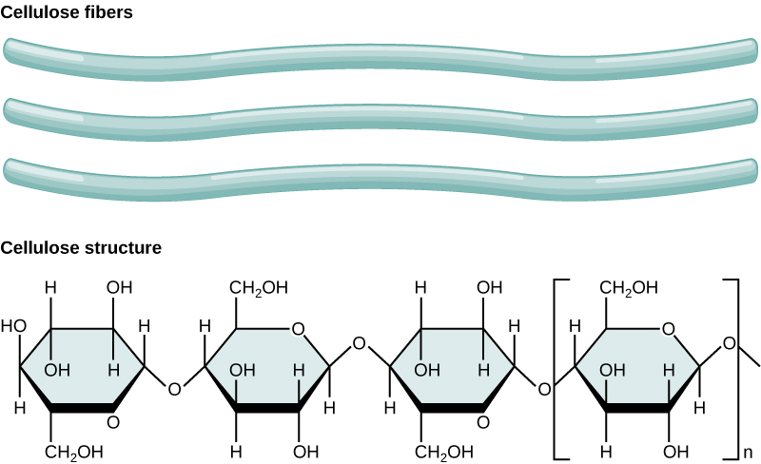
Glycogen is the storage form of glucose in humans and other vertebrates, and is made up of monomers of glucose
Cellulose is one of the most abundant natural biopolymers.
The cell walls of plants are mostly made of cellulose, which provides structural support to the cell.
Wood and paper are mostly cellulosic in nature.

Slide 13
Introduction to Lipids
The word fat typically brings up a negative picture in our minds. In diets, we’re often advised to stay away from fatty foods.
Do you know that our bodies require some fat in order to survive?
Lipids include a diverse group of compounds that are largely nonpolar in nature.
Lipids perform many different functions in a cell.
Cells store energy for long-term use in the form of fats.
Lipids also provide insulation from the environment for plants and animals.
For example, they help keep aquatic birds and mammals dry when forming a protective layer over fur or feathers because of their water-repellant hydrophobic nature. Lipids are also the building blocks of many hormones and are an important constituent of all cellular membranes. Lipids include fats, oils, waxes, phospholipids, and steroids.

Slide 14
Fats and Oils
A fat molecule, such as a triglyceride, consists of two main components—glycerol and fatty acids.
Glycerol is an organic compound with three carbon atoms, five hydrogen atoms, and three hydroxyl (–OH) groups.
Fatty acids have a long chain of hydrocarbons to which an acidic carboxyl group is attached, hence the name “fatty acid.”
The number of carbons in the fatty acid may range from 4 to 36; most common are those containing 12–18 carbons.
In a fat molecule, a fatty acid is attached to each of the three oxygen atoms in the –OH groups of the glycerol molecule with a covalent bond

Slide 15
Saturated & Unsaturated Fats
Fatty acids may be saturated or unsaturated.
In a fatty acid chain, if there are only single bonds between neighboring carbons in the hydrocarbon chain, the fatty acid is saturated. Saturated fatty acids are saturated with hydrogen.
When the hydrocarbon chain contains a double bond, the fatty acid is an unsaturated fatty acid.
Saturated fats tend to get packed tightly and are solid at room temperature.
Animal fats with stearic acid and palmitic acid contained in meat, and the fat with butyric acid contained in butter, are examples of saturated fats. Mammals store fats in specialized cells called adipocytes, where globules of fat occupy most of the cell.
Unsaturated fats or oils are usually of plant origin and contain unsaturated fatty acids.
Most unsaturated fats are liquid at room temperature and are called oils.
If there is one double bond in the molecule, then it is known as a monounsaturated fat (e.g., olive oil), and
If there is more than one double bond, then it is known as a polyunsaturated fat (e.g., canola oil).

Slide 16
Margarine, some types of peanut butter, and shortening are examples of artificially hydrogenated trans-fats.
Recent studies have shown that an increase in trans-fats in the human diet may lead to an increase in levels of low-density lipoprotein (LDL), or “bad” cholesterol, which, in turn, may lead to plaque deposition in the arteries, resulting in heart disease.
Many fast food restaurants have recently eliminated the use of trans-fats, and U.S. food labels are now required to list their trans-fat content.
In the food industry, oils are artificially hydrogenated to make them semi-solid, leading to less spoilage and increased shelf life. Simply speaking, hydrogen gas is bubbled through oils to solidify them. During this hydrogenation process, double bonds of the cis-conformation in the hydrocarbon chain may be converted to double bonds in the trans-conformation. This forms a trans-fat from a cis-fat. The orientation of the double bonds affects the chemical properties of the fat

Slide 17
Essential fatty acids
Essential fatty acids are fatty acids that are required but not synthesized by the human body.
They must be supplemented through the diet. There are two known essential fatty acids for humans:
Omega-3 fatty acids
Omega-6 fatty acids
Salmon, trout, and tuna are good sources of omega-3 fatty acids.
Omega-3 fatty acids are important in brain function and normal growth and development.
They may also prevent heart disease and reduce the risk of cancer.

Slide 18
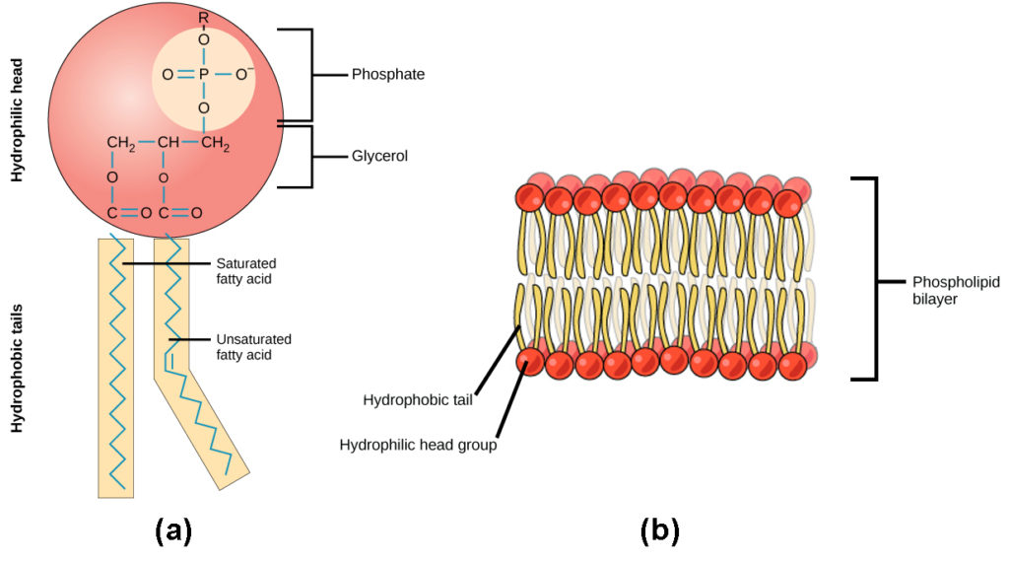
Phospholipids
Phospholipids are the major constituent of the plasma membrane.
Like fats, they are composed of fatty acid chains attached to a glycerol or similar backbone.
Instead of three fatty acids attached, however, there are two fatty acids and the third carbon of the glycerol backbone is bound to a phosphate group. The phosphate group is modified by the addition of an alcohol.
A phospholipid has both hydrophobic and hydrophilic regions.
The fatty acid chains are hydrophobic and exclude themselves from water, whereas the phosphate is hydrophilic and interacts with water.
Cells are surrounded by a membrane, which has a bilayer of phospholipids.
The fatty acids of phospholipids face inside, away from water, whereas the phosphate group can face either the outside environment or the inside of the cell, which are both aqueous.

Slide 19
Steroids and Waxes
All steroids have four, linked carbon rings and several of them, like cholesterol, have a short tail. They are hydrophobic.
Cholesterol is a steroid.
Cholesterol is mainly synthesized in the liver and is the precursor of many steroid hormones, such as testosterone and estradiol.
It is also the precursor of vitamins E and K, and bile salts
Although cholesterol is often spoken of in negative terms, it is necessary for the proper functioning of the body. It is a key component of the plasma membranes of animal cells.
Waxes are made up of a hydrocarbon chain with an alcohol (–OH) group and a fatty acid.
Examples of animal waxes include beeswax and lanolin.
Plants also have waxes, such as the coating on their leaves, that helps prevent them from drying out.

Slide 20
Introduction to Proteins
Protein Types and Functions
Type | Examples | Functions
Digestive Enzymes | Amylase, lipase, pepsin, trypsin | Help in digestion of food by catabolizing nutrients into monomeric units
Transport | Hemoglobin, albumin | Carry substances in the blood or lymph throughout the body
Structural | Actin, tubulin, keratin | Construct different structures, like the cytoskeleton
Hormones | Insulin, thyroxine | Coordinate the activity of different body systems
Defense | Immuno-globulins | Protect the body from foreign pathogens
Contractile | Actin, myosin | Effect muscle contraction
Storage | Legume storage proteins, egg white (albumin) | Provide nourishment in early development of the embryo and the seedling
Proteins are polymers of amino acids.
Proteins have different “layers” of structure:
primary,
secondary,
tertiary,
quaternary.
Proteins have a variety of function in cells.

Slide 21
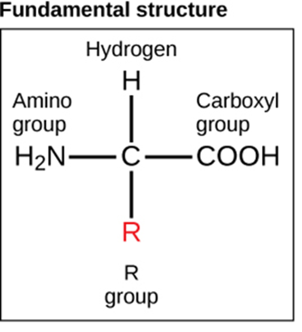
The Amino Acid
All proteins are made up of different arrangements of the same 20 kinds of amino acids.
Amino acids are the monomers that make up proteins.
Each amino acid consists of a central carbon atom bonded to
an amino group (–NH2),
a carboxyl group (–COOH),
a hydrogen atom.
A R group - A variable atom or group of atoms bonded to the central carbon atom known as the.
The R group is the only difference in structure between the 20 amino acids; otherwise, the amino acids are identical
The chemical nature of the R group determines the chemical nature of the amino acid within its protein (that is, whether it is acidic, basic, polar, or nonpolar).

Slide 22
Polypeptides
Each amino acid is attached to another amino acid by a covalent bond, known as a peptide bond, which is formed by a dehydration reaction.
The carboxyl group of one amino acid and the amino group of a second amino acid combine, releasing a water molecule.
The products formed by such a linkage are called polypeptides.
While the terms polypeptide and protein are sometimes used interchangeably, a polypeptide is technically a polymer of amino acids, whereas the term protein is used for a polypeptide or polypeptides that have combined together, have a distinct shape, and have a unique function.
The sequence and number of amino acids ultimately determine a protein’s shape, size, and function.

Slide 23
Protein Structure
The four levels of protein structure are:
primary, secondary, tertiary, and quaternary
The unique sequence and number of amino acids in a polypeptide chain is its primary structure. The unique sequence for every protein is ultimately determined by the gene that encodes the protein
Folding patterns resulting from interactions between the non-R group portions of amino acids give rise to the secondary structure of the protein. The most common are the
alpha (α)-helix and
beta (β)-pleated sheet structures.

Slide 24
The unique three-dimensional structure of a polypeptide is known as its tertiary structure. This structure is caused by chemical interactions between various amino acids and regions of the polypeptide. Primarily, the interactions among R groups create the complex three-dimensional tertiary structure of a protein.
In nature, some proteins are formed from several polypeptides, also known as subunits, and the interaction of these subunits forms the quaternary structure. Weak interactions between the subunits help to stabilize the overall structure. For example, hemoglobin is a combination of four polypeptide subunits.

Slide 25
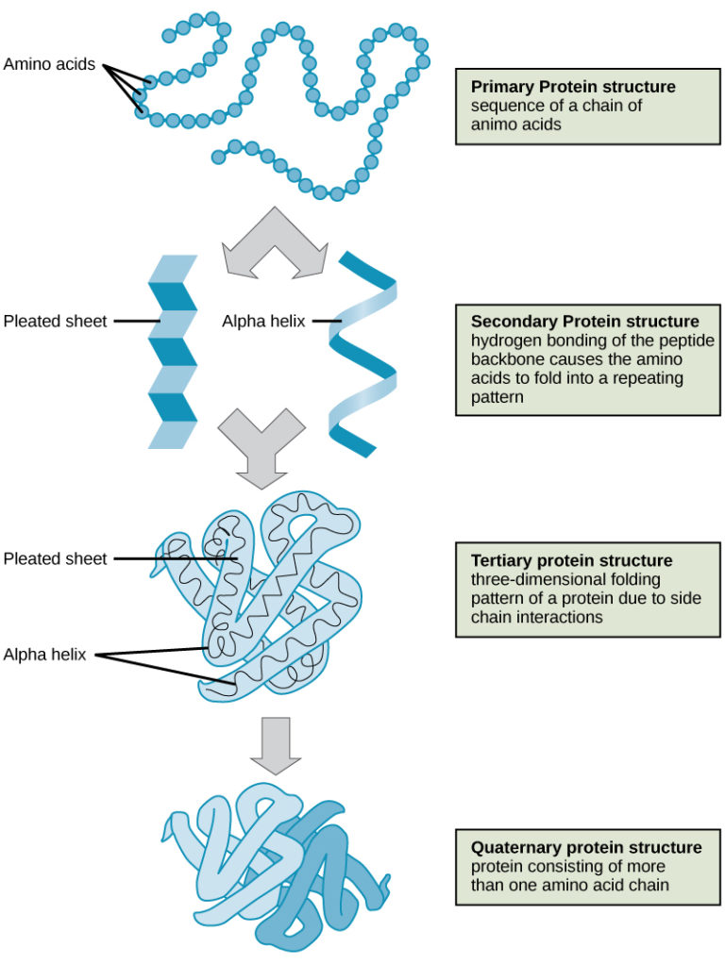
Levels of Protein Structure

Slide 26
Nucleic Acids
Nucleic acids are key macromolecules in the continuity of life. They carry the genetic blueprint of a cell and carry instructions for the functioning of the cell.
The two main types of nucleic acids are
Deoxyribonucleic acid (DNA) and
Ribonucleic acid (RNA).
DNA is the genetic material found in all living organisms, ranging from single-celled bacteria to multicellular mammals.
RNA, is mostly involved in protein synthesis.

Slide 27
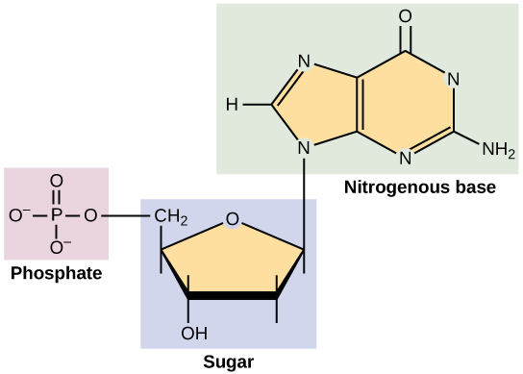
The Nucleotide
DNA and RNA are made up of monomers known as nucleotides.
Each nucleotide is made up of three components:
a nitrogenous base,
a pentose (five-carbon) sugar, and
a phosphate group.
Each nitrogenous base in a nucleotide is attached to a sugar molecule, which is attached to a phosphate group.
The nucleotides combine with each other to form a polynucleotide, DNA or RNA.

Slide 28
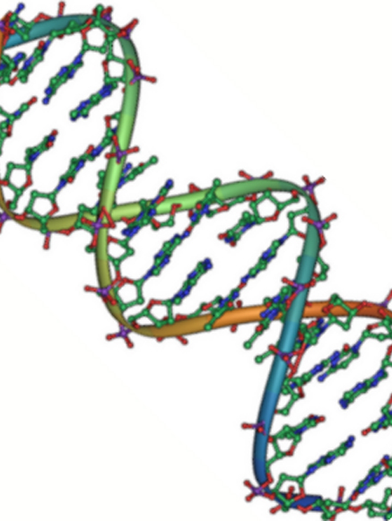
DNA Double-Helical Structure
DNA has a double-helical structure.
It is composed of two strands, or polymers, of nucleotides.
The strands are formed with bonds between phosphate and sugar groups of adjacent nucleotides.
The strands are bonded to each other at their bases with hydrogen bonds, and the strands coil about each other along their length, hence the “double helix” description, which means a double spiral.
The alternating sugar and phosphate groups lie on the outside of each strand, forming the backbone of the DNA.
The nitrogenous bases are stacked in the interior, like the steps of a staircase, and these bases pair; the pairs are bound to each other by hydrogen bonds.
The bases pair in such a way that the distance between the backbones of the two strands is the same all along the molecule.

Slide 29
DNA and RNA
While DNA and RNA are similar, they have very distinct differences.
There is only one type of DNA
There are multiple types of RNA:
Messenger RNA
ribosomal RNA (rRNA),
transfer RNA (tRNA),
small nuclear RNA (snRNA), and
microRNA.
Features of DNA and RNA
 | DNA | RNA
Function | Carries genetic information | Involved in protein synthesis
Location | Remains in the nucleus | Leaves the nucleus
Structure | DNA is double-stranded | Usually single-stranded
Sugar | Deoxyribose | Ribose
Pyrimidines | Cytosine, thymine | Cytosine, uracil
Purines | Adenine, guanine | Adenine, guanine

Slide 30
Central Dogma of Life
Information flow in an organism takes place from DNA to RNA to protein.
DNA dictates the structure of mRNA in a process known as transcription, and
RNA dictates the structure of protein in a process known as translation.
This is known as the Central Dogma of Life, which holds true for all organisms; however, exceptions to the rule occur in connection with viral infections.

Slide 31
You are What You Eat

