Slide 1
Chapter 5
0
The Working Cell

Slide 2
Conservation of Energy
Energy is defined as the capacity to perform work.
Kinetic energy is the energy of motion.
Potential energy is stored energy.
Notes:
Student Misconceptions and Concerns
1. Students with limited exposure to physics may have never understood the concepts of “energy” and the “conservation of energy” or distinguished between potential and kinetic energy. Understanding such broad and new abstract concepts requires time and concrete examples. Consider keeping your common examples before your class as a reference tool when discussing the significance of these ideas.
2. Although typically familiar with the concept of dietary Calories, students often struggle to think of Calories as a source of potential energy. To many students, it is not immediately clear how energy is stored as Calories in food.
Teaching Tips
1. Some students can relate well to the concept of entropy as it relates to the room where they live. Despite cleaning up and organizing the room on a regular (or irregular) basis, the room increasingly becomes disorganized, a victim of entropy, until another energy input (or effort) is exerted to make the room more orderly again. Students might even get to know “entropy” as the “dorm room effect.”
2. The heat produced by the engine of a car is typically used to heat the car during cold weather. But is this same heat available in warmer weather? Students are often unaware that their car “heater” works very well in the summer too. Just as exercise can warm us when it is cold, the same extra heat is released when we exercise in warm conditions. A car engine in the summer struggles to dissipate heat in the same way that a human struggles to cool off after exercising when weather is warm.
3. Here is a question that might make cellular respiration a little more meaningful to your students. Ask your students why they feel warm when it is 30º C (86º F) outside if their core body temperature is 37º C (98.6º F)? Shouldn’t they feel cold? The answer is, our bodies are always producing heat. At these higher temperatures, we are producing more heat than we need, to maintain a body temperature around 37º C. Thus, we sweat and behave in ways that help release our extra heat generated in cellular respiration.
4. Here is a calculation that has impressed some students. Depending upon the size and activity of a person, a human might burn 2,000 dietary Calories (kilocalories) a day. This is enough energy to raise the temperature of 20 liters of liquid water from 0º to 100º C. This is something to think about the next time you heat water on the stove! If you can bring in ten 2-liter bottles you can help students visualize how much liquid water can be raised from 0º to 100º C. (Note: 100 Calories raises about 1 liter of water 100º C; but it takes much more energy to melt ice or to convert boiling water into steam.)
5. The same mass of fat (about 9 kcal per gram) stores nearly twice as many Calories as an equivalent mass of protein or carbohydrates (about 4.5–5 kcal per gram). Thus, when comparing equal masses of fat, protein, and lipid, the fat has nearly twice the potential energy. Fat is therefore an efficient way to store energy in animals and many plants. To store an equivalent amount of energy in the form of carbohydrates or proteins would require about twice the mass, adding a significant burden to the organism’s structure. (For example, if you are 20 lbs. overweight, you would be nearly 40 lbs. overweight if the same energy were stored as carbohydrates or proteins instead of fat.)

Slide 3
Machines and organisms can transform kinetic energy to potential energy and vice versa.
In all such energy transformations, total energy is conserved.
Energy cannot be created or destroyed.
This is the principle of conservation of energy.
Every energy conversion releases some randomized energy in the form of heat.
Heat is a
Type of kinetic energy
Product of all energy conversions
Notes:
Student Misconceptions and Concerns
1. Students with limited exposure to physics may have never understood the concepts of “energy” and the “conservation of energy” or distinguished between potential and kinetic energy. Understanding such broad and new abstract concepts requires time and concrete examples. Consider keeping your common examples before your class as a reference tool when discussing the significance of these ideas.
2. Although typically familiar with the concept of dietary Calories, students often struggle to think of Calories as a source of potential energy. To many students, it is not immediately clear how energy is stored as Calories in food.
Teaching Tips
1. Some students can relate well to the concept of entropy as it relates to the room where they live. Despite cleaning up and organizing the room on a regular (or irregular) basis, the room increasingly becomes disorganized, a victim of entropy, until another energy input (or effort) is exerted to make the room more orderly again. Students might even get to know “entropy” as the “dorm room effect.”
2. The heat produced by the engine of a car is typically used to heat the car during cold weather. But is this same heat available in warmer weather? Students are often unaware that their car “heater” works very well in the summer too. Just as exercise can warm us when it is cold, the same extra heat is released when we exercise in warm conditions. A car engine in the summer struggles to dissipate heat in the same way that a human struggles to cool off after exercising when weather is warm.
3. Here is a question that might make cellular respiration a little more meaningful to your students. Ask your students why they feel warm when it is 30º C (86º F) outside if their core body temperature is 37º C (98.6º F)? Shouldn’t they feel cold? The answer is, our bodies are always producing heat. At these higher temperatures, we are producing more heat than we need, to maintain a body temperature around 37º C. Thus, we sweat and behave in ways that help release our extra heat generated in cellular respiration.
4. Here is a calculation that has impressed some students. Depending upon the size and activity of a person, a human might burn 2,000 dietary Calories (kilocalories) a day. This is enough energy to raise the temperature of 20 liters of liquid water from 0º to 100º C. This is something to think about the next time you heat water on the stove! If you can bring in ten 2-liter bottles you can help students visualize how much liquid water can be raised from 0º to 100º C. (Note: 100 Calories raises about 1 liter of water 100º C; but it takes much more energy to melt ice or to convert boiling water into steam.)
5. The same mass of fat (about 9 kcal per gram) stores nearly twice as many Calories as an equivalent mass of protein or carbohydrates (about 4.5–5 kcal per gram). Thus, when comparing equal masses of fat, protein, and lipid, the fat has nearly twice the potential energy. Fat is therefore an efficient way to store energy in animals and many plants. To store an equivalent amount of energy in the form of carbohydrates or proteins would require about twice the mass, adding a significant burden to the organism’s structure. (For example, if you are 20 lbs. overweight, you would be nearly 40 lbs. overweight if the same energy were stored as carbohydrates or proteins instead of fat.)

Slide 4
Chemical Energy
Molecules store varying amounts of potential energy in the arrangement of their atoms.
Organic compounds are relatively rich in such chemical energy.
Cellular respiration is the energy-releasing chemical breakdown of fuel molecules that provides energy for cells to do work.
Chemical energy is released by the breakdown of organic molecules during cellular respiration
Used to generate molecules of ATP
Notes:
Student Misconceptions and Concerns
1. Students with limited exposure to physics may have never understood the concepts of “energy” and the “conservation of energy” or distinguished between potential and kinetic energy. Understanding such broad and new abstract concepts requires time and concrete examples. Consider keeping your common examples before your class as a reference tool when discussing the significance of these ideas.
2. Although typically familiar with the concept of dietary Calories, students often struggle to think of Calories as a source of potential energy. To many students, it is not immediately clear how energy is stored as Calories in food.
Teaching Tips
1. Some students can relate well to the concept of entropy as it relates to the room where they live. Despite cleaning up and organizing the room on a regular (or irregular) basis, the room increasingly becomes disorganized, a victim of entropy, until another energy input (or effort) is exerted to make the room more orderly again. Students might even get to know “entropy” as the “dorm room effect.”
2. The heat produced by the engine of a car is typically used to heat the car during cold weather. But is this same heat available in warmer weather? Students are often unaware that their car “heater” works very well in the summer too. Just as exercise can warm us when it is cold, the same extra heat is released when we exercise in warm conditions. A car engine in the summer struggles to dissipate heat in the same way that a human struggles to cool off after exercising when weather is warm.
3. Here is a question that might make cellular respiration a little more meaningful to your students. Ask your students why they feel warm when it is 30º C (86º F) outside if their core body temperature is 37º C (98.6º F)? Shouldn’t they feel cold? The answer is, our bodies are always producing heat. At these higher temperatures, we are producing more heat than we need, to maintain a body temperature around 37º C. Thus, we sweat and behave in ways that help release our extra heat generated in cellular respiration.
4. Here is a calculation that has impressed some students. Depending upon the size and activity of a person, a human might burn 2,000 dietary Calories (kilocalories) a day. This is enough energy to raise the temperature of 20 liters of liquid water from 0º to 100º C. This is something to think about the next time you heat water on the stove! If you can bring in ten 2-liter bottles you can help students visualize how much liquid water can be raised from 0º to 100º C. (Note: 100 Calories raises about 1 liter of water 100º C; but it takes much more energy to melt ice or to convert boiling water into steam.)
5. The same mass of fat (about 9 kcal per gram) stores nearly twice as many Calories as an equivalent mass of protein or carbohydrates (about 4.5–5 kcal per gram). Thus, when comparing equal masses of fat, protein, and lipid, the fat has nearly twice the potential energy. Fat is therefore an efficient way to store energy in animals and many plants. To store an equivalent amount of energy in the form of carbohydrates or proteins would require about twice the mass, adding a significant burden to the organism’s structure. (For example, if you are 20 lbs. overweight, you would be nearly 40 lbs. overweight if the same energy were stored as carbohydrates or proteins instead of fat.)

Slide 5
The Structure of ATP
ATP (adenosine triphosphate)
Consists of adenosine plus a tail of three phosphate groups
Is broken down to ADP and a phosphate group, releasing energy
ATP
Acts as cellular energy
Stores energy obtained from food
Releases it later as needed
Notes:
Student Misconceptions and Concerns
1. Although students might already understand mechanical and chemical work in a cell, the idea of transport work might be new to them. Chapter 6, in a section on the electron transport system, develops an analogy between transport work and water behind a dam. Therefore, at this point you might consider making an analogy between transport work (against a gradient) and pumping water up into a reservoir (against gravity)—perhaps into a water tower.
2. Energy coupling at the cellular level may be new to many students, but it is a familiar concept when related to the use of money in our society. Students might be discouraged if the only benefit of work was the ability to make purchases from your employer. (Most of use would soon tire of a fast-food job that only pays its employees in free food!) Money permits the generation of value (a paycheck) analogous to an energy-releasing reaction to be coupled to an energy (money)-consuming reaction, making purchases in distant locations. This idea of “earn and spend” is a common concept most students know well.
Teaching Tips
1.The authors suggest an analogy between ATP and a spring. When a phosphate group is attached to ADP, it is like compressing the spring. When a phosphate group is lost, the spring is relaxed, and energy is released.
2. When introducing ATP and ADP, consider having them think of the terms as A-3-P and A-2-P, noting that the word roots “tri” means 3 and “di” means 2. It might help students to keep track of the number of phosphates more easily.
3. Recycling is essential in cell biology. Damaged organelles are broken down intracellularly and the chemical components recycled, monomers of the cytoskeleton are routinely recycled, and ADP is recycled. Several advantages are common to both human recycling of components of garbage and cellular recycling. For example, both save energy by avoiding the need to remanufacture the basic units, and both avoid an accumulation of waste products that could interfere with other “environmental” chemistry (the environment of the cell or the environment of the human population).

Slide 6
ENZYMES
Metabolism is the total of all chemical reactions in an organism.
Most metabolic reactions require the assistance of enzymes, proteins that speed up chemical reactions.
Activation energy
Activates the reactants
Triggers a chemical reaction
Enzymes lower the activation energy for chemical reactions.
Notes:
Student Misconceptions and Concerns
1. For students not previously familiar with activation energy, analogies can make all the difference. Activation energy can be thought of as a small input that is needed to trigger a large output. This is like (a) an irritated person who needs only a bit more frustration to explode in anger, (b) small waves that lift debris over a dam, or (c) lighting a match around lighter fluid. In each situation, the output was much greater than the input.
2. The specific interactions of enzymes and substrates can be illustrated with simple physical models. Many students new to these concepts will benefit from several forms of explanation, including diagrams such as those in the textbook, physical models, and the opportunity to manipulate or create their own examples. New concepts, like pitching a tent, are best constructed with many lines of support.
Teaching Tips
1. An induced fit is much like the change in shape of a glove when a hand is inserted. The glove’s general shape matches the hand, but the final “fit” requires some additional adjustments of the glove and hand.
2. Enzyme inhibitors that block the active site are like (a) a person sitting in your assigned theater seat or (b) a car parked in your parking space. Analogies for inhibitors that change the shape of the active site are more difficult to imagine. Consider challenging your students to think of such analogies.
3. Feedback regulation relies upon the negative feedback of the accumulation of a product. Ask students in class to suggest other products of reactions that inhibit the process that made them, when the product reaches high enough levels. (Gas station pumps routinely shut off when a high level of gasoline is detected. Furnaces typically turn off when enough heat has been produced, and toilets stop running when the tank is refilled.)
4. Consider challenging your class to suggest advantages to using specific enzyme inhibitors as insect poisons. Many advantages exist and include (a) the ability to target chemical reactions of only certain types of pest organisms and (b) the ability to target chemical reactions that are found in insects but not in humans.
5. The information in DNA is used to direct the production of RNA, which in turn directs the production of proteins. Yet in Chapter 3, four different types of biological molecules were noted as significant components of life. Students who think this through might wonder, and you could point out, that DNA does not directly control the production of carbohydrates and lipids. So how does DNA exert its influence over the synthesis of these two chemical groups? The answer is largely by way of enzymes, which are proteins with the ability to control the production of carbohydrates and lipids.

Slide 7
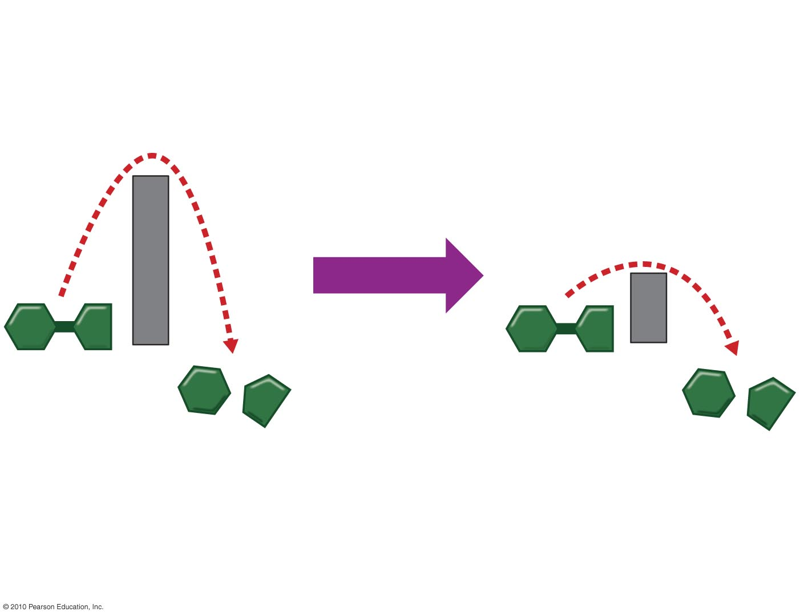
Activation energy
Enzyme added
Reactant
Reactant
Products
Products
Figure 5.UN02
Notes:
Figure UN2 Summary: enzyme reducing activation energy

Slide 8
Induced Fit
Every enzyme is very selective, catalyzing a specific reaction.
Each enzyme recognizes a substrate, a specific reactant molecule.
The active site fits to the substrate, and the enzyme changes shape slightly.
This interaction is called induced fit.
Notes:
Student Misconceptions and Concerns
1. For students not previously familiar with activation energy, analogies can make all the difference. Activation energy can be thought of as a small input that is needed to trigger a large output. This is like (a) an irritated person who needs only a bit more frustration to explode in anger, (b) small waves that lift debris over a dam, or (c) lighting a match around lighter fluid. In each situation, the output was much greater than the input.
2. The specific interactions of enzymes and substrates can be illustrated with simple physical models. Many students new to these concepts will benefit from several forms of explanation, including diagrams such as those in the textbook, physical models, and the opportunity to manipulate or create their own examples. New concepts, like pitching a tent, are best constructed with many lines of support.
Teaching Tips
1. An induced fit is much like the change in shape of a glove when a hand is inserted. The glove’s general shape matches the hand, but the final “fit” requires some additional adjustments of the glove and hand.
2. Enzyme inhibitors that block the active site are like (a) a person sitting in your assigned theater seat or (b) a car parked in your parking space. Analogies for inhibitors that change the shape of the active site are more difficult to imagine. Consider challenging your students to think of such analogies.
3. Feedback regulation relies upon the negative feedback of the accumulation of a product. Ask students in class to suggest other products of reactions that inhibit the process that made them, when the product reaches high enough levels. (Gas station pumps routinely shut off when a high level of gasoline is detected. Furnaces typically turn off when enough heat has been produced, and toilets stop running when the tank is refilled.)
4. Consider challenging your class to suggest advantages to using specific enzyme inhibitors as insect poisons. Many advantages exist and include (a) the ability to target chemical reactions of only certain types of pest organisms and (b) the ability to target chemical reactions that are found in insects but not in humans.
5. The information in DNA is used to direct the production of RNA, which in turn directs the production of proteins. Yet in Chapter 3, four different types of biological molecules were noted as significant components of life. Students who think this through might wonder, and you could point out, that DNA does not directly control the production of carbohydrates and lipids. So how does DNA exert its influence over the synthesis of these two chemical groups? The answer is largely by way of enzymes, which are proteins with the ability to control the production of carbohydrates and lipids.

Slide 9
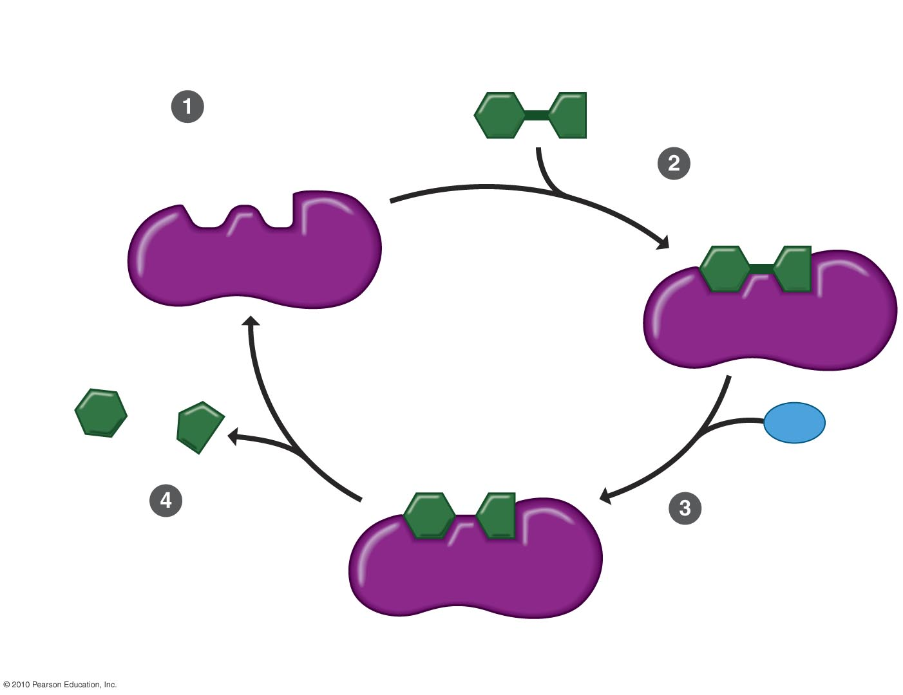
Substrate (sucrose)
Sucrase can accept a
molecule of its substrate.
Active site
Substrate binds
to the enzyme.
Enzyme
(sucrase)
Fructose
H₂O
Glucose
The products
are released.
The enzyme
catalyzes the
chemical reaction.
Figure 5.9-4
Notes:
Figure 5.9 How an enzyme works (Step 4)

Slide 10
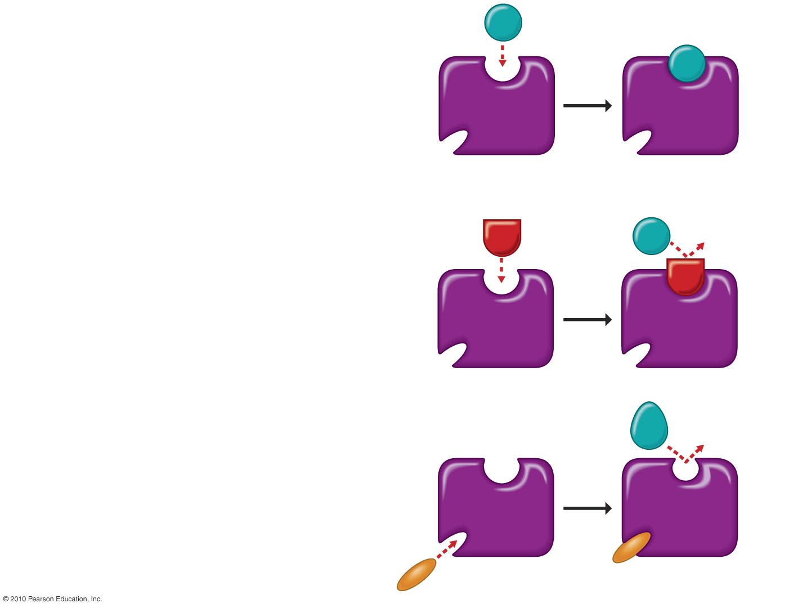
(a) Enzyme and substrate
binding normally
Substrate
Active site
Enzyme
Substrate
(b) Enzyme inhibition by
a substrate imposter
Inhibitor
Active site
Enzyme
(c) Enzyme inhibition by
a molecule that causes
the active site to change
shape
Substrate
Active site
Inhibitor
Enzyme
Figure 5.10
Notes:
Figure 5.10 Enzyme inhibitors

Slide 11
MEMBRANE FUNCTION
Working cells must control the flow of materials to and from the environment.
Membrane proteins perform many functions.
Transport proteins
Are located in membranes
Regulate the passage of materials into and out of the cell
Notes:
Student Misconceptions and Concerns
1. To students with limited science backgrounds, concepts such as diffusion and osmosis can take considerable time to fully understand and apply. Instructors often struggle to remember a time in their lives when they did not know about such fundamental scientific principles. Consider spending extra time to illustrate and demonstrate these key processes to the class. Consider short interactive class exercises in which students create analogies or think of examples of these principles in their lives.
2. Students easily confuse the term hypertonic and hypotonic. One challenge is to understand that these are relative terms, such as heavier, darker, or fewer. No single solution is “heavier”, no single cup of coffee is “darker”, and no single bag of M & M’s has “fewer” candies. Such terms only apply when comparing two or more items. A solution with a higher concentration is “hypertonic”. But the same solution might also be “hypotonic” to a third solution.
Teaching Tips
1. Students often benefit from reminders of diffusion in their lives. Smells can usually be traced back to their sources—the smell of dinner on the stove, the scent of a perfume or cologne to its bottle, the smoke drifting away from a campfire. These scents are strongest nearest the source and weaker as we move away.
2. Consider demonstrating simple diffusion. A large jar of water and a few drops of dark-colored dye work well over the course of a lecture period. Or release a strong scent of cologne or peppermint or peel part of an orange in the classroom and have students raise their hands as they first detect the smell. Students nearest the source will raise their hands before students farther away. The fan from an active overhead projector or overhead vent may bias the experiment a bit, so be aware of any directed movements of air in your classroom that might disrupt this demonstration.
3. The word root “hypo” means “below”. Thus, a hypodermic needle injects substances below the dermis. Students might best remember that hypotonic solutions have concentrations below that of the other solution(s).
4. After introducing the idea of hypertonic and hypotonic solutions, you may wish to challenge your students with the following: A marine salmon moves from the ocean up a freshwater stream to reproduce. The salmon is moving from a ___________ environment to a ___________ environment. (Answers: hypertonic to a hypotonic)
5. Your students may have noticed that their fingers wrinkle after taking a long shower, bath, or washing dishes. The skin wrinkles because it is swollen with water but still tacked down at some points. Oils inhibit the movement of water into our skin. Thus, soapy water results in wrinkling faster than plain water since the soap removes the natural layer of oil from our skin. Our skin is hypertonic to the solutions that produce the swelling that appears as large wrinkles.
6. The affects of hypertonic and hypotonic solutions are easily demonstrated if students soak carrot sticks, long slices of potato, or celery in hypertonic and hypotonic solutions. These also make nice class demonstrations.
7. The three stages of cell signaling can be compared to a human reaction. Consider someone calling your name. (1) Reception—The sound waves of someone’s voice hitting and changing the shape of your eardrum. (2) Transduction—Your ear converts sound waves to nerve impulses and sends a signal to your brain that your name has been called. (3) Response—You look around to see who is calling.

Slide 12
Passive Transport: Diffusion across Membranes
Molecules contain heat energy that causes them to vibrate and wander randomly.
Diffusion is the tendency for molecules of any substance to spread out into the available space.
Passive transport is the diffusion of a substance across a membrane without the input of energy.
Diffusion is an example of passive transport.
Substances diffuse down their concentration gradient, a region in which the substance’s density changes.
Notes:
Student Misconceptions and Concerns
1. To students with limited science backgrounds, concepts such as diffusion and osmosis can take considerable time to fully understand and apply. Instructors often struggle to remember a time in their lives when they did not know about such fundamental scientific principles. Consider spending extra time to illustrate and demonstrate these key processes to the class. Consider short interactive class exercises in which students create analogies or think of examples of these principles in their lives.
2. Students easily confuse the term hypertonic and hypotonic. One challenge is to understand that these are relative terms, such as heavier, darker, or fewer. No single solution is “heavier”, no single cup of coffee is “darker”, and no single bag of M & M’s has “fewer” candies. Such terms only apply when comparing two or more items. A solution with a higher concentration is “hypertonic”. But the same solution might also be “hypotonic” to a third solution.
Teaching Tips
1. Students often benefit from reminders of diffusion in their lives. Smells can usually be traced back to their sources—the smell of dinner on the stove, the scent of a perfume or cologne to its bottle, the smoke drifting away from a campfire. These scents are strongest nearest the source and weaker as we move away.
2. Consider demonstrating simple diffusion. A large jar of water and a few drops of dark-colored dye work well over the course of a lecture period. Or release a strong scent of cologne or peppermint or peel part of an orange in the classroom and have students raise their hands as they first detect the smell. Students nearest the source will raise their hands before students farther away. The fan from an active overhead projector or overhead vent may bias the experiment a bit, so be aware of any directed movements of air in your classroom that might disrupt this demonstration.
3. The word root “hypo” means “below”. Thus, a hypodermic needle injects substances below the dermis. Students might best remember that hypotonic solutions have concentrations below that of the other solution(s).
4. After introducing the idea of hypertonic and hypotonic solutions, you may wish to challenge your students with the following: A marine salmon moves from the ocean up a freshwater stream to reproduce. The salmon is moving from a ___________ environment to a ___________ environment. (Answers: hypertonic to a hypotonic)
5. Your students may have noticed that their fingers wrinkle after taking a long shower, bath, or washing dishes. The skin wrinkles because it is swollen with water but still tacked down at some points. Oils inhibit the movement of water into our skin. Thus, soapy water results in wrinkling faster than plain water since the soap removes the natural layer of oil from our skin. Our skin is hypertonic to the solutions that produce the swelling that appears as large wrinkles.
6. The affects of hypertonic and hypotonic solutions are easily demonstrated if students soak carrot sticks, long slices of potato, or celery in hypertonic and hypotonic solutions. These also make nice class demonstrations.
7. The three stages of cell signaling can be compared to a human reaction. Consider someone calling your name. (1) Reception—The sound waves of someone’s voice hitting and changing the shape of your eardrum. (2) Transduction—Your ear converts sound waves to nerve impulses and sends a signal to your brain that your name has been called. (3) Response—You look around to see who is calling.

Slide 13
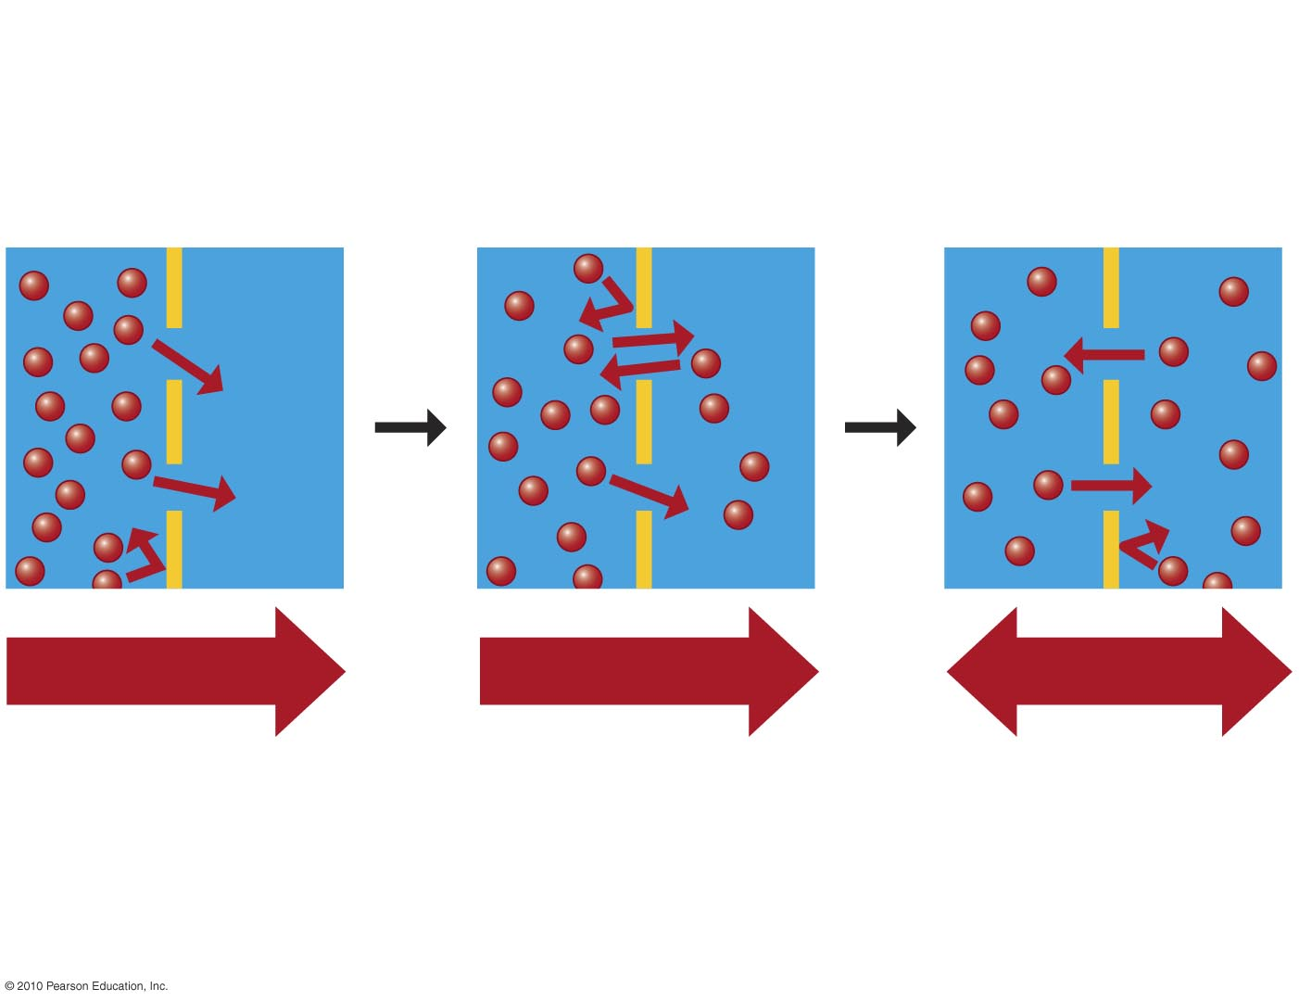
Molecules of dye
Membrane
Net diffusion
Net diffusion
Equilibrium
(a) Passive transport of one type of molecule
Figure 5.12a
Notes:
Figure 5.12a Passive transport of one type of molecule

Slide 14
Some substances do not cross membranes spontaneously.
These substances can be transported via facilitated diffusion.
Specific transport proteins act as selective corridors.
No energy input is needed.
The diffusion of water across a selectively permeable membrane is osmosis.
Notes:
Student Misconceptions and Concerns
1. To students with limited science backgrounds, concepts such as diffusion and osmosis can take considerable time to fully understand and apply. Instructors often struggle to remember a time in their lives when they did not know about such fundamental scientific principles. Consider spending extra time to illustrate and demonstrate these key processes to the class. Consider short interactive class exercises in which students create analogies or think of examples of these principles in their lives.
2. Students easily confuse the term hypertonic and hypotonic. One challenge is to understand that these are relative terms, such as heavier, darker, or fewer. No single solution is “heavier”, no single cup of coffee is “darker”, and no single bag of M & M’s has “fewer” candies. Such terms only apply when comparing two or more items. A solution with a higher concentration is “hypertonic”. But the same solution might also be “hypotonic” to a third solution.
Teaching Tips
1. Students often benefit from reminders of diffusion in their lives. Smells can usually be traced back to their sources—the smell of dinner on the stove, the scent of a perfume or cologne to its bottle, the smoke drifting away from a campfire. These scents are strongest nearest the source and weaker as we move away.
2. Consider demonstrating simple diffusion. A large jar of water and a few drops of dark-colored dye work well over the course of a lecture period. Or release a strong scent of cologne or peppermint or peel part of an orange in the classroom and have students raise their hands as they first detect the smell. Students nearest the source will raise their hands before students farther away. The fan from an active overhead projector or overhead vent may bias the experiment a bit, so be aware of any directed movements of air in your classroom that might disrupt this demonstration.
3. The word root “hypo” means “below”. Thus, a hypodermic needle injects substances below the dermis. Students might best remember that hypotonic solutions have concentrations below that of the other solution(s).
4. After introducing the idea of hypertonic and hypotonic solutions, you may wish to challenge your students with the following: A marine salmon moves from the ocean up a freshwater stream to reproduce. The salmon is moving from a ___________ environment to a ___________ environment. (Answers: hypertonic to a hypotonic)
5. Your students may have noticed that their fingers wrinkle after taking a long shower, bath, or washing dishes. The skin wrinkles because it is swollen with water but still tacked down at some points. Oils inhibit the movement of water into our skin. Thus, soapy water results in wrinkling faster than plain water since the soap removes the natural layer of oil from our skin. Our skin is hypertonic to the solutions that produce the swelling that appears as large wrinkles.
6. The affects of hypertonic and hypotonic solutions are easily demonstrated if students soak carrot sticks, long slices of potato, or celery in hypertonic and hypotonic solutions. These also make nice class demonstrations.
7. The three stages of cell signaling can be compared to a human reaction. Consider someone calling your name. (1) Reception—The sound waves of someone’s voice hitting and changing the shape of your eardrum. (2) Transduction—Your ear converts sound waves to nerve impulses and sends a signal to your brain that your name has been called. (3) Response—You look around to see who is calling.

Slide 15
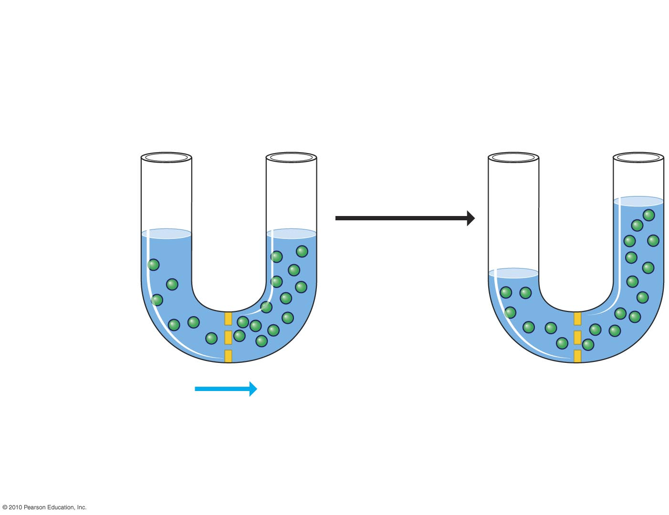
Hypotonic solution
Hypertonic solution
Isotonic solutions
Osmosis
Sugar
molecule
Selectively
permeable
membrane
Osmosis
Figure 5.13-2
Notes:
Figure 5.13 Osmosis (Step 2)

Slide 16
A hypertonic solution has a higher concentration of solute.
A hypotonic solution has a lower concentration of solute.
An isotonic solution has an equal concentration of solute.
Notes:
Student Misconceptions and Concerns
1. To students with limited science backgrounds, concepts such as diffusion and osmosis can take considerable time to fully understand and apply. Instructors often struggle to remember a time in their lives when they did not know about such fundamental scientific principles. Consider spending extra time to illustrate and demonstrate these key processes to the class. Consider short interactive class exercises in which students create analogies or think of examples of these principles in their lives.
2. Students easily confuse the term hypertonic and hypotonic. One challenge is to understand that these are relative terms, such as heavier, darker, or fewer. No single solution is “heavier”, no single cup of coffee is “darker”, and no single bag of M & M’s has “fewer” candies. Such terms only apply when comparing two or more items. A solution with a higher concentration is “hypertonic”. But the same solution might also be “hypotonic” to a third solution.
Teaching Tips
1. Students often benefit from reminders of diffusion in their lives. Smells can usually be traced back to their sources—the smell of dinner on the stove, the scent of a perfume or cologne to its bottle, the smoke drifting away from a campfire. These scents are strongest nearest the source and weaker as we move away.
2. Consider demonstrating simple diffusion. A large jar of water and a few drops of dark-colored dye work well over the course of a lecture period. Or release a strong scent of cologne or peppermint or peel part of an orange in the classroom and have students raise their hands as they first detect the smell. Students nearest the source will raise their hands before students farther away. The fan from an active overhead projector or overhead vent may bias the experiment a bit, so be aware of any directed movements of air in your classroom that might disrupt this demonstration.
3. The word root “hypo” means “below”. Thus, a hypodermic needle injects substances below the dermis. Students might best remember that hypotonic solutions have concentrations below that of the other solution(s).
4. After introducing the idea of hypertonic and hypotonic solutions, you may wish to challenge your students with the following: A marine salmon moves from the ocean up a freshwater stream to reproduce. The salmon is moving from a ___________ environment to a ___________ environment. (Answers: hypertonic to a hypotonic)
5. Your students may have noticed that their fingers wrinkle after taking a long shower, bath, or washing dishes. The skin wrinkles because it is swollen with water but still tacked down at some points. Oils inhibit the movement of water into our skin. Thus, soapy water results in wrinkling faster than plain water since the soap removes the natural layer of oil from our skin. Our skin is hypertonic to the solutions that produce the swelling that appears as large wrinkles.
6. The affects of hypertonic and hypotonic solutions are easily demonstrated if students soak carrot sticks, long slices of potato, or celery in hypertonic and hypotonic solutions. These also make nice class demonstrations.
7. The three stages of cell signaling can be compared to a human reaction. Consider someone calling your name. (1) Reception—The sound waves of someone’s voice hitting and changing the shape of your eardrum. (2) Transduction—Your ear converts sound waves to nerve impulses and sends a signal to your brain that your name has been called. (3) Response—You look around to see who is calling.

Slide 17
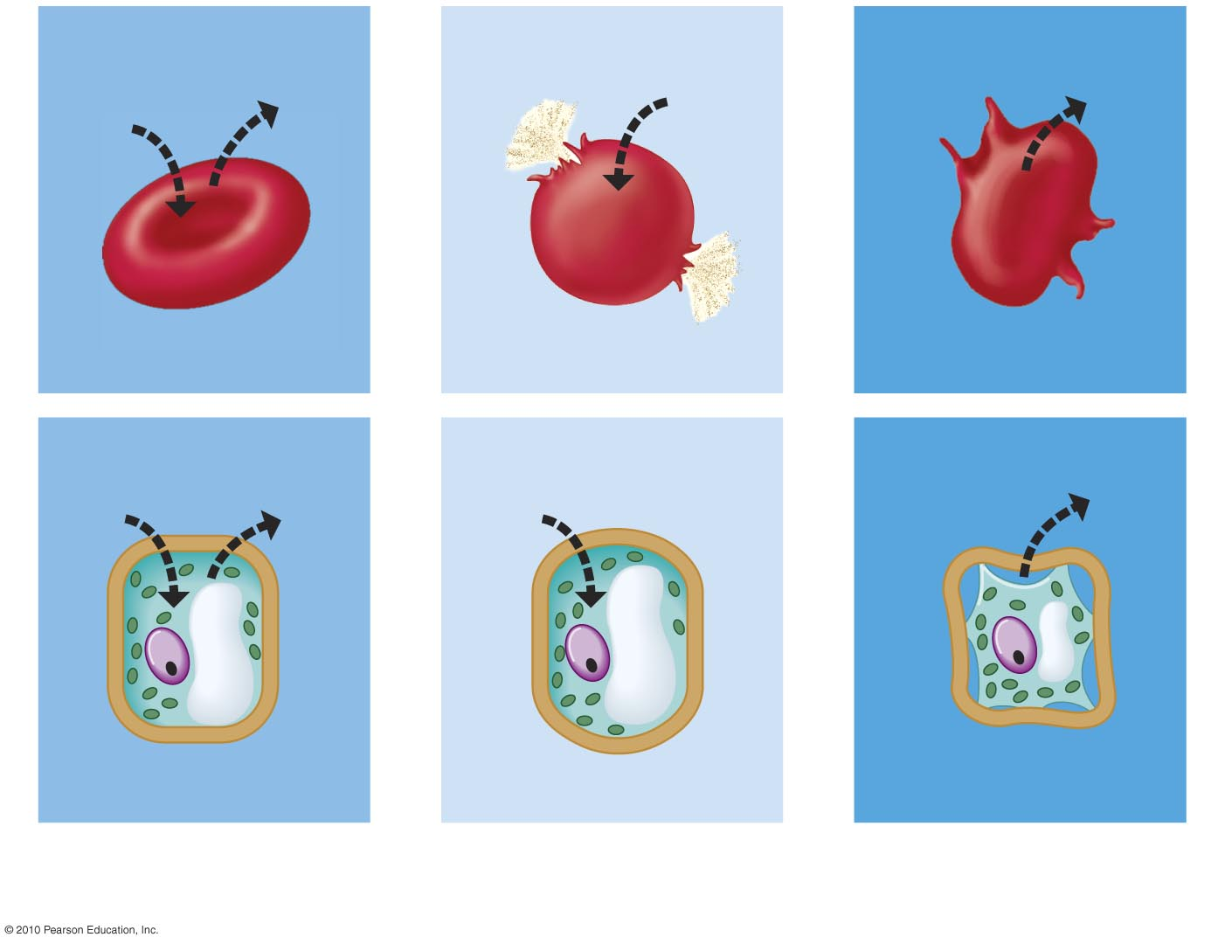
Animal cell
H₂O
H₂O
H₂O
H₂O
Normal
Lysing
Shriveled
Plant cell
Plasma
membrane
H₂O
H₂O
H₂O
H₂O
Flaccid (wilts)
Turgid
Shriveled
(a) Isotonic
solution
(b) Hypotonic
solution
(c) Hypertonic
solution
Figure 5.14
Notes:
Figure 5.14 The behavior of animal and plant cells in different osmotic environments

Slide 18
Water Balance in Plant Cells
Plant have rigid cell walls.
Plant cells require a hypotonic environment, which keeps these walled cells turgid.
As a plant cell loses water,
It shrivels.
Its plasma membrane may pull away from the cell wall in the process of plasmolysis, which usually kills the cell.
Notes:
Student Misconceptions and Concerns
1. To students with limited science backgrounds, concepts such as diffusion and osmosis can take considerable time to fully understand and apply. Instructors often struggle to remember a time in their lives when they did not know about such fundamental scientific principles. Consider spending extra time to illustrate and demonstrate these key processes to the class. Consider short interactive class exercises in which students create analogies or think of examples of these principles in their lives.
2. Students easily confuse the term hypertonic and hypotonic. One challenge is to understand that these are relative terms, such as heavier, darker, or fewer. No single solution is “heavier”, no single cup of coffee is “darker”, and no single bag of M & M’s has “fewer” candies. Such terms only apply when comparing two or more items. A solution with a higher concentration is “hypertonic”. But the same solution might also be “hypotonic” to a third solution.
Teaching Tips
1. Students often benefit from reminders of diffusion in their lives. Smells can usually be traced back to their sources—the smell of dinner on the stove, the scent of a perfume or cologne to its bottle, the smoke drifting away from a campfire. These scents are strongest nearest the source and weaker as we move away.
2. Consider demonstrating simple diffusion. A large jar of water and a few drops of dark-colored dye work well over the course of a lecture period. Or release a strong scent of cologne or peppermint or peel part of an orange in the classroom and have students raise their hands as they first detect the smell. Students nearest the source will raise their hands before students farther away. The fan from an active overhead projector or overhead vent may bias the experiment a bit, so be aware of any directed movements of air in your classroom that might disrupt this demonstration.
3. The word root “hypo” means “below”. Thus, a hypodermic needle injects substances below the dermis. Students might best remember that hypotonic solutions have concentrations below that of the other solution(s).
4. After introducing the idea of hypertonic and hypotonic solutions, you may wish to challenge your students with the following: A marine salmon moves from the ocean up a freshwater stream to reproduce. The salmon is moving from a ___________ environment to a ___________ environment. (Answers: hypertonic to a hypotonic)
5. Your students may have noticed that their fingers wrinkle after taking a long shower, bath, or washing dishes. The skin wrinkles because it is swollen with water but still tacked down at some points. Oils inhibit the movement of water into our skin. Thus, soapy water results in wrinkling faster than plain water since the soap removes the natural layer of oil from our skin. Our skin is hypertonic to the solutions that produce the swelling that appears as large wrinkles.
6. The affects of hypertonic and hypotonic solutions are easily demonstrated if students soak carrot sticks, long slices of potato, or celery in hypertonic and hypotonic solutions. These also make nice class demonstrations.
7. The three stages of cell signaling can be compared to a human reaction. Consider someone calling your name. (1) Reception—The sound waves of someone’s voice hitting and changing the shape of your eardrum. (2) Transduction—Your ear converts sound waves to nerve impulses and sends a signal to your brain that your name has been called. (3) Response—You look around to see who is calling.

Slide 19
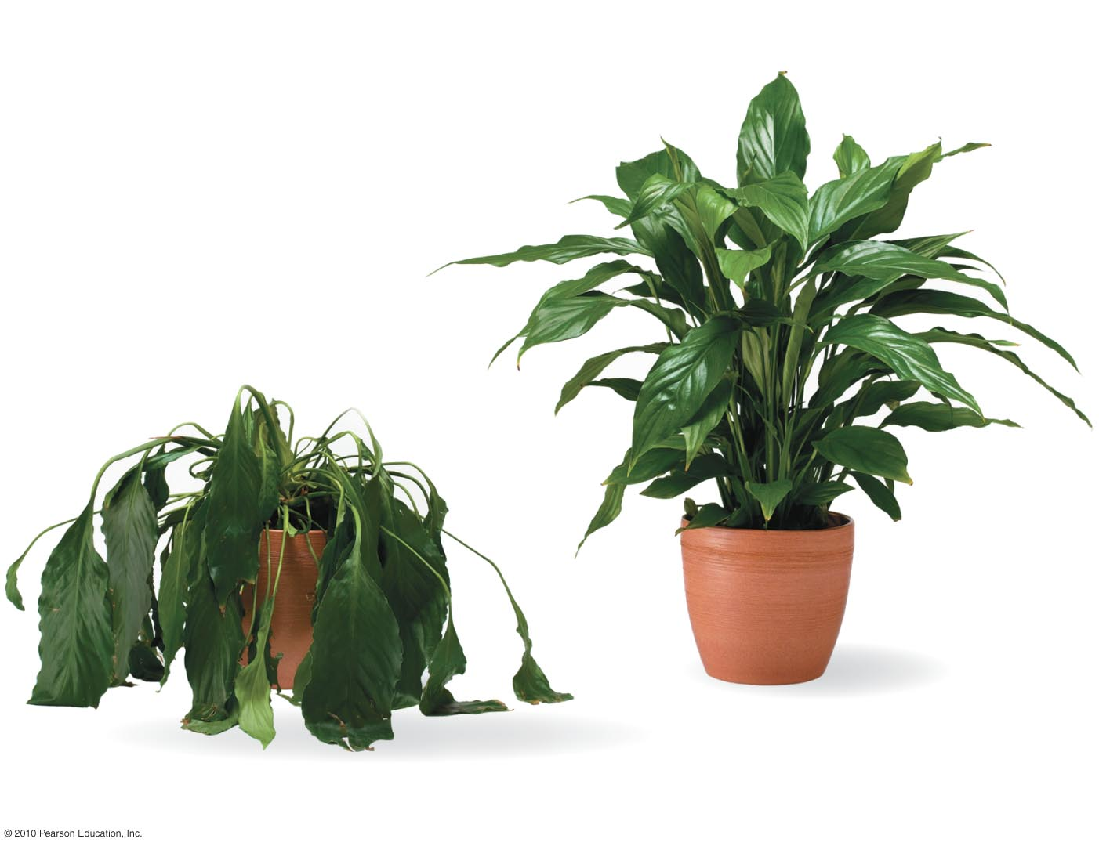
Figure 5.15
Notes:
Figure 5.15 Plant turgor

Slide 20
Active Transport: The Pumping of Molecules Across Membranes
Active transport requires energy to move molecules across a membrane.
© 2010 Pearson Education, Inc.
Notes:
Student Misconceptions and Concerns
1. To students with limited science backgrounds, concepts such as diffusion and osmosis can take considerable time to fully understand and apply. Instructors often struggle to remember a time in their lives when they did not know about such fundamental scientific principles. Consider spending extra time to illustrate and demonstrate these key processes to the class. Consider short interactive class exercises in which students create analogies or think of examples of these principles in their lives.
2. Students easily confuse the term hypertonic and hypotonic. One challenge is to understand that these are relative terms, such as heavier, darker, or fewer. No single solution is “heavier”, no single cup of coffee is “darker”, and no single bag of M & M’s has “fewer” candies. Such terms only apply when comparing two or more items. A solution with a higher concentration is “hypertonic”. But the same solution might also be “hypotonic” to a third solution.
Teaching Tips
1. Students often benefit from reminders of diffusion in their lives. Smells can usually be traced back to their sources—the smell of dinner on the stove, the scent of a perfume or cologne to its bottle, the smoke drifting away from a campfire. These scents are strongest nearest the source and weaker as we move away.
2. Consider demonstrating simple diffusion. A large jar of water and a few drops of dark-colored dye work well over the course of a lecture period. Or release a strong scent of cologne or peppermint or peel part of an orange in the classroom and have students raise their hands as they first detect the smell. Students nearest the source will raise their hands before students farther away. The fan from an active overhead projector or overhead vent may bias the experiment a bit, so be aware of any directed movements of air in your classroom that might disrupt this demonstration.
3. The word root “hypo” means “below”. Thus, a hypodermic needle injects substances below the dermis. Students might best remember that hypotonic solutions have concentrations below that of the other solution(s).
4. After introducing the idea of hypertonic and hypotonic solutions, you may wish to challenge your students with the following: A marine salmon moves from the ocean up a freshwater stream to reproduce. The salmon is moving from a ___________ environment to a ___________ environment. (Answers: hypertonic to a hypotonic)
5. Your students may have noticed that their fingers wrinkle after taking a long shower, bath, or washing dishes. The skin wrinkles because it is swollen with water but still tacked down at some points. Oils inhibit the movement of water into our skin. Thus, soapy water results in wrinkling faster than plain water since the soap removes the natural layer of oil from our skin. Our skin is hypertonic to the solutions that produce the swelling that appears as large wrinkles.
6. The affects of hypertonic and hypotonic solutions are easily demonstrated if students soak carrot sticks, long slices of potato, or celery in hypertonic and hypotonic solutions. These also make nice class demonstrations.
7. The three stages of cell signaling can be compared to a human reaction. Consider someone calling your name. (1) Reception—The sound waves of someone’s voice hitting and changing the shape of your eardrum. (2) Transduction—Your ear converts sound waves to nerve impulses and sends a signal to your brain that your name has been called. (3) Response—You look around to see who is calling.

Slide 21
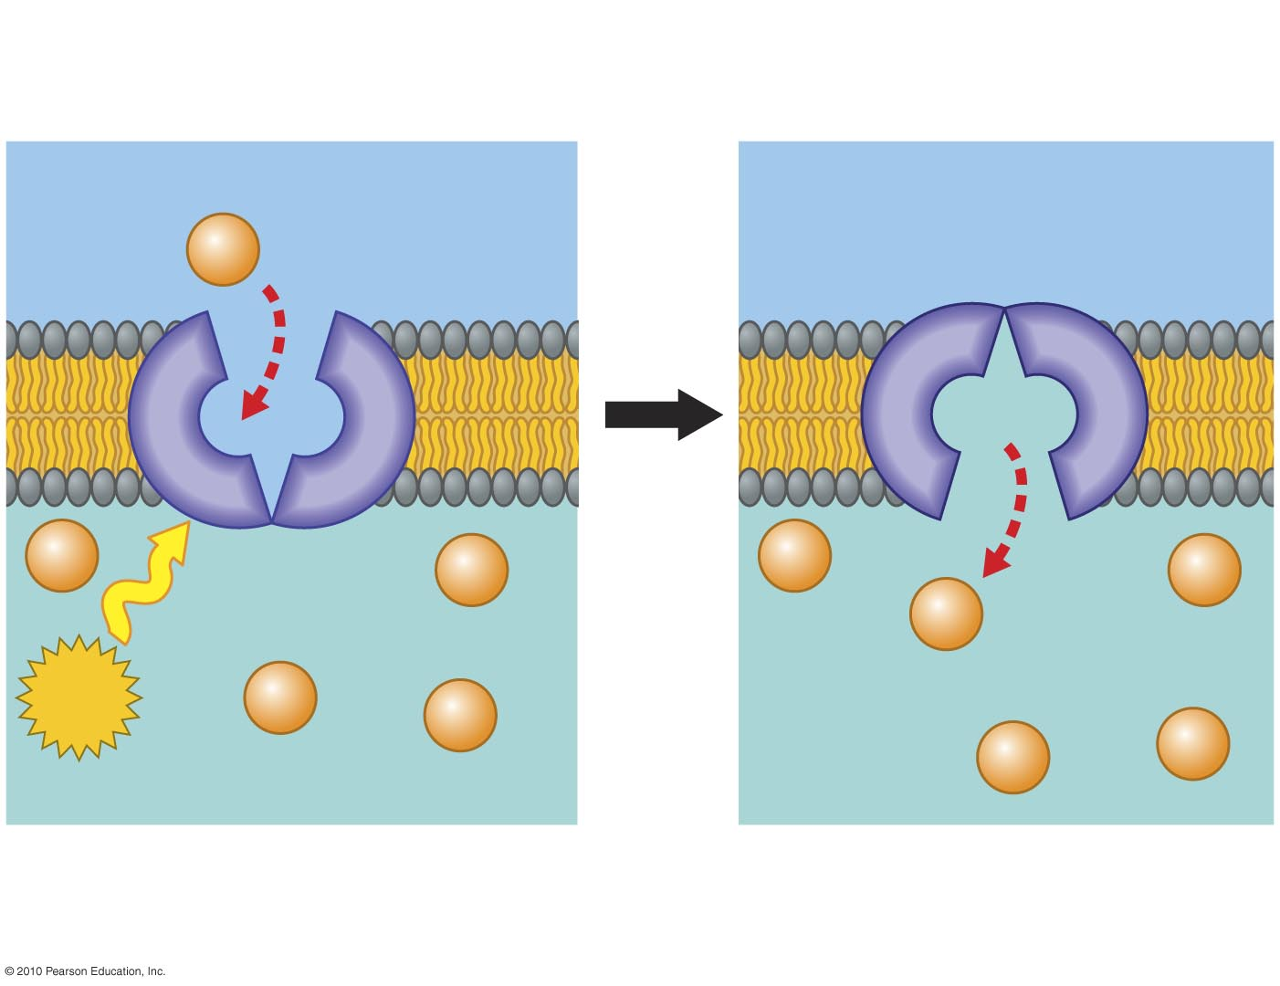
Lower solute concentration
Solute
ATP
Higher solute concentration
Figure 5.16-2
Notes:
Figure 5.16 Active transport (Step 2)

Slide 22
Exocytosis and Endocytosis: Traffic of Large Molecules
Exocytosis is the secretion of large molecules within vesicles.
Endocytosis takes material into a cell within vesicles that bud inward from the plasma membrane.
© 2010 Pearson Education, Inc.
Notes:
Student Misconceptions and Concerns
1. To students with limited science backgrounds, concepts such as diffusion and osmosis can take considerable time to fully understand and apply. Instructors often struggle to remember a time in their lives when they did not know about such fundamental scientific principles. Consider spending extra time to illustrate and demonstrate these key processes to the class. Consider short interactive class exercises in which students create analogies or think of examples of these principles in their lives.
2. Students easily confuse the term hypertonic and hypotonic. One challenge is to understand that these are relative terms, such as heavier, darker, or fewer. No single solution is “heavier”, no single cup of coffee is “darker”, and no single bag of M & M’s has “fewer” candies. Such terms only apply when comparing two or more items. A solution with a higher concentration is “hypertonic”. But the same solution might also be “hypotonic” to a third solution.
Teaching Tips
1. Students often benefit from reminders of diffusion in their lives. Smells can usually be traced back to their sources—the smell of dinner on the stove, the scent of a perfume or cologne to its bottle, the smoke drifting away from a campfire. These scents are strongest nearest the source and weaker as we move away.
2. Consider demonstrating simple diffusion. A large jar of water and a few drops of dark-colored dye work well over the course of a lecture period. Or release a strong scent of cologne or peppermint or peel part of an orange in the classroom and have students raise their hands as they first detect the smell. Students nearest the source will raise their hands before students farther away. The fan from an active overhead projector or overhead vent may bias the experiment a bit, so be aware of any directed movements of air in your classroom that might disrupt this demonstration.
3. The word root “hypo” means “below”. Thus, a hypodermic needle injects substances below the dermis. Students might best remember that hypotonic solutions have concentrations below that of the other solution(s).
4. After introducing the idea of hypertonic and hypotonic solutions, you may wish to challenge your students with the following: A marine salmon moves from the ocean up a freshwater stream to reproduce. The salmon is moving from a ___________ environment to a ___________ environment. (Answers: hypertonic to a hypotonic)
5. Your students may have noticed that their fingers wrinkle after taking a long shower, bath, or washing dishes. The skin wrinkles because it is swollen with water but still tacked down at some points. Oils inhibit the movement of water into our skin. Thus, soapy water results in wrinkling faster than plain water since the soap removes the natural layer of oil from our skin. Our skin is hypertonic to the solutions that produce the swelling that appears as large wrinkles.
6. The affects of hypertonic and hypotonic solutions are easily demonstrated if students soak carrot sticks, long slices of potato, or celery in hypertonic and hypotonic solutions. These also make nice class demonstrations.
7. The three stages of cell signaling can be compared to a human reaction. Consider someone calling your name. (1) Reception—The sound waves of someone’s voice hitting and changing the shape of your eardrum. (2) Transduction—Your ear converts sound waves to nerve impulses and sends a signal to your brain that your name has been called. (3) Response—You look around to see who is calling.

Slide 23
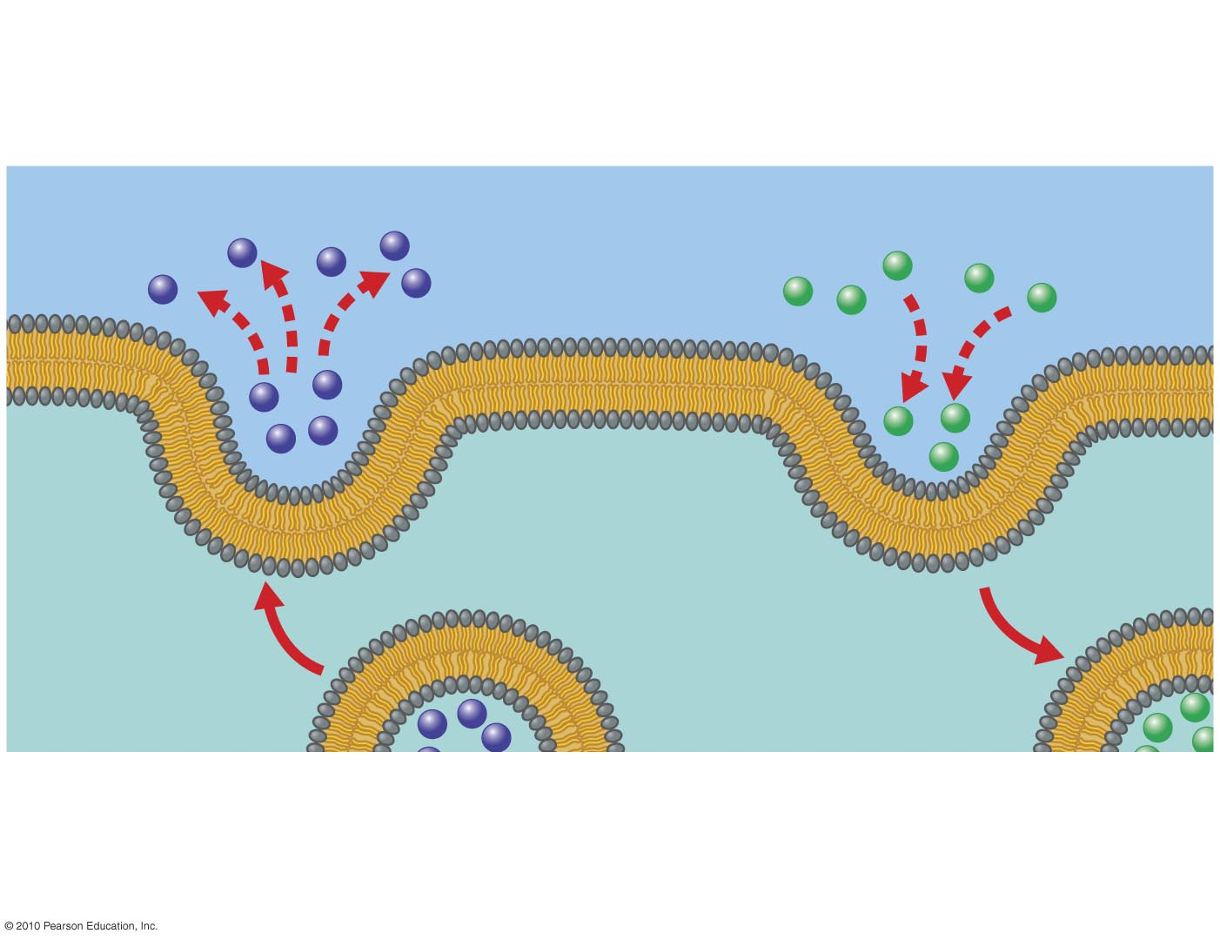
Exocytosis
Endocytosis
Figure 5.UN04
Notes:
Figure UN4 Summary: exocytosis and endocytosis

Slide 24
There are three types of endocytosis:
Phagocytosis (“cellular eating”); a cell engulfs a particle and packages it within a food vacuole
Pinocytosis (“cellular drinking”); a cell “gulps” droplets of fluid by forming tiny vesicles
Receptor-mediated endocytosis; a cell takes in very specific molecules
Notes:
Student Misconceptions and Concerns
1. To students with limited science backgrounds, concepts such as diffusion and osmosis can take considerable time to fully understand and apply. Instructors often struggle to remember a time in their lives when they did not know about such fundamental scientific principles. Consider spending extra time to illustrate and demonstrate these key processes to the class. Consider short interactive class exercises in which students create analogies or think of examples of these principles in their lives.
2. Students easily confuse the term hypertonic and hypotonic. One challenge is to understand that these are relative terms, such as heavier, darker, or fewer. No single solution is “heavier”, no single cup of coffee is “darker”, and no single bag of M & M’s has “fewer” candies. Such terms only apply when comparing two or more items. A solution with a higher concentration is “hypertonic”. But the same solution might also be “hypotonic” to a third solution.
Teaching Tips
1. Students often benefit from reminders of diffusion in their lives. Smells can usually be traced back to their sources—the smell of dinner on the stove, the scent of a perfume or cologne to its bottle, the smoke drifting away from a campfire. These scents are strongest nearest the source and weaker as we move away.
2. Consider demonstrating simple diffusion. A large jar of water and a few drops of dark-colored dye work well over the course of a lecture period. Or release a strong scent of cologne or peppermint or peel part of an orange in the classroom and have students raise their hands as they first detect the smell. Students nearest the source will raise their hands before students farther away. The fan from an active overhead projector or overhead vent may bias the experiment a bit, so be aware of any directed movements of air in your classroom that might disrupt this demonstration.
3. The word root “hypo” means “below”. Thus, a hypodermic needle injects substances below the dermis. Students might best remember that hypotonic solutions have concentrations below that of the other solution(s).
4. After introducing the idea of hypertonic and hypotonic solutions, you may wish to challenge your students with the following: A marine salmon moves from the ocean up a freshwater stream to reproduce. The salmon is moving from a ___________ environment to a ___________ environment. (Answers: hypertonic to a hypotonic)
5. Your students may have noticed that their fingers wrinkle after taking a long shower, bath, or washing dishes. The skin wrinkles because it is swollen with water but still tacked down at some points. Oils inhibit the movement of water into our skin. Thus, soapy water results in wrinkling faster than plain water since the soap removes the natural layer of oil from our skin. Our skin is hypertonic to the solutions that produce the swelling that appears as large wrinkles.
6. The affects of hypertonic and hypotonic solutions are easily demonstrated if students soak carrot sticks, long slices of potato, or celery in hypertonic and hypotonic solutions. These also make nice class demonstrations.
7. The three stages of cell signaling can be compared to a human reaction. Consider someone calling your name. (1) Reception—The sound waves of someone’s voice hitting and changing the shape of your eardrum. (2) Transduction—Your ear converts sound waves to nerve impulses and sends a signal to your brain that your name has been called. (3) Response—You look around to see who is calling.

Slide 25
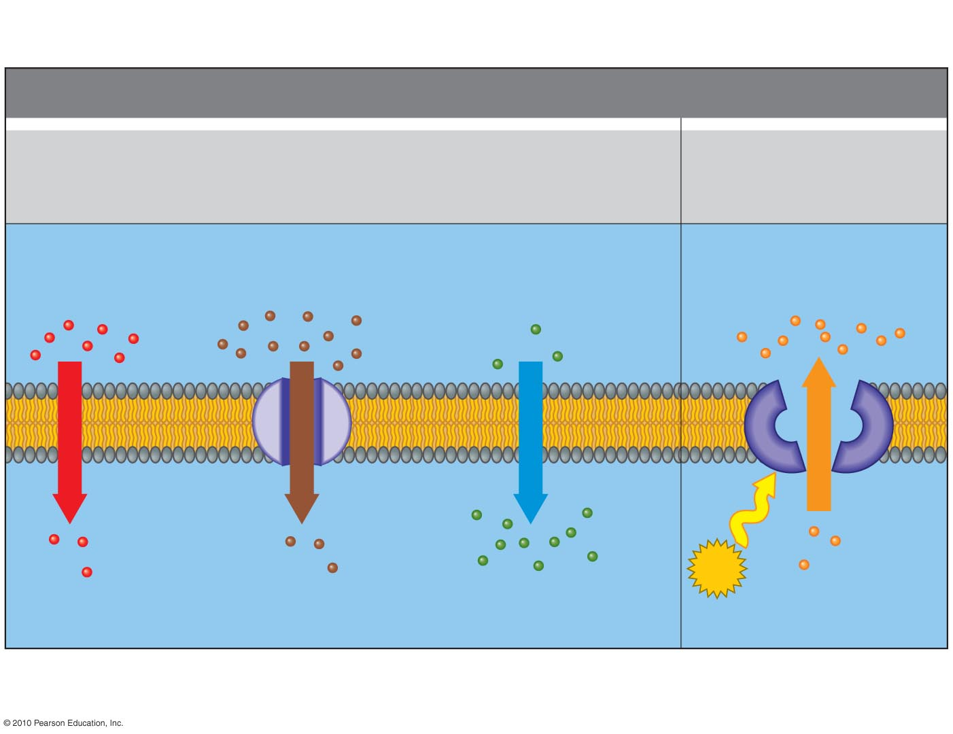
MEMBRANE TRANSPORT
Passive Transport
(requires no energy)
Active Transport
(requires energy)
Diffusion
Facilitated diffusion
Osmosis
Higher solute concentration
Higher water concentration
(lower solute concentration)
Higher solute
concentration
Solute
Solute
Solute
Water
Solute
ATP
Lower solute concentration
Lower water concentration
(higher solute concentration)
Lower solute
concentration
Figure 5.UN03
Notes:
Figure UN3 Summary: membrane transport

