Slide 1
Chapter 11: Early Hominins

Slide 2
Hominin versus Hominid

Slide 3
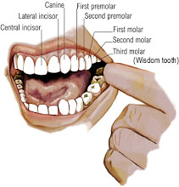
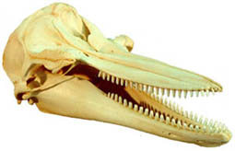
Dental records
Homodont
Heterodont
Having teeth that are uniform in form, shape, and function.
Tooth array in which different teeth have different forms and functions.

Slide 4
CP3 Honing Complex

Slide 5
Searching for early Hominins

Slide 6
Candidates
Sahelanthropus tchadensis: “the Sahara hominin from Chad.” Estimated at 5.2 – 7 mya. Is it a hominin or fossil ape?

Slide 7
Cont.
Orrorin tugenensis: “millennium man.” 6 mya, larger body size than expected for late-Miocene ape.

Slide 8
Cont.
Ardipithecus ramidus: “ground-living root hominin” found in Ethipoia, dated to 4.4 mya.

Slide 9
Incentives in fossils?
Advancing careers or advancing knowledge

Slide 10
Australopithecus

Slide 11
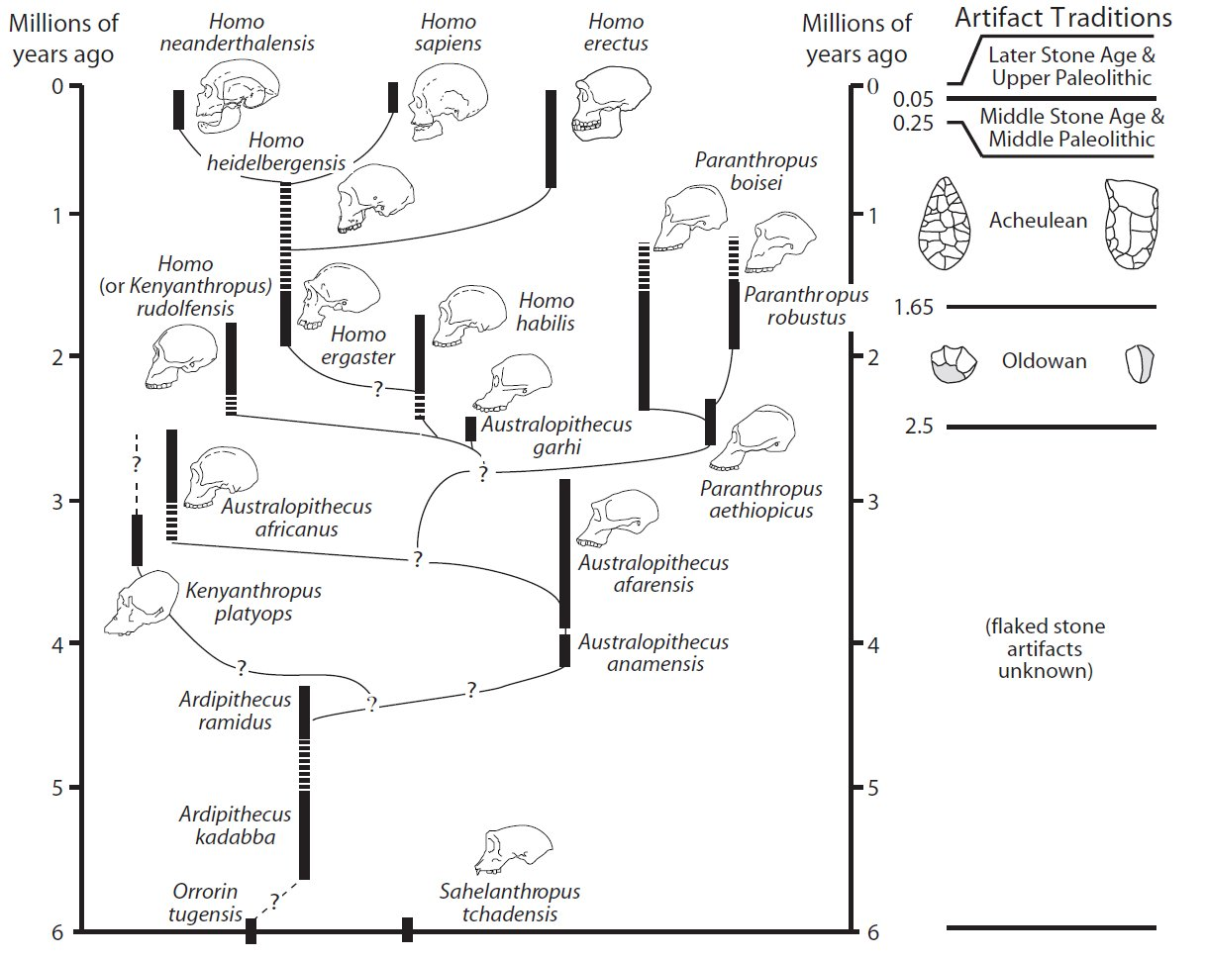

Slide 12
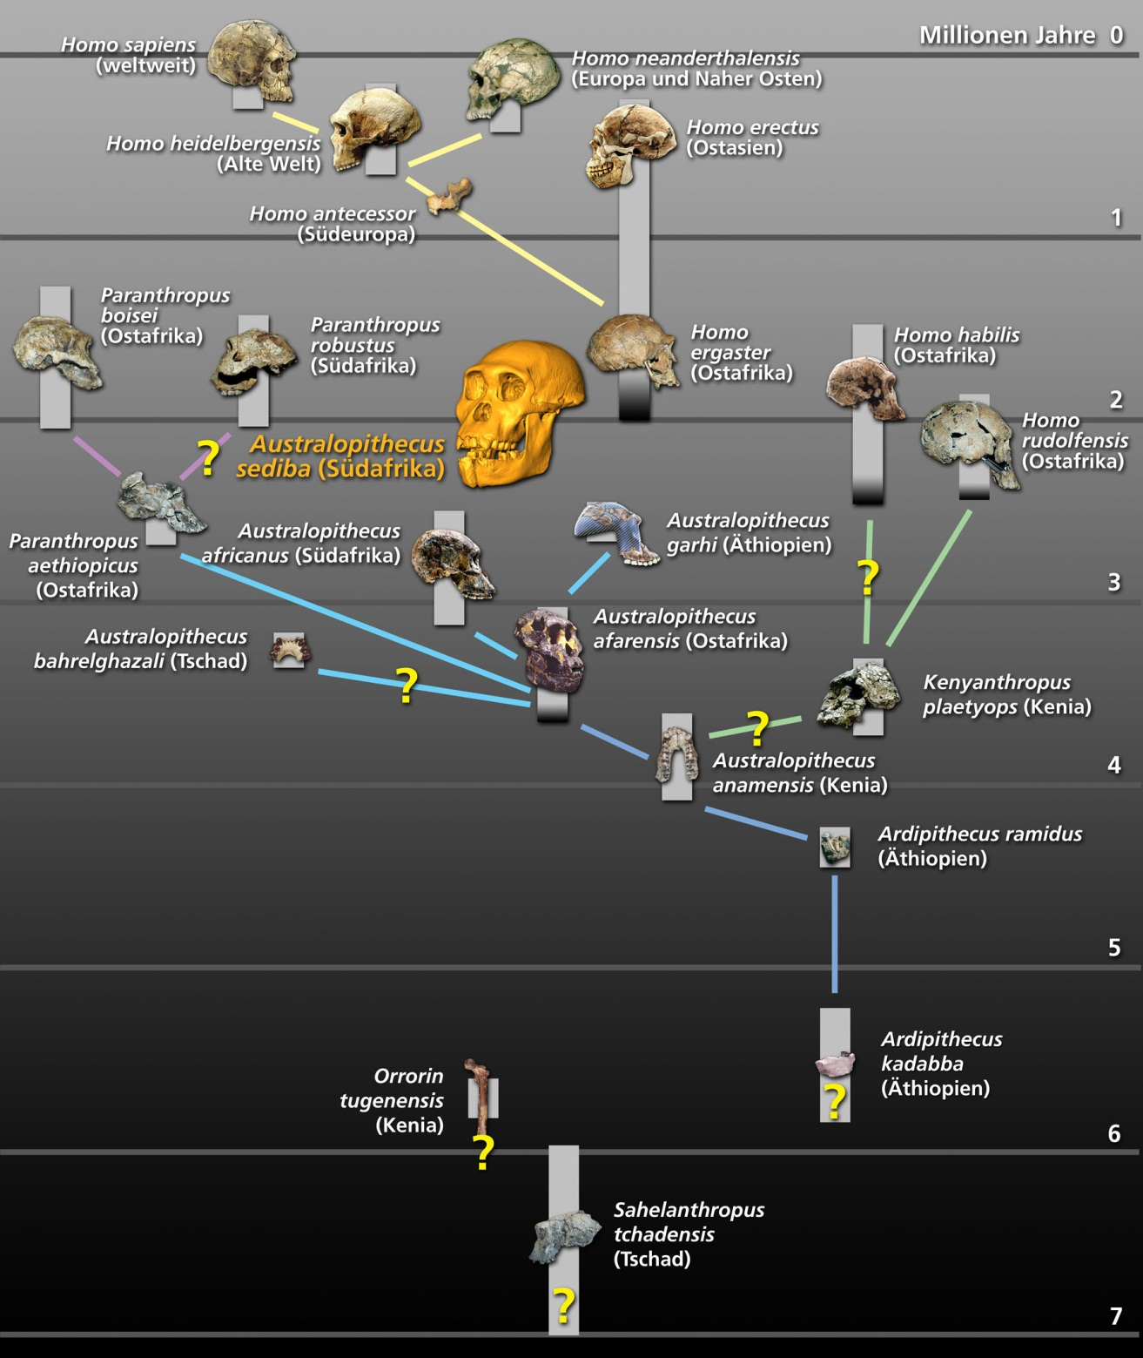

Slide 13
Name | Date | Location | Characteristics
Australopithecus anamensis | 4.2-3.9 mya | Lake Turkana, Kanapoi, Allila Bay (Kenya) | Smaller canine than Ardipithecus, CP3 complex.
Australopithecus afarensis | 3.9-2.9 mya | Awash Valley (Ethipopia) | Cranial capacity – 350-500 cc, biped, smaller teeth than chimpanzee, “Lucy”
Australopithecus bahrelghazali | 3.5-3.0 mya | West Africa | Single fossil: front mandible with seven teeth.
Kenyanthropus platyops | 3.5 mya | Lake Turkana (Kenya) | Flat face
Australopithecus garhi | 2.5 mya | Bouri (Ethiopia) | Small brain (45o cc), prognathic face, large canines, sagittal crest, near early tools.
Australopithecus africanus | 3.5-<2.0 mya | South Africa | “Taung Child,” ape-like jaw, moderate brain 450-550 cc, gracile Australopithecus.
Australopithecus sediba | 1.97-1.78 mya | South Africa | Brain – 420-435 cc
Australopithecus (P.) aethiopicus | 2.7-2.5 mya | Kenya | Sagittal crest, dished face, flared zygomatics, and huge molars.
Australopithecus (P.) boisei | 2.3-1.2 mya | Kenya, Tanzania, Ethiopia | Estimated body at 75 – 110 pounds.
Australopithecus (P.) robustus | 2.0-1.5 mya | South Africa | Cranial capacity – 500 – 550 cc

Slide 14
Australopithecus anamensis

Slide 15
Australopithecus afarensis

Slide 16
Australopithecus bahrelghazali

Slide 17
Kenyanthropus platyops

Slide 18
Australopithecus garhi

Slide 19
Australopithecus africanus

Slide 20
Australopithecus sediba

Slide 21
Australopithecus (P.) aethiopicus

Slide 22
Australopithecus (P.) boisei

Slide 23
Australopithecus (P.) robustus

Slide 24
Understanding the Australopithecine Radiation
Cohabitation
Tools and intelligence
Ancestors and Descendants

