Slide 1
PHOTOGRAPHY

Slide 2
Photography
Photography may be used to “capture reality,” and in the medium’s beginning, photographs were certainly regarded as informational: as showing the viewer a documented glimpse at something that exists in reality – you can photograph anything you see, so it must be there it a photograph exists of it.
Photographs, in essence, carry a promise of truth with them – they project an authenticity that rarely exists in other art forms.
Although this “truth” is hardly a reality, as photographs are easily manipulated to where the final image is far different than the starting point, it is still important that we perceive them as true.
Photography and the camera arts allow artists to explore time and motion. The camera can capture and preserve a moment in time, and in doing so, it allows our eyes to see motion slowed down.

Slide 3
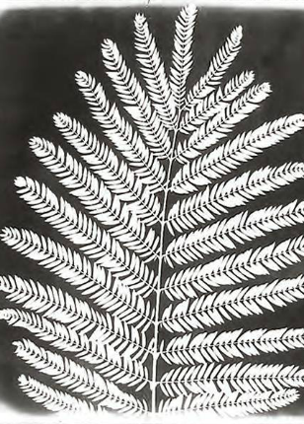
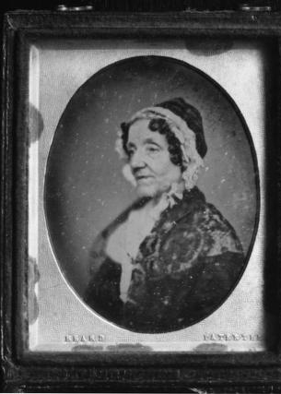
Early Photography
Camera obscuras were first used by artists in the 16th century. They could capture an image in two dimensions, but they could not preserve it.
In 1839, the problem of preserving this image was solved simultaneously by two inventors – William Henry Fox Talbot from England, and Louis-Jacques-Mandé Daguerre from France.
William Henry Fox Talbot developed a process for fixing negative images onto paper coated with light-sensitive chemicals. The resulting image on paper was called a photogenic drawing.
While Talbot was developing the photogenic drawing in England, Daguerre was developing a different process in France. He was able to fix positive images onto polished metal plates, and the resulting image was called a daguerreotype.

Slide 4
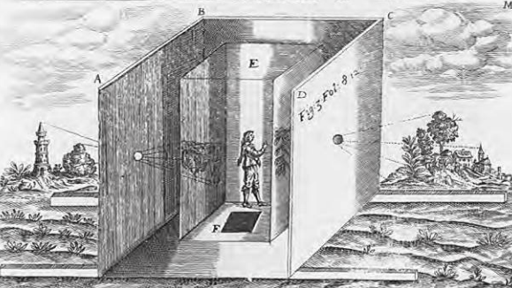
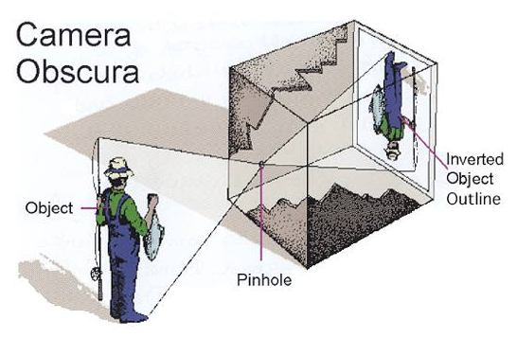
Above Left: Unidentified printmaker, Camera Obscura. Engraving, c. 1544. Bottom Right: illustration of camera obscura.
Camera is the Latin word for “room”.
By the 16th century, a darkened room called a camera obscura was used by artists to copy accurately.
A small hole on the side of a light-tight room lets in a ray of light that projects a scene, upside down, directly across from the hole.
This is essentially the same principle used by the camera today.

Slide 5
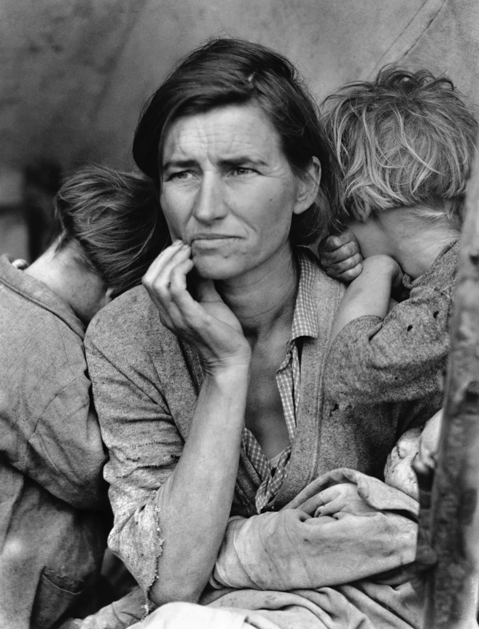
Dorothy Lange
“Migrant Mother”
Best known for her Depression-era work for the Farm Security Administration (FSA). Lange's photographs humanized the consequences of the Great Depression and influenced the development of documentary photography.
This photograph is the most well known of a larger series, shown on the next slide.

Slide 6
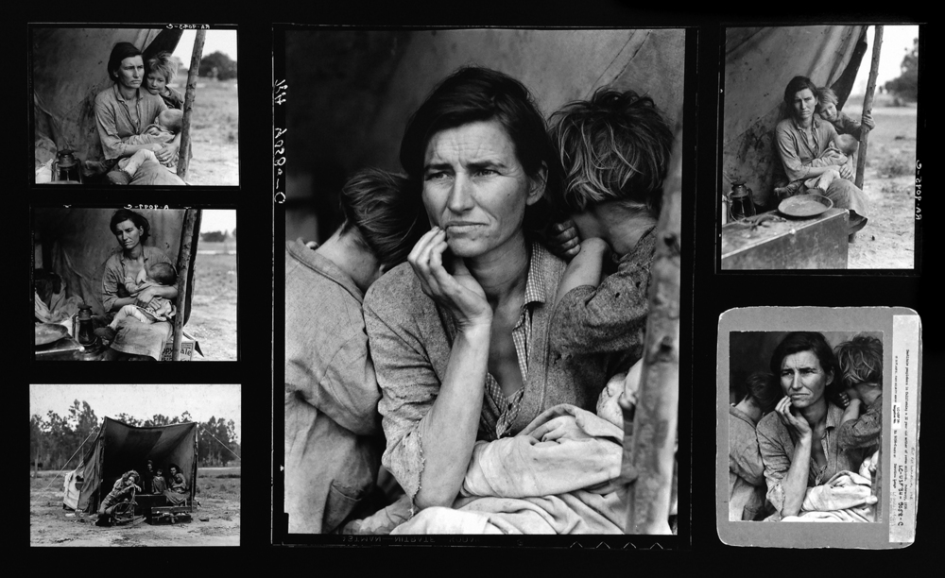
The rest of the images tell a larger story of a widowed mother of seven children. Pea crops had frozen over, leaving the mother without work.

Slide 7
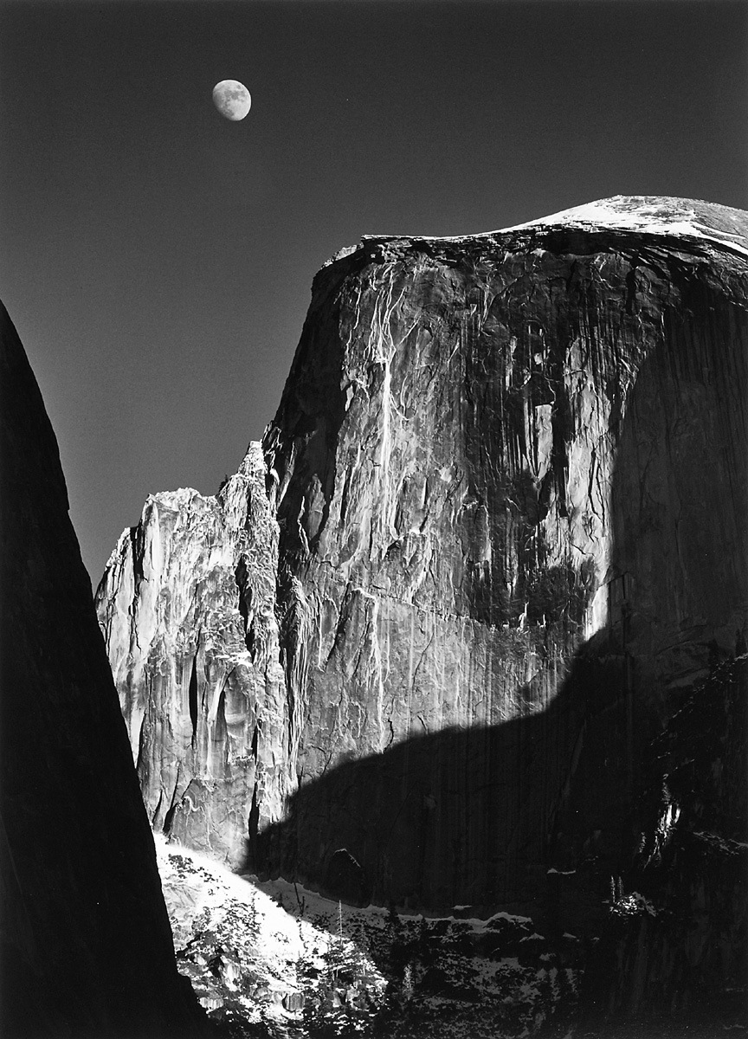
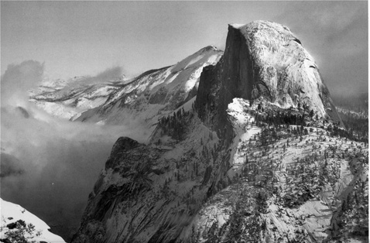
Ansel Adams was an American photographer and environmentalist. His black-and-white landscape photographs of the American West, especially Yosemite National Park, have been widely reproduced.

Slide 8
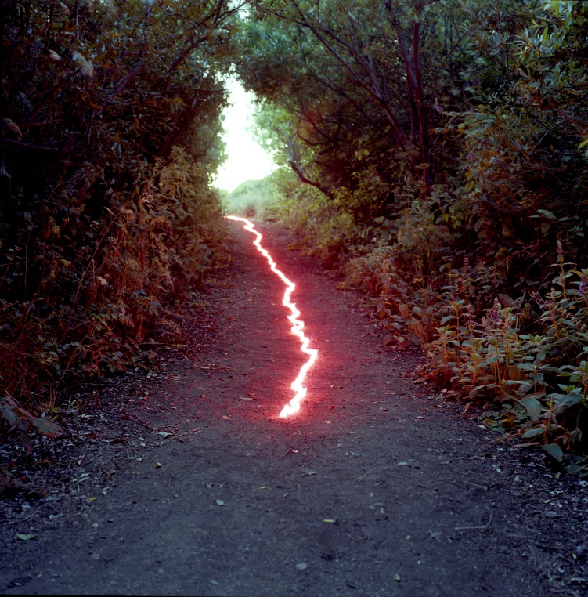
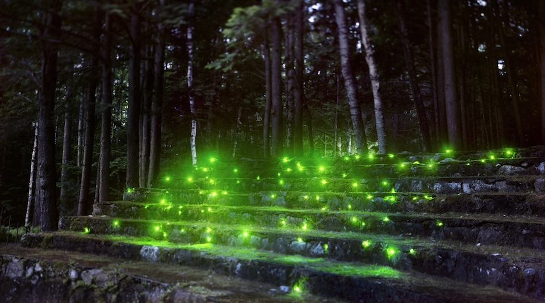
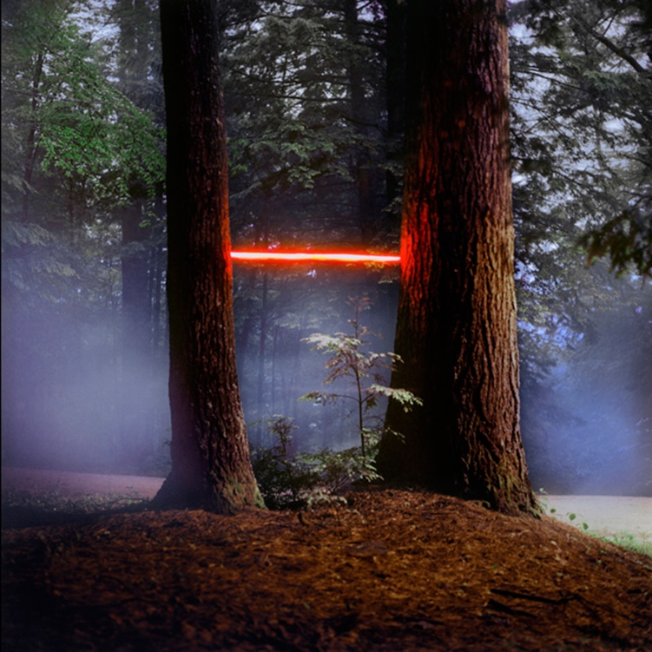
Barry Underwood staged photography- influenced by theater and lighting

Slide 9
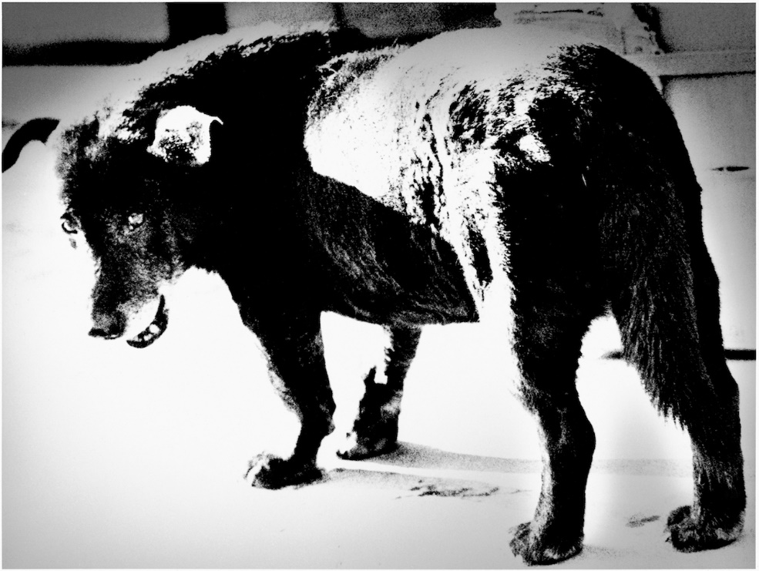
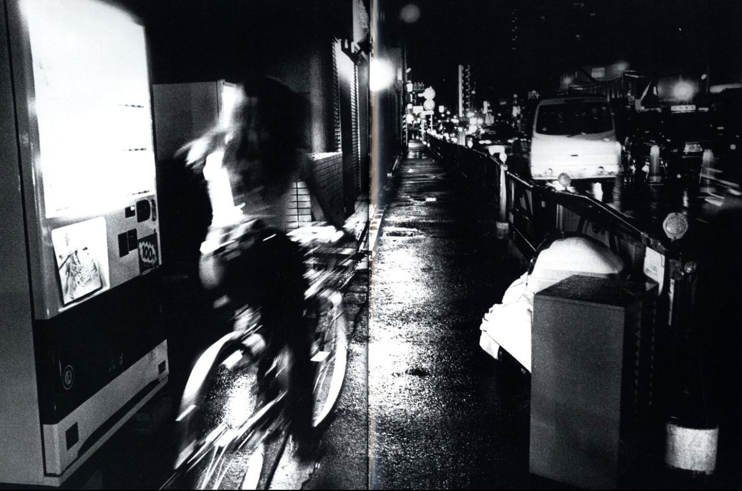
Daidō Moriyama noted for his images depicting the breakdown of traditional values in post-war Japan, showing the darker sides of urban life and the less-seen parts of cities.

Slide 10
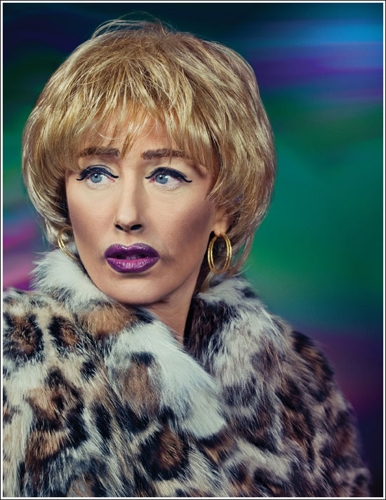
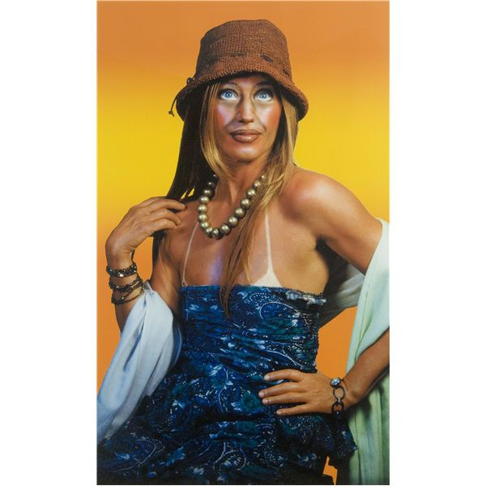
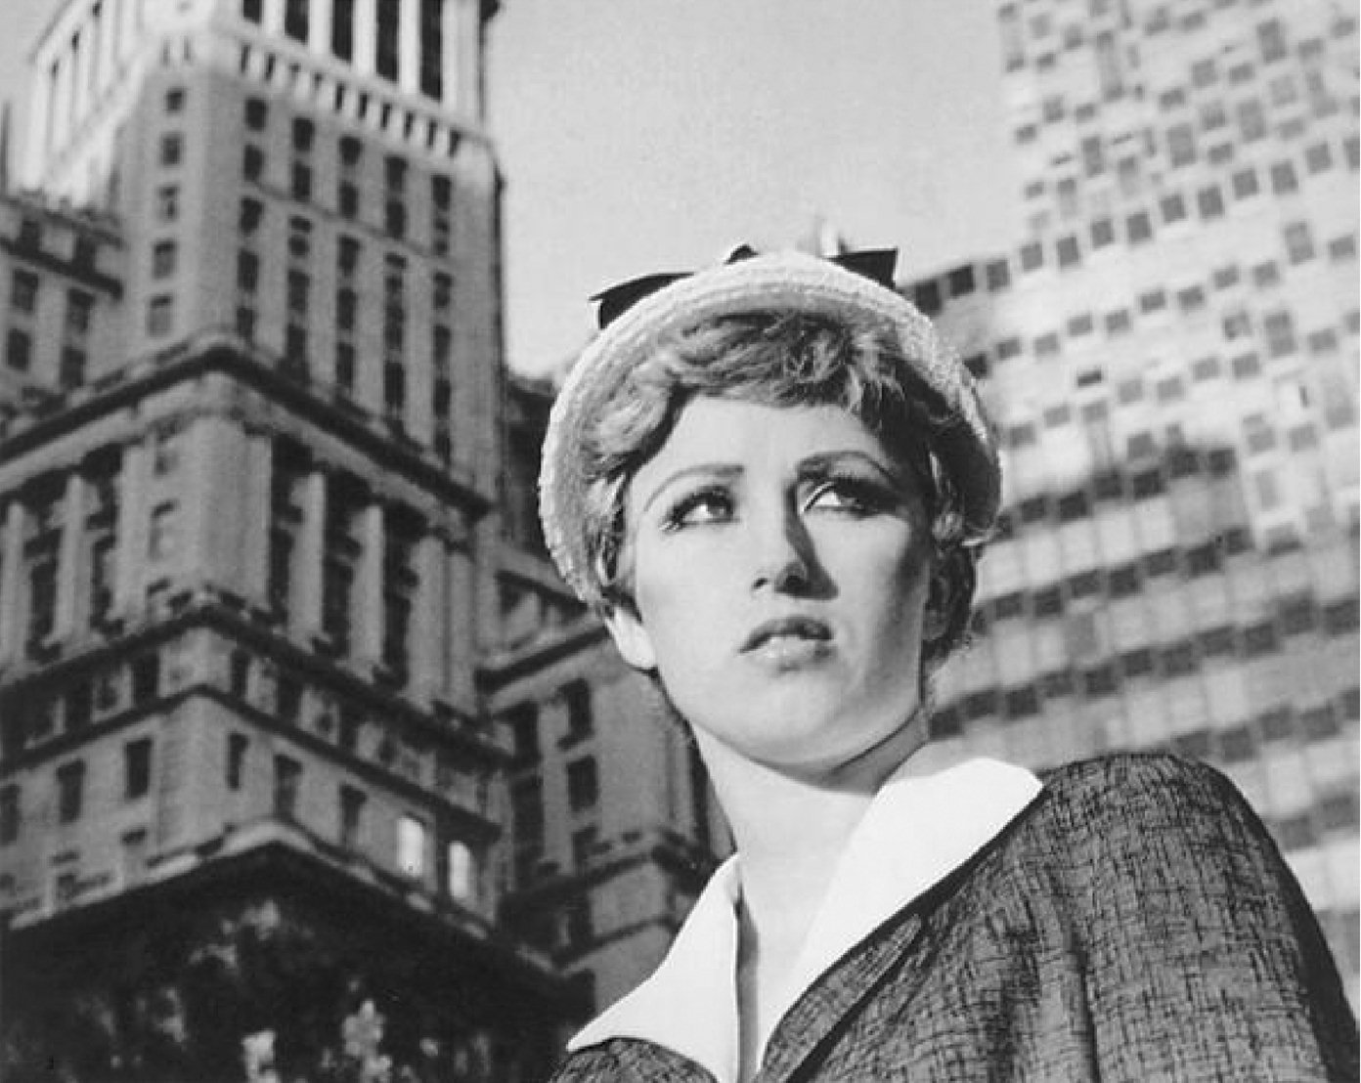
Cindy Sherman best known for "Complete Untitled Film Stills," a series of 70 black-and-white photographs which were meant to subvert the stereotypes of women in media. “Film Stills” series (right) and “Self Portrait” series (left and middle)

Slide 11
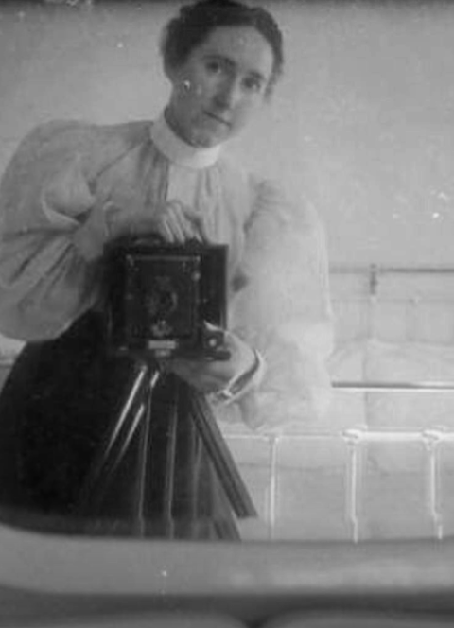
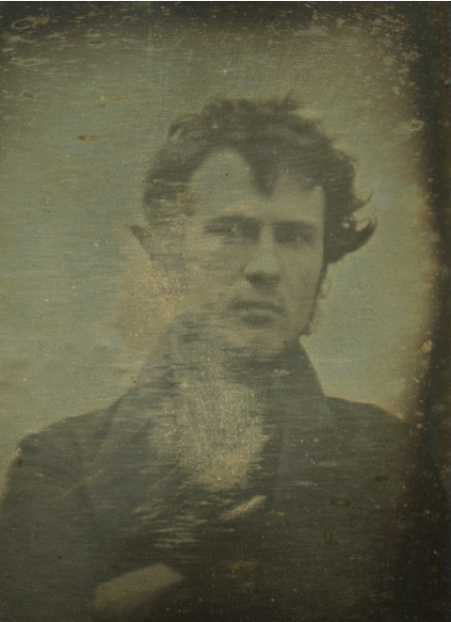
History of the “selfie”- photographers have always been interested in photographing themselves, sometimes through mirrors, to test equipment or as documentation

