Slide 1
Art and Social Responsibility
Social Practice and Community-based Artwork

Slide 2
What is Social Practice?
Social practice is an art medium that focuses on engagement through human interaction and social discourse. Since it is people and their relationships that form the medium of such works – rather than a particular process of production – social engagement is not only a part of a work’s organization, execution or continuation, but also an aesthetic in itself: of interaction and development. Socially engaged art aims to create social and/or political change through collaboration with individuals, communities, and institutions in the creation of participatory art. The discipline values the process of a work over any finished product or object.
Community-based art takes place in a community setting and engages that community.

Slide 3
Project Row Houses
Based in Houston, TX. Founded by Rick Lowe, who was awarded a MacArthur Genius grant for PRH
Project Row Houses (PRH) is a community-based arts and culture non-profit organization in Houston’s northern Third Ward, one of the city’s oldest African American neighborhoods. Founded in 1993 as a result of the vision of local African-American artists wanting a positive creative presence in their own community, PRH shifts the view of art from traditional studio practice to a more conceptual base of transforming the social environment.
Central to the vision of PRH is the social role of art as seen in neighborhood revitalization, historic preservation, community service, and youth education. The programs of PRH are built around Five Pillars inspired by the work of internationally renowned artist John Biggers and his principles concerning the components of row house communities:
Art and Creativity
Education
Social Safety Nets
Architecture
Sustainability

Slide 4
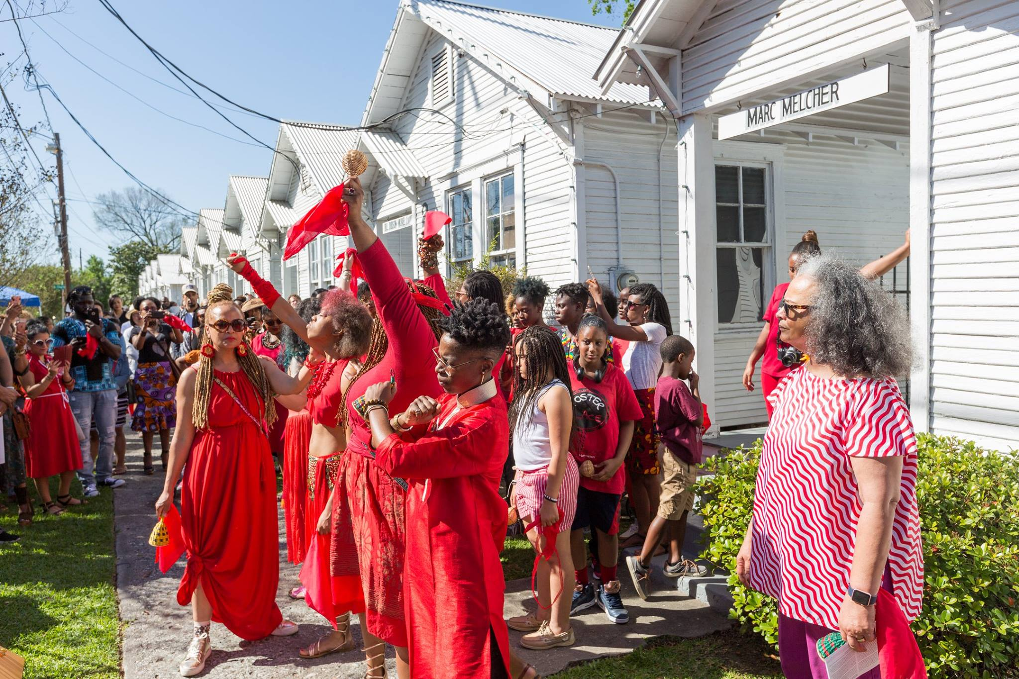
Round 46 | Black Women Artists for Black Lives Matter at Project Row Houses March 25 - June 4, 2017

Slide 5
Ai Weiwei
As a political activist, he has been highly and openly critical of the Chinese Government's stance on democracy and human rights.
He is an inspirational figure for many people both in the West and in China, and both in and outside the art world. Ai's struggle for freedom of speech and expression sheds light on specific issues that are important in their own right. More broadly, it reminds us of the power of visual art to move us as individuals, and sometimes entire nations, to action. Ai's work underscores the idea that art may have the power, and even the responsibility, to change society.

Slide 6
Dropping a Han Dynasty Urn (1995)
Outside his mother's home in Beijing, he dropped and smashed a 2000-year old ceremonial urn. Not only did the artifact have considerable value (the artist paid the equivalent of several thousand US dollars for it), but symbolic and cultural worth. The Han dynasty is considered a defining moment in Chinese civilization. Understandably, antique dealers were outraged, calling Ai's work an act of desecration. Ai countered by saying "General Mao used to tell us that we can only build a new world if we destroy the old one." It was a provocative act of cultural destruction in reference to the erasure of cultural memory in Communist China, an anti-elite society that carefully monitored access to information, especially about its dynastic history.

Slide 7
Mel Chin:
Born in 1951 in Houston, TX
Motivated largely by political, cultural, and social circumstances, Chin works in a variety of art media to calculate meaning in modern life. Chin places art in landscapes, in public spaces, and in gallery and museum exhibitions, but his work is not limited to specific venues. Chin once stated: “Making objects and marks is also about making possibilities, making choices—and that is one of the last freedoms we have. To provide that is one of the functions of art.”

Slide 8
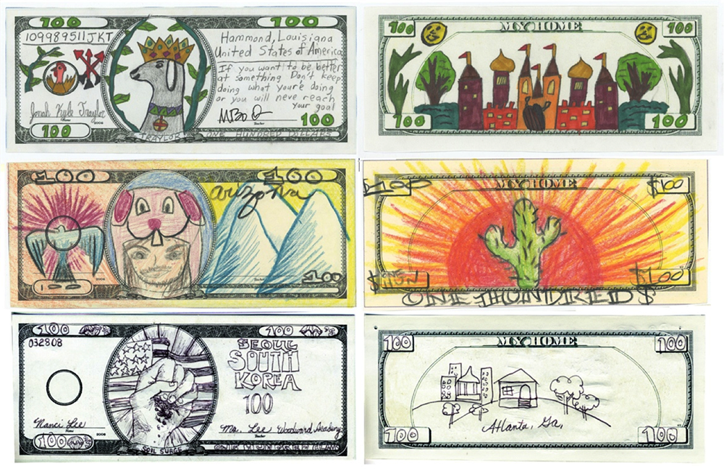
Operation Paydirt and the Fundred Dollar Bill Project
Operation Paydirt is an artist-initiated project inviting children, families and communities to imagine, express and actualize a future free of childhood lead poisoning. Central to Operation Paydirt is the Fundred Dollar Bill Project, a creative campaign advancing public education and community engagement through the creation and collection of Fundreds – original, hand-drawn interpretations of $100 bills. Fundreds represent the tangible voices of millions speaking to those with the power to end this national problem. The goal is to exchange the value of informed public voice into real resources to leverage 100% prevention.

Slide 9
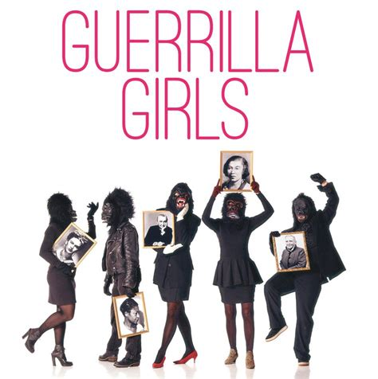
The Guerilla Girls
Guerrilla Girls is an anonymous group of feminist, female artists devoted to fighting sexism and racism within the art world. The group formed in New York City in 1985 with the mission of bringing gender and racial inequality into focus within the greater arts community. The group employs culture jamming in the form of posters, books, billboards, and public appearances to expose discrimination and corruption. To remain anonymous, members don gorilla masks and use pseudonyms that refer to deceased female artists. According to GG1, identities are concealed because issues matter more than individual identities, ainly, we wanted the focus to be on the issues, not on our personalities or our own work."

Slide 10
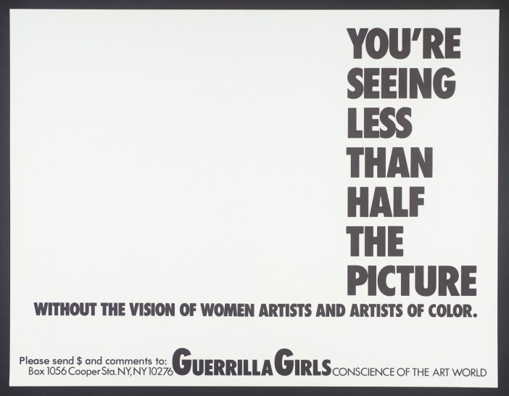

Slide 11
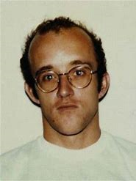
Keith Haring
Keith Allen Haring was an American artist whose pop art and graffiti-like work grew out of the New York City street culture of the 1980s. Haring's work grew to popularity from his spontaneous drawings in New York City subways – chalk outlines on blank black advertising-space backgrounds – depicting radiant babies, flying saucers, and deified dogs. After public recognition he created larger scale works such as colorful murals, many of them commissioned. His imagery has "become a widely recognized visual language". His later work often addressed political and societal themes – especially homosexuality and AIDS – through his own iconography.

Slide 12
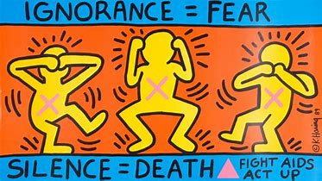

Slide 13
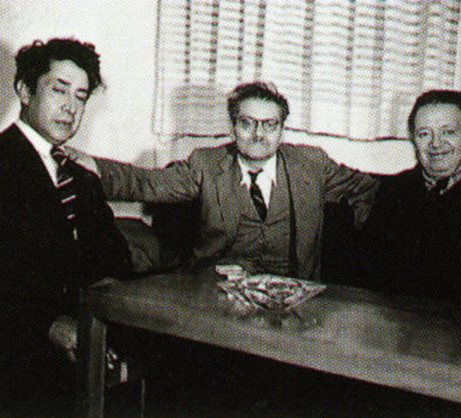
“The Big Three”
Mexican muralism was the promotion of mural painting starting in the 1920s, generally with social and political messages as part of efforts to reunify the country under the post Mexican Revolution government. It was headed by “the big three” painters, Diego Rivera, José Clemente Orozco and David Alfaro Siqueiros.

Slide 14
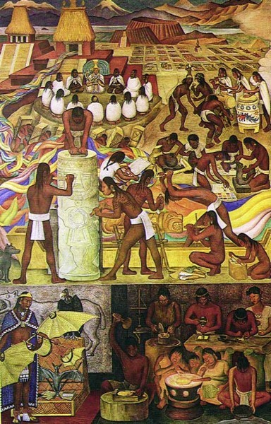

Slide 15
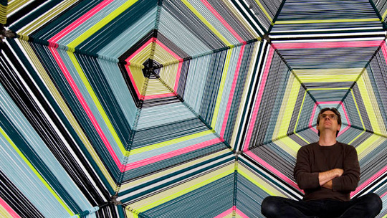
Pedro Reyes
Pedro Reyes is a Mexican artist. He uses sculpture, architecture, video, performance and participation. His works aims to increase individual or collective agency in social, environmental, political or educational situations.

Slide 16
