Slide 1
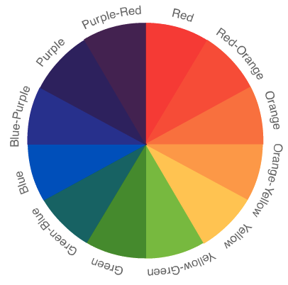
The Wonderful World of Color
Color Theory
Is a set of ideas having to do with how color operates. Theories of color are developed by both scientists (physicists) and artists.
Both means of exploring color,
and their subsequent color
theories, provide artists and designers
with a guide for solving color problems
and making color decisions.

Slide 2
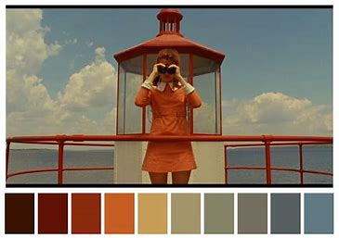
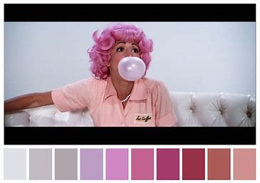
Each Color Theory suggests a different approach to thinking about color. Each system encourages us to look more closely… more analytically… more
consciously at color. They provide guides to making decisions about color and increasing
the chances for creating successful color schemes.
Color has psychological effects and is used to direct how we navigate space (exit signs, stop lights)- and influence how we feel in a space (interior design, advertising).
Above: Apple Ipod advertisement
Below: taken from Color Palette Cinema, Moonrise Kingdom (left) and Grease (right)

Slide 3
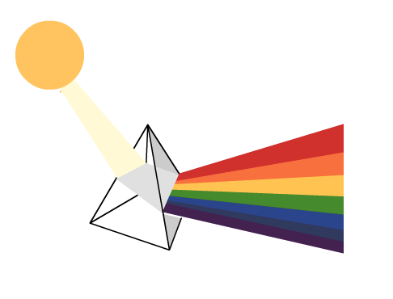
Color theories are based on color studies and many of these ideas have been verified through the scientific method. The color spectrum, for instance, is revealed when white light is projected through a prism. This fact supports the theory that white light contains the full range of light wavelengths.
Color Facts:
Objects have no color of their own
but merely the ability to reflect certain
rays of light.
Black objects absorb all color rays.
White objects reflect all color rays.
Blue objects absorb all the rays of light,
except blue rays which are reflected to
our eyes.
Sir Isaac Newton was the first to demonstrate that white light contained
the spectrum of all colors in the 17th century.

Slide 4
The retina’s photoreceptors translate light-waves into electrical impulses that are transmitted to the brain and converted into images constructed of value and hue.
Light is emitted as waves. Wavelength determines the color of the light. Red has
a long wavelength and violet has a short wavelength. Most light sources emit a
range of colors.*
Remember:
Hue = True Color
Value = Degree of Light or Darkness
Brightness = Color Intensity or Color Saturation
*Taken from:
http://www.cs.sunysb.edu/~tony/334/perception/perception.htm

Slide 5
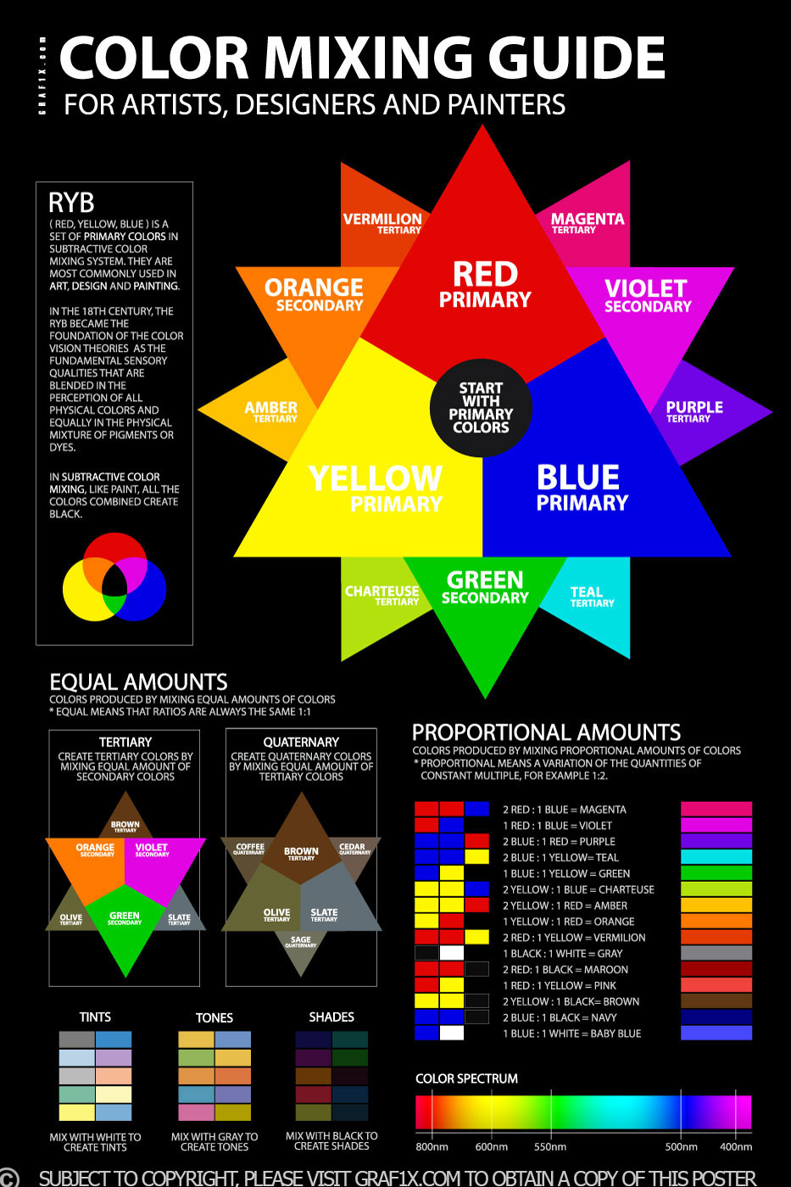
Color Terminology
Hue: Color
Tint: A color plus white.
Shade: A color plus black.
Tone: A color plus gray.
Brightness: the attribute of light-source colors by which emitted light is ordered continuously from light to dark in correlation with its intensity. Brightness is the general intensity of an image; if the brightness value of an image is lower, the image is darker. And if the brightness value of an image is higher, the image is lighter.
Saturation: The amount of brightness of a hue; the amount of purity of a hue.

Slide 6
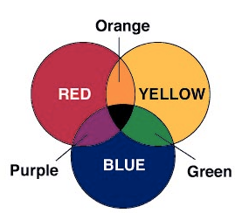
Subtractive Color
In theory all colors can be made by mixing
together the three primary colors on the color wheel.
In subtractive color mixing, (paint is a subtractive system), pigments combine. In this system light is absorbed by the pigments -- thus subtracted from the reflected light waves.
In other words the pigments absorb all colors (light waves) except those which are seen. The seen color is reflected back at the viewer.
For instance, blue paint is “blue” because all light waves are absorbed except those which are identified as blue. These are reflected back to the viewer.

Slide 7
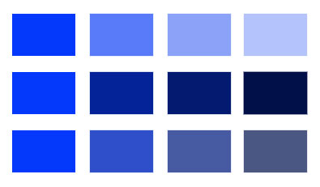
Monochromatic
A single hue, varying only in chroma, value, tint, or shade.

Slide 8
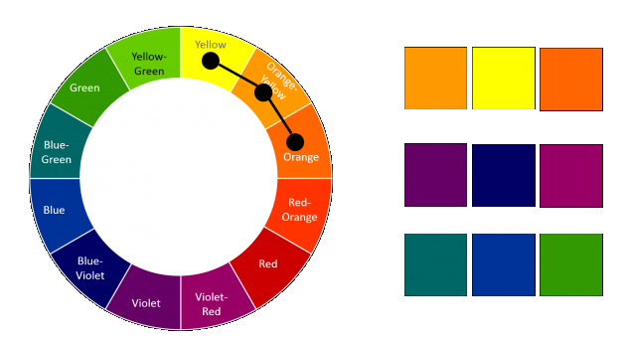
Analogous
Three or more neighboring hues.

Slide 9
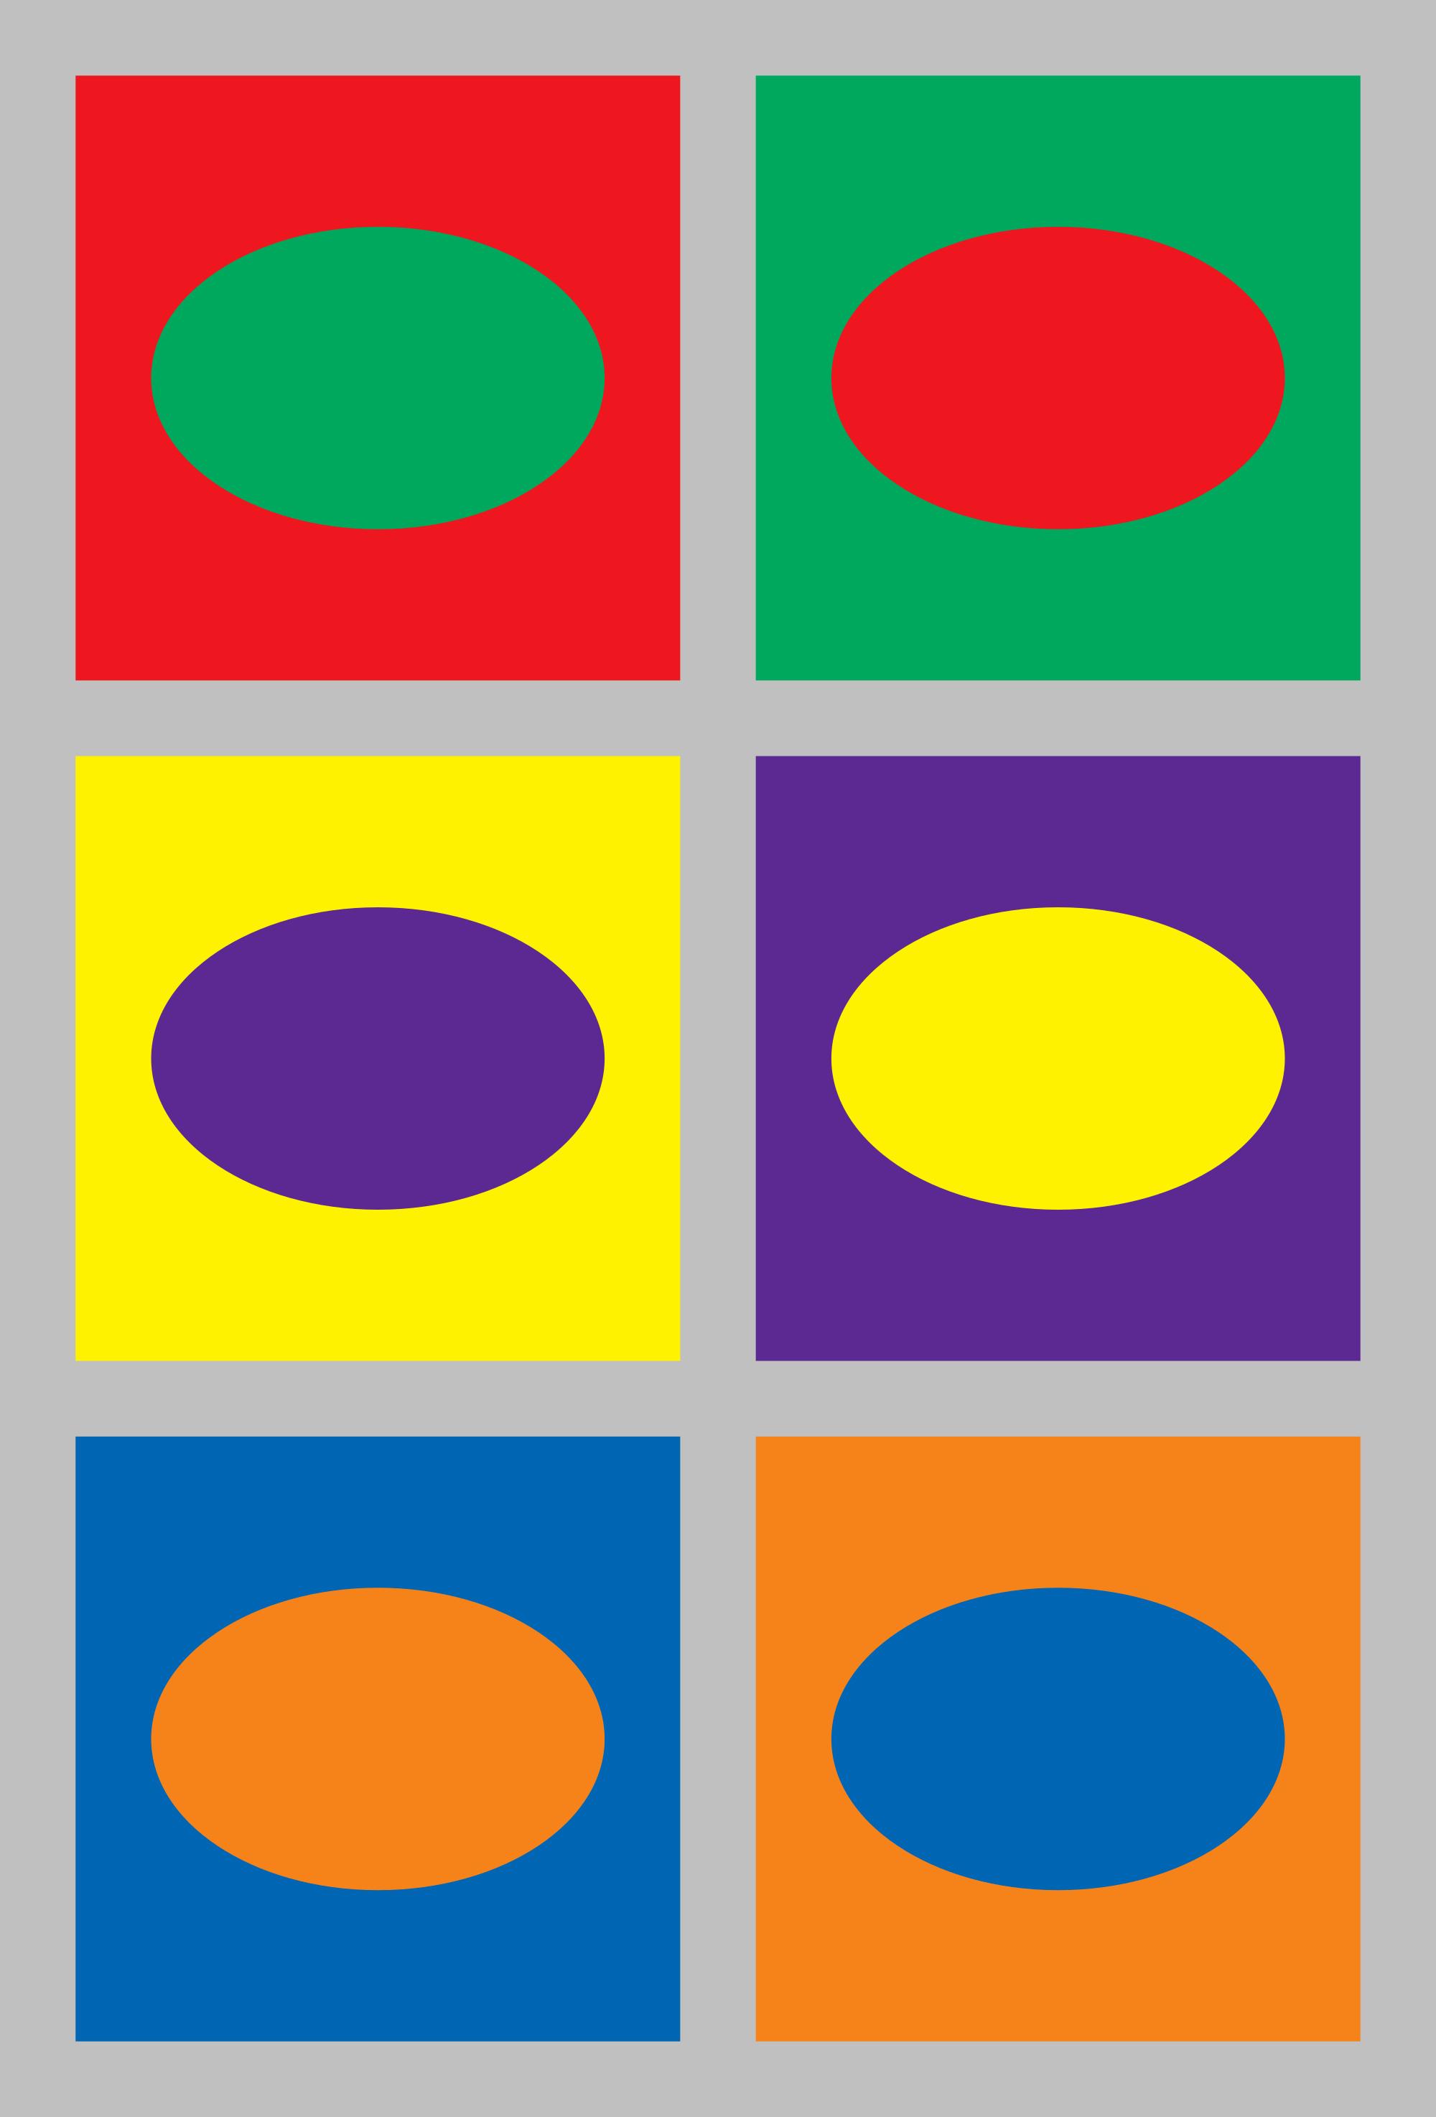
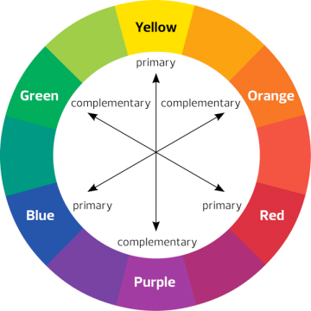
Complimentary
By crossing the wheel, you can find complimentary color schemes. Complimentary colors have the most hue contrast and pair easily.

Slide 10
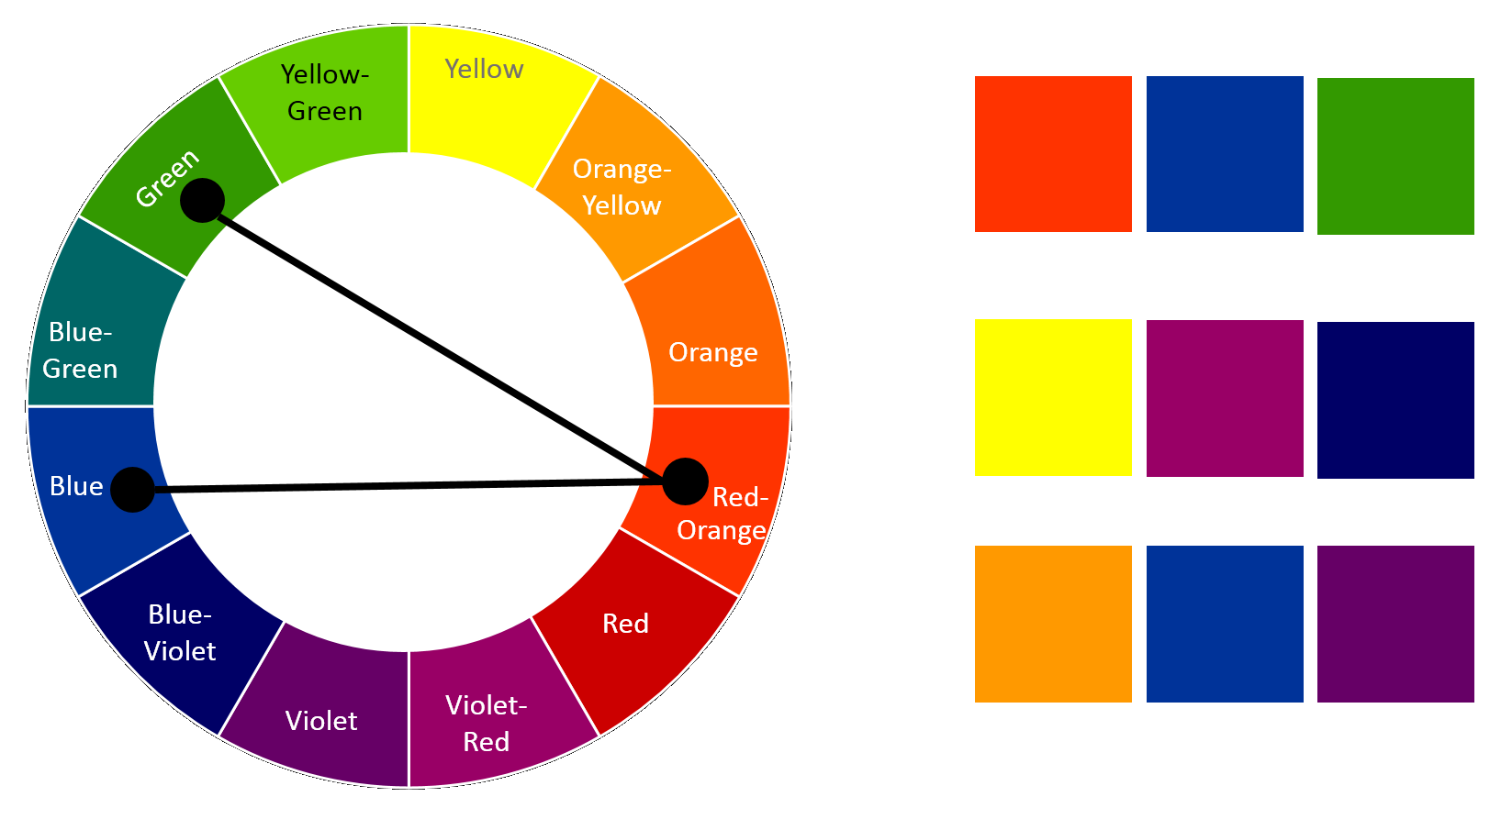
Split complimentary
A single hue and the two hues neighboring the complimentary hue.

Slide 11
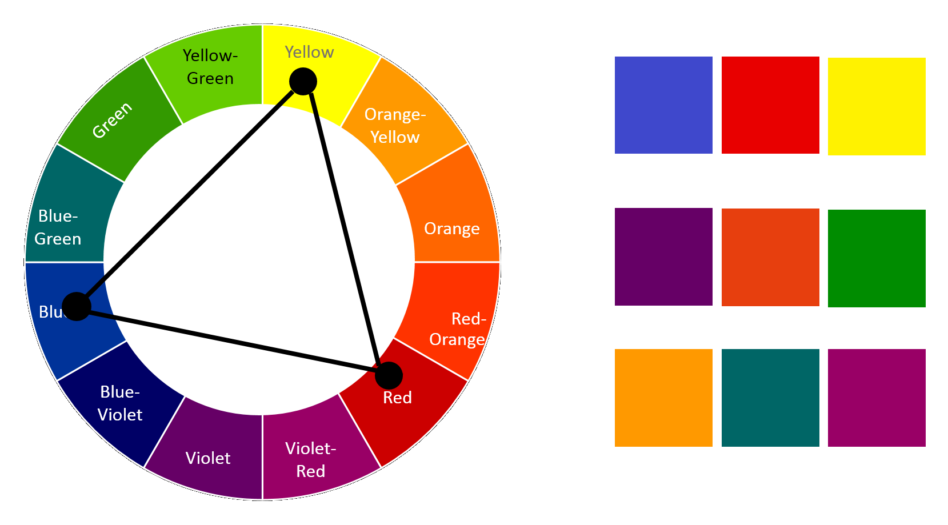
Triadic
Three hues equally spaced on the color wheel.
All primaries, all secondaries, or all tertiaries.

Slide 12
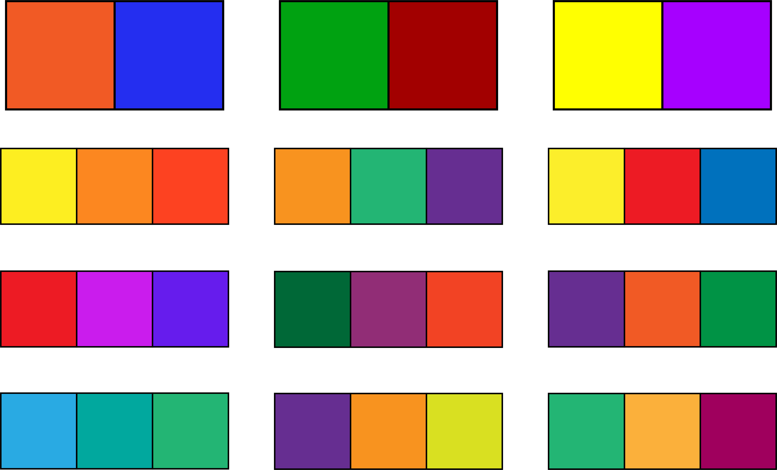
Complimentary
Analogous
Split complimentary
Triadic

Slide 13
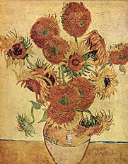
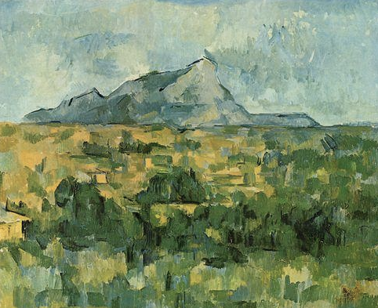
Monochromatic refers to color schemes
based on one color.
Polychromatic refers to multiple colors.
Van Gogh
c. 1888
Cezanne
c. 1902
Warm colors, reds,
oranges, and yellows,
appear to advance.
Cool colors, blues and
greens, appear
recede.

Slide 14
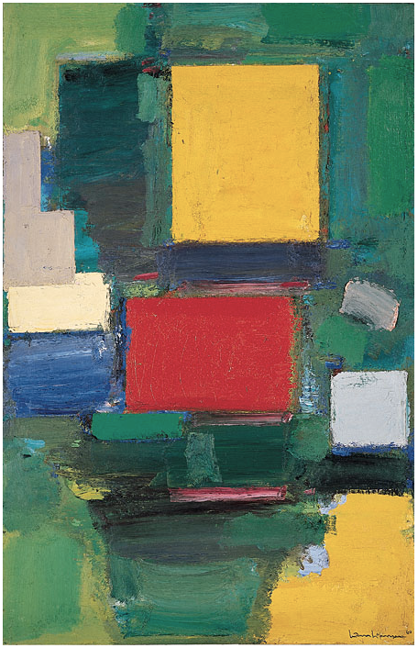
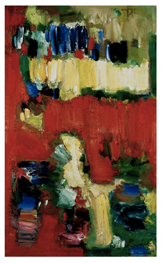
Saturated colors are colors of high intensity.
Hans Hofmann, c. 1960

Slide 15
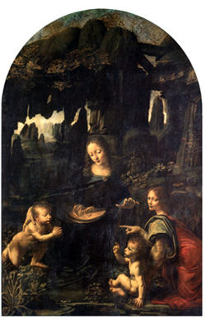
Systems of perspective are various methods of creating
the illusion of 3 dimensional space on a 2 dimensional (flat)
surface. There are mathematical, and linear perspective systems
for instance.
Atmospheric Perspective
takes advantage of the properties
of color and texture to
create an illusion of depth.
It is based on the understanding that
cool, gray colors appear to recede,
while warm, dark or saturated colors
appear to come forward. Added to
this is the knowledge that textures
become less distinct the further they
are from the viewer. This is known
as a tactile gradient.
Leonardo da Vinci
c. 1483

Slide 16
Afterimage is the “ghost” image of a color.
When one stares at an object and then looks at a white
surface, a “ghost” image of the object will appear. This
image will appear as
the complementary
color of the original
color. Additionally the
color will appear grayer.
This is also known
as successive
contrast.
Op artists often take
advantage of this
effect to create their
work.
Bridget Riley c. 1967

Slide 17
Simultaneous Contrast is the understanding that
colors that are adjacent to one another influence their
appearance. It is an idea that formed the basis of much
of Josef Albers’s work.
Josef Albers c. 1956

Slide 18
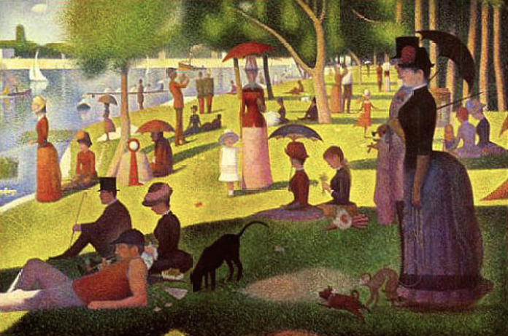
Optical (Color) Mixing occurs when colors are placed next
to one another. Simultaneous Contrast is a byproduct of this effect.
It was exploited by the Pointillists (aka: Divisionists) and is still used in
print and other media to create images. Pixels combine optical mixing
with additive color to create images on computer screens.
Georges Seurat c. 1884

Slide 19
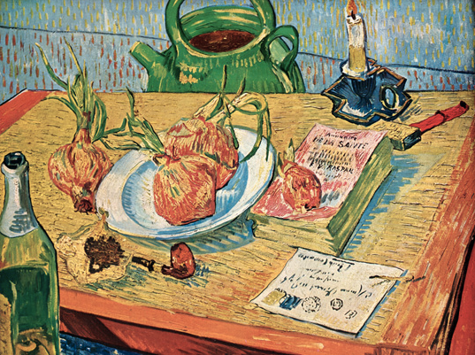
There are many color theorists and many color theories. Johann Wolfgang
von Goethe (1749-1832), the German poet, worked quite seriously with
color and even felt that his ideas on color would be more important than his
poetry. He emphasized color as a biological event in the eye rather than
focusing on the physics of light as Newton had. Goethe created detailed
descriptions of
visual phenomena
that were and are
of interest to
artists, such as
colored shadows,
simultaneous
contrast, and
successive contrast
(afterimage).
Van Gogh 1889

Slide 20
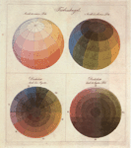
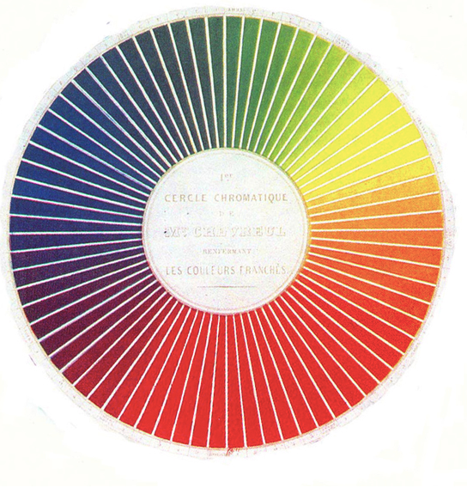
Philipp Otto Runge (1777-1810),
a German painter, published
The Color Sphere - this was the first attempt
To create a 3 dimensional model of color.
Runge Color
Spheres
Michel Eugene Chevreul (1786-1889), chemist and director of
the dye house for Gobelins tapestries in
Paris, developed a highly graded
2 dimensional color wheel. His
work verified the usefulness of
red, yellow, and blue as
primaries. (Not all theories
of subtractive color
mixing use the
same primaries).
Chevreul
Color Wheel

Slide 21
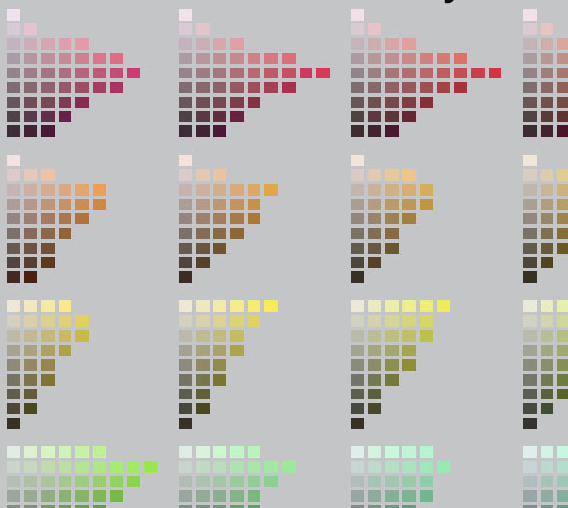
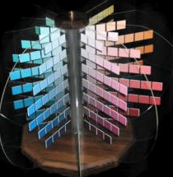
Albert Munsell (1858-1918), professor and artist, developed
the highly influential Munsell Color System. Munsell
recognized that
different hues
reached their
maximum
saturation at
different degrees
of value. He
also noted
that different
hues vary in
the number of
graded steps
between
true neutral
and maximum saturation.
Sample of the Munsell
Color System and
The Munsell Color Tree

Slide 22
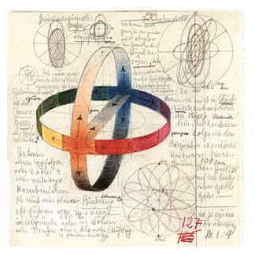
Artists coming out of Germany’s Bauhaus are very
important to our contemporary understanding of art and
design. Two of its professors,
Johannes Itten and Josef
Albers are considered
particularly significant due, in
part, to their contributions
in the area of color.
Itten worked from Runge’s
model of color but he also
believed that color per-
ception varied from person
to person. Consequently he
encouraged his students to
undertake the development
of their own color systems.
Itten ideational color studies

Slide 23
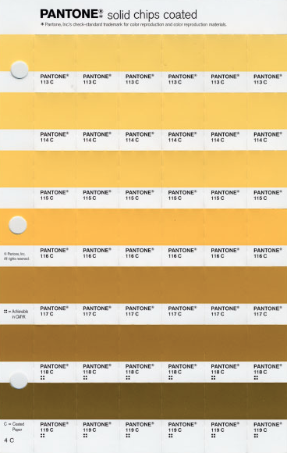
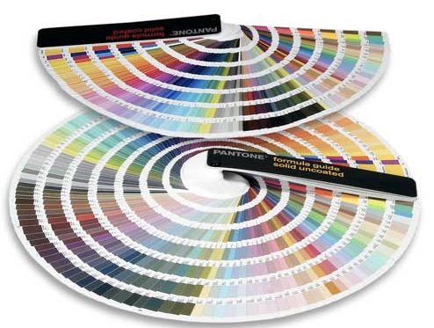
Pantone markers, fan books and a sheet
of “color chips.”

Slide 24
Some traditional, western, “readings” of colors:
Red is a color not commonly seen in nature, and when it is (fire, blood), it usually means danger, or a warning, prohibition (stop sign), negative (a budget in the red), excitement, hot
Dark Blue is the color of the ocean, it is stable, calming, trustworthy (often the color of police uniforms)
Light Blue is the color of the sky, it is cool, transparent
Green is the color of the landscape, It represents growth. it is positive, organic, go (traffic light), comforting
White is the color of a blank sheet of paper. It often represents purity (as when a bride dresses in white) or surrender
Black is the color of night, it is serious, heavy, often representing death or power
Gray is the color of fog, it is neutral
Brown is the color of earth, it is considered wholesome, unpretentious, dependable
Yellow and Orange are the colors of sunshine considered active, positive
Purple is traditionally the color of royalty

Slide 25
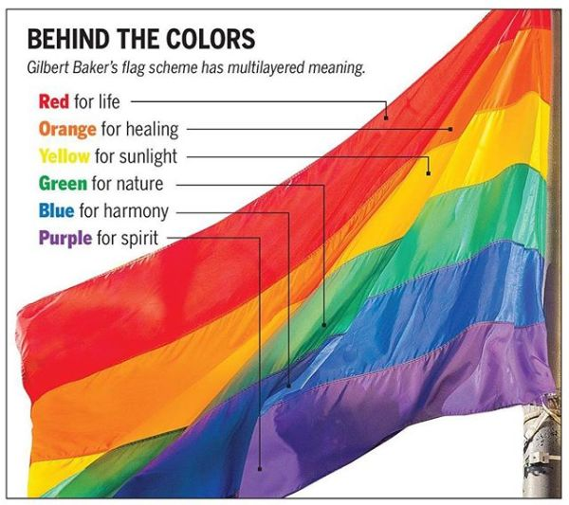
Color is a message

Slide 26
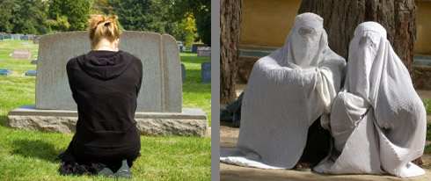
Every audience is unique
Every culture and person sees color differently!

