Slide 1
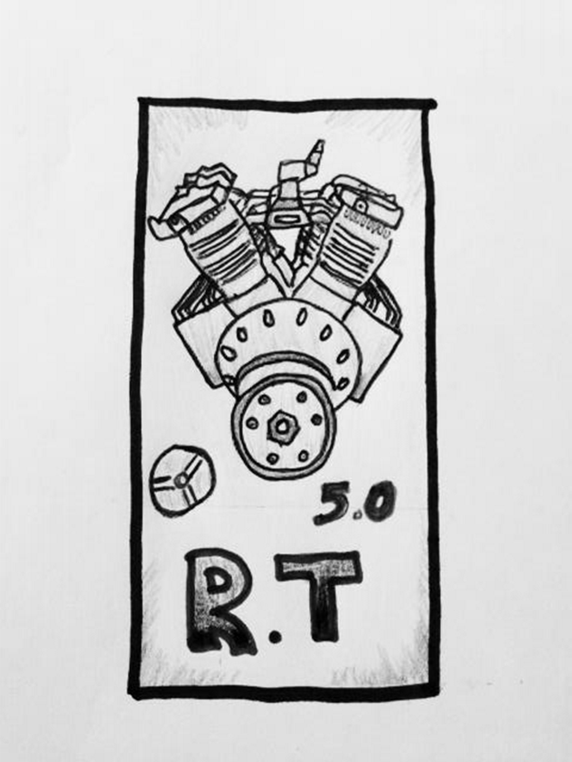
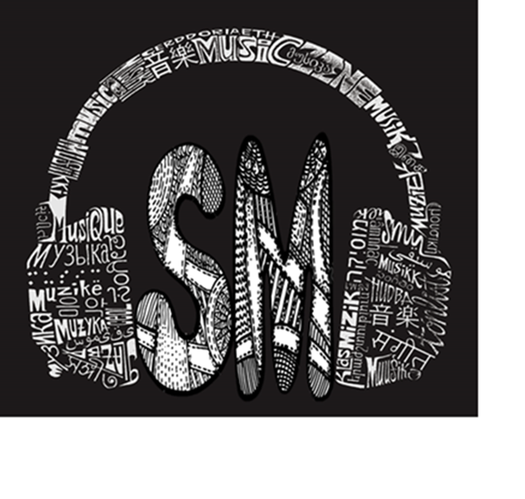

Slide 2
DESIGN YOUR OWN PERSONAL LOGO
We have studied how images can be simplified, then turned into a pattern, a shape, or a motif that is connected to meaning, in other words, a symbol. In connection with our look at visual communication design, we have seen how symbols are used in logo design to convey meaning instantaneously. With this in mind you, will design your own personal logo. This should not be thought of as a business card. Begin by thinking of things that mean something to you. Hobbies? Interests? Your occupation or major? A part of your culture or history? Some aspect of your personality? Try to think of symbols that are attached to these things. For example, if you are a nursing student you may think of things that have to do with nursing, like stethoscopes, a red cross, and EKG charts. Take some of the images of these things are connected to that occupation, simplify them and then that becomes your symbol that you use in your logo. You may or may not decide to use your initials or even your full name in your logo. If you do, consider the font style and how those shapes work with some of the others that convey meaning in your logo.
This logo should be approximately 2” x 2” to 3” x 3" in size and in black, white and shades of gray. It can be completely hand-drawn, designed on the computer, or a combination of both hand-drawn and computer generated images. You may import images and shapes from the web to help you. Try to design your logo as cleanly and is graphically powerful as you possibly can. This is the essence of a successful logo, to convey meaning visually, quickly, memorably. Submit your logo to me via email or bring it into class. This will be graded. I will select the top five to be voted on by the class.
The student with the best logo will receive extra credit on the next exam!

