Slide 1
learning.hccs.edu/faculty/nathan.smith2/open-educational-resources-information

Slide 2
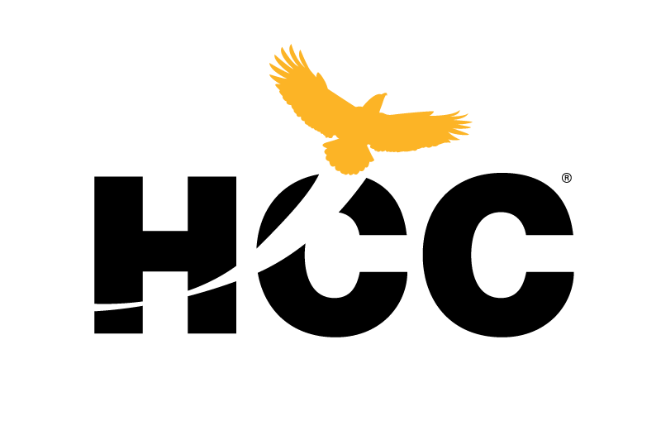
Using OER in Co-Requisite Instruction
Co-Requisite Professional Development Meeting
May 17, 2018

Slide 3
Student success depends on reducing barriers and increasing access.

Slide 4
Traditional copyright restricts access and increases costs
“Keep Out,” CC-BY Kate Merenda-Sinha, katemere, Flickr (2006)

Slide 5
Access = Subscription only

Slide 6
The 5 R’s of OER
OER materials preserve these 5 capacities (Wiley 2014):
Retain: the right to make, own , and control copies of the content.
Reuse: the right to use the content in a wide range of ways.
Revise: the right to adapt, adjust, modify, or alter the content itself.
Remix: the right to combine the original or revised content with other open content to create something new.
Redistribute: the right to share copies of the original content, your revisions, or your remixes with others.

Slide 7
Student success through customized course design
Assign only the materials you use
Make revisions/new editions only when you need them
Keep examples, readings, and problems up to date and relevant for students
Align resources with course objectives, outcomes, and assessments

Slide 8
Access to materials on the first day of class
Use materials that you are comfortable with
Provide those materials on the first day, through Canvas shell
Increase flexibility and consistency across campuses
Two large-scale studies at Tidewater CC:
lower drop rates for classes with OER (Wiley et al, 2016)
higher enrollment in terms where students take course with OER (enrollment intensity) (Hilton et al, 2016)

Slide 9
Student Engagement
Students can share in the creation of content used in the classroom or in future classes
Students can produce work – using content from the course – that can be published online
Preliminary study (of photography class) finds improved student outcomes when students are engaged in producing instructional videos for theor peers (Wiley, Webb, Weston, and Tonks, 2017)

Slide 10
There are so many OER materials in
your areas that you can adapt, remix,
revise, and reuse in your courses.

Slide 11
The Excelsior OWL (https://owl.excelsior.edu/)

Slide 12
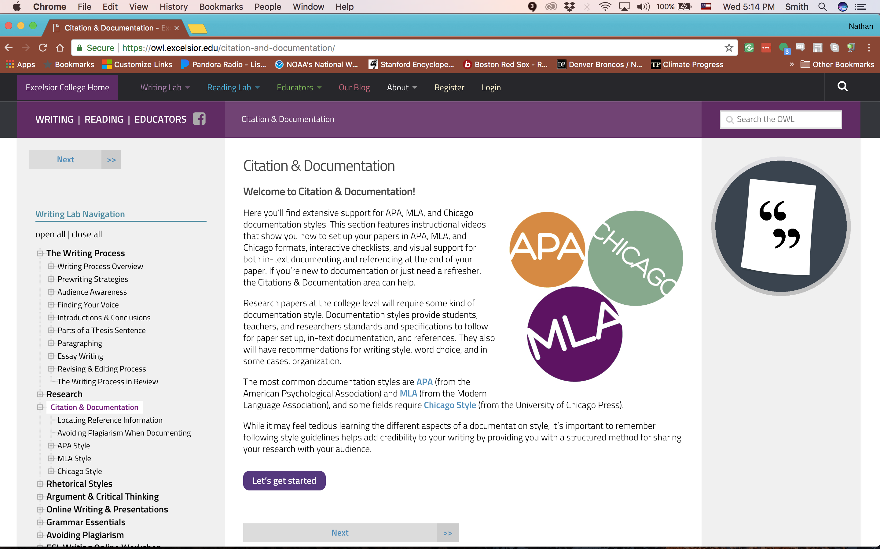

Slide 13
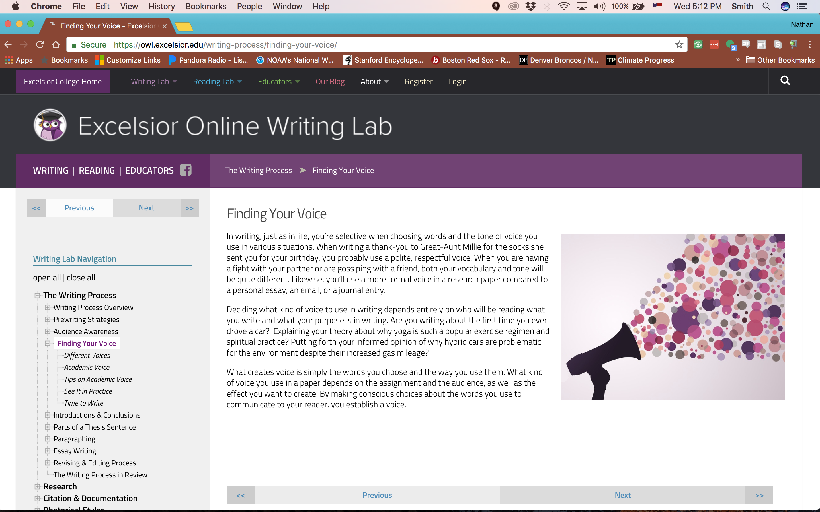

Slide 15
Saylor Academy (https://www.saylor.org/)

Slide 16
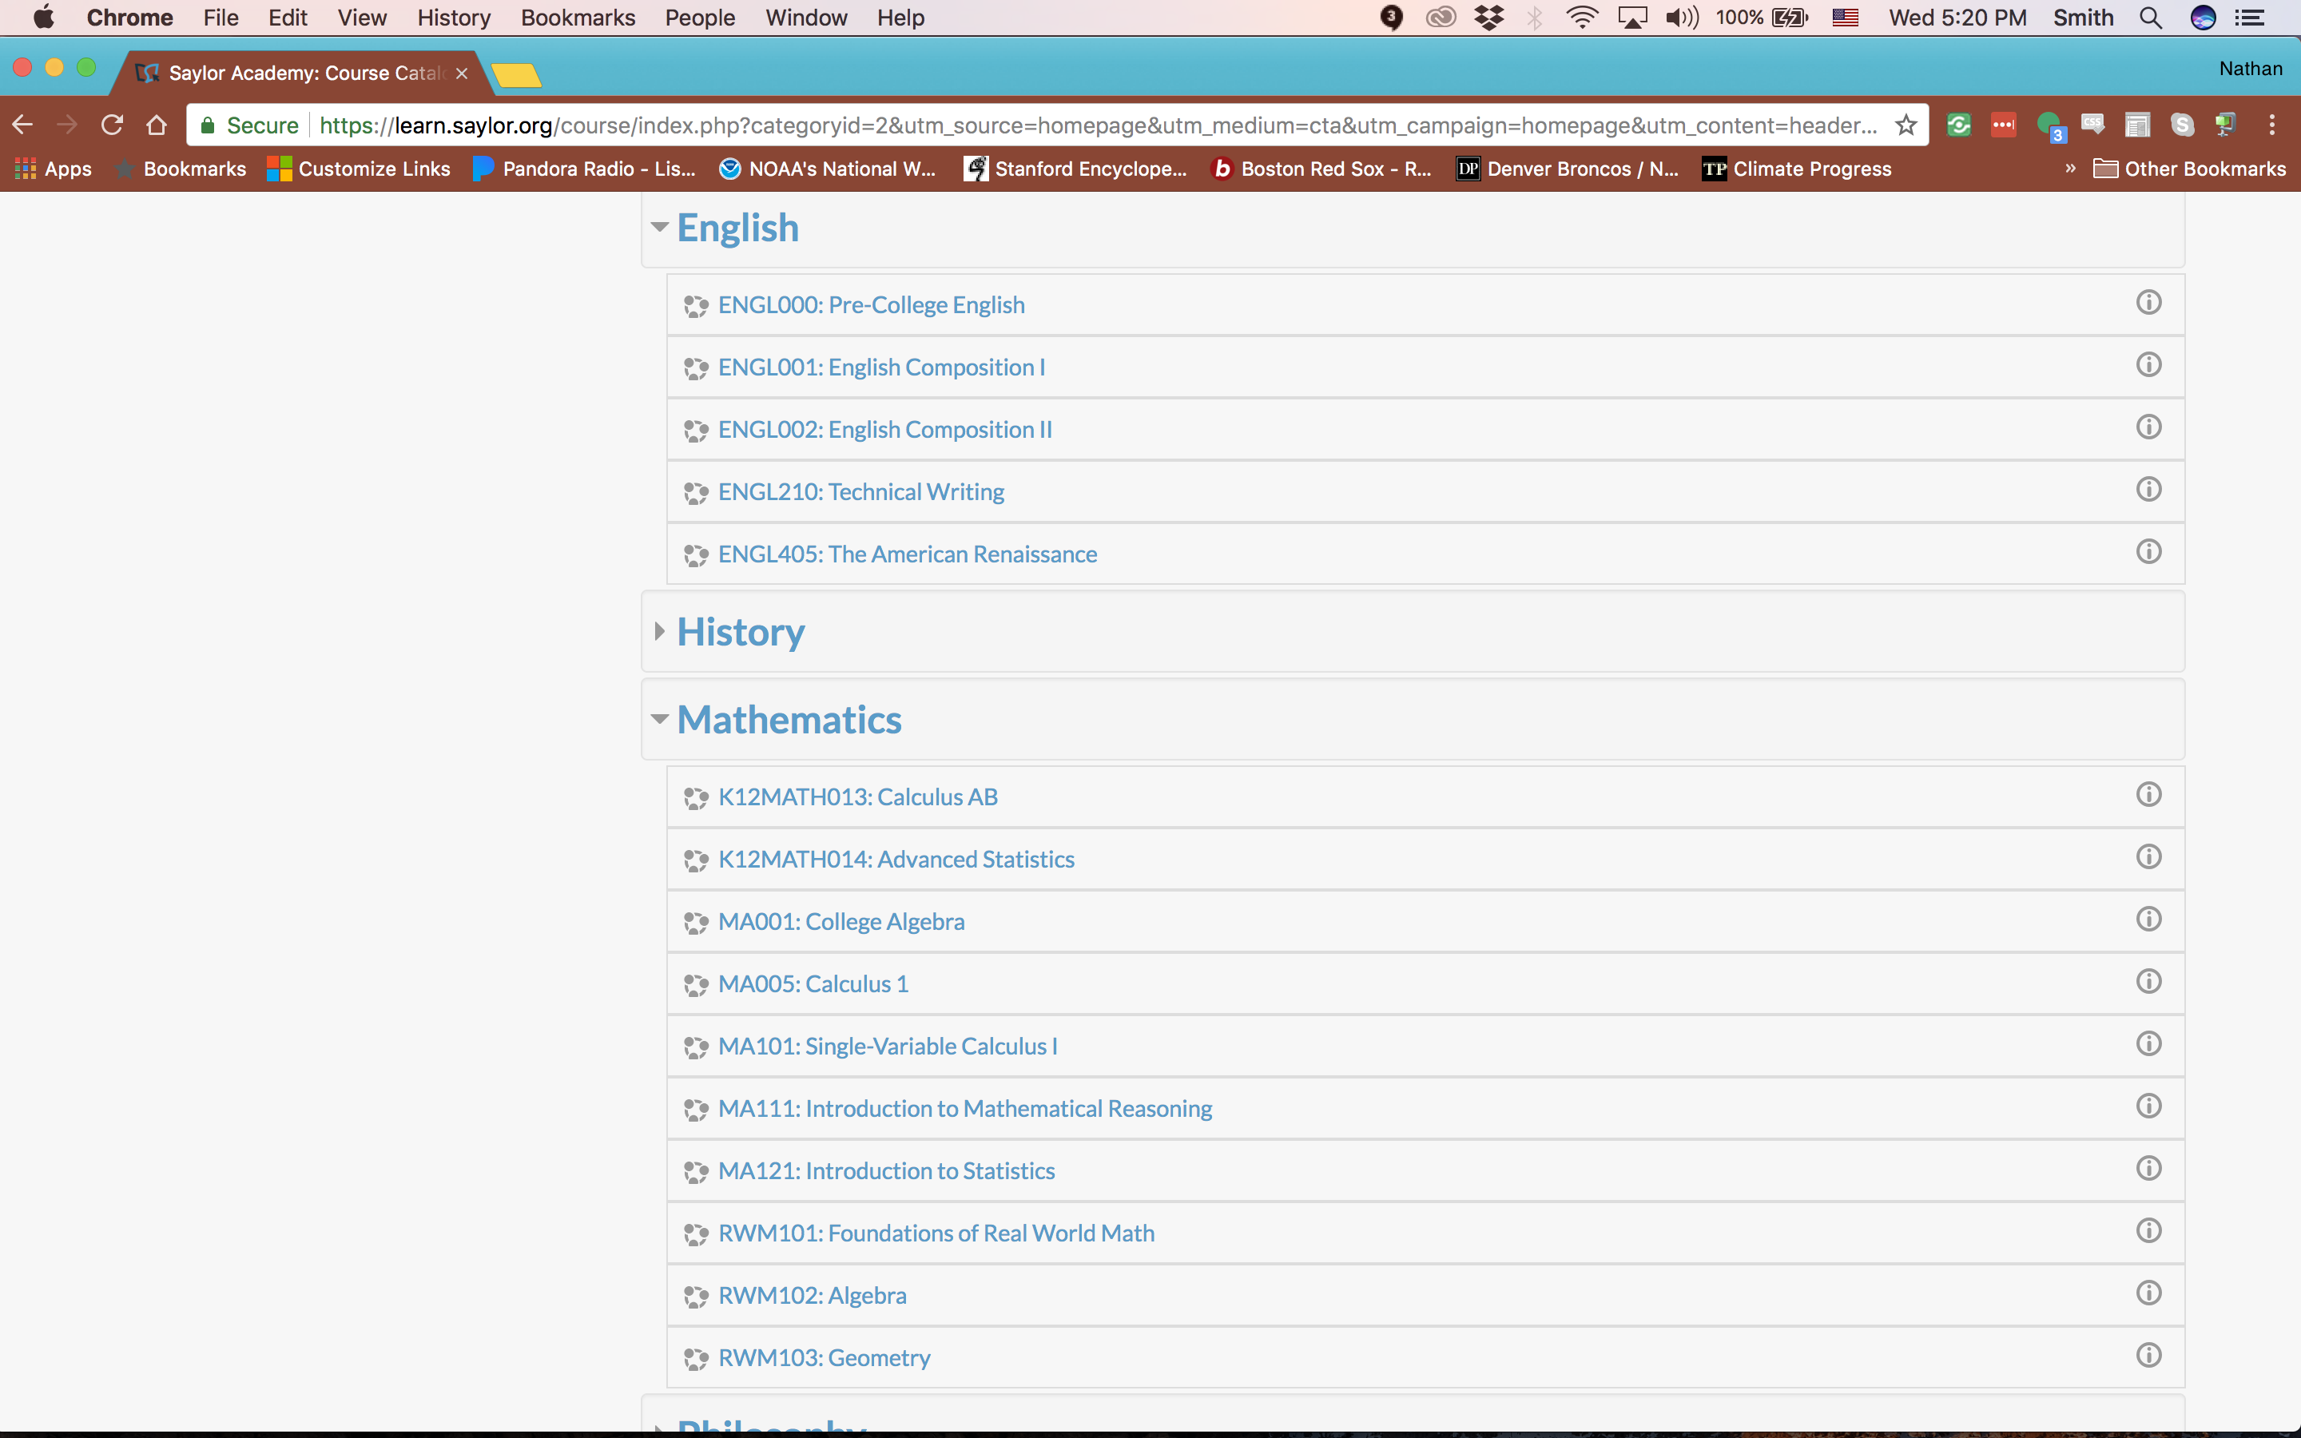

Slide 17
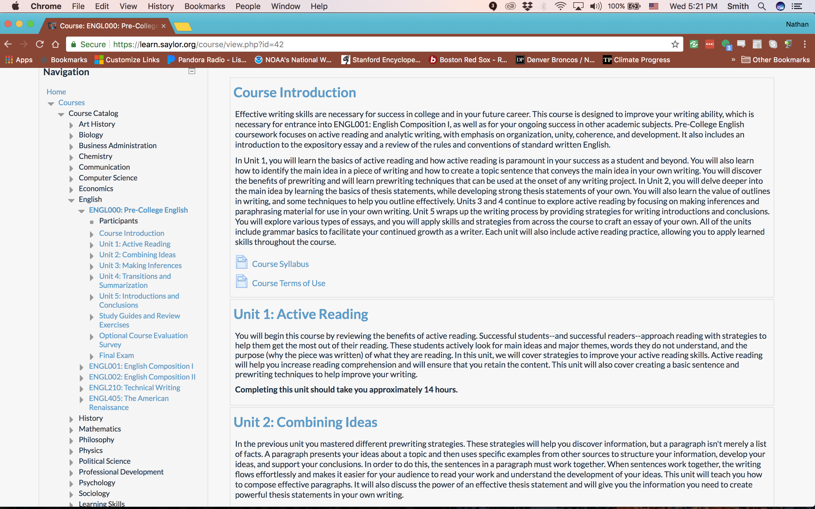

Slide 18
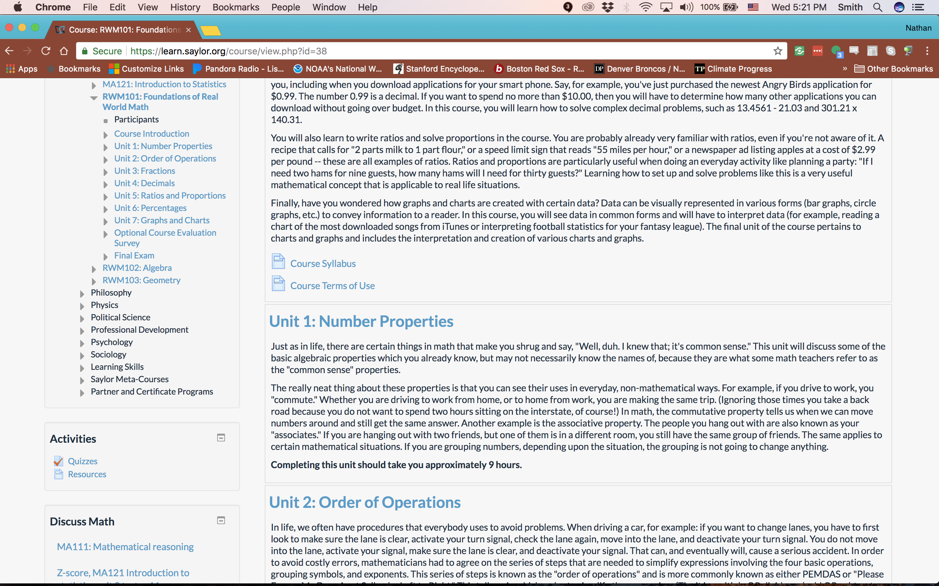

Slide 19
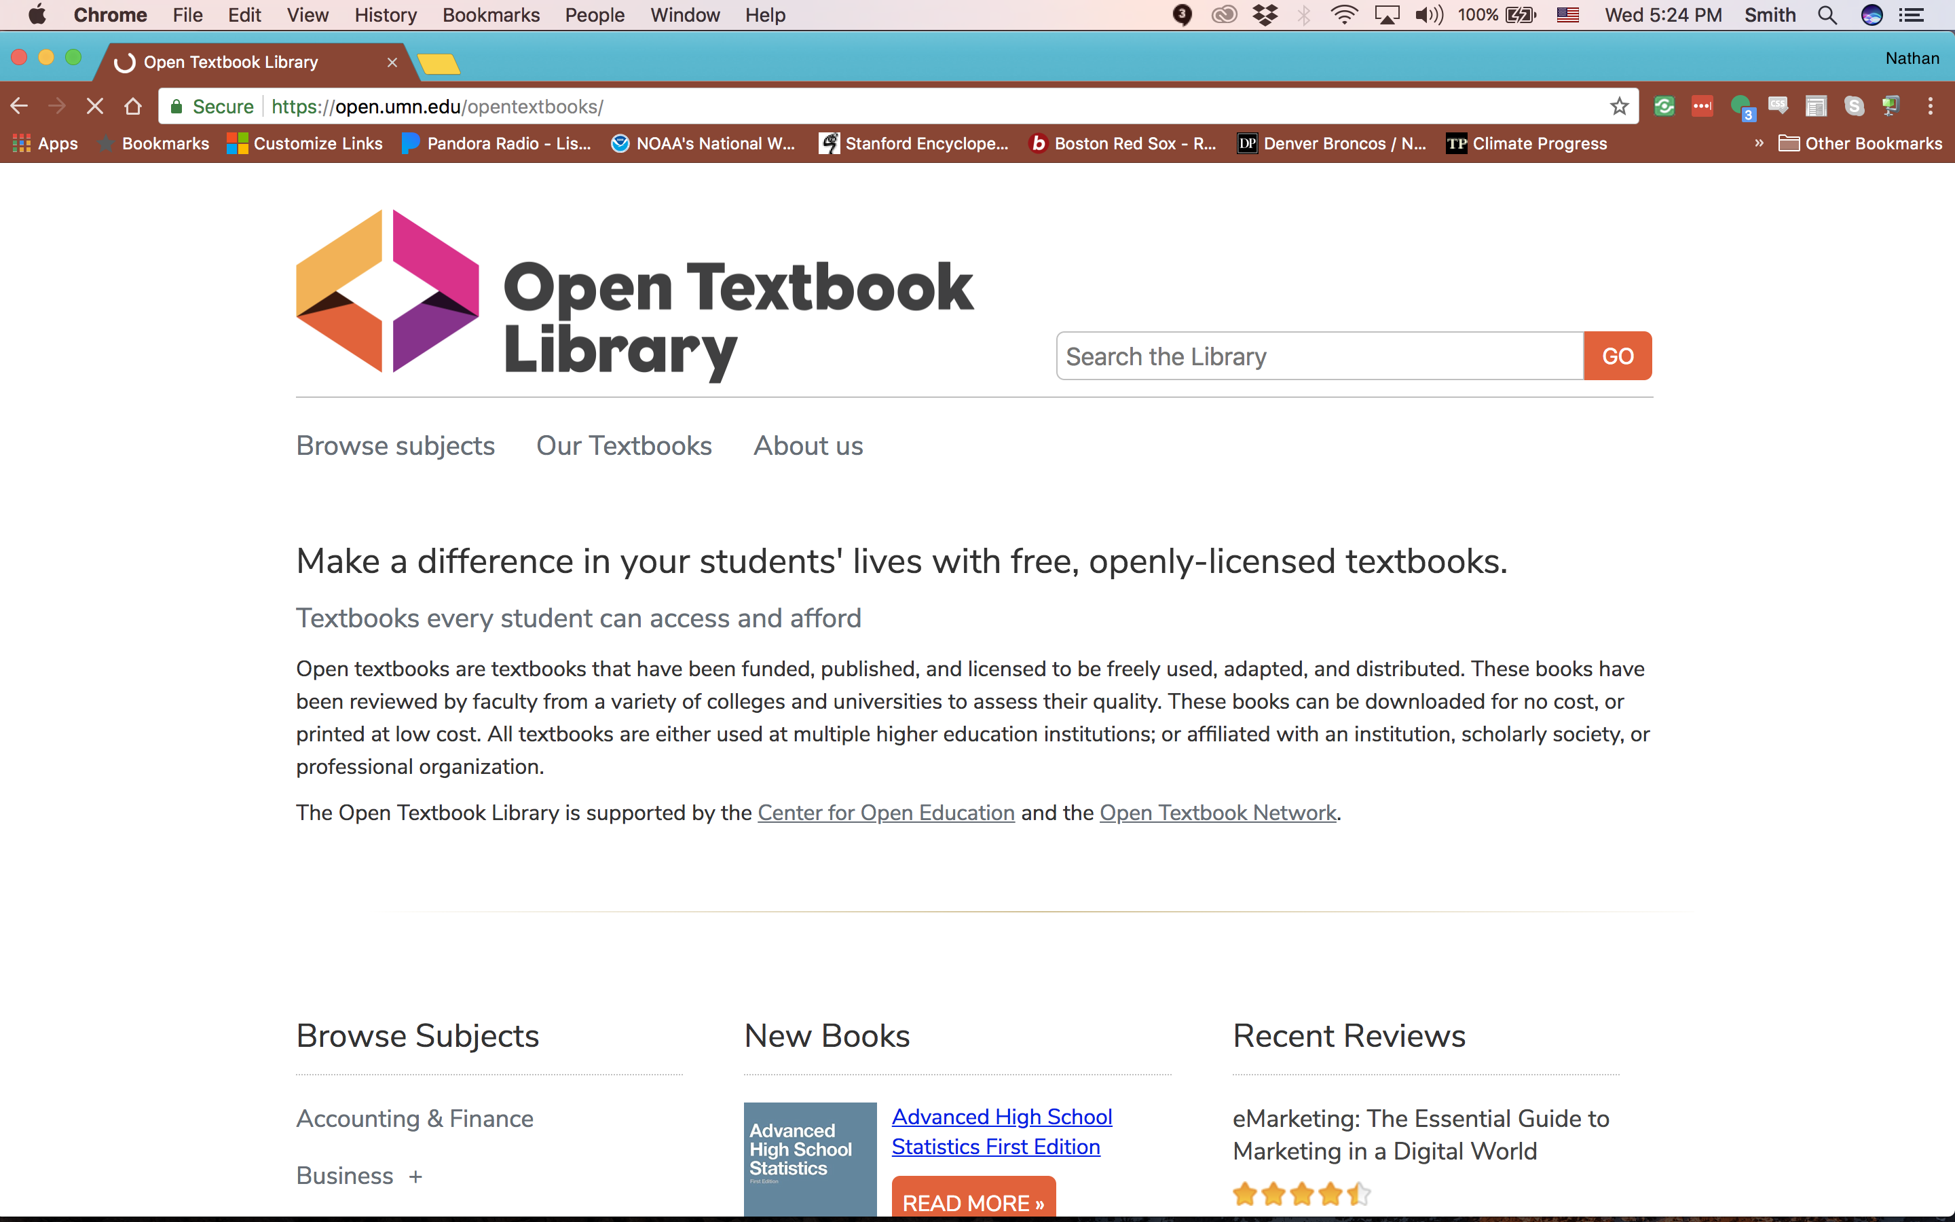
Open Textbook Library (https://open.umn.edu/opentextbooks/)

Slide 20
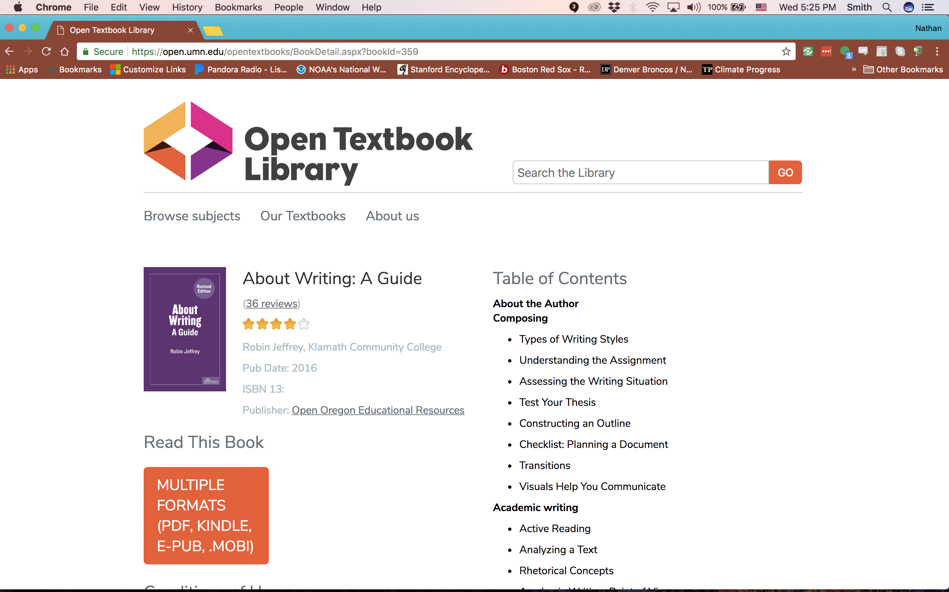

Slide 21
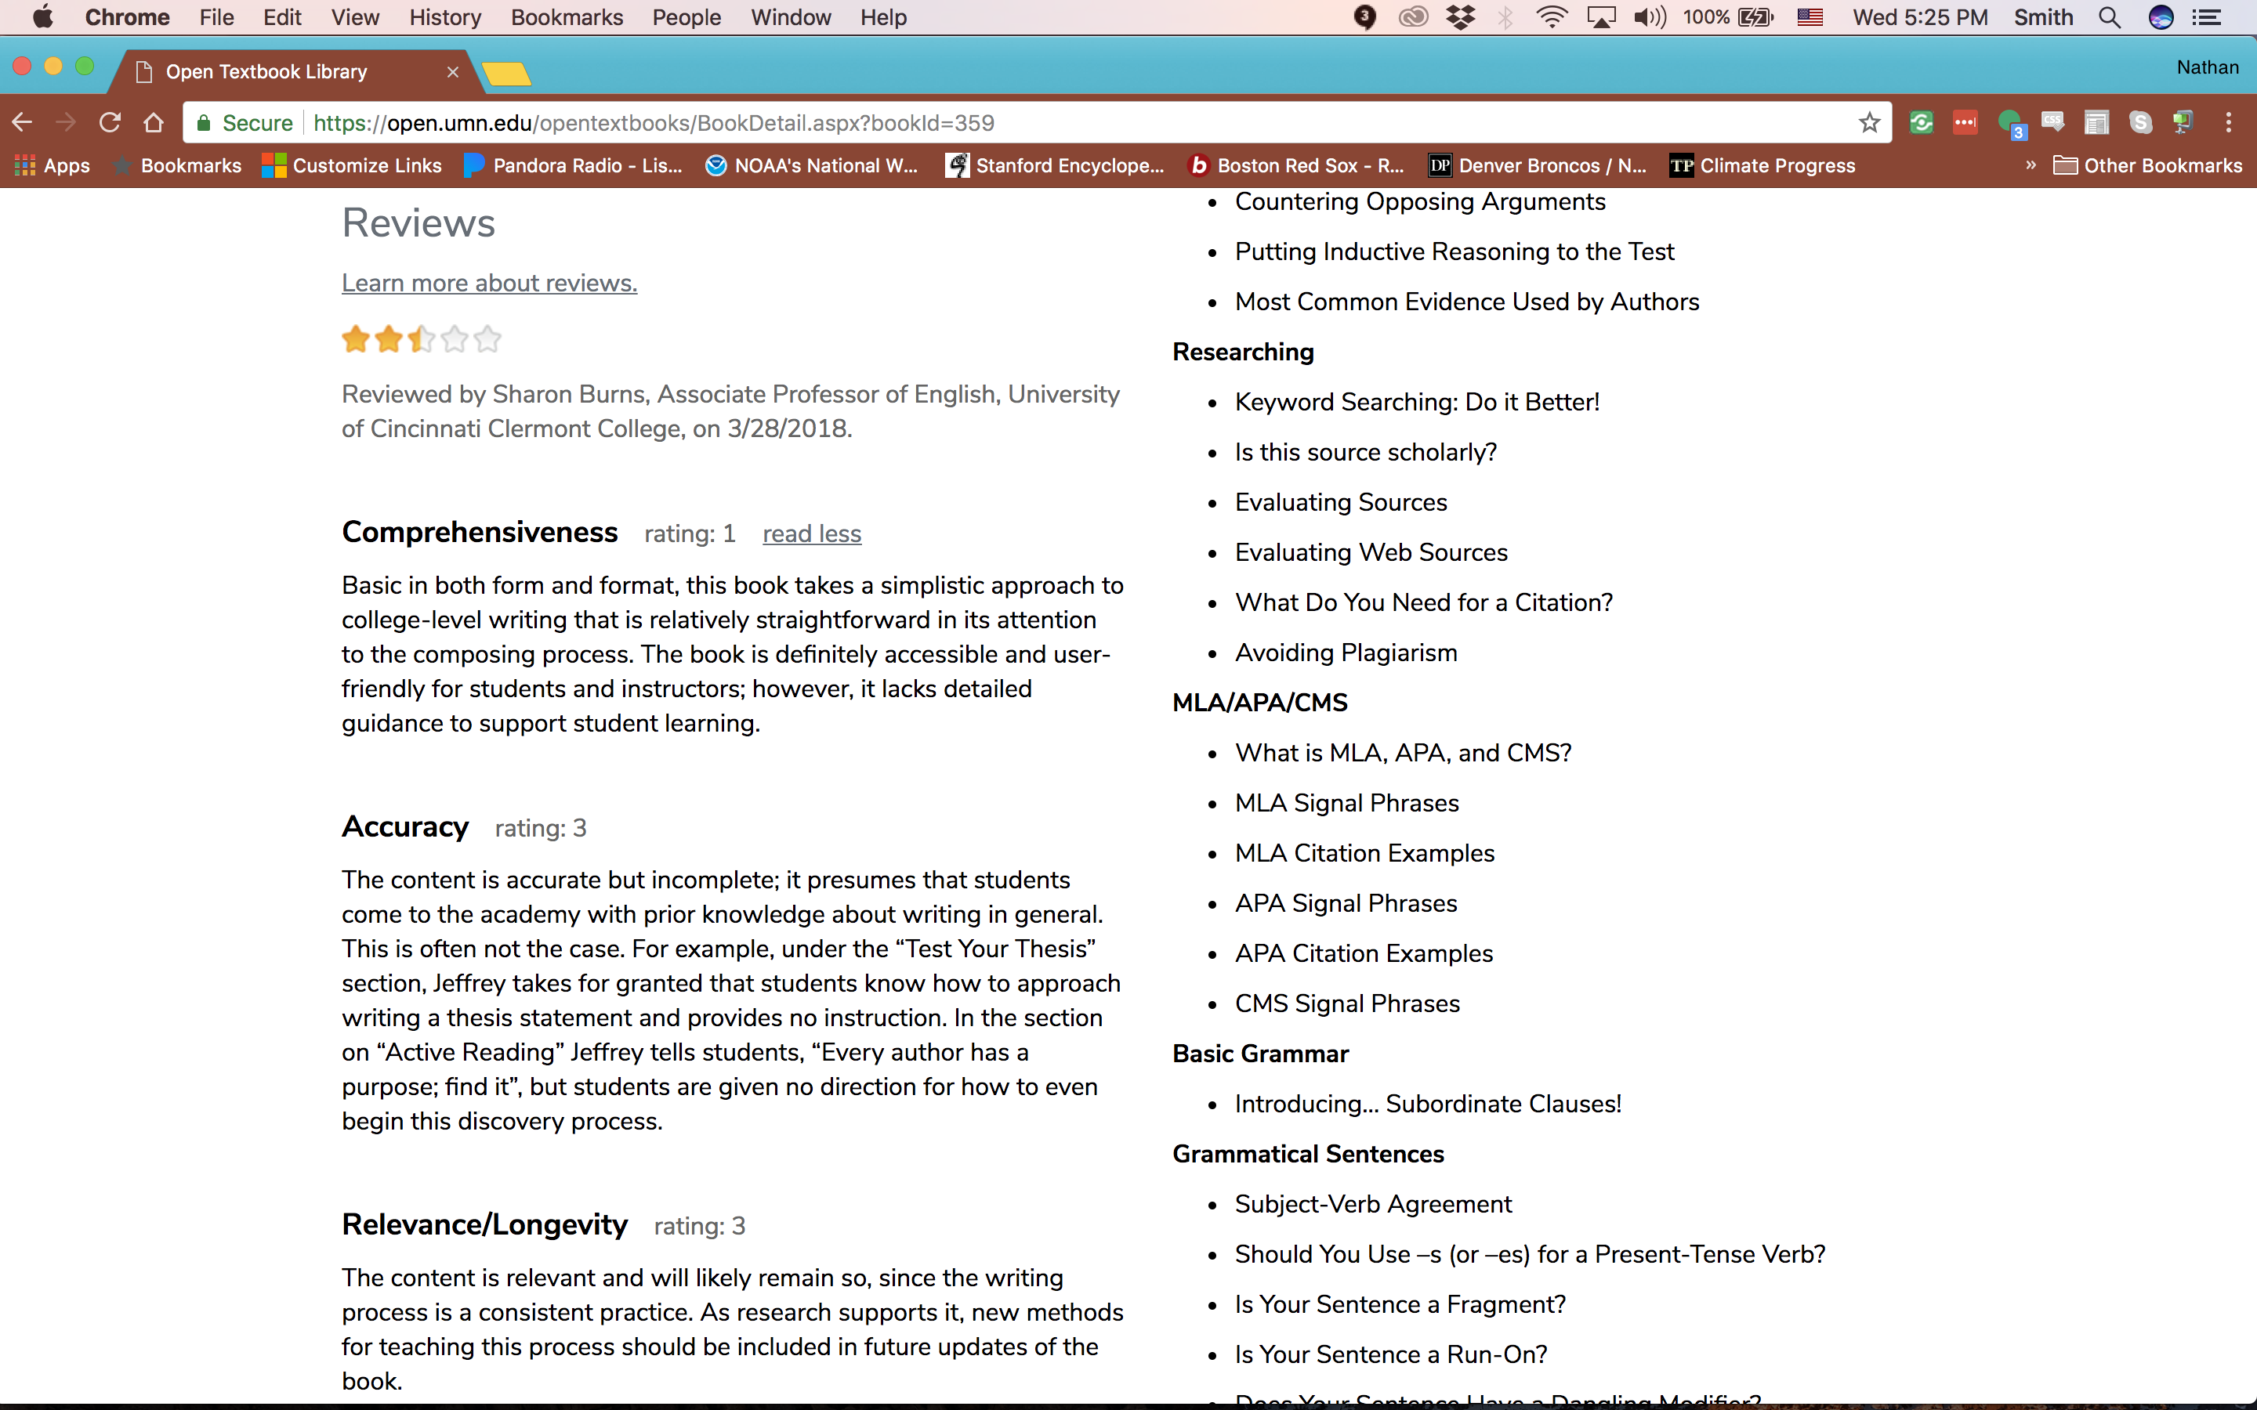

Slide 22
Khan Academy (https://www.khanacademy.org/math)

Slide 23
Mathispower4U (mathispower4U.com)

Slide 24
What about homework solutions?
If you need integrated courseware to
support your teaching it exists in OER.

Slide 25
NROC (http://nroc.org)

Slide 28
Lumen Learning OHM (https://lumenlearning.com/what/ohm/)

Slide 29
panOpen (https://www.panopen.com/)

Slide 30
Top Hat (https://tophat.com/)

Slide 31
Rethink pedagogy through the
power of Open

Slide 32
Explore, don’t drill
Instead of drilling grammar and sentence structure, have students explore grammar guides on the Internet and
reflect on lessons learned
create a cheat-sheet for themselves or other students
present one grammar/style lesson per week

Slide 33
Explore, don’t drill
Use class project assignments that require students to find tools and resources they on the Internet to solve real-world mathematical problems
when students find the resources themselves, they learn HOW to find those resources
students begin to understand the practical application of their class
Ask students to create playlists of video tutorials on specific math concepts

Slide 34
Resist the “disposable assignment”
Make classwork meaningful
Have a real audience or application
Build something permanent that can be used in the next class or that the student can take with her

Slide 35
References
Hilton III, J., Fischer, L., Wiley, D., and Williams, L. 2016. “Maintaining Momentum Toward Graduation: OER and The Course Throughput Rate,” International Review of Research in Open and Distributed Learning Vol 17 (No 6).
Wiley, D., Williams, L., DeMarte, D., and Hilton III, J. 2016. “The Tidewater Z-Degree and the INTRO Model for Sustaining OER Adoption,” Education Policy Analysis Archives Vol 24 (No 41).
Wiley, D., Webb, A., Weston, S. and Tonks, D. “A Preliminary Exploration of the Relationship Between Student-Created OER, Sustainability, and Success.” IRRODL Vol 18 (No 4).

