Slide 1
Nathan Smith (2019), Creative Commons Attribution, 4.0

Slide 2
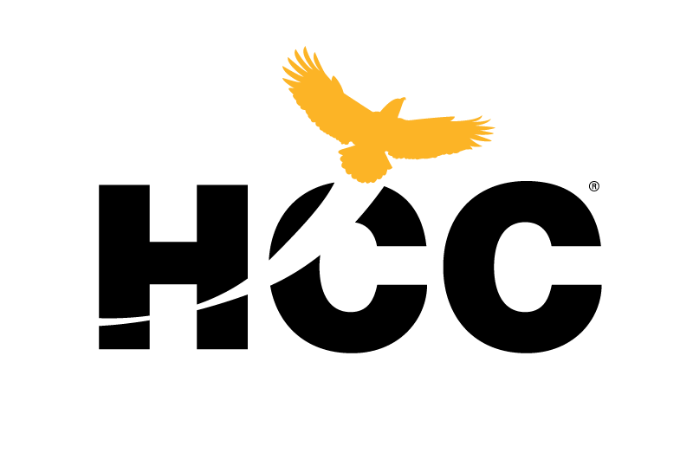
Open Educational Resources Introduction
Nathan Smith
OER Coordinator
New Full-Time Faculty Mentorship Program
November 20, 2020

Slide 3
What is the single biggest technological innovation to impact education since you started teaching?

Slide 4
Global communications systems – the Internet

Slide 5
The promise of the Internet
Free flow of information
Permanent archiving
Search and data analysis tools
Reproduction costs approaching $0
Ability to share, broadcast, and publish easily

Slide 6
The reality of copyright
©
Much of the content available on the Internet, though “free” to consume (in limited quantities), is protected by copyright.

Slide 7
The Internet’s role in publication and dissemination of knowledge
Barriers to the production of content are disappearing
For-profit companies gain market share by controlling the distribution of content

Slide 8
Look, listen, read, but don’t keep…
… the rise of the “subscription model”
“Keep Out,” CC-BY Kate Merenda-Sinha, katemere, Flickr (2006)

Slide 9
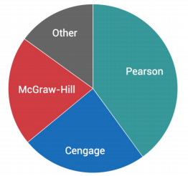
Share of Higher Ed Textbook Market
SPARC, ”Opposing the Merger Between Cengage and McGraw-Hill,” DOJ Filing, April 14, 2019.

Slide 11
HCC Students struggle to access learning materials
62% of HCC students rely on financial aid to purchase instructional materials
32% of HCC students have been unable to purchase instructional materials because of a delay in receiving financial aid
43% of HCC students spend more than $300 per semester on textbooks

Slide 12
OER Improves Access and Lowers Cost
“Beyond Definitions,” CC-By-SA Opensource.com, Flickr (2011)

Slide 13
Open Educational Resources
Open Educational Resources (OER) are teaching, learning, and research materials in any medium – digital or otherwise – that reside in the public domain or have been released under an open license that permits no-cost access, use, adaptation, and redistribution by others with no or limited restrictions.
- Unesco

Slide 14
Technical terminology
Public Domain
Public domain refers to material whose copyright term have expired or which have been intentionally released from all copyright claims.
Open Licensing
Some copyright licenses include permissions granted by the author to users. These licenses enable readers to use the work in various ways that would not be permitted under traditional copyright.

Slide 15
How can you start using OER?

Slide 16
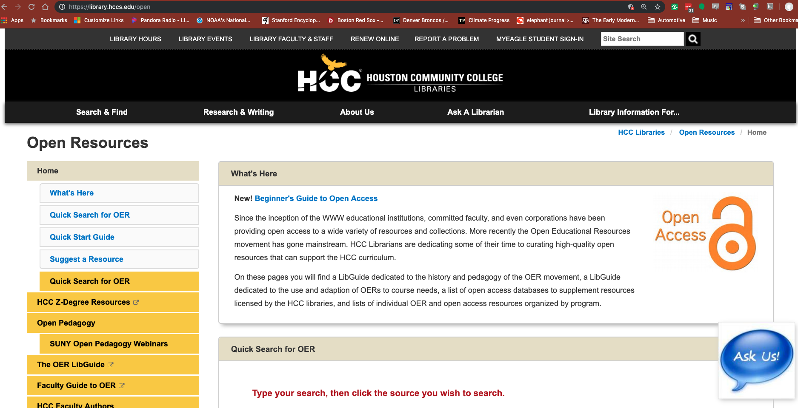
library.hccs.edu/open
Notes:
Nathan

Slide 17
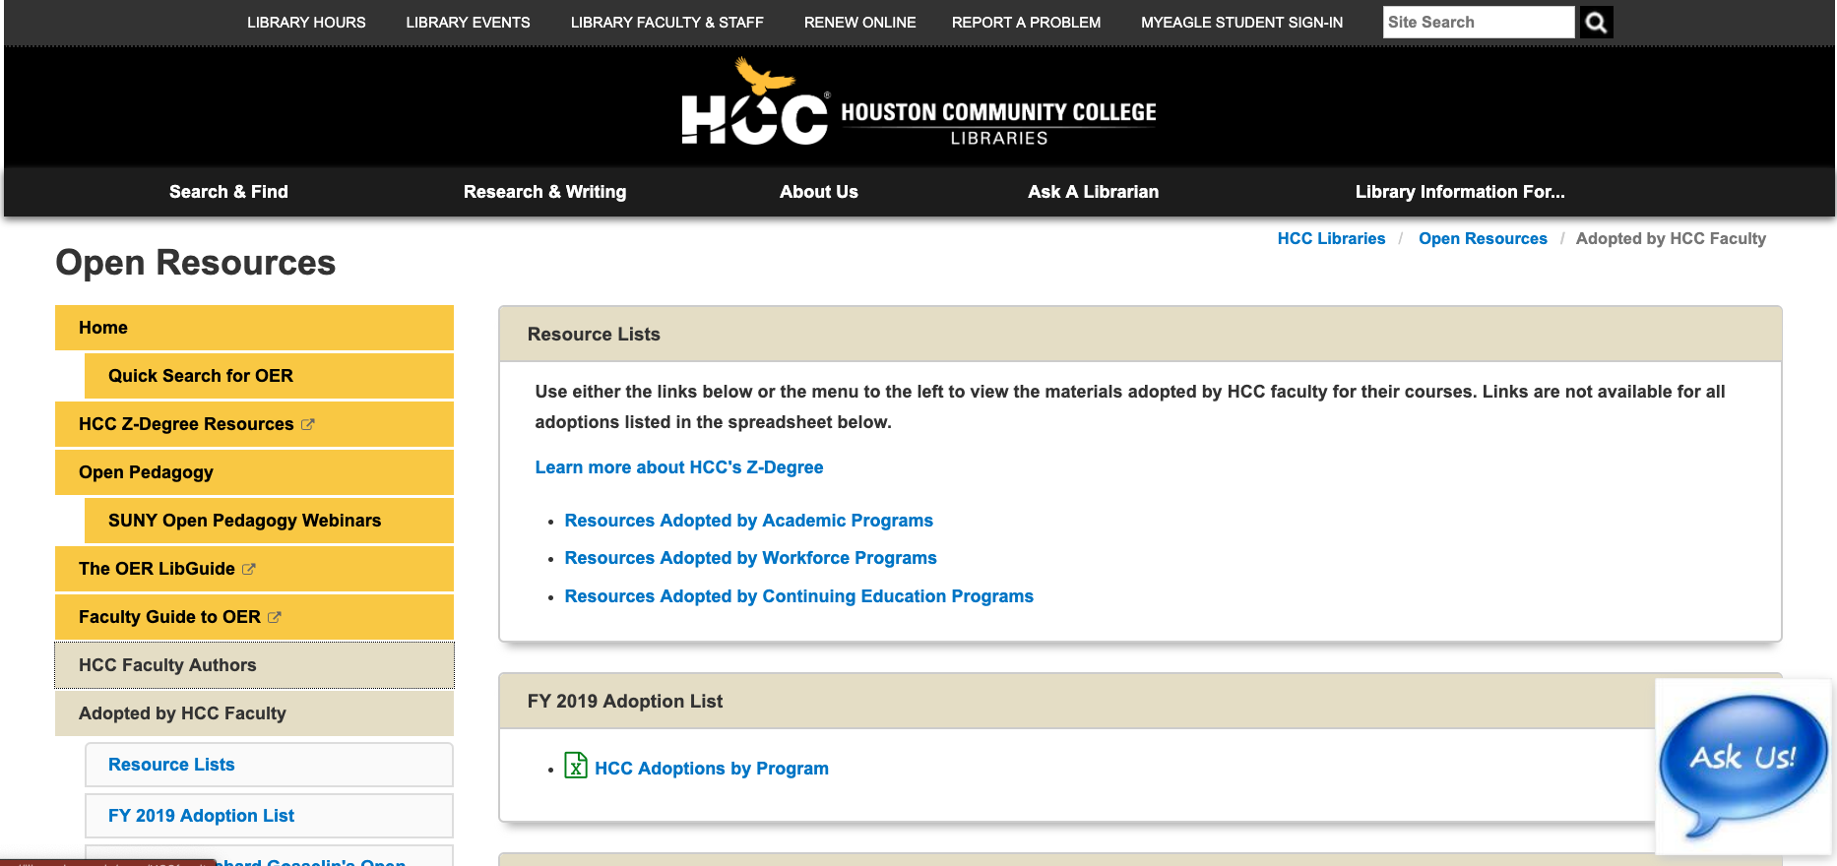
Adopted by HCC Faculty
Notes:
Nathan

Slide 18
Open Textbook Network

Slide 19
Open Textbook Network

Slide 20
OER Commons

Slide 21
OER Commons

Slide 22
OER Commons

Slide 23
OER Commons

Slide 24
OER Commons

Slide 25
google.com

Slide 26
google.com

Slide 27
Look for OER Workshops
Open Educational Resources Online Training: OE8000
Two sessions each semester
4-week sessions (about 12 hours of work)
OER Training certificate ($300)
OER Development stipends ($600 - $1800)
https://learning.hccs.edu/faculty/nathan.smith2/open-educational-resources-information

Slide 28
Thank you.

