Slide 2
The Z-Degree and Open Educational Resources (OER)
Nathan Smith, PhD
Philosophy Instructor & OER Coordinator

Slide 3
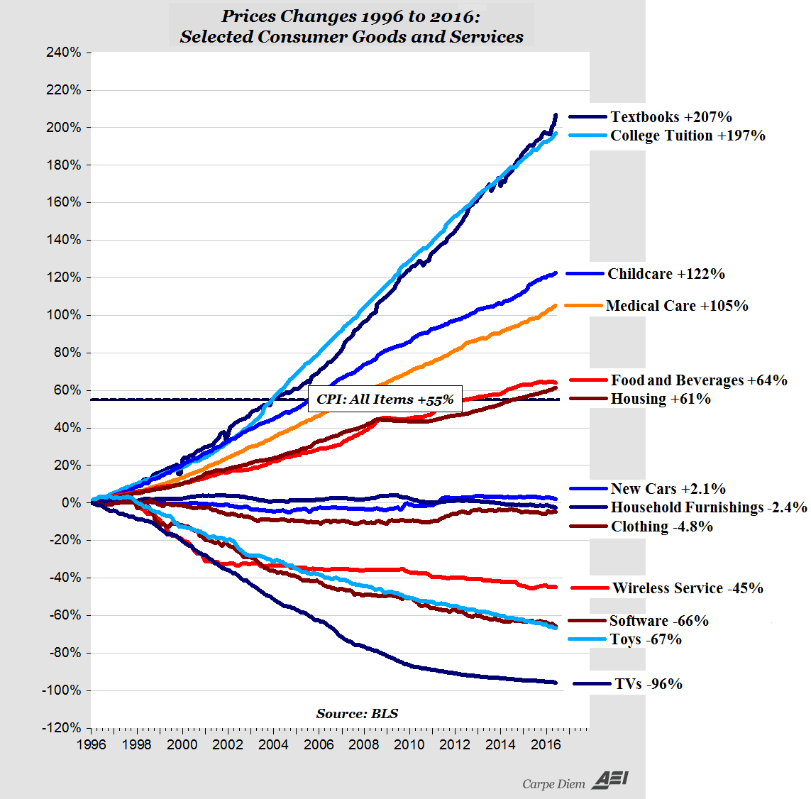

Slide 4
HCC Student & Faculty Surveys (2013-17)
78% of students spend over $150 per semester on textbooks
45% of students spend over $300 per semester
26% of faculty are moderately concerned about the price of textbooks
51% of faculty are extremely concerned about the price of textbooks

Slide 5
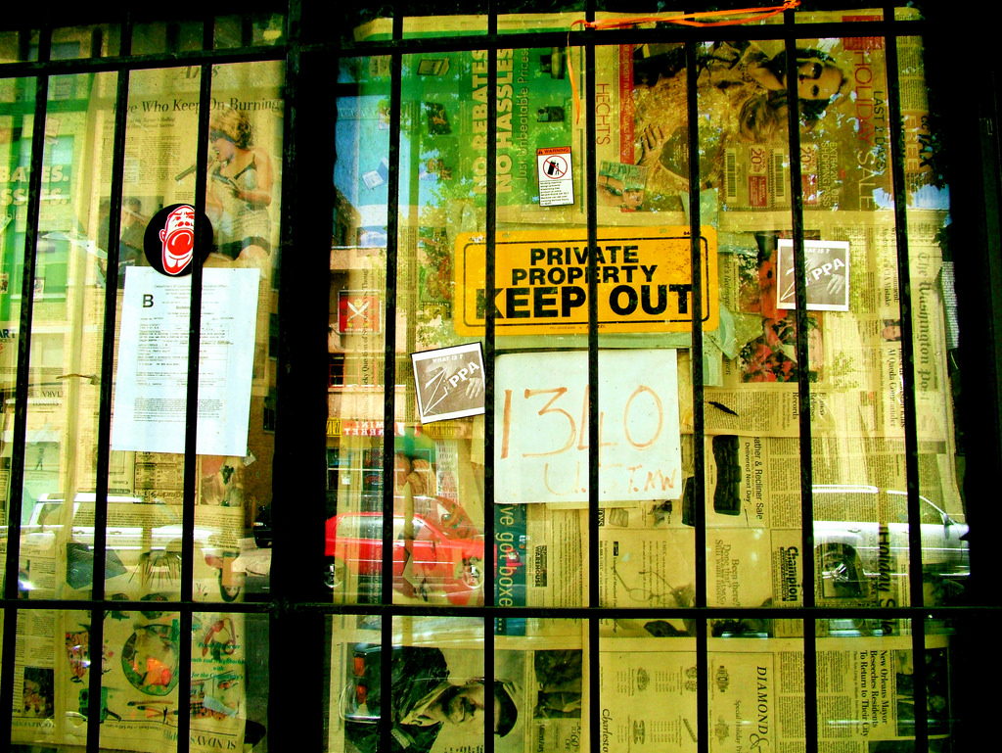
Copyright restricts access and increases costs
“Keep Out,” CC-BY Kate Merenda-Sinha, katemere, Flickr (2006)

Slide 6
OER Improves Access and Lowers Cost
“Beyond Definitions,” CC-By-SA Opensource.com, Flickr (2011)

Slide 7
What are we doing right now?
Over 30% of programs have adopted an OER
Nearly 40% of instructors use some OER in their courses
Two degree plans:
AA or AS in Multidisciplinary Studies
AA in Business Administration
At three campuses:
Central campus
Northline campus
Online
Expansion Fall 2018: Core Curriculum at Stafford and Spring Branch

Slide 8
 |  | Fall 2017 | Spring 2018
Sections |  | 28 | 49
 | Online | 11 | 25
 | Face to Face | 17 | 24
Enrollments |  | 712 | 1181
Courses |  | 12 | 16
Campuses |  | 2 | 3

Slide 9
Estimated Cost Savings
 | Z-Degree | All OER
Fall 2017 | $ 71,200.00 | $312,000.00
Spring 2018 | $118,100.00 | $402,000.00
Total | $189,300.00 | $714,000.00

Slide 10
What can you do?
Students:
search Low Cost Books (LCB) or Zero Cost Books (ZCB) in PeopleSoft when registering for courses
Faculty:
use OER in your class
work with program to adopt OER for your courses
tell your chair when you use LCB or ZCB to designate in schedule
sign up for the Z-Degree
Administrators and others:
learn more about OER
educate, encourage, and support OER

