Slide 1
Open Educational Resources for
Dual Credit
Access. The future of education.
Dr. Nathan Smith, OER Coordinator, HCC
Daniel Williamson, Managing Director, OpenStax, Rice University

Slide 2
What are OER?
Notes:
Nathan

Slide 3
Open Educational Resources are teaching, learning, and research resources that reside in the public domain or have been released under an intellectual property license that permits their free use and repurposing by others. OER include full courses, course materials, modules, textbooks, streaming videos, tests, software, and any other tools, materials, or techniques used to support access to knowledge.
“”
Source: William and Flora Hewlett Foundation (underlining added)
Notes:
Nathan

Slide 4
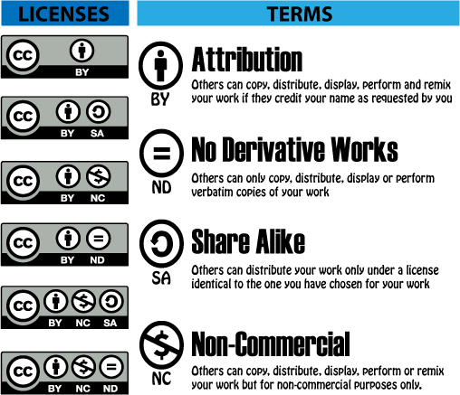
Open-licensing increases freedom
Notes:
Nathan

Slide 5
Why use OER?
Notes:
Nathan

Slide 6
Education is sharing
The core activities of education (teaching, learning, feedback, advising) all involve sharing.
OER facilitates sharing.
____________________________________
Therefore, OER facilitates the core activities of education.
Wiley, “High Impact OER Adoption Practices” CC-BY 4.0
Notes:
Nathan

Slide 7
The Internet facilitates sharing, and therefore education
 | Handwriting | Printing Press | Internet
Copying a book | $1000s per copy | $1s per copy | $0.0001s per copy
Distributing a book | $1000s per copy | $1s per copy | $0.0001s per copy
Wiley, “High Impact OER Adoption Practices” CC-BY 4.0
Notes:
Nathan

Slide 8
Except it doesn’t
©
Much of the content available on the Internet, though “free” to consume, is protected by copyright.
Notes:
Nathan

Slide 9
Internet Enables
Copyright Forbids
Wiley, “High Impact OER Adoption Practices” CC-BY 4.0
Notes:
Nathan

Slide 10
Look, listen, read, but don’t keep
Imgage: “Keep Out,” Kate Meerand-Senha, CC-BY 4.0
Notes:
Nathan

Slide 11
Expectation vs. Reality
Notes:
Nathan

Slide 12
Expectation vs. Reality
Notes:
Nathan

Slide 13
What is OpenStax?
Rice
University
Reports to the President’s office
501(c)(3)
Nonprofit
Money invested back into the content
Dr. Richard Baraniuk
Founded by a Rice faculty member
38 books
Published since 2012
Notes:
Daniel

Slide 14
Our nonprofit mission
Increase access to high-quality open educational content
Provide students financial relief
Increase academic freedom and flexibility for faculty
Improve completion rates and reduce time to graduation by reducing financial barriers presented by high-cost materials
Notes:
Daniel

Slide 15
Grant funding
Laura and John Arnold Foundation
Arthur and Carlyse Ciocca Charitable Foundation
Ann and John Doerr
Bill & Melina Gates Foundation
Girard Foundation
Google Inc.
The William and Flora Hewlett Foundation
The Calvin K. Kazanjian Economics Foundation
The Maxfield Foundation
Michelson 20MM Foundation
The Open Society Foundations
Brian D. Patterson USA-International Foundation
The Bill and Stephanie Sick Foundation
The Stuart Family Foundation
Memo Treviño
Rusty and John Jaggers
New titles we currently don’t have (pay all authors, reviewers, editors, etc.)
Teaching & learning academic research
New initiatives such as Tutor
Notes:
Daniel

Slide 16
Improving access
38 free and open textbook library
Elementary Algebra
Intermediate Algebra
Introductory Statistics
Pre-algebra
Precalculus
Business
Business Ethics
Introduction to Business
Introductory Business Statistics
Principles of Accounting 1 & 2
Organizational Behavior
Entrepreneurship
Principles of Management
Additive Manufacturing
General Ed
College Success
High School
AP Biology
AP Physics
AP Prin. of Macroeconomics 2e.
AP Prin. of Microeconomics 2e.
*highlighted: future books
Science
Anatomy and Physiology
Astronomy
Biology
Chemistry
Chemistry: Atoms First
College Physics
Concepts of Biology
Microbiology
University Physics
College Physics - Polish ver.
Social Studies
American Government
Introduction to Sociology 2e.
Principles of Economics 2e.
Principles of Macroeconomics 2e.
Principles of Microeconomics 2e.
Psychology
Humanities
U.S. History
Math
Algebra and Trigonometry
Calculus
College Algebra
Notes:
Daniel

Slide 17
Quality comparable to commercial texts
Standard scope and sequence
Expert-written
Extensively reviewed by peers and industry
Rigorous editorial process
Regular errata and industry updates
Notes:
So in 2012, we pivoted an instead of being a just a platform, we started publishing turn-key open textbooks that are comparable in quality to commercial textbooks.

Slide 18
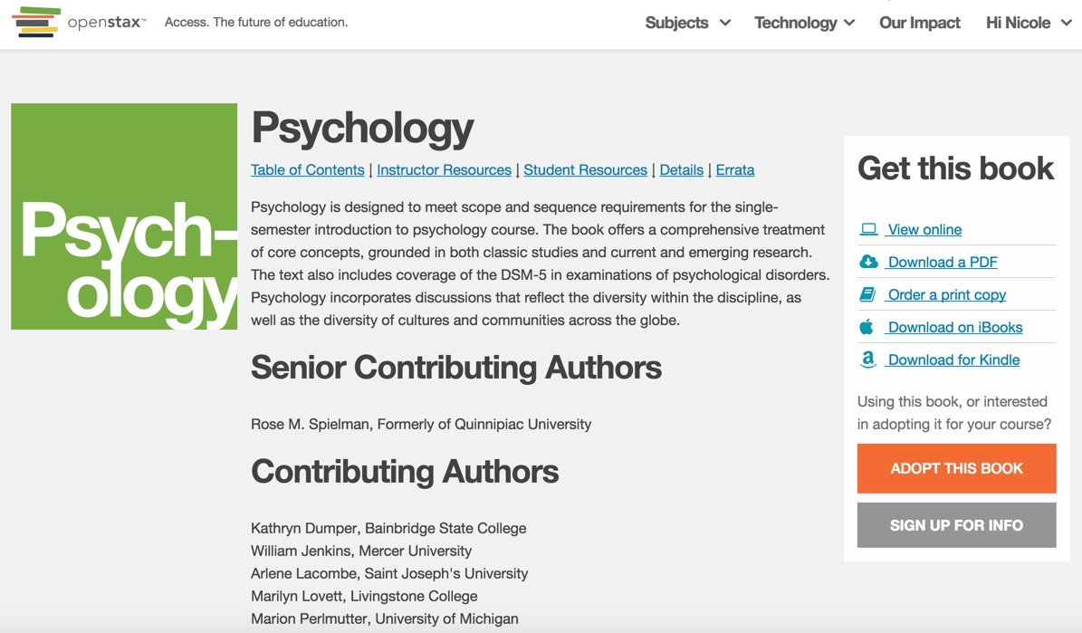
Access & formats students & faculty use
Notes:
Daniel
We make sure that students have access on day one to the core content that they need for their costs.
Our content is available for free and without needing a login or password as a
website
pdf
kindle
mobile apps (coming soon!)

Slide 19
Faculty often need more than a book
Online homework (from partners)
Online labs (from partners)
PowerPoint slides
Pronunciation guides
Solution Manuals
Test banks
And more (via community resources)
Notes:
Daniel

Slide 20
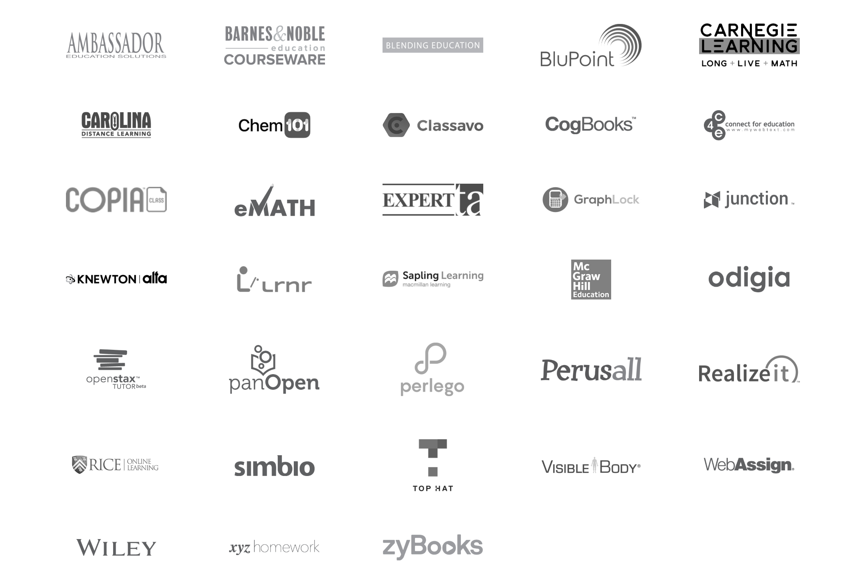
Notes:
Daniel

Slide 21
How does this help students learn?
Notes:
Daniel

Slide 22
28 hours working a
minimum wage job to purchase
a single $200 textbook
“”
“Covering the Cost,” Ethan Senack and Robert Donoghue, The Student PIRGS, February 2016
Notes:
Daniel

Slide 23
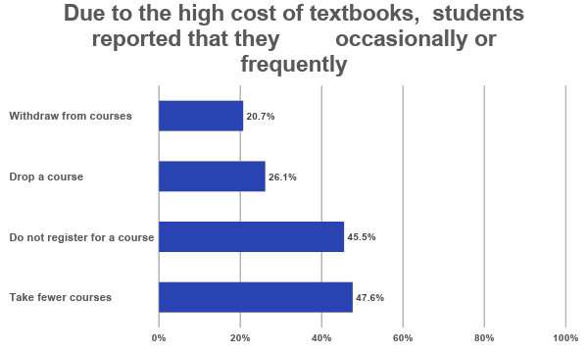
“2016 Student Textbook and Course Materials Survey”, Florida Virtual Campus, October 2016

Slide 24
Efficacy research
Increase number of credits taken
Fischer et al (2015). Students enrolled in OER courses took more courses in the semester they used OER and the following semester after the use of OER.
Robinson (2015)
Lower withdrawal rates
Feldstein et al. (2012)
Hilton and Laman (2012)
Wiley et al. (2016)
Notes:
Daniel

Slide 25
Efficacy research
11 peer-reviewed studies
48,623 students
93% of students did as well or better using OER
“As well” is still a win with students saving $
Analysis by John Hilton, Brigham Young University
Notes:
Daniel

Slide 26
Student benefits of OER beyond cost
Open Licensing means students have the freedom to access their content:
Wherever they want
Different formats for different devices and situations
Share on social networks and public forums
Share in blended learning environments
Whenever they want
Instant, unlimited access
Permanent access, they own the content forever
However they learn
Use content in their work legally
Make videos/class assignments legally
Put into a format that meets their study habits
Notes:
Daniel

Slide 27
Post-course student access to core content matters
Multi-semester courses
Retaking the course
Reference for advanced courses
Studying for higher education entrance exams & certification exams
Changing careers
Lifelong learning
Any of the above could mean a student needs to purchase another access code or rent the content again

Slide 28
How do I start using OER?
Notes:
Nathan

Slide 29
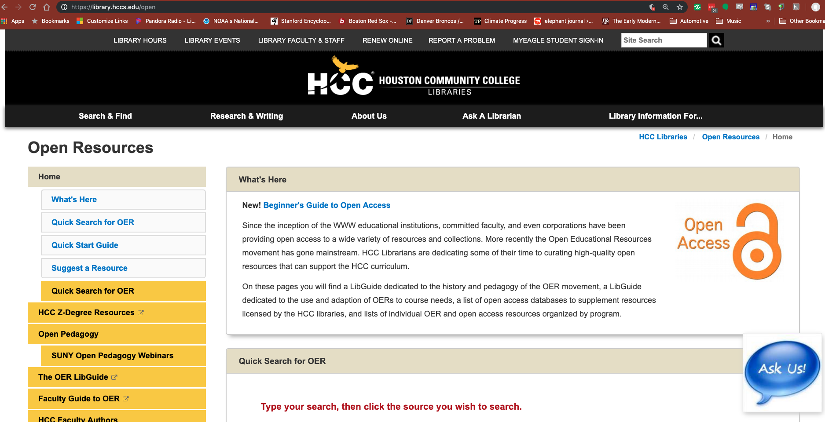
library.hccs.edu/open
Notes:
Nathan

Slide 30
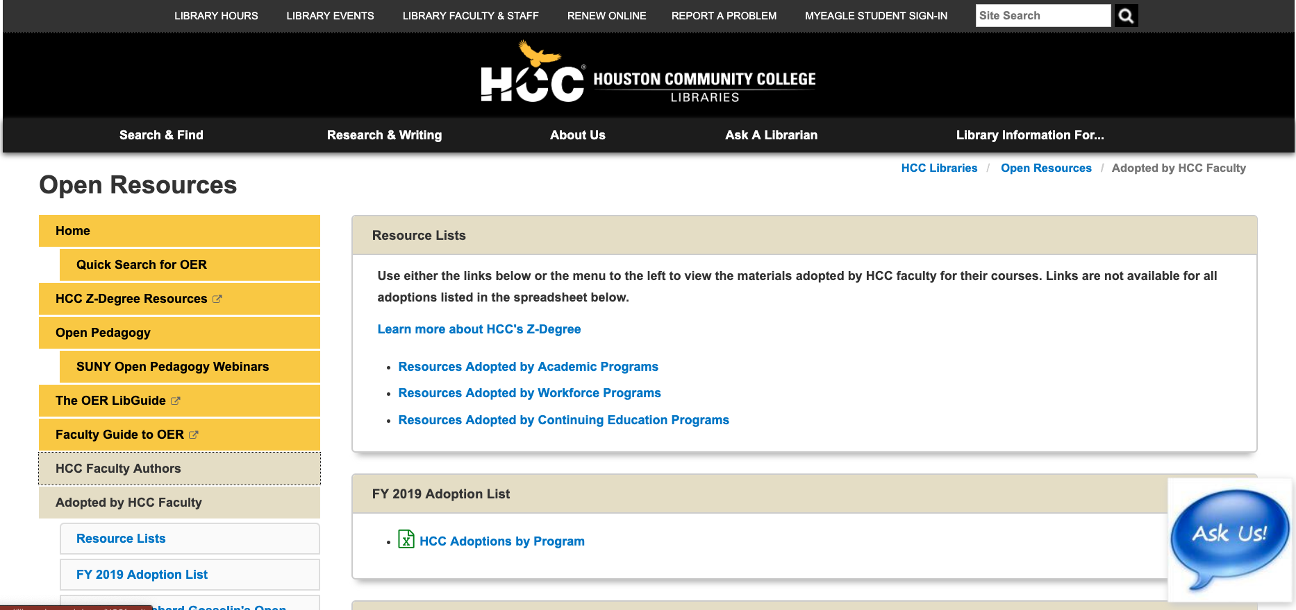
Adopted by HCC Faculty
Notes:
Nathan

Slide 31
Look for ancillaries, lesson plans, and other materials
Notes:
Nathan

Slide 32
OER Commons
Notes:
Nathan

Slide 33
OER Commons
Notes:
Nathan

Slide 34
OER Commons
Notes:
Nathan

Slide 35
google.com
Notes:
Nathan

Slide 36
youtube.com
Notes:
Nathan

Slide 37
youtube.com
Notes:
Nathan

Slide 38
youtube.com
Notes:
Nathan

Slide 39
flickr.com
Notes:
Nathan

Slide 40
flickr.com
Notes:
Nathan

Slide 41
flickr.com
Notes:
Nathan

Slide 42
Consider how OER might change the way you teach...
Notes:
Nathan

Slide 43
Academic Freedom and OER
Every student has immediate & unlimited access
Standard scope & sequence makes it easy to adopt
Variety of technology partners allow choice
Permission free use, editing & adaptation
Variety of formats/partners eliminates one size fits all
Ownership of the content. Forever
Moving to a new edition is optional
Notes:
Nathan

Slide 44
OER Enables Better Design
Traditional textbooks are imperfectly aligned with teaching preferences
Faculty must redesign courses, following new editions with little pedagogical benefit.
Textbooks can be out of date.
OER can be updated as needed by the faculty
OER can be tailored to align with objectives, assessments, and level of instruction in the course
OER can be designed with your students in mind
learning differences
cultural differences
differences in interests
Notes:
Nathan

Slide 45
Open Pedagogy opens new possibilities
It’s not just the license!
Consider the values embodied by “Open”:
Accessibility
Affordability
Sharing
Creativity
Empowerment
Inclusion
Notes:
Nathan

Slide 46
Two types of assignments
Traditional assignments are disposable
OER-enabled assignments can be reusable
the license enables: reuse, revision, remixing, redistribution
students and faculty can become collaborators
open pedagogy changes the cycle of content creation
http://openpedagogy.org/
Notes:
Nathan

Slide 47
And it’s working…
Notes:
Daniel

Slide 48
6,400+ institutions using OpenStax content
Houston Community College System
University of Texas at Austin
University of Houston
Harvard University
California State University System
Stanford University
Baylor College of Medicine
Rice University
Ivy Tech Community College System
Austin Community College
Maricopa Community College System
Arizona State University
Michigan State University
Purdue University
University of Georgia
Notes:
Daniel

Slide 49
$920 million saved
Notes:
Daniel

Slide 50
The Struggle for Equity in Education
Student debt is still on the rise. Now nearly $1.5T
Debt is racialized, and disproportionately impacts youth of color, especially black youth¹
42% of community college students experience food insecurity²
51% of community college students experience housing insecurity ²
12% of community college students were homeless²
1 Racial disparities in Student Loan Debt and the Reproduction of The Fragile Black Middle Class. Houle and Addo. February 2018. https://www.ssc.wisc.edu/cde/cdewp/2018-02.pdf
2 Still hungry and homelss in college. Goldrick et. al April 2018. http://wihopelab.com/publications/Wisconsin-HOPE-Lab-Still-Hungry-and-Homeless.pdf
Notes:
Another thing that hasn’t changed all that much over the past 10 years is the struggle for equity in education.
Education is often touted as the great equalizer, but a lot of recent research is actually pointing out that due to student loan debt or the unobtainability of a degree,
that trying to get an education can be the great perpetuator of the status quo.
****GO through stats..
These are challenging stats… and here I am talking about OER. The cost of a textbooks can seem so small when looking this big problem…
So Can OER help?

Slide 51
Can OER Help?
For many students, textbook costs are
the final straw
costing between $600-1,200/year.
Notes:
“Hello my name is Jenny Vega,
I'm a current student at Mt. San Jacinto college. I wanted to take the time I reach out to you guys to thank you for providing free online textbooks. I can't begin to tell you how grateful I am,
about a year ago I became homeless and had to withdraw from class leaving me unable to receive FAFSA.
Being a single mom of 2 children I couldn't possibly afford a 200$ dollar book,
but your book made it possible for me to go back to school with out the stress of "how will I afford it".
Thank you I really hope openstax grows, because you guys are providing a way for me and many other mother's the opportunity to get a better education so we could better our lives.
Sincerely, Jenny Vega”
This is why I have been working in OER for 10 years… letters like these that show the impact that simply making knowledge freely available can have on someone’s life.

Slide 52
You can help!
Rice University is exploring the idea of developing a professional development program for Houston-area Dual Credit teachers including training around OER.
Let us know what you would like to see in that program.
tinyurl.com/RiceHCC
openstax.org/blog
Notes:
“Hello my name is Jenny Vega,
I'm a current student at Mt. San Jacinto college. I wanted to take the time I reach out to you guys to thank you for providing free online textbooks. I can't begin to tell you how grateful I am,
about a year ago I became homeless and had to withdraw from class leaving me unable to receive FAFSA.
Being a single mom of 2 children I couldn't possibly afford a 200$ dollar book,
but your book made it possible for me to go back to school with out the stress of "how will I afford it".
Thank you I really hope openstax grows, because you guys are providing a way for me and many other mother's the opportunity to get a better education so we could better our lives.
Sincerely, Jenny Vega”
This is why I have been working in OER for 10 years… letters like these that show the impact that simply making knowledge freely available can have on someone’s life.

Slide 53
Thank you
For more information visit OpenStax.org and https://library.hccs.edu/open

