Slide 2
Z-Degree Faculty Training
Welcome to the Z-Degree
Thank you for participating!

Slide 3
Paperwork
We want to pay you for participating in the Z-Degree, but in order to do so, you will need to fill out some forms.
“Paperwork,” Damian Gada, CC-BY, flickr.com

Slide 4
Available Stipends and Procedures
Please see my Learning Web page for a complete collection of required stipend materials.
Types of stipend:
Training $300
Adoption $300
TLE Certified OER Course $600
Adaptation, Creation, and Improvement of OER $600, $1200, or $1800

Slide 5
Stipend Process
Complete form with personal information
Sign and give to your supervisor
Position #
Department
Dept ID
Signature
Return to me (Nathan Smith)
I send as a batch (wait until I receive from everyone)
Send to AVC Dr. Levey – then 3-4 weeks before it becomes available

Slide 6
Some questions about you
Do you know what OER are?
Have you used OER in your courses?
How much?
Some
Most
All
Have you written, adapted, or improved an existing OER?
Are you philosophically or pedagogically committed to OER? Why or why not?
What brings you here?

Slide 7
Course Map and Alignment

Slide 8
TLE Certified OER Course Map
Name:
Course:
Module | Course Student Learning Outcomes (SLOs) | Course Learning Objectives | Learning Activities | Assessments | Instructional Materials (provide url) | Notes
Use this to organize your course shell | (What will the students learn by the end of the course?) | (What specific learning objectives will help students achieve this SLO?) | (What ungraded activities are used to support the objectives and assessments?) | (What graded assessments measure my learning objectives?) | Note license information here

Slide 9
Open Licensing, the Law,
and OER Basics

Slide 10
Why OER?
Education is sharing (Wiley)
The core activities of education (teaching, learning, feedback, advising) all involve sharing.
OER facilitates sharing.
Therefore, OER facilitates the core activities of education.

Slide 11
The Internet facilitates sharing, and therefore education
 | Handwriting | Printing Press | Internet
Copying a book | $1000s per copy | $1s per copy | $0.0001s per copy
Distributing a book | $1000s per copy | $1s per copy | $0.0001s per copy
Wiley, “High Impact OER Adoption Practices” CC-BY 4.0

Slide 12
Except it doesn’t
©
Much of the content available on the Internet, though “free” to consume, is protected by copyright.

Slide 13
Internet Enables
Copyright Forbids
Wiley, “High Impact OER Adoption Practices” CC-BY 4.0

Slide 14
Look, listen, read, but don’t keep

Slide 15
Expectation vs. Reality
A Knowledge ”Commons”
Shared resources available publicly

Slide 16
OER
Open Educational Resources are teaching, learning, and research resources that reside in the public domain or have been released under an intellectual property license that permits their free use and re-purposing by others. (William and Flora Hewlett Foundation)

Slide 18
The 5 R’s of OER
Importantly OER materials attempt to preserve these 5 capacities (Wiley 2014):
Retain: the right to make, own , and control copies of the content.
Reuse: the right to use the content in a wide range of ways.
Revise: the right to adapt, adjust, modify, or alter the content itself.
Remix: the right to combine the original or revised content with other open content to create something new.
Redistribute: the right to share copies of the original content, your revisions, or your remixes with others.

Slide 19
Open = Free
?

Slide 20
Open = Free
?

Slide 21
Free, but not open
Pay with advertisements
Take-down notices for reuse and redistribution
Pay with data (terms of use)
…

Slide 22
Open, but not free

Slide 23
Increasingly: Access = Subscription only

Slide 24
Increasingly: Access = Subscription only

Slide 27
What about “fair use”?
Fair use is a defense against a claim of copyright infringement not an allowance in copyright.
Application of fair use is subjective – many variables, lots of uncertainty (four factors)
Transformative factor
Nature of the work
Quantity and substantiality of the portion taken
Effect of the use on potential markets

Slide 28
The TEACH Act
There are established guidelines for using copyrighted works for the purposes of education:
Include copyright notice
Provide a limited portion (book chapter, article, chart, image, film clip…)
One copy per student
The TEACH Act extends these guidelines to online education
IMPORTANTLY: use of copyrighted materials cannot replace a textbook – the use must be LIMITED, CURRENT, and NOT REPEATED

Slide 29
Let’s Play a Game Called “Is it Open?”
The following websites host online materials that may be used in teaching and learning. You tell me, open or not open:
The New York Times
Wikipedia
Encyclopedia.com
Saylor Academy
The American Yawp
The Stanford Encyclopedia of Philosophy
Purdue OWL

Slide 31
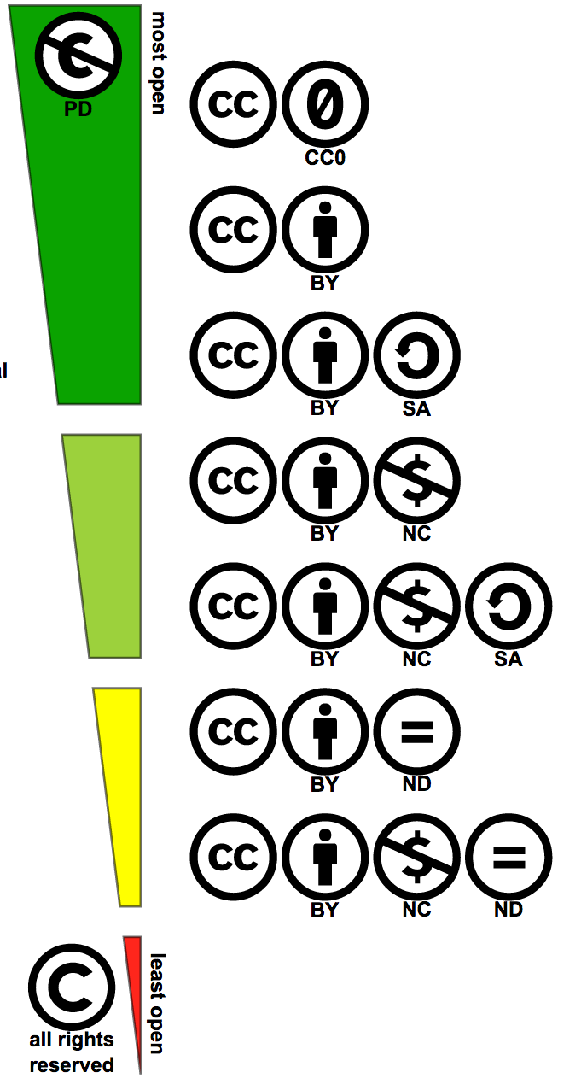

Slide 32
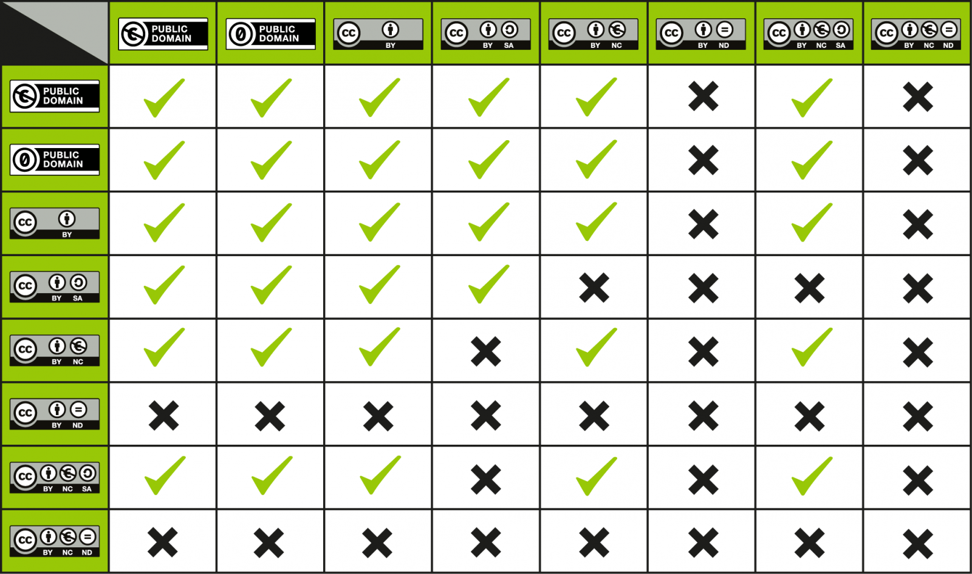

Slide 33
The 5 R’s
Ensure that materials enable these permissions:
Retain: make, own, and control copies of the content.
Reuse: use the content in a wide range of ways.
Revise: adapt, adjust, modify, or alter the content itself.
Remix: combine the original or revised content with other open content to create something new.
Redistribute: share copies of the original content, your revisions, or your remixes with others.

Slide 34
Lunch

Slide 35
Now you know something, it’s time to start doing stuff…

Slide 36
Three ways to look for OER
Common web search tools
HCC OER LibGuide
Open Textbook Repositories

Slide 37
google.com

Slide 38
google.com

Slide 39
google.com

Slide 40
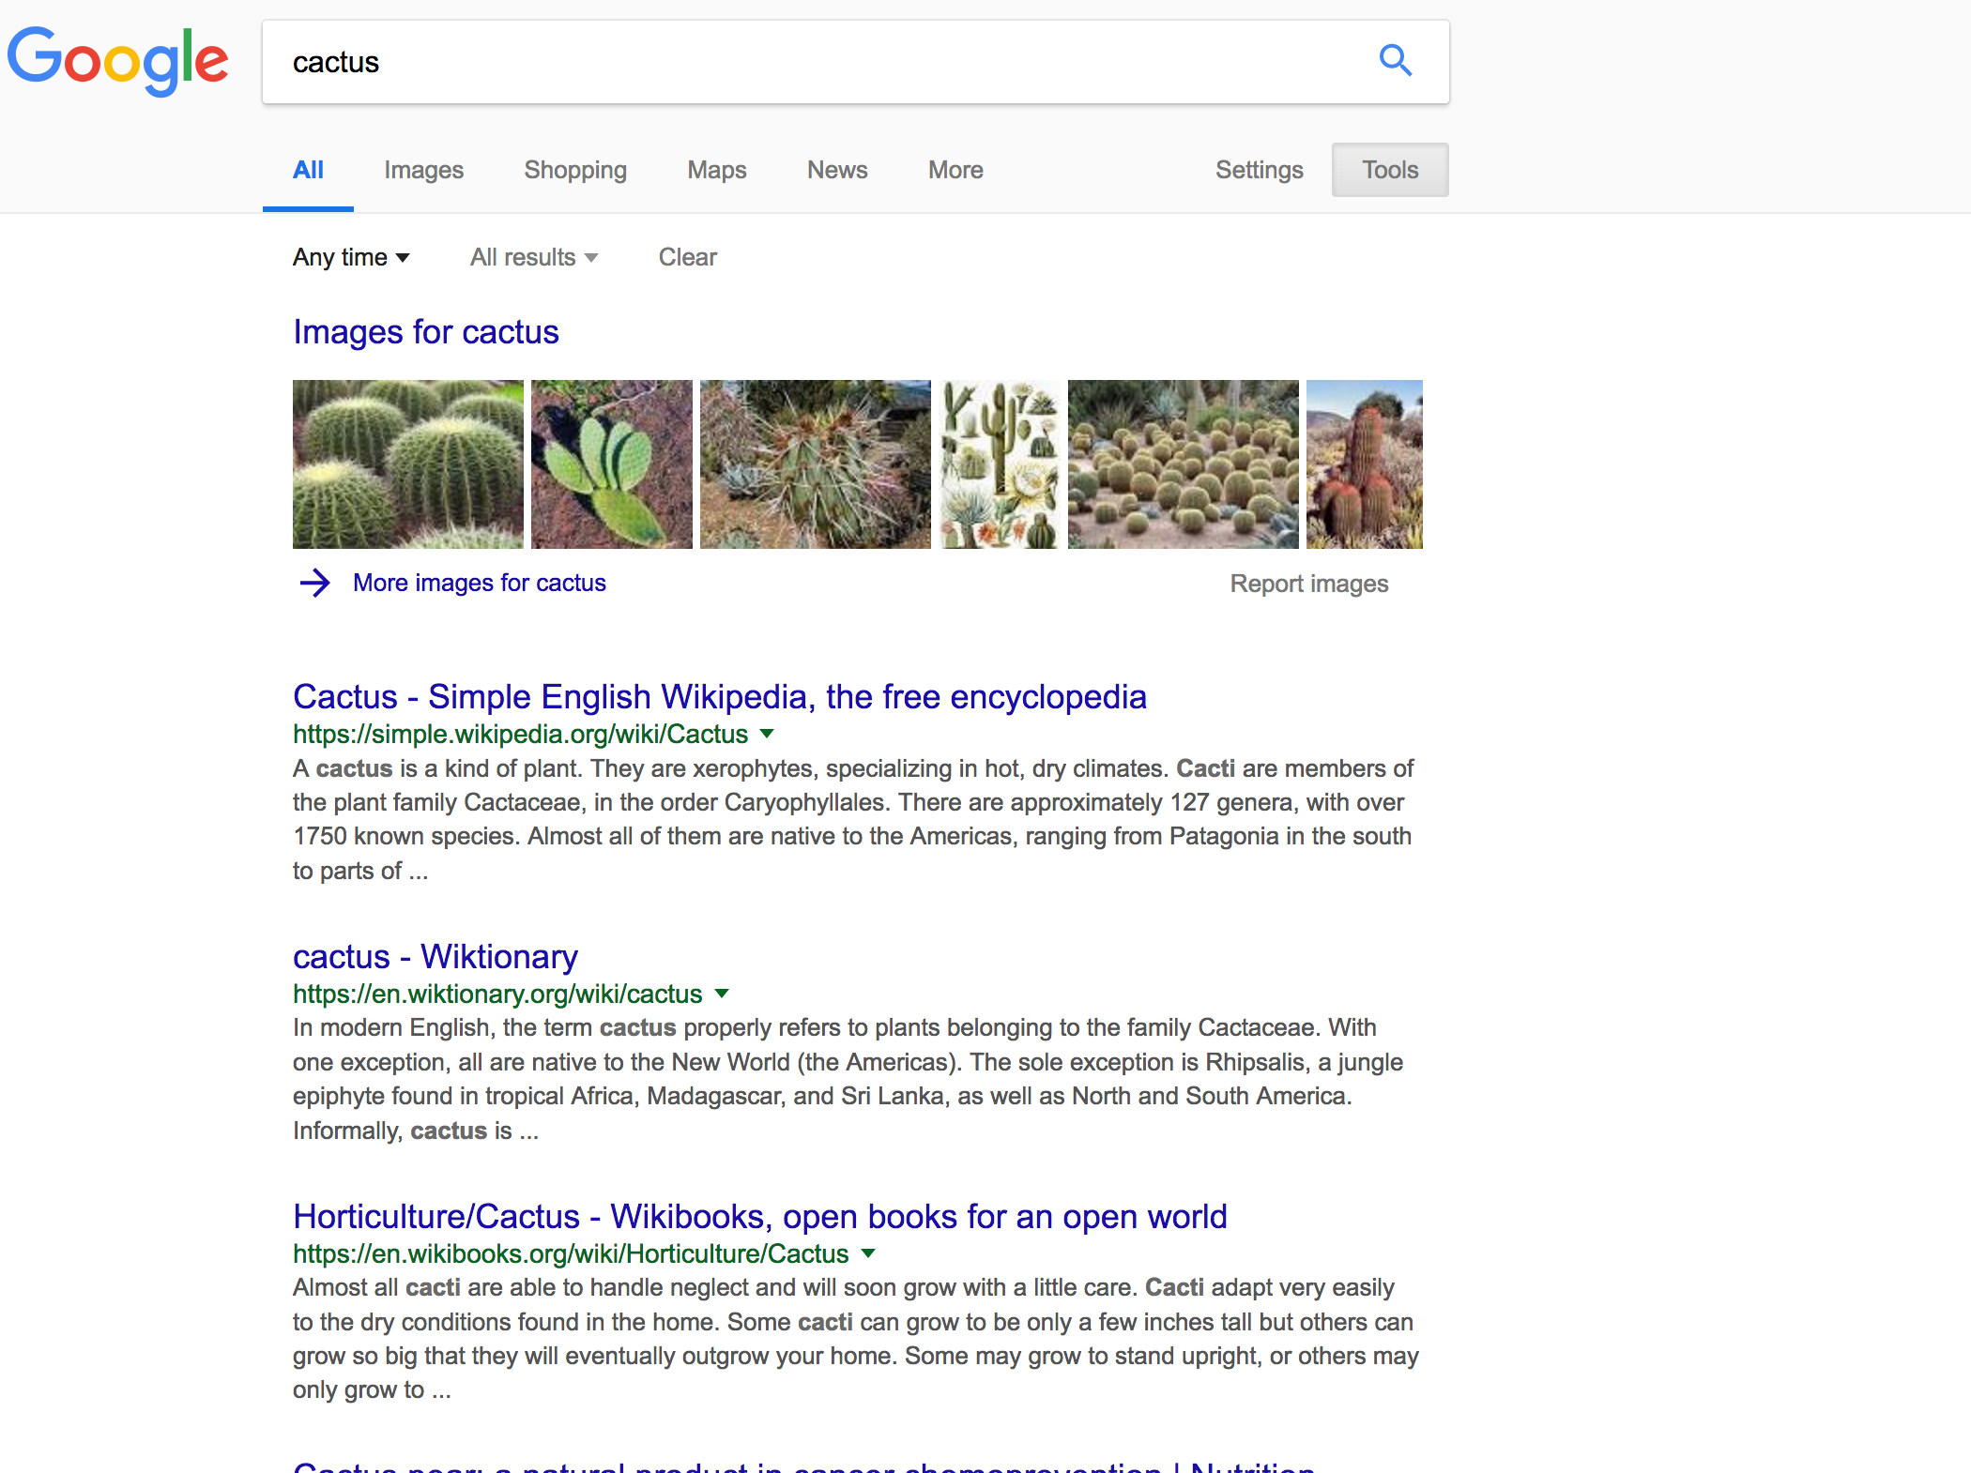

Slide 41
youtube.com

Slide 42
youtube.com

Slide 43
youtube.com

Slide 44
youtube.com

Slide 45
youtube.com

Slide 46
flickr.com

Slide 47
flickr.com

Slide 48
flickr.com

Slide 49
flickr.com

Slide 50
library.hccs.edu/oer

Slide 51
library.hccs.edu/oer

Slide 52
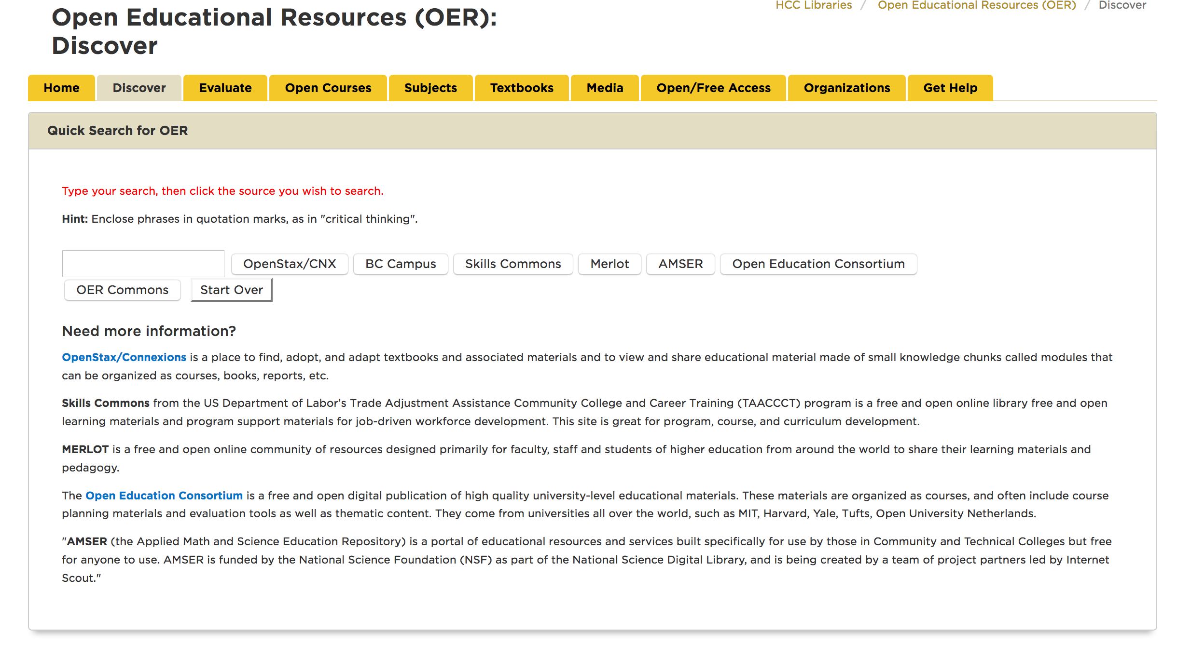

Slide 53
Open Textbook Network

Slide 54
Open Textbook Network

Slide 55
OER Commons

Slide 56
OER Commons

Slide 57
OER Commons

Slide 58
Go forth and discover!

Slide 59
But leave your tabs open!!

Slide 60
Now it’s time to plan next steps

Slide 61
Z-Degree Faculty Training Plan
If you want to work with other members in your discipline, now would be a good time to congregate.
Fill out this worksheet as if it were a decision tree: answer step one, then lead to step two, etc.
I will be walking around. Flag me down if you need anything!

Slide 62
Now return to your course maps
Use some of the materials you found during your searches to fill in the maps.
Add rows and columns as you need them.

