Slide 1
DOES GOD EXIST?
Arguments Supporting The Existence of God

Slide 2
Can something come from nothing?

Slide 3
Cosmological Argument
Gods existence is strongly implied by the existence of the universe
1. The universe is not infinitely old
2. The universe had a beginning
3. If something has a beginning it cannot be the cause of its own existence
4. If something exists then it has a cause.
5. The universe exists.
6. If God exists then we can identify him as the cause of the existence of the universe.
__________________________________________________
7. So, God exists.
http://www.youtube.com/watch?v=6CulBuMCLg0

Slide 4
Argument from Contingency and Necessity
The existence of a contingent universe, requires the existence of some being that is necessary.
1. If something is contingent then at some time it will not or did not exist.
2.Only a necessary being must exist at all times.
3. The universe is contingent.
4.If everything were contingent, then at some time nothing would exist.
5. The universe currently exists.
6. So, not everything is contingent.
7. There is some necessary being.
8. God is a necessary being.
_____________________________________
9. So, God exists.

Slide 5
Does everything that exist have a creator?
Is there anything in existence that created itself?

Slide 6
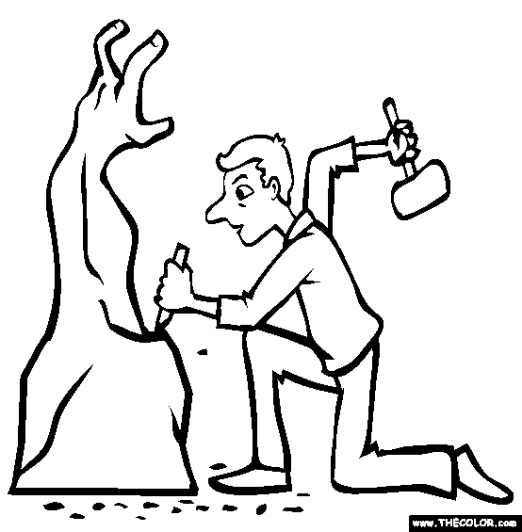
Argument from Design
The universe must have a creator who designed the universe to be the way it is
“Fundamental laws of the universe are very precisely coordinated such that a slight variation in them would result in a universe that could not support intelligent life.”

Slide 7
1. The constants of the universe are precisely fine-tuned in such a way that enabled the existence of intelligent life
2.If they were to vary even slightly it would be impossible for intelligent life to exist.
3. But intelligent life exists.
4.So the constants must have been determined to be exactly as they are; They must be fine-tuned.
5. They must have been fine-tuned by an intelligent designer.
6. God is the intelligent designer
__________________________________________
7. So, God exists.

Slide 8
St. Thomas Aquinas, Summa Theologicae
The existence of God can be proved in 5 ways……

Slide 9
Motion
1. Whatever is in motion is put in motion by another.
2. This cannot go on for infinity
3. There has to be a first mover
4. God is the first mover
______________________________
5. So, God exists

Slide 10
Efficient Cause
1. Everything is caused by something
2. The first efficient cause causes the intermediate cause.
3. The intermediate cause causes the ultimate cause.
4. God is the first efficient cause.
____________________________________
So, God exists

Slide 11
Possibility and Necessity
1. If everything is possible not to be, then at one time there could have been nothing in existence.
2. If the above statement were true then nothing will exist today.
3. Stuff exists today.
4. Whatever exists only begins to exist by something already existing.
5.The first thing existing makes all others exist and is necessary.
6. God is necessary
________________________________
7. So, God exists.

Slide 12
Gradation
1. In order for things to be more or less than one another there has to be a most or a highest that they are compared to.
2. God is the highest, the best, the most.
____________________________
3. So, God exists.

Slide 13
Governance of the World
1. Whatever lacks intelligence cannot move towards an end unless it is directed by something that has the knowledge and intelligence.
2. Some intelligent being exists that directs all the non-intelligent things to their end.
3. God is that intelligent being.
_________________________________
4. So, God exists.

Slide 14
Anselm’s Ontological Argument
1. Everyone has an understanding of God.
2. God is something that which nothing greater can be imagined.
3. It is greater to exist both in understanding and reality
4. God is something greater than the understanding and reality.
5. So, God must exist in reality
______________________________
6. So, God exists

Slide 15
The Island Example
Argument: There is an island. It is called the “lost island.” It has no owner and no inhabitants. It is the best of all islands but nobody has seen the island. Does it truly exist? If that doesn’t exist, how can God exist?

Slide 16
The Island Example
This island is said to be the most excellent.
If this island doesn’t exist then there is another island that exists that is the most excellent.
God is the most excellent.
If God is the most excellent and he doesn’t exist, the most excellent that does exist is God. So God, exists.

