Slide 1
Understanding Critical Thinking
Common Places: Integrated Reading and Writing
Copyright © McGraw-Hill Education. All rights reserved. No reproduction or distribution without the prior written consent of McGraw-Hill Education.

Slide 2
Example Application:
“What degree should I seek?”

Slide 3
Critical Thinking Involves:
Is a degree in business
really going to lead me
to a good job?
I assume I'll get
a good job if I major in business.
Examining assumptions
Asking questions
Solving problems
What degree
should I seek?
niaaa.nih.gov

Slide 4
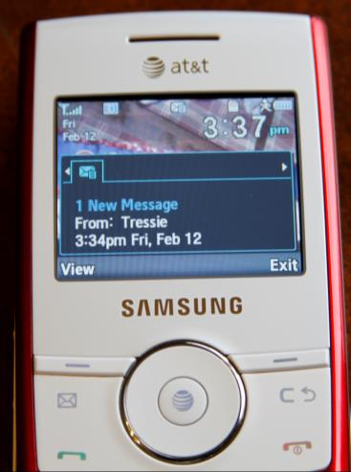
Learn to Examine Assumptions
An assumption is a belief or expectation held to be true without much evidence.
EXAMPLE: It's really important to have a cell phone and to check your messages.

Slide 5
Question the Assumption:
What does "important" mean?
What kinds of things are really important in life?
Does having a cell phone usually affect those really important things in your life?
What would life be like without a cell phone?
Is a cell phone worth the cost?

Slide 6
Other Assumptions
I need a decent car.
Critical questions to ask:
1. Do you "need" a car or do you "want" a car?
2. Why do you need (or want) a car?
3. What would happen if you didn't have a car?
4. What do you mean by decent?
5. If a car solves a problem for you, are there other ways you might solve that problem?

Slide 7
Solving Problems What should I major in?
Examine Your Assumptions:
Ask Critical Questions:
Possible assumption: "I know business majors will get good jobs."
Possible assumption: "I will like working in business."
Possible assumption: "I'll do fine in the courses I'll have to take to get a business degree."
Do business majors really get good jobs?
What kinds of jobs do they get?
Are there opportunities for business majors in my city or region?
Will I like a job in the business field?
Will I be able to handle business courses?

Slide 8
Solving Problems with Critical Thinking
Critical Thinking =
Examining Assumptions + Asking Critical Questions
and leads to Problem Solving
What jobs are plentiful in the city I want to live in?
From these plentiful jobs, is there one I'd enjoy?
What kind of degree is required for that job?
How would I fare in the courses for that degree?

Slide 9
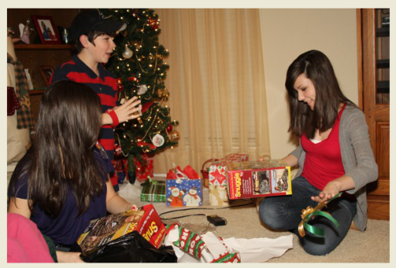
Try it!
What is a "good Christmas?" or "good birthday? "
1. Write down one assumption about what makes a Christmas or a birthday "good." Don't question the assumption; just write it down.
2. Now, make a list of critical questions to ask about the assumption.
3. What did you learn from questioning this assumption?

Slide 10
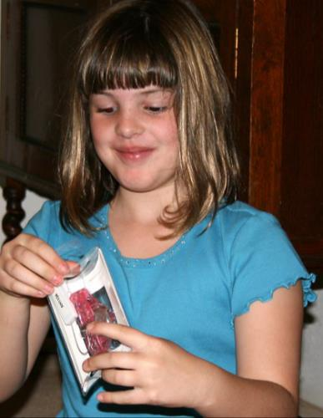
Try Problem Solving with Critical Thinking
Problem: You have a daughter who is about to cele-brate her 8th birthday. She has been begging for months for a $150 gizmo. It’s true, as she insists, that all of her friends have one. However, you definitely cannot afford the gizmo. How might you address this problem?
What assumptions are you starting with?
What questions will help you examine those assumptions?
Having examined your assumptions, what are some possible solutions to the problem?

Slide 11
The End

