Slide 1
Broader or Narrower?
Common Places: Integrated Reading and Writing
Copyright © McGraw-Hill Education. All rights reserved. No reproduction or distribution without the prior written consent of McGraw-Hill Education.

Slide 2
Animals
Insects
Crustaceans
Fish
Amphibians
Birds
Mammals

Slide 3
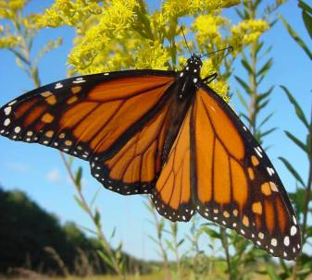
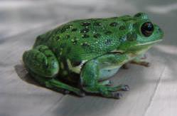
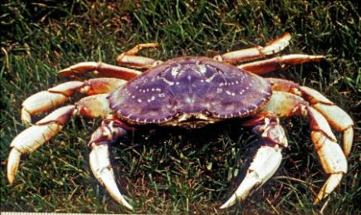
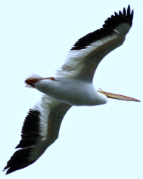
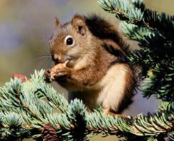
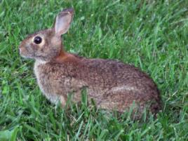
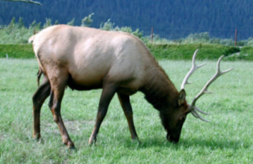
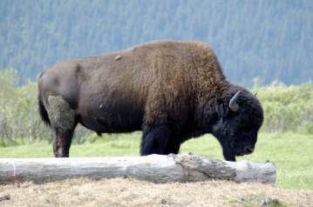
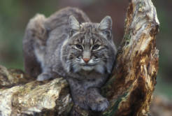
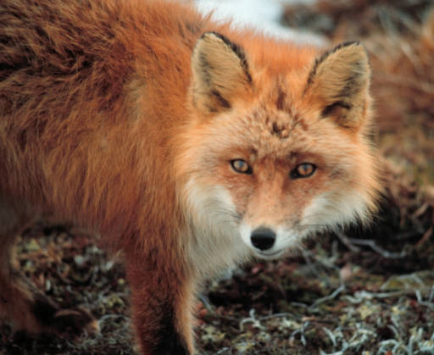
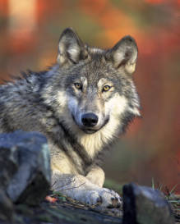
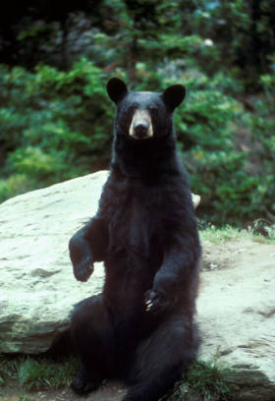
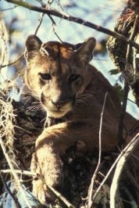
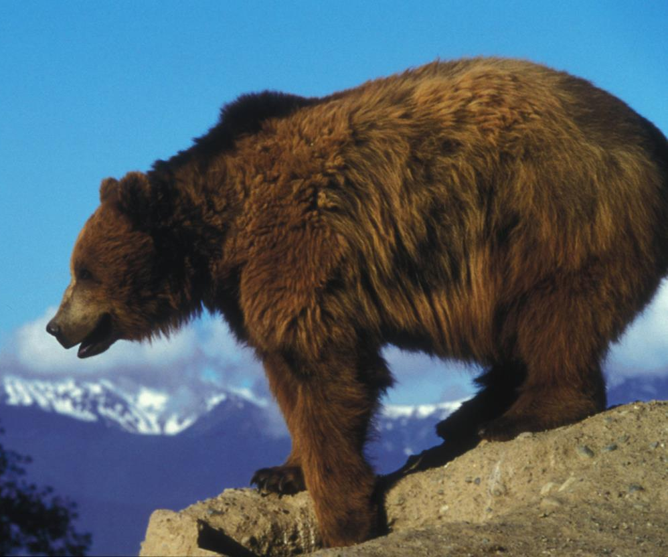
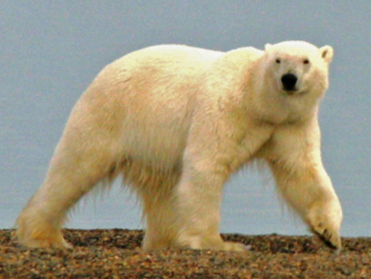
Animals

Slide 4
Animals
Insects
Crustaceans
Fish
Amphibians
Birds
Mammals

Slide 5
Mammals
Herbivores
Carnivores

Slide 6
Mammals

Slide 7
Mammals
Herbivores
Carnivores

Slide 8
Carnivores
Felines
Canines
Bears

Slide 9
Carnivores

Slide 10
Carnivores
Felines
Canines
Bears

Slide 11
Bears
Black bears
Polar Bears
Grizzly Bears

Slide 12
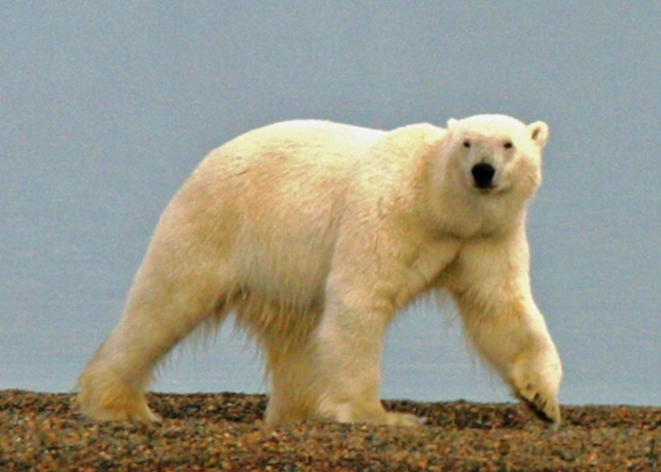
Bears

Slide 13
Bears
Black bears
Polar Bears
Grizzly Bears

Slide 14
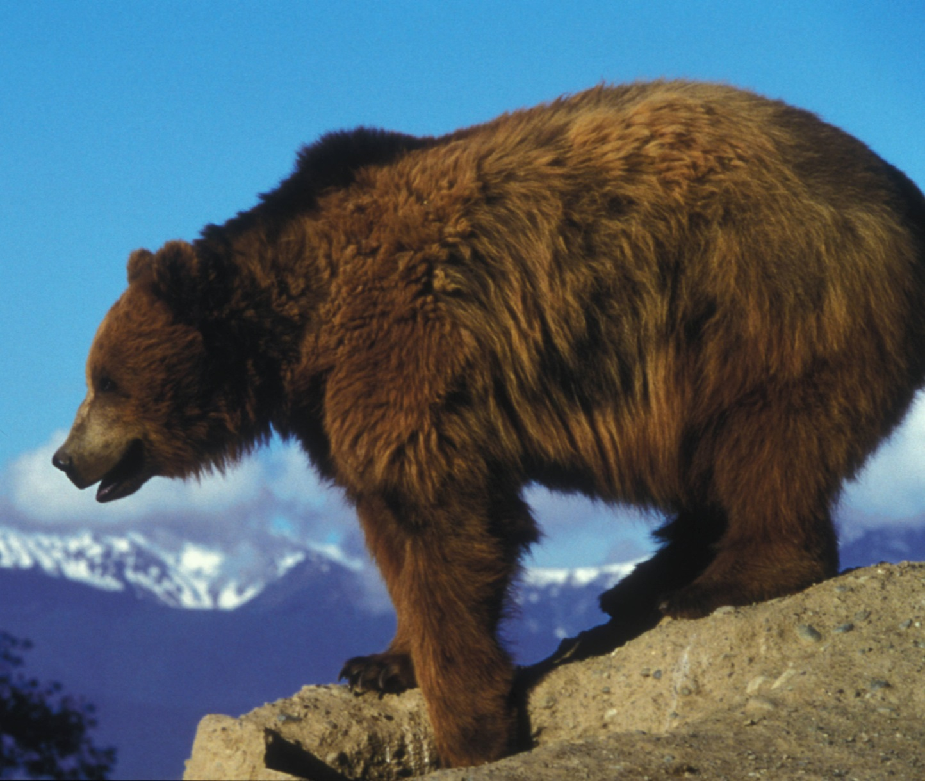
Grizzly Bears

Slide 15
Narrower
Broader
Animals
Mammals
Carnivores
Bears
Grizzly
Bears

Slide 16
Your Turn
Narrow each of these broad categories. How may sub-categories can you create for each one?
Sports
Business
Healthcare
Finances

Slide 17
Your turn
Narrow each of these broad categories. How may sub-categories can you create for each one?
Sports
Business
Healthcare
Finances

Slide 18
The End
All images used are in the public domain. Images were accessed from the Official Web page of the U.S. Fish and Wildlife Service National Digital Library.
http://digitalmedia.fws.gov/cdm/landingpage/collection/natdiglib

