Slide 1
Fusion: Integrated Reading and Writing Book 2, Third Edition
Dave Kemper, Verne Meyer, John Van Rys, and Pat Sebranek, Fusion: Integrated Reading and Writing, Book 2, 3rd Edition. © 2019 Cengage Learning, Inc. All Rights Reserved. May not be scanned, copied or duplicated, or posted to a publicly accessible website, in whole or in part.

Slide 2
Chapter 13 Sentence Basics
Dave Kemper, Verne Meyer, John Van Rys, and Pat Sebranek, Fusion: Integrated Reading and Writing, Book 2, 3rd Edition. © 2019 Cengage Learning, Inc. All Rights Reserved. May not be scanned, copied or duplicated, or posted to a publicly accessible website, in whole or in part.

Slide 3
Chapter 13 Outline
This chapter addresses:
13.1 Subjects and Predicates
13.2 Special Types of Subjects
13.3 Special Types of Predicates
13.4 Adjectives
13.5 Adverbs
13.6 Prepositional Phrases
13.7 Clauses

Slide 4
13.1 Subjects and Predicates (Verbs) (1 of 3)
The subject of a sentence tells what the sentence is about.
The predicate of a sentence tells what the subject does or is.
Simple subject: the subject without any modifiers
Simple predicate: the verb and any helping verbs without modifiers or objects
The black and white schnauzer was barking all day long.
Simple subject: schnauzer
Simple predicate: was barking

Slide 5
13.1 Subjects and Predicates (Verbs) (2 of 3)
Complete subject: the subject with the modifiers
Complete predicate: the verb with modifiers and objects
The black and white schnauzer was barking all day long.
Complete subject: The black and white schnauzer
Complete predicate: was barking all day long

Slide 6
13.1 Subjects and Predicates (Verbs) (3 of 3)
Implied Subject: a subject is not explicitly stated; this only appears in commands in English
Example: (You) Stop barking!
Inverted Order: in questions and sentences that begin with here or there, the subject comes after the predicate
Examples:
Why are you so loud?
Here is a biscuit.

Slide 7
13.2 Special Types of Subjects (1 of 2)
Compound Subjects: My [sister and I] swim well.
Infinitives as Subjects: [To become a park ranger] is my dream.
Gerunds as Subjects: [Hiking] builds strong calves.
[Hiking the Appalachian trail] is amazing.
Noun Clauses as Subjects: [Whoever hikes the trail] should bring boots.
[Whatever you need] must be carried on your
back.

Slide 8
13.2 Special Types of Subjects (2 of 2)
Compound Predicates: I [watched] and [laughed].
Predicates with Direct Objects: I [pointed] [the laser].
Predicates with Indirect Objects: My cat [shot] [me] [a puzzled look].
Passive Predicates (Verbs)
Passive: [My cat] [was exhausted] by the [game].
Active: The [game] [exhausted] [my cat].

Slide 9
13.4 Adjectives (1 of 2)
Adjectives – words that modify nouns. Adjectives answer questions, such as: which, what kind of, how many, or how much.

Slide 10
13.4 Adjectives (2 of 2)
Adjective phrases and clauses - phrases and clauses can also act as adjectives to modify nouns.

Slide 11
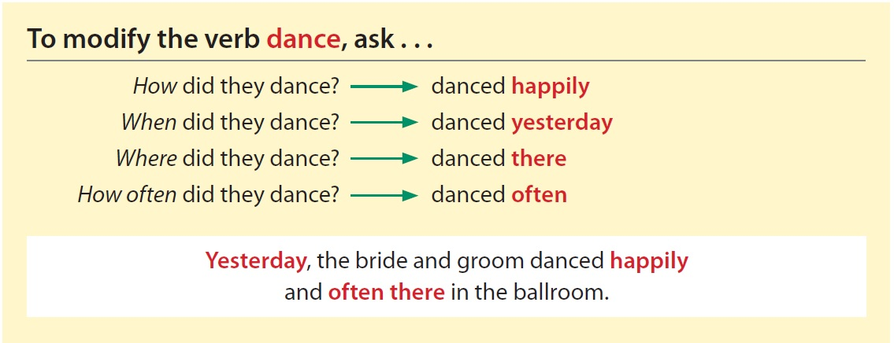
13.5 Adverbs (1 of 2)
Adverbs – words that modify a verb. Adverbs often answer these basic questions: how? when? where? why? low long? and how often?

Slide 12
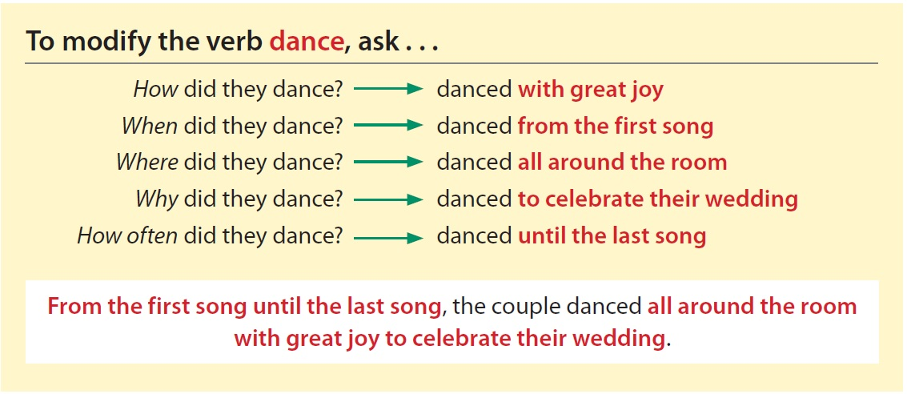
13.5 Adverbs (2 of 2)
Adverb phrases and clauses – phrases and clauses can also act as adverbs to modify verbs.

Slide 13
13.6 Prepositional Phrases
Prepositional phrase – preposition followed by an object (a noun or pronoun) and any modifiers

Slide 14
13.7 Clauses
Clause – group of words with a subject and a predicate.
Independent clause – clause that has a subject and a predicate and expresses a complete thought
Dependent clause – clause that has a subject and a predicate but doesn’t express a complete thought
Adverb clause: begins with a subordinating conjunction
Adjective clause: begins with a relative pronoun
Noun clause: begins with a subordinating conjunction and functions as a noun

