Slide 1
Eolian Systems
Chapter 16
Dynamic Earth
Eric H Christiansen

Slide 2
Major Concepts
Wind is not an effective agent in eroding the landscape, but it can produce deflation basins and yardangs as well as small pits and grooves on rocks.
The major result of wind activity is the transportation of loose, unconsolidated fragments of sand and dust. Wind transports sand by saltation and surface creep. Dust is transported in suspension, and it can remain high in the atmosphere for long periods.
Sand dunes migrate as sand grains are blown up and over the windward side of the dune and accumulate on the lee slope. The internal structure of a dune consists of strata inclined in a downwind direction. Various types of dunes form, depending on wind velocity, sand supply, and constancy of wind direction.

Slide 3
Major Concepts
Wind-blown dust (loess) forms blanket deposits, which can mask the older landscape beneath them. The source of loess is desert dust or the fine rock debris deposited by glaciers. Some deep oceanic sediment is wind-blown dust from continents.
Desertification, the loss of farmable land on the margins of deserts, can be caused by human activity or by slight climatic fluctuations.

Slide 4
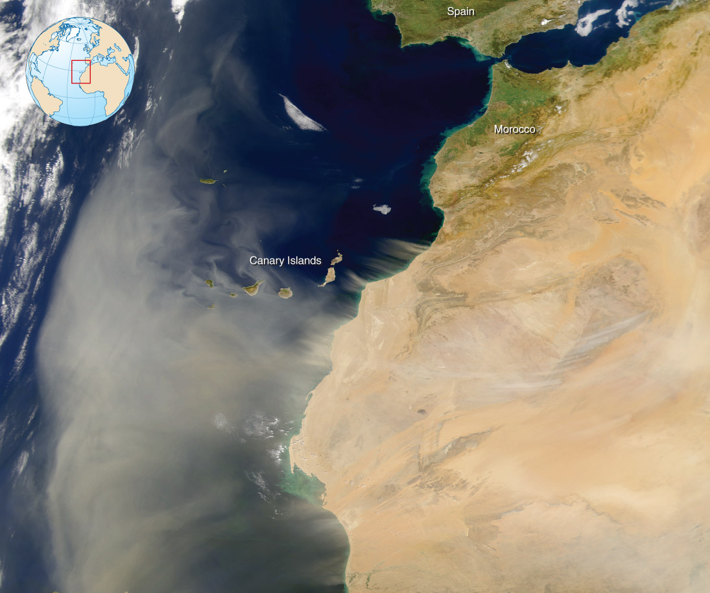
The Global Eolian System
The eolian system is a dynamic open system driven by heat from the Sun. The great deserts of the world, where the effects of the wind are most obvious, form in low-latitude regions in zones roughly 30° north and south of the equator. There wind lifts, transports, and eventually deposits loose sand and dust, but its ability to erode solid rock is limited.
Courtesy of SeaWiFS Project, Goddard Space Flight Center, and ORBIMAGE/NASA
Figure 16.13: Dust storms in the Sahara Desert, as seen from a satellite.

Slide 5
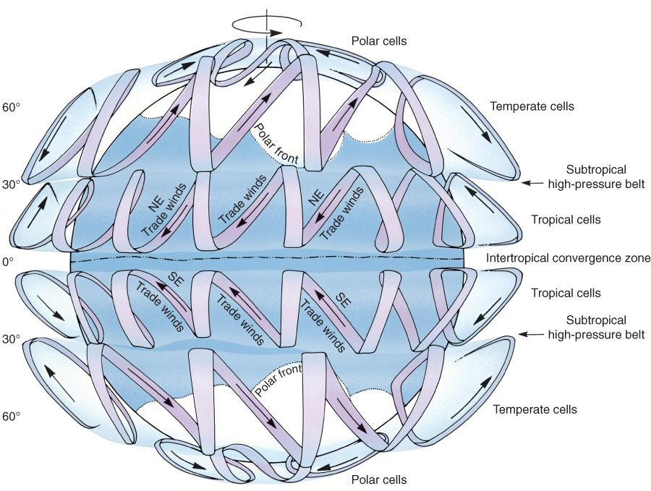
Eolian Systems and Deserts
Wind patterns are generated by the uneven distribution of solar radiation in combination with Earth’s rotation.
In the equatorial regions, air is intensely heated; the heating reduces its density, and the air rises.
At higher altitudes, this air cools, becomes denser, and descends, forming the subtropical high-pressure belts (deserts) on either side of the equator.
Near the surface, this air then moves back toward the equator to complete the cycle, causing trade winds.
Temperate cells form a complementary spiral, creating strong west-to-east winds.
Cold polar air tends to wedge itself toward the lower latitudes and forms polar fronts.
Figure 09.08: Atmospheric circulation and prevailing wind patterns generated by uneven distribution of solar radiation combining Earth’s rotation.

Slide 6
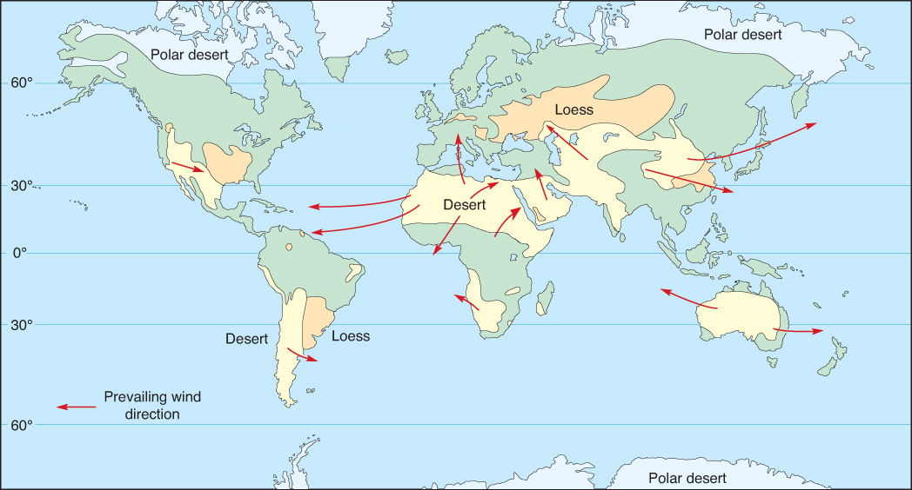
Figure 16.01: The major deserts, the Sahara, the Arabian, the Kalahari, and the deserts of Australia, are near 30° north or south of the equator.
Notes:
The major deserts of the world, the Sahara, the Arabian, the Kalahari, and the deserts of Australia, are near 30° north or south of the equator. These bands are under almost constant high atmospheric pressure where dry air subsides. Desert and near-desert areas cover nearly one-third of the land surface. Wind-blown dust (loess) accumulates downwind from major deserts or along former margins of Pleistocene glaciers. Prevailing winds (arrows) transport dust from the Sahara and Kalahari deserts to the Atlantic Ocean and from deserts of Australia to adjacent seas. Dry descending air currents also create polar deserts, where precipitation is low, but so is the temperature.

Slide 7
The Eolian System
Figure 16.02: The eolian system is driven by energy from the Sun.
Energy from the Sun.
Flowing air erodes, transports, and deposits fine sediment to form distinctive landforms and rock bodies.
Sand sheets, sand dunes, and layers of loess are the major eolian deposits.
Lags of coarse particles are left behind.
Notes:
The eolian system is driven by energy from the Sun. Flowing air erodes, transports, and deposits fine sediment to form distinctive landforms and rock bodies. Sand sheets, sand dunes, and layers of loess are the major eolian deposits. Lags of coarse particles are left behind.

Slide 8
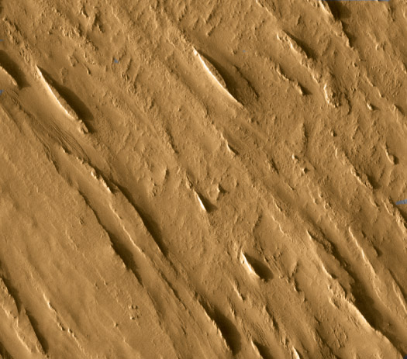
Wind Erosion
Wind erosion acts in two ways: (1) By deflation, the lifting and removal of loose sand and dust particles from Earth’s surface.
(2) By abrasion, the sandblasting action of wind-blown sand. This is the mechanical removal of rock by wind blown sand.
Linear yardangs on Mars.
Courtesy of JPL/ASU/NASA
Notes:
Courtesy of JPL/ASU/NASA

Slide 9
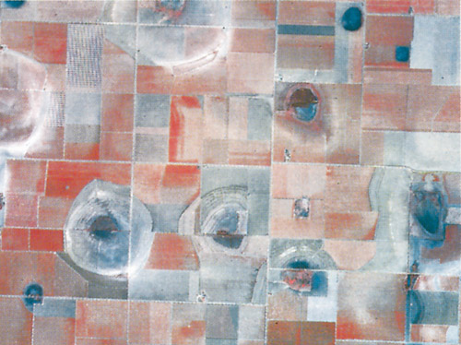
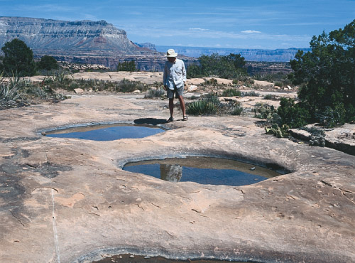
Wind Erosion: Deflation Basins
Courtesy of U.S. Geological Survey
Figure 16.03A: Deflation basins in Great Plains of TX are produced where solution activity in the layers of horizontal bedrock dissolves the cement.
Figure 16.03B: Small deflation basins in sandstone formations in the Colorado Plateau form in a similar manner.
Notes:
Deflation basins are wind erosion features that range in size from small depressions to large basins several kilometers in diameter.
Deflation basins in the Great Plains of Texas are produced where solution activity in the layers of horizontal bedrock dissolves the cement that binds the sand grains. <FS>(Courtesy of U.S. Geological Survey)
Small deflation basins in sandstone formations in the Colorado Plateau form in a similar manner.

Slide 10
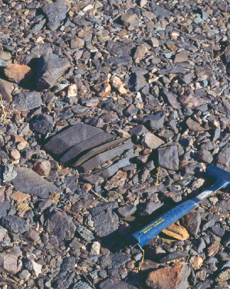
Wind Erosion: Deflation and Lag Gravels
The blowing away of loose sand, silt, and clay sized particles
Larger particles remain
Only takes place in desert areas, or in the absence of vegetation
Roots tend to hold soil in place
Figure 16.05: Lag gravels consist of angular clasts that range from fragments 30 cm or so across to small pebbles. Once the clasts become concentrated like this, they protect the surface from further erosion.
Notes:
Lag gravels consist of angular clasts that range from fragments 30 cm or so across to small pebbles. Once the clasts become concentrated like this, they protect the surface from further erosion.

Slide 11
Wind Erosion: Deflation
Figure 16.04: Desert pavement results as wind selectively removes sand and fine sediment, leaving the coarser gravels to form a lag deposit.
Desert pavement results as wind selectively removes sand and fine sediment, leaving the coarser gravels to form a lag deposit.
The protective cover of lag gravel acts as an armor limiting future deflation

Slide 12
Wind Erosion: Deflation and Desert Pavement
Figure 16.06: Lag gravel and desert pavement, not sand dunes, are major parts of the landscape in many desert regions.
Lag gravel and desert pavement, not sand dunes, are major parts of the landscape in many desert regions like the Sahara Desert in Morocco.
Desert pavement forms where small particles are swept away by the wind.

Slide 13
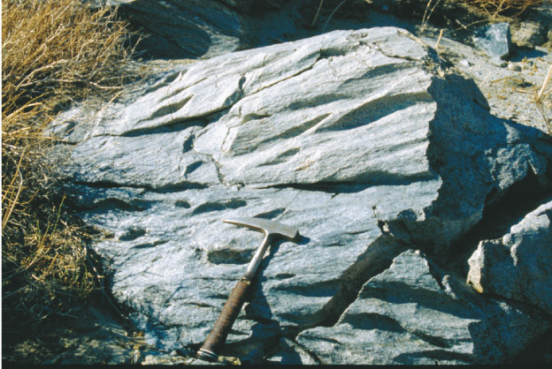
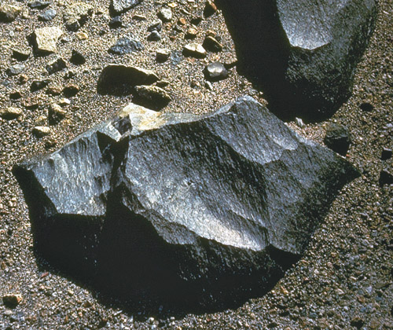
Wind Abrasion
Erosional grooves
Ventifacts faceted by the wind
Courtesy of U.S. Geological Survey
Figure 16.07A: Grooves eroded on bedrock near Palm Springs, California.
Figure 16.07B: Ventifact shaped by wind abrasion into flat surfaces.
Notes:
Wind abrasion is a process very much like sandblasting. Grooves and polished surfaces are apparent on cobbles and on bedrock in most of the world’s deserts.
a. Grooves eroded on bedrock near Palm Springs, California.
b. Ventifact shaped by wind abrasion into flat surfaces. <FS>(Courtesy of U.S. Geological Survey)

Slide 14
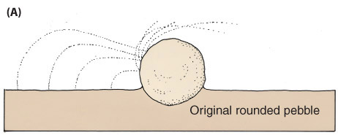
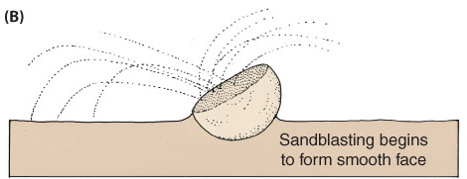
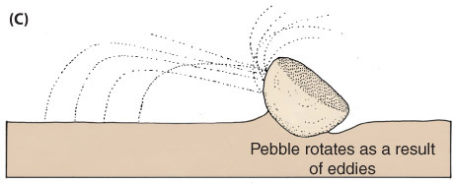
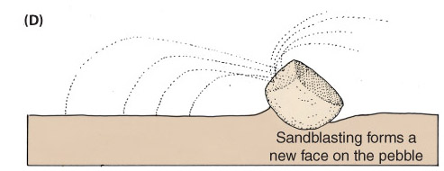
Wind Abrasion: Ventifacts
Figure 16.08A-D: Ventifacts are pebbles shaped and polished by wind action.
Notes:
Ventifacts are pebbles shaped and polished by wind action. They commonly have two or more well-polished sides formed as the sandblasting action of wind reshapes one side and then another.
a. Original round pebble exposed by deflation of surrounding sediment, for example.
b. A facet (smooth face) is formed by sandblasting on the side facing the prevailing wind.
c. Removal of the sand by deflation causes the pebble to rotate so that another faceted and
d. Polished surface is produced on another side of the pebble (D).

Slide 15
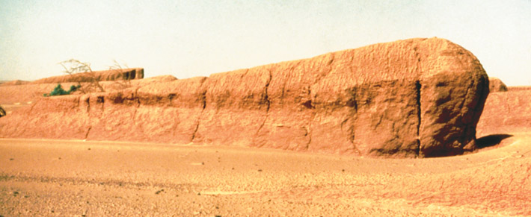
Wind Erosion: Yardangs
Figure 16.09: Yardangs are elongate ridges formed by wind erosion of relatively soft material. Note the streamlined shape.
Yardangs are elongate ridges formed by wind erosion of relatively soft material between the ridges. Note the streamlined shape.
Photograph by Alan L. Mayo
Notes:
(Photograph by Alan L. Mayo)

Slide 16
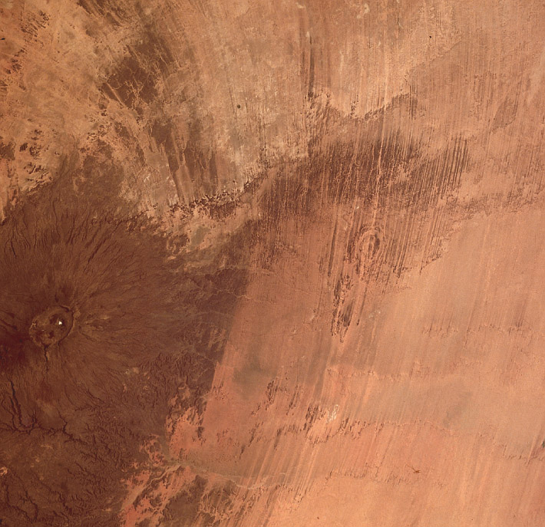
Wind Erosion: Yardangs
Yardangs and windstreaks in the Tibesti area of Chad
Carved into horizontally bedded nonresistant sedimentary rocks as regional winds are diverted around the eastern side of a large shield volcano.
Figure 16.10: Yardangs and windstreaks in the Tibesti area of Chad are carved out of horizontally bedded nonresistant sedimentary rocks.
Courtesy of NASA
Notes:
(Courtesy of NASA)

Slide 17
Transportation of Sediment by Wind
Wind transports sand by saltation and surface creep.
Silt and dust-sized particles are carried in suspension.
Courtesy of SeaWiFS Project, Goddard Space Flight Center, and ORBIMAGE/NASA
Figure 16.13: Dust storms in the Sahara Desert, as seen from a satellite.
Notes:
Dust storms in the Sahara Desert, as seen from a satellite. This storm formed by dissipating thunderstorms and then picked up loose sediment and moved it westward. The Canary Islands disturb the flow of the dust-laden winds. Storms like this can carry sediment into the Atlantic Ocean and as far west as the Americas. Eolian dust from such storms is an important component of deep-ocean sediment. (Courtesy of NASA SeaWIFS Project)

Slide 18
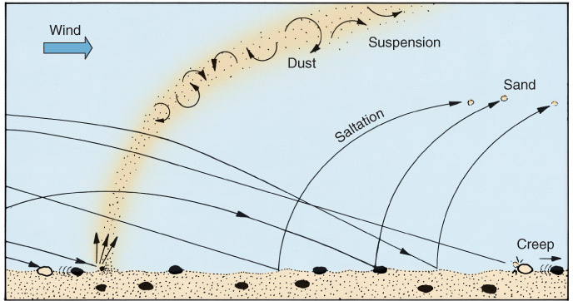
Transport of Sediment
Wind is not as effective at moving particles as water
Viscosity of air
18 * 10⁻³ mPa/s
Viscosity of water
1 mPa/s
Wind must overcome resisting forces to lift grains
Weight of grains
Cohesion between grains
Figure 16.11: The transportation of sediment by wind is accomplished by surface creep, saltation, and suspension.

Slide 19
Transportation of Sediment by the Wind
Transport depends on:
Particle size, wind Velocity
Critical wind velocity needed to move a specific grain size
Wind blowing past a grain:
Lift – formation of a zone of low pressure around a grain
Drag – impact of air molecules on the grain
Figure 16.11: The transportation of sediment by wind is accomplished by surface creep, saltation, and suspension.

Slide 20
Transportation of Sediment by the Wind
Eolian sediment moves by:
Surface creep
Coarse grains move by impact from other grains and slide or roll
Saltation,
Medium grains move by skipping or bouncing
Suspension.
Fine silt and clay move in suspension
Figure 16.11: The transportation of sediment by wind is accomplished by surface creep, saltation, and suspension.

Slide 21
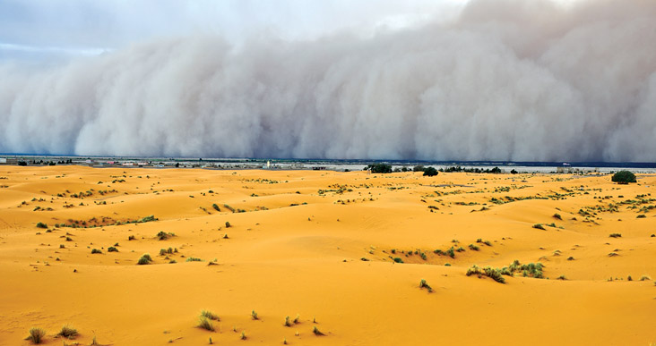
Wind-Blown Dust
A dust storm Sudan, Africa) results when cool air descends and moves laterally over the surface as a density current.
As the dense, cool air moves across the surface, it sweeps up dust and sand in its turbulent flow, creating a dust storm, or haboob.
Eolian dust from such storms is an important component of deep-ocean sediment.
Figure 16.12: A dust storm in the Blue Nile area results when cool air descends and moves laterally over the surface as a density current.
© Pavliha/iStockphoto
Notes:
© Pavliha/iStockphoto

Slide 22
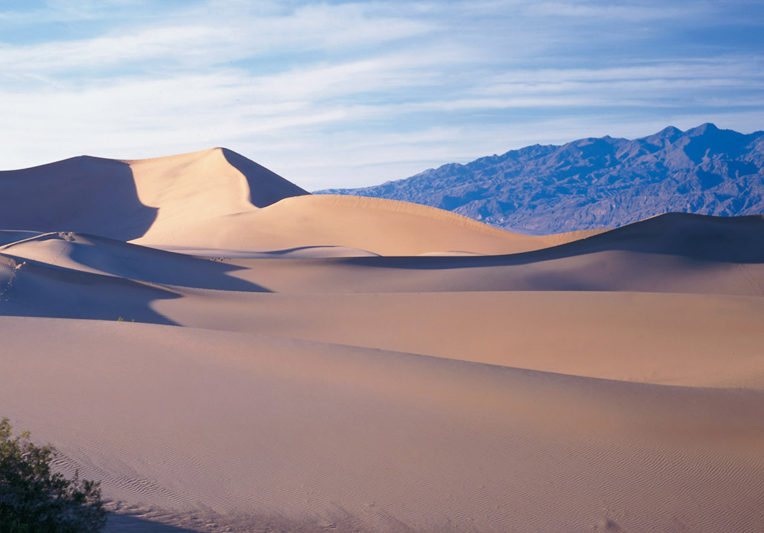
Deposits of Wind-Blown Sand
Wind-blown sand accumulates to form sand sheets, ripples, and dunes.
Different kinds of sand dunes result from variations in sand supply, wind direction, and velocity.
transverse dunes
barchan dunes
longitudinal dunes
star dunes
parabolic dunes.
Notes:
Sand seas in south Africa have been mapped with the use of satellite photography. A sand sea covers much of Namibia where some of Earth’s highest sand dunes are found. Some are as much as 300 m high. A variety of dune types are formed as a result of variations in wind velocity and direction, supply of sand, and the nature of the surface over which the sand moves. This image shows an area about 100 km across. (Courtesy of U.S. Geological Survey and Eros Data Center)

Slide 23
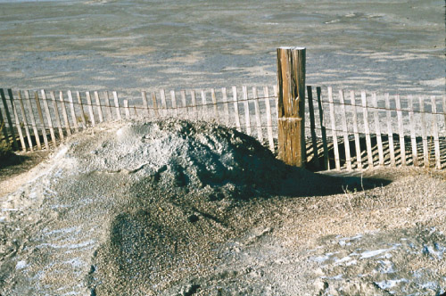
Sand Dunes
Figure 16.15: Sand dunes commonly originate in wind shadows.
Sand dunes commonly originate in wind shadows.
Wind-blown sand is deposited in protected areas, and eventually forms a dune.
The dune itself then acts as a barrier, making its own wind shadow, and thus causes additional accumulation of sand

Slide 24
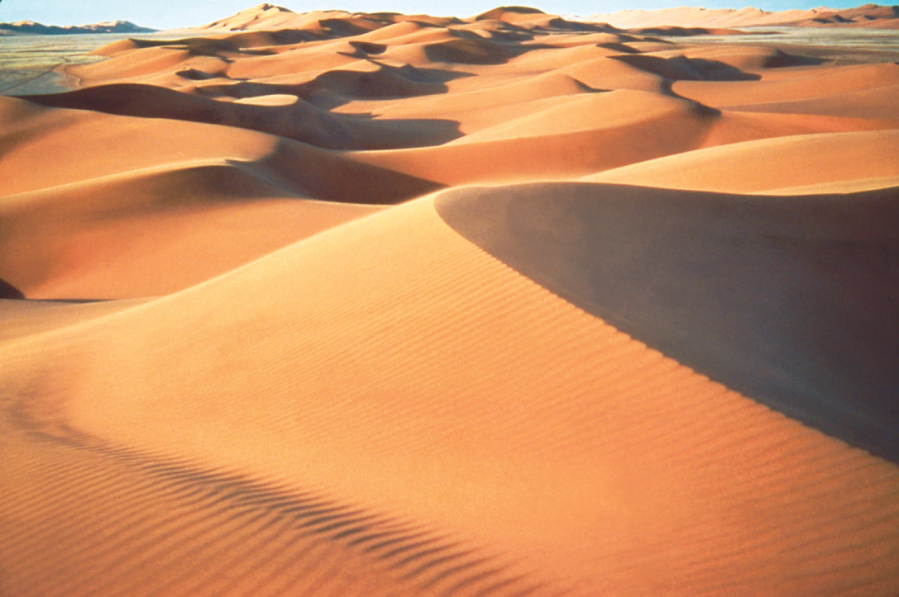
Photograph by E. McKee, U.S. Geological Survey
Figure 16.16: A sand dune migrates as sand grains move up the slope of the dune and accumulate in a protected area on the downwind face.
Notes:
A sand dune migrates as sand grains move up the slope of the dune and accumulate in a protected area on the downwind face. The dune slowly moves grain by grain. As the grains accumulate on the downwind slope, they produce a series of layers (cross-beds) inclined in a downwind direction. (Photograph by E. McKee, U.S. Geological Survey)

Slide 25
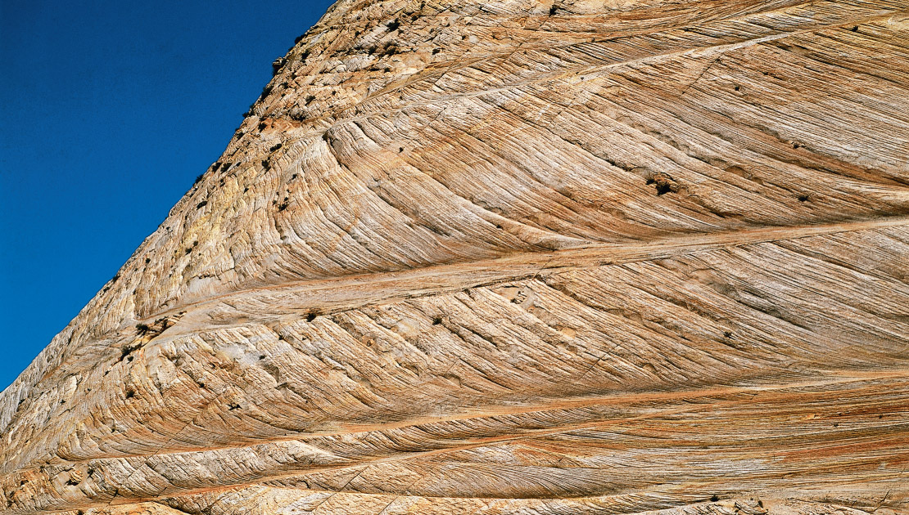
“Fossilized” Sand Dunes with Cross Bedding
Figure 16.17: Cross-bedding in the Navajo Sandstone in Zion National Park, Utah, is evidence that the rock formed in an ancient desert.
Notes:
Cross-bedding in the Navajo Sandstone in Zion National Park, Utah, is evidence that the rock formed in an ancient desert. The inclination of the strata shows that the wind blew from north to south (from left to right, in the photograph) for most of the time during which this formation was being deposited.

Slide 28
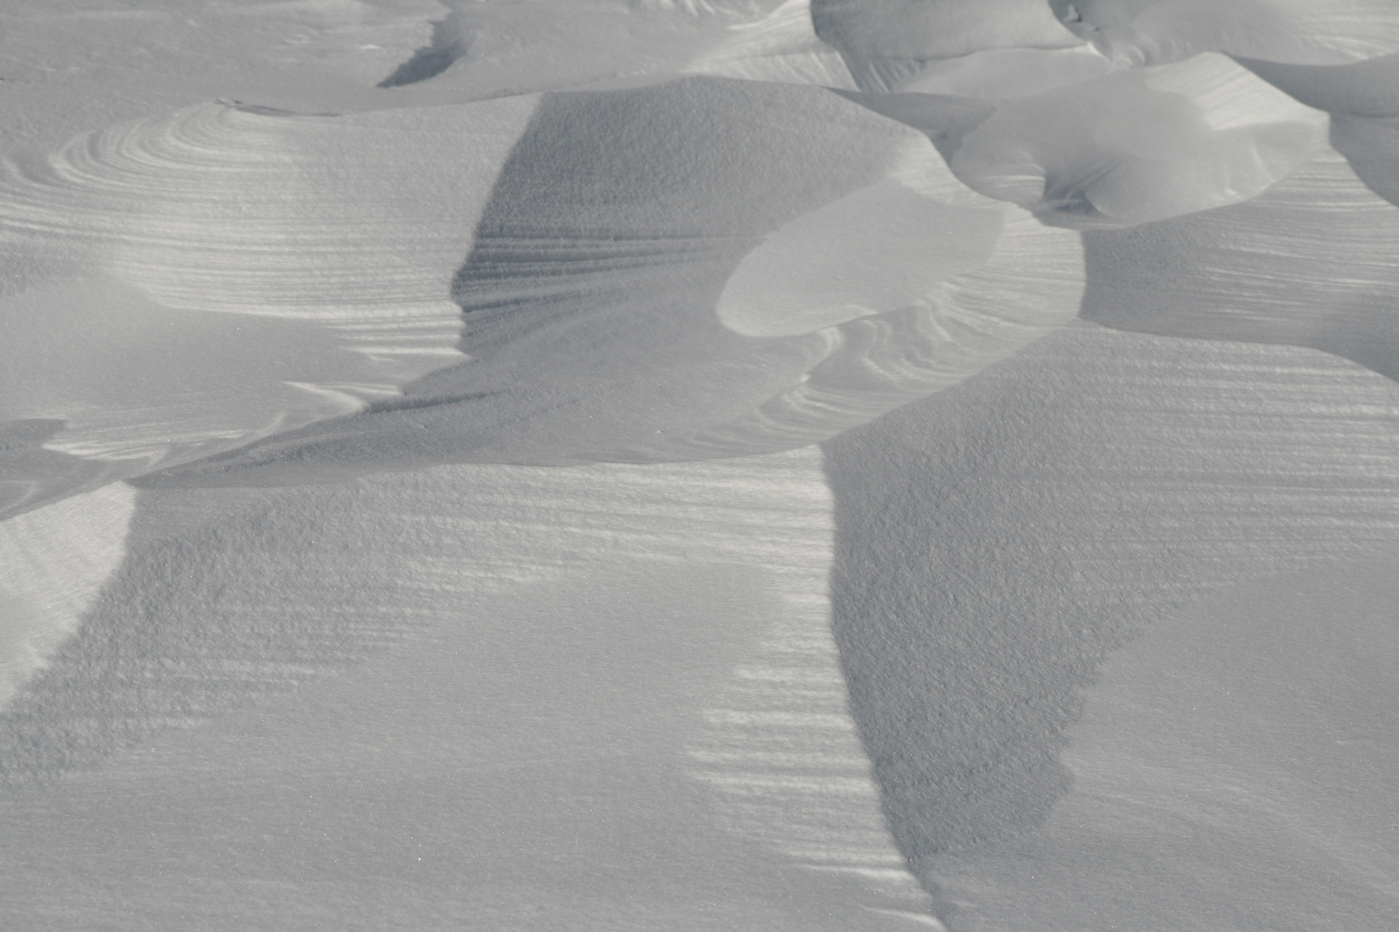

Slide 29
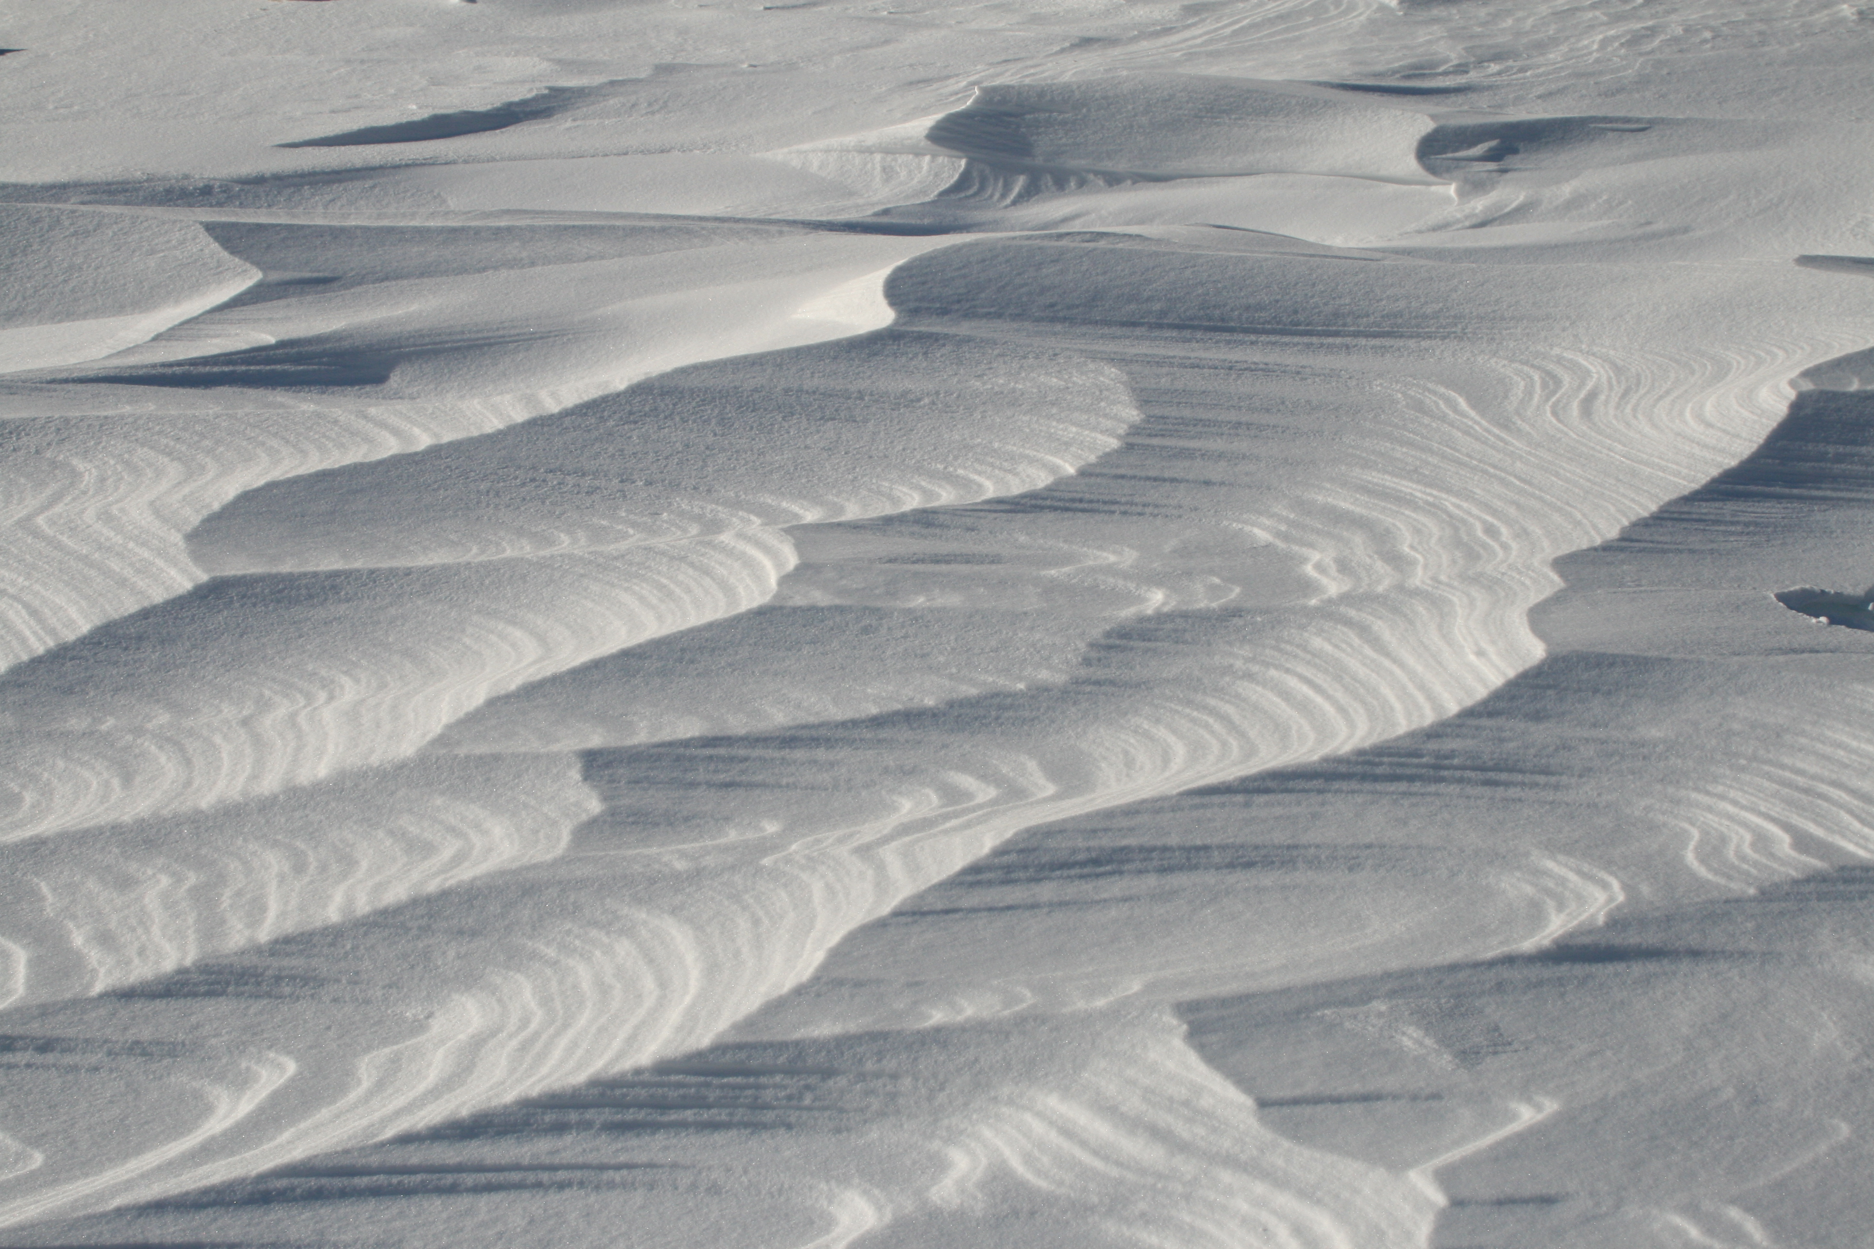

Slide 30
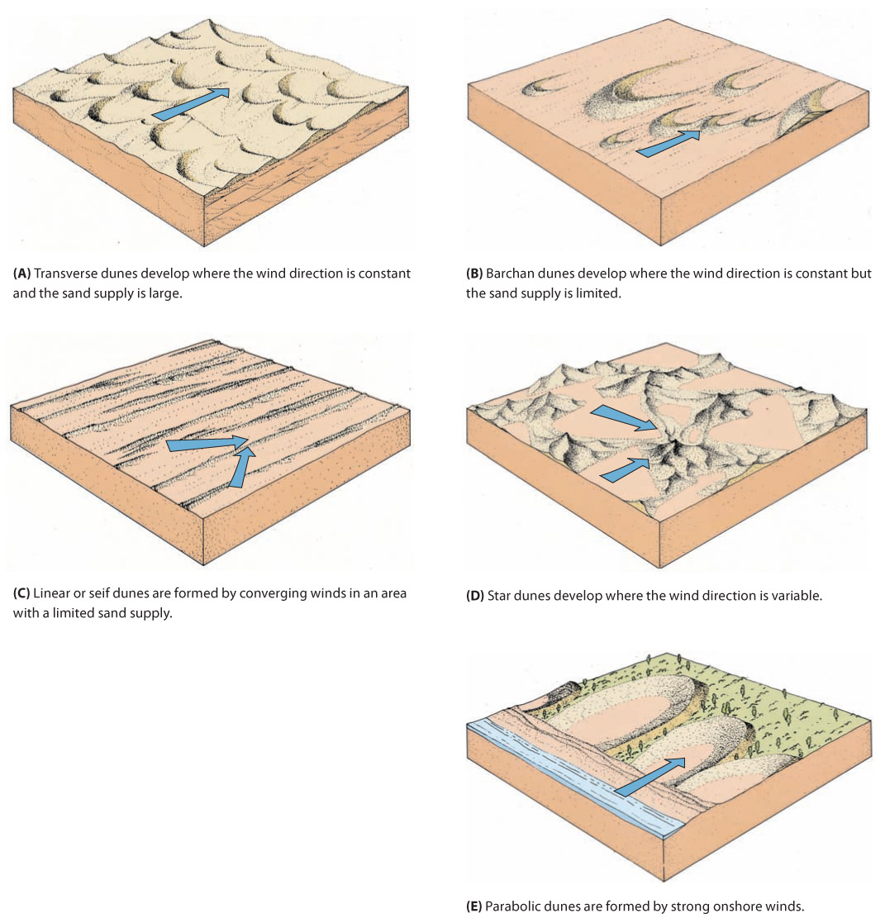
Sand Dune Types
Transverse dunes develop where the wind direction is constant and the sand supply is large.
Barchan dunes develop where the wind direction is constant but the sand supply is limited.
Linear or seif dunes are formed by converging winds in an area with a limited sand supply.
Star dunes develop where the wind direction is variable.
Parabolic dunes are formed by strong onshore winds.
Figure 16.18: Each of the major types of sand dunes represents a unique balance between sand supply, wind velocity, and variability in wind direction. The arrows show the major wind directions.

Slide 31
An Ancient Sand Sea, Grand Staircase
Figure 16.20: Ancient sand seas are evidenced by thick deposits of wind-blown sand in Colorado Plateau and adjacent regions of the western US.
Notes:
Ancient sand seas are evidenced by thick deposits of wind-blown sand in the Colorado Plateau and adjacent regions of the western United States. During the early Mesozoic Era, this region was a vast dry plain where eolian sands accumulated in a subsiding basin. This photograph of the White Cliffs in the Grand Staircase is typical of the deposits of more than five major sand seas now preserved in the rock record.

Slide 32
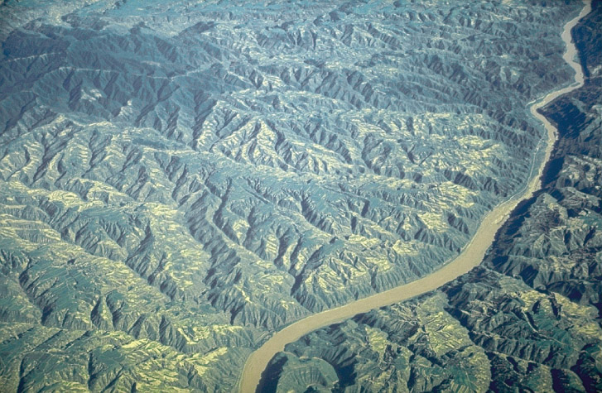
Deposits of Wind-Blown Dust: Loess
Loess is a deposit of wind-blown dust (silt and clay) that accumulates slowly
Loess covers one-tenth of the world’s present land surface.
The dust is derived either from nearby deserts or from rock flour originating near recently glaciated regions.
Wind-blown dust also settles in the oceans and is an important source of deep-marine mud
Figure 16.24: Loess plateaus of China are highly dissected into an intricate network of tributaries to the Yellow River.
Notes:
Loess plateaus of China are highly dissected into an intricate network of tributaries to the Yellow River, so-named because of the abundance of fine sediment in the river.

Slide 33
Loess Deposits in China
Figure 16.21: Loess deposits in central China cover vast areas and are exceptionally thick.
Typical properties of loess--fine grain size, sequences of buried soils, buff color, and steep cliff faces.

Slide 34
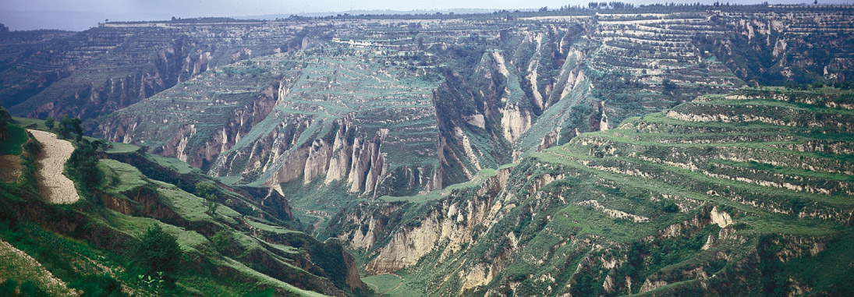
Loess Deposits in China
Figure 16.23: Young loess deposits in northern China are as much as 100 m thick and are widely used for agriculture.
Young loess deposits in northern China are as much as 100 m thick and are widely used for agriculture.
Stream erosion has cut deep valleys, but there is still a tendency to stand in vertical cliffs.

Slide 35
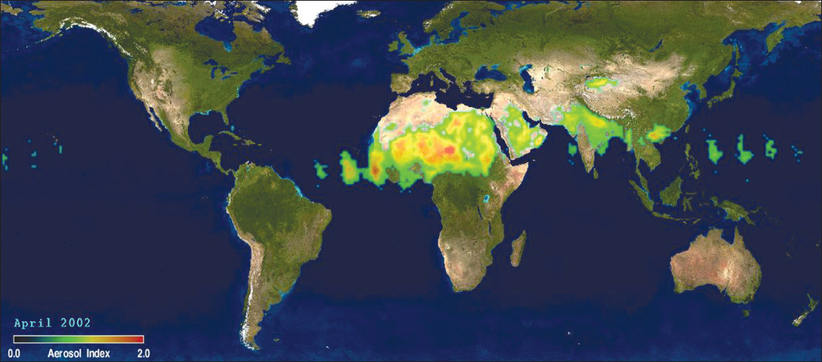
Dust Distribution
Figure 16.22: Dust sources and distribution paths are shown for April 2002.
Courtesy of J. Herman, Laboratory for Atmospheres, Goddard Space Flight Center
Notes:
Dust sources and distribution paths are shown for April 2002. They are based on satellite measurements of aerosols in the atmosphere. Most dust is derived from the deserts of Arabia and north Africa and then blown toward the Atlantic by prevailing winds. Dust plumes are also common north and south of the Himalaya Mountains. (Courtesy of J. Herman, Laboratory for Atmospheres, Goddard Space Flight Center)

Slide 36
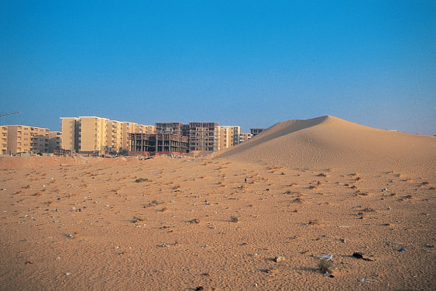
Desertification
Desertification (or land degradation) occurs naturally or as a result of the activities of people.
Exploitation and overgrazing of sensitive lands adjacent to natural deserts can cause a desert to expand.
Figure 16.14A: Migrating sand dunes may obliterate or damage almost anything in their path.

Slide 37
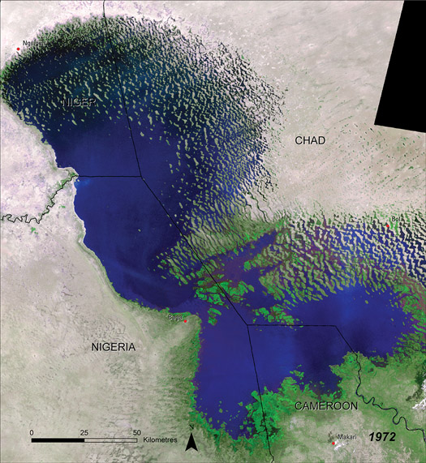
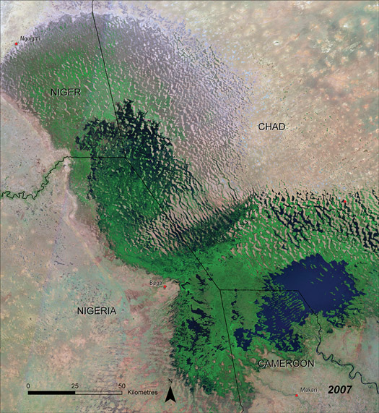
Desiccation of Lake Chad, Africa
Figure 16.25AB: Lake Chad is a shallow freshwater lake between the Sahara Desert and the tropics.
Notes:
Lake Chad is a shallow freshwater lake between the Sahara Desert and the tropics. Climatic variations cause the lake to expand or shrink. During the ice age, the lake covered 1,000,000 km². (© UNEP, n.d., Lake Chad. Environmental Change Hotspots. Division of Early Warning and Assessment (DEWA). United Nations Environment Programme (UNEP))
In 1972, the lake covered only about 20,000 km².
The lake shrank to 1200 km² during the drought of the Sahel. Fishing villages once on the shore are now stranded many kilometers from water.

Slide 38
Summary of Major Concepts
Wind is not an effective agent in eroding the landscape, but it can produce deflation basins and yardangs as well as small pits and grooves on rocks.
The major result of wind activity is the transportation of loose, unconsolidated fragments of sand and dust. Wind transports sand by saltation and surface creep. Dust is transported in suspension, and it can remain high in the atmosphere for long periods.
Sand dunes migrate as sand grains are blown up and over the windward side of the dune and accumulate on the lee slope. The internal structure of a dune consists of strata inclined in a downwind direction. Various types of dunes form, depending on wind velocity, sand supply, and constancy of wind direction.

Slide 39
Summary of Major Concepts
Wind-blown dust (loess) forms blanket deposits, which can mask the older landscape beneath them. The source of loess is desert dust or the fine rock debris deposited by glaciers. Some deep oceanic sediment is wind-blown dust from continents.
Desertification, the loss of farmable land on the margins of deserts, can be caused by human activity or by slight climatic fluctuations.

