Slide 1
Chapter 4 Basic concepts about matter
(images are either from internet or from the textbook)
Chemistry studies matter
What is matter?
This is different from the question: What is the matter with you?
Matter is anything that has mass and occupies space.
What are not matter here? Rocks, air, bacteria, heat, light,

Slide 2
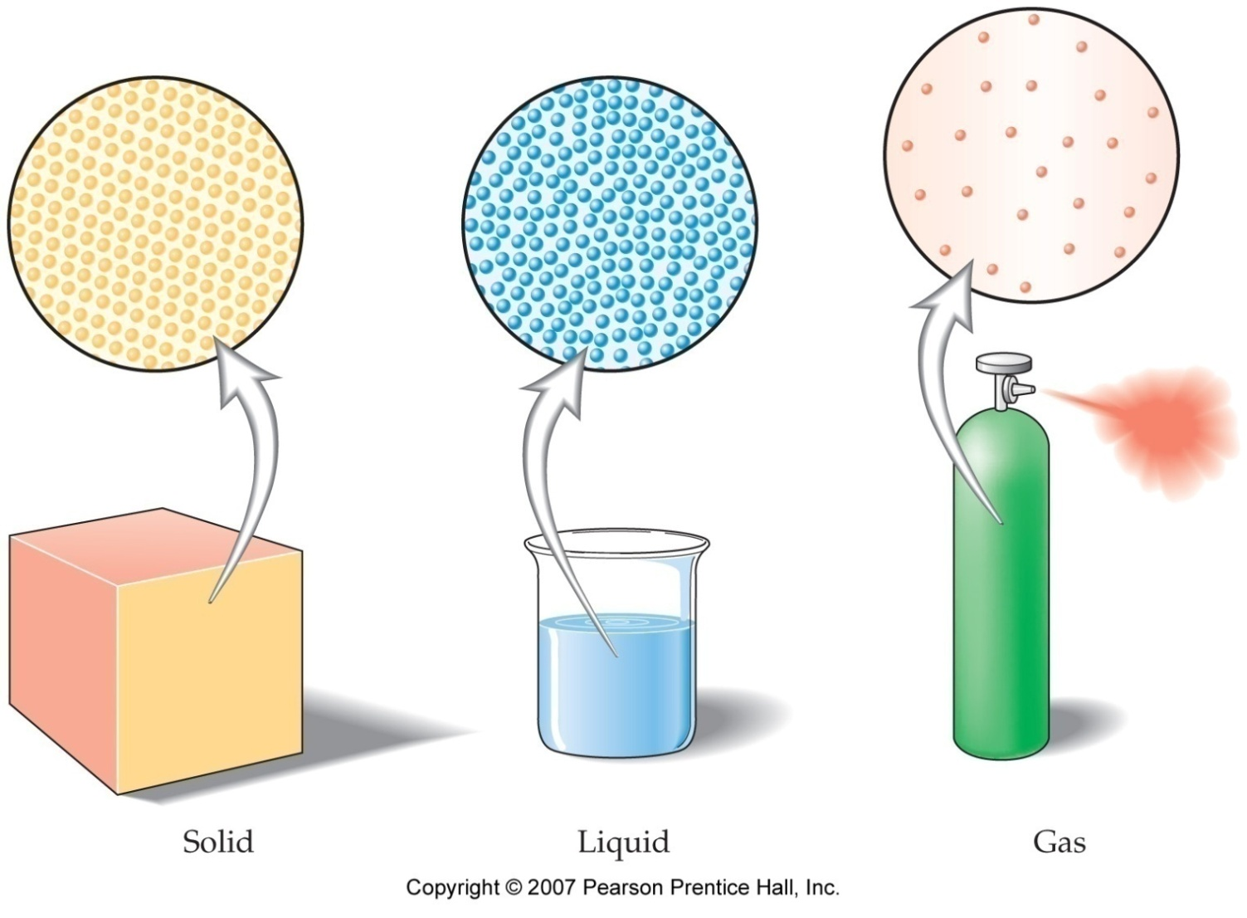
Let’s look at the Physical States of Matter
As you may have known, there are three common physical states: solid, liquid, and gas
Solid has definite shape and volume
Liquid has definite volume but no definite shape
Gas has no definite volume or shape. Do you agree that its shape is defined by the container?

Slide 3
1. Physical Properties and chemical properties
How are matters different from one another?
By having different properties. There are two pairs of properties
Physical properties are those properties of a substance that can be observed without changing the substance (its chemical identity).
Examples:
Color
Mass
Weight

Slide 4
Chemical properties are those properties of a substance that can only be studied by forming new substances.
Examples of chemical properties are: heat of combustion, reactivity with water, PH,
Earth Metals are VERY reactive and Inert Gases are UNreactive. Metals react with acids.
rotten of fruit
explosion of fireworks
lighting a match
burning gas in a stove
melting point,
viscosity
density.
smell,
freezing point,
boiling point,

Slide 5
Chemical properties are those properties of a substance that can only be studied by forming new substances.
Please indicate in the following table which side represents physical properties and which side represents chemical properties.
“React, decompose, combust, rust, oxidate” usually indicate chemical properties
Please be able to distinguish chemical properties from physical properties.

Slide 6
2. Intensive Properties and extensive properties
Intensive Properties…
Extensive Properties…
Are independent of the amount of the substance that is present.
Depend upon the amount of the substance present.
Please indicate which of the following are intensive, or extensive properties: Mass, Density, boiling point, color, temperature, volume,

Slide 7
There are two types of Changes
These are changes in matter that do not change the composition of a substance.
Physical Changes
Chemical Changes
are changes result in new substances.
Please categorize the following changes: Combustion, oxidation, Changes of state, temperature, volume, decomposition (hint: this is similar to physical and chemical properties categorization)

Slide 8
Practice question: Which of the following is chemical change and which is physical change?
A. gasoline vaporizes from an open container
B. a piece of magnesium metal burns in air to form a white powder called magnesium oxide
C. a dull knife is sharpened with a whetstone
D. Ice melting

Slide 9
Now we look at Classification of Matter

Slide 10
Classification of Matter

Slide 11
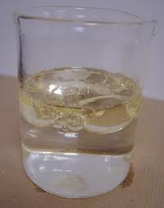
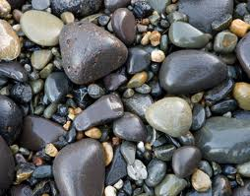
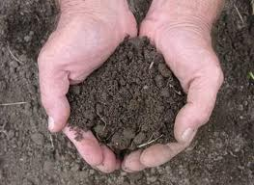
Classification of Matter

Slide 12
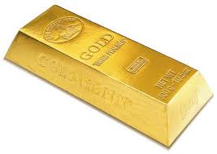
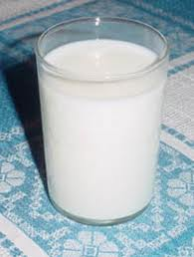
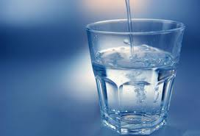
Classification of Matter

Slide 13
Classification of Matter

Slide 14
Classification of Matter

Slide 15
Classification of Matter

Slide 16
Classification of Matter

Slide 17
Classification of Matter
Matter
And
Measurement

Slide 18
Classification of Matter
Please be able to categorize a sample into one of these categories based on descriptions. There is an example on the next slide.

Slide 19
Consider the following properties that involve the metal silver:
Silver metal cannot be decomposed into simpler substances using chemical techniques.
Silver metal reacts with gaseous hydrogen sulfide to form the black solid silver sulfide (silverware tarnish).
Sterling silver is a metal alloy that contains 92.5% silver and 7.5% copper by mass.
Argenite ore, a source for silver metal, is found in Mexico and Peru.
Based on these properties, classify each of the following silver-containing entities as an element, compound, homogeneous mixture, or heterogeneous mixture.
a. sterling silver b. argenite ore c. silverware tarnish d. silver metal
Hint: generally speaking, if it cannot be decomposed, it is an element; if a sample can be separated by chemical means but not by physical means, it is a compound; if a sample can be separated by physical means, it is a mixture (either a heterogeneous or homogenous).

Slide 20
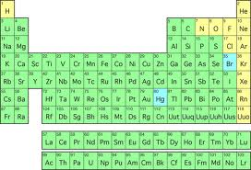
It is time to learn names and chemical symbols of the elements
Look at the periodic table, which is the table for elements. How many elements are there?
118 elements. Think about it, in a world that is so big, there are only 118 elements
Each element has a unique name (see the 1st page of your book)
Each element has a chemical symbol, with one or two letters

Slide 21
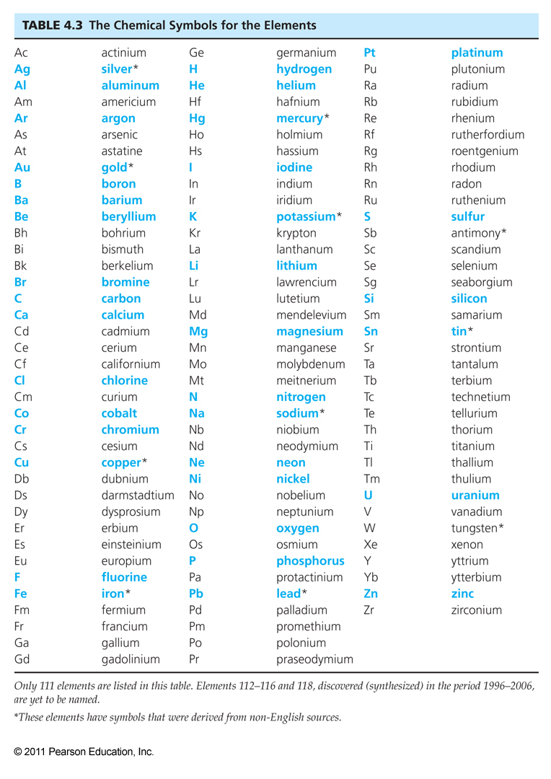
By looking at this table, please answer: How many letters are there in each chemical symbol?
Capitalized or non capital?
Are they all derived from their English name?
Not always. Please Memorize the blue colored names and symbols. Advice: You may want to press ESC and move the table up and down to view the full table.

Slide 23
Please know the symbol and name of these elements

Slide 24
Elements
Which of the following represent elements and which represent compounds?
C, Ca, Al, HI, BN, In, HBr (hint: I in Al is small case l)
Please enjoy an element rap here:
http://www.youtube.com/watch?v=8h2tUj-WbdU&feature=related

Slide 25
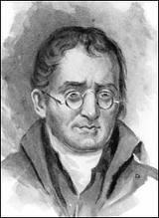
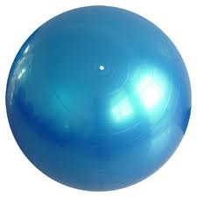
What is the smallest unit that comprises of an element?
An atom is the smallest particle of an element that can exist and still have the properties of the element.
Dalton established atomic theory, and thought that all matter is made up of atoms.
Here we use balls to represent atoms.

Slide 26
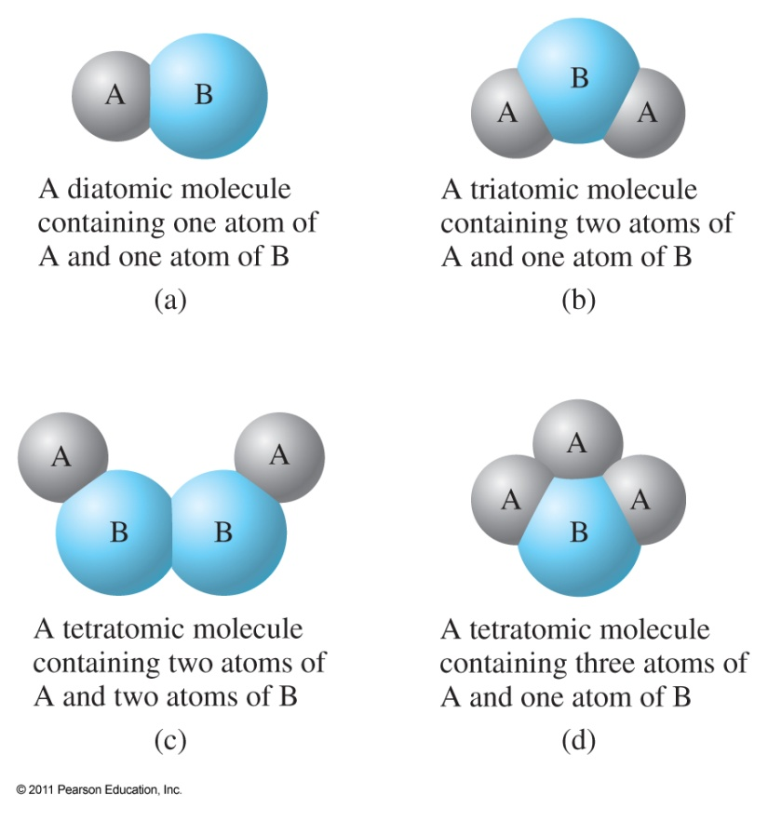
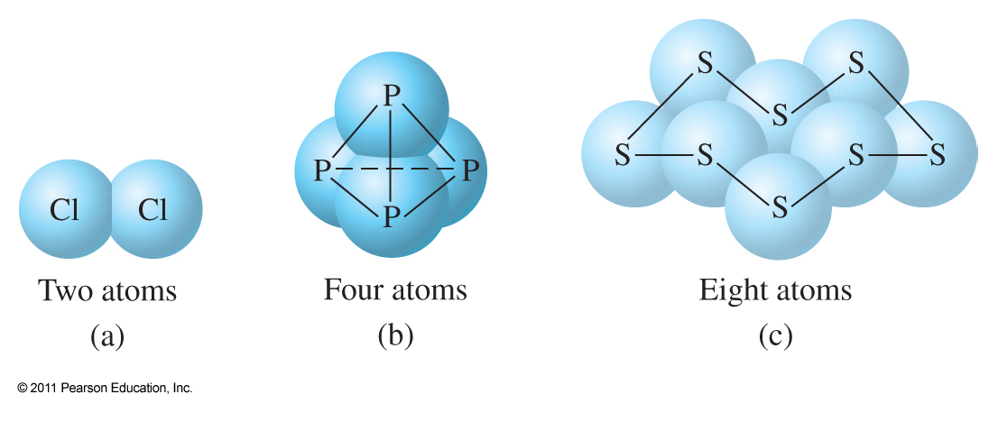
Here are some easy terms to learn:
atom
1. Molecules: two or more atoms tightly bind together
2. Homoatomic molecules: molecules made of the same type of atoms
3. Heteroatomic molecules: molecules made of different types of atoms

Slide 27
4. Compounds: heteroatomic substances are called compounds
If atoms in a compound share electrons, it is a molecular compounds
If an atom loses (or gains) electrons, it becomes an ion. Compounds contain ions are called ionic compounds. (In later chapters you will learn that most ionic compounds contain metals)
Identify molecules/compounds: H2, CO2, He, Co, CO

Slide 28
Here is a little explanation about phases in description of matters
Phase in chemistry means physical state of matters, such as solid, liquid and gas phases.
For “Two substances present. One phase”, the matter may be both …….
For “One substances present. Two phases”, it is ………, for example, ….

Slide 29
Now let’s look at the last topic of this chapter: Chemical Formulas
It is Elemental symbols followed by subscripts that indicate the No. of atoms per compound unit
Type 1 formula: X_{n}Y_{m}Z_{p}…… If n, m, or p is 1, then omit it
C₄H₈O
Type 2 formula: X_{n}(Y_{m}Z)_{p}…… In this case, number p means everything inside ( ) should times p
Pb(C₂H₅)₄ means in each compound there are ___ Pb, ____ C and _____ H
Writing formula should follow the capitalization rules for elemental symbols
Please tell the difference between: CoCl₂ and COCl₂
How many each kind of atoms (or total atoms) are there in one unit of the following compounds? (NH₄)₂C₂O₄ Ca₁₀(PO₄)₆(OH)₂

Slide 30
Review questions for exam II
A sample has been isolated in the laboratory. Based on the two characteristics below, how can the substance be classified?
I. The species cannot be separated by physical means.
II. The species can be separated by chemical means.
In which of the following sequences of elements do each of the elements have a symbol which starts with a letter not the first letter of the element's English name?
silver, mercury copper, helium,

Slide 31
A sample has been isolated in the laboratory. Based on the two characteristics below, how can the substance be classified? I. The species cannot be separated by physical means. II. The species can be separated by chemical means.
Homogeneous mixture
Heterogeneous mixture
Compound
element

Slide 32
In which of the following sequences of elements do each of the elements have a symbol which starts with a letter not the first letter of the element's English name? silver, mercury copper, helium,
Silver only
Silver and mercury
Silver, mercury, copper
All of the four

Slide 33
How many of the following pairs of elements and symbols are entirely correct, Silver, Si Manganese, Mg Potassium, P ?
0
1
2
3

Slide 34
What difference in meaning is there in notations of CoBr₂ and COBr₂?
There are three atoms in each COBr2
There are three atoms in each CoBr2
CO is cobalt
Co refers Carbon and oxygen

Slide 35
All of the following are examples of molecules EXCEPT A) Co B) CO C) H₂ D) NH₃
Co
CO
H2
NH3

Slide 36
In which of the following sequences of elements do each of the elements have a two-letter symbol? A) sodium, lithium, iodine B) potassium, fluorine, carbon C) tin, hydrogen, iodine
Choice A)
Choice B)
Choice C)
None of above

Slide 37
What is the total number of atoms in 5 formula units of Fe₂(C₂O₄)₃?
55
80
100
96

Slide 38
If 1lb = 453.59 grams, 1 inch =2.54 centimeter, then 5.3000 g/mL = ? Lb/ft³
330.87
0.35615
77422
8333.7Enter Answer Text

Slide 39
If 1lb = 453.59 grams, 1 inch =2.54 centimeter, then 5.3000 g/mL = ? Lb/ft³
330.87
0.35615
77422
8333.7

Slide 40
Review questions for exam II
How many of the following pairs of elements and symbols are entirely correct?
Silver, Si Manganese, Mg Potassium, P
(Even though manganese was not required to be memorized, but Mg was)
What difference in meaning is there in notations of CoBr₂ and COBr₂? How many atoms are there in each unit? And what does o or O mean?
All of the following are examples of molecules EXCEPT
A) Co B) CO C) H₂ D) NH₃

Slide 41
Review questions for exam II
In which of the following sequences of elements do each of the elements have a two-letter symbol?
A) sodium, lithium, iodine B) potassium, fluorine, carbon
C) tin, hydrogen, iodine
What is the total number of atoms in 5 formula units of Fe2(C2O4)3?
A) 55
B) 80
C) 100
D) 96

Slide 42
Review for exam II
Three physical states, each with definite (or indefinite) volume/shape
Classify a statement as physical property, chemical property, physical change, or chemical change
Classify a sample as heterogeneous mixture (multiple substances with multiple phases), homogeneous mixture (multiple substances with one phase), compound (can be separate via chemical method, cannot be separate via physical method), element (cannot be separate via chemical method), pure substance
Match element name with symbol, or vise versa

