Slide 1
Public Policy in Texas
CHAPTER 11

Slide 2
Steps in the Policy-Making Process: The “Policy Cycle”
The policy-making cycle, in ideal form, is a set of distinct stages
Problem identification and agenda setting; policy formulation; policy adoption; policy implementation; and policy evaluation
In practice, there is often no policy evaluation stage
Often, policy formulation may lack critical analysis of the impact of the proposed policy or any alternatives
Legislators may react without great forethought to constituent complaints
In some cases, new policies are largely symbolic

Slide 3
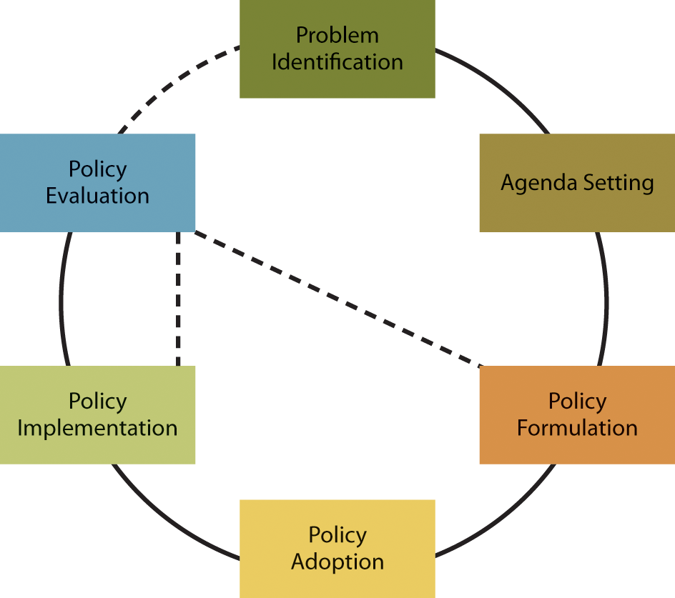
FIGURE 11.1 The Policy-Making Cycle
Although the cycle is depicted as moving from one stage to the next, ideally stages are revisited as the policy and its effects are evaluated. Changes may be recommended in problem identification and agenda setting; in policy formulation; or in policy implementation.

Slide 4
Policy Liberalism Index
“Policy liberalism” is a common scientific measure used to compare the 50 states
Policy differences can be understood in terms of ideology along a left-right, or liberal-conservative, spectrum
Note that a variety of factors, including specific policy problems and different historical “legacies,” accounts for differences
A number of different policy liberalism indices compare the states, according to a set of policies, and they are remarkably consistent in their findings

Slide 5
Policy Liberalism Index 2
Texas ranks as one of the more conservative states
Texans oppose gun control, are more often pro-life/ anti-abortion, and favor regressive consumer taxes
The states ranked near or below Texas are either Western or Southern states

Slide 6
Public Policy Areas in Texas State Government
States play an important role in implementing policies set at both the state and federal levels
States vary quite a bit, however, in terms of policy output and outcomes
Tax policy (discussed in Chapter 13)
Regulatory policy
Welfare policy
Education policy
Social policy
Water policy
Policies affecting immigrants and veterans

Slide 7
Regulatory Policy
State governments regulate a range of activities, including the following:
Life, property, and auto insurance
The court system
Professions and occupations
Public utilities
Labor law
The environment, including land use

Slide 8
Regulatory Policy: Texas’s Pro-Business Policies
Texas’s regulatory policies tend to be pro-business
Anti-union and pro-employer policies include a right-to-work law and a policy allowing employers to opt for a “tort” model, rather than workers’ compensation, in the case of employee injury
State and local governments actively recruit and support businesses with tax abatements and subsidies; and Texas has no corporate income tax
These policies are criticized by liberal Democrats as “corporate welfare” and by libertarian Republicans as “crony capitalism”

Slide 9
Regulatory Policy: Land Use in Texas
Texas is one of the least regulated states in the country on land use
The state and individual localities place relatively few restrictions on subdividing and building
One benefit is low home prices and rents; but costs include loss of natural habitat and lower quality of life for residents who oppose development
State policies heavily restrict the use of eminent domain—the process whereby the government can take private land for a public purpose

Slide 10
Regulatory Policy: Licensing and the Court System in Texas
Texas has a history of burdensome licensing regulations, but reforms have recently been made
Occupational licenses, now issued for a wide range of workers, are often justified as safer for the public; but they can reduce competition, opportunity, and affordability
Licensing fees have been eliminated for some professionals; and licensing requirements have been reduced for a number of other occupations
One area where Texas is not very pro-business is its court system: the state is comparatively friendly to plaintiffs who sue businesses

Slide 11
Welfare Policy
States have considerable leeway in determining eligibility for some federal programs providing benefits to the poor, unemployed, and disabled
In the case of Medicaid, which is run by the states, Texas’s eligibility requirements are relatively stringent
As of January 2016, Texas was also one of 19 states not to expand Medicaid as intended under the Affordable Care Act (ACA)
Texas provides lower benefit levels and additional eligibility requirements in other programs as well
Finally, Texas spends less than most other states on welfare programs as a share of the state budget

Slide 12
Healthcare Policy
The Affordable Care Act (ACA) passed in 2010
The Supreme Court upheld most of the law, but rejected the portion requiring expansion of Medicaid eligibility, leaving the decision to expand up to the states
A key provision—the requirement that every person purchase health insurance—depends on insurance marketplaces, or exchanges
Texas has declined to run its own exchange, so Texans use a federally run exchange
The majority of states defaulting to a federal exchange have Republican governors

Slide 13
TABLE 11.2 Key Provisions of the ACA
Provision | Description
Guaranteed Coverage | Health insurers cannot refuse to cover an individual because of current or prior health problems (called “preexisting conditions”).
Benefit Standards | Health insurance policies must provide certain benefits, called “minimum essential coverage.”
Individual Mandate | Individuals are required to buy health insurance or pay a fee (what critics contend is a tax) for not having coverage.
Health Insurance Exchanges | Individuals who do not have health insurance through their employer or the government must buy coverage through a state or federal exchange (i.e., online “Health Insurance Marketplace”).
Low Income Subsidies | Individuals who buy coverage through an exchange and whose income is below a certain threshold are eligible for a government subsidy. In other words, the government pays a portion of that person’s insurance premiums.
Medicaid Expansion | The income threshold used to qualify individuals for Medicaid coverage has been raised. (Note: States may opt out of this expansion and continue to use the prior income threshold to determine whether individuals qualify for their state’s program.)
Coverage for Young Adults | Children can remain on their parents’ insurance plan until age 26.
Annual and Lifetime Limits | Insurance companies cannot limit the dollar amount they would spend for most of an individual’s covered benefits, either during a given year or during the entire time a person is enrolled in that insurance plan.
Sources: Mike Patton, “Obamacare: Seven Major Provisions And How They Affect You,” Forbes, November 27, 2013, http://www.forbes.com/ sites/mikepatton/2013/11/27/how-obamacare-will-change-the-american-health-system/#1d8423ab6593; U.S. Department of Health and Human Services, “Key Features of the Affordable Care Act By Year,” http://www.hhs.gov/healthcare/facts-and-features/key-features-of-aca-by-year/index.html.

Slide 14
Healthcare Policy 2
In 2014, Texas had the highest percentage of uninsured people in the U.S.: 19% of the population
The national average was 10.4%
Proponents of the ACA say it will reduce the number of uninsured and drive down costs
Opponents argue it is an overreach of federal authority and will stress state budgets
Texas’s past two governors have firmly opposed the health care law

Slide 15
Primary and Secondary Education in Texas: Funding
The cost of public K–12 education is shared by the state, the federal government, and local districts
In 2014–2015, local districts covered about 49%
Because the primary source of local funding is the property tax, the money available per pupil varies by district
A system whereby rich districts directly provided money for poor districts—the Robin Hood Plan—was challenged in court and rejected by voters
In a newer “Robin Hood” law that has been upheld, when a district’s property tax wealth per student exceeds the cap, the district has several choices on how to proceed, with most funds then going to poorer districts

Slide 16
Primary and Secondary Education in Texas: Testing
Local governments follow guidelines set by the State Board of Education (SBE) and enforced by the Texas Education Authority (TEA)
To measure student and school performance, basic mandatory standardized testing is administered
Students must achieve a cumulative satisfactory score in reading and writing, math, science, and social studies
The role of these tests in the evaluation of school districts may be leading teachers to “teach to the test”

Slide 17
Primary and Secondary Education in Texas: Curriculum
Certain curriculum issues in particular stir controversy in Texas school board elections and across the nation
Sex education and creationism are issues primarily driven by “social conservatives,” who have sought to limit sex education to abstinence-based programs and to require the teaching of creationism along with evolution
Bilingual education has been a controversial issue dating back to the early twentieth century, prompting numerous efforts to prohibit the teaching of languages other than English

Slide 18
Hispanics and Bilingual Education
FOCUS ON
The issue of bilingual education is again current in Texas with the explosive growth of the state’s Hispanic population
Texas law requires that bilingual education and instruction in English as a second language (ESL) both be offered
Typically bilingual education involves students being taught all academic subjects using a mix of Spanish and English
There is continued debate over which instruction models are best and over whether students should be required to learn English

Slide 19
Higher Education in Texas
Texas’s public higher education system is vast
38 four-year institutions
50 community and junior college districts
4 technical colleges
3 state colleges
9 health science centers
Taxpayers pay part of the cost
The schools received $18.7 billion in 2014 and enrolled more than 1.6 million students

Slide 20
Higher Education in Texas: Tuition and Fees
For years universities had not been permitted to set their own tuition rates; but in 2003, the Republican majority passed a policy of “deregulated” tuition
From fall 2003 to fall 2011, the average tuition at Texas public universities jumped by 90%
Because higher education funding is not part of the budget fix—required spending on certain items—it can be reduced
As tuition costs have risen, state funding has gone down
While there is continued pressure to keep costs down, there is also concern that cost-cutting will affect quality

Slide 21
Higher Education in Texas: Curriculum and Degree Requirements
The Texas legislature has in recent years made laws and rules that impact curriculum choices
All state universities must offer a set number of courses in the core curriculum; and students must complete them in order to graduate
The total hours required for degree completion is limited to 120 for most degrees; and students can receive a rebate of $1,000 if they graduate within 3 credit hours of the total
Undergraduate students pay in-state tuition rates up to a certain number of total hours
Grades of as low as “D” in courses at one school must be accepted as transfer credit at another

Slide 22
Higher Education in Texas: Funds
Higher education has certain funds available for capital projects—that is, longer-term investments
These funds are an example of public policy prioritizing education over other ends
The Permanent University Fund (PUF) was established in 1876 to support the University of Texas and Texas A&M University systems
The Higher Education Assistance Fund (HEAF) was created in 1984 to support institutions not covered by PUF
In 2015 Governor Abbott introduced the Governor’s University Research Initiative to recruit researchers and boost the state’s economy through research advances

Slide 23
Higher Education in Texas: Access
In the 1980s, access to higher education in Texas began to shift away from “open enrollment”
Higher enrollment standards conflicted with efforts to increase minority enrollment
Affirmative action programs prompted a lawsuit; and when affirmative action at the University of Texas law school was ended with the 1996 Hopwood Decision, the ruling was applied to all Texas state colleges and universities
Hopwood was ultimately overturned in Grutter v. Bollinger, 2003: the U.S. Supreme Court found the Constitution does not prohibit using race in admissions policies

Slide 24
Higher Education in Texas: Access 2
Before the Grutter v. Bollinger decision, the legislature attempted a different solution to the problems of minority representation and equal opportunity
Any new student graduating in the top 10% of a high school class was granted automatic admission
This “Top Ten Percent Plan” may have increased minority enrollment; but it has also created problems for some high-performing students at highly competitive high schools
The U.S. Supreme Court has continued to uphold the constitutionality of race in admissions

Slide 25
Social Policy: Firearms
Texas has traditionally had more restrictive gun laws than many other states; but some restrictions have recently been lifted
As of January 2016, a new law permits “open carry”—allowing licensed gun owners to carry a loaded or unloaded handgun, holstered, in plain view
Open carry is prohibited on college campuses, but a different law passed in 2016 allows concealed handguns
The cost of an initial permit to carry a firearm in Texas is higher than in most other states

Slide 26
Social Policy: Gay Rights
Texas was one of the last states to maintain antisodomy laws aimed at homosexuals
Before the landmark ruling in Obergefell v. Hodges (2015) found them legal nationwide, Texas also had a long-standing ban on same-sex marriages
Texans may adopt children without consideration of their sexual orientation
While there is no statewide antidiscrimination law protecting the LGBT community, some local governments in Texas have passed such laws

Slide 27
Social Policy: Abortion
In 1973’s Roe v. Wade, the U.S. Supreme Court ruled that laws banning abortions were unconstitutional
Since Roe, states have tried to implement limits
In 2013, in the face of intense Democratic opposition, the Texas legislature enacted a controversial abortion law that is considered especially strict
When it first went into effect, about half the abortion clinics in the state closed; and it has been subject to multiple court challenges
Several of the law’s provisions were struck down in 2016

Slide 28
Social Policy: Sex Education
Sex education is frequently a controversial component of public school curricula
Texas accepts no federal funding for sex education programs that promote anything beyond celibacy
Many Texans believe sex education should be the responsibility of parents; and if schools are to be involved, they should teach abstinence
These attitudes have implications for public health
A controversial executive order requiring schoolgirls be vaccinated against a common sexually transmitted infection was overturned by the Texas legislature

Slide 29
Immigration Policy
While immigration policy is set at the federal level, Texas plays a prominent role in immigration matters
In 2010–2014, 16.5% of Texans were foreign-born
Legal immigrants go through a variety of processes to become lawful permanent residents (LPR) and can subsequently apply for U.S. citizenship
Illegal immigrants enter or remain in the country without government permission
There has been a reported surge of illegal immigrants entering the state in recent years

Slide 30
Immigration Policy 2
The large illegal immigrant population has a financial impact on the state
Undocumented immigrants do generate state revenue—primarily from sales tax and other government fees
Illegal immigrants are not eligible for federal programs but are eligible for K-12 education and some medical care, the costs borne disproportionately by local governments
Reform attempts at the federal level have failed to pass or—in the case of executive order—been blocked
Texas recently committed $800 million in state funds to bolster security along the state’s border with Mexico

Slide 31
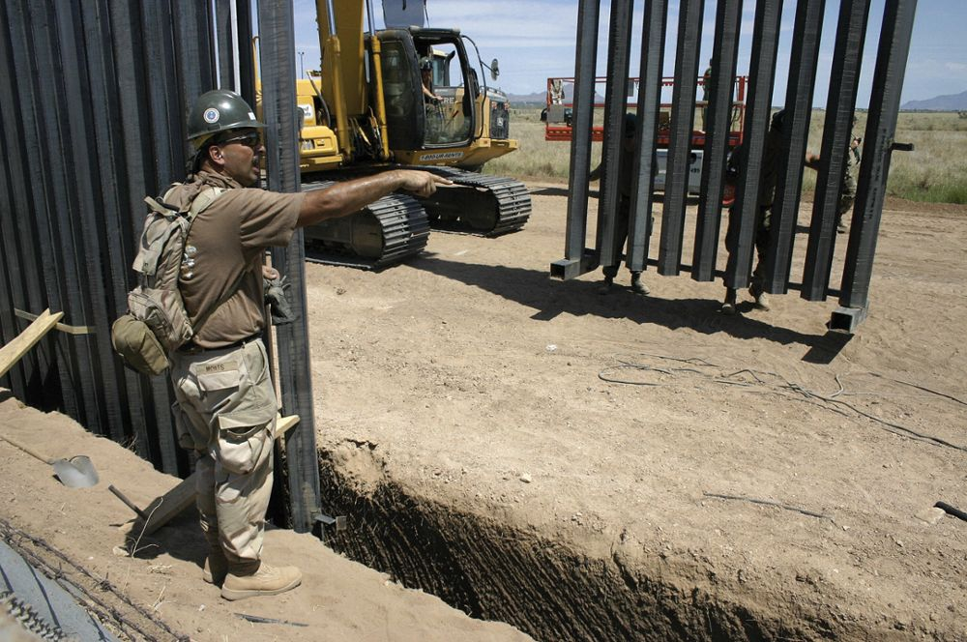
Members of the U.S. Army install part of the fence along the border near Puerto Palomas, Mexico.
The federal government is building a 745-mile fence along the U.S.–Mexico border to reduce the flow of illegal migrants into the United States.
© Guadalupe Williams/AFP/Getty Images

Slide 32
Water Policy
Water demand in Texas is expected to grow, from now to 2060, at about one-fourth the rate of population growth
Municipal, manufacturing, and steam electricity uses are expected to increase; while livestock and irrigation uses are expected to decline
Urban areas will experience the greatest increase in demand
Groundwater currently provides about 59% of the state’s water demand; surface water, 41%

Slide 33
Water Policy 2
Water law deals both with the right to use a given quantity and with efforts to keep it safe
Texas owns surface water, but citizens can obtain exclusive rights to use a certain quantity
These surface water rights can then be sold
According to the “rule of capture,” groundwater under a landowner’s property is private property
The Texas legislature has made efforts to regulate groundwater through the creation of conservation districts with limited powers over the spacing of wells and the quantity of water pumped

Slide 34
Water Policy 3
Texas faces a number of water related challenges, including drought and risks to water safety
The Texas Water Development Board (TWDB) oversees a statewide water planning process for surface and groundwater every five years
At the end of each five-year cycle, the TWDB synthesizes 16 regional water plans and other sources to create the State Water Plan
The Texas Commission on Environmental Quality (TCEQ) carries out the Federal Clean Water Act and Safe Drinking Water Act, as well as state water quality statutes, to prevent water contamination

Slide 35
Veteran Policy
Texas has one of the largest veteran populations
The main public agency for veterans’ issues is the Texas Veterans Commission (TVC)
The TVC assists veterans with obtaining benefits, provides employment and education services, and oversees delivery of a number of federal programs for veterans—such as the Montgomery and Post-9/11 GI Bills
Other assistance to veterans comes through the Texas Veterans Leadership Program, the College Credit for Heroes Program, and a range of other programs and policies

Slide 36
Conclusion
State and local government policy decisions impact a wide range of issues and areas
The Texas state government is actively involved in regulating business activity, providing welfare and educational services, attempting to manage natural resources and land use, and restricting certain behaviors or protecting certain rights

