Slide 1
Copyright © 2014 McGraw-Hill Education. All rights reserved. No reproduction or distribution without the prior written consent of McGraw-Hill Education.

Slide 2
Chapter Preview
Resources for
Effective
Life Changes
Role of
Psychology
in Living Well
Health Psychology
Making Positive
Life Changes
Towards a
Healthier Body
Notes:
Chapter 17

Slide 3
Health Psychology & Behavioral Medicine
Health Psychology
establishing health and preventing illness
focuses on social, behavioral and cognitive factors
Behavioral Medicine
integrates behavioral and biomedical knowledge
focuses on social, behavioral and biomedical factors
Health Promotion
integrates behavioral and biomedical knowledge
Public Health
integrates behavioral and biomedical knowledge
Copyright © 2014 McGraw-Hill Education. All rights reserved. No reproduction or distribution without the prior written consent of McGraw-Hill Education.
17-3

Slide 4
Biopsychosocial Model
Health psychology integrates biological, psychological, and social factors in health.
Copyright © 2014 McGraw-Hill Education. All rights reserved. No reproduction or distribution without the prior written consent of McGraw-Hill Education.
17-4

Slide 5
Theoretical Models of Behavioral Change
Theory of Reasoned Action
Effective change requires
specific intentions about behavior
positive attitude about the new behavior
perceptions of social group support
Theory of Planned Behavior
Effective change also requires
perceptions of control over the outcome
Copyright © 2014 McGraw-Hill Education. All rights reserved. No reproduction or distribution without the prior written consent of McGraw-Hill Education.
17-5

Slide 6
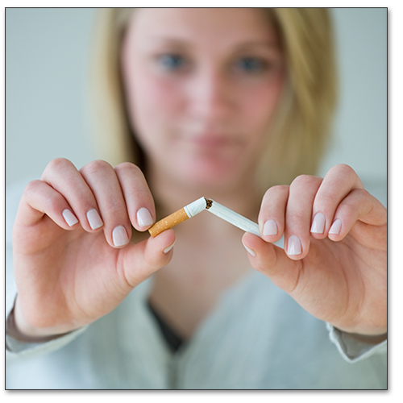
How Do Individuals Make Healthy Lifestyle Changes?
Stages of Change Model
precontemplation
not ready to even think about it
contemplation
acknowledge problem
preparation/determination
plan action, explore options
action/willpower
commit to and enact plan
maintenance
long term success / avoiding relapse
Copyright © 2014 McGraw-Hill Education. All rights reserved. No reproduction or distribution without the prior written consent of McGraw-Hill Education.
17-6
Notes:
Discussion: Have class describe each stage for someone overcoming addiction or applying for a job

Slide 7
Resources for Effective Life Change
Personal Motivation
self determination theory
intrinsic v. extrinsic motivation
implementation intentions
Why do we do the things we shouldn’t do?
Copyright © 2014 McGraw-Hill Education. All rights reserved. No reproduction or distribution without the prior written consent of McGraw-Hill Education.
17-7
Notes:
Suggestion: Attempt to tie students’ responses to the discussion question back to the bullet points.

Slide 8
Resources for Effective Life Change
Social Relationships
tangible assistance
information
emotional support
Religious Faith
linked to longer, healthier life
Copyright © 2014 McGraw-Hill Education. All rights reserved. No reproduction or distribution without the prior written consent of McGraw-Hill Education.
17-8
Notes:
Discussion: Has anyone ever helped you change? Would you feel comfortable sharing that experience with the class?
8

Slide 9
Impact of Stress
General Adaptation Syndrome (GAS)
alarm
resistance
exhaustion
Normal level of resistance to stress
1
Alarm Stage
2
Resistance
3
Exhaustion
Copyright © 2014 McGraw-Hill Education. All rights reserved. No reproduction or distribution without the prior written consent of McGraw-Hill Education.
17-9
Notes:
Suggestion: Instructor could point out that the fight or flight response which stress elicits requires energy and personal resources.

Slide 10
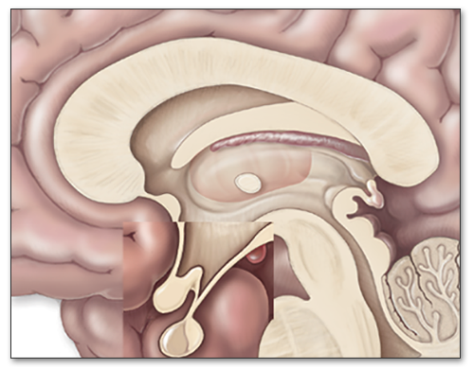
Impact of Stress
Hypothalamic-Pituitary-Adrenal Axis (HPA)
controls reactions to stressful events
Copyright © 2014 McGraw-Hill Education. All rights reserved. No reproduction or distribution without the prior written consent of McGraw-Hill Education.
17-10

Slide 11
Impact of Stress
Psycho·neuro·immunology
explores connections among psychological factors, nervous system, and immune system
stress can profoundly affect immune system
effects of acute stressors and chronic stressors
Copyright © 2014 McGraw-Hill Education. All rights reserved. No reproduction or distribution without the prior written consent of McGraw-Hill Education.
17-11
Notes:
Suggestion: Tie this back to Selye’s G.A.S. model.

Slide 12
Impact of Stress
Cardiovasular Disease
chronic emotional stress
major life changes increase risk
Cancer
stress inhibits cellular immune responses
Copyright © 2014 McGraw-Hill Education. All rights reserved. No reproduction or distribution without the prior written consent of McGraw-Hill Education.
17-12

Slide 13
Coping with Stress
Cognitive Appraisal
Optimism
Emotion-Focused v. Problem-Focused Coping
Hardiness
sense of commitment and of control
perceives problems as challenges, not threats
Stress Management Programs
Copyright © 2014 McGraw-Hill Education. All rights reserved. No reproduction or distribution without the prior written consent of McGraw-Hill Education.
17-13

Slide 14
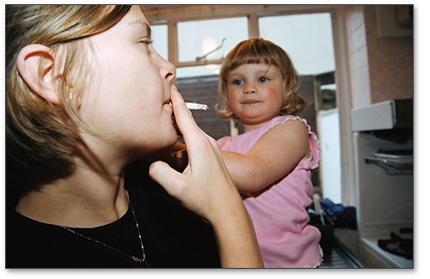
Toward A Healthier Body
Becoming Physically Active
Eating Right
Quitting Smoking
http://visual.pearsoncmg.com/mypsychlab/index.php?clipId=91
Copyright © 2014 McGraw-Hill Education. All rights reserved. No reproduction or distribution without the prior written consent of McGraw-Hill Education.
17-14
Notes:
14

Slide 15
Chapter Summary
Describe the scope of health psychology and behavioral medicine.
Describe the various theoretical models of change.
Discuss psychological and social tools that promote effective life change.
Describe how stress can effect personal wellness and identify strategies to control it.
Describe how decisions about physical activity, diet and nutrition, and smoking affect health and well-being.
Copyright © 2014 McGraw-Hill Education. All rights reserved. No reproduction or distribution without the prior written consent of McGraw-Hill Education.
17-15

