Slide 2
Chapter Preview
Nervous
System
Nervous
System
Neurons
Neurons
Brain
Endocrine
System
Brain
Endocrine
System
Damage,Plasticity,
And
Repair
Genetics
And
Behavior
Health
And
Wellness
Damage,Plasticity,
And
Repair
Genetics
And
Behavior
Health
And
Wellness

Slide 3
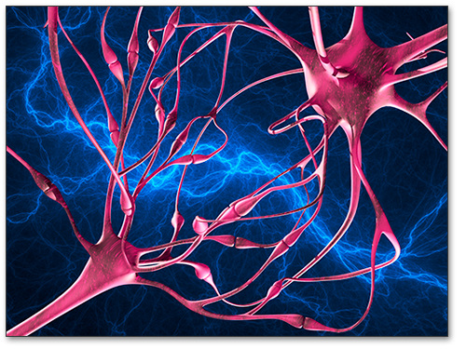
Neuroscience
Study of the body’s electrochemical communication circuitry

Slide 4
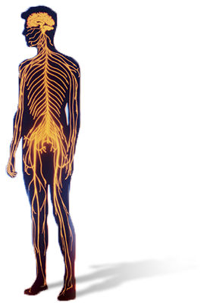
Nervous System
Complex
Integrated
Adaptable (plasticity)
Electrochemical transmission

Slide 5
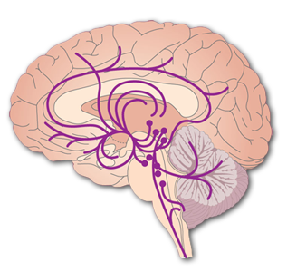
Nervous System: Pathways
Nerves carry information
afferent →
efferent ←
Body
Brain
Which type connects with skin?
With muscle?
Notes:
Caution: Both types of nerves connect with muscle.
Note: Instructor may delete discussion question, or may add analogous questions about bone joints and internal organs

Slide 6
Nervous System: Divisions Nervous Systems (NS)
Central (CNS)
brain and spinal cord
Peripheral (PNS)
Somatic NS
sensory nerves
motor nerves
Autonomic NS
sympathetic NS
parasympathetic NS
muscular activity
internal organs
arouses
calms

Slide 7
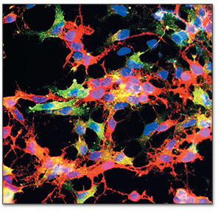
Nervous System - Cells
Glial Cells
provide support and nutrition
Neurons (about 100 billion in brain)
information processing
computing & communicating
mirror neurons (in primates)
imitation, social perception
Notes:
Note: As the text points out, recent evidence suggests that some glial cells do participate in some computational/communicative processes after all.

Slide 8
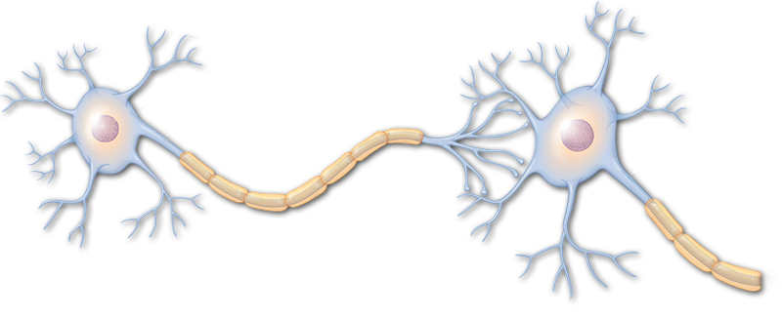
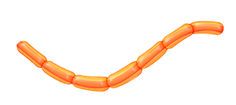
Neurons: Structure
Would be nice if highlighting of corresponding portion of graphic were possible, especially for extended entities like axons and dendrites
Cell Body
Dendrites
Axon
Impulse
Myelin Sheath

Slide 9
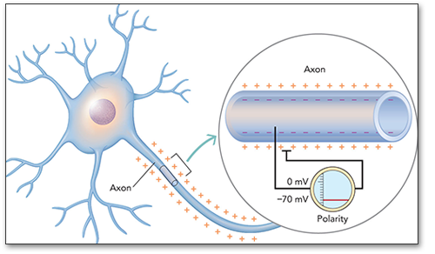
Neural Impulse
Negatively + Positively Charged Ions
Polarization (Imbalance in Charges)
Resting Potential

Slide 10
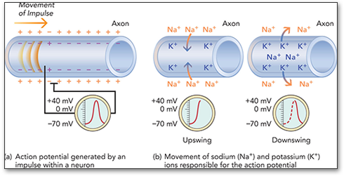
Neural Impulse
Semipermeable Membrane
Ion Channels
Depolarizaton (Ion channels open)
Threshold
Action Potential (Ion exchange sweeps
along length of axon)
All-or-None Principle

Slide 11
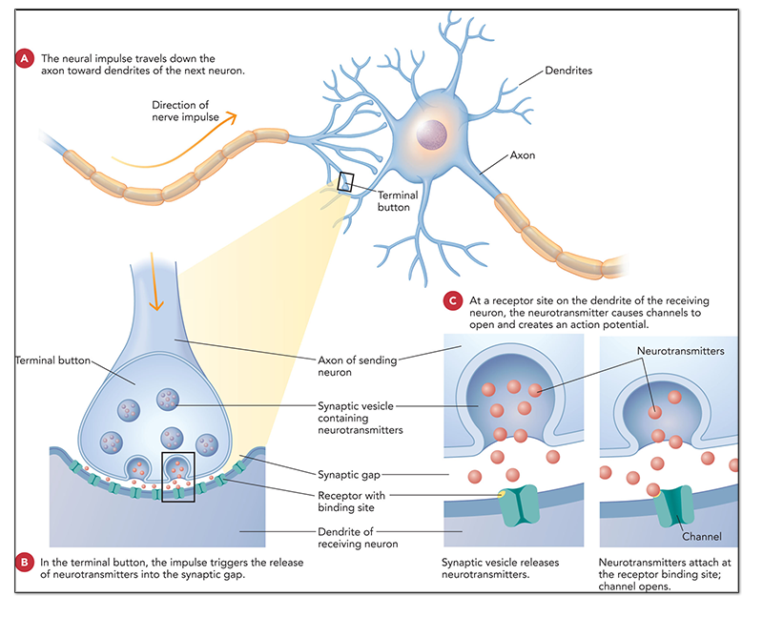
Synapses and Neurotransmitters
Synaptic Transmission
Electrical impulse is converted into a chemical signal.
Axon vesicle releases neurotransmitter into gap.
Dendrite receptor site detects neurotransmitter
Synapse
Neurotransmitters
Vesicle
Synaptic Gap
Receptor Site

Slide 12
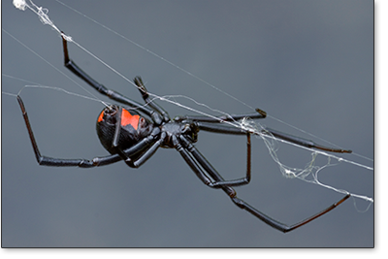
Neurotransmitters
Neurotransmitters carry information across the synaptic gap to the next neuron.
Acetylcholine
muscle actions, learning, memory
black widow venom ↑ Ach levels
Botox (botulin) ↓ Ach levels
Alzheimer’s disease: ↓ Ach levels
GABA
Anxiety: ↓ GABA levels

Slide 13
Neurotransmitters
Glutamate
excitatory
learning and memory
involved in many psychological disorders
Norepinephrine
stress and mania: ↑ norepinephrine levels
depression: ↓ norepinephrine levels
regulates sleep states in conjunction with Ach

Slide 14
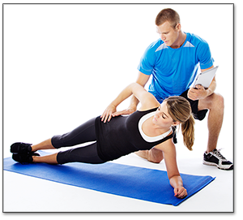
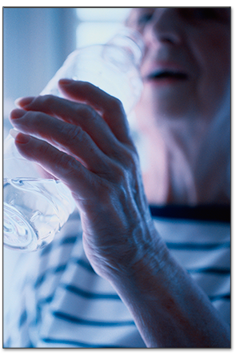
Neurotransmitters
Dopamine
voluntary movement
reward anticipation
stimulant drugs: activate dopamine receptors
parkinson’s disease: ↓ dopamine levels
schizophrenia: ↑ dopamine levels

Slide 15
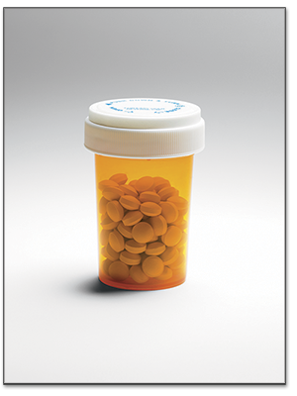
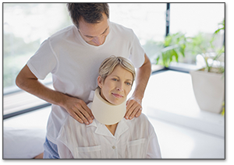
Neurotransmitters
Serotonin
regulation of sleep, mood, attention, learning
depression: ↓ serotonin levels
Prozac: ↑ serotonin levels
Endorphins
natural opiates
mediate feelings of pleasure and pain

Slide 16
Neurotransmitters
Oxytocin
both a hormone and a neurotransmitter
related to onset of lactation in new mothers
related to attachment/emotional bonds
Note: Drugs can interfere with neurotransmitters.
mimic or enhance NT effects
block effects of NT

Slide 17
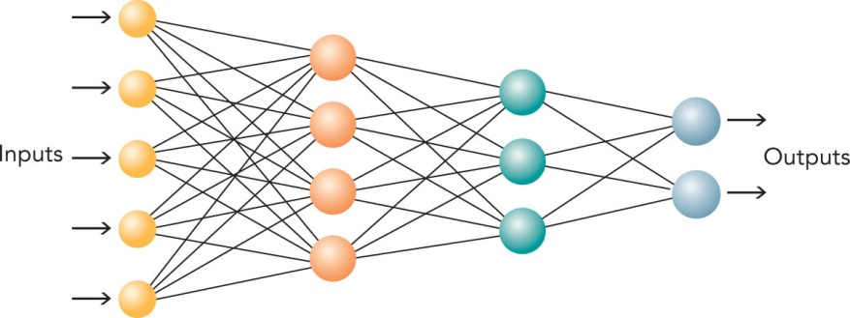
Neural Networks
Interconnected pathways of nerve cells
Integrate sensory input
and motor output
Develops across the years
Where a given piece of information is stored:
not in a lone neuron or connection
but spread over multiple connections and neurons

Slide 18
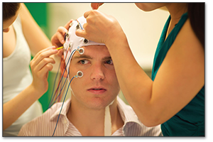
Studying the Brain
Brain Lesioning
naturally occurring or induced
Electrical Recording
electroencephalograph (EEG)
single-unit recording

Slide 19
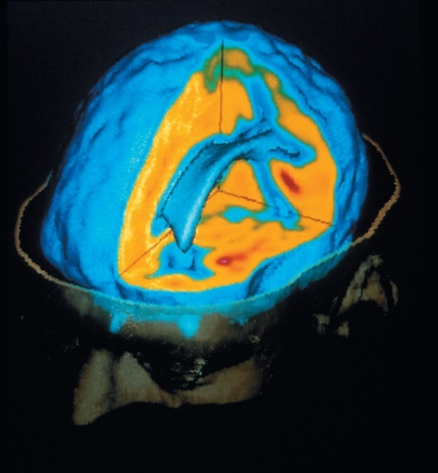
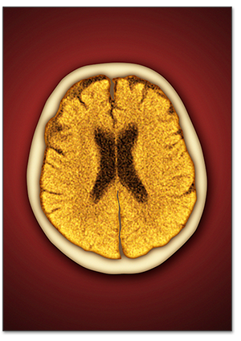
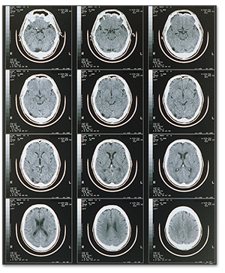
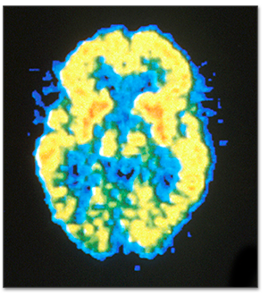
Brain Imaging
X-Ray
CT Scan
PET
MRI
fMRI

Slide 20
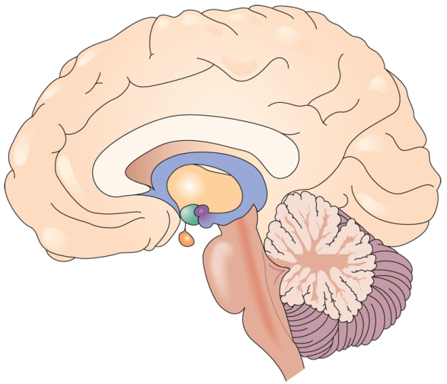
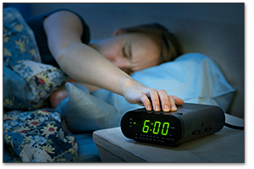
Hindbrain
Parts of the Brain
Brainstem
medulla – control breathing, regulate reflexes
pons – sleep and arousal
Cerebellum
motor coordination

Slide 21
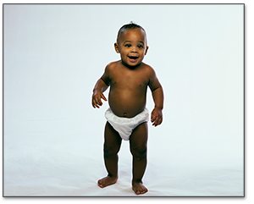
Midbrain
Substantia Nigra
Parkinson’s Disease
Reticular Formation
Stereotyped Behavior Patterns (like walking)
Notes:
Note: As mentioned on the previous slide, the substantia nigra is considered a subcortical component of the basal ganglia. It is located just above the pons. The reticular formation is by many experts considered an antiquated/obsolete classification, though it is still required content for graduate students studying physiological psychology. The reticular formation passes through the length of the center of the brain stem and ends in the midbrain.

Slide 22
Forebrain
Limbic System
memory and emotion
amygdala
discrimination of objects needed for survival
emotional awareness and expression
hippocampus
Formation and recall of memories
Thalamus
relay station for much sensory information
McGraw-Hill Education/Eclipse Studios, COPYRIGHT Frieghtened,
Liam Norris/Getty Images, © Paul Bradbury / age fotostock,
Notes:
Note: Though many experts consider the classification “Limbic System” obsolete, it is still a highly utilized piece of nomenclature. There is considerable disagreement about which brain components it includes, but it is generally accepted that in addition to the amygdala and hippocampus, it includes the hypothalamus (see next slide) and the septum.

Slide 23
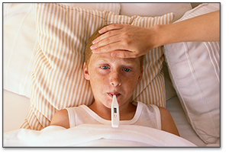
Forebrain (cont’d)
Basal Ganglia
coordination of voluntary movements
Hypothalamus
eating, drinking, sexual behaviors
regulate body’s internal state
emotion, stress, reward
Notes:
Note: The basal ganglia is a multi-component system mostly residing at the base of the cerebral cortex, but also including the subthalamic nucleus in the diencephalon and the substantia nigra in midbrain

Slide 24
The Brain in Different Species
What brain structures are similar across species?
How is the brain suited to each species?
Mice on Drugs
Notes:
http://learn.genetics.utah.edu/content/addiction/mouse/?src=asp-cu&typ=dl&cid=3408

Slide 25
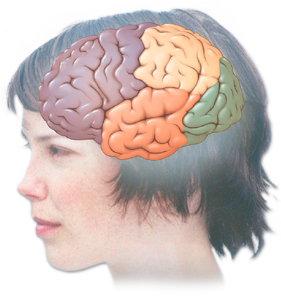
Cerebral Cortex
Neocortex: Outermost Layer
Four Lobes:
occipital (vision)
temporal (hearing, language processing, memory)
frontal (intelligence, personality, voluntary muscles)
parietal (spatial location, attention, motor control)
Frontal
Parietal
Occipital
Temporal

Slide 26
Processing Humor
Temporal – Occipital – Parietal Junction(TOPJ)
detecting & resolving conflict

Slide 27
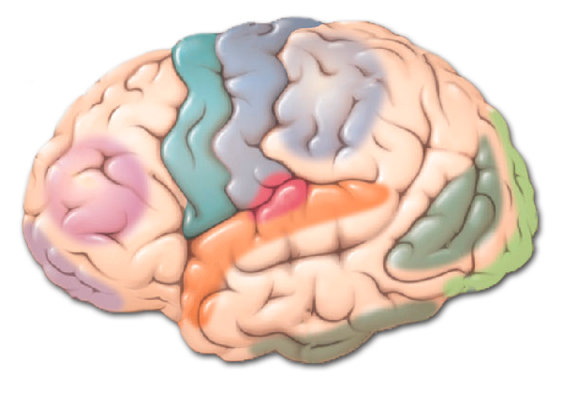
Somatosensory, Motor, and Association Cortex
Somatosensoy Cortex (in parietal lobe)
body sensations / touch
Motor Cortex (in frontal lobe)
voluntary movements
point-to-point mapping
Association Cortex (75% of cortex)
not sensory or motor, but associations between

Slide 28
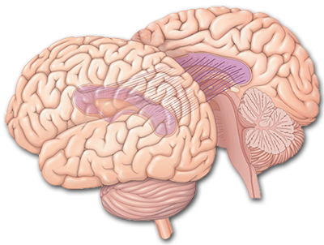
Split-Brain Research
Corpus Callosum
large bundle of axons that connects the two hemispheres of the brain
W.J., the Split Brain Patient

Slide 29
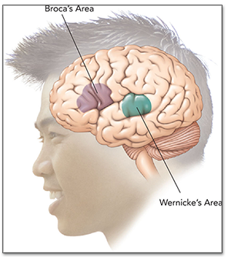
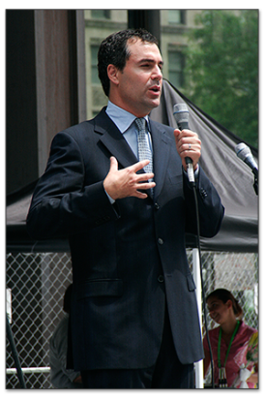
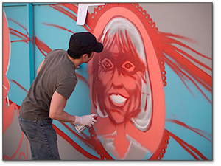
Hemispheres of the Cortex
Hemispheric Specialization of Function
left hemisphere
- verbal processing, speech, grammar
Broca’s Area
Wernicke’s Area
right hemisphere
- spatial perception,
visual recognition,
emotion
Notes:
Note: It is important to debunk the myth that people are either right-brained or left-brained, as discussed in the text. Also, help student’s appreciate that the asymmetry described is necessarily an over-simplification: Not all brains are equally asymmetrical, and function specialization is rarely 100% one-sided

Slide 30
Happy Brains?
Happiness: Prefrontal Lobe Asymmetry
Positive emotional responses
More left prefrontal lobe activity
Negative emotional responses
More right prefrontal lobe activity
Biofeedback
Mindfulness (Awareness) Meditation

Slide 31
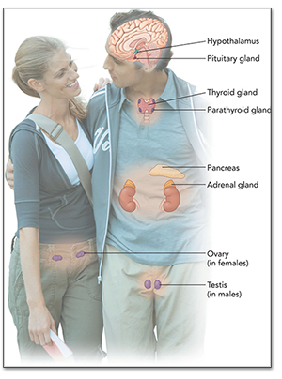
Endocrine System
Set of glands that regulate the body by secreting hormones into the bloodstream
{
pituitary, thyroid, parathyroid, pancreas, adrenal, ovaries, testes
{
chemical messages
{
relatively slow
communication system
interconnected with the nervous system

Slide 32
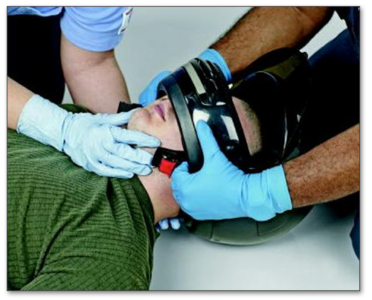
Brain Damage and Plasticity
Recovery from brain damage depends on
age of the individual
extent of the damage
Repairing the damaged brain
collateral sprouting
substitution of function
neurogenesis
brain tissue grafts
https://youtu.be/kR7_oMSUBFE
Notes:
Note: The brain is an immunologically-privileged site, able to accept implants of foreign brain tissue without fear of rejection by the body.

Slide 33
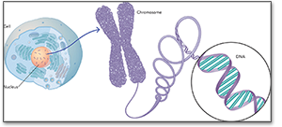
Genetics and Behavior
Chromosomes, Genes, and DNA
Human Genome Project
Dominant-Recessive Genes Principle
Molecular Genetics
Selective Breeding
Behavior Genetics and Adoption Studies

Slide 34
Genes and the Environment: genetic expression
Genotype
genetic heritage
+ Effects of experience
environment alters how genetic traits develop
= Phenotype
observable characteristics
both physical & psychological

Slide 35
Biological Foundations and Health and Wellness
Stressors
circumstances and events that threaten individuals and/or tax their coping abilities
Stress
our response to those stressors
Causes/Effects of Acute and Chronic Stress

Slide 36
Chapter Review
Describe the parts and functions of the nervous system.
Explain what neurons are and how they process information.
Identify the brain's levels, structures and functions.
State what the endocrine system is and how it affects behavior.
Describe the brain's capacity for recovery and repair.
Explain how genetics increases our understanding of behavior.
Describe the role of the biological foundations of human psychology in the body's stress response.
Notes:
http://visual.pearsoncmg.com/mypsychlab/index.php?clipId=20
36

