Slide 1
Copyright © 2014 McGraw-Hill Education. All rights reserved. No reproduction or distribution without the prior written consent of McGraw-Hill Education.

Slide 2
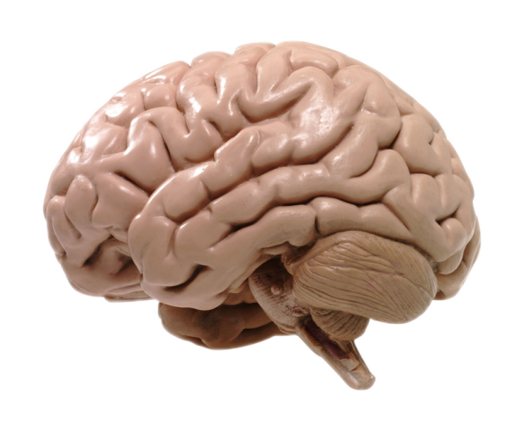
Chapter Preview
Observational Learning
Classical Conditioning
Health and Wellness
Factors That Affect Learning
Operant Conditioning
Notes:
For chapter 6

Slide 3
Learning Theory
Learning
a systematic, relatively permanent change in behavior that occurs through experience
Behaviorism
Associative Learning /
Conditioning
Observational Learning
Copyright © 2014 McGraw-Hill Education. All rights reserved. No reproduction or distribution without the prior written consent of McGraw-Hill Education.
6-3
Notes:
Note: “durable” is an excellent gloss for “relatively permanent.” “Exposure, practice, & repetition” are what a behaviorist means by “experience”

Slide 4
Types of Learning
Classical Conditioning
Operant Conditioning
Helps to explain voluntary behavior.
Performing well in swim competition (behavior) becomes associated with getting awards (consequence).

Slide 5
Types of Learning
Classical Conditioning
Operant Conditioning
Helps to explain involuntary behavior.
Control of a response [fear] is shifted to a new stimulus [office].
Notes:
Note: The instructor may wish to point out that in the example of classical conditioning, getting stuck with a needle was NOT a consequence of the subject’s behavior (namely, being fearful)– after all, what doctor would punish fearful patients by sticking them whenever they express fear?
Rather, the fear response is shifted from being elicited by a natural [reflexive] stimulus (namely, pain) to a once neutral stimulus, the sight of a doctor’s office. Hence, Classical Conditioning is characterized as a shift in stimulus control.

Slide 6
Classical Conditioning
Unconditioned Stimulus
Food
(Stimulus)
UCS
Innate S-R Association
Neutral Stimulus
NS
No Response
Repeatedly
Paired
Unlearned
Reflex
Unconditioned Response
UCR
Sound
(Stimulus 2)
Drool
(Response)
Learned Association
CS
Acquisition/Learning
CR
Conditioned Stimulus
Conditioned Response
Notes:
Pavlov’s research

Slide 7
Classical Conditioning
Food
(Stimulus)
UCS
Repeatedly
Paired
Unlearned
Reflex
NS
UCR
Sound
(Stimulus 2)
Drool
(Response)
Learned Association
CS
CR
Contingency: CS regularly followed by UCS
Contiguity: Time between CS & UCS
Notes:
Note: Rescorla points out that the nature of contingency that best promotes classical conditioning is the same as the contingency a researcher might use to infer cause and effect (as if the CS causes the UCS)

Slide 8
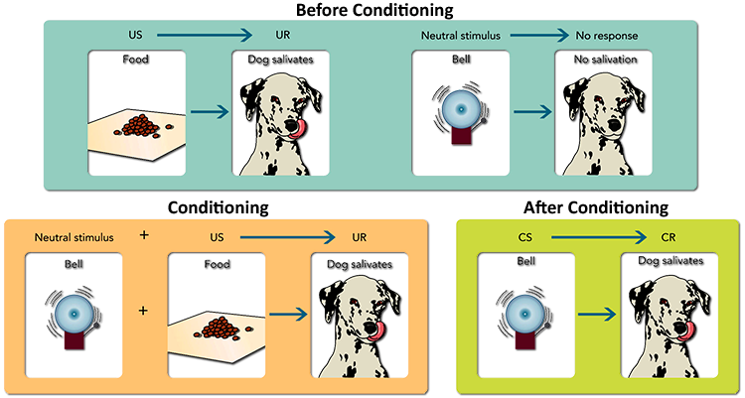
Classical Conditioning: Pavlov
Copyright © 2014 McGraw-Hill Education. All rights reserved. No reproduction or distribution without the prior written consent of McGraw-Hill Education.
6-8
Notes:
Suggestion: Instructor might point out that the frame labeled “conditioning” is not repeated merely once, but dozens of times.

Slide 9
Classical Conditioning
Food
(Stimulus)
UCS
Repeatedly
Paired
Unlearned
Reflex
NS
UCR
Sound
(Stimulus 2)
Drool
(Response)
Learned Association
CS
CR
Generalization
CRs may also appear after various new NS that are similar to the CS
Notes:
Suggestion: Generalization is easily illustrated with sounds from markedly different bells, one on which the subject is trained, the second on which the subject is tested for generalization.

Slide 10
Classical Conditioning
Food
(Stimulus)
UCS
Repeatedly
Paired
Unlearned
Reflex
NS
UCR
Sound
(Stimulus 2)
Drool
(Response)
Learned Association
CS
CR
Discrimination
CRs appear after the CS but not after other CSs.
Discrimination generally learned by presenting other CSs without the UCS
Notes:
Eventually the subject learns that one bell works and the other doesn’t

Slide 11
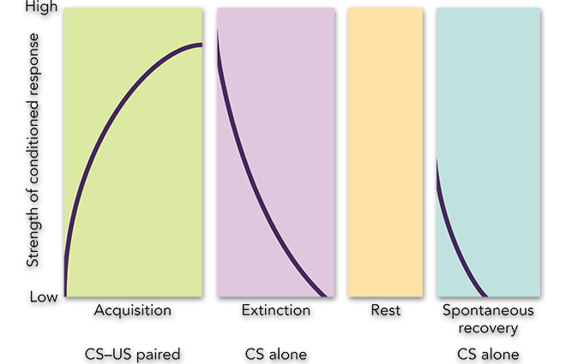
Classical Conditioning
Extinction
CR weakened by presenting the CS without the UCS
Pavlov rang bell but did not present food; the dog stopped salivating.
Spontaneous Recovery
CR recurs after a time delay and without additional learning.
When Pavlov rang the bell the next day, the dog salivated.
Copyright © 2014 McGraw-Hill Education. All rights reserved. No reproduction or distribution without the prior written consent of McGraw-Hill Education.
6-11

Slide 12
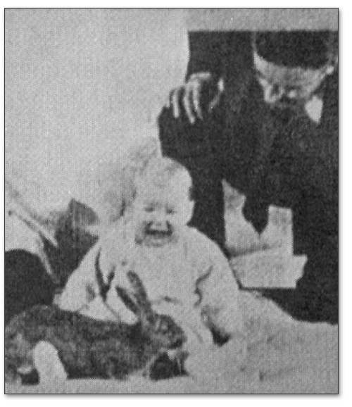
Classical Conditioning
Bang
UCS
Repeatedly
Paired
Unlearned
Reflex
NS
UCR
Rabbit
Fear
Learned Association
CS
CR
Phobias
Watson and Rayner (1920) – Little Albert.

Slide 13
Classical Conditioning
Bullying
UCS
Repeatedly
Paired
Unlearned
Reflex
NS
UCR
School
Fear
Learned Association
CS
CR
Friend
Fun
Counterconditioning
Goal: Associate CS with new, incompatible CR
Means: CS paired with new UCS
Notes:
This diagram illustrates how school itself can become aversive when associated with bullies, but pleasant when associated with kindly friends. Thus, to counteract the association with bullies, keep the bullies away (extinction) and replace them with kindly friends (producing an incompatible response).

Slide 14
Classical Conditioning
Ad Actors
UCS
Repeatedly
Paired
Unlearned
Reflex
NS
UCR
Product
Fun
Learned Association
CS
CR
Application
Advertising
Notes:
The positive associations with gorgeous actors having a grand time can become associated with a product they are shown using in a commercial ad.

Slide 15
Classical Conditioning
Medicine in Pill
UCS
Repeatedly
Paired
Unlearned
Reflex
NS
UCR
Pill
Pain Relief, immune response
Learned Association
CS
CR
Application
Placebo Effect
immune and endocrine responses
Notes:
Through classical conditioning, the sight of or act of taking a pill with medicine soon comes to elicit the same pain relief as the medicine itself produces.
You may want to point out in the next slide that precisely the opposite effect occurs with drug tolerance.

Slide 16
Classical Conditioning
Drug Effect
UCS
Repeatedly
Paired
Unlearned
Reflex
NS
UCR
Drug Paraphernalia
Body Counteracts Drug
Learned Association
CS
CR
Application
Drug Tolerance / Habituation
Notes:
See text Intersection: Can Classical Conditioning Help Us Understand Drug Abuse– discussion of “Sign Tracking”
Note: The body naturally protects itself by attempting to neutralize the affects of psychoactive drugs (this is an unlearned reflex). Through classical conditioning, the body learns to anticipate the drug in the presence of drug paraphernalia, and begins neutralizing the drug before it is actually consumed. Thus, the body must take in even more of the drug to get the same effect. This is how classical conditioning creates drug tolerance. Also, this is why simply seeing drug paraphernalia can trigger withdrawal symptoms or “cravings”.

Slide 17
Classical Conditioning
Illness
UCS
Paired
Unlearned
Reflex
NS
UCR
New Taste
Nausea
Learned Association
CS
CR
Application
Taste Aversion
Notes:
Note: Unlike conventional classical conditioning, taste aversion can occur under very impoverished learning conditions. In particular, a powerful taste aversion can be learned with just one exposure (rather than dozens) where the UCR does not occur for several hours (instead of within a split second). This is considered a counterexample to Pavlov’s theory, and shows that not all S-R associations stand on equal footing. Some are biologically primed, or as we shall see toward the end of the presentation, biologically “prepared”.

Slide 18
Operant Conditioning
Better explains voluntary behaviors.
The consequences of a behavior change the probability of that behavior’s occurrence.
Copyright © 2014 McGraw-Hill Education. All rights reserved. No reproduction or distribution without the prior written consent of McGraw-Hill Education.
6-18

Slide 19
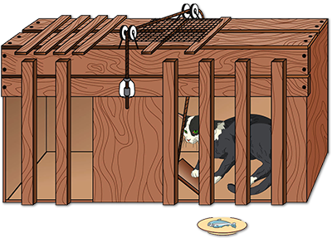
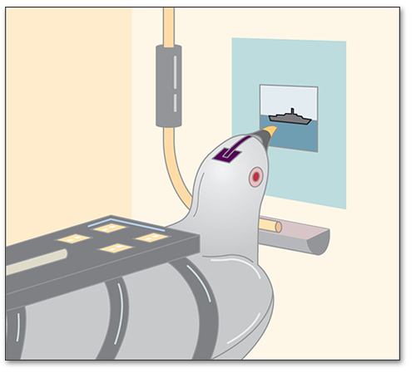
Operant Conditioning
Thorndike’s Law of Effect
consequence strengthens or weakens an S – R connection
B.F. Skinner
expanded on Thorndike’s work
shaping (reward approximations of the desired behavior)
Copyright © 2014 McGraw-Hill Education. All rights reserved. No reproduction or distribution without the prior written consent of McGraw-Hill Education.
6-19
Notes:
Note: An important contribution of B.F. Skinner was that he standardized the language scientists use to refer to learning. After all, Skinner’s undergraduate studies were not in Psychology, but English Literature.
Skinner worked with the U.S. military to train pigeons to guide missiles/torpedoes, per above illustration.

Slide 20
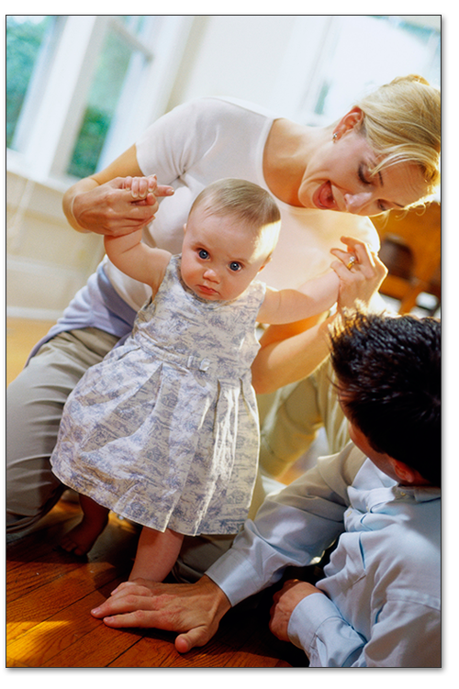
Reinforcement
Reinforcement increases behavior.
Positive Reinforcement
behavior followed by rewarding consequence
rewarding stimulus is “added”
Negative Reinforcement
behavior followed by rewarding consequence
aversive (unpleasant) stimulus is “removed”
Copyright © 2014 McGraw-Hill Education. All rights reserved. No reproduction or distribution without the prior written consent of McGraw-Hill Education.
6-20
Notes:
Note: It is important to stress that positive means “something is added,” that negative means “something is removed,” and that reinforcement is defined by the resulting effect on behavior (increase).
Activity/Demonstration: Ask students to generate examples of both positive and negative reinforcement.

Slide 21
Reinforcement
Reinforcement increases behavior.
Positive Reinforcement
Teacher praises
Behavior
Turn homework in on time
Negative Reinforcement
Teacher stops criticizing
What is the effect on the behavior?

Slide 22
Reinforcement
Reinforcement increases behavior.
Positive Reinforcement
Great music starts playing
Behavior
Press an odd button on dashboard of friend’s car
Negative Reinforcement
Annoying music stops playing
What is the effect on the behavior?
Notes:
Note: The scenario here is you sit down in a friend’s car and notice that there are several interesting buttons on the dash. You randomly press one out of curiosity.

Slide 23
Reinforcement
Reinforcement increases behavior.
Behavior
Avoidance Reinforcement
Avoid negative stimulus
Negative stimulus never occurs
What is the effect on the behavior?
http://visual.pearsoncmg.com/mypsychlab/index.php?clipId=122
Notes:
Note: The consequence in avoidance reinforcement is indirect: It amounts to consequence prevention, which is far different from negative reinforcement. The latter is stimulus removal—an actual consequence.

Slide 24
Reinforcement
Learned helplessness:
an organism learns it has no control over negative outcomes
Behavior
Failure To Reinforce
All kinds of attempts
Nothing Works

Slide 25
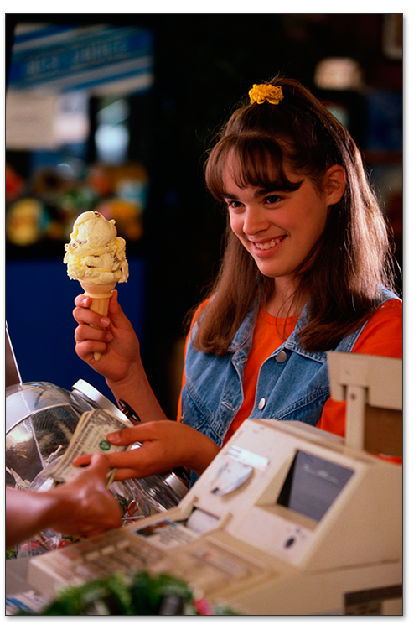
Types of Reinforcers
Primary Reinforcers
innately satisfying
Secondary Reinforcers
become satisfying through experience
repeated association with a pre-existing reinforcer
token economy
Copyright © 2014 McGraw-Hill Education. All rights reserved. No reproduction or distribution without the prior written consent of McGraw-Hill Education.
6-25
Notes:
Note: A few decades ago, secondary reinforcement was proffered as an account of why young children cling to their mothers. Mom feeds the infant: Food (primary reinforcer) ; Mom (secondary). Keep in mind that Harlow’s research with monkeys and terry-cloth mothers has debunked this analysis. Social stimulation is definitely a primary reinforcer.

Slide 26
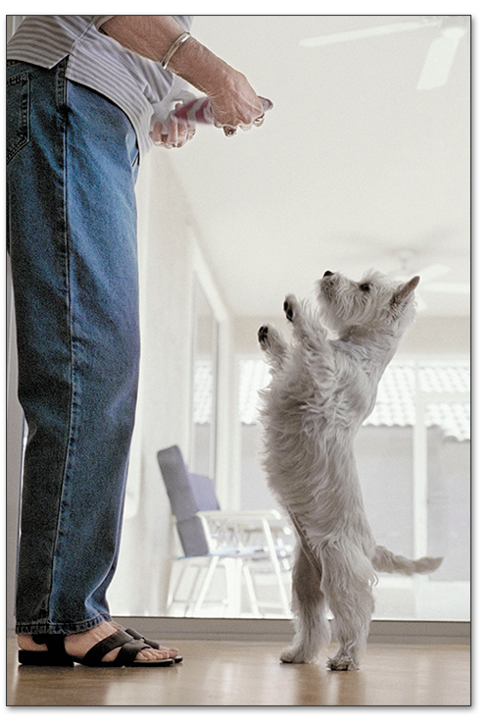
Types of Reinforced Behavior
Generalization
stimulus “sets the occasion” for the response
responding occurs to similar stimuli
Discrimination
stimuli signal when behavior will or will not be reinforced
Extinction and Spontaneous Recovery
behavior decreases when reinforcement stops
Copyright © 2014 McGraw-Hill Education. All rights reserved. No reproduction or distribution without the prior written consent of McGraw-Hill Education.
6-26
Notes:
Note: Remind students that these concepts are a carryover from Classical Conditioning

Slide 27
Schedules of Reinforcement
Continuous Reinforcement
Partial Reinforcement
fixed
variable
ratio
interval
Copyright © 2014 McGraw-Hill Education. All rights reserved. No reproduction or distribution without the prior written consent of McGraw-Hill Education.
6-27
Notes:
27

Slide 28
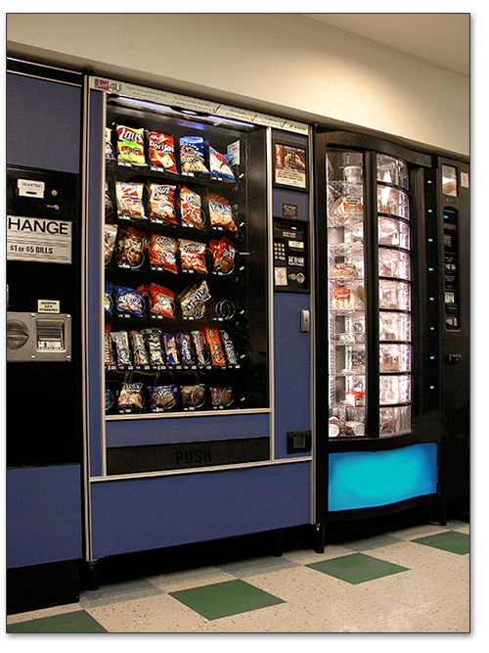
Schedules of Reinforcement
Fixed Ratio (FR)
reinforcement follows a set # of behaviors
Variable Ratio (VR)
reinforcement follows an unpredictable # of behaviors (e.g., an average)
Copyright © 2014 McGraw-Hill Education. All rights reserved. No reproduction or distribution without the prior written consent of McGraw-Hill Education.
6-28

Slide 29
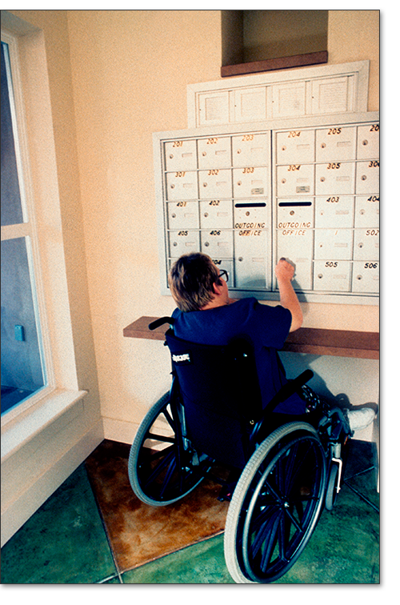
Schedules of Reinforcement
Fixed Interval (FI)
reinforcement follows behavior that occurs after a set amount of time has elapsed
Variable Interval (VI)
reinforcement follows behavior that occurs after an unpredictable amount of time has elapsed
Copyright © 2014 McGraw-Hill Education. All rights reserved. No reproduction or distribution without the prior written consent of McGraw-Hill Education.
6-29
Notes:
Note: A commonly used but incorrect example of Fixed Interval schedule of reinforcement is the weekly paycheck. By definition, a “fixed interval” of time is an interval of waiting, where behavior would be pointless because it will not be reinforced. Note that unlike waiting for the regularly scheduled mail delivery, waiting for a paycheck without working in the meantime is not conducive to eliciting reinforcement from one’s employer. The worker needs to work the entire week in order to receive a delayed reward. Waiting until payday before you start working—a bad idea. So the weekly paycheck is a delayed reward schedule, not a fixed interval schedule. On the other hand, waiting until payday to look for the check in the mail, that is indeed an interval schedule of reinforcement, but it is just a specific case of the original example of checking the mail.

Slide 30
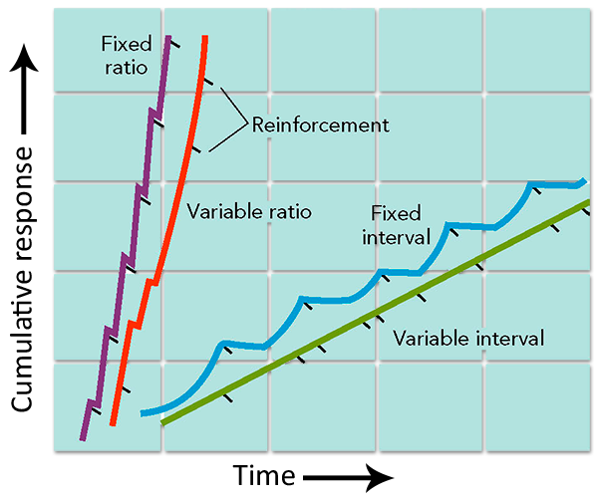
Schedules of Reinforcement
Copyright © 2014 McGraw-Hill Education. All rights reserved. No reproduction or distribution without the prior written consent of McGraw-Hill Education.
6-30

Slide 31
Punishment
Punishment decreases behavior.
Positive Punishment
behavior followed by aversive consequence
aversive (unpleasant) stimulus is “added”
Negative Punishment
behavior followed by aversive consequence
rewarding stimulus is “removed”
Copyright © 2014 McGraw-Hill Education. All rights reserved. No reproduction or distribution without the prior written consent of McGraw-Hill Education.
6-31

Slide 32
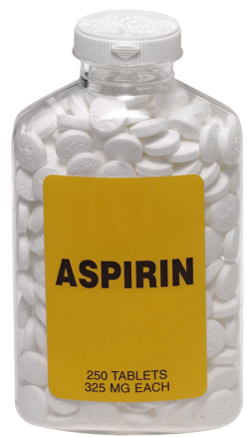
Reinforcement
Punishment decreases behavior.
Positive Punishment
Allergic reaction
Behavior
Negative Reinforcement
Take aspirin for headache
Headache goes away
Negative Punishment
Lose sympathetic attention of spouse
What is the effect on the behavior?
Notes:
Note: The answer to the question, “What is the effect on the behavior?” is not the same for the three consequences presented on this slide.

Slide 33
Reinforcement
Punishment decreases behavior.
Positive Punishment
Get pulled over and ticketed
Behavior
Negative Reinforcement
Show off by speeding
Lose gangster who had been tailing you
Negative Punishment
Lose $250 to pay ticket
What is the effect on the behavior?
Notes:
Note: This example presumes that getting pulled over and ticketed is aversive in its own right, even if you only get a warning.

Slide 34
Operant Conditioning
Timing of Consequences
immediate versus delayed reinforcement
immediate versus delayed punishment
http://visual.pearsoncmg.com/mypsychlab/index.php?clipId=40
Applied Behavior Analysis
behavior modification
Copyright © 2014 McGraw-Hill Education. All rights reserved. No reproduction or distribution without the prior written consent of McGraw-Hill Education.
6-34
Notes:
Delayed consequences work much differently (more effectively) on adult humans than on animals and small children.

Slide 35
Observational Learning
Learning that occurs when a person
observes and imitates behavior (modeling).
Albert Bandura – Social Cognitive Theory
Four Processes of Observational Learning
attention
retention
motor reproduction
reinforcement
Copyright © 2014 McGraw-Hill Education. All rights reserved. No reproduction or distribution without the prior written consent of McGraw-Hill Education.
6-35
Notes:
Stopped here 2/6

Slide 36
Cognitive Factors in Learning
Do cognitions matter?
Does learning involve more than environment-behavior connections?
Purposive Behavior in Humans
goal directed
goal setting
self-regulation and self-monitoring
Copyright © 2014 McGraw-Hill Education. All rights reserved. No reproduction or distribution without the prior written consent of McGraw-Hill Education.
6-36

Slide 37
Cognitive Factors in Learning
Expectancy Learning
information value
Latent Learning/Implicit Learning
Insight Learning
Copyright © 2014 McGraw-Hill Education. All rights reserved. No reproduction or distribution without the prior written consent of McGraw-Hill Education.
6-37

Slide 38
Other Factors in Learning
Biological Constraints
instinctive drift
preparedness
Cultural Influences
Psychological Constraints
mindset: fixed v. growth
Copyright © 2014 McGraw-Hill Education. All rights reserved. No reproduction or distribution without the prior written consent of McGraw-Hill Education.
6-38
Notes:
Note: For biological preparedness, recall taste aversion.
Cultures can influence emphasis on types of learning as well as content

Slide 39
Other Factors in Learning: Critical Controversy
Learning Styles
visual, aural, kinesthetic
Research suggests there is no actual advantage to instruction within one’s preferred style.
Copyright © 2014 McGraw-Hill Education. All rights reserved. No reproduction or distribution without the prior written consent of McGraw-Hill Education.
6-39

Slide 40
Learning and Health and Wellness
Factors influencing degree of stress
predictability of stressor
control over stressor
improvement of (reduction in) stressor
outlets for frustration
Copyright © 2014 McGraw-Hill Education. All rights reserved. No reproduction or distribution without the prior written consent of McGraw-Hill Education.
6-40

Slide 41
Chapter Review
Describe learning.
Explain classical conditioning.
Explain operant conditioning.
Understand observational learning.
Describe the role of cognition in learning.
Identify biological, cultural, and psychological factors in learning.
Describe how principles of learning apply to health and wellness.
Copyright © 2014 McGraw-Hill Education. All rights reserved. No reproduction or distribution without the prior written consent of McGraw-Hill Education.
6-41
Notes:
Note: Instructors may use the learning objectives presented on this slide to review the chapter material.

