Slide 1
Notes:
Note: Several memory demonstration activities are included in this slide presentation. The instructor may elect to use these, or to delete them. There are numerous online memory demonstration activities that are available in lieu of these.

Slide 2
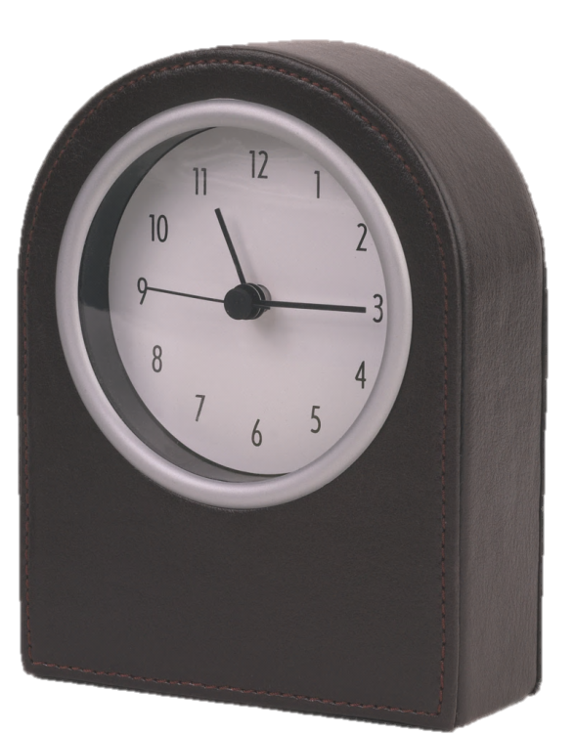
Chapter Preview
Nature
Encoding, Storage,
Retrieval
Forgetting
Study Tips
Health and
Wellness
Notes:
For chapter 7

Slide 3
The Nature of Memory
Retention of Information or Experience over Time
Three Phases of Memory
encoding
storage
retrieval
Notes:
Why is memory important? What if you couldn’t remember anything that happened before you were 16 years old? Before last week? Before this minute?
Instructors might use this question to introduce the importance of memory and memory research. It might also serve as a prompt for a reflective paper, for small group/class discussions, or as a prompt for the instructor to discuss the obvious and not-so-obvious responses to this question.

Slide 4
Encoding: Sensory Input
Automatic vs. Effortful Encoding
What is the Role of Attention?
selective attention (purposive focus)
divided attention (multitasking)
sustained attention (vigilance)
Notes:
What is the role of attention? Without looking, can you tell us what is on [the back wall] of this classroom? (You see it every time you come to class.)
Again, it might be useful for students to think about how little they remember due, in part, to attentional mechanisms.

Slide 5
Good/Power Task
On a scale from one to ten, rate each word GOOD / BAD
or POWERFUL / WEAK and give reasons why.
Example: Mushroom
Good = 6 (Yummy but poisonous)
Power = 7 (Could kill you)
Here we go!
YARD
SQUEEZE
WEDDING
TOOTH
DANCE
COINS
PILLOW
TORNADO
MOTHER
BLADE
TRACTOR
LIVER
CANDY
Notes:
A few students may be confused that they are not to count or track anything. Reassure them that they need only attend to the task.

Slide 6
Good/Power Task
BLADE
TRACTOR
CANDY
LIVER
TORNADO
YARD
PILLOW
SQUEEZE
WEDDING
COINS
DANCE
MOTHER
TOOTH
Remember rating GOOD / POWERFUL words?
Please list all of the words from that second list that you can remember.
Copyright © 2014 McGraw-Hill Education. All rights reserved. No reproduction or distribution without the prior written consent of McGraw-Hill Education.
7-6
Notes:
Before revealing the word list on this slide, give students some time to write down what they remember. Once it appears that no one is writing anything, or after a comparable amount of time to what you allowed for the previous slide, reveal the list. One by one, call out each word on the list and have students raise their hand if they remembered it and wrote it down. As you go, give a rough estimate of the number of students who got each word. You may want to keep track of how many words no one recalled. Point out that this task was easier than the other one despite their being told not to keep track of anything. The difference is because they processed each word meaningfully.

Slide 7
Levels of Processing
How many of you did well on the list?
How many did better than they thought?
Rating Good / Powerful is “deeper” processing than counting or just memorizing the words.
Deep processing automatically leads to better recall
Why?
Notes:
Generally, almost the entire class will have done better on the second list. Tie this in to depth/levels of processing theory on the next slide.

Slide 8
Encoding: Levels of Processing
Encoding as a process that occurs on a continuum…
Shallow
Intermediate
Deep
Rote physical traits
Category label
Meaningful personal experience
Deeper processing promotes better recall
Notes:
Tie this back to the demo on the previous set of slides.

Slide 9
Elaboration
Elaboration enhances memory.
Memory strategies all use elaboration.
Target
Better chances of happening on one of the cues and thus finding target.
Cue
Vivid Imagery
Self Referencing Effect
Memory Wizards
Cue
Cue
Elaborated
Target
Cue
Cue
Only one cue leads to this target.
If you don’t happen to find this cue, you can never find the target.
But what if there were many cues, all leading to the same target?
Cue
Notes:
Help students understand that the target node is the material to be remembered and the cues are the associations linked up to the target. According to the Elaboration Model, the only way to remember the target is by first accessing one of the cues. If you fail to access at least one of the cues, you will be unable to recall the target. The more cues there are associated with the target, the more likely you will be able to access at least one of them. Students may relate to having studied an item worded one way (with one set of cues) in their notes, but on the test, the question about the item used different wording (a different set of cues), so they got it wrong. They did not have a well-elaborated understanding of the item studied.
Suggestion: Point out that memory wizards use strategies that take advantage of elaborative encoding

Slide 10
Encoding: Imagery
Dual-Code Hypothesis (Paivio)
verbal code – word or label
image code – detailed and distinctive
Images are stored in both codes.
Superior to verbal codes alone

Slide 11
Atkinson-Shiffrin Theory (1968)
Sensory Memory
Encoding
Sensory Memory
Short Term Memory
Long Term Memory
Attention
Detailed information
In original sensory form
Very brief duration
Echoic (Auditory) Memory
Iconic (Visual) Memory
Rehearsal
Retrieval

Slide 12
Atkinson-Shiffrin Theory (1968)
Sensory Memory
Sensory Memory
Short Term Memory
Long Term Memory
Attention
Attention: Sensory Memory → STM

Slide 13
Atkinson-Shiffrin Theory (1968)
Short Term Memory
Sensory Memory
Short Term Memory
Long Term Memory
Limited duration (about 30 seconds)
Limited capacity (7 ± 2)

Slide 14
Atkinson-Shiffrin Theory (1968)
Short Term Memory
Sensory Memory
Short Term Memory
Long Term Memory
Rehearsal

Slide 15
Working Memory
(alternative model to STM)
Atkinson-Shiffrin Theory (1968)
Visuo-Spatial Sketchpad
Sensory Memory
Short Term Memory
Long Term Memory
Central Executive
Phonological Loop

Slide 16
Working Memory
(alternative model to STM)
Visuo-Spatial Sketchpad
Sensory Memory
Short Term Memory
Long Term Memory
Central Executive
Phonological Loop

Slide 17
Working Memory
(alternative model to STM)
Atkinson-Shiffrin Theory (1968)
Visuo-Spatial Sketchpad
Encoding
Sensory Memory
Short Term Memory
Long Term Memory
Central Executive
Rehearsal
Retrieval
Phonological Loop
Encoding = Memorizing
Retrieval = Remembering

Slide 18
Atkinson-Shiffrin Theory (1968)
Long Term Memory
Sensory Memory
Short Term Memory
Long Term Memory
Rehearsal
Relatively permanent with “unlimited” capacity

Slide 19
Atkinson-Shiffrin Theory (1968)
Sensory Memory
Long Term Memory
Sensory Memory
Short Term Memory
Long Term Memory
Detailed Information
In Original Sensory Form
Very Brief Duration
Echoic (Auditory) Memory
Iconic (Visual) Memory

Slide 20
FULL REPORT Write down as many of the following letters as you can:
Z B M
C W J
K T N
G K F
J B L
D N H
G K F
J B L
D N H
Z B M
C W J
K T N
M C V
R Z Q
X T P
M C V
R Z Q
X T P
Ready
Set
Go
Ready
Set
Go
Ready
Set
Go
Sperling’s Sensory Memory Study
Notes:
Sperling Demonstration: Warn students letters flash very quickly. Click to present stimulus, then ask students to write down as many letters as they can in the correct order. Click again to reveal the answer key. Have students self rate, then ask “How many got all 9? 8? 7? Etc. Stop at 2 or 3 so as not to embarrass students who did extremely poorly on the task. This task repeats 3 times with a different letter set each time.

Slide 21
Why can we report only 3 or 4 letters?
Hypothesis 1: Our S.M. can only hold 3 or 4 items.
Hypothesis 2: Our S.M. holds all the items, but fades by the time we have reported 3 or 4 of them.
Both hypotheses are consistent with the data, so how do we tell which is true?
Notes:
Most likely the majority of the students will recall 3 or 4 letters, as was typical in Sterling’s findings.

Slide 22
PARTIAL REPORT Write down the letters in the indicated row only:
K M D
T L N
F X H
R G L
B K C
W F V
X R C
W B Z
H L Q
R G L
B K C
W F V
X R C
W B Z
H L Q
K M D
T L N
F X H
Top
Ready
Set
Go
Ready
Set
Go
Ready
Set
Go
Middle
Bottom
Sperling’s Sensory Memory Study
Notes:
Note: Because this demonstration cannot exactly replicate Sterling’s method, students are likely not to perform as well as Sterling’s subjects did.
Briefing: The partial report procedure is the same as the full report procedure, only the students must only write down the three letters in the row bracketed by the red rectangle. Since the rectangle does not appear until after the letters disappear, subjects must rely on their memory to respond correctly. Sperling’s subjects generally remembered all three letter on each trial. Your students might not replicate their performance, because the viewing conditions are significantly different for them: Your students are unlikely to be able to see the entire matrix clearly without moving their eyes to scan it—and there is no time to do that; whereas Sperling’s subjects could take in all nine letters in a single glance. Although this demonstration cannot exactly replicate Sterling’s method, it can provide students with a hands-on experience very close to it.

Slide 23
Reconciling the Findings
In Sperling’s study, subjects’ performance was near perfect for partial report.
Which hypothesis fits the partial report data?
Hypothesis 1: Our S.M. can only hold 3 or 4 items
Hypothesis 2: Our S.M. holds all the items, but fades by the time we have reported 3 or 4 of them.
Notes:
If Hypothesis 1 were true, subjects would get the row 100% correct whenever they guessed the right row to attend to in advance, but 0% correct when they guessed the wrong row, so on average they would get 1/3rd of the trials perfectly correct and 2/3^{rds} perfectly incorrect. This is not what Sperling found. If Hypothesis 2 were true, subjects would always get each row 100% correct before SM faded, since they only had to report 3 letters. This is what Sperling found.

Slide 24
Atkinson-Shiffrin Theory (1968)
Short Term Memory
Sensory Memory
Sensory Memory
Short Term Memory
Long Term Memory
Rehearsal
Limited duration (about 30 seconds)
Limited capacity (7 ± 2)

Slide 25
Short-Term Memory
How can we improve STM?
Chunking
grouping items into a unit
Rehearsal
conscious repetition of information
prolongs STM duration indefinitely
Notes:
Note: Chunking allows arbitrarily large units of information to be stored in any one of STM’s 7 slots. The possible size of a chunk is limited only by the individual’s experience with the content/subject matter of the chunk.

Slide 26
Atkinson-Shiffrin Theory (1968)
Short Term Memory
Long Term Memory
Sensory Memory
Short Term Memory
Long Term Memory
Relatively Permanent with “Unlimited” Capacity

Slide 27
Long-Term Memory
These will be examined in turn:
Explicit Long-Term Memory (Declarative)
episodic memory
semantic memory
Implicit Long-Term Memory (Nondeclarative)
procedural memory
classical conditioning
priming
Notes:
Note: Of course, this is not an exhaustive listing of all the types of long-term memory, nor of all the types of explicit and implicit memory.

Slide 28
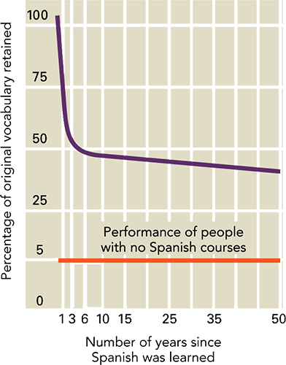
Storage: Explicit LTM
Declarative Memory
conscious recollection of specific facts and events that can be verbally communicated
Bahrick (1984) – Recall College Spanish
initial learning is important
permastore content
effect of distributed practice

Slide 29
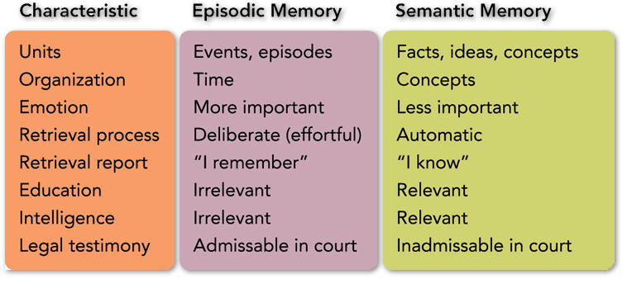
Storage: Explicit LTM
Subtypes of Explicit Memory
Episodic
autobiographical memories
Semantic
knowledge about the world

Slide 30
Storage: Implicit LTM
Nondeclarative Memory
affected by a past experience
without consciously recalling it
Procedural Memory
Classical Conditioning
Priming

Slide 31
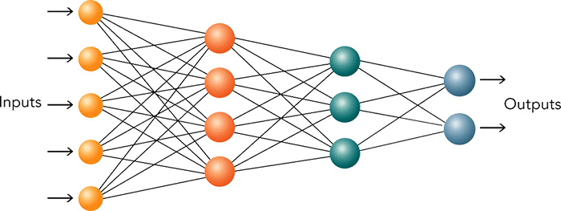
Memory: Organization
Schemas
scripts (event schema)
Connectionist Networks
parallel distributed processing (PDP)
Notes:
We stopped here!

Slide 32
Memory: Location
Storage is Diffuse
Circuits of Neurons
Neurotransmitter Involvement
Long-Term Potentiation

Slide 33
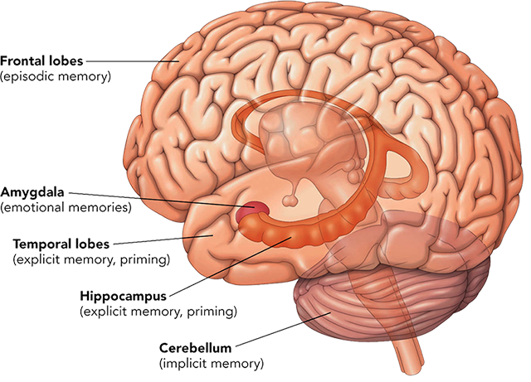
Memory: Brain Structures
Explicit Memory
hippocampus, frontal lobes, amygdala
Implicit Memory
hippocampus, temporal lobes, cerebellum

Slide 34
Serial Position Effect
…tendency to recall items
at beginning and end of a list
more readily than those in middle
When memorizing a list of items, which items are easier?
Items early in the list or later in the list?
Primacy effect
Recency effect

Slide 35
Serial Position Effect
Performance
x
Primacy Effect
Recency Effect
x
Double
Whammy
x
x
x
x
x
Recent items still in working memory
>> Decreasing space for rehearsal in working memory
1st 2nd 3rd 4th . . . Next Last Last
Serial Position of Item within List

Slide 36
Retrieval: Tasks and Cues
Types of Tasks
recall
recognition
Encoding Specificity
information present at encoding effective as retrieval cue
context-dependent memory

Slide 37
Retrieval: Special Cases
Autobiographical Memories
life time periods
reminiscence bump
general events
event-specific information
Emotional Memories
flashbulb memories
traumatic events
repressed memories: motivated forgetting
first forgotten and later recovered
Freudian defense mechanism
https://www.youtube.com/watch?v=2QtEZYJRq7s

Slide 38
False Memory Recovery?
Childhood Sexual Abuse, Other Events
Recovered or Created Memories?
Abuse is under-acknowledged.
Most victims accurately remember at least a part.
Loss of memory for abuse is possible.
False reconstruction of memory is possible.
Difficult to separate accurate and inaccurate memories
Adults Tend to Believe Children’s False Denials.
Notes:
Activity/Demonstration: You have the opportunity to stage an “event” in the classroom and subsequently ask students to describe and/or identify your accomplice.

Slide 39
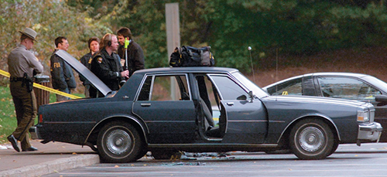
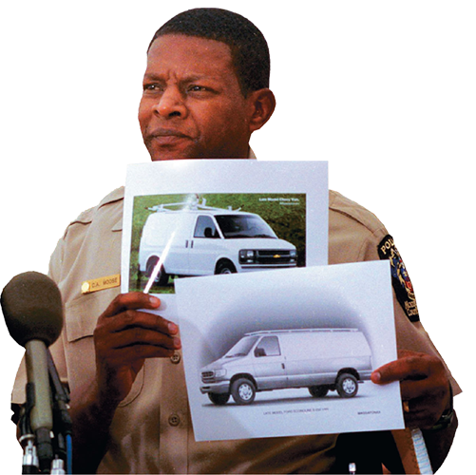
Eyewitness Testimony
Distortion
Bias
Inaccuracy

Slide 40
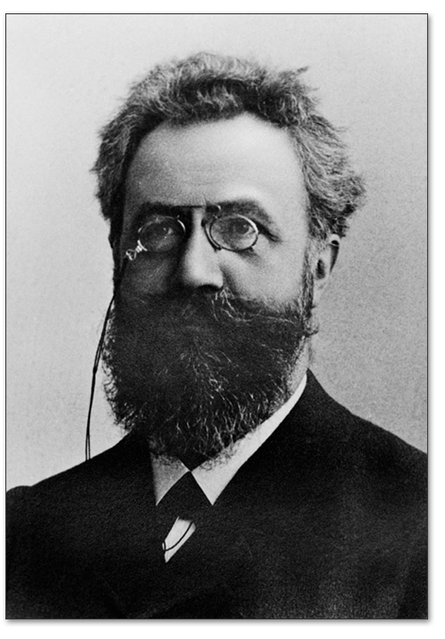
Forgetting: Memory Failure
Ebbinghaus
encoding failure
retrieval failure/interference theory
proactive interference
retroactive interference

Slide 41
Proactive v. Retroactive Interference
Proactive
Interfering material learned before target material is.
“I can’t take in any more new information”
Retroactive
Interfering material learned after target material is.
“Too much has happened since I studied it”
Material to be learned Material to be recalled
proactively
OLD NEW TEST
Psychology Sociology
retroactively
Psychology
Sociology

Slide 42
Forgetting: Memory Failure
Decay Theory
passage of time → forgetting
does not explain all instances of forgetting
Tip-of-the-Tongue Phenomenon
effortful retrieval of known information
can retrieve some but not all information

Slide 43
Forgetting: Memory Failure
Prospective Memory
remembering to do something in the future
content: remembering what to do
timing: remembering when to do it
absentmindedness
Amnesia
anterograde amnesia
inability to store new information and events
retrograde amnesia
inability to retrieve past information and events

Slide 44
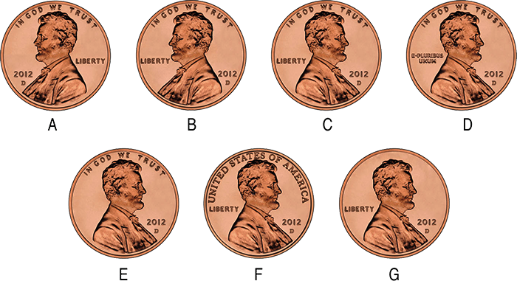
Retrieval Failure
Notes:
Note: Each penny has a different design. Only one is correct. Your students have seen the correct design many times, and probably have even carefully examined a penny once in a while. Almost no one can recall which penny is correct. This is an example of retrieval failure.
Actual penny is C

Slide 45
Study Tips - Encoding
Give Undivided Attention
Process Deeply
Make Associations
Use Imagery
Use Chunking
Encode Early and Often
Notes:
Note: Many of these tips may seem obvious, but it is commonplace for students to dismiss and ignore these tips, believing they [the students] are different, or perhaps that the benefit isn’t worth the effort.

Slide 46
Study Tips - Rehearse
Redo notes.
Talk to others.
Test yourself.
Ask yourself questions.
Rest and eat well.

Slide 47
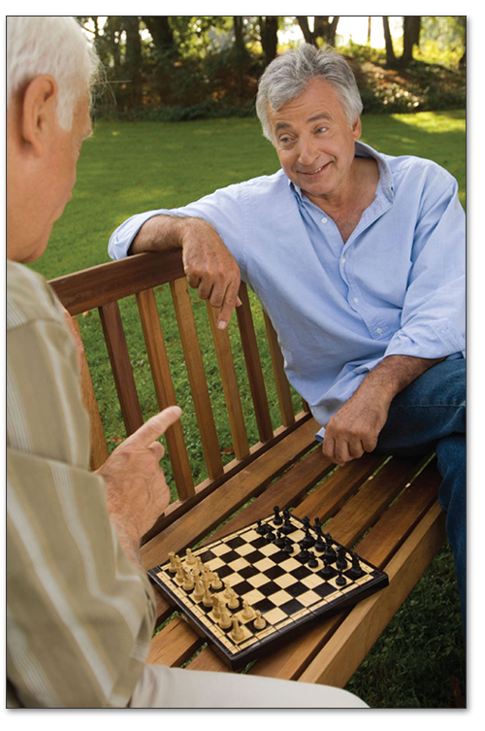
Health and Wellness
Roles of Autobiographical Memories
Learn from our experience
Develop sense of identity
Bond with others
Memory and Aging
Indicator of brain functioning
Activity inoculates against mental decline
Both physical and mental activity are important

Slide 48
Chapter Review
Identify the process of memory.
Explain how memories are encoded.
Discuss how memories are stored.
Summarize how memories are retrieved.
Describe how the failure of encoding and retrieval are involved in forgetting.
Evaluate study strategies based on an understanding of memory.
Identify the multiple functions of memory in human life.
Notes:
Note: Instructors may use the learning objectives presented on this slide to review the chapter material.
http://visual.pearsoncmg.com/mypsychlab/index.php?clipId=46

