Slide 1
Copyright © 2014 McGraw-Hill Education. All rights reserved. No reproduction or distribution without the prior written consent of McGraw-Hill Education.

Slide 2
Chapter Preview
Exploring Development
Child Development
Adolescence
Adulthood and Aging
Health and Wellness
Notes:
Chapter 9 example 2

Slide 3
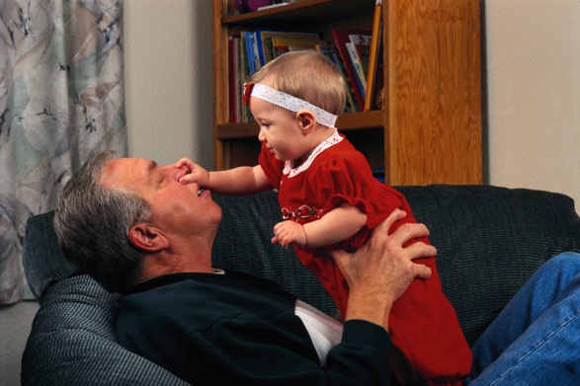
Development
The pattern of continuity and change in human capabilities that occurs throughout life.
Growth
Decline
Copyright © 2014 McGraw-Hill Education. All rights reserved. No reproduction or distribution without the prior written consent of McGraw-Hill Education.
9-3

Slide 4
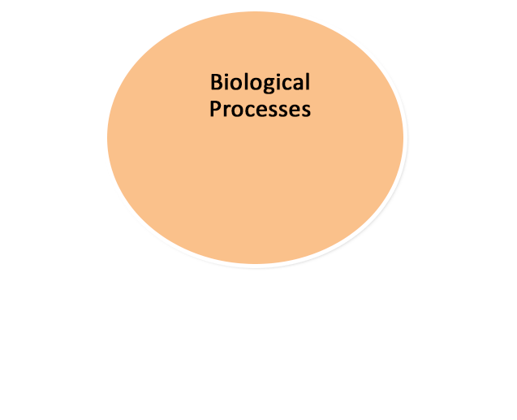
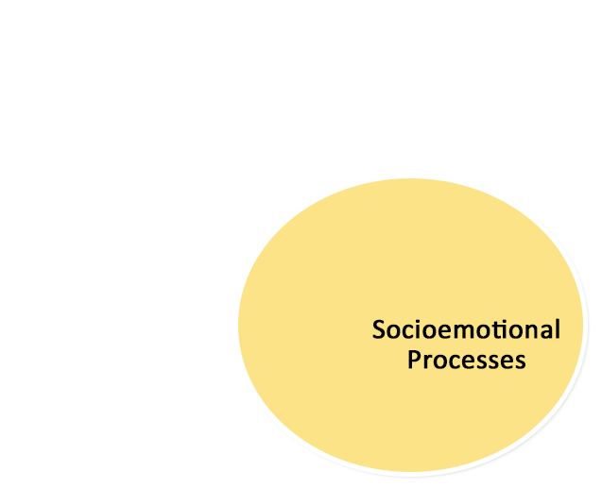
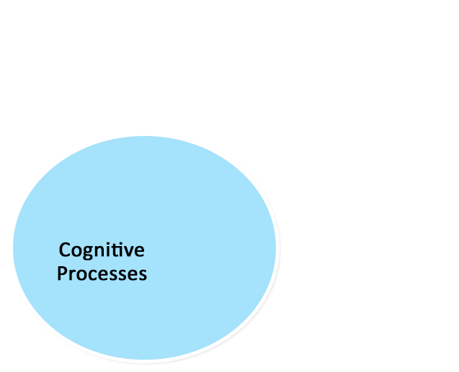
Development
Copyright © 2014 McGraw-Hill Education. All rights reserved. No reproduction or distribution without the prior written consent of McGraw-Hill Education.
9-4
Notes:
Note: Instructors should indicate that each developmental period that will be covered marks important physical, cognitive, and socioemotional changes, and that all are “intricately interwoven.”

Slide 5
Research Methods in Developmental Psychology
Age-Related Differences
cross-sectional studies
cohort effects
longitudinal studies
Copyright © 2014 McGraw-Hill Education. All rights reserved. No reproduction or distribution without the prior written consent of McGraw-Hill Education.
9-5
Notes:
5

Slide 6
Nature and Nurture
Nature
biological inheritance
Nurture
environmental experiences
Self
individuals take active roles in own development
Copyright © 2014 McGraw-Hill Education. All rights reserved. No reproduction or distribution without the prior written consent of McGraw-Hill Education.
9-6

Slide 7
Resilient Children
Which has a greater impact:
early or later experience?
Resilience
a person’s ability to recover from or adapt to difficult times
Resilient children become capable adults.
Copyright © 2014 McGraw-Hill Education. All rights reserved. No reproduction or distribution without the prior written consent of McGraw-Hill Education.
9-7

Slide 8
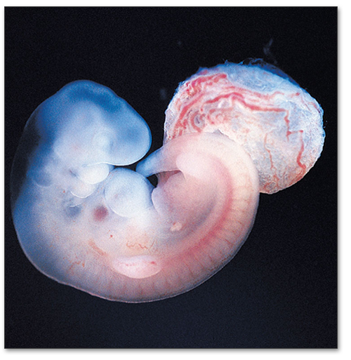
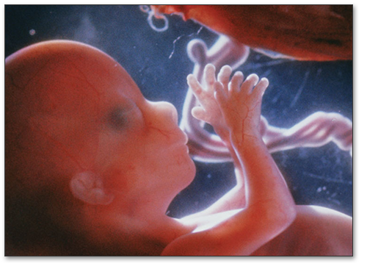
Prenatal Development
Germinal Period (Weeks 1-2)
conception
fertilization
zygote
Embryonic Period (Weeks 3-8)
differentiation of tissue
organ formation
Fetal Period (Months 2-9)
development of functionality
Copyright © 2014 McGraw-Hill Education. All rights reserved. No reproduction or distribution without the prior written consent of McGraw-Hill Education.
9-8

Slide 9
Prenatal Development
Teratogens are agents that cause birth defects
nicotine
alcohol
STIs
Effects of teratogens depend on…
timing of exposure
genetic characteristics
postnatal environment
Copyright © 2014 McGraw-Hill Education. All rights reserved. No reproduction or distribution without the prior written consent of McGraw-Hill Education.
9-9

Slide 10
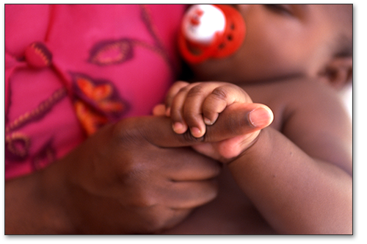
Physical Development
Reflexes are genetically wired behaviors.
Some are crucial for survival.
persist throughout life
coughing, blinking, yawning
disappear with neurological development
grasping, rooting, moro
Copyright © 2014 McGraw-Hill Education. All rights reserved. No reproduction or distribution without the prior written consent of McGraw-Hill Education.
9-10
Notes:
Note: Many infant reflexes have no known natural utility and are often referred to as “useless” reflexes, e.g., Babinsky, Moro. Physicians do use them, however, for diagnosis of neurological pathology.

Slide 11
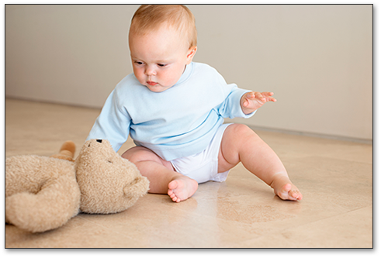
Perceptual and Motor Development
Motor Skills
locomotion
reach & grasp
Preferential Looking
give “choice” and measure preferences
Copyright © 2014 McGraw-Hill Education. All rights reserved. No reproduction or distribution without the prior written consent of McGraw-Hill Education.
9-11

Slide 12
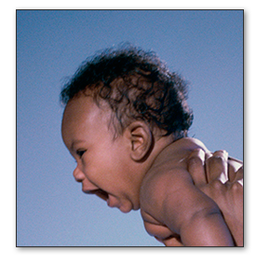
Brain Development
Myelination continues after birth.
Synaptic connections increase dramatically.
Brain mass increases dramatically.
Copyright © 2014 McGraw-Hill Education. All rights reserved. No reproduction or distribution without the prior written consent of McGraw-Hill Education.
9-12
Notes:
Note: Through age 2, synaptic connections are massively over-produced. After that age, gradual synaptic pruning brings the number of synapses down to the adult level. It is presumed that genetically programmed over-production coupled with experientially directed pruning allows the brain to develop a vast neural network precisely tuned to the environment the individual is raised in.

Slide 13
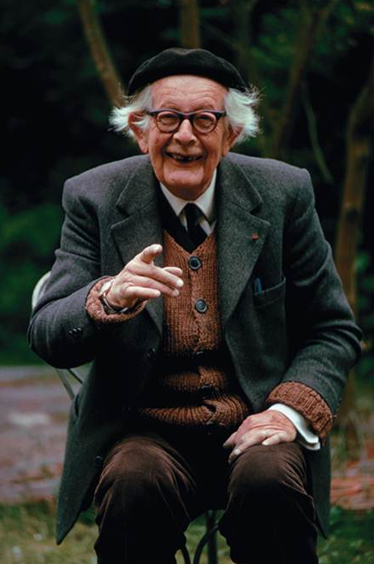
Cognitive Development
Jean Piaget (1896-1980)
Children actively construct their cognitive world using:
Schemas
concepts or frameworks that organize information
Assimilation
incorporate new info into existing schemas
Accommodation
adjust schemas to new information
Copyright © 2014 McGraw-Hill Education. All rights reserved. No reproduction or distribution without the prior written consent of McGraw-Hill Education.
9-13

Slide 14
Piaget’s Theory
Sensorimotor Stage (birth - 2 years)
coordinate sensations with movements
object permanence
progress from reflexive action to symbolic thought
Preoperational Stage (2 - 7 years)
symbolic thinking: words & images
intuitive reasoning
egocentrism
Copyright © 2014 McGraw-Hill Education. All rights reserved. No reproduction or distribution without the prior written consent of McGraw-Hill Education.
9-14

Slide 15
Piaget’s Theory
Concrete Operational Stage (7 – 11 yrs)
operational thinking (e.g., conservation)
classification skills
reason logically in concrete contexts
Formal Operational Stage (11-15 yrs)
lasts through adulthood
abstract and idealistic thought
hypothetical-deductive reasoning
Copyright © 2014 McGraw-Hill Education. All rights reserved. No reproduction or distribution without the prior written consent of McGraw-Hill Education.
9-15

Slide 16
Evaluating Piaget’s Theory
Underestimated Infant Object Permanence
(as well as other child abilities)
Overestimated Adolescent/Adult Hypothetical-Deductive thought
Culture and education also influence development.
Copyright © 2014 McGraw-Hill Education. All rights reserved. No reproduction or distribution without the prior written consent of McGraw-Hill Education.
9-16

Slide 17
Other Theories of Intellectual Development
Baillargeon and Nativist Approach
Vygotsy’s Sociocultural Cognitive Theory
child as apprentice to expert adults
Information-Processing Theory
memory
executive function
Copyright © 2014 McGraw-Hill Education. All rights reserved. No reproduction or distribution without the prior written consent of McGraw-Hill Education.
9-17

Slide 18
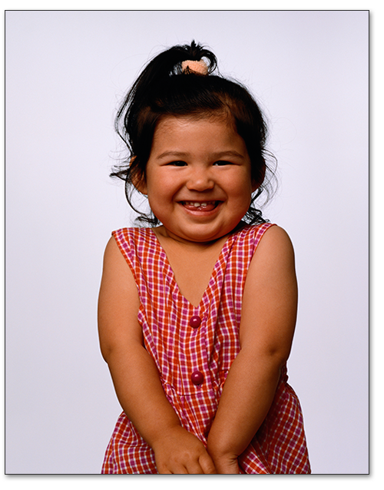
Temperament
an individual’s behavioral style or characteristic way of responding
Three Clusters of Temperament
Easy Difficult Slow-to-Warm-up
Other Perspectives on Temperament
Effortful Control / Self-Regulation Inhibition Negative Affectivity
Copyright © 2014 McGraw-Hill Education. All rights reserved. No reproduction or distribution without the prior written consent of McGraw-Hill Education.
9-18

Slide 19
Infant Attachment
the close emotional bond between an infant and its caregiver
may provide important foundation for subsequent development
Copyright © 2014 McGraw-Hill Education. All rights reserved. No reproduction or distribution without the prior written consent of McGraw-Hill Education.
9-19

Slide 20
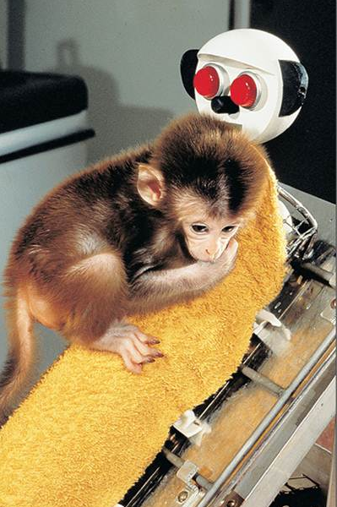
Infant Attachment
Harlow Study
infant rhesus monkeys
Is it nourishment or contact that matters?
chose between two surrogate “mothers”
wire mother with food versus cloth mother
Infants preferred cloth mother across situations.
Contact comfort is critical to attachment.
Copyright © 2014 McGraw-Hill Education. All rights reserved. No reproduction or distribution without the prior written consent of McGraw-Hill Education.
9-20
Notes:
Suggestion: Instructor might point out that this study was conducted at a time where science generally viewed attachment as a behavior that exists essentially because of reinforcement from being fed by caregivers.

Slide 21
Infant Attachment
John Bowlby
Infant attachment lays foundation for all future relationships.
Mary Ainsworth – Strange Situation Test
Caregivers leave infant alone with stranger, then return.
Secure attachment or insecure attachment?
Copyright © 2014 McGraw-Hill Education. All rights reserved. No reproduction or distribution without the prior written consent of McGraw-Hill Education.
9-21

Slide 22
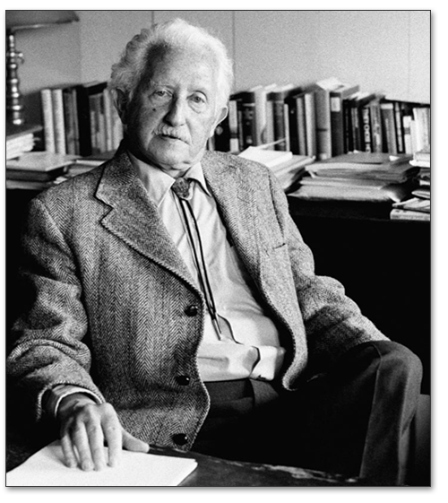
Socioemotional Development
Erik Erikson (1902-1994)
Theory emphasizes lifelong development.
Eight psychosocial stages of development
Each stage represents a developmental task.
crisis that must be resolved
personal competence or weakness
Copyright © 2014 McGraw-Hill Education. All rights reserved. No reproduction or distribution without the prior written consent of McGraw-Hill Education.
9-22

Slide 23
Erikson’s Theory
First Four Stages: Childhood
trust versus mistrust
basic needs met by sensitive caregivers
autonomy versus shame and doubt
discover and assert will of their own
Copyright © 2014 McGraw-Hill Education. All rights reserved. No reproduction or distribution without the prior written consent of McGraw-Hill Education.
9-23

Slide 24
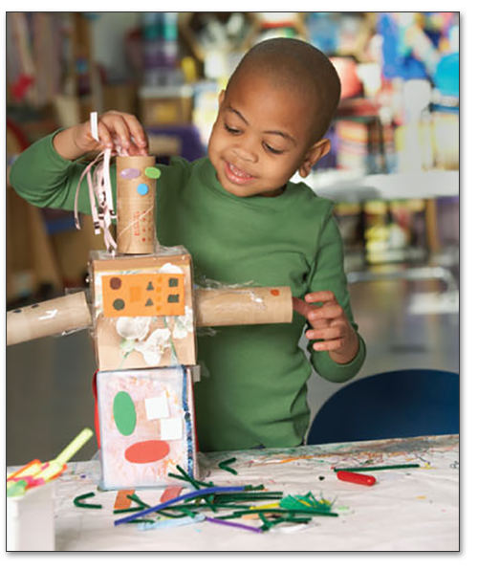
Erikson’s Theory
First Four Stages: Childhood
initiative versus guilt
challenged to assume responsibility
industry versus inferiority
mastering knowledge & intellectual skills
Copyright © 2014 McGraw-Hill Education. All rights reserved. No reproduction or distribution without the prior written consent of McGraw-Hill Education.
9-24
Notes:
Discussion: Ask class whether they recall starting into elementary school as a pleasant or unpleasant experience, and why. Tie in to challenges Erikson sees in this stage transition

Slide 25
Evaluating Erikson’s Theory
Primary focus on case-study research
Omitted important developmental tasks
Copyright © 2014 McGraw-Hill Education. All rights reserved. No reproduction or distribution without the prior written consent of McGraw-Hill Education.
9-25

Slide 26
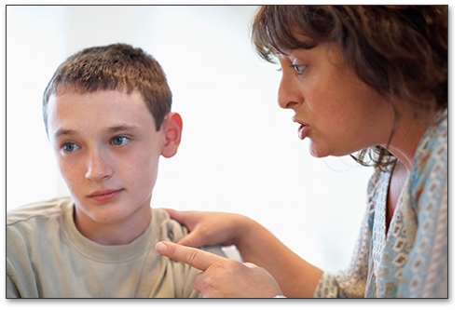
Baumrind’s Parenting Styles
Authoritarian
parents are controlling and punitive
correlated with child’s lack of initiative, poor communication skills, social incompetence
Authoritative
parents encourage independence with limits
correlated with child’s social competence, social responsibility, and self-reliance
Copyright © 2014 McGraw-Hill Education. All rights reserved. No reproduction or distribution without the prior written consent of McGraw-Hill Education.
9-26
Notes:
Suggestion: The instructor could take this opportunity to revisit the correlation-is-not-causation principle.
Discussion: The instructor could ask students to classify their own parents.

Slide 27
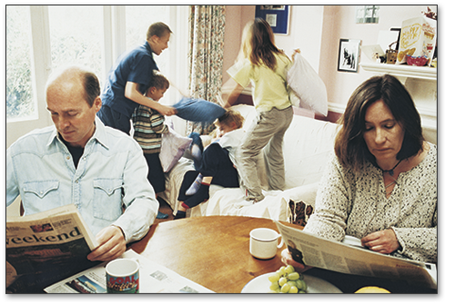
Baumrind’s Parenting Styles
Neglectful
parents generally uninvolved
correlated with less social competence and poor self-control in child
Permissive
parents are involved, but place few limits
correlated with child’s poor social competence, lack of respect for others, poor self-control
Copyright © 2014 McGraw-Hill Education. All rights reserved. No reproduction or distribution without the prior written consent of McGraw-Hill Education.
9-27

Slide 28
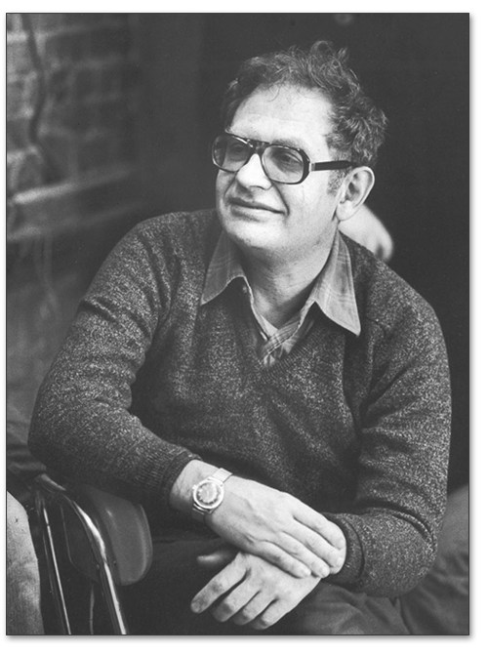
Moral Development
Kohlberg (1927-1987)
presented moral dilemmas and analyzed responses
Preconventional
behavior guided by punishments and rewards
Conventional
standards learned from parents and society
Postconventional
contracts, rights and abstract principles
Copyright © 2014 McGraw-Hill Education. All rights reserved. No reproduction or distribution without the prior written consent of McGraw-Hill Education.
9-28
Notes:
Suggestion: Have class work through one of Kohlberg’s moral dilemmas.
Note: Because Kohlberg’s theory parallels Piaget’s theory of cognitive development, it may be helpful to point out the similarities / overlap.
Note: Instructors should point out that as moral development proceeds, morality shifts from being externally controlled to internally controlled

Slide 29
Evaluating Kohlberg’s Theory
Moral Reasoning ≠ Moral Behavior
what we say and do are not always consistent.
Misses Gender-Related Reasoning Styles
justice perspective (men) < Kohlberg
care perspective (women) < Gilligan
Copyright © 2014 McGraw-Hill Education. All rights reserved. No reproduction or distribution without the prior written consent of McGraw-Hill Education.
9-29

Slide 30
Current Research on Moral Development
Prosocial Behavior
correlated with supportive parenting
correlated with self-control
Conscience Formation
forms by age 3 and carries over into adulthood
parent-child interactions
clear, elaborate, rich with emotional content
shared positive emotion
Copyright © 2014 McGraw-Hill Education. All rights reserved. No reproduction or distribution without the prior written consent of McGraw-Hill Education.
9-30

Slide 31
Moral Development
Parenting Strategies Associated with Morality in Children:
warm and supportive rather than harsh
reasoning with child when disciplining
help child learn to take others’ perspective
involve child in decision making
model moral behavior and thinking
Copyright © 2014 McGraw-Hill Education. All rights reserved. No reproduction or distribution without the prior written consent of McGraw-Hill Education.
9-31

Slide 32
Understanding Adolescence
Transition from Childhood to Adulthood
starts age 10-12
ends age 18-21
Copyright © 2014 McGraw-Hill Education. All rights reserved. No reproduction or distribution without the prior written consent of McGraw-Hill Education.
9-32
Notes:
Suggestion: Forewarn students of the amendment of these age norms in the up-coming discussion of extended adolescence

Slide 33
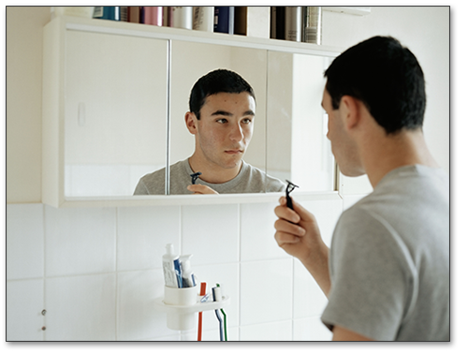
Adolescent Physical Development
Puberty
rapid skeletal and sexual maturation
puberty begins at beginning of adolescence
Testosterone (androgen) — boys
genital development, height, voice changes
Estrodiol (estrogen) — girls
breast, uterine, and skeletal development
Copyright © 2014 McGraw-Hill Education. All rights reserved. No reproduction or distribution without the prior written consent of McGraw-Hill Education.
9-33

Slide 34
Adolescent Brain Development
Early
amygdala
emotions
Late
prefrontal cortex
reasoning and decision making
risk taking
Copyright © 2014 McGraw-Hill Education. All rights reserved. No reproduction or distribution without the prior written consent of McGraw-Hill Education.
9-34

Slide 35
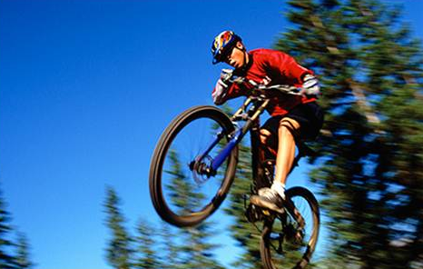
Cognitive Development
Piaget’s Formal Operational Stage
Adolescent Egocentrism
the belief that others are as preoccupied with the adolescent as he or she is
sense of uniqueness
sense of invincibility →
risky behaviors
Copyright © 2014 McGraw-Hill Education. All rights reserved. No reproduction or distribution without the prior written consent of McGraw-Hill Education.
9-35
Notes:
Note: It is important to point out that not everyone engages in formal operational thought. Some remain at Piaget’s concrete operational stage.

Slide 36
Socioemotional Development
Erikson: Psychosocial Development
Identity versus Identity Confusion
Marcia’s Four Identity Statuses
Identity Diffusion: no exploration or commitment
Identity Foreclosure: commitment without exploration
Identity Moratorium: exploration without commitment
Identity Achievement: commitment after exploration
Copyright © 2014 McGraw-Hill Education. All rights reserved. No reproduction or distribution without the prior written consent of McGraw-Hill Education.
9-36
Notes:
Note: Erikson held that healthy development requires distancing from and challenging of parental values. He repudiated his own father (Waldemar Salomonsen) and changed his last name, naming himself after himself.

Slide 37
Socioemotional Development
Ethnic Identity
attachment to ones minority group
attachment to larger culture
biculturalism
Influence of Parents and Peers
parent as manager/counselor/monitor
balance involvement and allowing to explore
peer relations peak in importance
Copyright © 2014 McGraw-Hill Education. All rights reserved. No reproduction or distribution without the prior written consent of McGraw-Hill Education.
9-37
Notes:
37

Slide 38
Adult Development and Aging
Emerging Adulthood
extended adolescence
five key features
identity exploration
instability
self-focus
feeling “in between”
age of possibilities
Copyright © 2014 McGraw-Hill Education. All rights reserved. No reproduction or distribution without the prior written consent of McGraw-Hill Education.
9-38
Notes:
Discussion: What are the defining characteristics of “adulthood”? Students are likely to mention independence (self-sufficiency, transitioning from school to career) and being depended on (starting one’s own family). Help them see how prolonged schooling in college paid for by parents tends to undermine these criteria when applied to legal adults of age 18.

Slide 39
Physical Changes in Adulthood
Early Adulthood
peak of physical development
Middle Adulthood
most lose height, many gain weight
menopause for women (late 40s or early 50s)
Late Adulthood
accumulated wear and tear
less ability to repair and regenerate
Copyright © 2014 McGraw-Hill Education. All rights reserved. No reproduction or distribution without the prior written consent of McGraw-Hill Education.
9-39
Notes:
Discussion: What is the ideal age to be? Why? Tie student responses to lecture material.

Slide 40
Biological Theories of Aging
Cellular-Clock Theory
maximum # of cell divisions possible
predicts human life span of about 120 years
shortening telomeres
Free-Radical Theory
cause DNA and cell damage
Hormonal Stress Theory
stress hormones linger longer
Copyright © 2014 McGraw-Hill Education. All rights reserved. No reproduction or distribution without the prior written consent of McGraw-Hill Education.
9-40

Slide 41
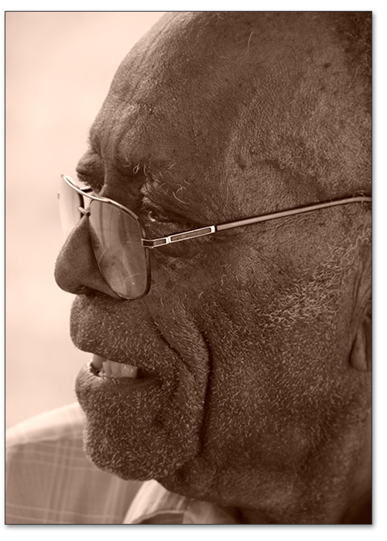
The Aging Brain
Some new brain cells grow in hippocampus and olfactory bulb.
Surviving/healthy neurons take up slack for their deceased/disabled neighbors.
Reduced lateralization of brain function: both hemispheres are used more equally.
Copyright © 2014 McGraw-Hill Education. All rights reserved. No reproduction or distribution without the prior written consent of McGraw-Hill Education.
9-41
Notes:
Note: While the discovery that brain cells continue to multiply on into late adulthood astounded scientists who had previously agreed that neurogenisis ended during childhood and in fact mostly was completed before birth, the astonishment has led to a tendency to exaggerate the significance of the finding. The old view was not all that far off the mark. The evidence strongly suggests, for most (almost all) of the brain, if neurons die, they are not replaced by fresh neurons. Instead, existing/neighboring neurons that have been around since birth do their best to take over the function of the deceased neurons. Nonetheless, whether medical science can artificially change all that is another matter altogether.

Slide 42
Cognitive Development
Early Adulthood
Idealism gives way to realistic pragmatism.
reflection on worldview
Middle Adulthood
Memory peeks.
Numerical ability declines.
Copyright © 2014 McGraw-Hill Education. All rights reserved. No reproduction or distribution without the prior written consent of McGraw-Hill Education.
9-42

Slide 43
Cognitive Development
Late Adulthood
speed of processing generally declines
memory retrieval skills decline
wisdom increases in some individuals
strategy training and physical activity can improve cognitive function
Copyright © 2014 McGraw-Hill Education. All rights reserved. No reproduction or distribution without the prior written consent of McGraw-Hill Education.
9-43

Slide 44
Socioemotional Development
Erikson’s Theory
Last Four Stages
Identity versus Identity Confusion
Who am I & where am I going?
Intimacy versus Isolation
Individuals form intimate relationships with others.
Copyright © 2014 McGraw-Hill Education. All rights reserved. No reproduction or distribution without the prior written consent of McGraw-Hill Education.
9-44

Slide 45
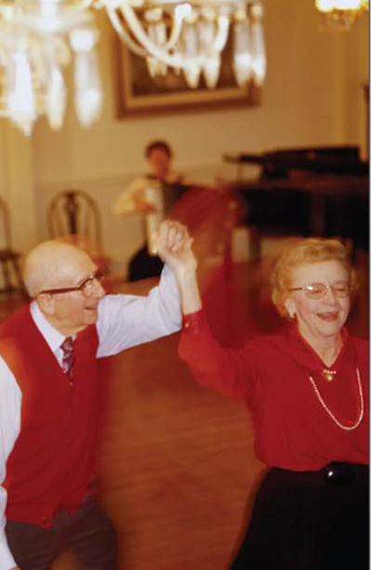
Socioemotional Development
Erikson’s Theory
Last Four Stages
Generativity versus Stagnation
legacy: assist younger generation
Integrity versus Despair
What have I done with my life?
Copyright © 2014 McGraw-Hill Education. All rights reserved. No reproduction or distribution without the prior written consent of McGraw-Hill Education.
9-45

Slide 46
Marriage
Erikson’s Stage 6: Intimacy versus Isolation
Women and men are marrying later
Principles for successful marriages
nurturing fondness and admiration
turning toward each other as friends
giving up some power
solving conflicts together
Copyright © 2014 McGraw-Hill Education. All rights reserved. No reproduction or distribution without the prior written consent of McGraw-Hill Education.
9-46

Slide 47
Parenting
Erikson’s Stage 7: Generativity versus Stagnation
wellness through contribution to next generation
contribution through rearing children
Critical Controversy: Is parenthood associated with happiness?
Copyright © 2014 McGraw-Hill Education. All rights reserved. No reproduction or distribution without the prior written consent of McGraw-Hill Education.
9-47
Notes:
47

Slide 48
Winding Down
Erikson’s Stage 8: Integrity versus Despair
wellness through reminiscence
seeking meaning through life review
confronting own pending death
importance of meaning: past and present!
more selective about social network
Copyright © 2014 McGraw-Hill Education. All rights reserved. No reproduction or distribution without the prior written consent of McGraw-Hill Education.
9-48
Notes:
48

Slide 49
Health and Wellness
Coping with life’s difficulties
assimilation and accommodation (Piaget)
Copyright © 2014 McGraw-Hill Education. All rights reserved. No reproduction or distribution without the prior written consent of McGraw-Hill Education.
9-49

Slide 50
Chapter Review
Explain how psychologists think about development.
Describe children’s development from prenatal stages to adolescence.
Discuss adult development and the positive dimensions of aging.
Discuss important factors in successful adult psychological development.
Copyright © 2014 McGraw-Hill Education. All rights reserved. No reproduction or distribution without the prior written consent of McGraw-Hill Education.
9-50
Notes:
Note: Instructors may use the learning objectives presented on this slide to review the chapter material.

