Slide 2
Objectives Overview
Differentiate among laptops, tablets, and servers
Describe the purpose and uses of smartphones, digital cameras, portable media players, e-book readers, and game devices
Describe the relationship between data and information
Briefly explain various input options
Differentiate the Internet from the web, and describe the relationship among the web, webpages, websites, and web servers
Explain the purpose of a browser, a search engine, and an online social network
See Page 2
for Detailed Objectives

Slide 3
Objectives Overview
Briefly describe digital security risks associated with viruses and other malware, privacy, your health, and the environment
Differentiate between an operating system and applications
Differentiate between wired and wireless technologies, and identify reasons individuals and businesses use networks
Discuss how society uses technology in education, retail, finance, entertainment, health care, travel, government, science, publishing, and manufacturing
Identify technology used by home users, small office/home office users, mobile users, power users, and enterprise users
See Page 2
for Detailed Objectives

Slide 4
Class Discussion
What is the role of technology in your life?
Where do you use it?
Merits of computer use in school
https://www.youtube.com/watch?v=7o35ruCZ6S4

Slide 5
A World of Technology
Because technology changes, you must keep up with the changes to remain digitally literate
Digital literacy involves having a current knowledge and understanding of computers, mobile devices, the Internet, and related technologies
Pages 2 - 3
Figure 1-1

Slide 6
Computers
A computer is an electronic device, operating under the control of instructions stored in its own memory
Accepts data (input)
Processing
Produces information (output)
Page 4

Slide 7
Question?
What is hardware?
What is software?
What is a server?
https://www.youtube.com/watch?v=2n4rCztECT8

Slide 8
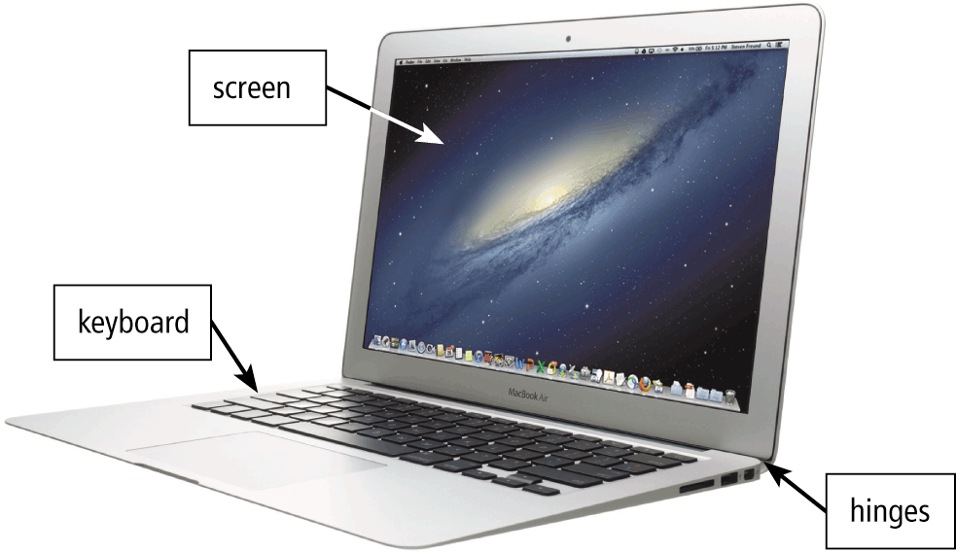
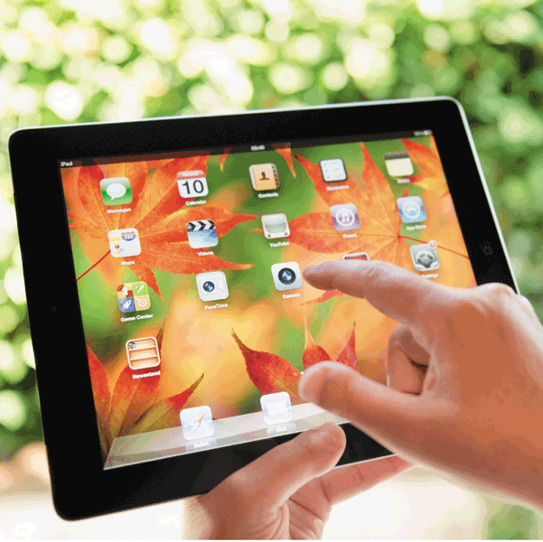
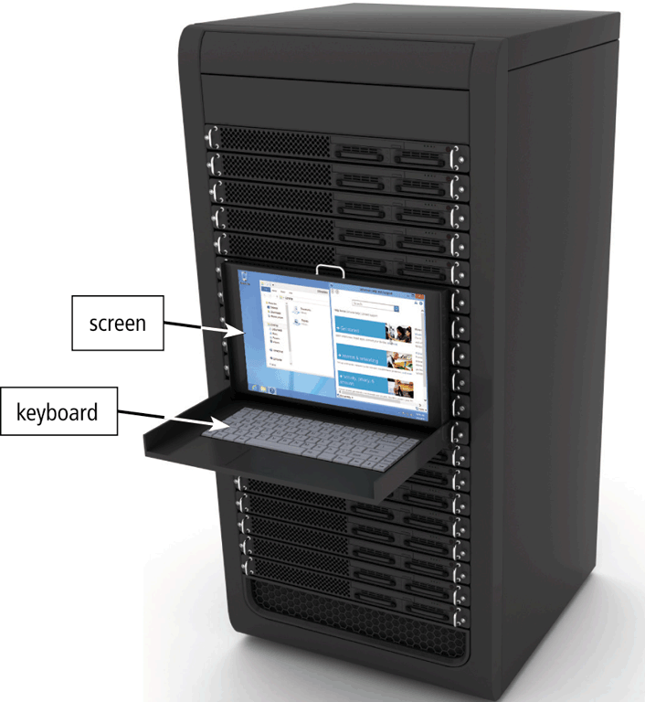
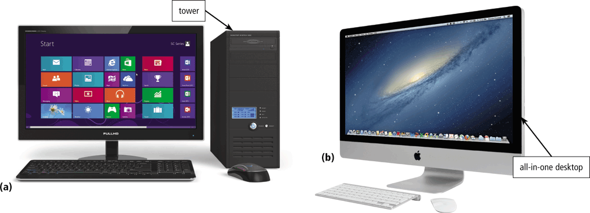
Computers
describe personal computers with which you are familiar. What factors influence the choice of a personal computer?
Pages 4 and 6
Figures 1-2 – 1-5

Slide 9
Mobile and Game Devices
Smartphone
Digital camera
Portable media player
E-book reader
Game console
Pages 7 - 9
Figures 1-6 – 1-10

Slide 10
Data and Information
Data vs Information
https://www.youtube.com/watch?v=KdWLZDHMW0w
Examples?
Page 11
Figure 1-11

Slide 11
Data and Information
Page 11
Figure 1-11

Slide 12
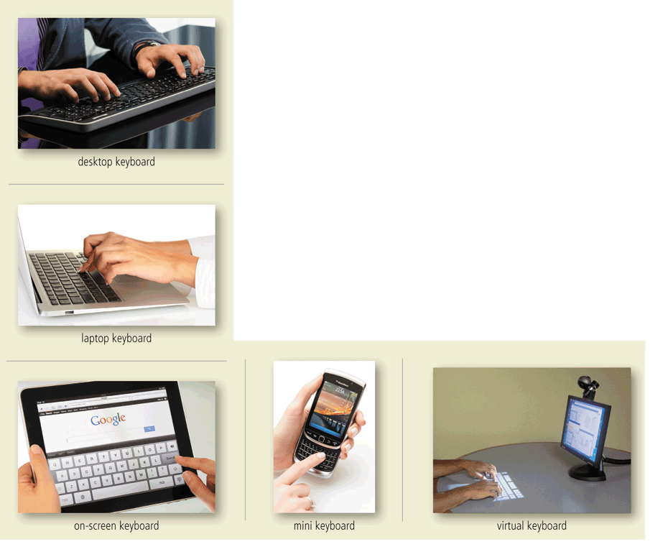
Data and Information
A keyboard contains keys you press to enter data and instructions into a computer or mobile device
Page 12
Figure 1-12

Slide 13
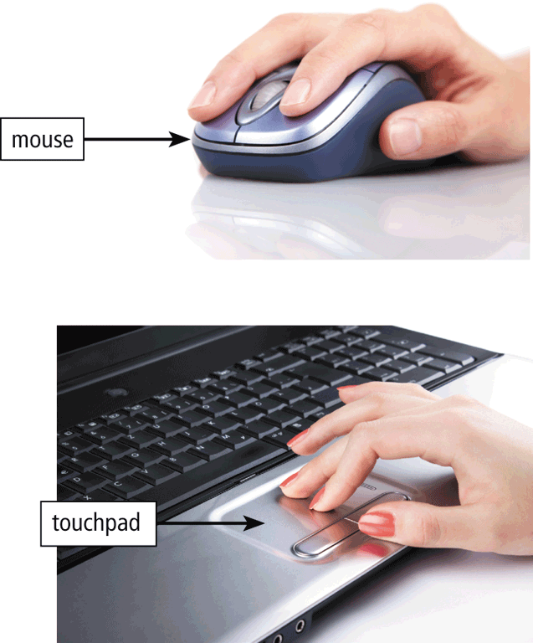
Data and Information
A pointing device is an input device that allows a user to control a small symbol on the screen called a pointer
What is video or voice input?
Pages 12 – 13
Figure 1-14

Slide 14
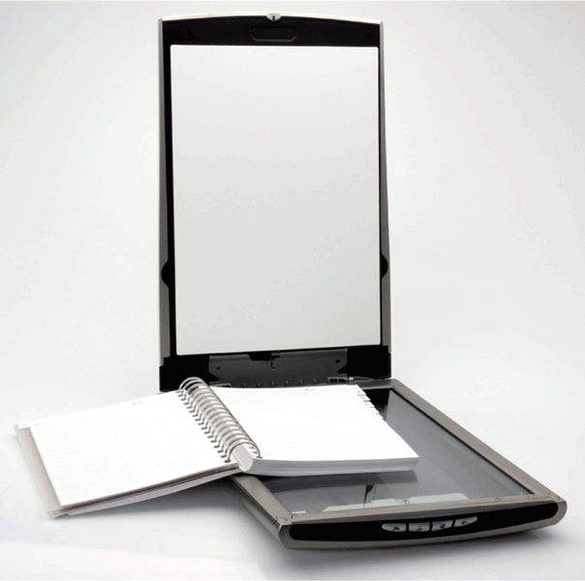
Data and Information
A scanner is a light-sensing input device that converts printed text and images into a form the computer can process
Page 13
Figure 1-15

Slide 15
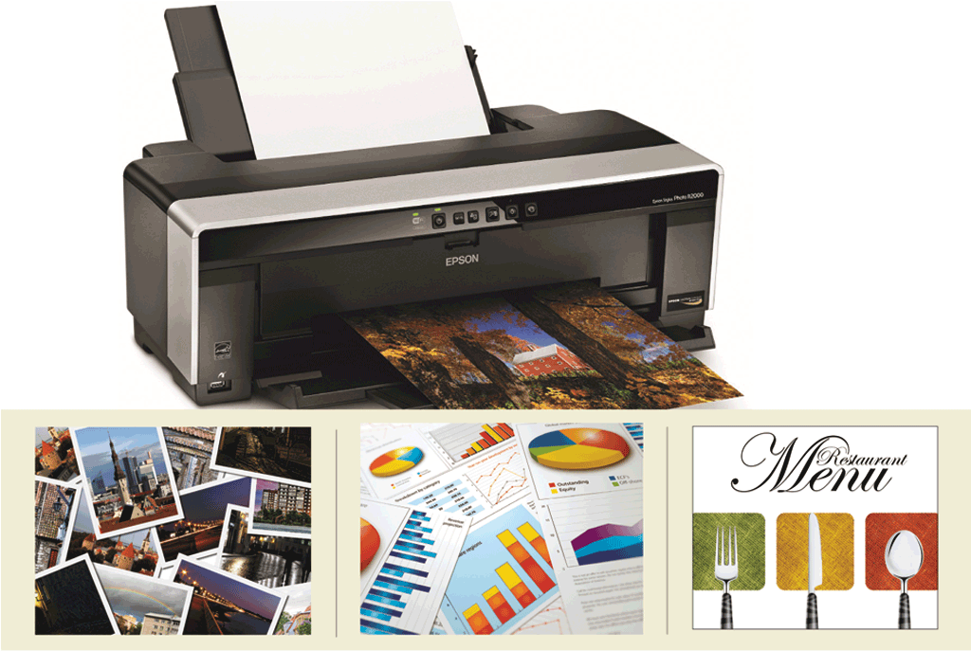
Data and Information
An output device is any hardware component that conveys information from a computer or mobile device to one or more people
A printer is an output device that produces text and graphics on a physical medium such as paper
Page 14
Figure 1-16

Slide 16
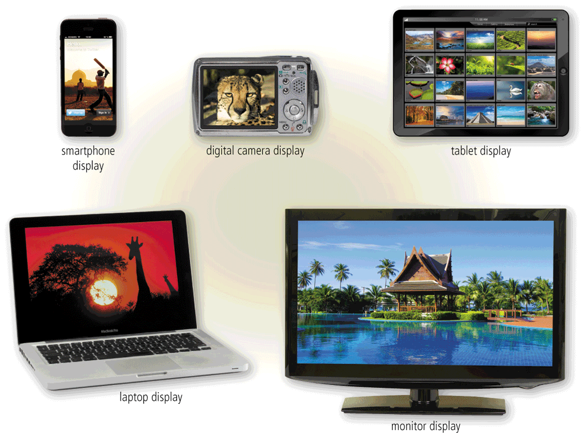
Data and Information
A display is an output device that visually conveys text, graphics, and video information
Page 14
Figure 1-17

Slide 17
Data and Information
Speakers allow you to hear audio such as music, voice, and other sounds
Earbuds
Headphones
Page 15
Figure 1-18

Slide 18
Data and Information
https://www.youtube.com/watch?v=tY1HM2JMnfE
Memory consists of electronic components that store instructions waiting to be executed and the data needed by those instructions
A computer keeps data, instructions, and information on a storage media
A storage device records (writes) and/or retrieves (reads) items to and from storage media
Page 15

Slide 19
Data and Information
Hard Disk
Solid-State Drive
USB Flash Drive
Memory Card
Optical Disc
Cloud Storage
Pages 15 – 17
Figures 1-19 – 1-24

Slide 20
Cloud Storage
https://www.youtube.com/watch?v=COFHR5L-yCk

Slide 21
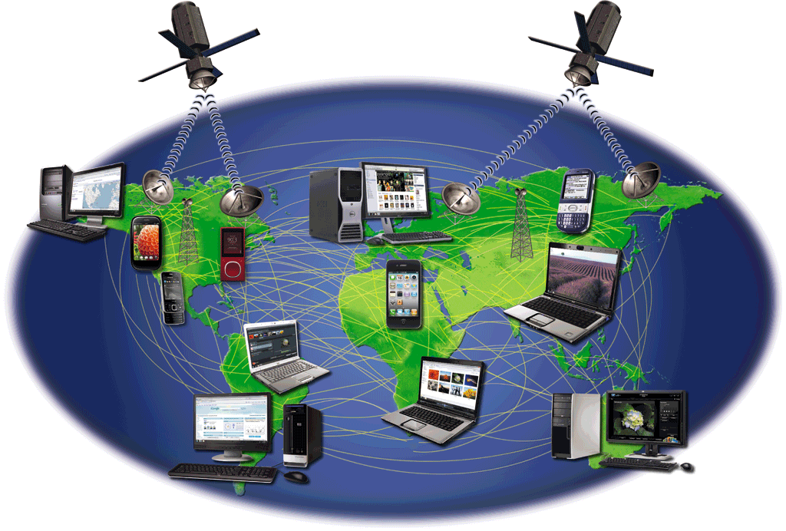
The Internet
The Internet is a worldwide collection of networks that connects millions of businesses, government agencies, educational institutions, and individuals
Pages 18 – 19
Figure 1-25

Slide 22
The Internet
The World Wide Web (or web, for short) is a global library of information available to anyone connected to the Internet
The web consists of a worldwide collection of electronic documents, each of which is called a webpage
A website is a collection of related webpages which are stored on a web server
A web server is a computer that delivers requested webpages to your computer
Pages 19 - 20

Slide 23
The Internet
Page 19
Figure 1-26

Slide 24
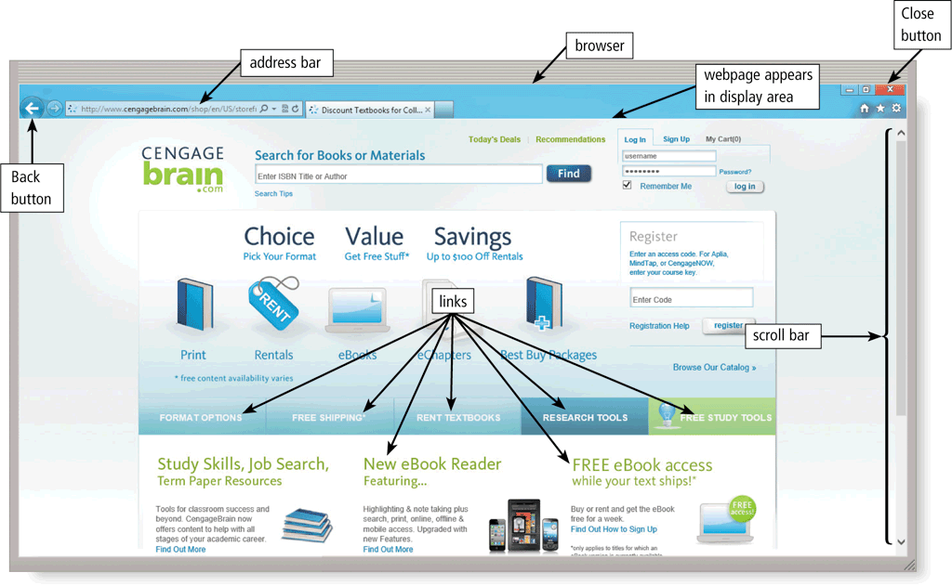
The Internet
A browser is software that enables users with an Internet connection to access and view webpages on a computer or mobile device
Page 20

Slide 25
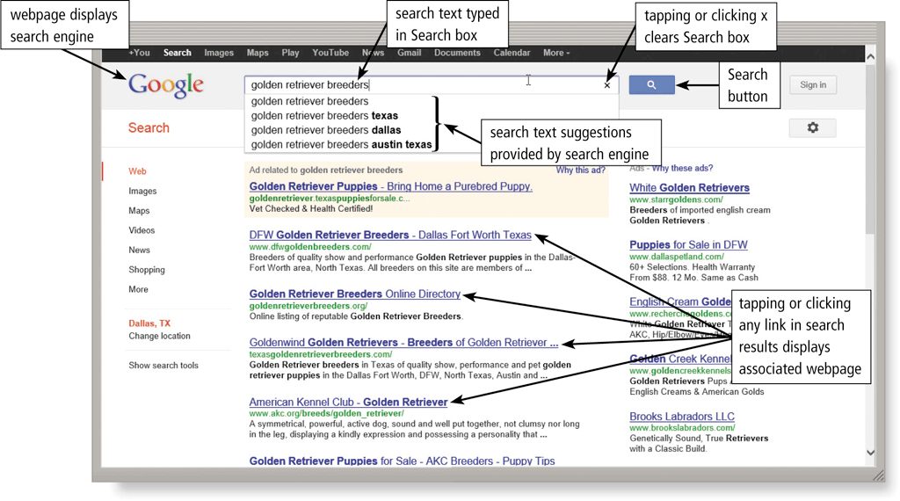
The Internet
A search engine is software that finds websites, webpages, images, videos, news, maps, and other information related to a specific topic
Page 21

Slide 26
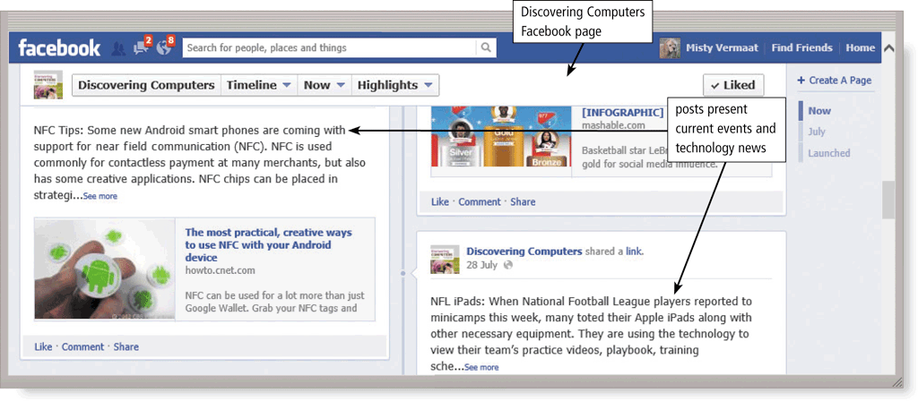
The Internet
An online social network encourages members to share their interests, ideas, stories, photos, music, and videos with other registered users
Pages 21 – 22
Figure 1-27

Slide 27
Class Activity
Have you ever created a webpage or website. If so, what type of information did you provide on that page or site?
Quick quiz
What can a webpage contain?

Slide 28
Digital Safety and Security
It is important that users protect their computers and mobile devices
Viruses and Other Malware
Privacy
Health Concerns
Environmental Issues
Pages 23 - 24

Slide 29
Security
Identity theft
http://www.youtube.com/watch?v=zBheC5afBfc
Page 25

Slide 30
Digital Safety and Security
Green computing involves reducing the electricity consumed and environmental waste generated when using a computer
Strategies include:
Recycling
Using energy efficient hardware and energy saving features
Regulating manufacturing processes
Extending the life of computers
Immediately donating or properly disposing of replaced computers
Page 25

Slide 31
Programs and Apps
Difference between computer hardware and computer software
Software, also called a program, tells the computer what tasks to perform and how to perform them
System Software
Operating system
Utility program
Application Software
Pages 25 - 26
Figure 1-28

Slide 32
Programs and Apps
Installing is the process of setting up software to work with the computer, printer, and other hardware
Once installed, you can run an application so that you can interact with it
You interact with a program or application through its user interface
Page 27

Slide 33
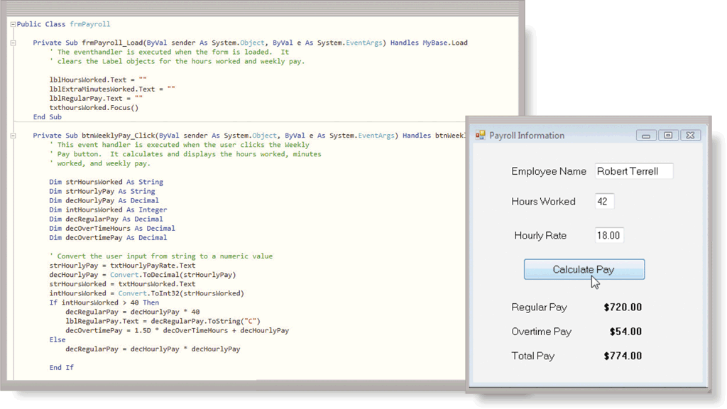
Programs and Apps
A software developer, sometimes called an application developer or computer programmer, is someone who develops programs and apps or writes the instructions that direct the computer or mobile device to process data into information
Page 28
Figure 1-29

Slide 34
Communications and Networks
In the course of a day, it is likely you use, or use information generated by, one or more of these communications technologies
Chat rooms
Email
Fax
FTP
GPS
Instant messaging
Internet
Newsgroups
RSS
Video conference
Voice mail
VoIP
Wireless Internet access points
Wireless messaging services
Page 29

Slide 35
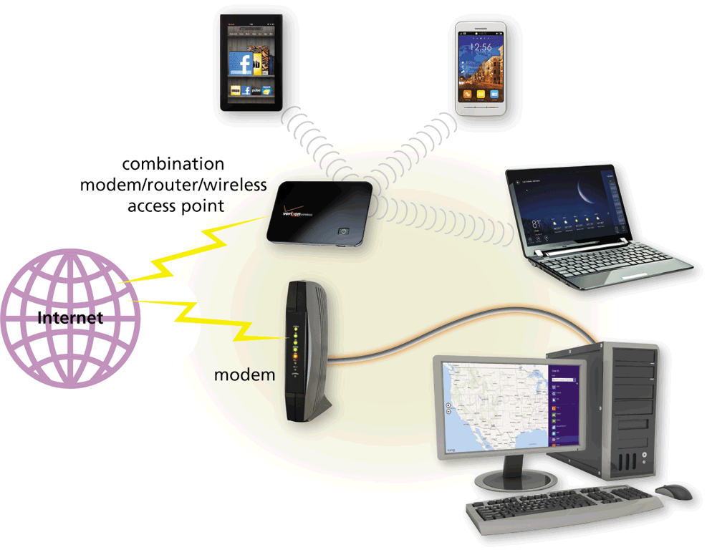
Communications and Networks
A communications device is hardware capable of transferring items from computers and devices to transmission media and vice versa
https://www.youtube.com/watch?v=7xnNRQjmTMg
Page 29
Figure 1-30

Slide 36
Communications and Networks
Examples of wireless communications technologies include:
Wi-Fi
Bluetooth
Cellular radio
Page 30

Slide 37
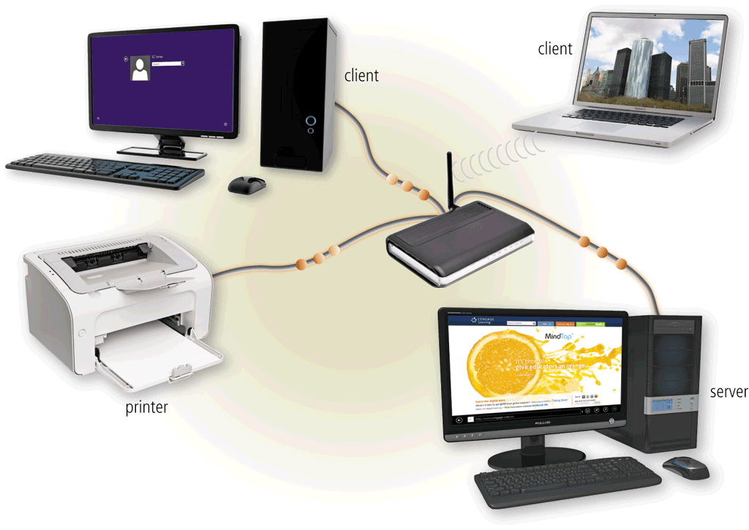
Communications and Networks
A network is a collection of computers and devices connected together via communications devices and transmission media
Pages 30 – 31
Figure 1-31

Slide 38
Communications and Networks
Home Networks
Connect to the Internet
Access photos, music, videos, and other content
Share devices
Connect game consoles to the Internet
Subscribe to and use VoIP
Play multiplayer games
Share a single high-speed Internet connection
Business Networks
Facilitate communications
Share hardware
Share data, information, and software
Page 31

Slide 39
Uses of Technology in Society
Education
Government
Finance
Retail
Entertainment
Health Care
Travel
Science
Publishing
Manufacturing
Pages 33 - 38

Slide 40
Technology Users
Home User
Small/Home Office User
Mobile User
Power User
Enterprise User
Pages 38 - 39

Slide 41
Quick Quiz
Electronic components in computers process data using ---------, which are the steps that tell the computer how to perform a particular task.
a)Information
b)Instructions
c)Tags
d)Links
Answer : Instructions

Slide 42
Quick Quiz
A ------- is a collection of computers and devices connected together, often wirelessly.
A)webpage
B)website
C)server
D)network
Answer : Network

Slide 43
Quick Quiz
--------- consists of electronic components that store instructions waiting to be executed and the data needed by those instructions.
A)networking
B)data
C)memory
D)storage
Answer: Memory

Slide 44
Chapter Summary
Basic computer concepts
Various methods for input, output, memory, and storage
The Internet
Digital security and safety risks and precautions
Uses of technology applications in society
Page 41

Slide 45
Chapter 1 Complete

