Slide 1
Chapter 10
Digital Security

Slide 2
Objectives Overview
Define the term, digital security risks, and briefly describe the types of cybercriminals
Discuss techniques to prevent unauthorized computer access and use
Explain the ways that software manufacturers protect against software piracy
Discuss how encryption, digital signatures, and digital certificates work
Describe various types of Internet and network attacks, and explain ways to safeguard against these attacks
See Page 202
for Detailed Objectives

Slide 3
Objectives Overview
Identify safeguards against hardware theft, vandalism, and failure
Explain the options available for backing up
Recognize issues related to information accuracy, intellectual property rights, codes of conduct, and green computing
Discuss issues surrounding information privacy
Identify risks and safeguards associated with wireless communications
See Page 202
for Detailed Objectives

Slide 4
Digital Security Risks
A digital security risk is any event or action that could cause a loss of or damage to a computer or mobile device hardware, software, data, information, or processing capability
Any illegal act involving the use of a computer or related devices generally is referred to as a computer crime
A cybercrime is an online or Internet-based illegal act
Page 202

Slide 5
Digital Security Risks
Page 203
Figure 5-1

Slide 6
Digital Security Risks
Hacker
Cracker
Script kiddie
Corporate spies
Unethical employees
Cyberextortionist
Cyberterrorist
Page 204

Slide 7
Internet and Network Attacks
Information transmitted over networks has a higher degree of security risk than information kept on an organization’s premises
Malware, short for malicious software, consists of programs that act without a user’s knowledge and deliberately alter the operations of computers and mobile devices
Pages 204 - 205
Table 5-1

Slide 8
Internet and Network Attacks
Page 205
Figure 5-2

Slide 9
Internet and Network Attacks
A botnet is a group of compromised computers or mobile devices connected to a network
A compromised computer or device is known as a zombie
A denial of service attack (DoS attack) disrupts computer access to Internet services
Distributed DoS (DDoS)
A back door is a program or set of instructions in a program that allow users to bypass security controls
Spoofing is a technique intruders use to make their network or Internet transmission appear legitimate
Pages 206 - 207

Slide 10
Questions?
https://www.youtube.com/watch?v=TIjWIBN8wms
Why would someone execute a DOS attack?
How can you determine if your computer or mobile device is vulnerable to an internet or network attack?

Slide 11
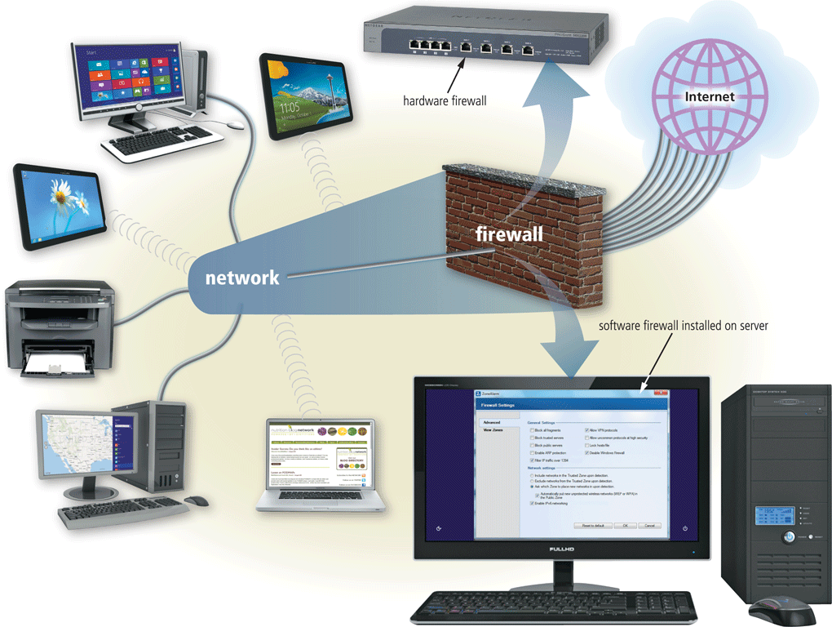
Internet and Network Attacks
A firewall is hardware and/or software that protects a network’s resources from intrusion
Pages 208 - 209
Figure 5-4

Slide 12
Unauthorized Access and Use
Unauthorized access is the use of a computer or network without permission
Unauthorized use is the use of a computer or its data for unapproved or possibly illegal activities
Page 210

Slide 13
Unauthorized Access and Use
Organizations take several measures to help prevent unauthorized access and use
Acceptable use policy
Disable file and printer sharing
Page 210
Figure 5-5

Slide 14
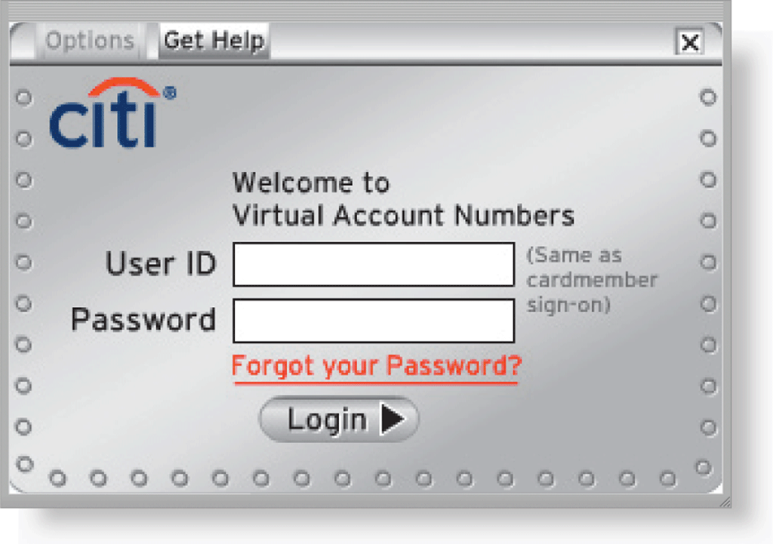
Unauthorized Access and Use
Access controls define who can access a computer, device, or network; when they can access it; and what actions they can take while accessing it
The computer, device, or network should maintain an audit trail that records in a file both successful and unsuccessful access attempts
User name
Password
Passphrase
CAPTCHA
Pages 211 - 212
Figure 5-6

Slide 15
Unauthorized Access and Use
A possessed object is any item that you must carry to gain access to a computer or computer facility
Often are used in combination with a PIN (personal identification number)
A biometric device authenticates a person’s identity by translating a personal characteristic into a digital code that is compared with a digital code in a computer
Page 213

Slide 16
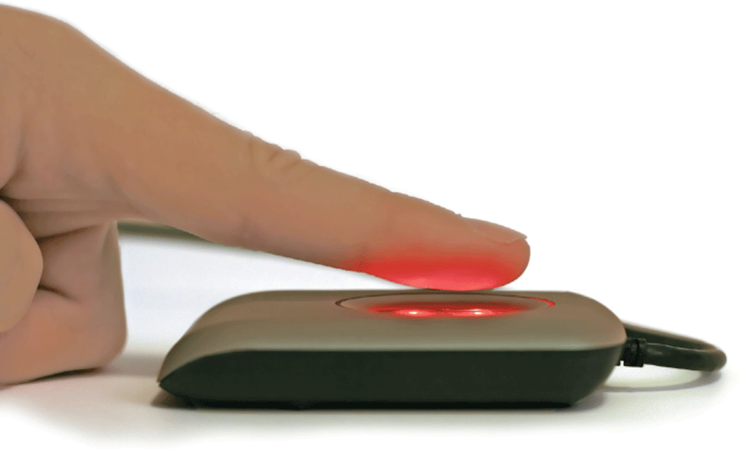
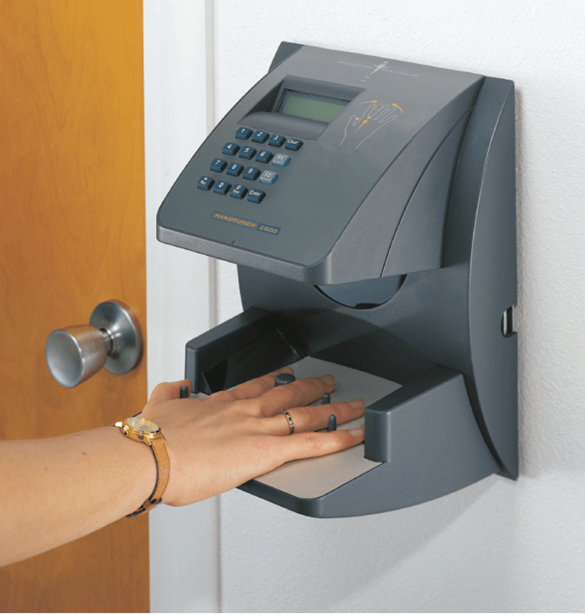
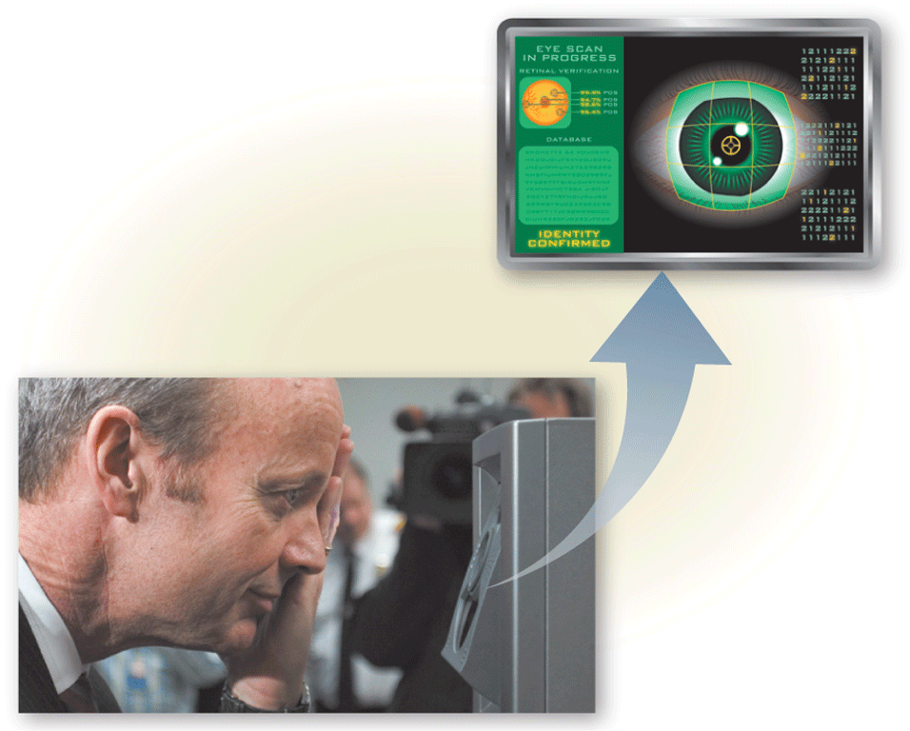
Unauthorized Access and Use
Fingerprint reader
Face recognition system
Hand geometry system
Voice verification system
Signature verification system
Iris recognition system
Pages 213 – 214
Figures 5-8 – 5-10

Slide 17
Unauthorized Access and Use
Digital forensics is the discovery, collection, and analysis of evidence found on computers and networks
Many areas use digital forensics
Law enforcement
Criminal prosecutors
Military intelligence
Insurance agencies
Information security departments
Page 214

Slide 18
Digital Forensics
https://www.youtube.com/watch?v=QPi6fQNwxbI
Why is it important?

Slide 19
Software Theft
Software theft occurs when someone:
Steals software media
Intentionally erases programs
Illegally copies a program
Illegally registers and/or activates a program
Page 215

Slide 20
Software Theft
Many manufacturers incorporate an activation process into their programs to ensure the software is not installed on more computers than legally licensed
During the product activation, which is conducted either online or by phone, users provide the software product’s identification number to associate the software with the computer or mobile device on which the software is installed
Page 215

Slide 21
Software Theft
A single-user license agreement typically contains the following conditions:
Pages 215 – 216
Figure 5-11

Slide 22
Information Theft
Information theft occurs when someone steals personal or confidential information
Encryption is a process of converting data that is readable by humans into encoded characters to prevent unauthorized access
Pages 216 - 217
Table 5-2

Slide 23
Information Theft
https://www.youtube.com/watch?v=EBmr4WCi6iQ
Public key and private key
What is plaintext?
What is cipbertext?

Slide 24
Information Theft
Page 217
Figure 5-12

Slide 25
Information Theft
A digital signature is an encrypted code that a person, website, or organization attaches to an electronic message to verify the identity of the sender
Often used to ensure that an impostor is not participating in an Internet transaction
A digital certificate is a notice that guarantees a user or a website is legitimate
A website that uses encryption techniques to secure its data is known as a secure site
Page 218

Slide 26
Digital signature and digital certificate
https://www.youtube.com/watch?v=9F0wk8e8KB8

Slide 27
Information Theft
Page 218
Figure 5-13

Slide 28
Hardware Theft, Vandalism, and Failure
Hardware theft is the act of stealing digital equipment
Hardware vandalism is the act of defacing or destroying digital equipment
Page 219

Slide 29
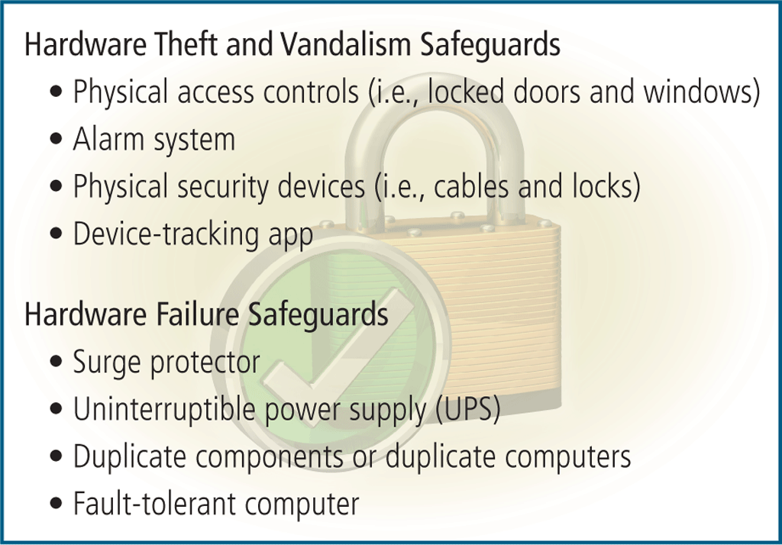
Hardware Theft, Vandalism, and Failure
To help reduce the of chances of theft, companies and schools use a variety of security measures
Page 219
Figure 5-14

Slide 30
Backing Up – The Ultimate Safeguard
A backup is a duplicate of a file, program, or media that can be used if the original is lost, damaged, or destroyed
To back up a file means to make a copy of it
Off-site backups are stored in a location separate from the computer or mobile device site
Cloud Storage
Page 219

Slide 31
Backing Up – The Ultimate Safeguard
Categories of backups:
Full
Differential
Incremental
Selective
Continuous data protection
Three-generation backup policy
Grandparent
Parent
Child
Page 219

Slide 32
Backing Up – The Ultimate Safeguard
Page 220
Table 5-3

Slide 33
Wireless Security
Wireless access poses additional security risks
Some intruders intercept and monitor communications as they transmit through the air
Others connect to a network through an unsecured wireless access point (WAP) or combination router/WAP
Page 221
Figure 5-16

Slide 34
Questions?
Would you connect to an unsecured wireless network?
Can you detect if someone is accessing your wireless home network?

Slide 35
Ethics and Society
Computer ethics are the moral guidelines that govern the use of computers, mobile devices, and information systems
Information accuracy is a concern
Not all information on the web is correct
Pages 224 - 225
Figure 5-18

Slide 36
Ethics and Society
Intellectual property refers to unique and original works such as ideas, inventions, art, writings, processes, company and product names, and logos
Intellectual property rights are the rights to which creators are entitled to their work
A copyright protects any tangible form of expression
Digital rights management (DRM) is a strategy designed to prevent illegal distribution of movies, music, and other digital content
Page 225

Slide 37
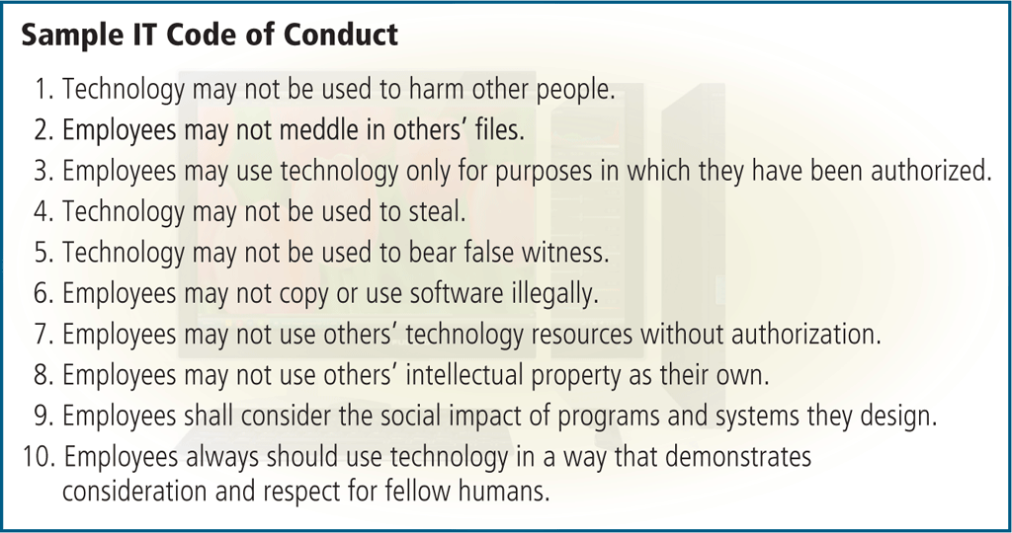
Ethics and Society
A code of conduct is a written guideline that helps determine whether a specification is ethical/unethical or allowed/not allowed
Page 226
Figure 5-19

Slide 38
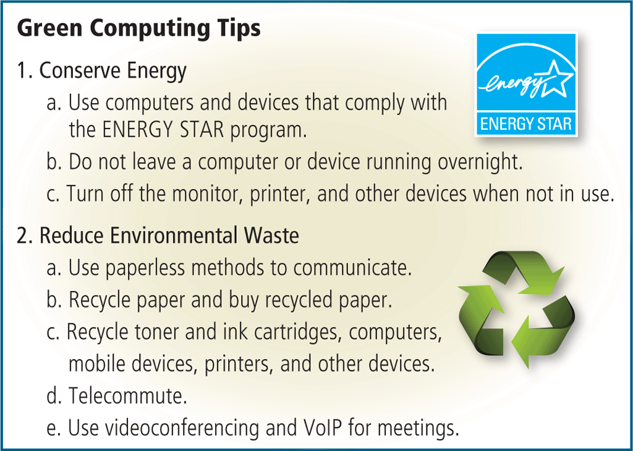
Ethics and Society
Green computing involves reducing the electricity and environmental waste while using computers, mobile devices, and related technologies
Pages 226 - 227
Figure 5-20

Slide 39
Information Privacy
Information privacy refers to the right of individuals and companies to deny or restrict the collection and use of information about them
Huge databases store data online
It is important to safeguard your information
Page 227

Slide 40
Information Privacy
Page 228
Figure 5-21

Slide 41
Information Privacy
Information about you can be stored in a database when you:
Fill out a printed or online form
Create a social networking profile
Register a product warranty
Pages 228 - 229
Figure 5-22

Slide 42
Information Privacy
A cookie is a small text file that a web server stores on your computer
Websites use cookies for a variety of reasons:
Allow for personalization
Store user names and/or passwords
Assist with online shopping
Track how often users visit a site
Target advertisements
Page 229

Slide 43
Question?
Do websites ever sell information stored in cookies?

Slide 44
Information Privacy
Page 230
Figure 5-23

Slide 45
Information Privacy
Phishing is a scam in which a perpetrator sends an official looking email message that attempts to obtain your personal and/or financial information
With clickjacking, an object that can be clicked on a website contains a malicious program
Page 231

Slide 46
Information Privacy
Spyware is a program placed on a computer or mobile device without the user’s knowledge that secretly collects information about the user and then communicates the information it collects to some outside source while the user is online
Adware is a program that displays an online advertisement in a banner or pop-up window on webpages, email messages, or other Internet services
Page 231

Slide 47
Information Privacy
Social engineering is defined as gaining unauthorized access to or obtaining confidential information by taking advantage of the trusting human nature of some victims and the naivety of others
Page 232

Slide 48
Information Privacy
Employee monitoring involves the use of computers, mobile devices, or cameras to observe, record, and review an employee’s use of a technology, including communications such as email messages, keyboard activity (used to measure productivity), and websites visited
Many programs exist that easily allow employers to monitor employees. Further, it is legal for employers to use these programs
Page 233

Slide 49
Question?
Do employers have right to read employee email messages?

Slide 50
Ethics and Society
Content filtering is the process of restricting access to certain material on the Web
Many businesses use content filtering
Web filtering software restricts access to specified websites
Page 234
Figure 5-24

Slide 51
Summary
Variety of digital security risks
Cybercrime and cybercriminals
Risks and safeguards associated with Internet and network attacks, unauthorized access and use, software theft, information theft, and hardware theft, vandalism, and failure
Various backup strategies and methods of securing wireless communications
Ethical issues in society and various ways to protect the privacy of personal information
Page 235

Slide 52
Chapter 5 Complete

