Slide 2
Objectives Overview
Discuss the evolution of the Internet
Briefly describe various broadband Internet connections
Describe the purpose of an IP address and its relationship to a domain name
Describe features of browsers and identify the components of a web address
Describe ways to enter effective search text
Explain benefits and risks of using social networking sites
See Page 54
for Detailed Objectives

Slide 3
Objectives Overview
Describe uses of various types of websites
Identify and briefly describe the steps required for web publishing
Explain how the web uses graphics, animation, audio, video, and virtual reality
Explain how email, email lists, instant messaging, chat rooms, discussion forums, VoIP, and FTP work
Identify the rules of netiquette
See Page 54
for Detailed Objectives

Slide 4
The Internet
The Internet is a worldwide collection of networks that links millions of businesses, government agencies, educational institutions, and individuals
Pages 54 - 55
Figure 2-1

Slide 5
Evolution of the Internet
https://www.youtube.com/watch?v=CRD7TnJvIN8
The Internet originated as ARPANET in September 1969 and had two main goals:
Allow scientists at different physical locations to share information and work together
Function even if part of the network were disabled or destroyed by a disaster
Page 54

Slide 6
Evolution of the Internet
1969 ARPANET becomes functional
1984 ARPANET has more than 1,000 individual computers linked as hosts
Today Millions of hosts connect to the Internet
Page 54

Slide 7
Connecting to the Internet
With wired connections, a computer or device physically attaches via a cable or wire to a communications device
Computers without a communications device can use a wireless modem
Page 56

Slide 8
Connecting to the Internet
Page 56
Figure 2-2

Slide 9
Connecting to the Internet
Wired
Wireless
Cable Internet service
DSL (digital subscriber line)
Fiber to the Premises (FTTP)
Wi-Fi (wireless fidelity)
Mobile broadband
Fixed wireless
Satellite Internet Service
Page 57

Slide 10
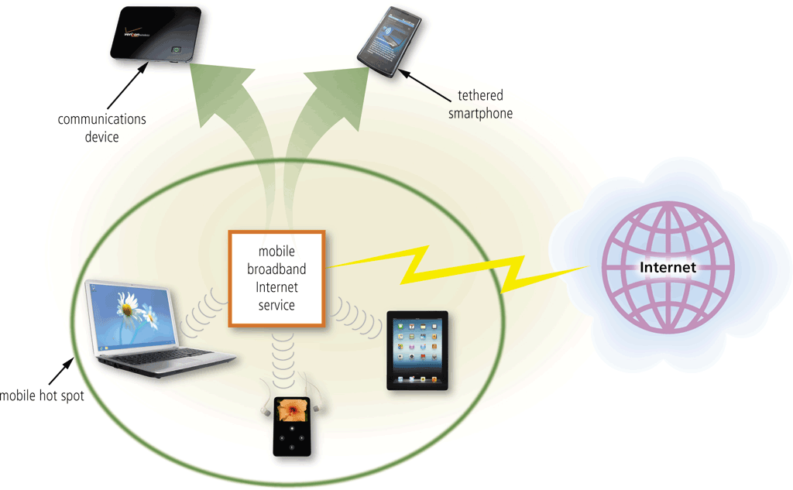
Connecting to the Internet
A cybercafé is a location that provides computers with Internet access, usually for a fee
A hot spot is a wireless network that provides Internet connections to mobile computers and devices
Page 57
Figure 2-3

Slide 11
Connecting to the Internet
An Internet service provider (ISP) is a business that provides individuals and organizations access to the Internet free or for a fee
Bandwidth represents the amount of data that travels over a network
Megabyte (MB)
Gigabyte (GB)
Page 58

Slide 12
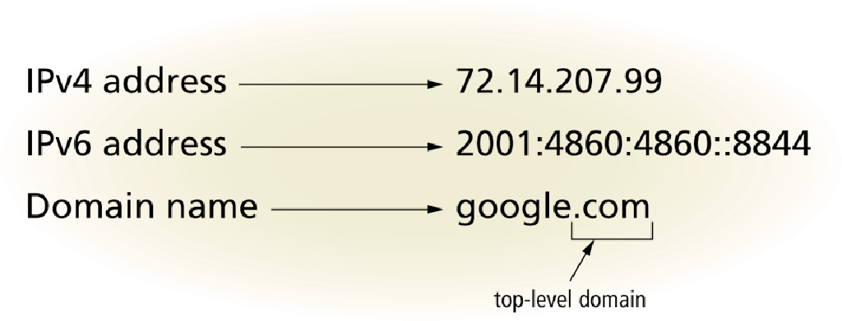
Connecting to the Internet
An IP address is a sequence of numbers that uniquely identifies each computer or device connected to the Internet
A domain name is a text-based name that corresponds to the IP address
A DNS server translates the domain name into its associated IP address
Pages 60 - 61
Figure 2-5

Slide 13
Connecting to the Internet
https://www.youtube.com/watch?v=bD_7YdX_iQ4

Slide 14
Connecting to the Internet
Page 61
Figure 2-6

Slide 15
The World Wide Web
The World Wide Web (WWW), or web, consists of a worldwide collection of electronic documents (webpages)
A website is a collection of related webpages and associated items
A web server is a computer that delivers requested webpages to your computer
Pages 61 - 62

Slide 16
The World Wide Web
A browser is an application that enables users with an Internet connection to access and view webpages on a computer or mobile device
A home page is the first page that a website displays
Desktop browsers typically support tabbed browsing
Pages 62 - 63
Figure 2-7

Slide 17
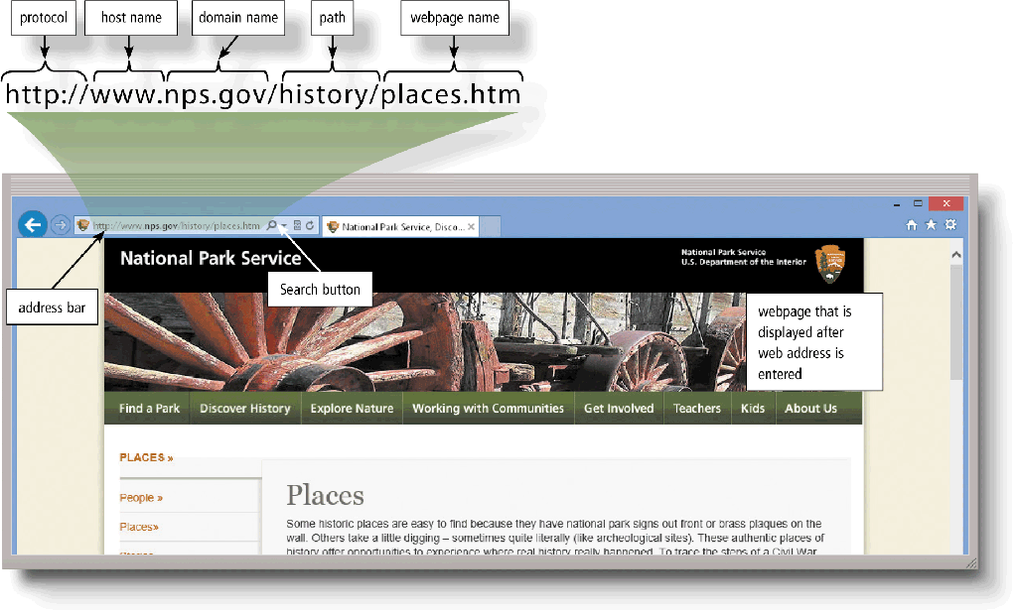
The World Wide Web
A webpage has a unique address called a web address or URL
Pages 64 - 65
Figure 2-8

Slide 18
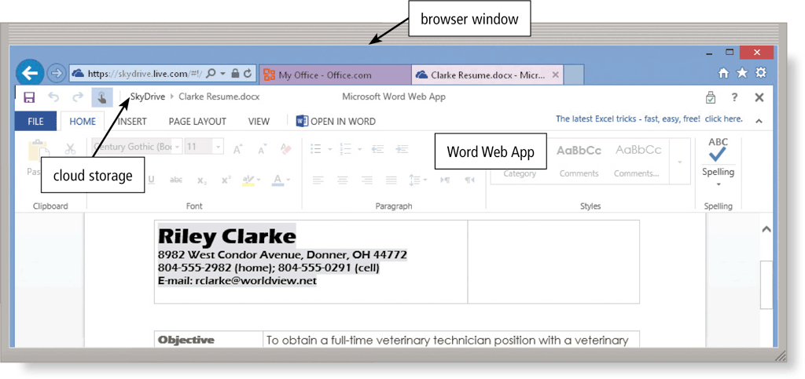
The World Wide Web
A web app is an application stored on a web server that you access through a browser
Web app hosts usually provide storage for users’ data and information on their servers, known as cloud storage
Pages 65 – 66
Figure 2-10

Slide 19
Types of Websites
A search engine is software that finds websites, webpages, images, videos, news, maps, and other information related to a specific topic
A subject directory classifies webpages in an organized set of categories, such as sports or shopping, and related subcategories
Pages 67 - 68

Slide 20
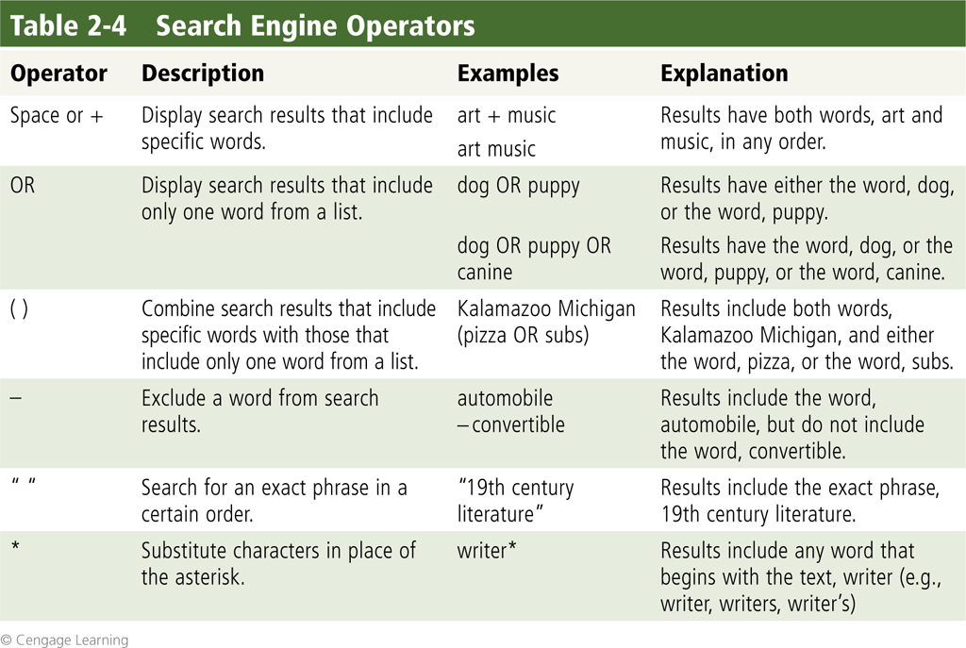
Types of Websites
Search operators can help to refine your search
Page 68
Table 2-4

Slide 21
The World Wide Web
There are thirteen types of Web sites
Online social network
Informational
Media sharing and bookmarking sites
News, weather, sports, and other mass media
Educational
Business, Governmental, and Organizational
Pages 68 – 72

Slide 22
The World Wide Web
Blogs
Wikis
Health and Science
Entertainment
Financial
Travel and Mapping
Pages 72 – 75

Slide 23
The World Wide Web
Shopping and Auctions
Careers and Employment
E-Commerce
Portals
Pages 75 – 78

Slide 24
The World Wide Web
Web publishing is the development and maintenance of websites
Plan the website
Design the website
Create the website
Host the website
Maintain the website
Pages 78 - 79

Slide 25
Web Publishing
https://www.youtube.com/watch?v=_STBFycDkmU

Slide 26
Media on the Web
Multimedia refers to any application that combines text with:
Graphics
Animation
Audio
Video
Virtual Reality
Page 79

Slide 27
Media on the Web
A plug-in is a program that extends the capability of a Web browser
Page 83

Slide 28
Other Internet Services
Email is the transmission of messages and files via a computer network
An email program allows you to create, send, receive, forward, store, print, and delete email messages
Page 84

Slide 29
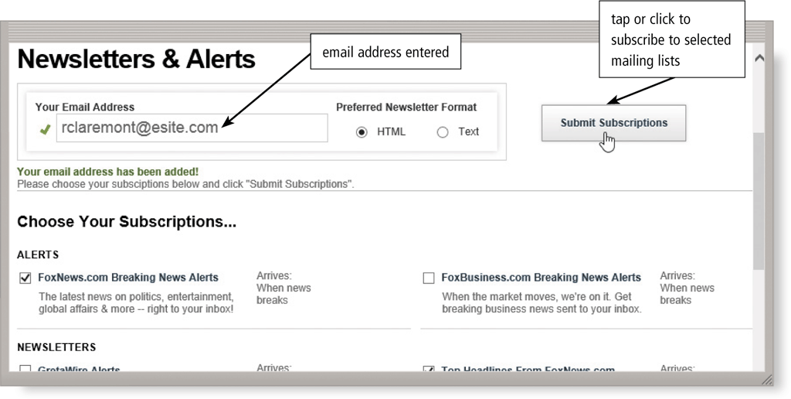
Other Internet Services
An email list is a group of email addresses used for mass distribution of a message
Page 86
Figure 2-26

Slide 30
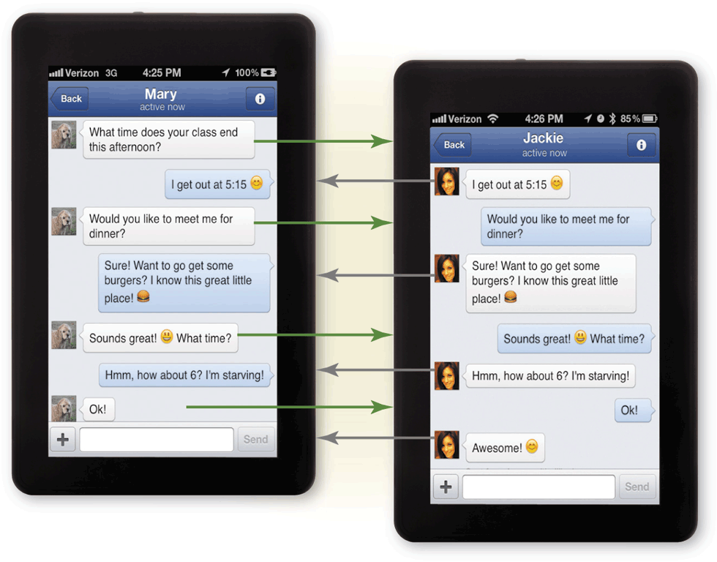
Other Internet Services
Instant messaging (IM) is a real-time Internet communications service
Page 86
Figure 2-27

Slide 31
Other Internet Services
A chat is a real-time typed conversation that takes place on a computer or mobile device
A chat room is a website or application that permits users to chat with others who are online at the same time
Page 87
Figure 2-30

Slide 32
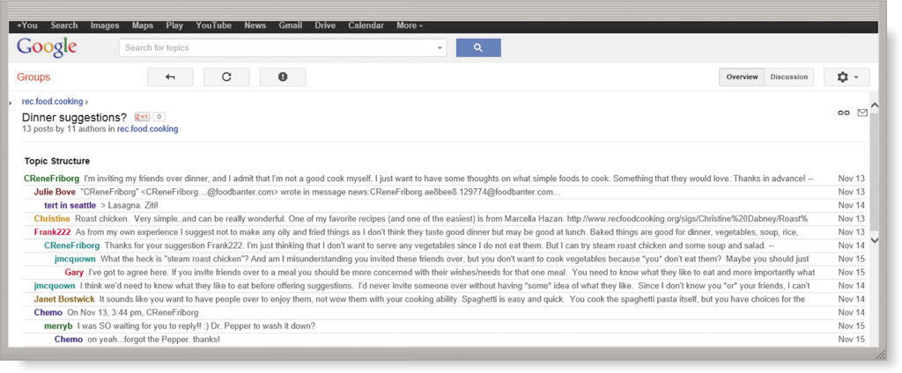
Other Internet Services
A discussion forum is an online area in which users have written discussions about a particular subject
Page 87
Figure 2-29

Slide 33
Other Internet Services
VoIP (Voice over IP) enables users to speak to other users over the Internet
Page 88
Figure 2-31

Slide 34
Other Internet Services
FTP (File Transfer Protocol) is an Internet standard that permits file uploading and downloading to and from other computers on the Internet
Many operating systems include FTP capabilities
An FTP server is a computer that allows users to upload and/or download files using FTP
Page 88

Slide 35
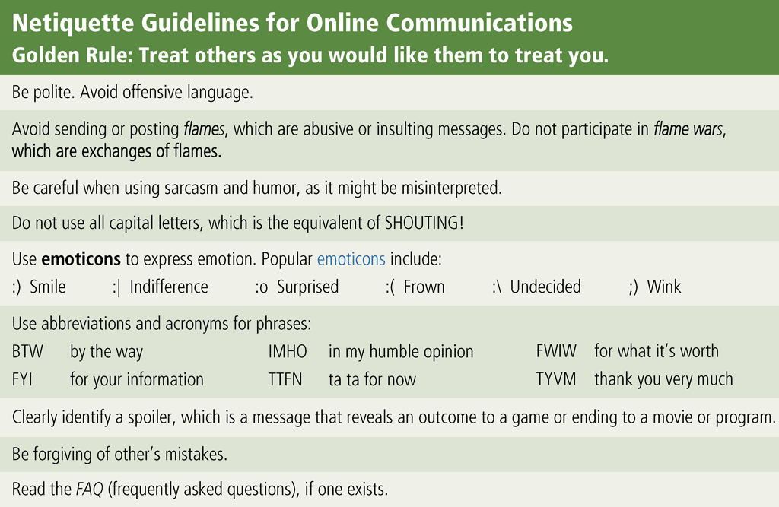
Netiquette
Netiquette is the code of acceptable Internet behavior
Page 90
Figure 2-30

Slide 36
Quick Quiz
1- Most e-commerce actually takes place between businesses. What is this called?
a)consumer-to-business (C2B) e-commerce
b)business-to-consumer (B2C) e-commerce
c)consumer-to-consumer (C2C) e-commerce
d)business-to-business (B2B) e-commerce
Answer: d

Slide 37
Question 2
2. host in a network performs which of the following tasks?
a)ensures satellite communications are functional
b)exclusively monitors wireless networks to search for data transmission errors
c)routes transmissions over a network to guarantee data reaches its intended destination
d)provides services and connections to other computers on the network
Answer :d

Slide 38
Question 3
3. What is the purpose of an Internet Protocol address (IP address)?
a)It specifies whether a computer is using a broadband network or a direct-dial network.
b)It differentiates between a server computer and a client computer and contains codes to identify whether the computer can send data or receive data.
c)It contains the protocol schema used to identify whether the computer is on a wired or wireless network.
d)It uniquely identifies the location of each computer or device connected to the Internet.
Answer : d

Slide 39
Summary
Evolution of the Internet
The Web
Various types of websites
Other services available on the Internet
Netiquette
Page 91

Slide 40
Chapter 2 Complete

